Slide 2
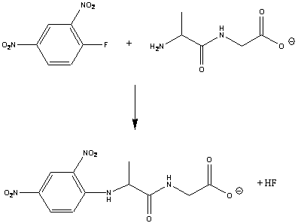
Termini
Dinitrophenyl fluoride (DNPF)
Cys - Gly
N
C
DNP- Cys - Gly

