Slide 2
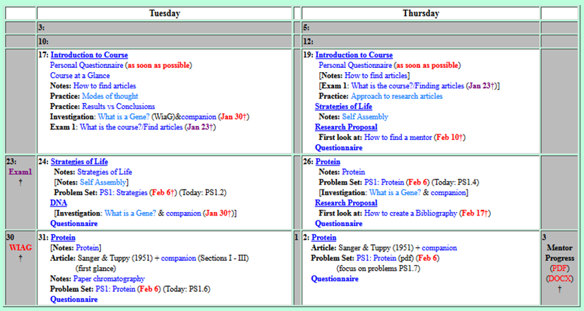
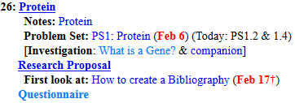

Welcome to Molecular Biology Through Discovery Thursday, 26 January 2017
…the hardest part for me is deciding on a specific topic that is narrow enough to suffice as a good research proposal

Slide 3
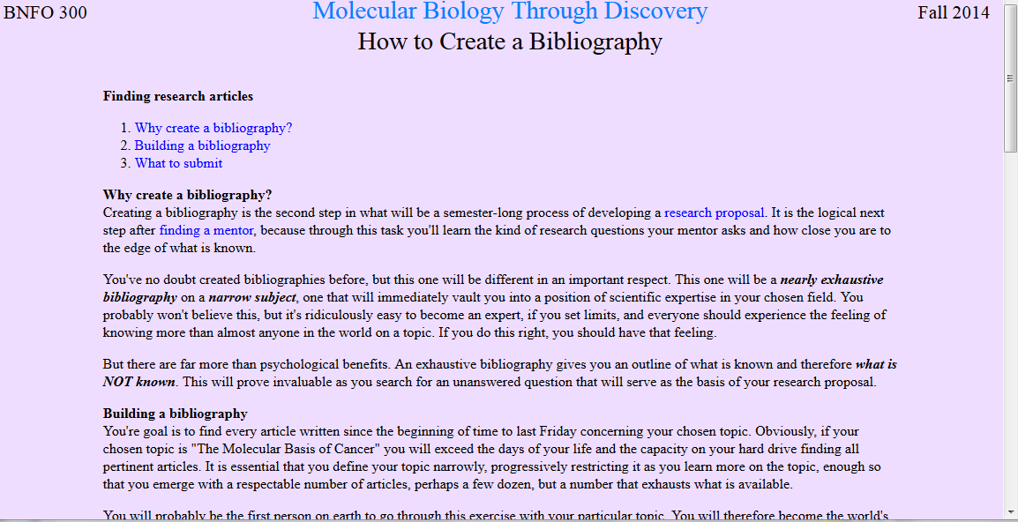
…the hardest part for me is deciding on a specific topic that is narrow enough to suffice as a good research proposal

Slide 4
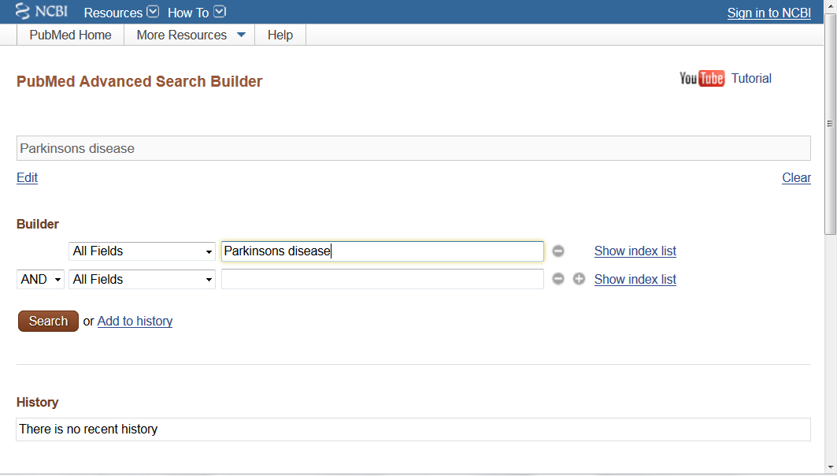

Slide 5
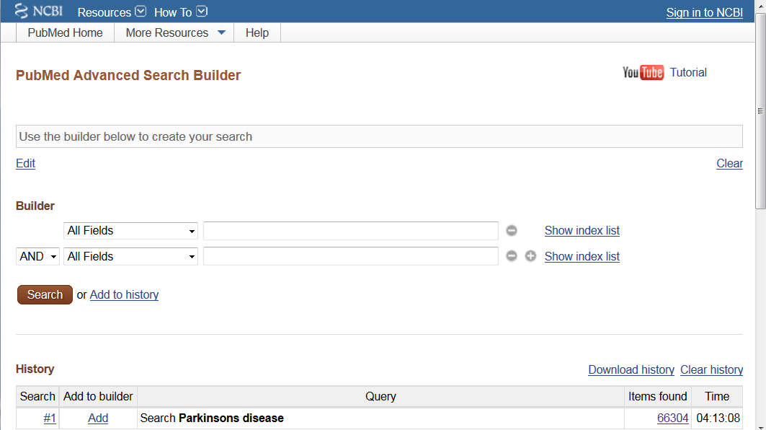

Slide 6
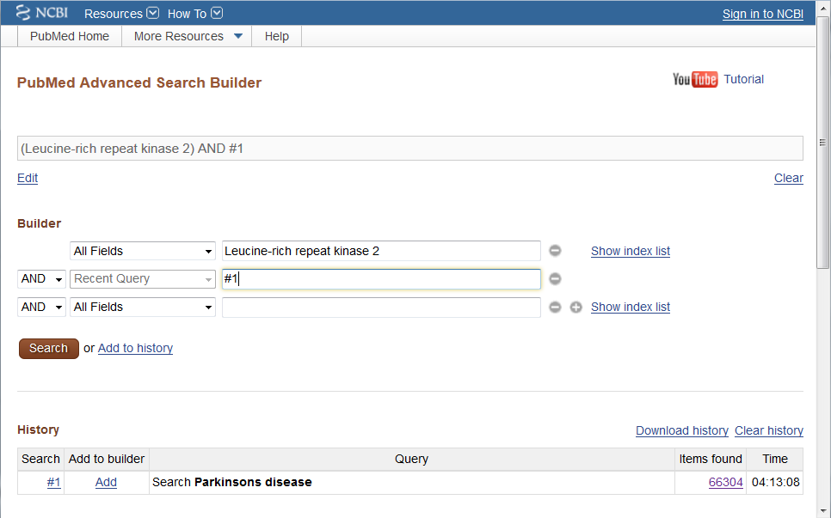

Slide 7
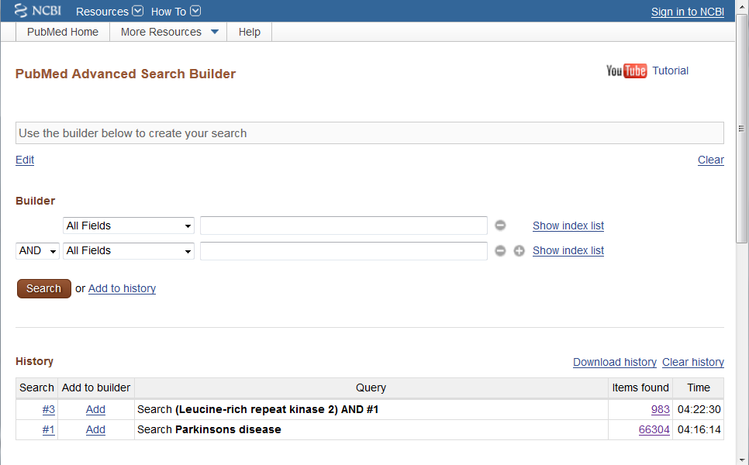

Slide 8
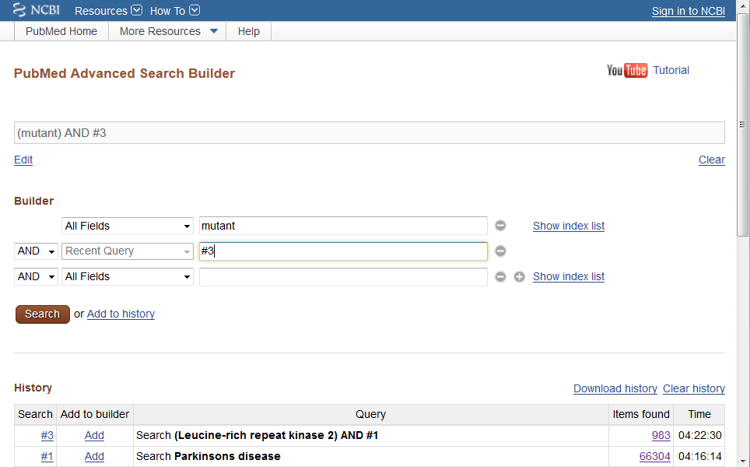

Slide 9
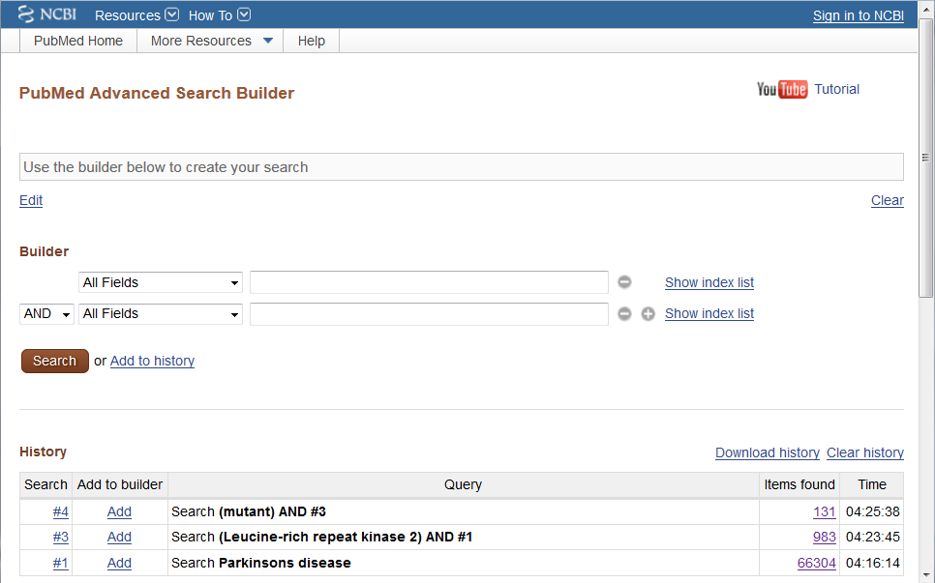

Slide 10
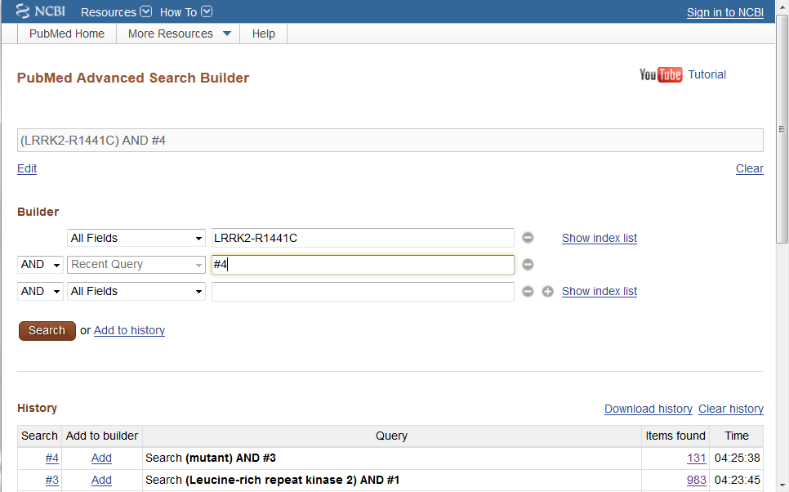

Slide 11
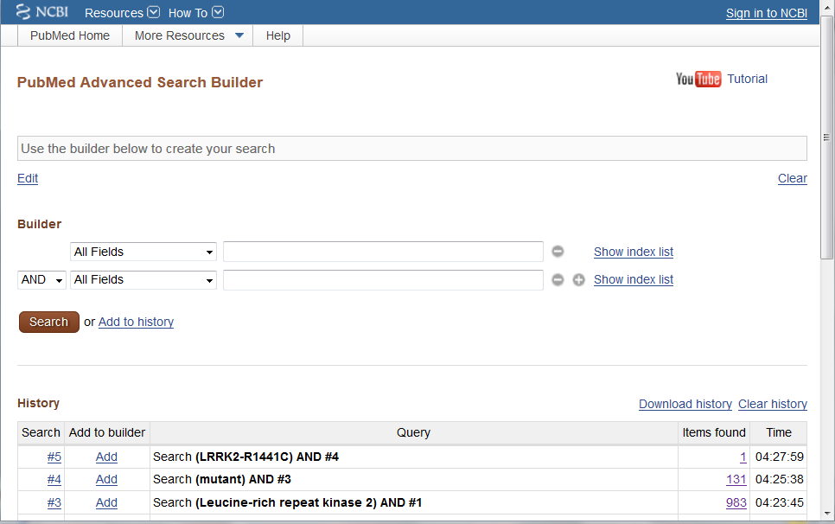

Slide 12
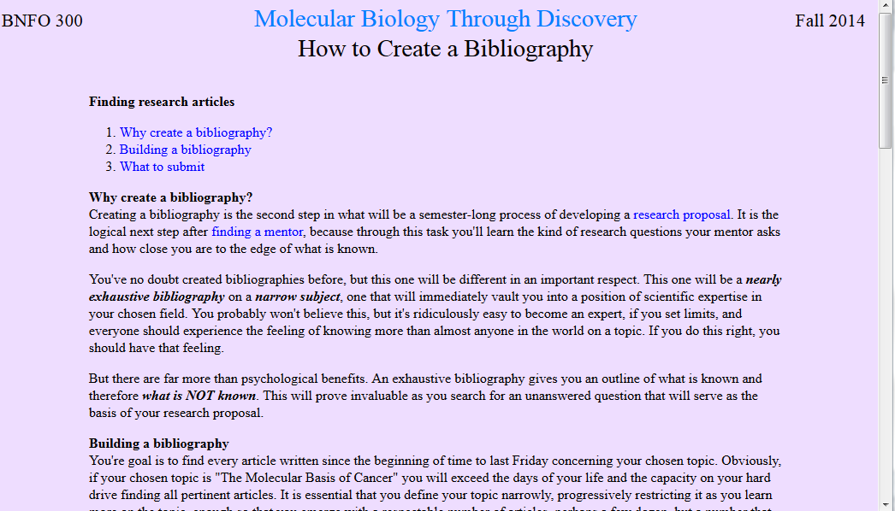
…the hardest part for me is deciding on a specific topic that is narrow enough to suffice as a good research proposal

Slide 13
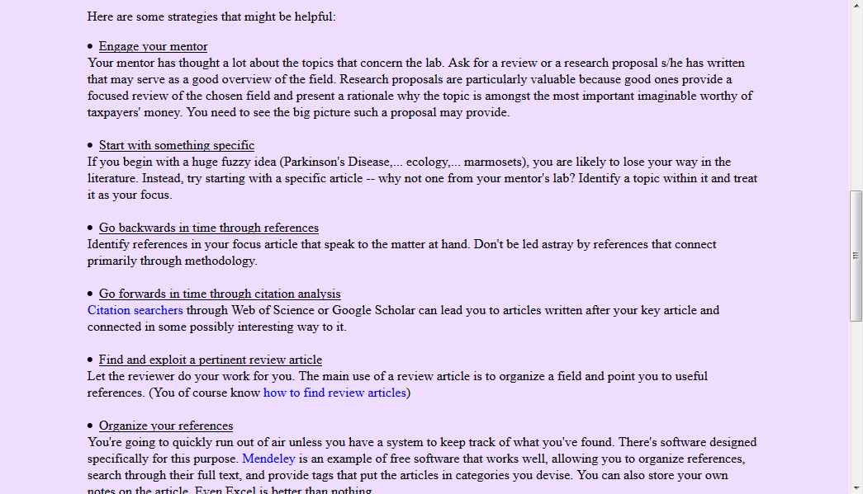
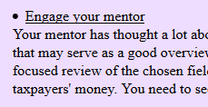
…the hardest part for me is deciding on a specific topic that is narrow enough to suffice as a good research proposal

Slide 14

…the hardest part for me is deciding on a specific topic that is narrow enough to suffice as a good research proposal

Slide 15

…the hardest part for me is deciding on a specific topic that is narrow enough to suffice as a good research proposal

Slide 16

…the hardest part for me is deciding on a specific topic that is narrow enough to suffice as a good research proposal

Slide 17
Welcome to Molecular Biology Through Discovery Thursday, 26 January 2017
Are material like Proteins and Genes supposed to be review or can it be new material to some of us?

Slide 18
Welcome to Molecular Biology Through Discovery Thursday, 26 January 2017
It would benefit me if we talked about how primary, secondary, tertiary and quaternary structures differed.

Slide 19
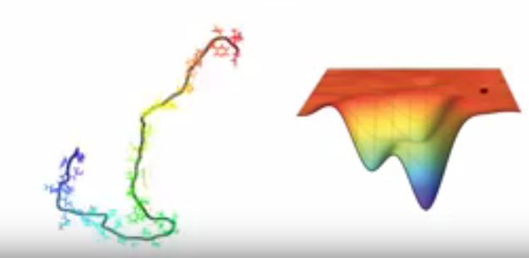
Protein
https://www.youtube.com/watch?v=YANAso8Jxrk

Slide 20
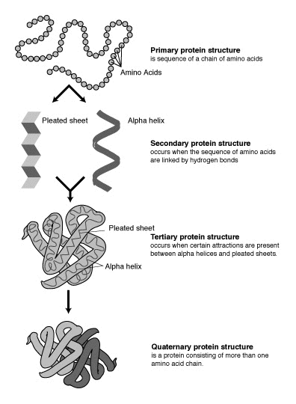
Protein
1. Enumeration
Primary Structure

Slide 21
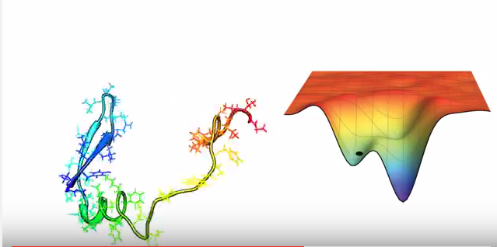
Protein
https://www.youtube.com/watch?v=YANAso8Jxrk

Slide 22
Protein
1. Enumeration
Primary Structure
2. Local interaction
Secondary Structure

Slide 23
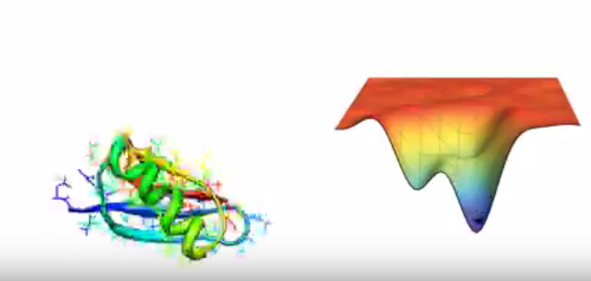
Protein
https://www.youtube.com/watch?v=YANAso8Jxrk

Slide 24
Protein
1. Enumeration
Primary Structure
2. Local interaction
Secondary Structure
3. Distant interaction
Tertiary Structure

Slide 25
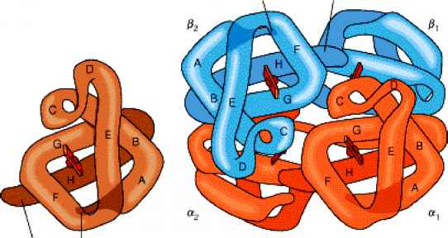
Protein
Compare
hemoglobin
myoglobin

Slide 26
Protein
1. Enumeration
Primary Structure
2. Local interaction
Secondary Structure
3. Distant interaction
Tertiary Structure
4. Interaction between subunits
Quaternary Structure

Slide 27
Welcome to Molecular Biology Through Discovery Thursday, 26 January 2017

Slide 28
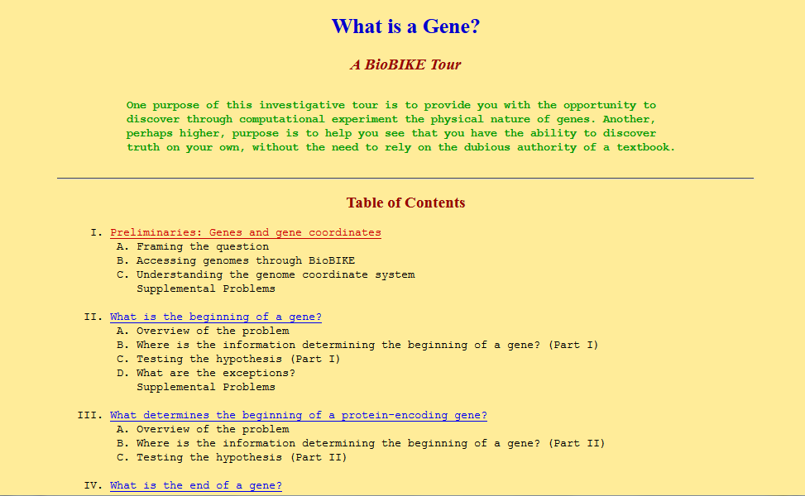

Slide 29

What is a Gene?
Me
1N
1S
2N
2S
3N
3S
4N
4S
5N
5S
6N
6S
7S

Slide 30
What is a Gene?
Me
1N
1S
2N
1
2
3
4
2S
3N
3S
4N
5
6
7
8
4S
5N
5S
6N
9
10
11
12
6S
7S

Slide 31
What is a Gene?
Connect to: https://vcu.zoom.us/j/2504526209
Me
1N
1S
Prathija Prem Elaf Alaithan Amanda Atrash Amanda Luong
Ashria Arora Deeksha Jain Alex Leath Rachel Miller
Lasya Gundlapudi Erin Cochran Britt Hazard Adi Balu
Danny Rayes Tom Mathew Colin Hawkes Ankita Thakur
2N
2S
3N
3S
Aisha Ikram Gerell Malazarte Chris Rowe Aarthi Prakash
Mouni Talari Peter Samuel Wesal Alhammadi Rishabh Patel
Diana Marquez Jacob Jaminet Bharath Peddibhotla
Tom Raymond Jesse Raynor Darius Saunders Samuel Young
4N
4S
5N
5S
Kaivalya Dandamudi E Alqaffas Ryan Duong Neel Gohil
Bethany Yachuw Fadi Hijaz Jared Mann Yonathan Regassa
Nikhita Puthuveeti Lamis Farah Kevin Limlengco Lucas Rizkalla
Ruairidh Barlow Rahul Warrier Jacob McGill
6N
6S
7S

Slide 32
Welcome to Molecular Biology Through Discovery Thursday, 26 January 2017

Slide 33

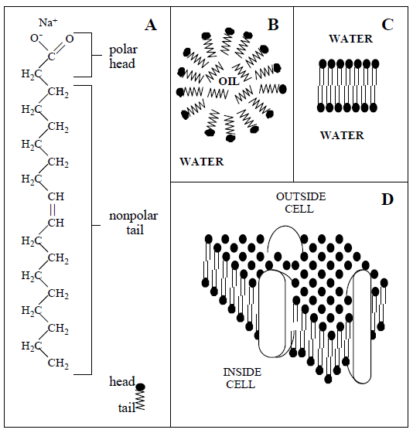
I really like how you had us draw the soap bubble… Really brought out the artist in me.
Draw a picture with one error
I was unclear on how to add an intentional error to the slides… what should we have made look wrong?

Slide 34
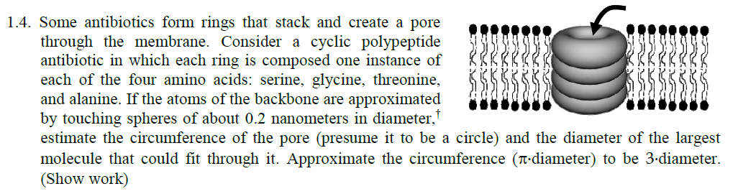

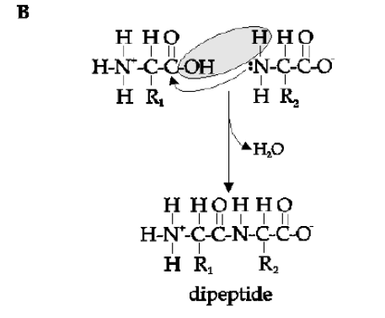
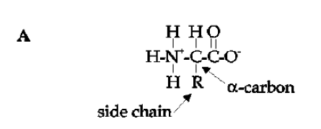

Slide 35
What is a Gene?
power strips would be a huge help
Me
1N
1S
Prathija Prem Elaf Alaithan Amanda Atrash Amanda Luong
Ashria Arora Deeksha Jain Alex Leath Rachel Miller
Lasya Gundlapudi Erin Cochran Britt Hazard Adi Balu
Danny Rayes Tom Mathew Colin Hawkes Ankita Thakur
2N
2S
3N
3S
Aisha Ikram Gerell Malazarte Chris Rowe Aarthi Prakash
Mouni Talari Peter Samuel Wesal Alhammadi Rishabh Patel
Diana Marquez Jacob Jaminet Bharath Peddibhotla
Tom Raymond Jesse Raynor Darius Saunders Samuel Young
4N
4S
5N
5S
Kaivalya Dandamudi E Alqaffas Ryan Duong Neel Gohil
Bethany Yachuw Fadi Hijaz Jared Mann Yonathan Regassa
Nikhita Puthuveeti Lamis Farah Kevin Limlengco Lucas Rizkalla
Ruairidh Barlow Rahul Warrier Jacob McGill
6N
6S
7S

Slide 36
What is a Gene?
Connect to: https://vcu.zoom.us/j/2504526209
Me
1N
1S
Prathija Prem Elaf Alaithan Amanda Atrash Amanda Luong
Ashria Arora Deeksha Jain Alex Leath Rachel Miller
Lasya Gundlapudi Erin Cochran Britt Hazard Adi Balu
Danny Rayes Tom Mathew Colin Hawkes Ankita Thakur
2N
2S
3N
3S
Aisha Ikram Gerell Malazarte Chris Rowe Aarthi Prakash
Mouni Talari Peter Samuel Wesal Alhammadi Rishabh Patel
Diana Marquez Jacob Jaminet Bharath Peddibhotla
Tom Raymond Jesse Raynor Darius Saunders Samuel Young
4N
4S
5N
5S
Kaivalya Dandamudi E Alqaffas Ryan Duong Neel Gohil
Bethany Yachuw Fadi Hijaz Jared Mann Yonathan Regassa
Nikhita Puthuveeti Lamis Farah Kevin Limlengco Lucas Rizkalla
Ruairidh Barlow Rahul Warrier Jacob McGill
6N
6S
7S

Slide 37
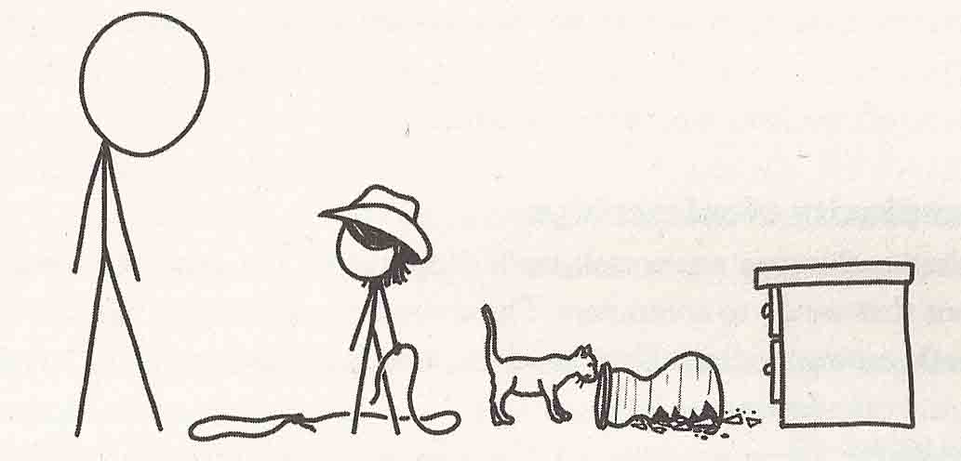
Modes of Thought
From What If by Randall Munroe

Slide 38
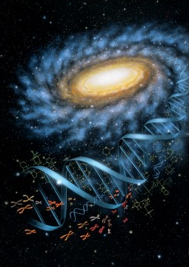
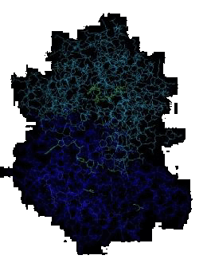


Molecular Biology through Discovery Tuesday, 17 January 2017

