Slide 2
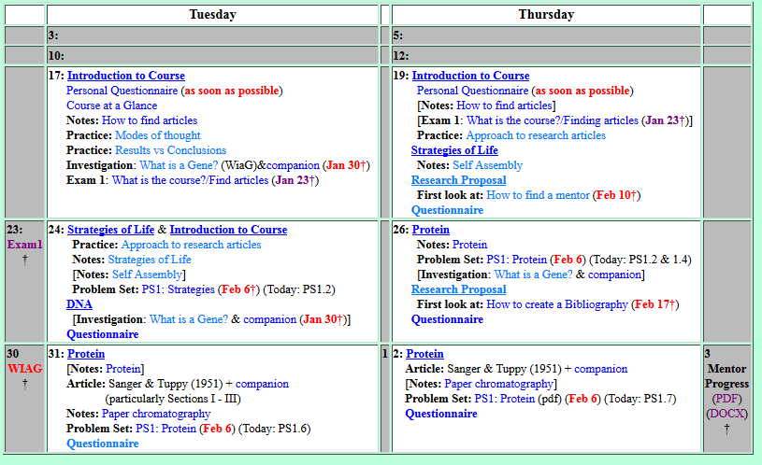
Welcome to Molecular Biology Through Discovery Thursday, 26 January 2017

Slide 3
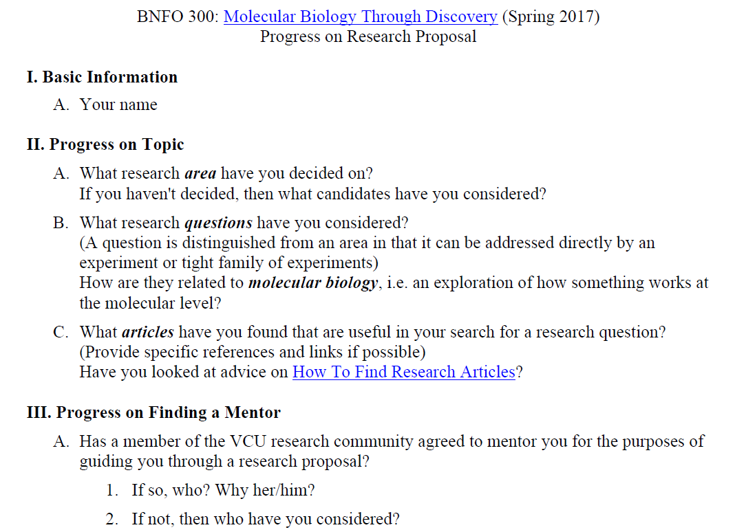

what should I do if I've found a research article written by a faculty member but I can't access it (even when I went through VCU) without buying it?

Slide 4
It would be helpful if there was a list of faculty that have published papers… that are in line with molecular bio.
I think that VCU does not have a virology department. Do you know how I could go about finding a mentor who has experience in virology

Slide 5
Welcome to Molecular Biology Through Discovery Thursday, 26 January 2017
I was confused about whether I had to formally turn in the questions for the What is a Gene tutorial.
Are we suppose to answer every question in the notes…?

Slide 6
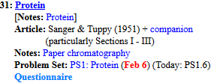
Welcome to Molecular Biology Through Discovery Thursday, 26 January 2017

Slide 7
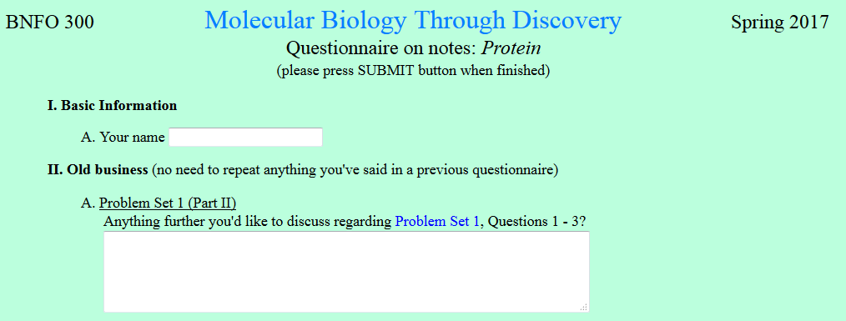
Regarding question 3, if one of the fatty acid tails of a phospholipid were removed,.. how the membrane would be drastically structurally changed considering it still has another hydrophobic tail that can form a bilayer.
…I know that physical properties and laws can become obsolete at the micro level

Slide 8

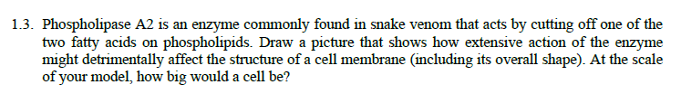
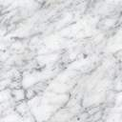
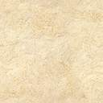

Slide 9

Phospholipase A2

Slide 10
Phospholipase A2

Slide 12
Welcome to Molecular Biology Through Discovery Thursday, 26 January 2017

Slide 13
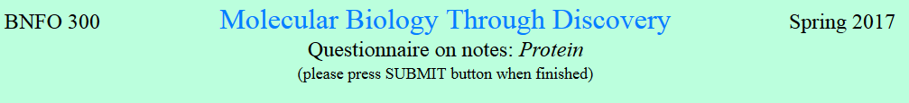
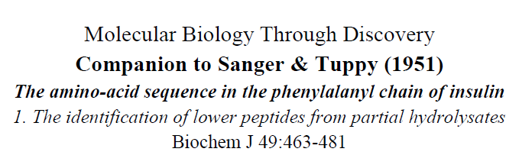
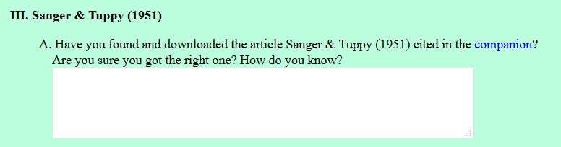
Yes, the title and the year of publication are the same as the article in the companion.
it does make mention of the Phenylalanyl chain that was also seen in the companion.

Slide 14
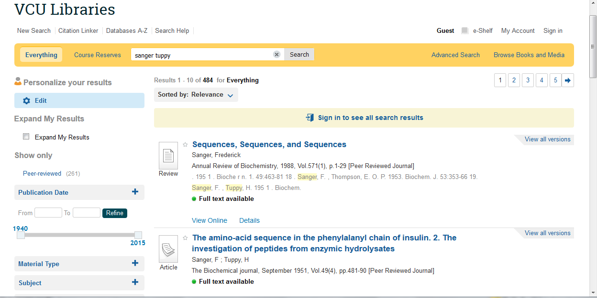

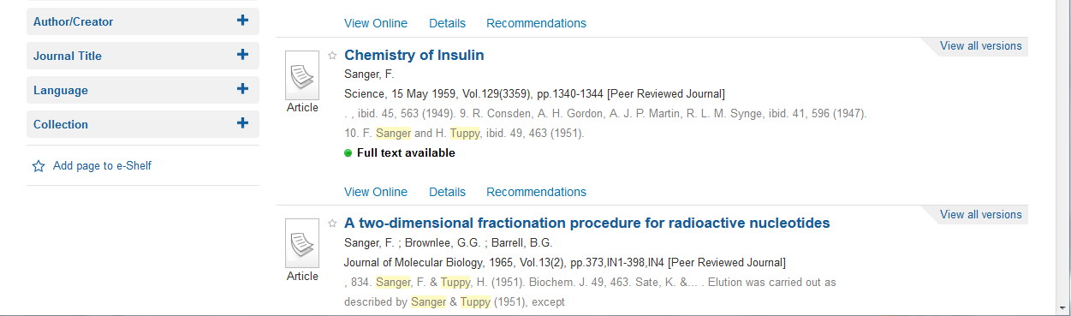

Slide 15
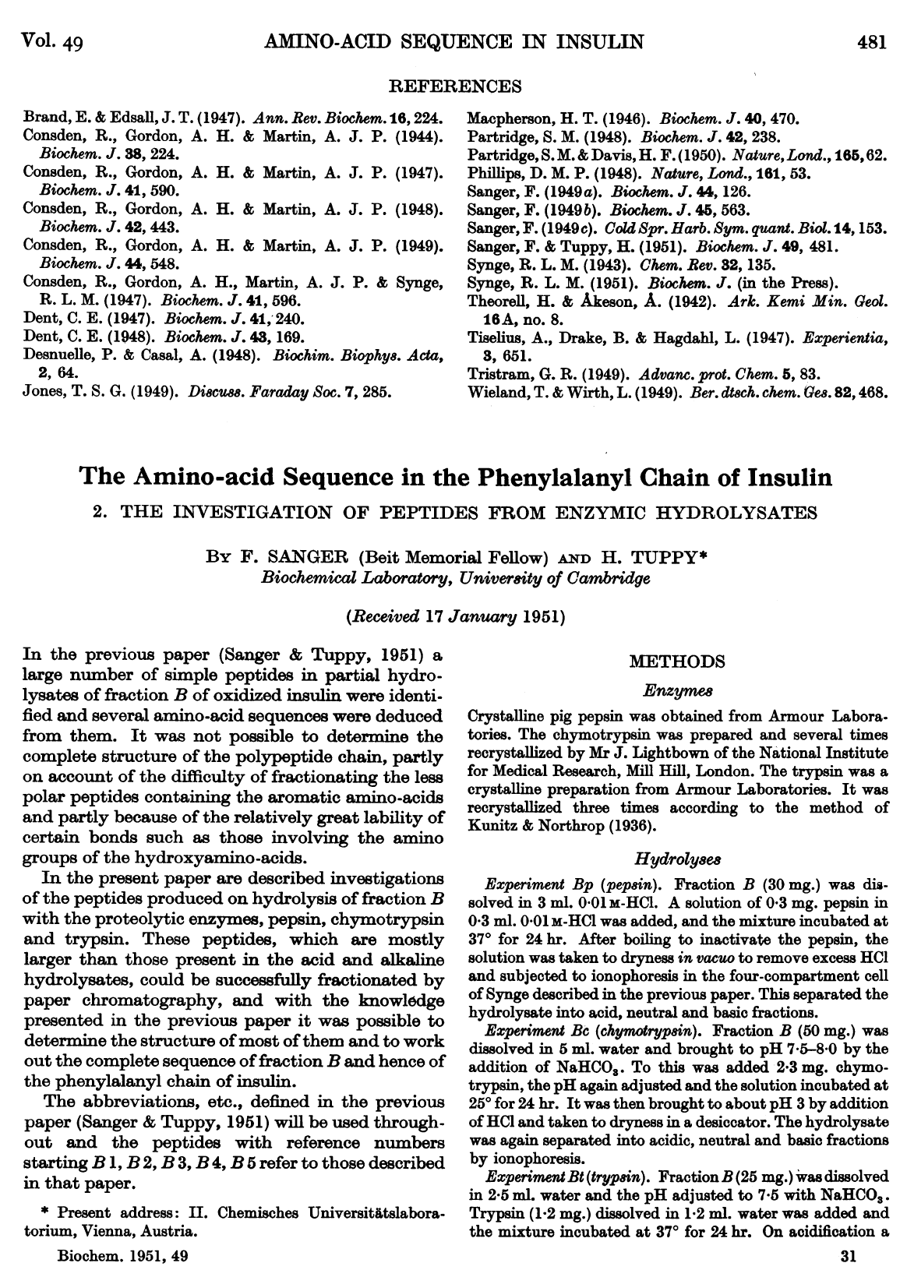

Slide 16
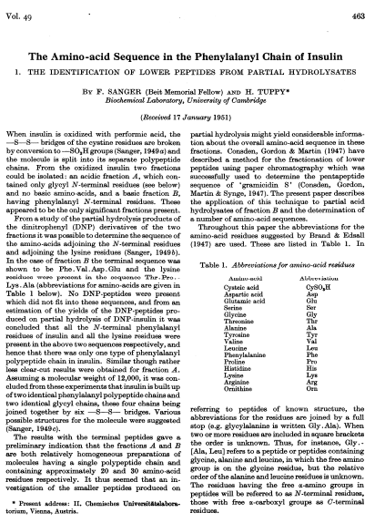

Slide 17
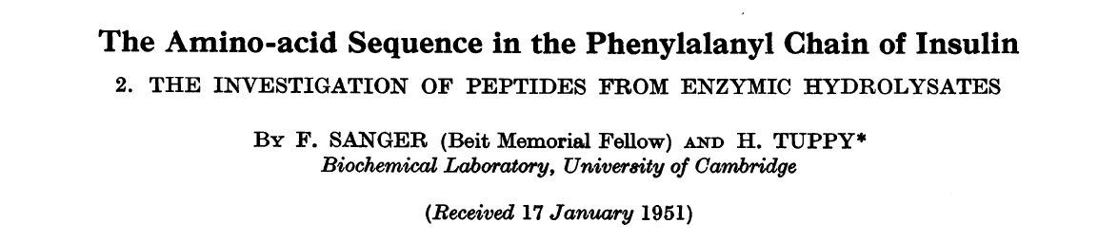
I think class time could be best spent if we discuss how to approach reading research articles… understanding what is important…
Going over SQ9 in class would be helpful for me.
SQ9. Are there amino acids found in insulin that are absent in the phenylalanine chain of insulin?
Find the data

Slide 18
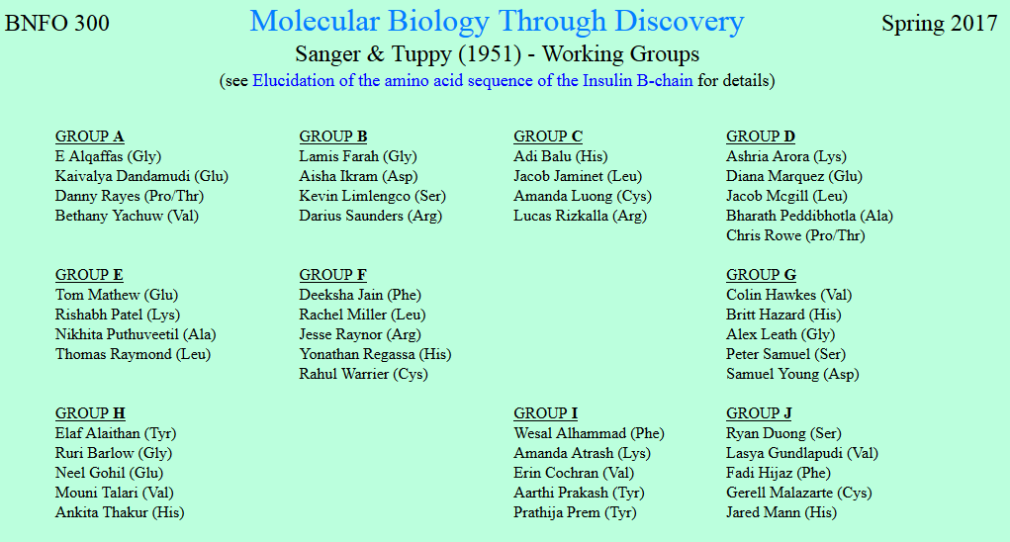

Slide 19

Sanger and Tuppy (1951)
Me
1N
1S
2N
2S
3N
3S
4N
4S
5N
5S
6N
6S
7S

Slide 20
Sanger and Tuppy (1951)
Me
1N
1S
2N
A
B
C
D
2S
3N
3S
4N
E
F
G
4S
5N
5S
6N
H
I
J
6S
7S

Slide 22
SQ9. Are there amino acids found in insulin that are absent in the phenylalanine chain of insulin?
Find the data

Slide 24
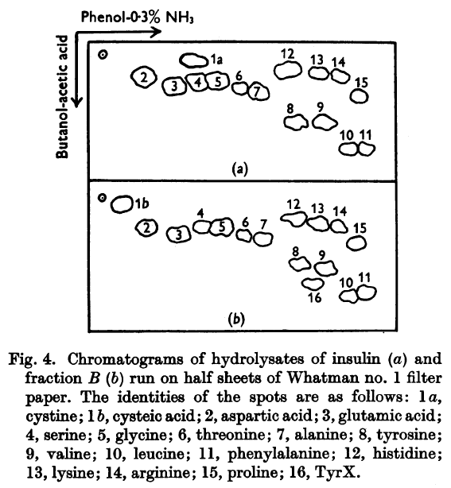
Sanger and Tuppy (1951)
SQ9. Are there amino acids found in insulin that are absent in the phenylalanine chain of insulin?

Slide 25
…in the Sanger/Tuppy paper… I understand the graph… but am having trouble connecting how the table corresponds.

Slide 26
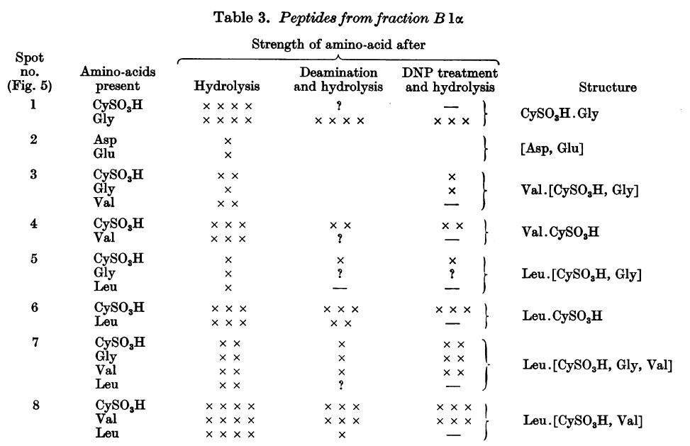
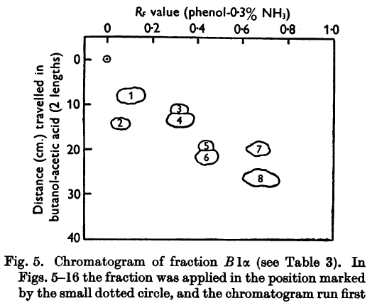
Sanger and Tuppy (1951)

Slide 27
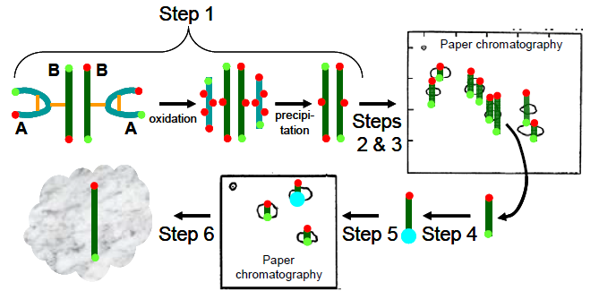
Strategy to determine protein sequence
Separate
Analyze

Slide 28
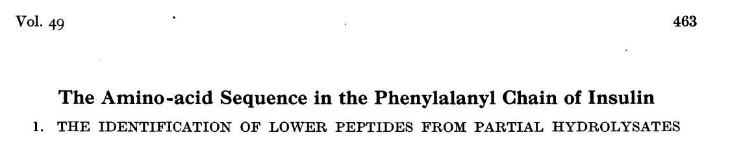
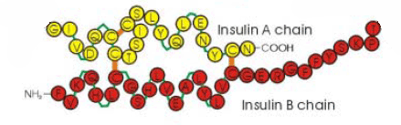
Sanger and Tuppy (1951)

Slide 29
Sanger and Tuppy (1951)
How to determine structure?
Break at random

Slide 30
Sanger and Tuppy (1951)
How to determine structure?
Break at random

Slide 31
Sanger and Tuppy (1951)
How to determine structure?
Break at random
About how many fragments?

Slide 32
Sanger and Tuppy (1951)

Slide 33
Strategy to determine protein sequence
Separate
Analyze

Slide 34
Sanger and Tuppy (1951)

Slide 36
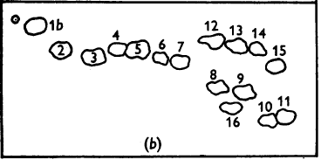
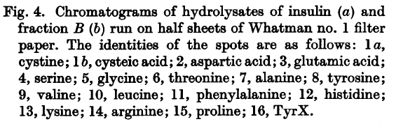
Sanger and Tuppy (1951)
How to determine the identity and order of the amino acids in each spot?
Phenol-0.3% NH₃
Butanol-acetic acid

Slide 37
Sanger and Tuppy (1951)
How to determine the identity and order of the amino acids in each spot?
Phenol-0.3% NH₃
Butanol-acetic acid
Cys
Gly

Slide 38
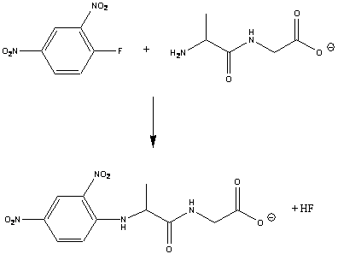
Sanger and Tuppy (1951)
How to determine the identity and order of the amino acids in each spot?
₃HN
CO₂
Cys - Gly

Slide 39
Sanger and Tuppy (1951)
How to determine the identity and order of the amino acids in each spot?
Cys - Gly

Slide 40
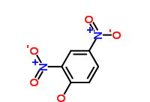
Sanger and Tuppy (1951)
How to determine the identity and order of the amino acids in each spot?
Cys - Gly
Di-nitro-phenyl-…
Cys - Gly

Slide 41
Sanger and Tuppy (1951)
How to determine the identity and order of the amino acids in each spot?
Phenol-0.3% NH₃
Lys
Butanol-acetic acid
Val

Slide 42
Sanger and Tuppy (1951)
How to determine the identity and order of the amino acids in each spot?
Phenol-0.3% NH₃
Lys
Butanol-acetic acid
Val

Slide 43
Sanger and Tuppy (1951)

Slide 44
Welcome to Molecular Biology Through Discovery Thursday, 26 January 2017
Could we go over problem 1.4 from the problem set in class?

Slide 45

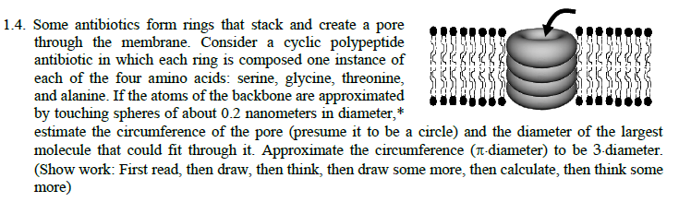

. The entire 2nd half of the question does not make sense to me.

Slide 47

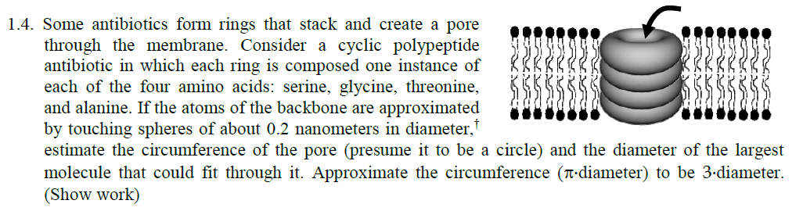

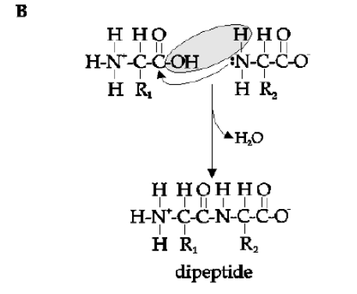
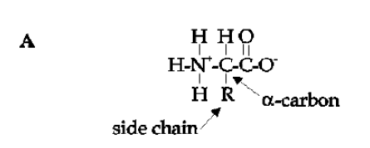

Slide 49
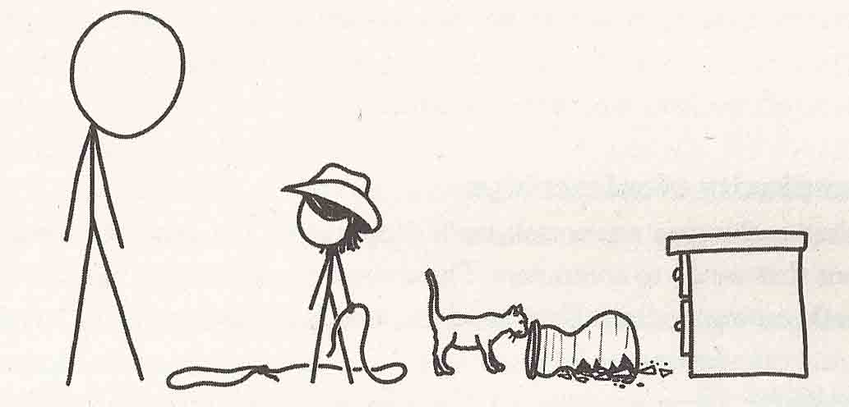
Modes of Thought
From What If by Randall Munroe

Slide 50
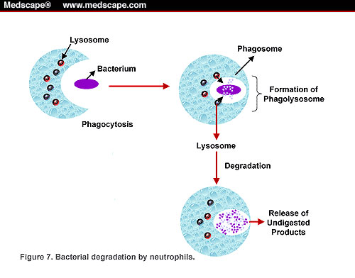
How do white blood cells fight off disease?
Phagocytosis
Neutrophil
www.medscape.com/viewarticle/436533_5

Slide 51
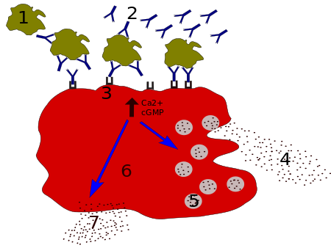
How do white blood cells fight off disease?
Degranulation
Neutrophil
en.wikipedia.org/wiki/Degranulation

Slide 52
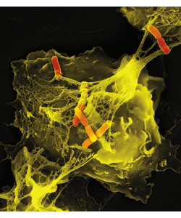
How do white blood cells fight off disease?
Neutrophil Extracellular Trap (NET)
Bacterium
Neutrophil
DNA!
stke.sciencemag.org/content/2007/379

Slide 53
How do white blood cells fight off disease?
Where does NET DNA come from?
Internal: NET from own neutrophil’s own DNA
External: NET from other DNA
Do neutrophils make their own NETs?

Slide 54
How do white blood cells fight off disease?
Where does NET DNA come from?
+
Label neutrophil DNA
Internal
External

Slide 55
How do white blood cells fight off disease?
Phagocytosis
Big Idea
Neutrophil
www.medscape.com/viewarticle/436533_5

Slide 56
How do white blood cells fight off disease?
Neutrophil Extracellular Trap (NET)
Bacterium
Small logical steps (experimental results)
Neutrophil
DNA!
stke.sciencemag.org/content/2007/379

Slide 57
How do white blood cells fight off disease?
Where does NET DNA come from?
Internal: NET from own neutrophil’s own DNA
External: NET from other DNA
Small Question (susceptible to experiment)
Do neutrophils make their own NETs?

Slide 58
How do white blood cells fight off disease?
Where does NET DNA come from?
+
Label neutrophil DNA
Internal
External
Experiment

Slide 59
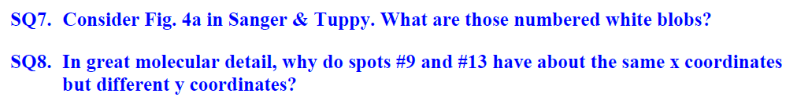
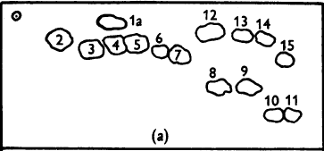
Sanger and Tuppy (1951)
Phenol-0.3% NH₃
Lys
Amino Acids of Insulin
Lys
Butanol-acetic acid
Val
Val

Slide 60
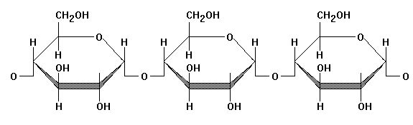
Paper Chromatography
organic solvent
water

Slide 61
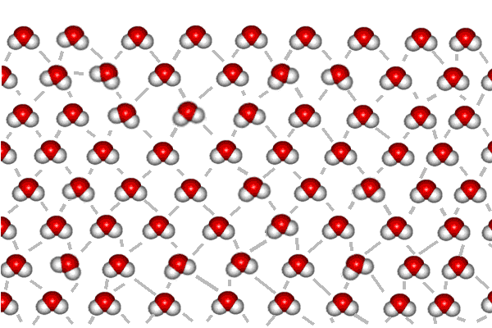
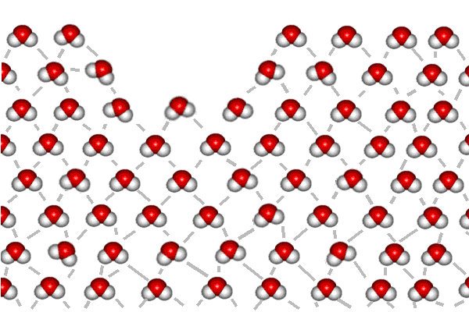
Interaction with water
Air
Water
Valine?
Lysine?
Air

Slide 62
Sanger and Tuppy (1951)
Phenol-0.3% NH₃
Lys
Amino Acids of Insulin
Lys
Butanol-acetic acid
Val
Val

Slide 63
Visualize Val+Lys in Solvent
Phenol + ammonia
butanol + acetic acid

Slide 64
Visualize Val+Lys in Solvent
Phenol + ammonia
butanol + acetic acid

Slide 65
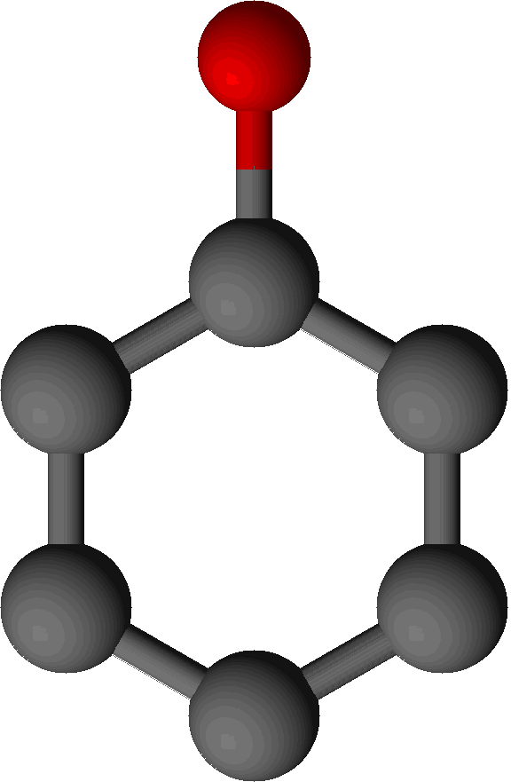
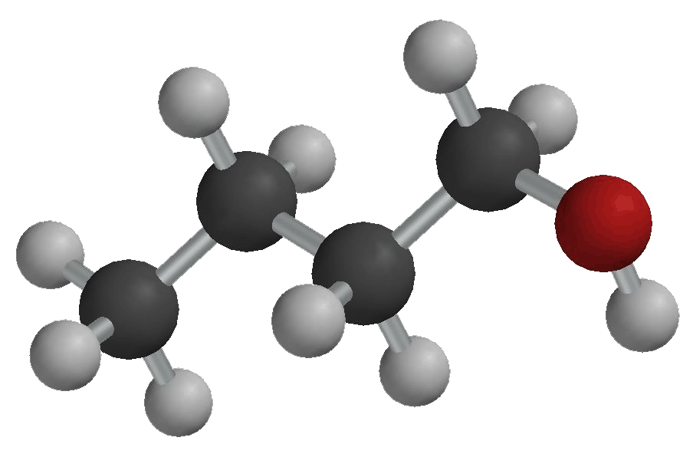
Visualize Val+Lys in Solvent
Phenol + ammonia
butanol + acetic acid

Slide 66
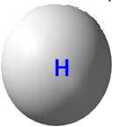
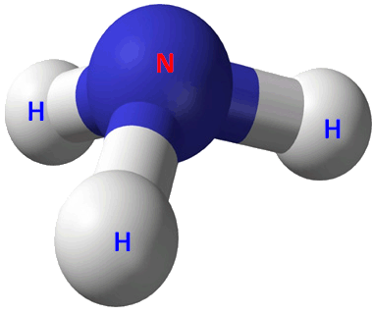
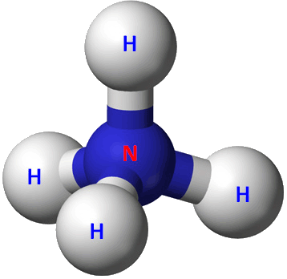
Visualize Val+Lys in Solvent
Phenol + ammonia
butanol + acetic acid
pH: neutral
+

Slide 67
Visualize Val+Lys in Solvent
Phenol + ammonia
butanol + acetic acid
pH: high
+

Slide 68
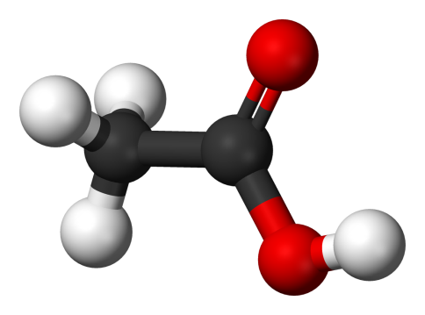
Visualize Val+Lys in Solvent
Phenol + ammonia
butanol + acetic acid
pH: high
pH: neutral
+

Slide 69
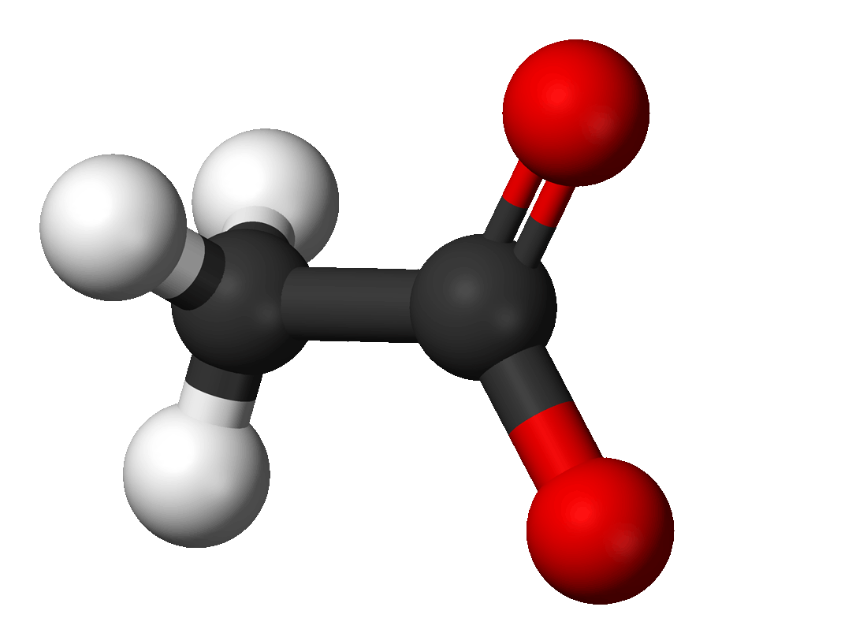
Visualize Val+Lys in Solvent
Phenol + ammonia
butanol + acetic acid
pH: high
pH: neutral
+
-

Slide 70
Visualize Val+Lys in Solvent
Phenol + ammonia
butanol + acetic acid
pH: high
pH: low
+
-

Slide 71
Visualize Val+Lys in Solvent
Phenol + ammonia
butanol + acetic acid
pH: high
pH: low
+
-

Slide 72
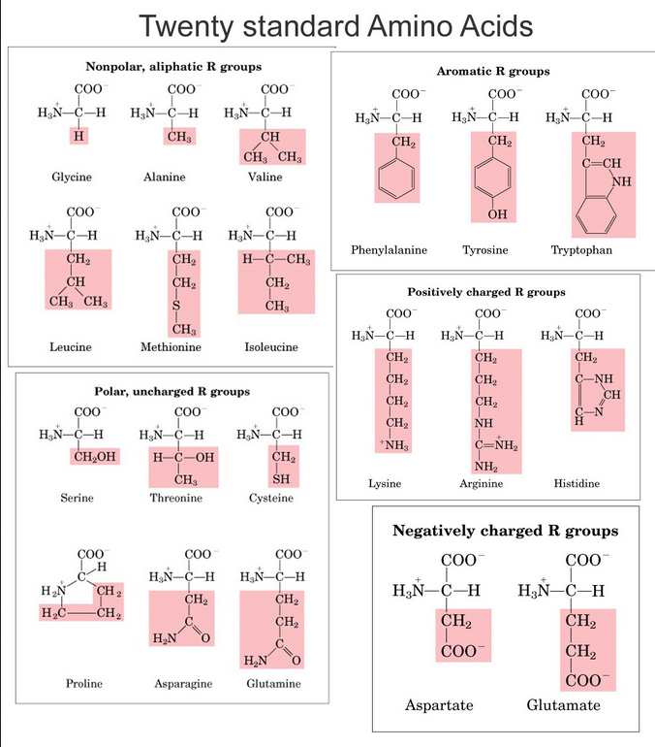

Slide 74
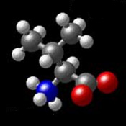
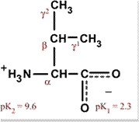
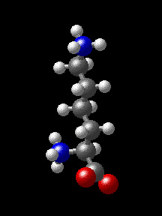

Interaction with water
Valine
Lysine
+

Slide 75

Visualize Val+Lys in Solvent
Phenol + ammonia
butanol + acetic acid
pH: high
pH: low

Slide 76

Visualize Val+Lys in Solvent
Phenol + ammonia
butanol + acetic acid
pH: high
pH: low
+
+

Slide 77
Sanger and Tuppy (1951)
Phenol-0.3% NH₃
Lys
Amino Acids of Insulin
Lys
Butanol-acetic acid
Val
Val

Slide 78


Slide 80
Sanger and Tuppy (1951)
Phenol-0.3% NH₃
Lys
Amino Acids of Insulin
Lys
Butanol-acetic acid
Val
Val

Slide 81
Amino Acids of Insulin
Phenol-0.3% NH₃
Lys
Butanol-acetic acid
Val

