Slide 2
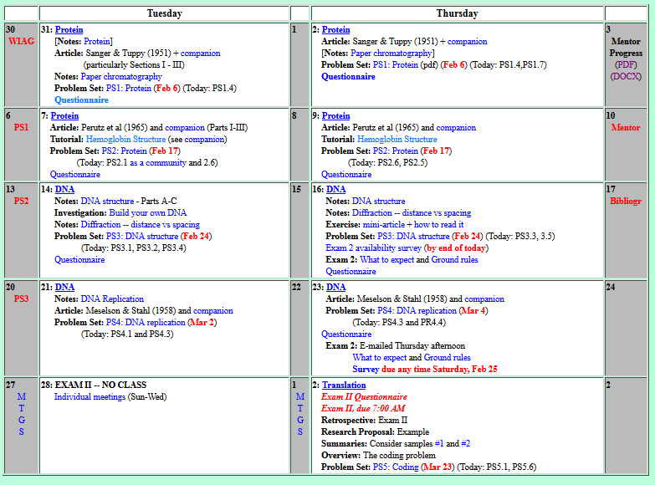

Welcome to Molecular Biology Through Discovery Thursday, 2 February 2017

Slide 3
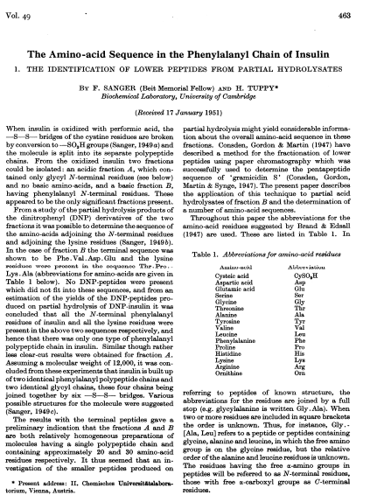

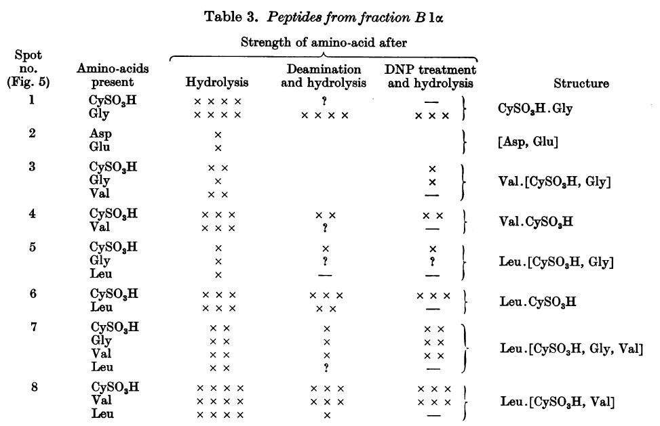
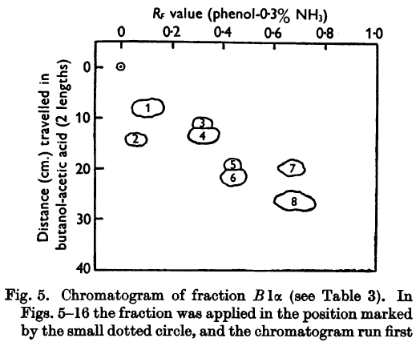
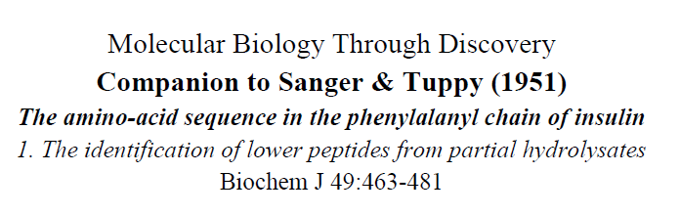

Slide 4
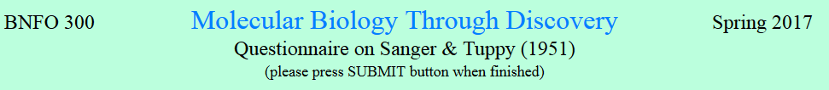
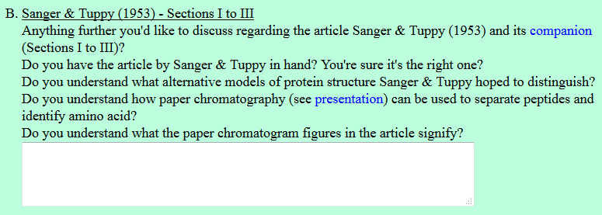

I didn't quite catch on to why there were differences in the amino acids between insulin and the fraction B.

Slide 5
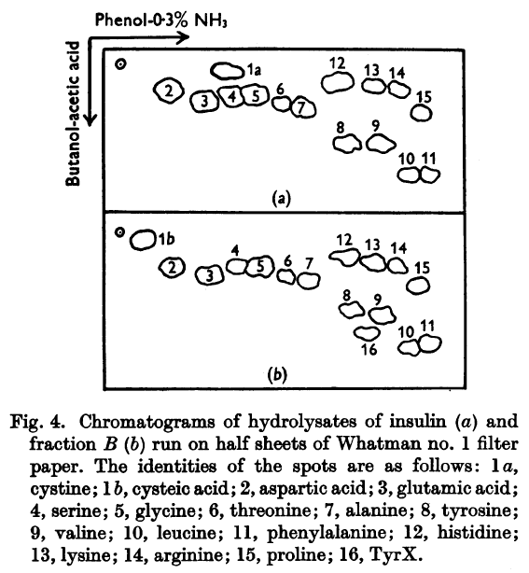
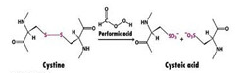
Sanger and Tuppy (1951)
Insulin
I didn't quite catch on to why there were differences in the amino acids between insulin and the fraction B.
cystine
cysteic acid
Fraction B

Slide 6
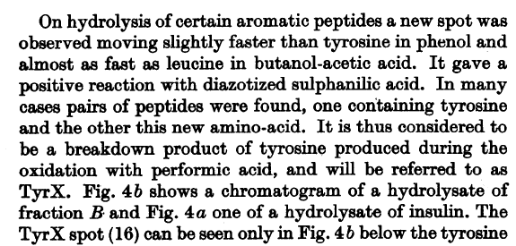
Sanger and Tuppy (1951)
Insulin
I didn't quite catch on to why there were differences in the amino acids between insulin and the fraction B.
cystine
cysteic acid
TyrX
Fraction B

Slide 7
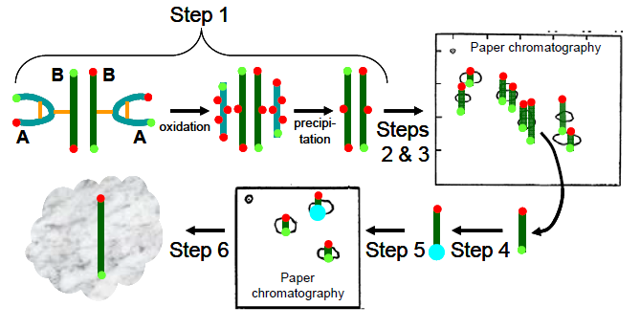
Strategy to determine protein sequence
Separate
Insulin
B chain
Analyze

Slide 8
Sanger and Tuppy (1951)
Insulin
I didn't quite catch on to why there were differences in the amino acids between insulin and the fraction B.
cystine
cysteic acid
TyrX
Fraction B

Slide 9
I'm still unsure how to interpret the charts with the hydrolysis and DNP treatment…
I can't figure out how they decide the order…

Slide 10
Sanger and Tuppy (1951)

Slide 11
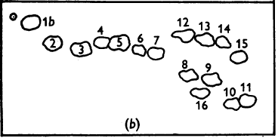
Sanger and Tuppy (1951)
How to determine the identity and order of the amino acids in each spot?
Phenol-0.3% NH₃
Butanol-acetic acid

Slide 12
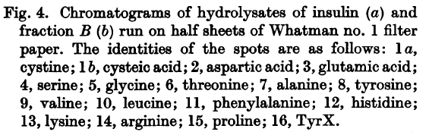
Sanger and Tuppy (1951)
How to determine the identity and order of the amino acids in each spot?
Phenol-0.3% NH₃
Butanol-acetic acid
Cys
Gly

Slide 13
Sanger and Tuppy (1951)
How to determine the identity and order of the amino acids in each spot?
Phenol-0.3% NH₃
Butanol-acetic acid
Cys
Gly

Slide 14
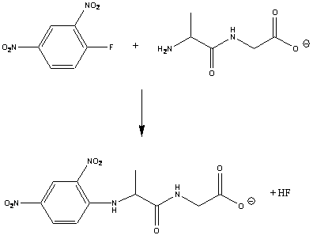
Sanger and Tuppy (1951)
How to determine the identity and order of the amino acids in each spot?
₃HN
CO₂
Cys - Gly

Slide 15
Sanger and Tuppy (1951)
How to determine the identity and order of the amino acids in each spot?
Di-nitro
Cys - Gly

Slide 16
Sanger and Tuppy (1951)
How to determine the identity and order of the amino acids in each spot?
Di-nitrophenyl
Cys - Gly

Slide 17
Sanger and Tuppy (1951)
How to determine the identity and order of the amino acids in each spot?
Di-nitrophenyl
Cys - Gly
fluoride
DNPF

Slide 18
Sanger and Tuppy (1951)
How to determine the identity and order of the amino acids in each spot?
DNPF
Cys - Gly
DNP-Cys - Gly

Slide 19
Sanger and Tuppy (1951)
How to determine the identity and order of the amino acids in each spot?
Phenol-0.3% NH₃
Lys
Butanol-acetic acid
Cys
Gly
Val
Without DNPF pretreatment

Slide 20
Sanger and Tuppy (1951)
How to determine the identity and order of the amino acids in each spot?
Phenol-0.3% NH₃
Lys
Butanol-acetic acid
Gly
Val
With DNPF pretreatment

Slide 21
Sanger and Tuppy (1951)

Slide 22
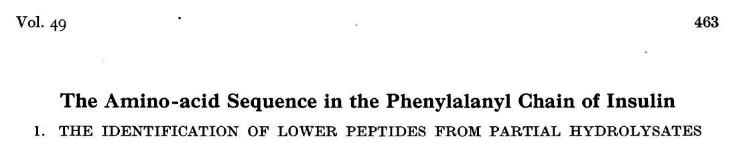
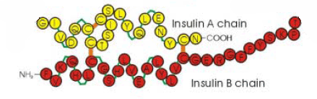
Sanger and Tuppy (1951)
How to determine structure?
I believe it may be a time consuming task…
Break at random

Slide 23

Culture of Science

Slide 24
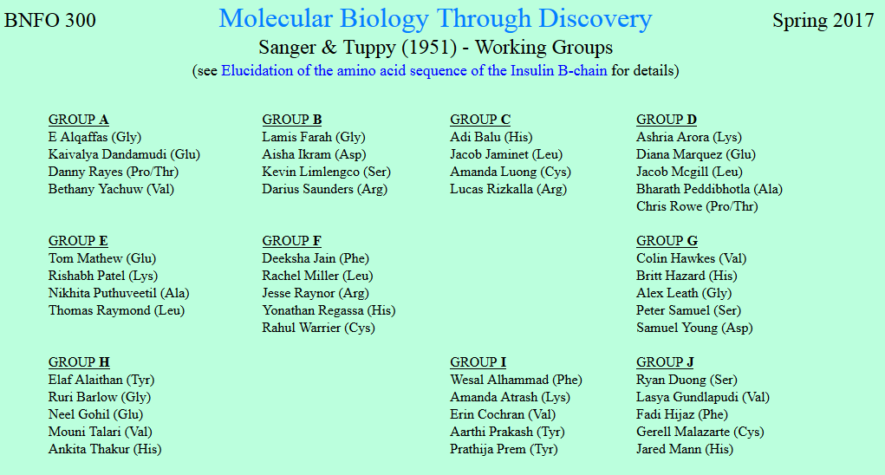
I have very little confidence in my ability to parse the Sanger & Tuppy paper without instruction.

Slide 25
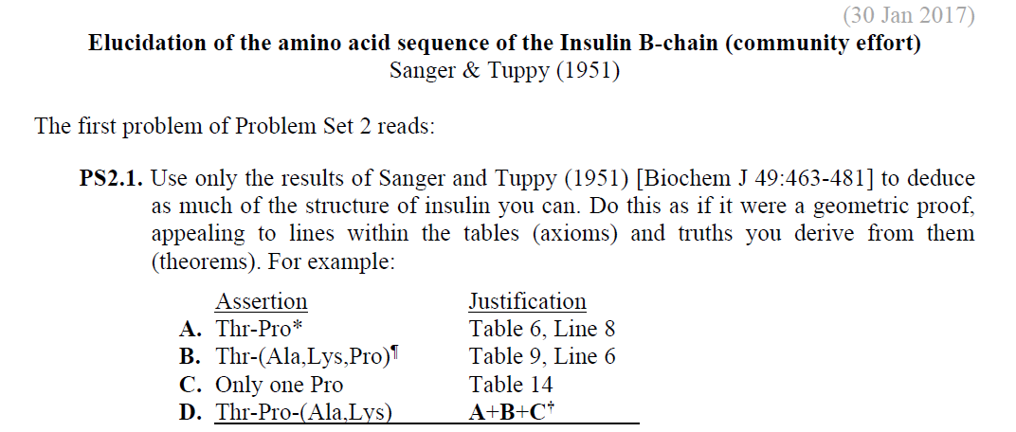
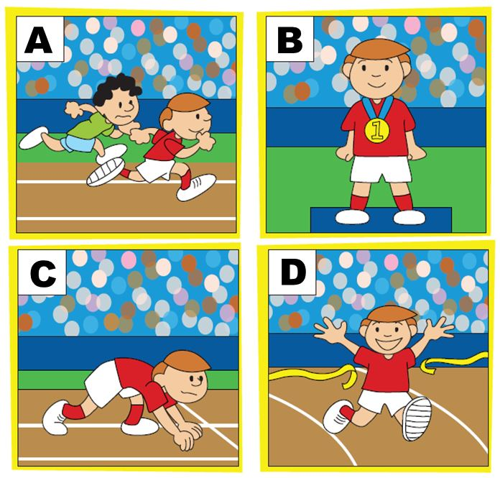

Thr-Pro-(Ala,Lys)
Thr-Lys-Ala-Pro
+ Thr-Pro-Glu

Slide 26
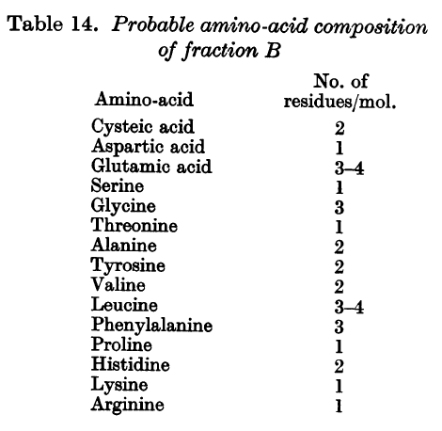
Thr-Pro-(Ala,Lys)
Thr-Lys-Ala-Pro
Regarding SQ17/18, I am having trouble figuring out exactly what table 14 means...
+ Thr-Pro-Glu

Slide 27
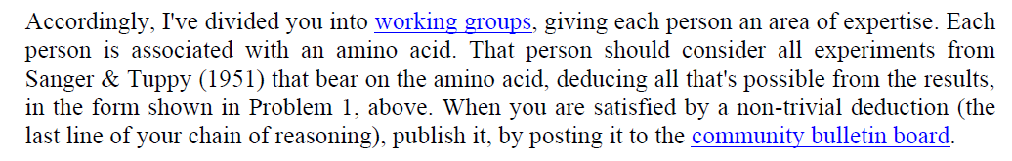

Slide 28


Slide 29
Welcome to Molecular Biology Through Discovery Thursday, 2 February 2017

Slide 30

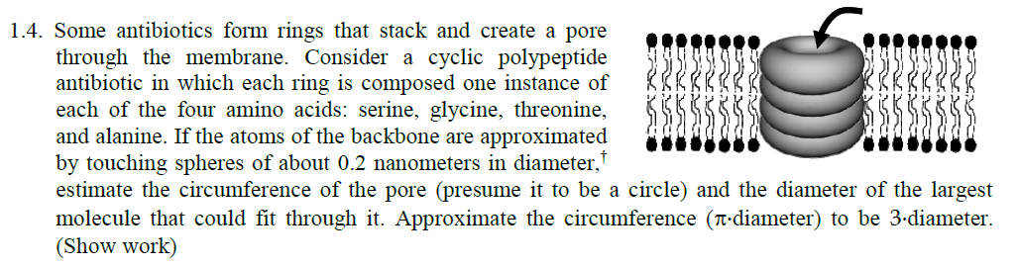

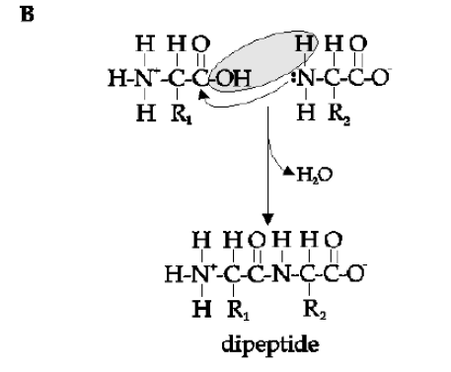
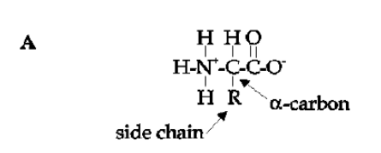

Slide 31

Sanger and Tuppy (1951)
Me
1N
1S
2N
2S
3N
3S
4N
4S
5N
5S
6N
6S
7S

Slide 32
Sanger and Tuppy (1951)
Me
1N
1S
2N
A
B
C
D
2S
3N
3S
4N
E
F
G
4S
5N
5S
6N
H
I
J
6S
7S

