Slide 2
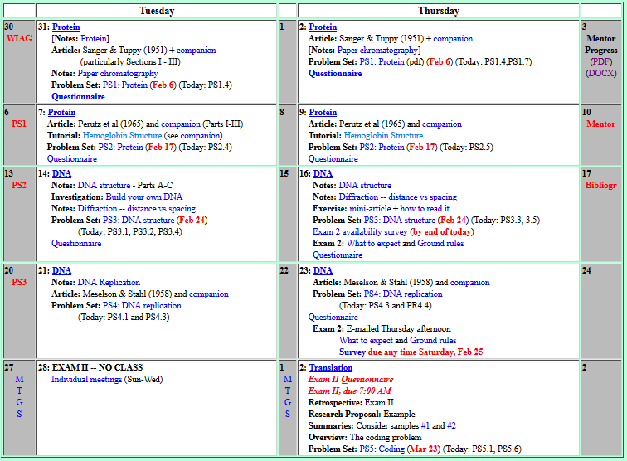

Welcome to Molecular Biology Through Discovery Tuesday, 7 February 2017

Slide 3
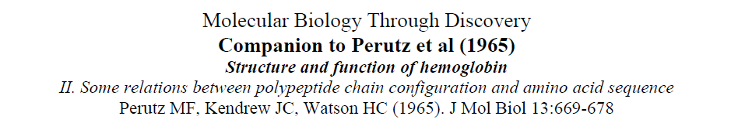
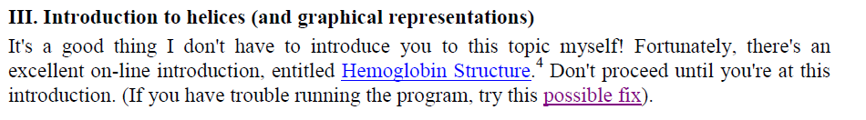

Slide 4
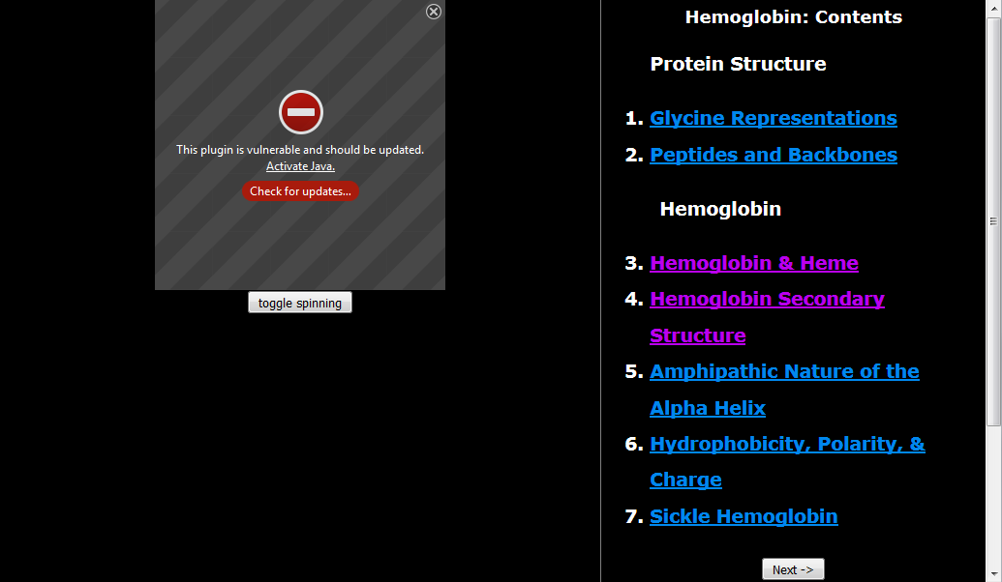

It keep telling me that my device doesn't meet the requirements. .
I haven't been able to make it work, I will try other computer
Will try with other browsers

Slide 6
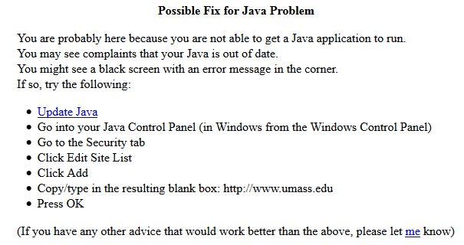
I will need to download Java first.

Slide 7
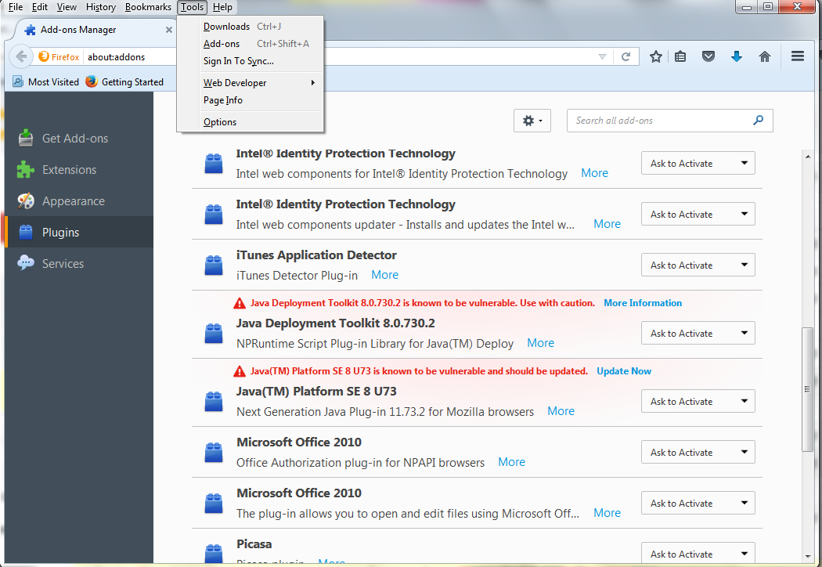
I tried reinstalling Java, and I got no web browser plugin listed in Firefox's plugins menu.

Slide 8
Accessed after some troubleshooting.
Took a while to fix browser security for Hgb Structure but I got it.
I tried using the possible solution and I could not get it to work.
I had to add the website in my preferences in the java control panel, but after that it worked fine.

Slide 10
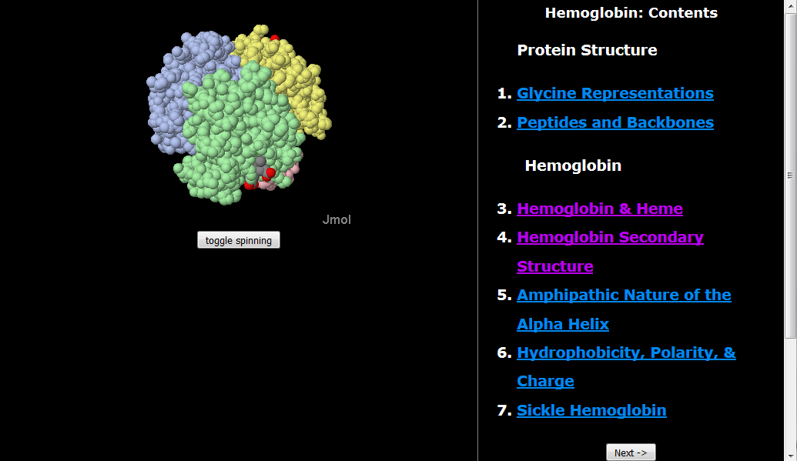

Slide 11
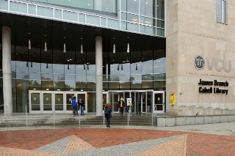
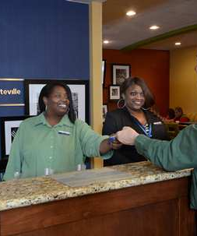
VCU Cabell Library Help Desk

Slide 12

Sanger and Tuppy (1951)
Me
1N
1S
2N
2S
3N
3S
4N
4S
5N
5S
6N
6S
7S

Slide 13
Sanger and Tuppy (1951)
Me
1N
1S
2N
A
B
C
D
2S
3N
3S
4N
E
F
G H
4S
5N
5S
6N
I J
K
L
6S
7S

Slide 14
Welcome to Molecular Biology Through Discovery Tuesday, 7 February 2017

Slide 15
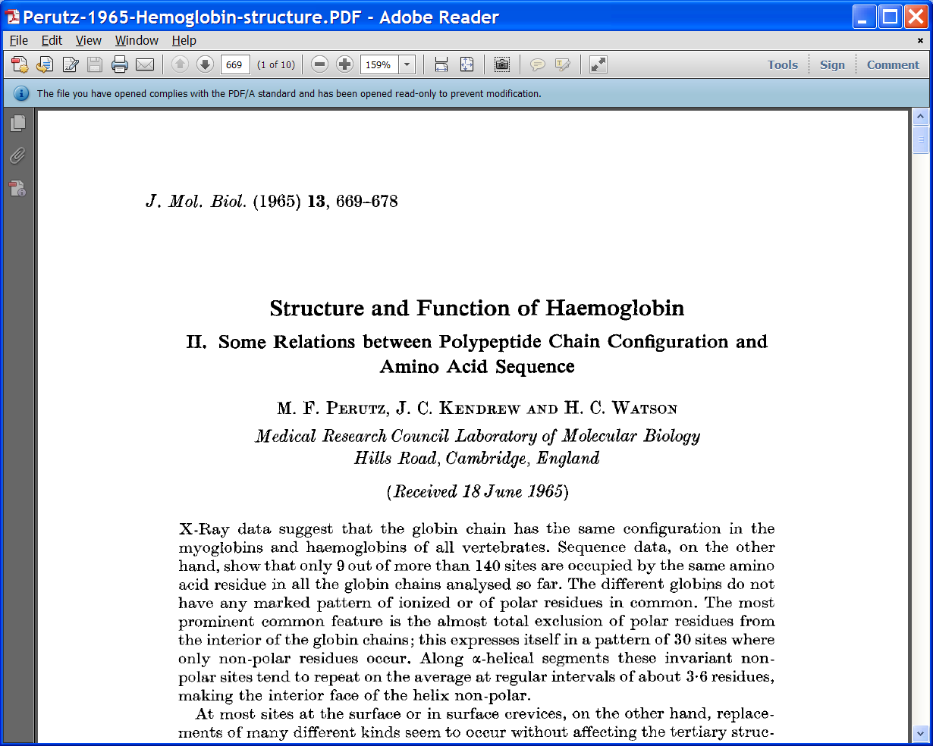
Perutz et al (1965)
Why does yours have marshmallows and mine’s just sticks?
SQ1. From the first paragraph of the Introduction of Perutz et al (1965), what question is central to the work reported in this article? What motivated the question?

Slide 16
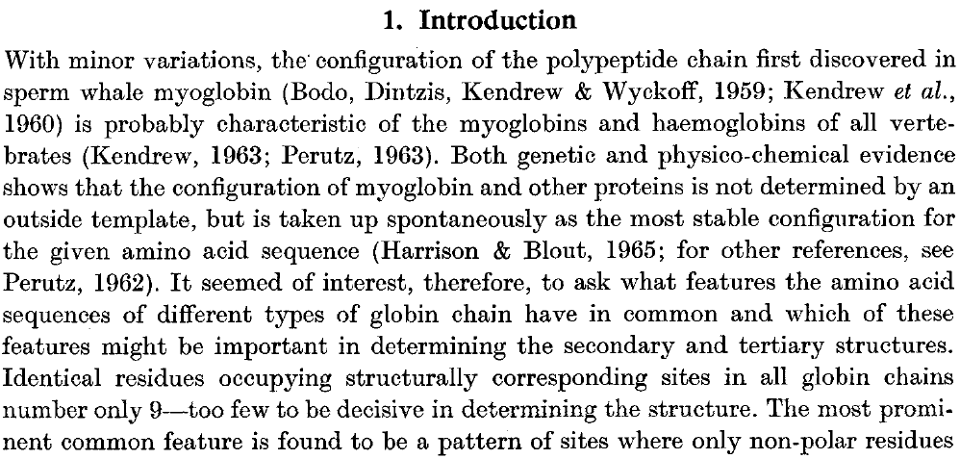
Perutz et al (1965)
SQ1. From the first paragraph of the Introduction of Perutz et al (1965), what question is central to the work reported in this article? What motivated the question?

Slide 17
Perutz et al (1965)
- Globin structures all the same
SQ1. From the first paragraph of the Introduction of Perutz et al (1965), what question is central to the work reported in this article? What motivated the question?

Slide 18

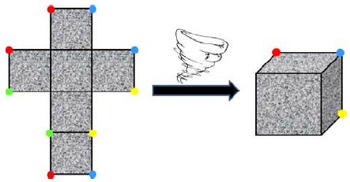
Perutz et al (1965)
- Globin structures all the same
SQ1. From the first paragraph of the Introduction of Perutz et al (1965), what question is central to the work reported in this article? What motivated the question?

Slide 19
Perutz et al (1965)
- Globin structures all the same
- Structures come from amino acid sequences
SQ1. From the first paragraph of the Introduction of Perutz et al (1965), what question is central to the work reported in this article? What motivated the question?

Slide 20
Perutz et al (1965)
- Globin structures all the same
- Structures come from amino acid sequences
SQ1. From the first paragraph of the Introduction of Perutz et al (1965), what question is central to the work reported in this article? What motivated the question?

Slide 21
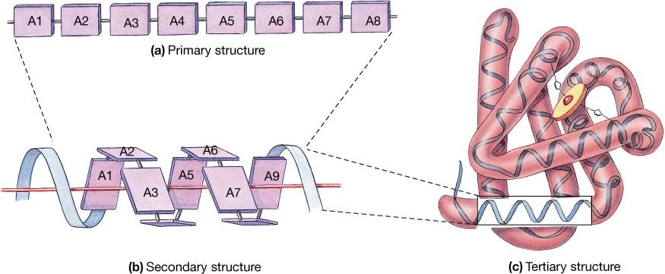
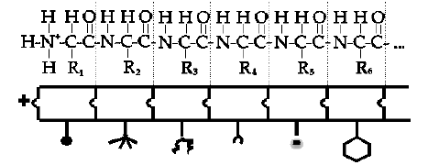
Secondary/Tertiary Structure
Primary structure

Slide 22
Secondary/Tertiary Structure
Primary structure
Secondary structure
Tertiary structure

Slide 23
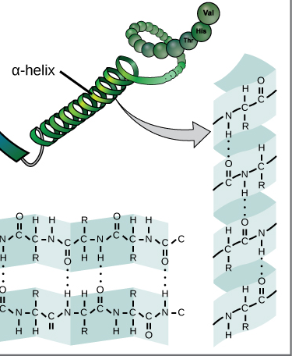
Secondary/Tertiary Structure

Slide 24
Perutz et al (1965)
- Globin structures all the same
- Structures come from amino acid sequences
SQ1. From the first paragraph of the Introduction of Perutz et al (1965), what question is central to the work reported in this article? What motivated the question?

Slide 25
Perutz et al (1965)
- Globin structures all the same
- Structures come from amino acid sequences
- Look for common features in sequences
SQ1. From the first paragraph of the Introduction of Perutz et al (1965), what question is central to the work reported in this article? What motivated the question?

Slide 26
Perutz et al (1965)
- Globin structures all the same
- Structures come from amino acid sequences
- Look for common features in sequences
SQ1. From the first paragraph of the Introduction of Perutz et al (1965), what question is central to the work reported in this article? What motivated the question?

Slide 27
Perutz et al (1965)
- Globin structures all the same
- Structures come from amino acid sequences
- Look for common features in sequences
- Invariant amino acids are rare
Then what makes globin globin?
SQ1. From the first paragraph of the Introduction of Perutz et al (1965), what question is central to the work reported in this article? What motivated the question?

Slide 28
Perutz et al (1965)
- Globin structures all the same
- Structures come from amino acid sequences
- Look for common features in sequences
- Invariant amino acids are rare
Then what makes globin globin?
I think class time would be best to go over the connection between Fig. 1 and Table 2

Slide 29
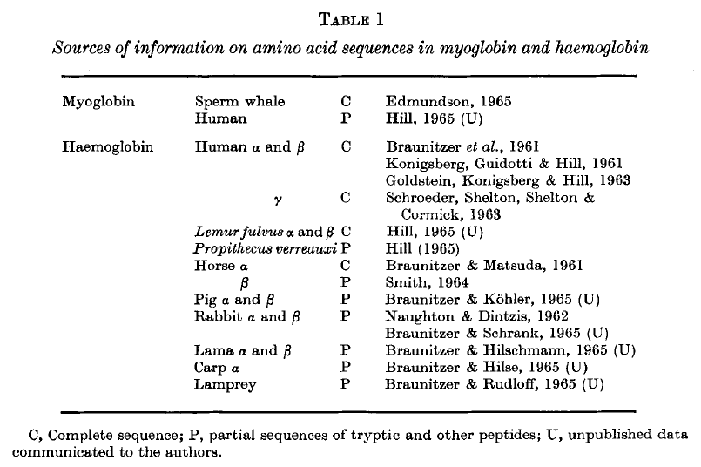
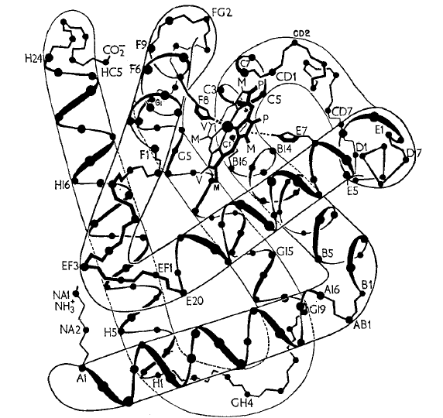
Perutz et al (1965)

Slide 30
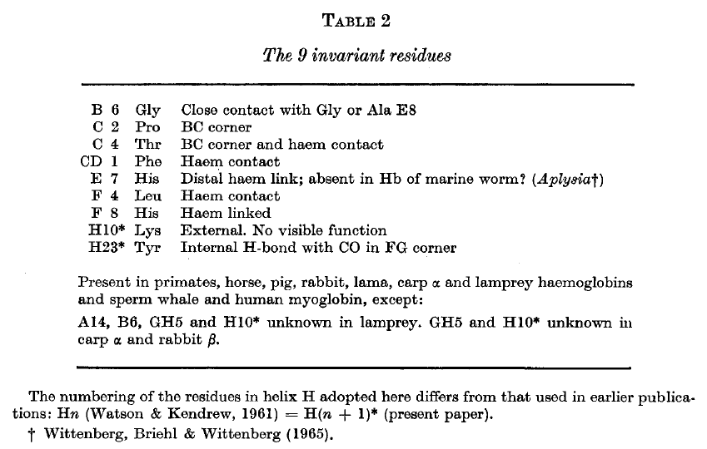
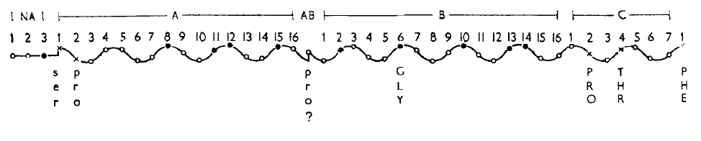
Perutz et al (1965)
Fig. 1

Slide 31
Perutz et al (1965)
Fig. 1

Slide 32
Perutz et al (1965)
Fig. 1

Slide 33
Perutz et al (1965)
Fig. 1

Slide 34
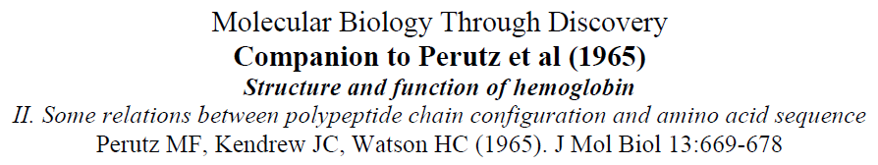
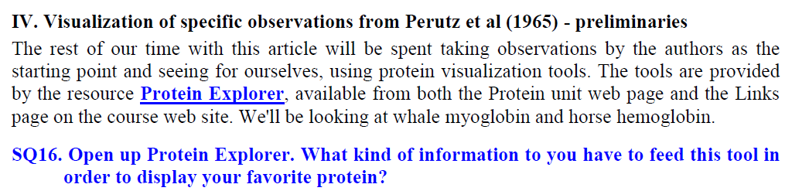

Slide 35
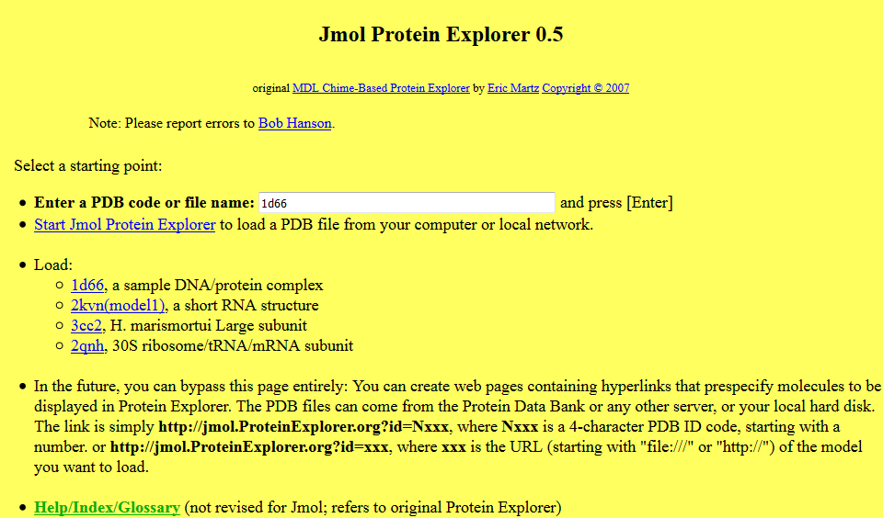

Slide 36
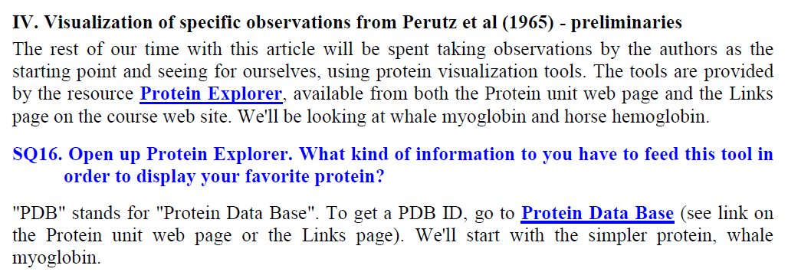
I could not figure out how to bring in whale myoglobin. I looked in the index for the code, but could not find it.

Slide 37
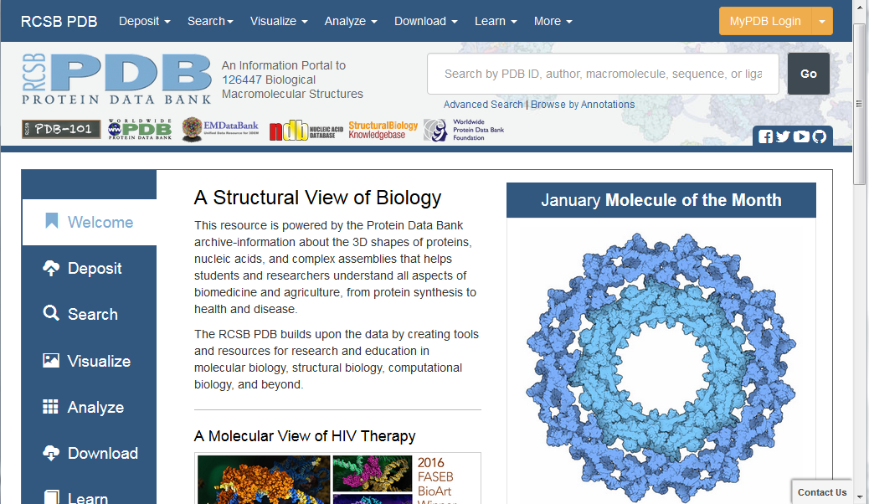

Slide 38
Perutz et al (1965)
I find it hard to navigate through the article to find what I'm looking for. Is there any method of reading the article in a general way to understand it better.

Slide 39
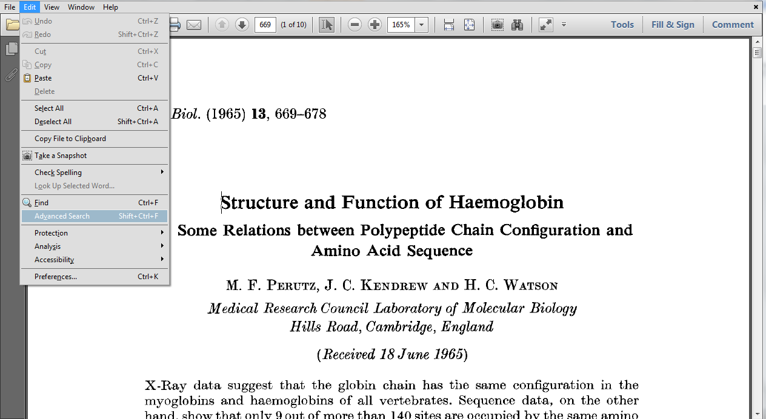

Slide 40
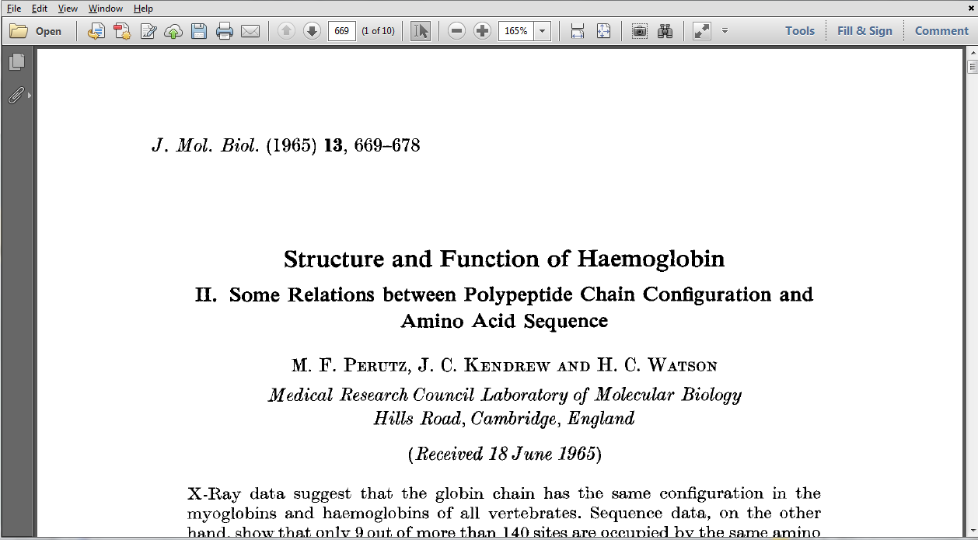
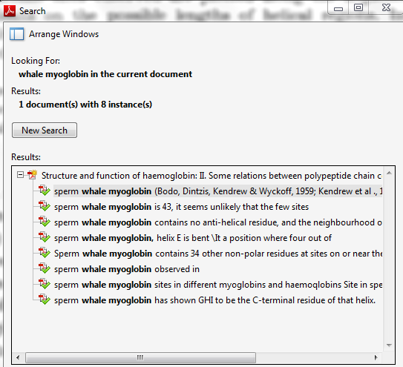

Slide 41
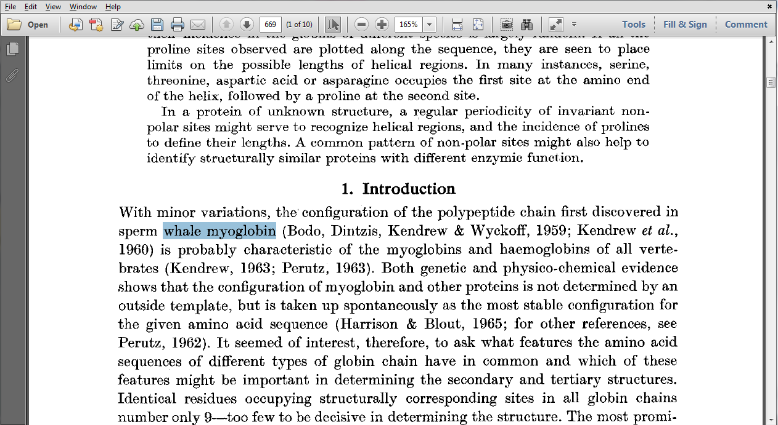

Slide 44
Perutz et al (1965)
Fig. 1

Slide 45
Welcome to Molecular Biology Through Discovery Tuesday, 7 February 2017

Slide 46

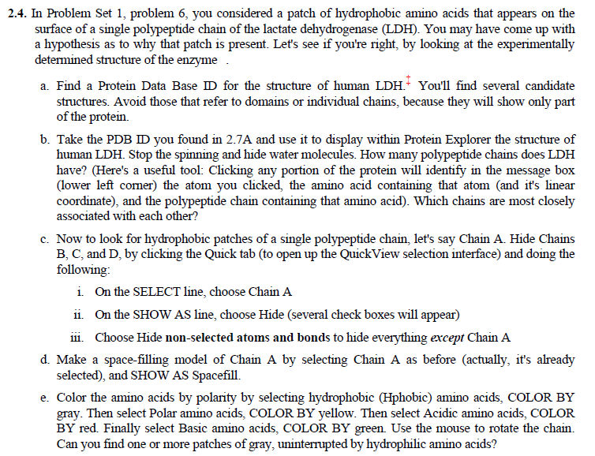

Slide 47



Slide 48
Sanger and Tuppy (1951)
Me
1N
1S
2N
2S
3N
3S
4N
4S
5N
5S
6N
6S
7S

Slide 49
Sanger and Tuppy (1951)
Me
1N
1S
2N
A
B
C
D
2S
3N
3S
4N
E
F
G H
4S
5N
5S
6N
I J
K
L
6S
7S

Slide 51
Perutz et al (1965)

Slide 52
Perutz et al (1965)

Slide 53
Perutz et al (1965)

Slide 54
Perutz et al (1965)

Slide 55
