Slide 2
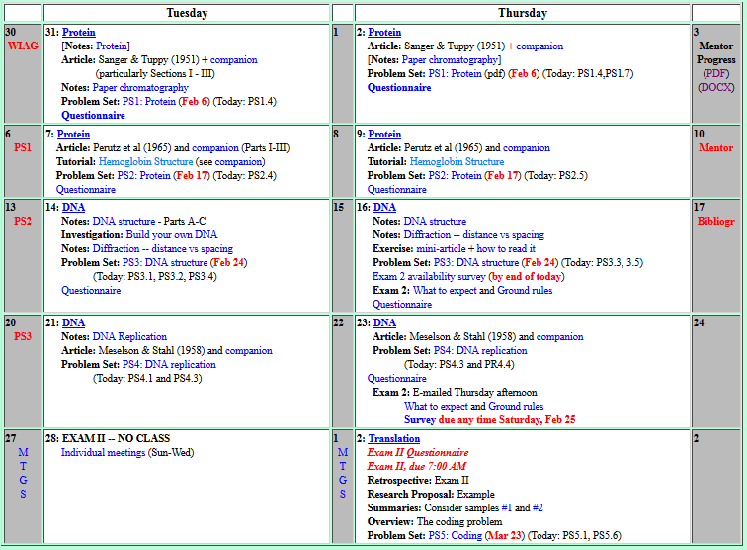

Welcome to Molecular Biology Through Discovery Thursday, 9 February 2017
I’m like terrified that I’m going to come off as stupid

Slide 3
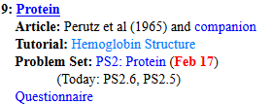
Welcome to Molecular Biology Through Discovery Thursday, 9 February 2017
Can you please go over question 2.2 in class, specifically part b

Slide 4

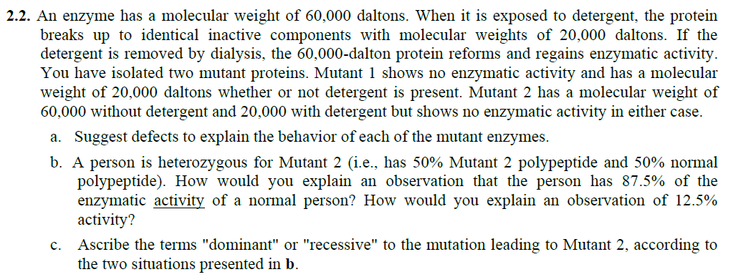

Slide 5
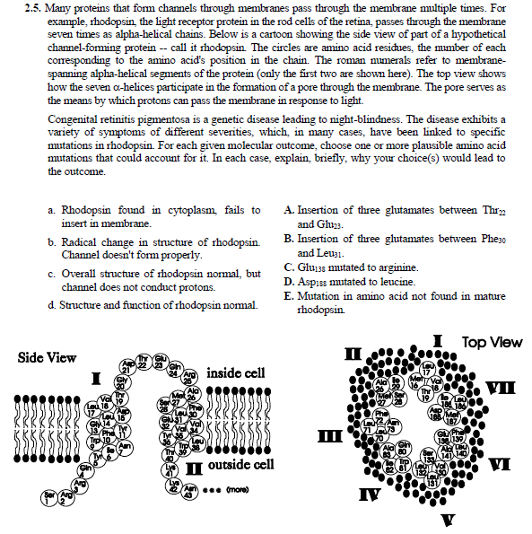

Slide 6
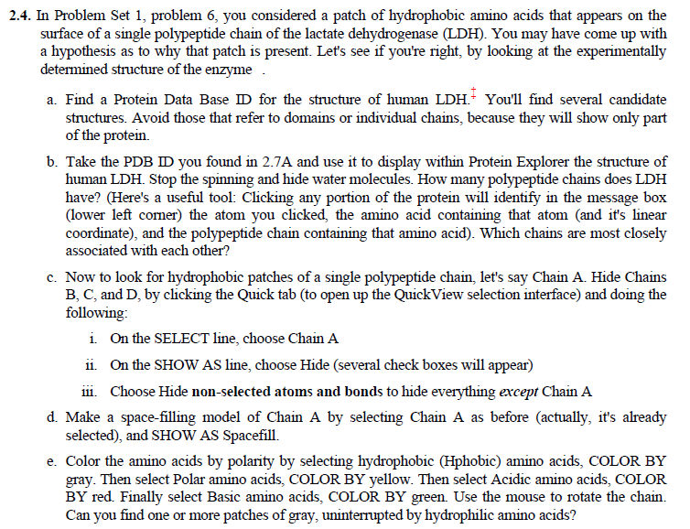

Slide 7
Why is there a patch of hydrophobic amino acids on lactate dehydrogenase?
Your group’s considered opinion (conclusion)
Justification (result / method)
Organized on a slide or page (to be shared – Zoom)
One intentional error

Slide 8

PS2, problems 4, 2, 5
Me
1N
1S
2N
2S
3N
3S
4N
4S
5N
5S
6N
6S
7S

Slide 9
PS2, problems 4, 2, 5
Connect to: https://vcu.zoom.us/j/2504526209
Me
1N
1S
2N
A
B
C
D
2S
3N
3S
4N
E
F
G H
4S
5N
5S
6N
I J
K
L
6S
7S

