Slide 2
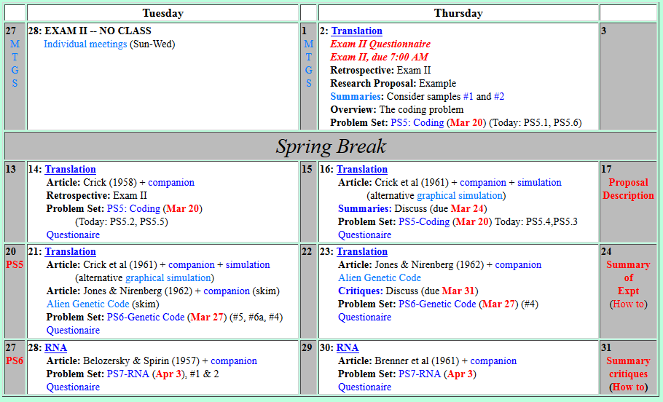

Welcome to Molecular Biology Through Discovery Tuesday, 28 March 2017
When we are critiquing, should we comment on their post or send them an email with the critique…

Slide 3
Welcome to Molecular Biology Through Discovery Thursday, 23 March 2017
When we are critiquing, should we comment on their post or send them an email with the critique…

Slide 4

Welcome to Molecular Biology Through Discovery Thursday, 23 March 2017

Slide 5
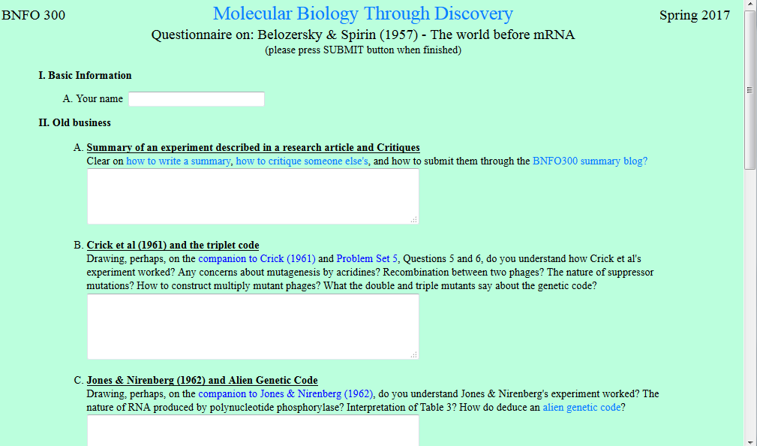
…it was very difficult to find any sort of pattern with the alien genetic code. Why would the two samples give different amino acids for the same RNA sequence?

Slide 7
I had trouble understanding how to determine if the alien code was degenerate or not? …I did not know how to interpret my data when I translated a random mRNA of nucleotide frequency 80%U 20%

Slide 9
Welcome to Molecular Biology Through Discovery Thursday, 23 March 2017

Slide 10
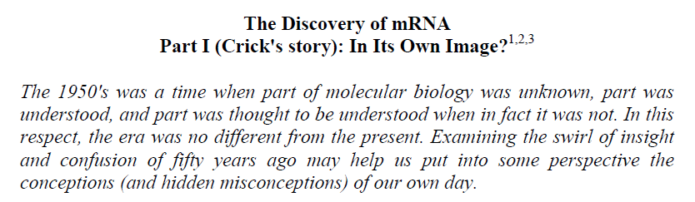


Slide 11
I'm having trouble calculating G + C / A + T. The best I could figure is that ratio is the same as a/g and c/t alone.

Slide 16
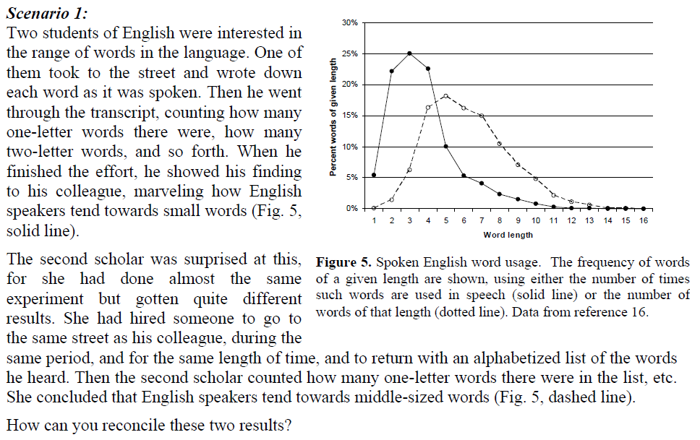

Slide 17
DO IT YOURSELF

Slide 18
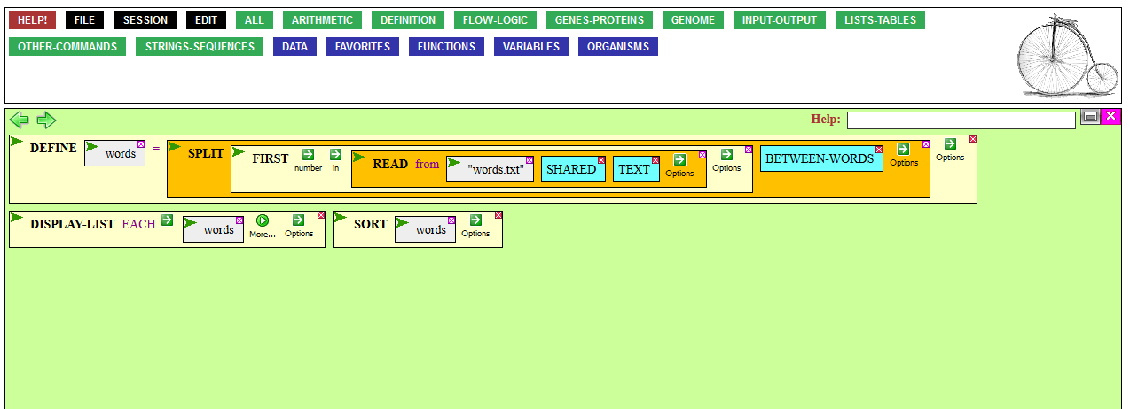
Help in Doing Scenario #1
(CyanoBIKE)

Slide 19
DO IT YOURSELF

Slide 20

Belozersky Scenario 1
Me
1N
1S
2N
2S
3N
3S
4N
4S
5N
5S
6N
6S
7S

Slide 22
I'm having a hard time understanding the relationship between their results and the 1-gene 1-ribosome 1-protein model.

Slide 25
I'm having a hard time understanding the relationship between their results and the 1-gene 1-ribosome 1-protein model.
DNA nucleotides
RNA nucleotides
G A C T
G A C T
Clostridium perfringens

Slide 26
I'm having a hard time understanding the relationship between their results and the 1-gene 1-ribosome 1-protein model.
DNA nucleotides
RNA nucleotides
G A C T
G A C T
Mycobacterium tuberculosis

Slide 27
Welcome to Molecular Biology Through Discovery Thursday, 23 March 2017

Slide 28
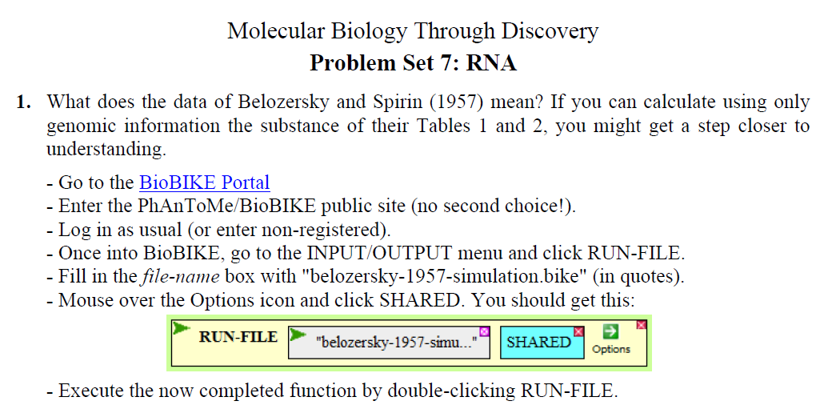
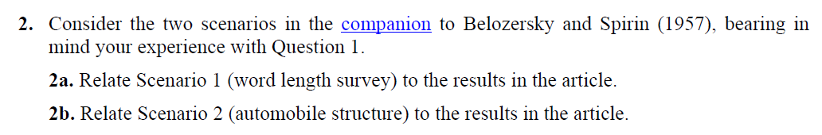

Slide 29
…regarding SQ13, I cant see why the numbers might be regarded as suspicious.
SQ13. Reinterpret the numbers for experiment J108, in light of the minus polynucleotide control… What makes them suspicious?

Slide 30
Problem Set 7, #1, #2
Me
Connect to: https://vcu.zoom.us/j/2504526209
1N
1S
2N
A
B
C
D
2S
3N
3S
4N
E
F
G H
4S
5N
5S
6N
I J
K
L
6S
7S

