Slide 2
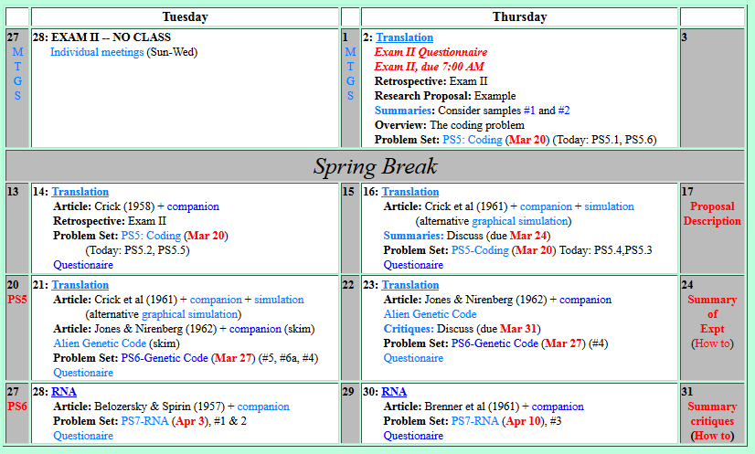

Welcome to Molecular Biology Through Discovery Thursday, 30 March 2017

Slide 3
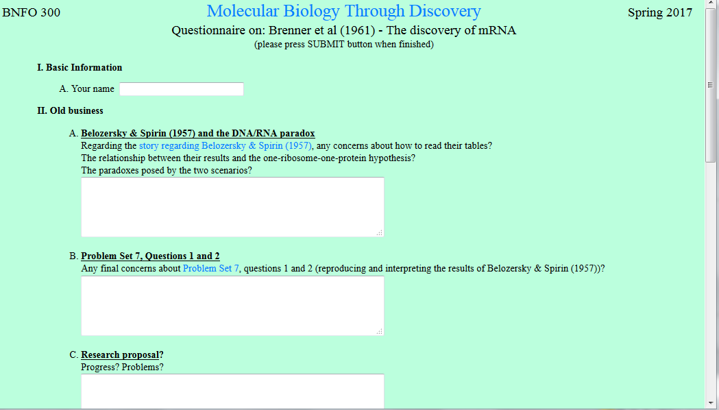

I still don't understand how in Scenario 1, the results differed between the two students even though the data was the same….

Slide 4
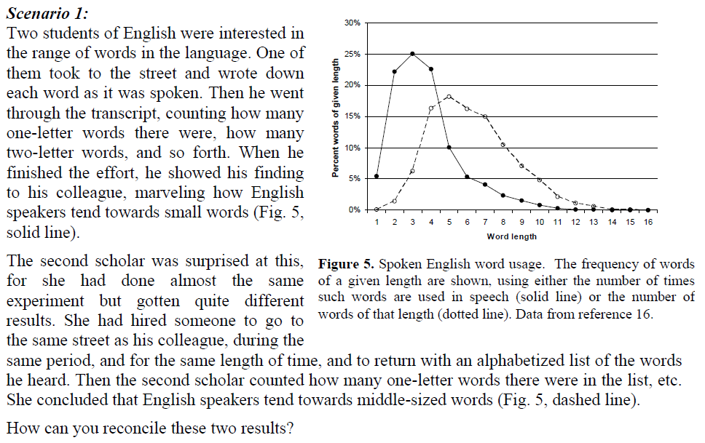
DO IT YOURSELF
…Is it because they are analyzing the data in different ways (alphabetical or length)? But, if you were to measure the lengths of the words for both students shouldn't they be the same?

Slide 5
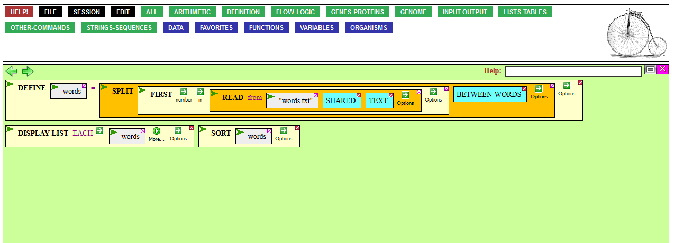
Help in Doing Scenario #1
(CyanoBIKE)

Slide 6
Welcome to Molecular Biology Through Discovery Thursday, 30 March 2017
I am having a hard time following Figure 4 in the notes. I don't understand what is happening in each model, will you please explain it?
Please explain figure 4

Slide 7
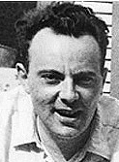
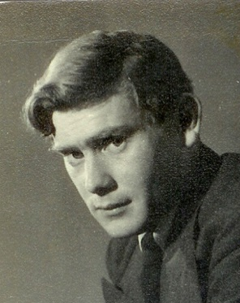
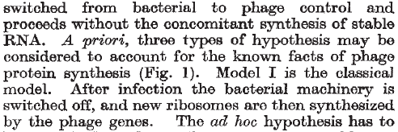

Francoise Jacob
Sydney Brenner

Slide 8

Francoise Jacob
Sydney Brenner

Slide 9
Francoise Jacob
Sydney Brenner

Slide 10
What are Ribosomes? (1950’s)
One Gene – One Ribosome – One Protein

Slide 11


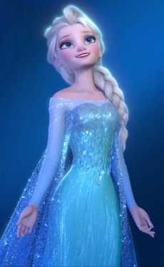
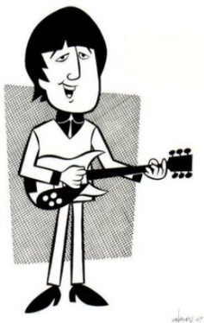


MODEL I (one-ribosome-one-protein)
Francoise Jacob
Sydney Brenner
no infection
infection
Let It Go
Let It Be

Slide 12
MODEL I (one-ribosome-one-protein)
Francoise Jacob
Sydney Brenner
no infection
infection

Slide 13
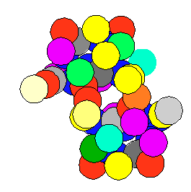
What are Ribosomes? (really)
Replication
DNA

Slide 14
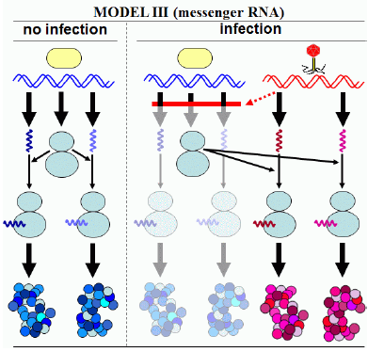

Francoise Jacob
Sydney Brenner

Slide 15
Francoise Jacob
Sydney Brenner

Slide 16
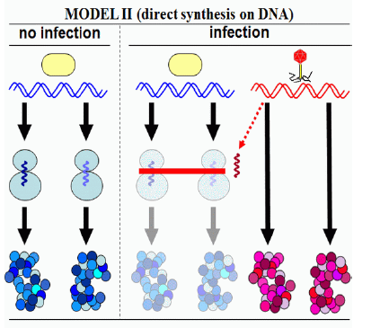
Francoise Jacob
Sydney Brenner

Slide 17
Francoise Jacob
Sydney Brenner

Slide 18
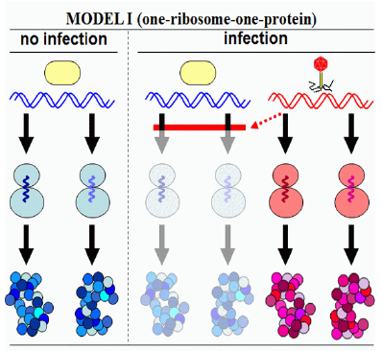

How to tell?

Slide 19
What experiment?

Slide 20
Welcome to Molecular Biology Through Discovery Thursday, 30 March 2017

Slide 21

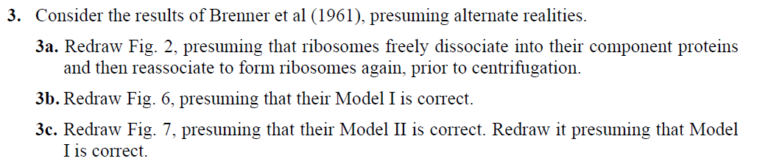

Slide 22
Brenner et al (1961) Figure 2
What was the experiment?
What does it mean?

Slide 23
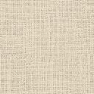
Problem Set 7, #3
Me
Connect to: https://vcu.zoom.us/j/2504526209
1N
1S
2N
A
B
C
D
2S
3N
3S
4N
E
F
G H
4S
5N
5S
6N
I J
K
L
6S
7S

Slide 24
Brenner et al (1961) Figure 2
What was the experiment?
PS 7.3a. Redraw Fig. 2 from Brenner et al (1961), presuming that ribosomes freely dissociate into their component proteins and then reassociate to form ribosomes again, prior to centrifugation.

Slide 25
Brenner et al (1961) Figure 4
What was the experiment?
SQ32. Label the four peaks shown in Fig. 4.

Slide 26
Brenner et al (1961) Figure 4
What was the experiment?
14
12
14
12
¹⁵N + ¹³C
¹⁴N + ¹²C
0
Heavy medium? Light medium?
SQ32. Label the four peaks shown in Fig. 4.

Slide 27
Brenner et al (1961) Figure 4
What was the experiment?
14
12
14
12
¹⁵N + ¹³C
¹⁴N + ¹²C
0
¹⁴C-uracil
Radioactive label?
SQ31. What macro-molecule(s) would radioactive 14C-uracil be expected to label?

Slide 28

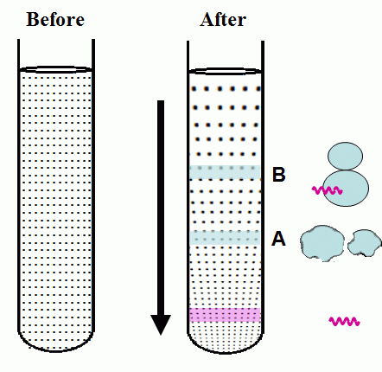
Brenner et al (1961) Density Gradient Centrifugation

Slide 29
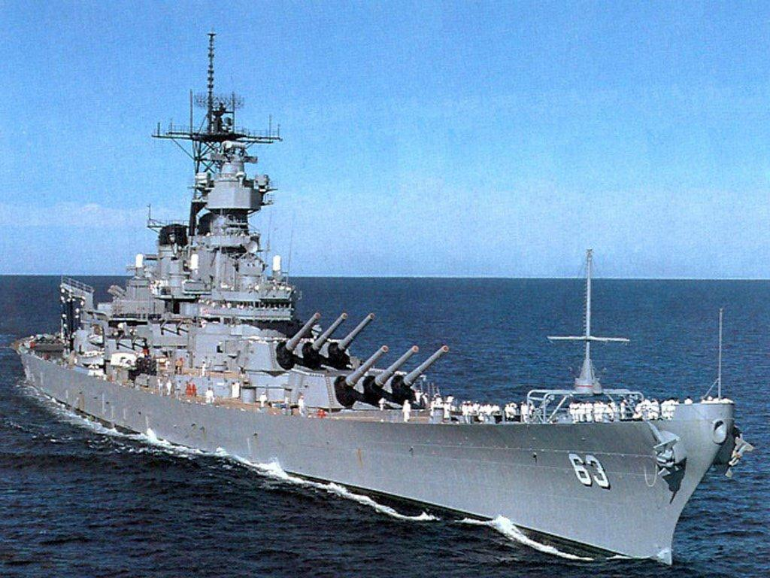
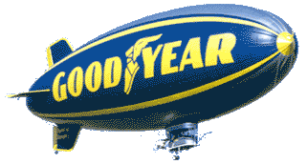
Brenner et al (1961) Density Gradient Centrifugation

Slide 30
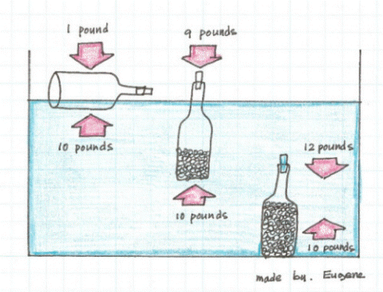
Brenner et al (1961) Density Gradient Centrifugation

Slide 31
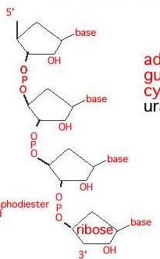
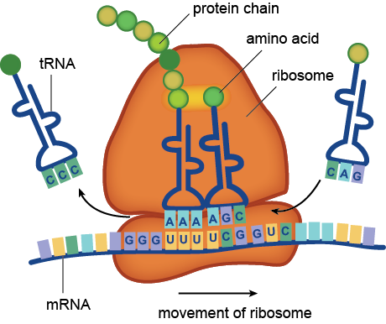
Brenner et al (1961) Density Gradient Centrifugation
RNA
O
O
O
O
O
O

Slide 32
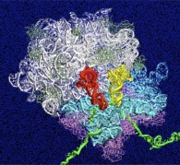
Brenner et al (1961) Density Gradient Centrifugation
RNA
O
O
O
O
O
O

Slide 33
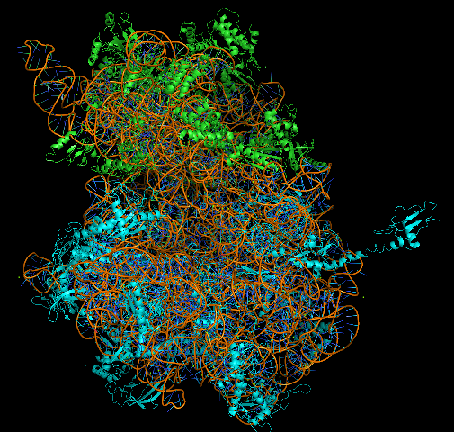
Brenner et al (1961) Density Gradient Centrifugation
RNA
O
O
O
O
O
O

Slide 34
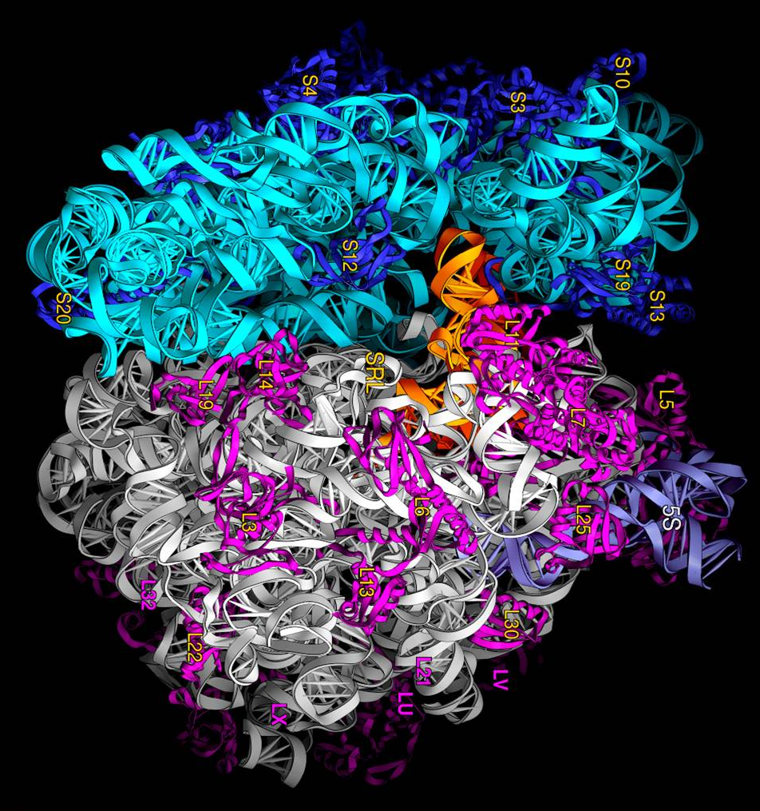
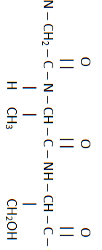
Brenner et al (1961) Density Gradient Centrifugation
RNA
O
O
O
O
O
O

Slide 35
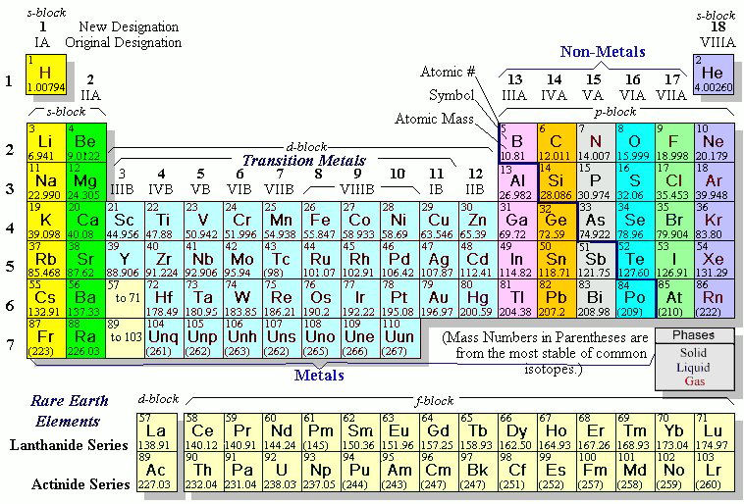

Slide 36
Brenner et al (1961) Density Gradient Centrifugation

Slide 37
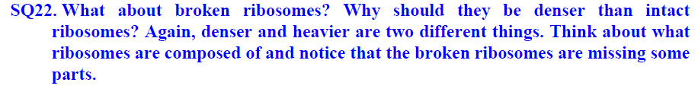
Brenner et al (1961) Density Gradient Centrifugation

Slide 38
