Slide 2
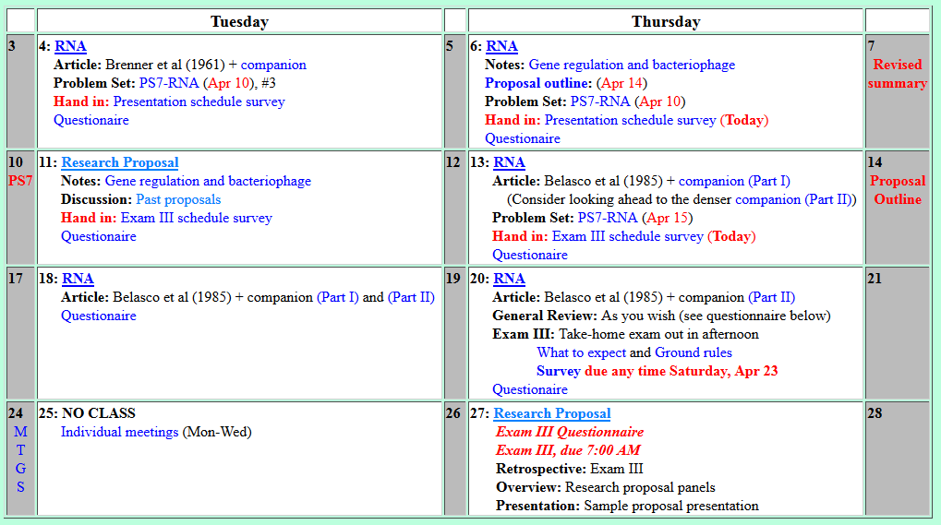
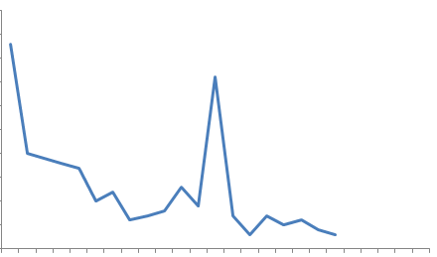
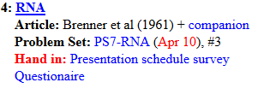
Welcome to Molecular Biology Through Discovery Tuesday, 4 April 2017
Questionnaire Responses
Exam I
Exam II

Slide 3

Welcome to Molecular Biology Through Discovery Tuesday, 4 April 2017
This is a little advance, but could you speak about the proposal outline coming up in a couple weeks?

Slide 4
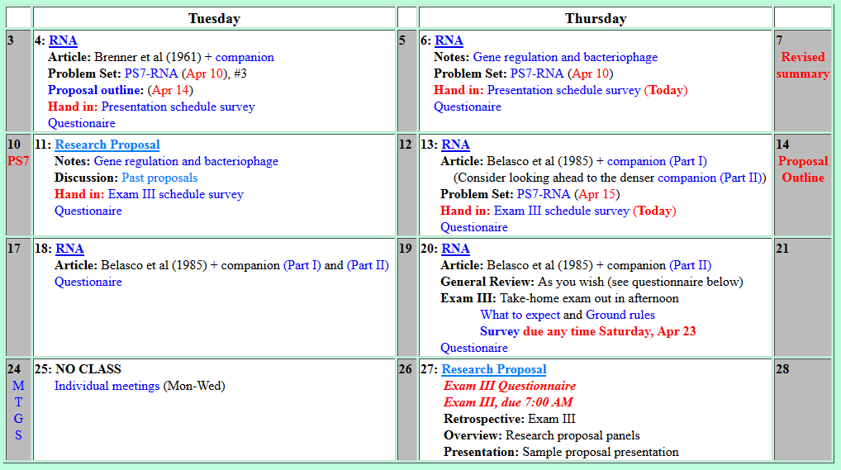
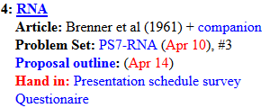
Welcome to Molecular Biology Through Discovery Tuesday, 4 April 2017
This is a little advance, but could you speak about the proposal outline coming up in a couple weeks?

Slide 5
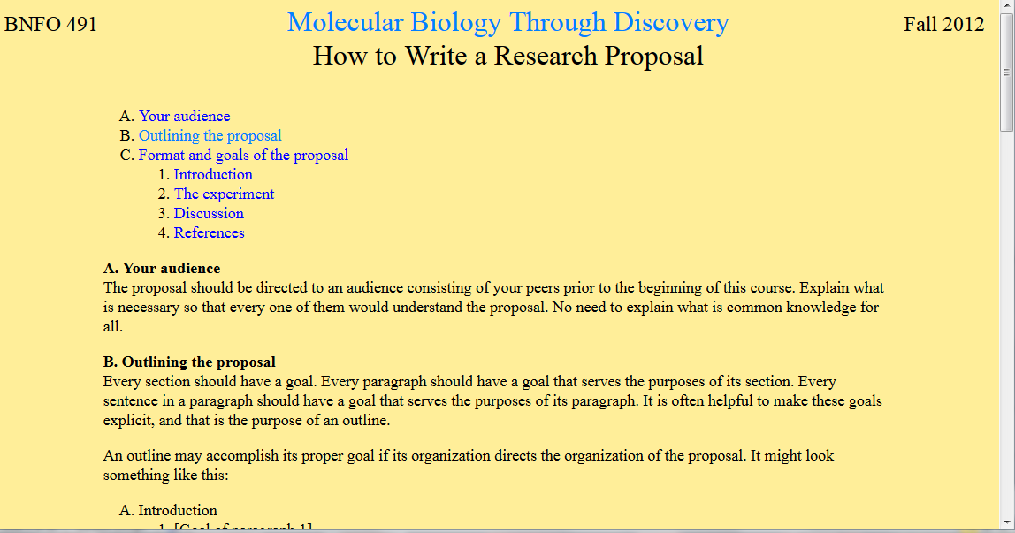

Slide 6
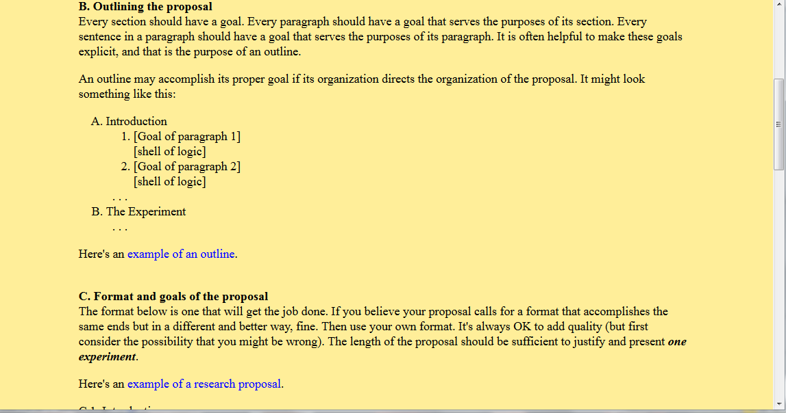

Slide 8
Welcome to Molecular Biology Through Discovery Tuesday, 4 April 2017
What is our next step if nobody critiqued our experiment summaries?

Slide 9
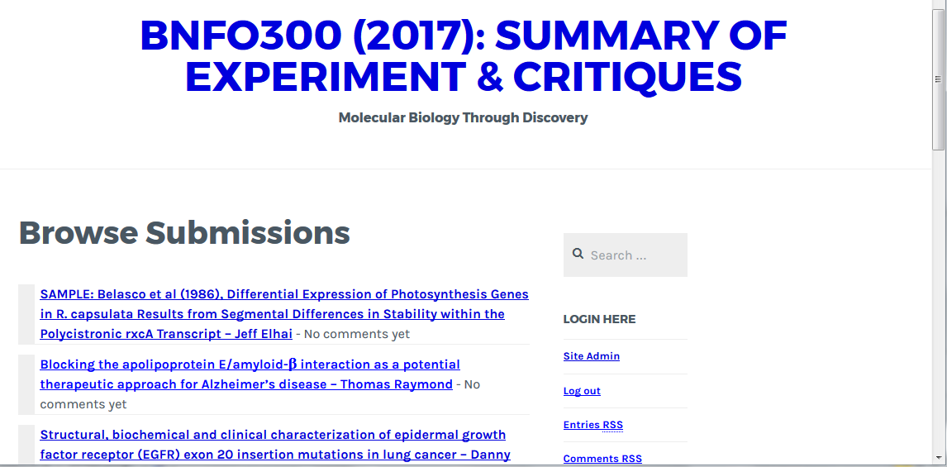

Slide 10
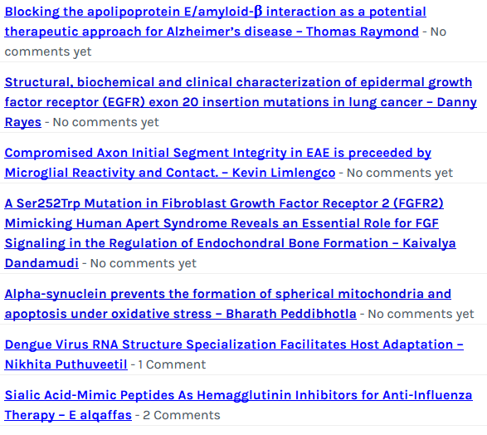
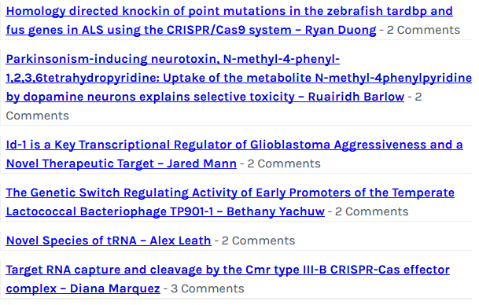

Slide 11
Welcome to Molecular Biology Through Discovery Tuesday, 4 April 2017
May we seek outside sources for critiques before the upcoming submission of the revised version?

Slide 12
Welcome to Molecular Biology Through Discovery Tuesday, 4 April 2017

Slide 13
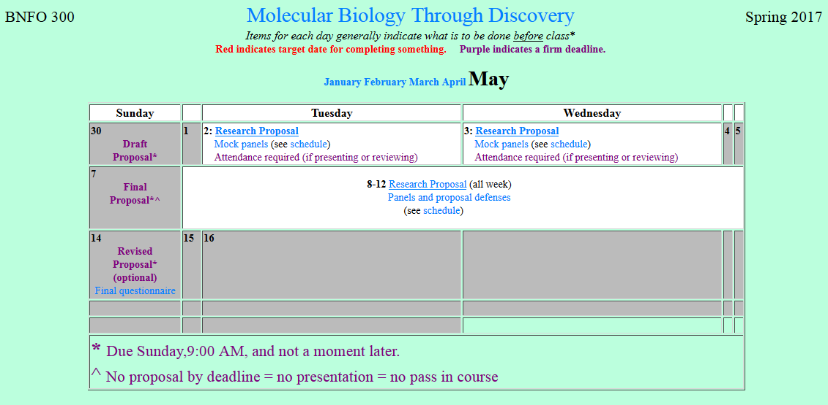
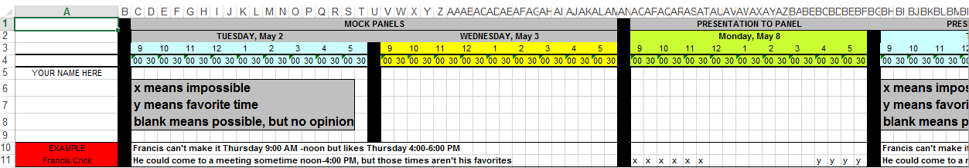

Slide 14
Welcome to Molecular Biology Through Discovery Tuesday, 4 April 2017
I am having trouble calculating the absorbance for heavy band A (Question 26 in the notes).

Slide 15
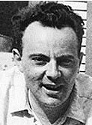
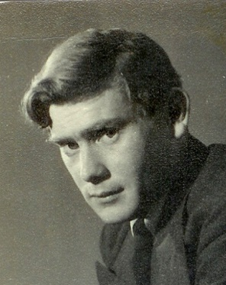
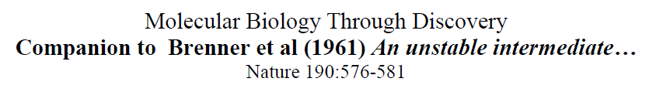
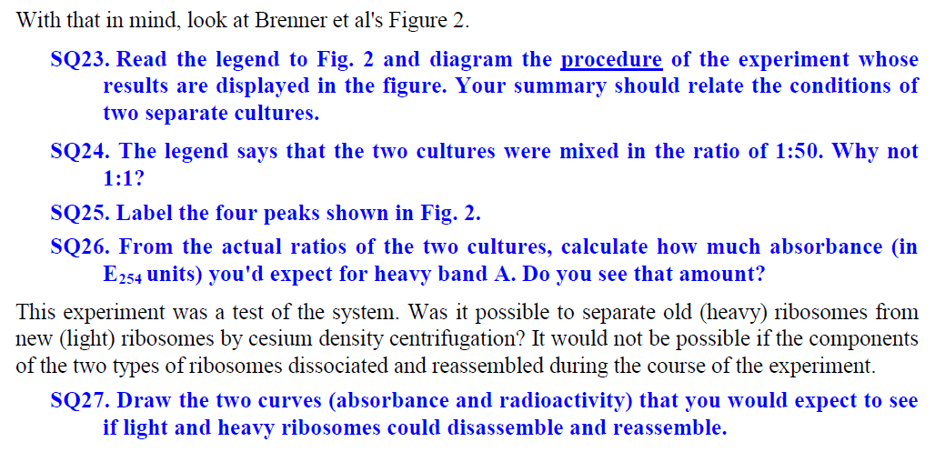
Francoise Jacob
Sydney Brenner
I am having trouble calculating the absorbance for heavy band A (Question 26 in the notes).

Slide 16
Brenner et al (1961) Figure 2
What was the experiment?
SQ25. Label the four peaks shown in Fig. 2.

Slide 17
Brenner et al (1961) Figure 2
What was the experiment?
SQ25. Label the four peaks shown in Fig. 2.

Slide 18
Brenner et al (1961) Figure 2
What was the experiment?
SQ25. Label the four peaks shown in Fig. 2.

Slide 19
Brenner et al (1961) Figure 2
What was the experiment?
SQ24. The legend says that the two cultures were mixed in the ratio of 1:50. Why not 1:1?

Slide 20
Brenner et al (1961) Figure 2
What was the experiment?
SQ26. From the actual ratios of the two cultures, calculate how much absorbance (in E254 units) you'd expect for heavy band A.

Slide 21
Francoise Jacob
Sydney Brenner
I… don't understand why absorption and radioactivity would change in ribosomes if they could dissemble and reassemble

Slide 22
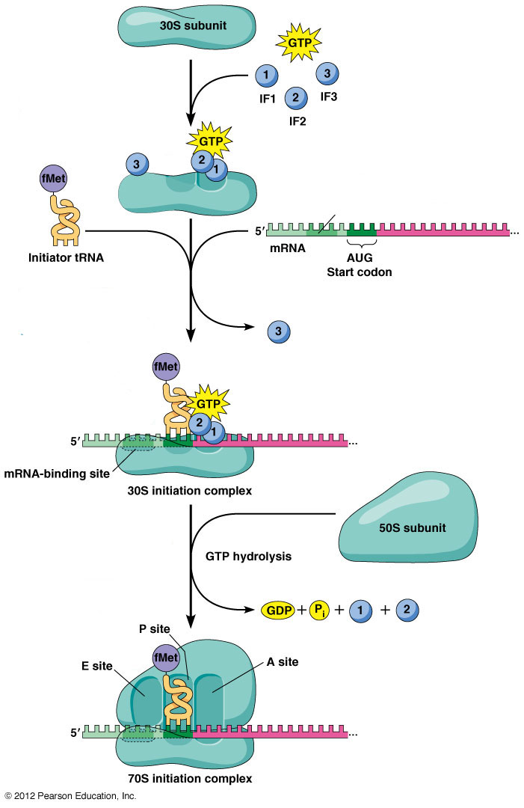
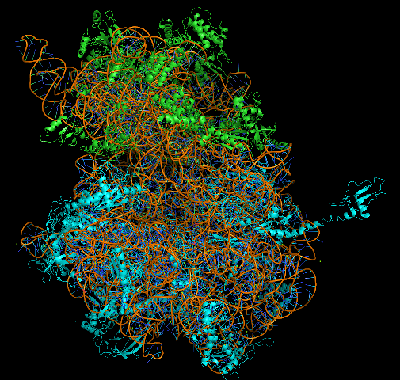
Structure of Ribosomes
30S
30S
50S

Slide 23
Structure of Ribosomes
30S
mRNA
tRNA
30S
50S

Slide 24
Structure of Ribosomes
30S
mRNA
tRNA
30S
50S

Slide 25
Structure of Ribosomes
30S
mRNA
tRNA
30S
50S
50S

Slide 26
Structure of Ribosomes
30S
mRNA
tRNA
30S
50S
50S

Slide 27
Structure of Ribosomes
30S
mRNA
tRNA
50S
30S
50S

Slide 28
Welcome to Molecular Biology Through Discovery Tuesday, 4 April 2017

Slide 29

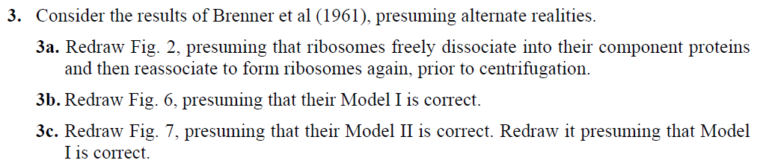

Slide 30

Problem Set 7, #3
Me
Connect to: https://vcu.zoom.us/j/2504526209
1N
1S
2N
A
B
C
D
2S
3N
3S
4N
E
F
G H
4S
5N
5S
6N
I J
K
L
6S
7S

Slide 31
Brenner et al (1961) Figure 4
What was the experiment?
SQ32. Label the four peaks shown in Fig. 4.

Slide 32

Brenner et al (1961) Figure 4
What was the experiment?
14
12
14
12
¹⁵N + ¹³C
¹⁴N + ¹²C
0
Heavy medium? Light medium?
SQ32. Label the four peaks shown in Fig. 4.

Slide 33
Brenner et al (1961) Figure 4
What was the experiment?
14
12
14
12
¹⁵N + ¹³C
¹⁴N + ¹²C
0
¹⁴C-uracil
Radioactive label?
SQ31. What macro-molecule(s) would radioactive 14C-uracil be expected to label?

Slide 34

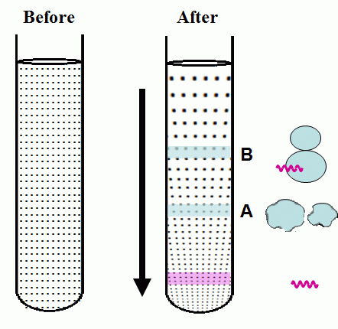
Brenner et al (1961) Density Gradient Centrifugation

Slide 35
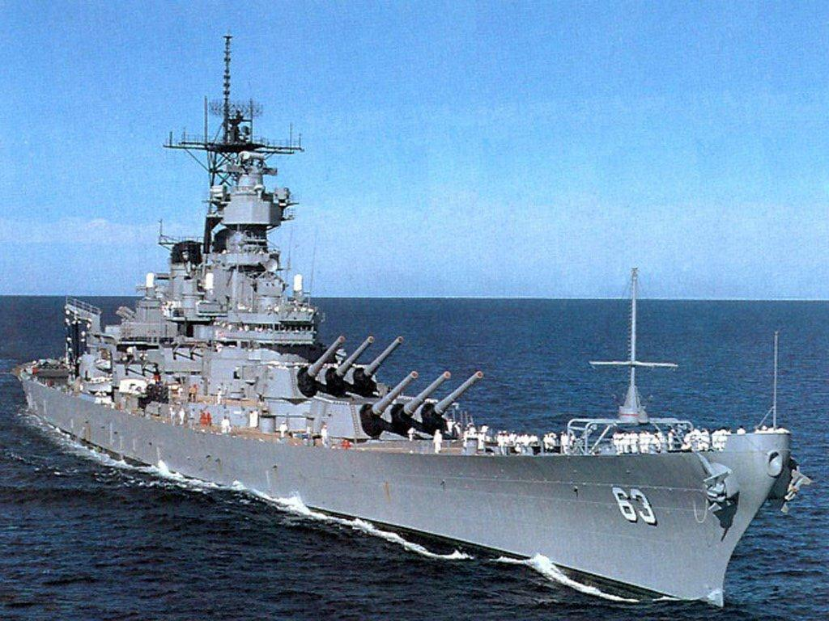

Brenner et al (1961) Density Gradient Centrifugation

Slide 36
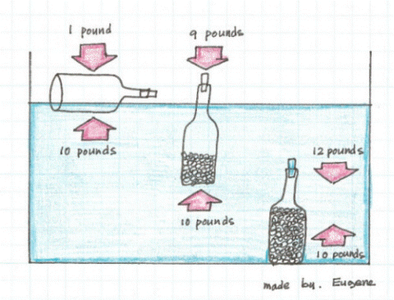
Brenner et al (1961) Density Gradient Centrifugation

Slide 37
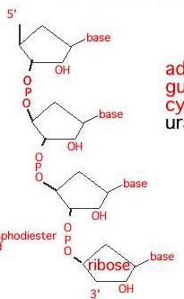
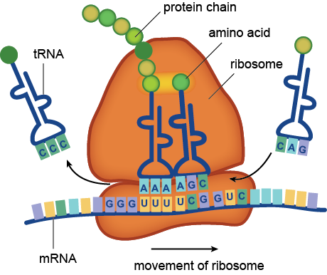
Brenner et al (1961) Density Gradient Centrifugation
RNA
O
O
O
O
O
O

Slide 38
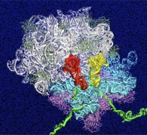
Brenner et al (1961) Density Gradient Centrifugation
RNA
O
O
O
O
O
O

Slide 39
Brenner et al (1961) Density Gradient Centrifugation
RNA
O
O
O
O
O
O

Slide 40
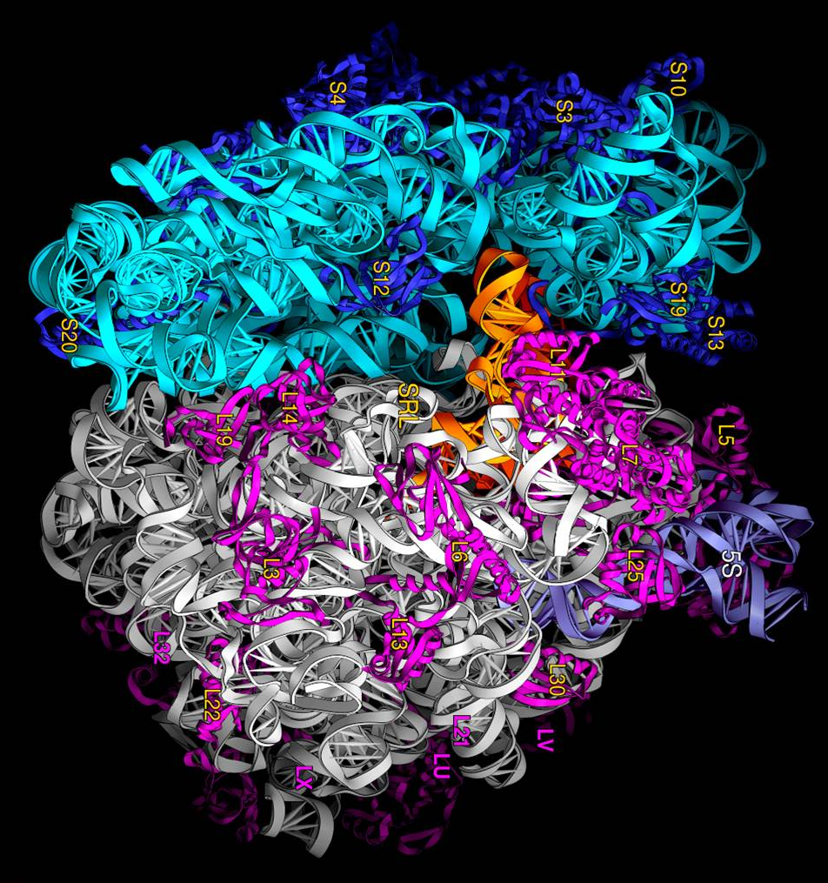
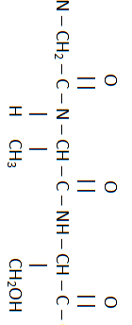
Brenner et al (1961) Density Gradient Centrifugation
RNA
O
O
O
O
O
O

Slide 41
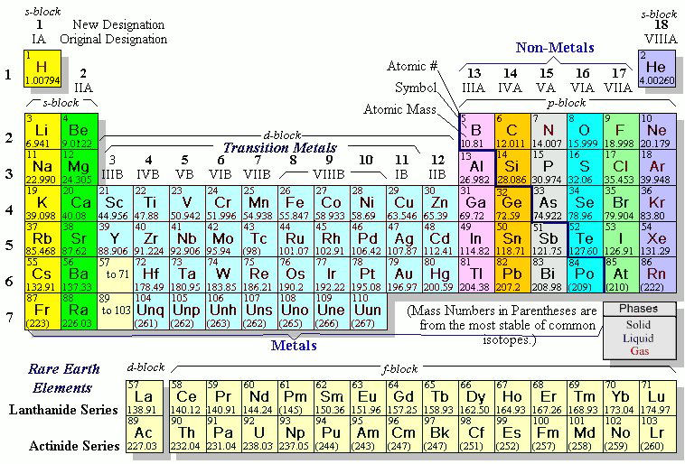

Slide 42
Brenner et al (1961) Density Gradient Centrifugation

Slide 43
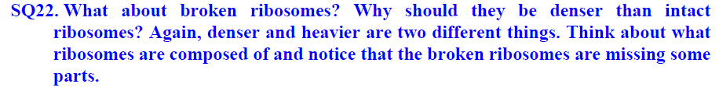
Brenner et al (1961) Density Gradient Centrifugation

