Slide 2
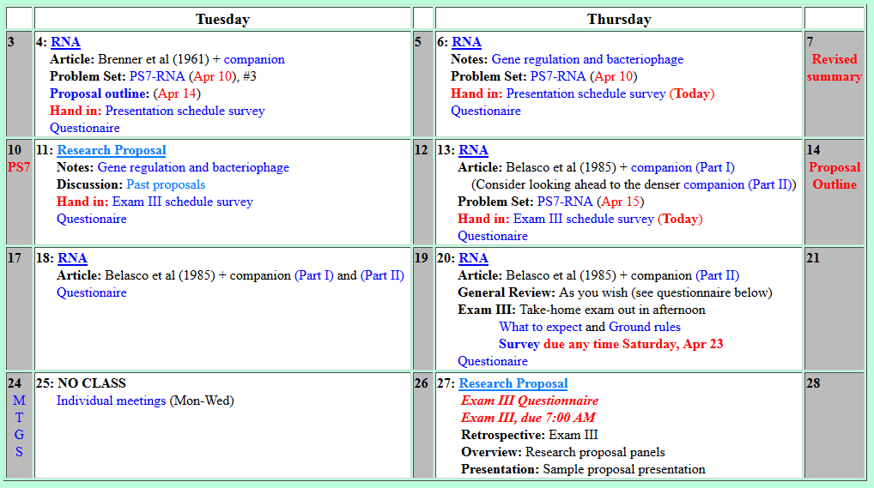
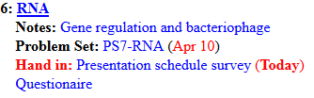
Welcome to Molecular Biology Through Discovery Thursday, 6 April 2017

Slide 3
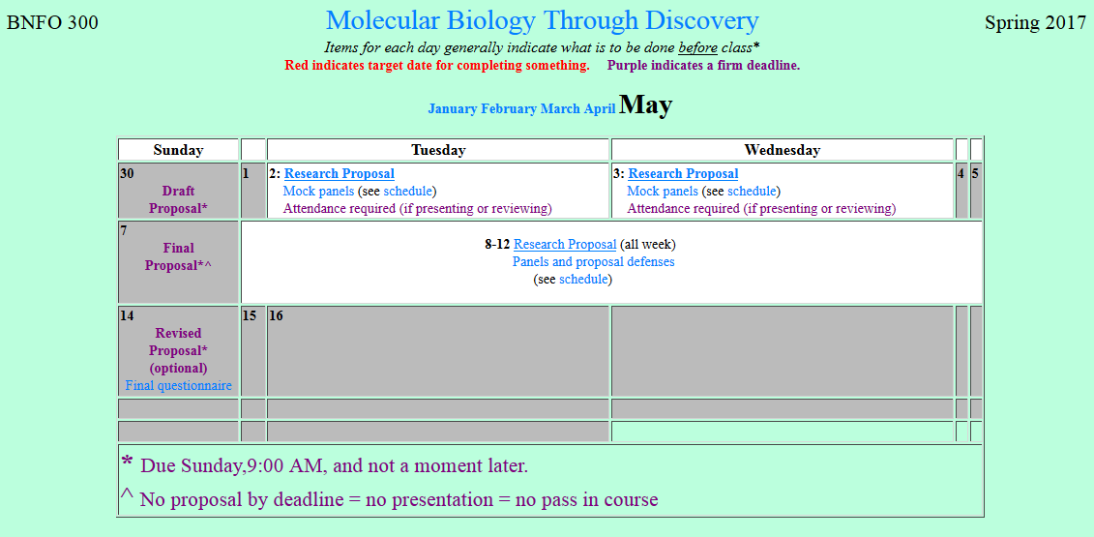
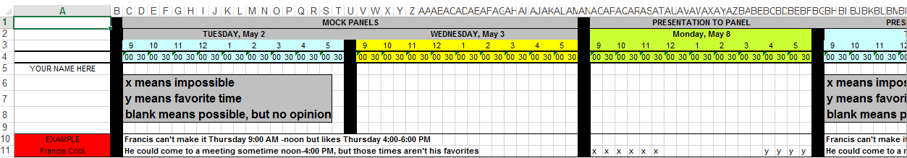

Slide 4
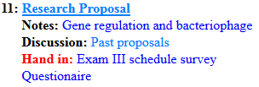
Welcome to Molecular Biology Through Discovery Thursday, 6 April 2017

Slide 5
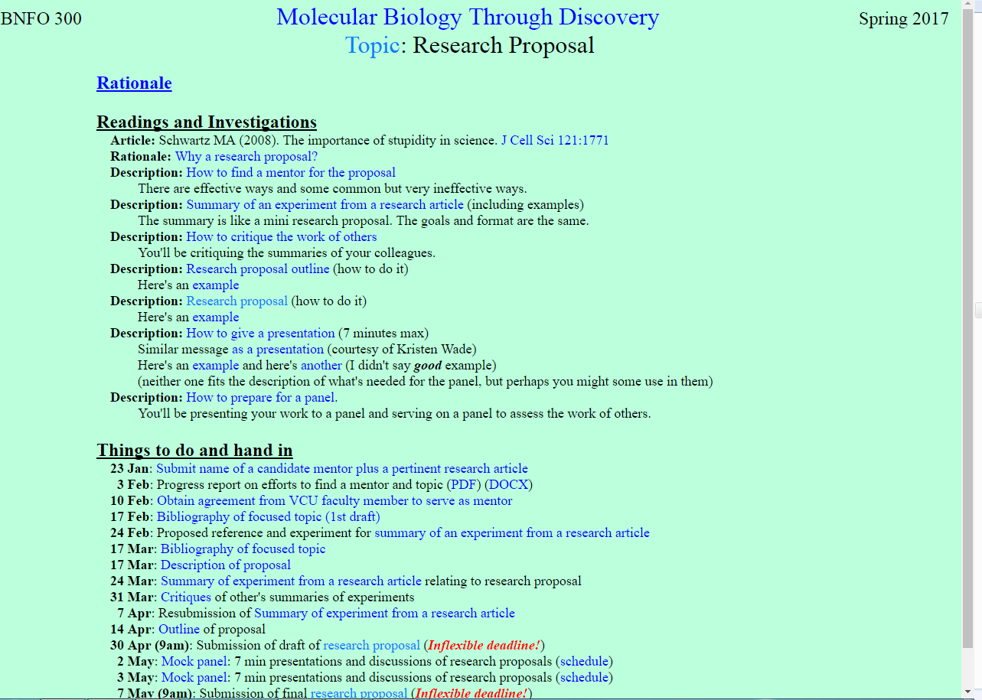

Slide 6
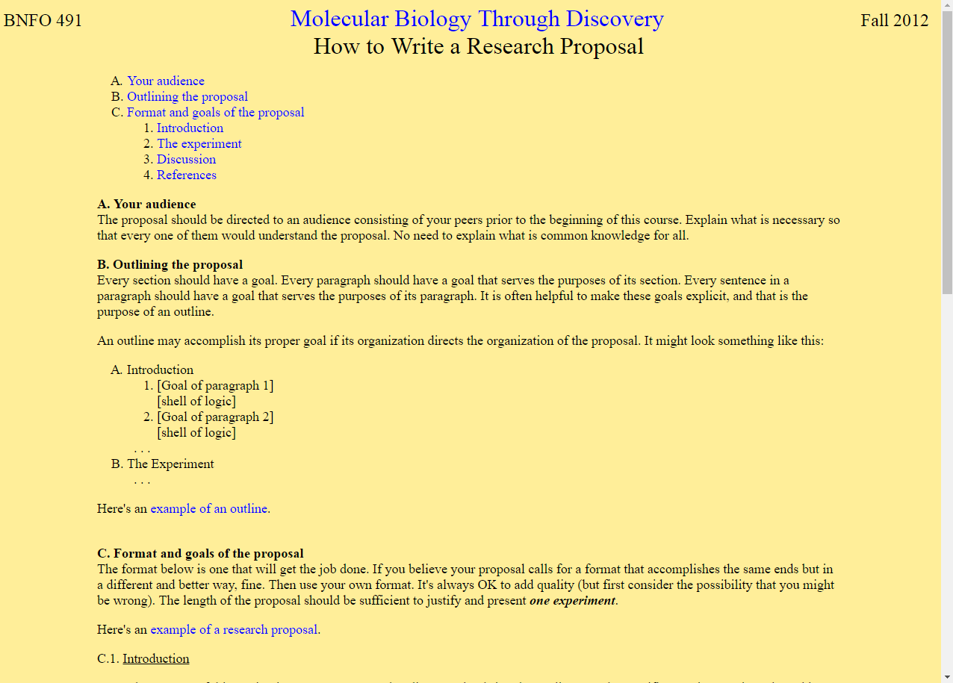

Slide 7
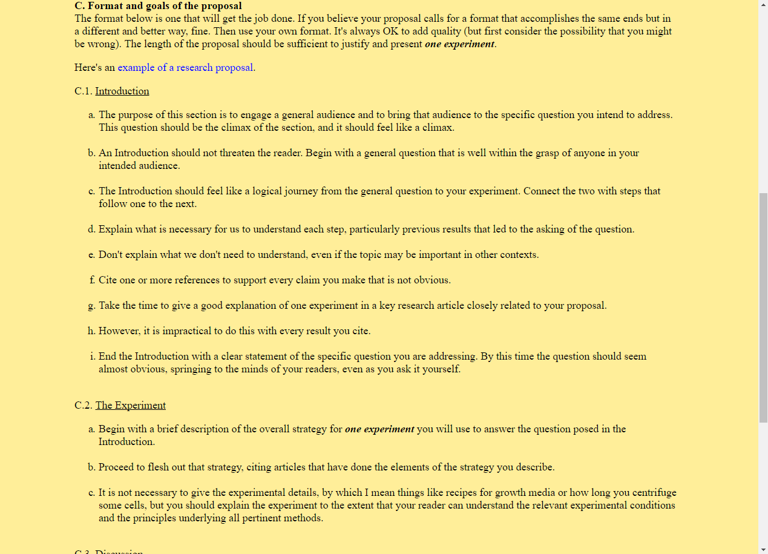

Slide 8
Welcome to Molecular Biology Through Discovery Thursday, 6 April 2017

Slide 9

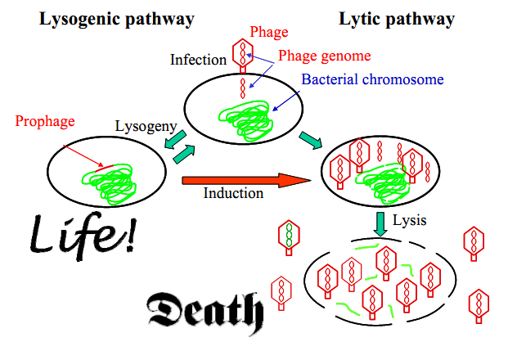
Infection by phage Lambda

Slide 10
Infection by phage Lambda

Slide 11
Infection by phage Lambda

Slide 12
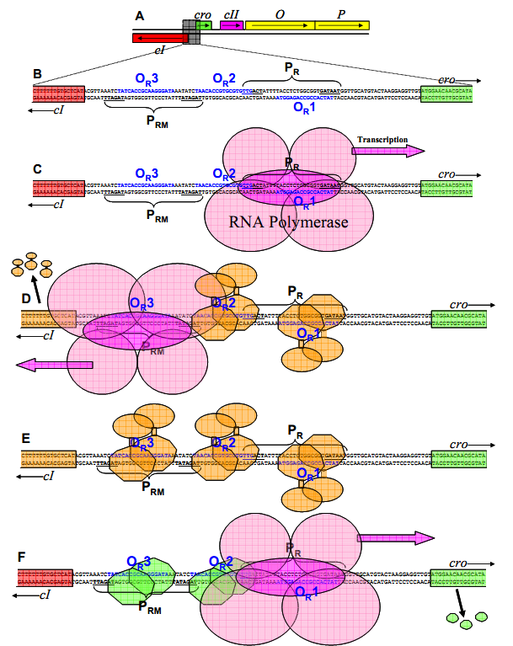
Mechanisms of Regulating Gene Expression

Slide 13
Mechanisms of Regulating Gene Expression

Slide 14
Mechanisms of Regulating Gene Expression

Slide 15
Mechanisms of Regulating Gene Expression
Positive feedback loop
Negative regulation
Moderate level of Cro protein Low level of cI Repressor

Slide 16
Mechanisms of Regulating Gene Expression
Positive feedback loop
Negative regulation
Low level of Cro protein Moderate level of cI Repressor

Slide 17
Mechanisms of Regulating Gene Expression
High level of Cro protein High level of Lac Repressor
???

Slide 18
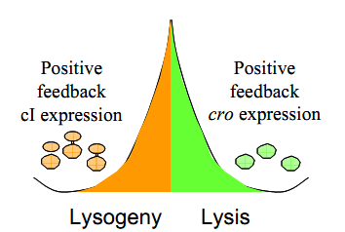

Mechanisms of Regulating Gene Expression
Is CI a gene that leads to lytic growth and the cro protein is a repressor which binds to the CI gene and therefore, leads to lysogeny?
Or is it the other way around??

Slide 19
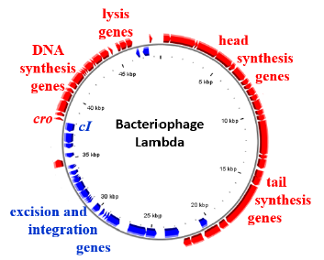
Mechanisms of Regulating Gene Expression

Slide 20
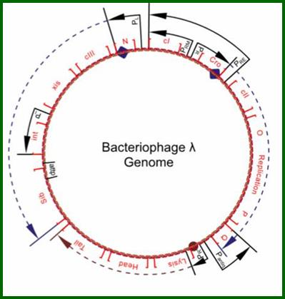
Mechanisms of Regulating Gene Expression
cro
cI
Bacteriophage Lambda
Richard Wheeler (Zephyrus)

Slide 21
Mechanisms of Regulating Gene Expression
…when cro and CI proteins are absent, the cro gene is transcribed and not the CI gene.
Why does the cro gene have the higher priority?

Slide 22
Mechanisms of Regulating Gene Expression
cro
cI
Bacteriophage Lambda
Richard Wheeler (Zephyrus)

Slide 23
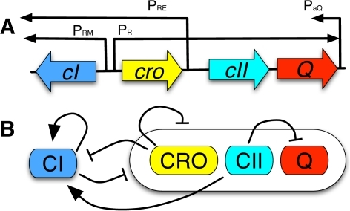
Mechanisms of Regulating Gene Expression
Joh & Weitz (2011) PLoS Comp Biol 7:1002006

Slide 24
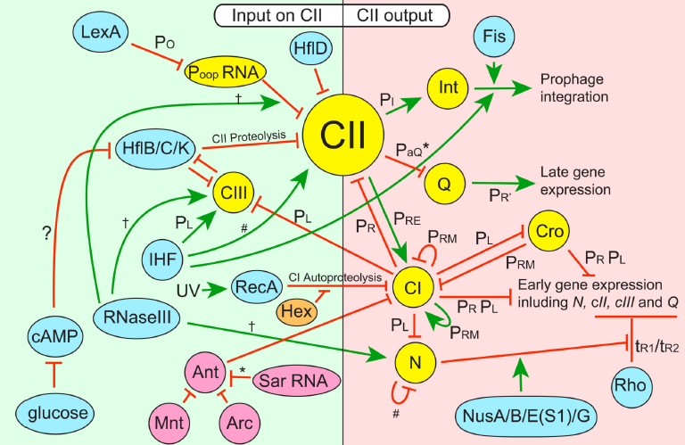
Mechanisms of Regulating Gene Expression
Casjens & Hendrix (2015) Virol 479-480:310-330

Slide 25
Mechanisms of Regulating Gene Expression
…when cro and CI proteins are absent, the cro gene is transcribed and not the CI gene.
Why does the cro gene have the higher priority?

Slide 26
Welcome to Molecular Biology Through Discovery Thursday, 6 April 2017

Slide 27

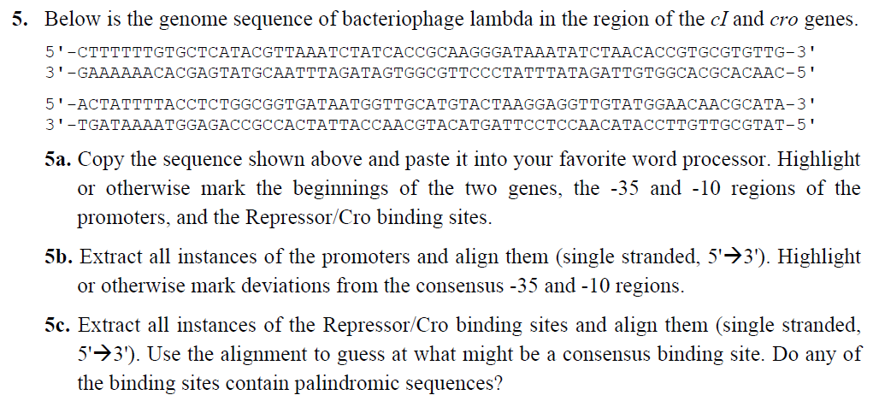

Slide 28
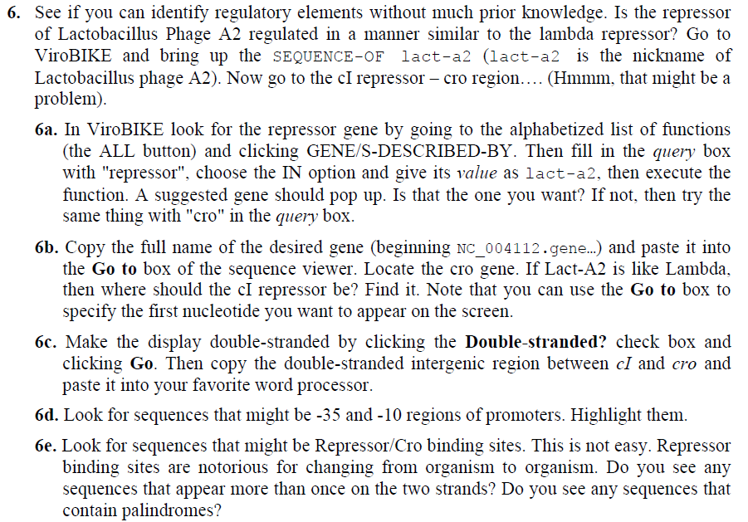

Slide 29

Problem Set 7, #5,6
Me
Connect to: https://vcu.zoom.us/j/2504526209
1N
1S
2N
A
B
C
D
2S
3N
3S
4N
E
F
G H
4S
5N
5S
6N
I J
K
L
6S
7S

