Slide 2
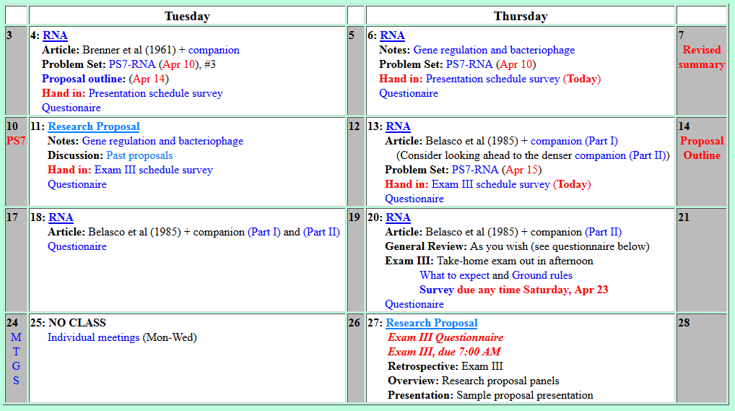
Welcome to Molecular Biology Through Discovery Tuesday, 11 April 2017

Slide 3


Slide 4
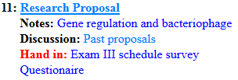
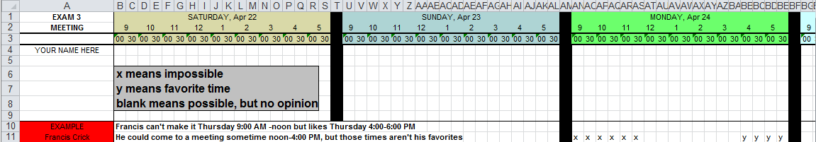
Welcome to Molecular Biology Through Discovery Tuesday, 11 April 2017

Slide 5
Welcome to Molecular Biology Through Discovery Tuesday, 11 April 2017

Slide 7

The EmBee Awards
Best Opening Sentence
Worst Opening Sentence
Best Focus Question
Worst Focus Question
Best Experimental Overview
Worst Experimental Overview
Best/Worst (you fill in)

Slide 8

Research Proposals
Me
Connect to: https://vcu.zoom.us/j/2504526209
1N
1S
2N
1
1
3
3
2S
3N
3S
4N
2
2
4 4
4S
5N
5S
6N
I J
K
L
6S
7S

