Slide 2
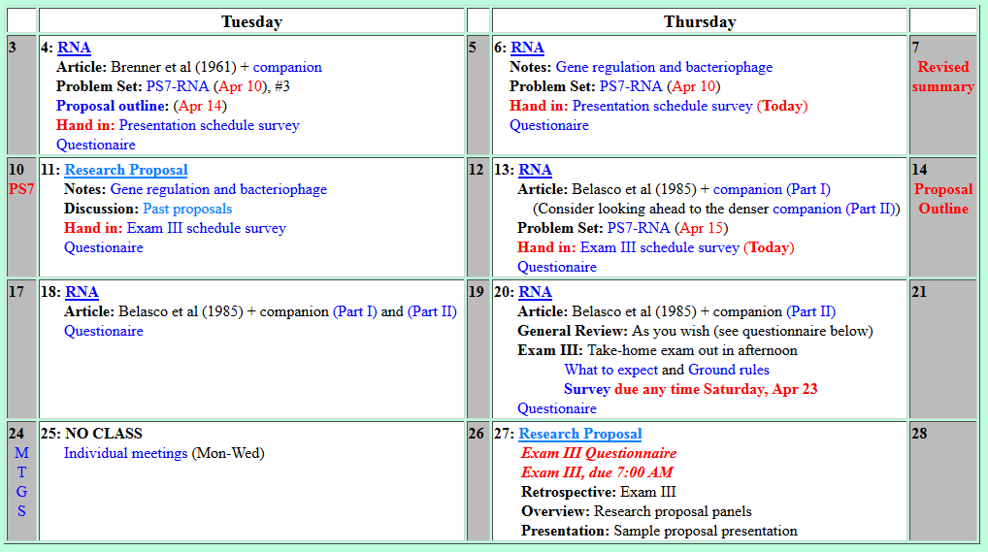
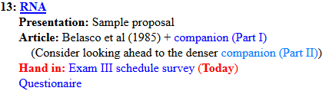
Welcome to Molecular Biology Through Discovery Thursday, 13 April 2017

Slide 3

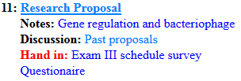
Welcome to Molecular Biology Through Discovery Tuesday, 11 April 2017

Slide 4
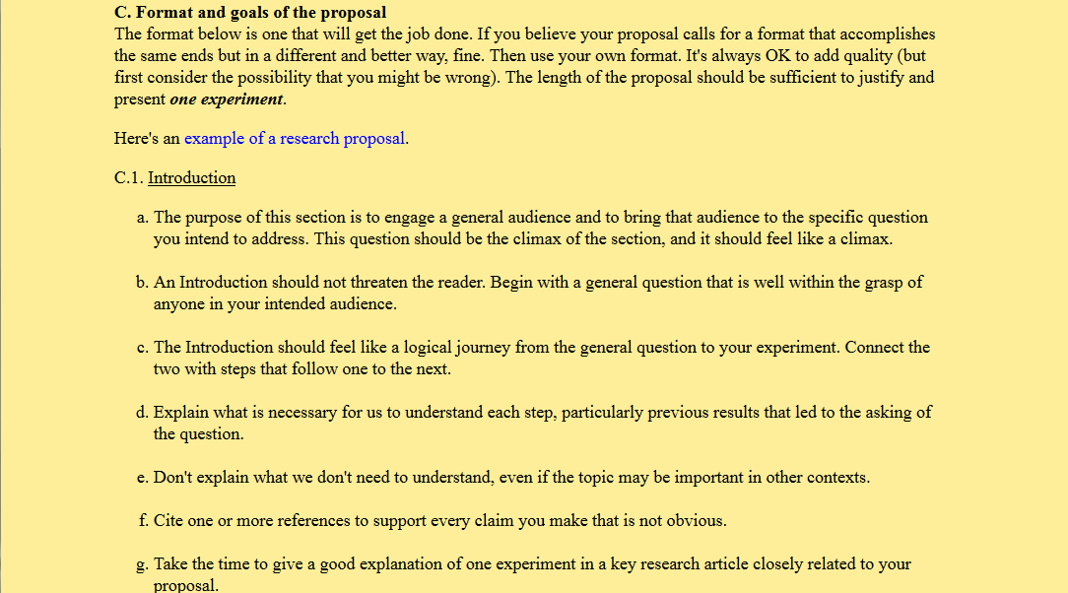

…what exactly needs to be cited.
…in the first sentence… the writer used a source when defining Alzheimer's.
I myself would likely not have cited that due to it being a definition…

Slide 5
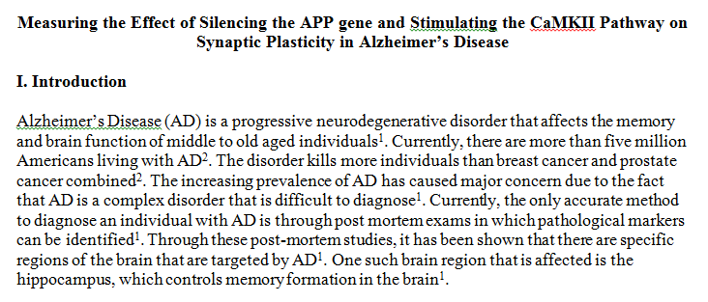
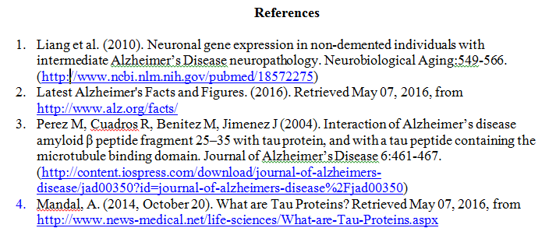

Slide 8
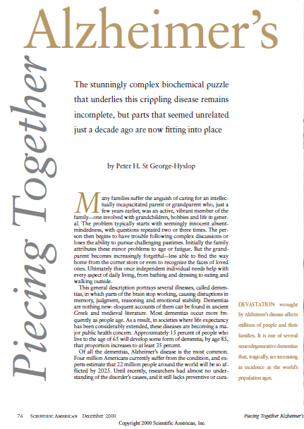
St George-Hyslop PH (2000).
Piecing together Alzheimer's. Sci Am 283(6):76-83.
.

Slide 9
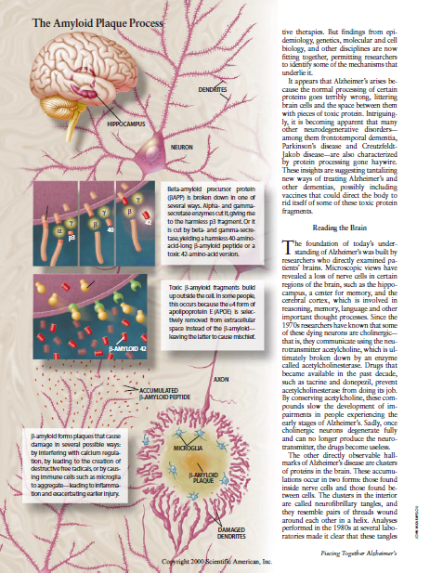
St George-Hyslop PH (2000).
Piecing together Alzheimer's. Sci Am 283(6):76-83.
.
Be helpful

Slide 10
Welcome to Molecular Biology Through Discovery Tuesday, 11 April 2017

Slide 11
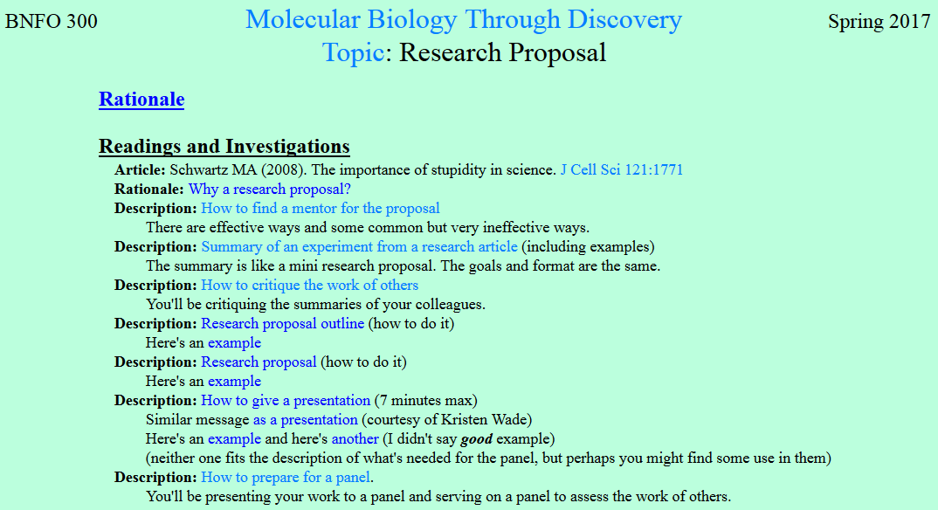

Slide 12
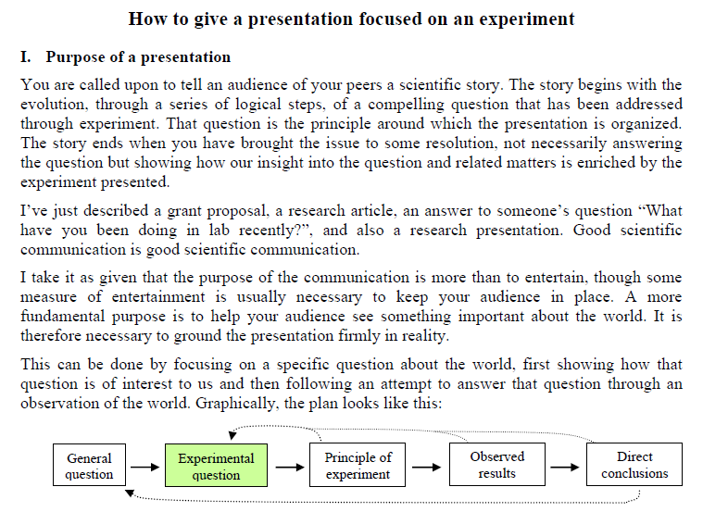

Slide 13
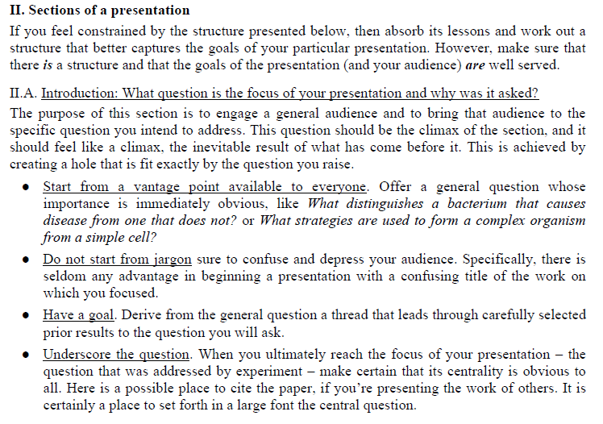

Slide 14
Welcome to Molecular Biology Through Discovery Thursday, 13 April 2017

Slide 16
Welcome to Molecular Biology Through Discovery Thursday, 13 April 2017

Slide 17
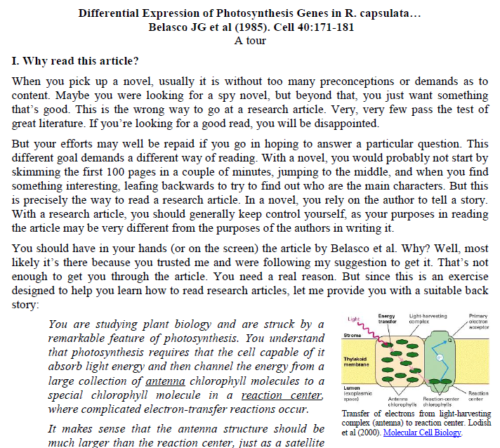
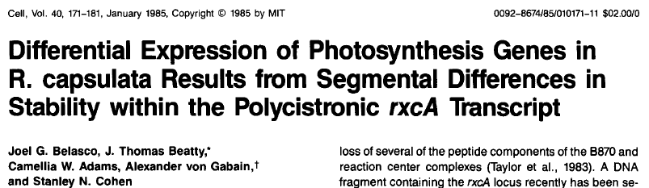

Slide 18
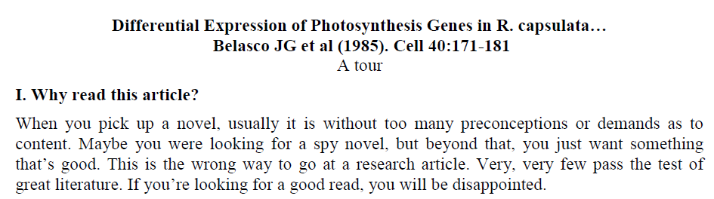
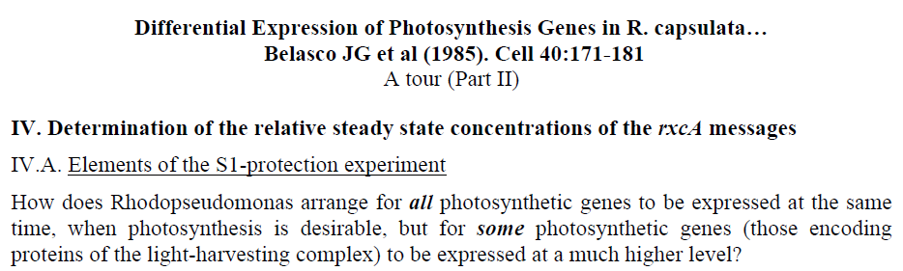


Slide 19

Belasco et al, I and II
Me
Connect to: https://vcu.zoom.us/j/2504526209
1N
1S
2N
A
B
C
D
2S
3N
3S
4N
E
F
G H
4S
5N
5S
6N
I J
K
L
6S
7S

Slide 21
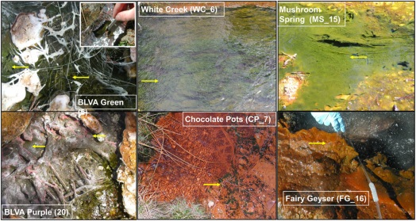
Mats of phototrophic bacteria
Klatt CG et al (2014) Front Microbiol 4:106

Slide 22
Acquisition of variable light

Slide 23
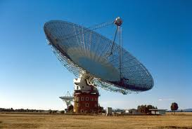
Parts of a radio telescope
Reaction center
Antenna

Slide 24
Parts of a radio telescope
Reaction center
Antenna

Slide 25
Parts of a radio telescope
Reaction center
Antenna

Slide 26
Acquisition of variable light

Slide 27
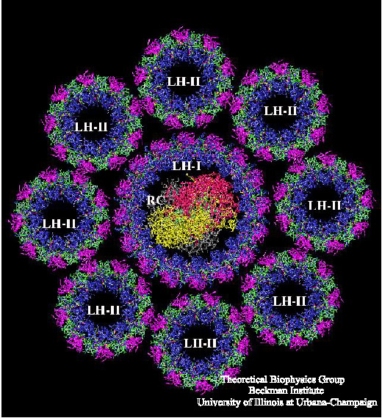
Acquisition of variable light

Slide 29
The lac operon

Slide 30
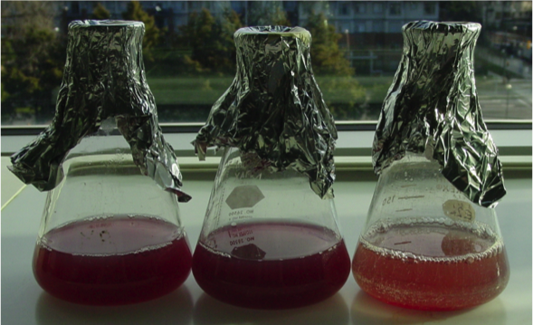
Mats of phototrophic bacteria
Rhodopseudomonas capsulata
Klatt CG et al (2014) Front Microbiol 4:106

Slide 32
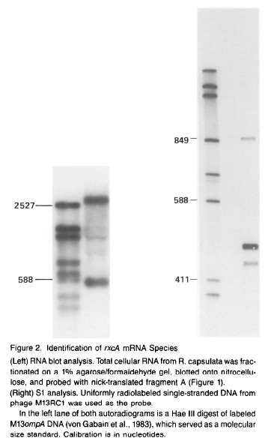
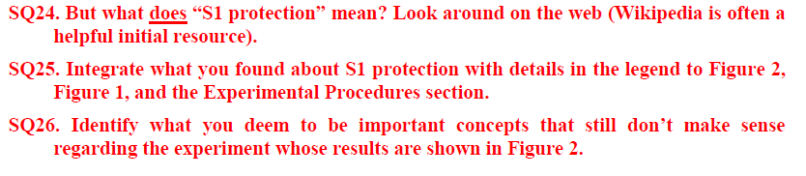
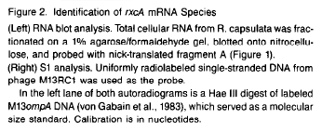
(Companion, Part 1)

Slide 33
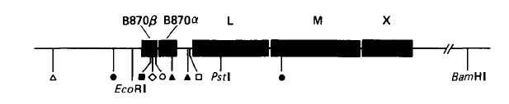
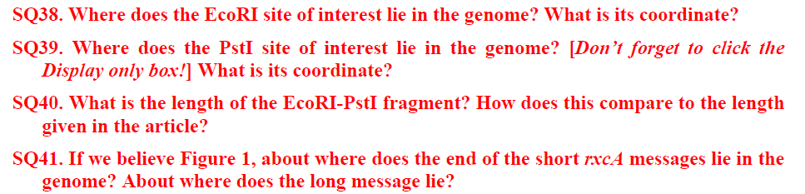
Figure 1
(Companion, Part 2)

