Slide 2
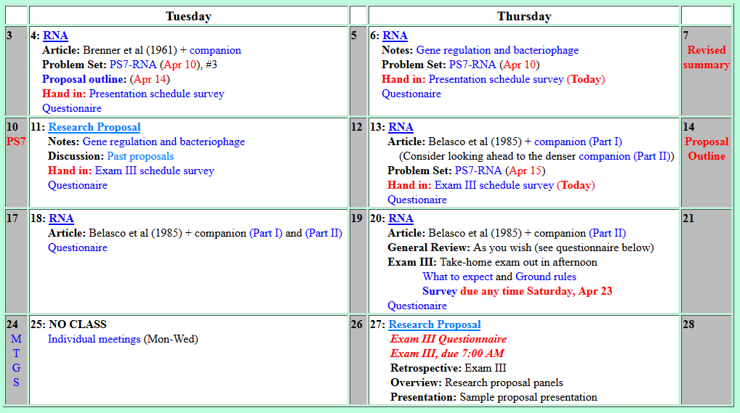
Welcome to Molecular Biology Through Discovery Tuesday, 18 April 2017

Slide 3
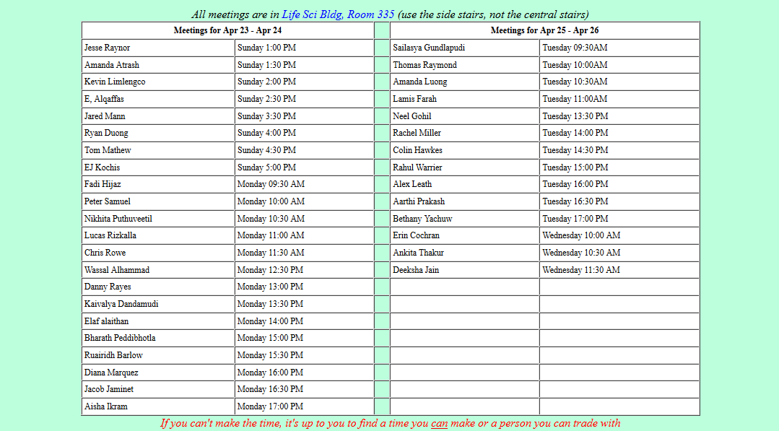

Slide 4


Welcome to Molecular Biology Through Discovery Thursday, 13 April 2017
SQ10 is kinda confusing, the logic is faulty from the beginning….

Slide 5

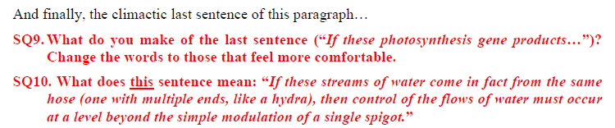
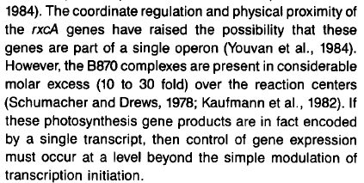

Slide 7


Slide 13
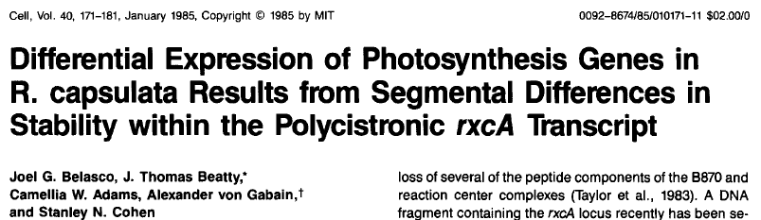

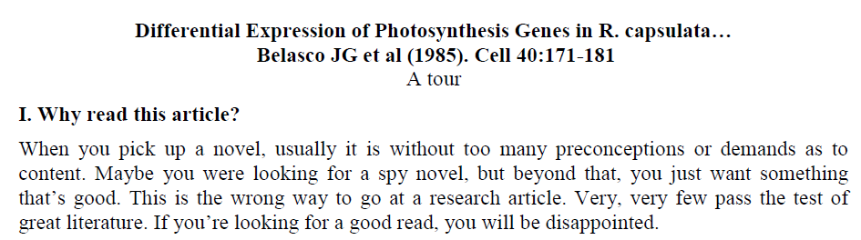
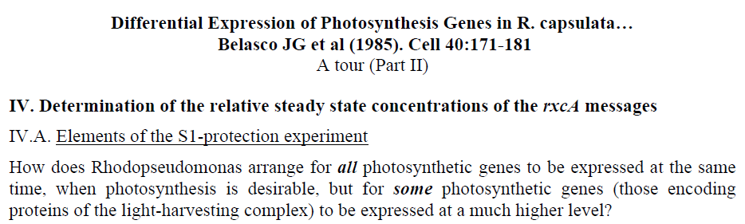


Slide 14

Belasco et al, I and II
Me
Connect to: https://vcu.zoom.us/j/2504526209
1N
1S
2N
A
B
C
D
2S
3N
3S
4N
E
F
G H
4S
5N
5S
6N
I J
K
L
6S
7S

Slide 16
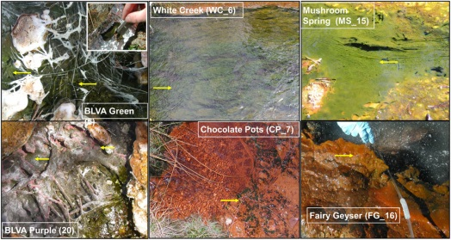
Mats of phototrophic bacteria
Klatt CG et al (2014) Front Microbiol 4:106

Slide 17
Acquisition of variable light

Slide 18
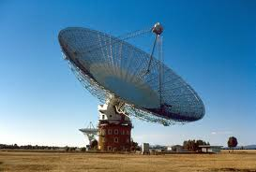
Parts of a radio telescope
Reaction center
Antenna

Slide 19
Parts of a radio telescope
Reaction center
Antenna

Slide 20
Parts of a radio telescope
Reaction center
Antenna

Slide 21
Acquisition of variable light

Slide 22
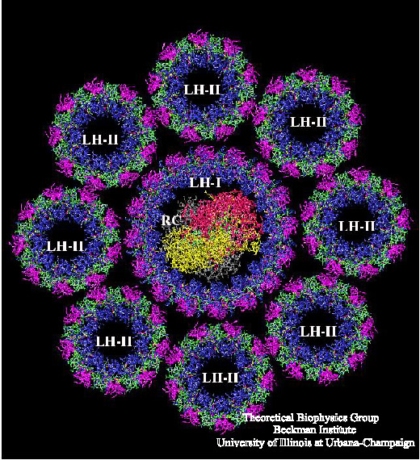
Acquisition of variable light

Slide 24
The lac operon

Slide 25
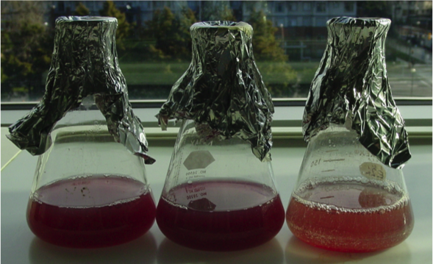
Mats of phototrophic bacteria
Rhodopseudomonas capsulata
Klatt CG et al (2014) Front Microbiol 4:106

Slide 27
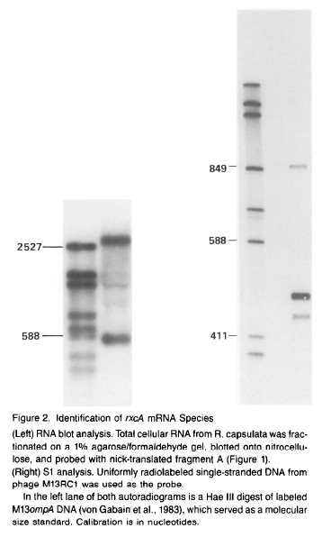
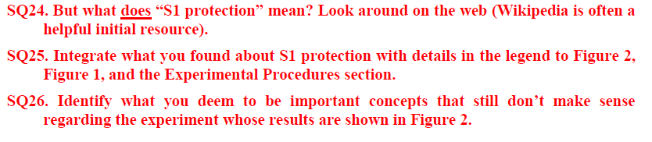
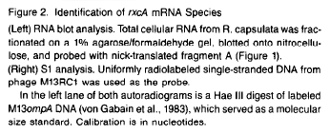
(Companion, Part 1)

Slide 28
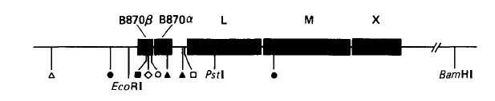
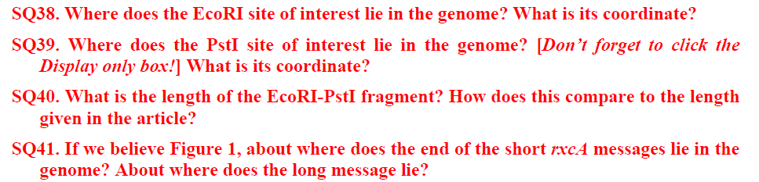
Figure 1
(Companion, Part 2)

