Slide 2

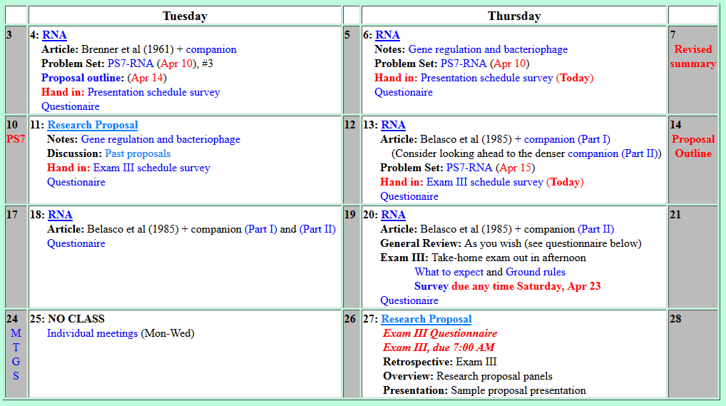
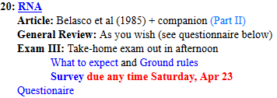
Welcome to Molecular Biology Through Discovery Thursday, 20 April 2017
…what should we be sending in? …it was suggested that I resubmit my bibliography…. It seems at this point like rewriting a bibliography would not help me in my proposal,

Slide 3
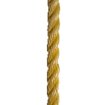



Goals of Course
Specific Goals
Why did you take this course? What do you hope to gain from it?

Slide 4
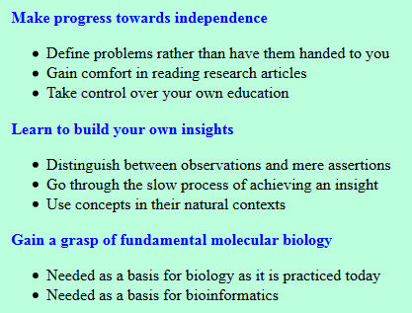
Goals of Course

Slide 5
Welcome to Molecular Biology Through Discovery Thursday, 20 April 2017
…what should we be sending in? …it was suggested that I resubmit my bibliography…. It seems at this point like rewriting a bibliography would not help me in my proposal,

Slide 6
Welcome to Molecular Biology Through Discovery Thursday, 20 April 2017
In reference to the Crick et al (1961) article,… how do they know that not plating on K is a characteristic of the r phenotype?

Slide 7
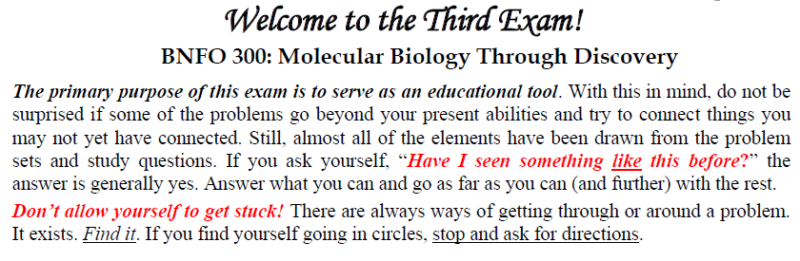

Slide 8
Welcome to Molecular Biology Through Discovery Thursday, 20 April 2017
In reference to the Crick et al (1961) article,… how do they know that not plating on K is a characteristic of the r phenotype?

Slide 9
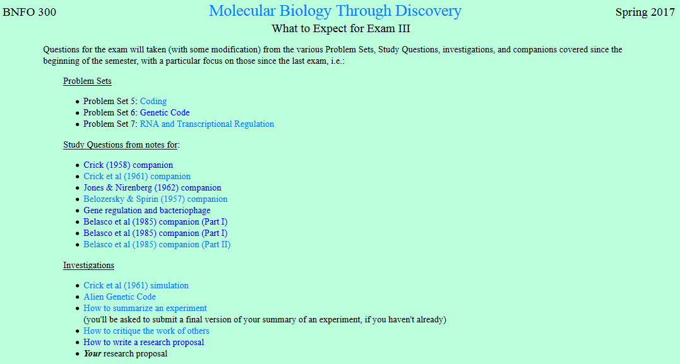

Slide 10
Welcome to Molecular Biology Through Discovery Thursday, 20 April 2017
In reference to the Crick et al (1961) article,… how do they know that not plating on K is a characteristic of the r phenotype?

Slide 11
Welcome to Molecular Biology Through Discovery Thursday, 20 April 2017
I've skimmed back through the article and my notes to no avail.

Slide 12
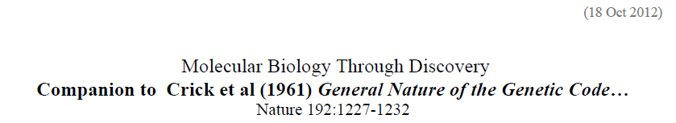
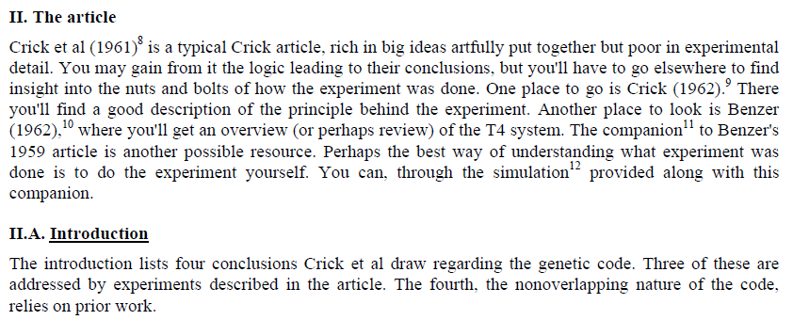

Slide 13
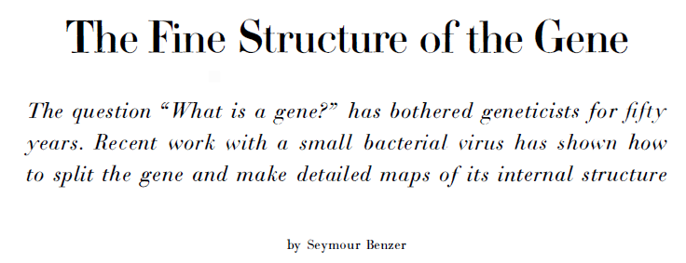
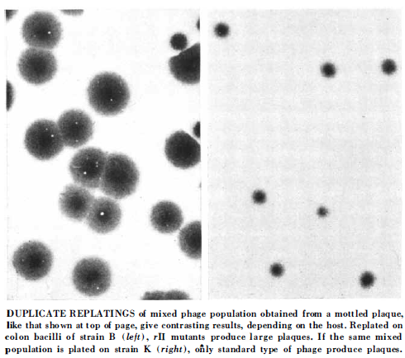
Benzer S (1962). Sci Am 206:70-84 (January, 1962).

Slide 14
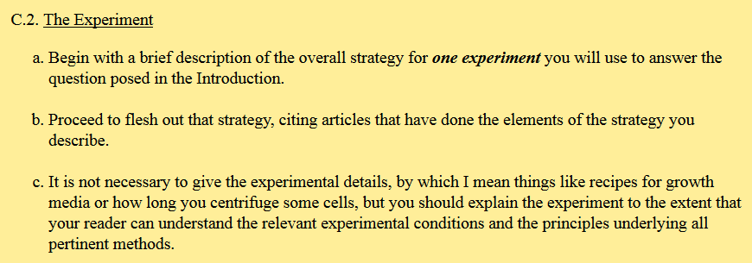

Slide 16
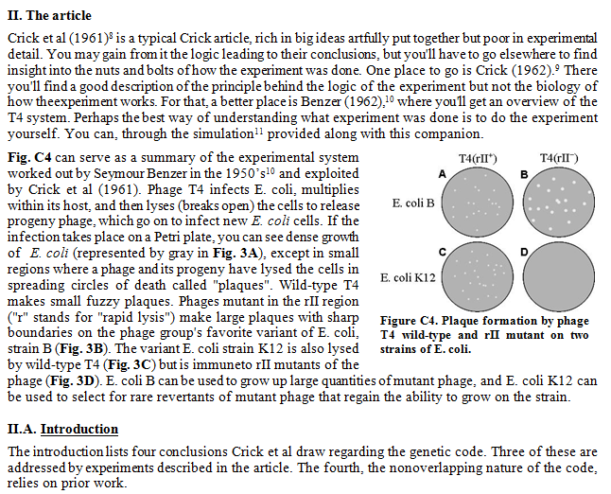
(20 Apr 2018)

Slide 17
Crick et al (1961) experiment

Slide 18
Crick et al (1961) experiment

Slide 19
Crick et al (1961) experiment

Slide 20
Crick et al (1961) experiment

Slide 21
Crick et al (1961) experiment

Slide 22
Crick et al (1961) experiment
Small (R+)
Large (R-)

Slide 23
Welcome to Molecular Biology Through Discovery Thursday, 20 April 2017

