Slide 1
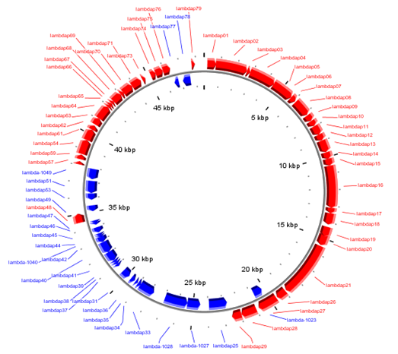
lysis genes
head synthesis
genes
DNA synthesis
genes
cro
cI
Bacteriophage Lambda
tail synthesis genes
excision and integration genes

