Slide 1
Self Assembly
Click the mouse
or
press the right arrow key
to continue
Best viewed as a slide show!
BNFO 491 Molecular Biology Through Discovery (2012)
http://www.people.vcu.edu/~elhaij/bnfo491-12
Jeff Elhai
Center for the Study of Biological Complexity
Virginia Commonwealth University

Slide 2
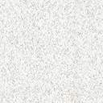

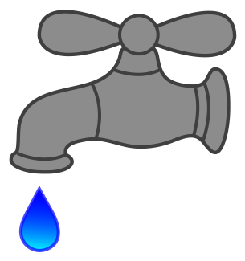
Suppose that you have several hollow glass beads sitting in a glass Petri dish. Of course, they don’t move.
Then you fill the Petri dish with water, …

Slide 3
…allowing them to float. Where do they go?
At first they wander aimlessly, but if they get close to the glass wall of the Petri dish… Voom!

Slide 4

Now try it again, but
this time adding several hollow plastic beads.
What will they do
when you add water?

Slide 5

What will they do?
Think about it a bit before doing the experiment.

Slide 6
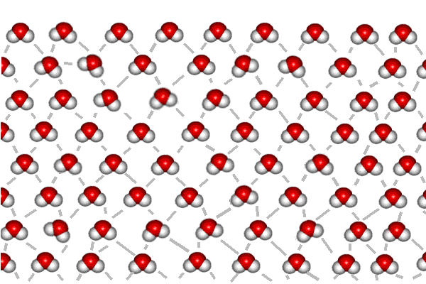
This might help get your creative juices flowing…
Consider the plight of water
at an air-water interface.
The oxygen atoms of water molecules away from the interface are completely hydrogen bonded – each oxygen ( ) interacting with two hydrogen atoms ( ).
Look at the interface layer. How many oxygen atoms do not have hydrogen bonds?
Air
Water
Water molecules courtesy of Cal State University Stanislaus Chemistry Dept
http://wwwchem.csustan.edu/chem2000/Exp5/BKG.HTM

Slide 7
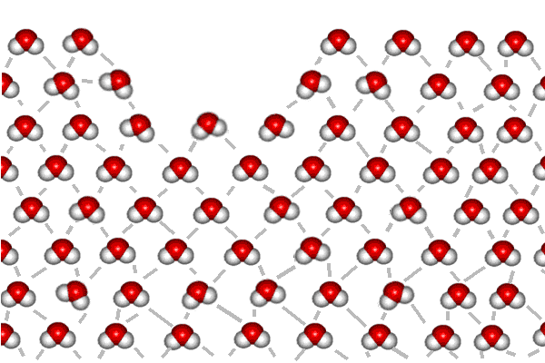
But float a bead on the water, one made of plastic and not interacting with water…
The air-water interface is distorted by the bead.
Now how many oxygens
are not participating in hydrogen bonds?
Each lost hydrogen bond represents an expenditure
of energy. It takes energy
to disrupt the interaction
amongst water molecules.
Air
Water
Air
Water

Slide 8
Worse yet, if there are two plastic beads, then there are twice as many water molecules disrupted (count them) and twice as much energy
required to do this. Unless…
…How can you minimize
the number of oxygens
without hydrogen bonds?
Air
Water
Air
Water

Slide 9
Now count the oxygens.
(Hold that thought)
Air
Water
Air
Water

Slide 10
Turning to glass beads…
They pose a different problem, because glass (mostly SiO₂) interacts well with water.
With glass beads, the goal
is to increase interaction
with water…
Air
Water
(The red spiky things are supposed to represent
potential hydrogen bonds
to oxygens in SiO₂)
Air
Water

Slide 11
…which is possible if the bead is at the meniscus formed between the water and the
glass wall of the Petri dish.
Muse on that, then pop back
to the question at hand.
Air
Water
Air
Water

Slide 12
So how do you think
the glass and plastic beads will arrange themselves when allowed to float freely?

Slide 13
The glass beads scoot
to the side as before,
but the plastic beads tend to aggregate.
Bottom line: the two dimensional properties are determined in part by the properties of
the individual units.

Slide 14
A modification of that experiment…
This time run a string through the beads:
first five plastic beads,
then five glass beads,
then five plastic beads.
Now grab hold of the
two free ends of the
string and yank.

Slide 15
Suppose the beads can float freely as before, the plastic beads induced by water’s surface tension to stick to each other. Suppose that the glass beads repulse each other and have no attraction to the plastic beads.
What structure do you predict will result?

Slide 16
Plausible…
Now suppose that there’s enough turbulence for the beads to come together
and fly apart until they
arrive at the structure that is most stable, i.e. least likely to fly apart.
What would that be?

Slide 17
This is what I thought of.
If you thought of pretty much the same thing without our discussing the result, then it follows that simply knowing rules and properties enables us to predict the final structure.
Now go a step further…

Slide 18
Suppose there are many such
structures, thousands of them.
How will they aggregate?

Slide 19
This is pretty good. The glass beads are exposed to the water, and the plastic
beads have sequestered themselves.
But there is a large plastic-water
interface at the bottom.
What to do about that?
Solution: have the bottoms
interface with each other,…

Slide 20
…producing a bilayer membrane.
All of this came about because
we could specify the order of
glass and plastic beads.

Slide 21
One last experiment…
Instead of just two types of beads (hydrophilic glass beads vs hydrophobic plastic beads),…

Slide 22
…suppose that there are lots of different types, each type with different properties. As before,
we can still specify their order.

Slide 23
It becomes difficult to predict
what will happen, but whatever
does happen is determined by
the order of the types on the string.
In other words…

Slide 24
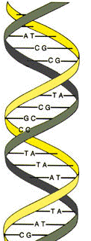
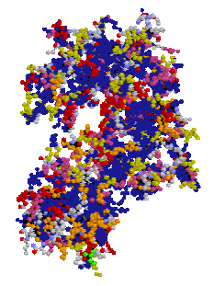
Information
Structure
+
Function
+
Self-assembly
C
G
A
C
C
A
T
C
G
C
C
T
T
A
G
T
A
C
DNA
Protein
Study Question 1
How do genes exert control over cellular processes?

Slide 25
Disclaimer and Added Notes
Glass beads don’t behave in water exactly as I implied in these thought experiments. To learn more about such things, try:
Vella D, Mahadevan L (2005). The ‘Cheerios Effect’.
Am. J. Phys. 73, 817 (http://dx.doi.org/10.1119/1.1898523)
Boys CV (1896 ). Soap Bubbles and the Forces that Mould Them.
Society for Promoting Christian Knowledge, London.
(http://www.gutenberg.org/files/33370/33370-h/33370-h.htm)

