Slide 2
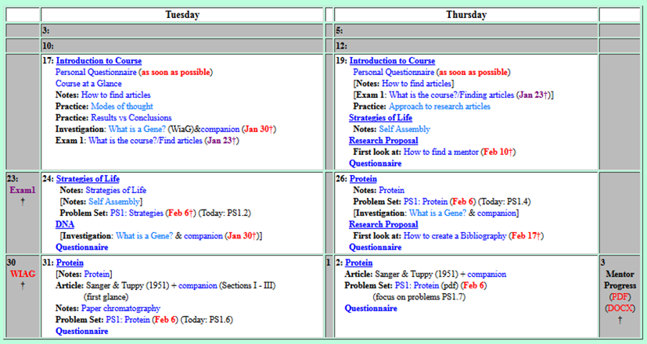
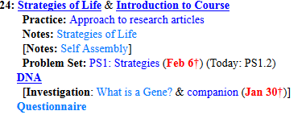
Welcome to Molecular Biology Through Discovery Tuesday, 24 January 2017

Slide 3

General Concerns
Can we be shown in class what previous students who passed the course achieved to get an idea on what we need to have done by the end.

Slide 4
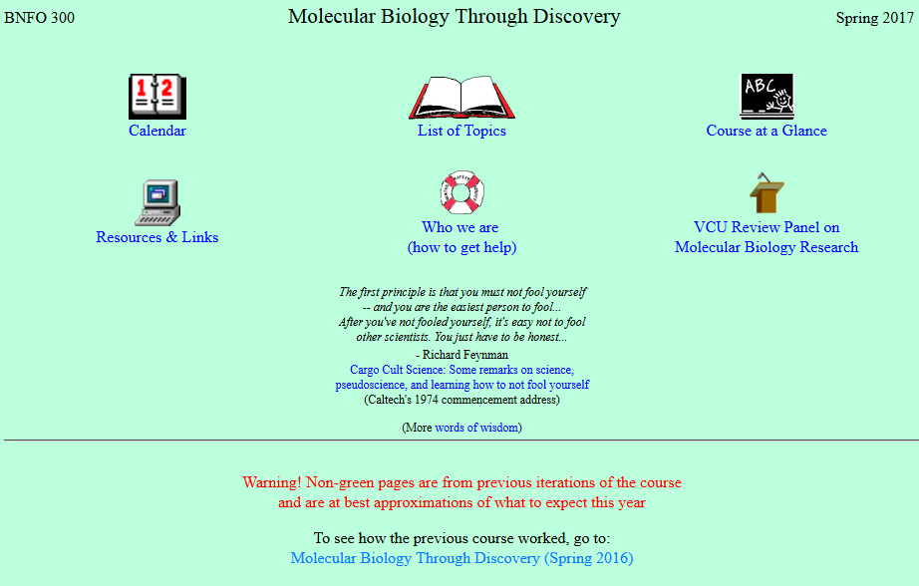

Slide 5
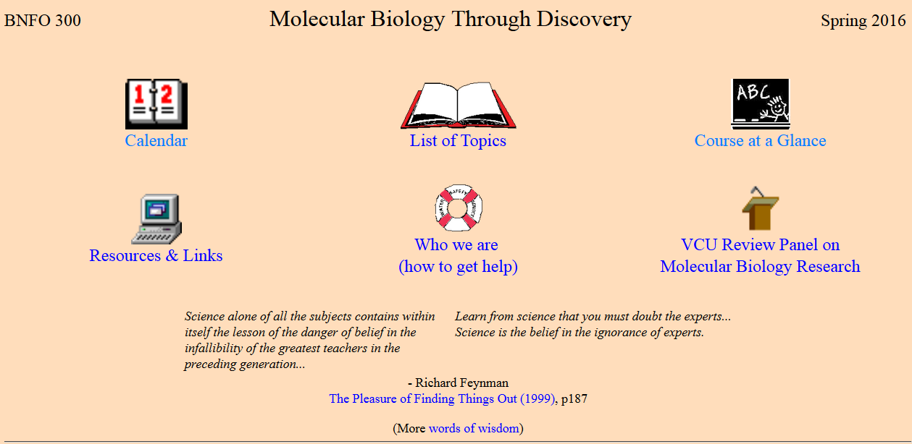


Slide 6
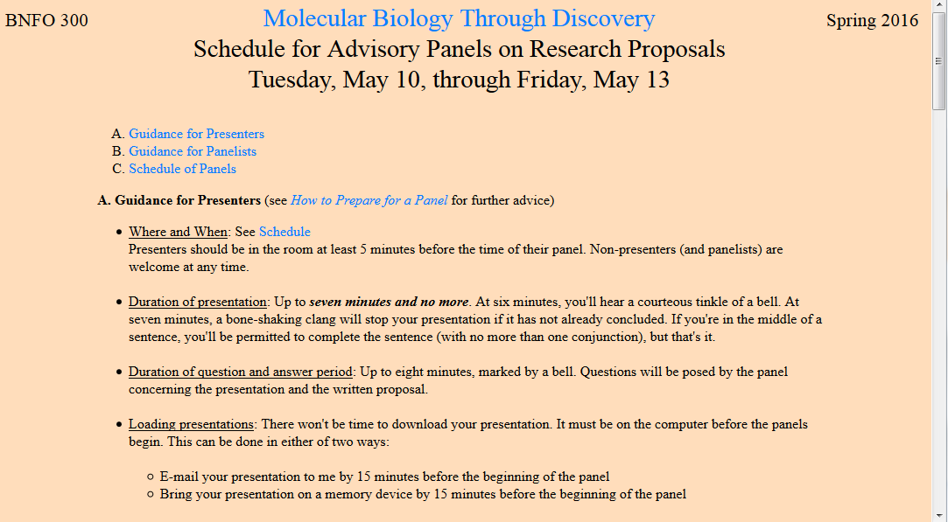

Slide 7
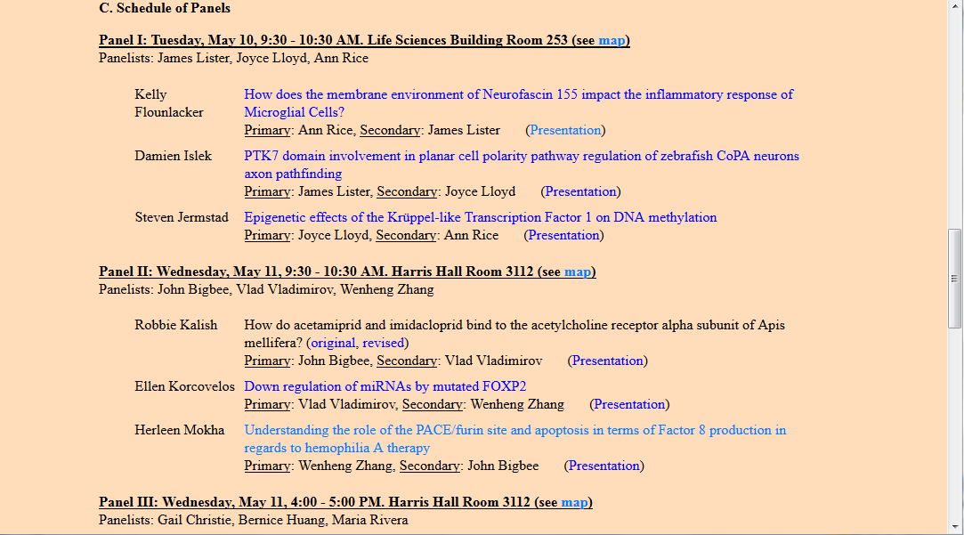

Slide 8
General Concerns
I still find myself relatively confused on what needs to be done by a certain day/ what I should be focusing my time on outside of the classroom.
It’d be nice to have a cleaner version of the schedule if possible.

Slide 9
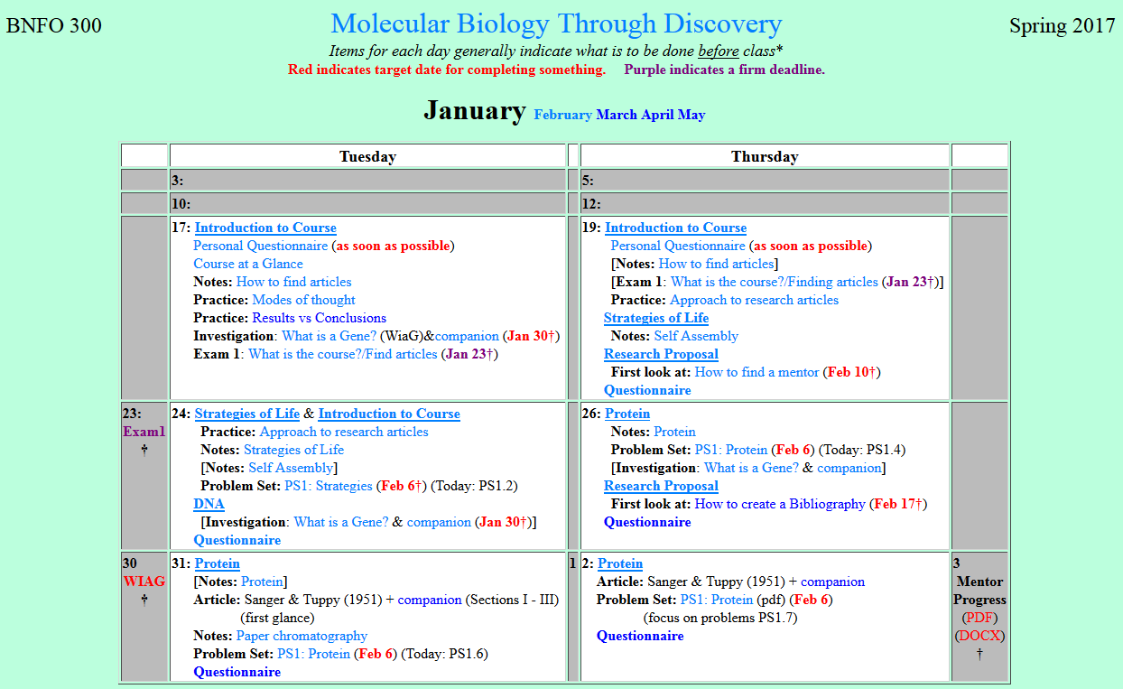

Slide 10
General Concerns
When will we receive feedback? I'd like to work on my research topic a little more so I can feel comfortable reaching out to a mentor
The whole mentor thing and the topic is a little intimidating to me.

Slide 11
General Concerns
Are the questions in the reading just for us to check over the reading in requiring the main points, or would we go through them together as a class in class?
will we do the activities in the tutorials in class?

Slide 12
General Concerns
Class time could be best spent to meet my needs by going through the study questions
Go over the tutorials (portions) as a class and answer anything confusing
A general review of the material to ensure that I have a full and coherent understanding

Slide 13
General Concerns
Can you go over some main points you want us to emphasize on knowing in class?
Explaining some good take away points we should know by the end of the reading.

Slide 14
General Concerns
I received an error message and was unable to submit the questionnaire… I am attaching it to this email.
"straight quotes"
“curly quotes”

Slide 15
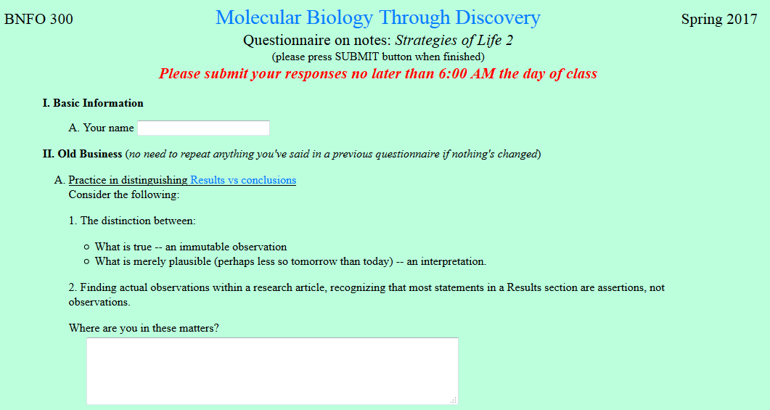
With regards to what is true… what becomes difficult is when reading some articles (more news than scientific) there is no distinction and reference to science and instead based upon quotes and lines pulled at will from the original research.

Slide 16
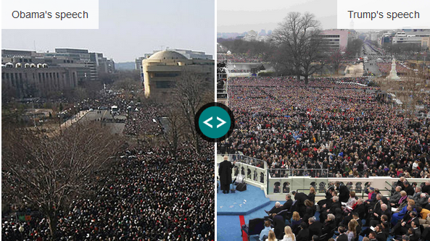
Truth in the News
"the largest audience to ever see an inauguration" -Sean Spicer, White House
BBC 20 Jan 2017

Slide 17
Truth in the News
"the turnout for the inauguration of President Donald Trump appears to be smaller than that of his predecessor“ - CNN
"the largest audience to ever see an inauguration" -Sean Spicer, White House
BBC 20 Jan 2017

Slide 18
I don't understand why statements in the results sections are assertions and not observations.

Slide 19
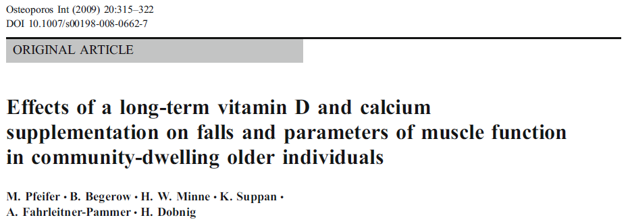
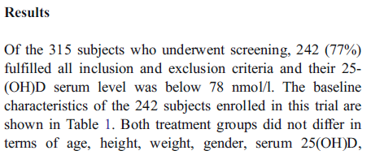
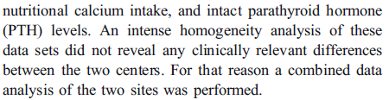

Slide 20
Welcome to Molecular Biology Through Discovery Tuesday, 24 January 2017

Slide 21
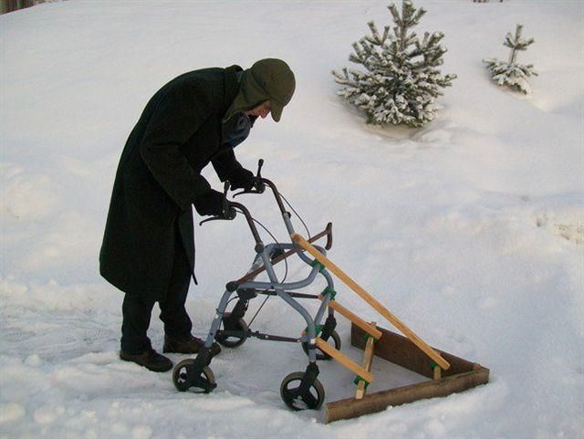
How to know what to do?

Slide 22





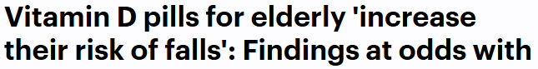
How to know what to do?

Slide 23

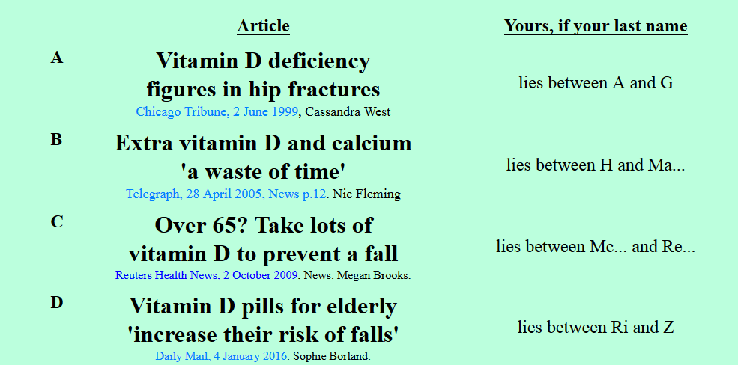

Slide 24
Is it a good idea for your elderly aunt to take Vitamin D?
Your group’s considered opinion (conclusion)
Experimental justification (result / method)
Organized on a slide or page (to be shared – Zoom)
One intentional error

Slide 25

Is it a good idea for your elderly aunt to take Vitamin D?
power strips would be a huge help
Me
1N
1S
2N
2S
3N
3S
4N
4S
5N
5S
6N
6S
7S

Slide 26
Is it a good idea for your elderly aunt to take Vitamin D?
Connect to: https://vcu.zoom.us/j/2504526209
Me
1N
1S
A. Neel Gohil
B. Alex Leath
C. Danny Rayes
C. Rish Patel
D. Rahul Warrier
A. Erin Cochran A. Wesal Alhammad
B. Jacob Jaminet
C. Jesse Raynor
D. Ankita Thakur
A . Elaf Alaithan A. Lamis Farah
B. Colin Hawkes
C. Prathija Prem
D. Bethany Yachuw
A. E Alqaffas
B. Diana Marquez C. Aarthi Prakash D. Yash Singh
2N
2S
3N
3S
A. Ashria Arora B. Deeksha Jain B. Jared Mann
C. Rachel Miller
D. Peter Samuel
A. Adi Balu
A. Kaivalya Dandamudi
B. Aisha Ikram
C. Thomas Raymond
D. Lucas Rizkalla
A. Ruri Barlow
B. Fadi Hijaz B. Gerell Malazarte
C. Nikhita Puthuveetil
D. Mouni Talari
4N
4S
5N
5S
A. Lasya Gundlapudi
B. Amanda Luong C. Bharath Peddibhotla D. Darius Saunders
A. Ryan Duong
B. Alex Leath
B. Brittany Hazard
C. Jacob Mcgill
D. Sam Young
A. Amanda Atrash
B. Josh Kadrich
B. Kevin Limlengco
C. Yonathan Regassa D. Chris Rowe
6N
6S
7S

Slide 27
Welcome to Molecular Biology Through Discovery Tuesday, 24 January 2017

Slide 28
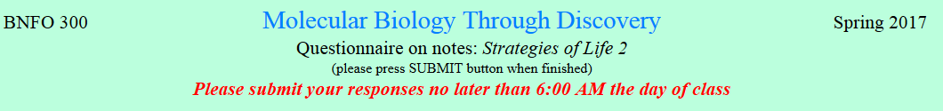
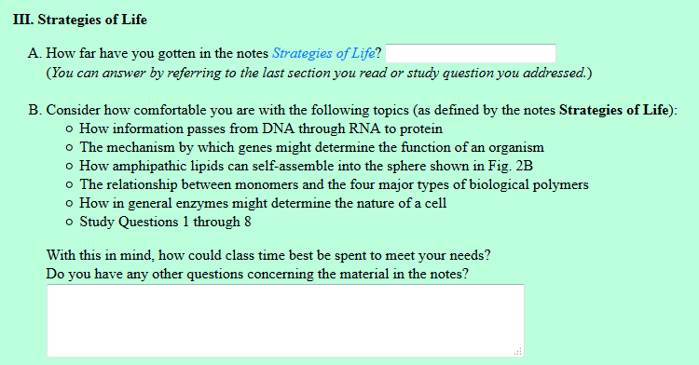
I was confused at the comparison of DNA to a self-folding box. I was confused at the word "spontaneous" because, initially, I thought that it meant that the DNA makes the 2D structure and then it somehow turns into a 3D structure. How does it do that?...

Slide 29
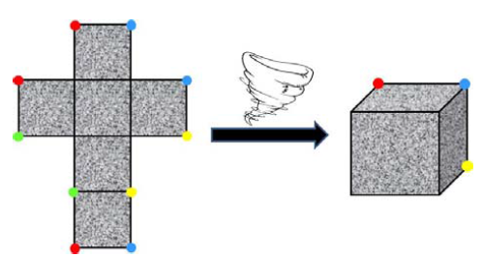
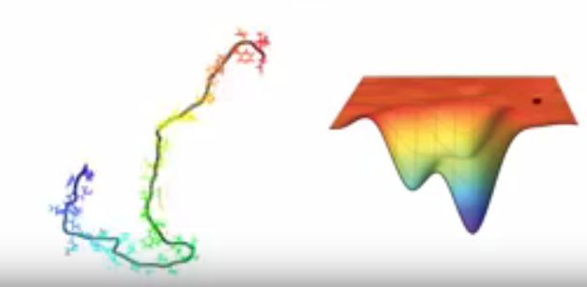
How do 2D structures self-assemble to 3D?
https://www.youtube.com/watch?v=YANAso8Jxrk

Slide 30
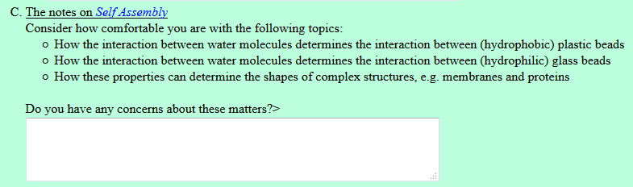
I’m not clear on how the interaction between plastic beads and the water requires energy. Is it because the hydrogen bonds are broken?

Slide 31
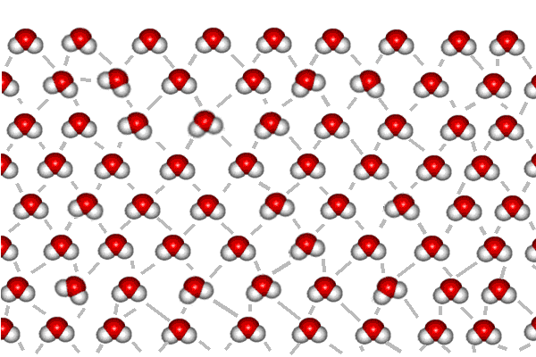
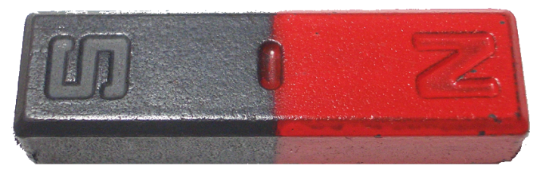

But float a bead on the water, one made of plastic and not interacting with water…
The air-water interface is distorted by the bead.
Now how many oxygens are not participating in hydrogen bonds?
Each lost hydrogen bond represents an expenditure of energy. It takes energy to disrupt the interaction amongst water molecules.
Air
Water
I’m not clear on how the interaction between plastic beads and the water requires energy. Is it because the hydrogen bonds are broken?

Slide 32

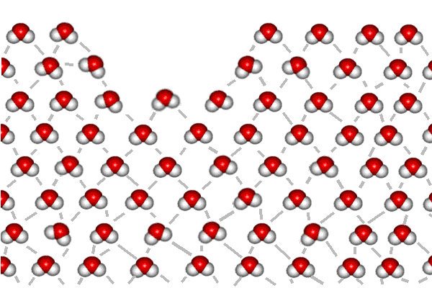
But float a bead on the water, one made of plastic and not interacting with water…
The air-water interface is distorted by the bead.
Now how many oxygens are not participating in hydrogen bonds?
Each lost hydrogen bond represents an expenditure of energy. It takes energy to disrupt the interaction amongst water molecules.
Air
Water
Air
Water
I’m not clear on how the interaction between plastic beads and the water requires energy. Is it because the hydrogen bonds are broken?

Slide 33
Worse yet, if there are two plastic beads, then there are twice as many water molecules disrupted (count them) and twice as much energy required to do this. Unless…
…How can you minimize the number of oxygens without hydrogen bonds?
Air
Water
Air
Water

Slide 34
Now count the oxygens.
(Hold that thought)
Air
Water
I’m missing the connection on why the plastic beads come together or why the water pushes them toward one another?
If the interaction is hydrophobic it causes them to stay away from the water.
Air
Water
With the principle of like attracts like,...

Slide 35

…producing a bilayer membrane.
…if similar membranes could form in hydrophobic substances, such as oil.
All of this came about because we could specify the order of glass and plastic beads.

Slide 36


Slide 37
Is it a good idea for your elderly aunt to take Vitamin D?
Connect to: https://vcu.zoom.us/j/2504526209
Me
1N
1S
A. Neel Gohil
B. Alex Leath
C. Danny Rayes
C. Rish Patel
D. Rahul Warrier
A. Erin Cochran A. Wesal Alhammad
B. Jacob Jaminet
C. Jesse Raynor
D. Ankita Thakur
A . Elaf Alaithan A. Lamis Farah
B. Colin Hawkes
C. Prathija Prem
D. Bethany Yachuw
A. E Alqaffas
B. Diana Marquez C. Aarthi Prakash D. Yash Singh
2N
2S
3N
3S
A. Ashria Arora B. Deeksha Jain B. Jared Mann
C. Rachel Miller
D. Peter Samuel
A. Adi Balu
A. Kaivalya Dandamudi
B. Aisha Ikram
C. Thomas Raymond
D. Lucas Rizkalla
A. Ruri Barlow
B. Fadi Hijaz B. Gerell Malazarte
C. Nikhita Puthuveetil
D. Mouni Talari
4N
4S
5N
5S
A. Lasya Gundlapudi
B. Amanda Luong C. Bharath Peddibhotla D. Darius Saunders
A. Ryan Duong
B. Alex Leath
B. Brittany Hazard
C. Jacob Mcgill
D. Sam Young
A. Amanda Atrash
B. Josh Kadrich
B. Kevin Limlengco
C. Yonathan Regassa D. Chris Rowe
6N
6S
7S

Slide 38
Welcome to Molecular Biology Through Discovery Tuesday, 24 January 2017

Slide 39
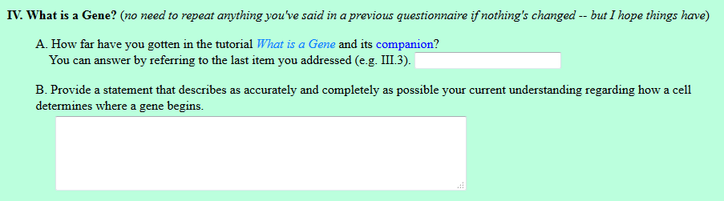

the coordinate system is still vague. I'm having difficulty connecting the example with how the cell uses such method to find a gene.

Slide 40
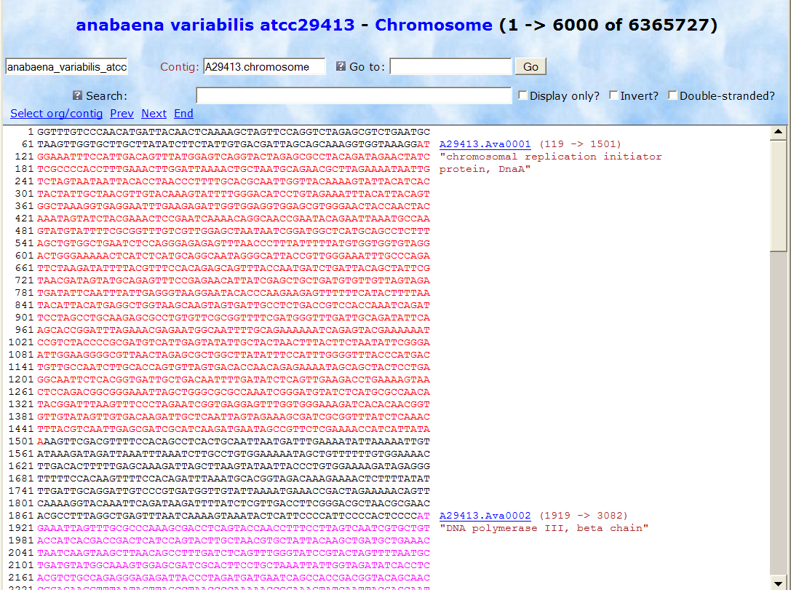
1
6365727

Slide 41
How do 2D structures self-assemble to 3D?
https://www.youtube.com/watch?v=YANAso8Jxrk

Slide 42
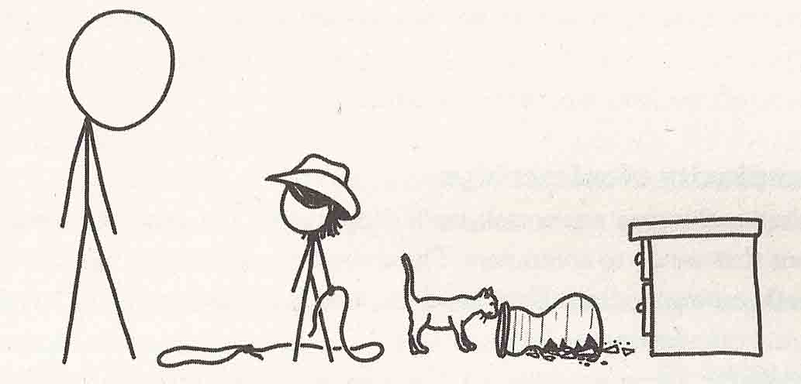
Modes of Thought
From What If by Randall Munroe

Slide 43
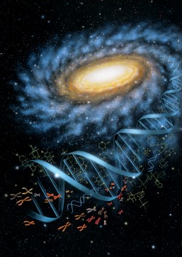
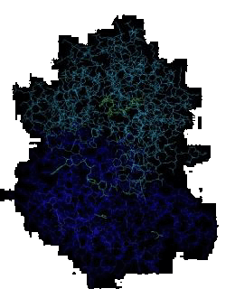


Molecular Biology through Discovery Tuesday, 17 January 2017

