Slide 2
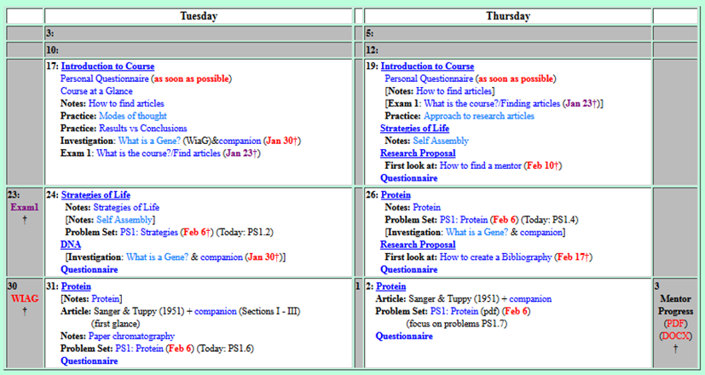
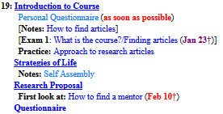
Welcome to Molecular Biology Through Discovery Thursday, 19 January 2017
What do we talk about?

Slide 3
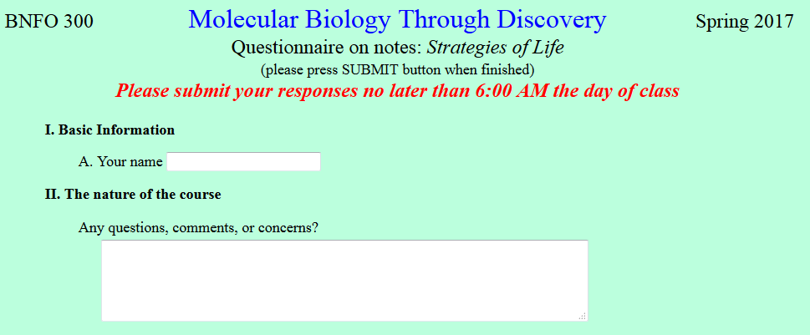

What would you suggest being the best approach to spend our time wisely in getting everything we need to do done?

Slide 4
Welcome to Molecular Biology Through Discovery Thursday, 19 January 2017
What do we talk about?

Slide 5
Welcome to Molecular Biology Through Discovery Thursday, 19 January 2017
What do we talk about?

Slide 6
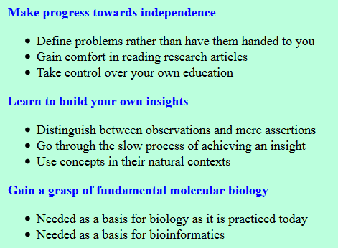

Slide 7
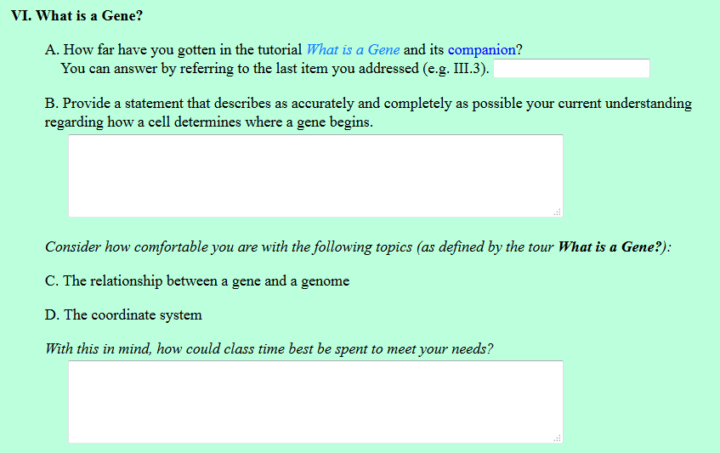
Skimmed though the article

Slide 8
Skimmed though the article
According to "What is a Gene," all start codons are ATG//AUG?

Slide 9
Outline of the readings could be provided by the teacher in a verbal fashion…
I can't say I'm very comfortable with the coordinate system

Slide 10
Sample Question
General frame
I’m confused about the coordinate system.

Slide 11
Sample Question
General frame
I’m confused about the coordinate system.
Specific frame

Slide 12
Sample Question
General frame
I’m confused about the coordinate system. Specifically, I don’t understand how to use the numbers near genes to find their sequences.
Specific frame

Slide 13
Sample Question
General frame
I’m confused about the coordinate system. Specifically, I don’t understand how to use the numbers near genes to find their sequences.
Specific frame
Specific example

Slide 14
Sample Question
General frame
I’m confused about the coordinate system. Specifically, I don’t understand how to use the numbers near genes to find their sequences. I tried with the first number for Ava0001 (119), but that number doesn’t exist amongst the coordinates shown.
Specific frame
Specific example

Slide 15
Sample Question
General frame
I’m confused about the coordinate system. Specifically, I don’t understand how to use the numbers near genes to find their sequences. I tried with the first number for Ava0001 (119), but that number doesn’t exist amongst the coordinates shown.
Specific frame
Specific example
Attempt to resolve

Slide 16
Sample Question
General frame
I’m confused about the coordinate system. Specifically, I don’t understand how to use the numbers near genes to find their sequences. I tried with the first number for Ava0001 (119), but that number doesn’t exist amongst the coordinates shown. I tried counting from coordinate 1 but that led me to the letters GAT when I believe the gene should begin ATG.
Specific frame
Specific example
Attempt to resolve

Slide 17
Sample Question
General frame
I’m confused about the coordinate system. Specifically, I don’t understand how to use the numbers near genes to find their sequences. I tried with the first number for Ava0001 (119), but that number doesn’t exist amongst the coordinates shown. I tried counting from coordinate 1 but that led me to the letters GAT when I believe the gene should begin ATG.
Specific frame
Specific example
Attempt to resolve
Optional rant

Slide 18
Sample Question
General frame
I’m confused about the coordinate system. Specifically, I don’t understand how to use the numbers near genes to find their sequences. I tried with the first number for Ava0001 (119), but that number doesn’t exist amongst the coordinates shown. I tried counting from coordinate 1 but that led me to the letters GAT when I believe the gene should begin ATG. What kind of idiot would invent such a non-intuitive system?!?!?
Specific frame
Specific example
Attempt to resolve
Optional rant

Slide 19
Sample Question
General frame
I’m confused about the coordinate system. Specifically, I don’t understand how to use the numbers near genes to find their sequences. I tried with the first number for Ava0001 (119), but that number doesn’t exist amongst the coordinates shown. I tried counting from coordinate 1 but that led me to the letters GAT when I believe the gene should begin ATG. What kind of idiot would invent such a non-intuitive system?!?!?
Specific frame
Specific example
Attempt to resolve
Optional rant
Specific request

Slide 20
Sample Question
General frame
I’m confused about the coordinate system. Specifically, I don’t understand how to use the numbers near genes to find their sequences. I tried with the first number for Ava0001 (119), but that number doesn’t exist amongst the coordinates shown. I tried counting from coordinate 1 but that led me to the letters GAT when I believe the gene should begin ATG. What kind of idiot would invent such a non-intuitive system?!?!? I wonder if you could give some insight as to why my experiment failed.
Specific frame
Specific example
Attempt to resolve
Optional rant
Specific request

Slide 21
Sample Question
General frame
I’m confused about the coordinate system. Specifically, I don’t understand how to use the numbers near genes to find their sequences. I tried with the first number for Ava0001 (119), but that number doesn’t exist amongst the coordinates shown. I tried counting from coordinate 1 but that led me to the letters GAT when I believe the gene should begin ATG. What kind of idiot would invent such a non-intuitive system?!?!? I wonder if you could give some insight as to why my experiment failed. Thanks.
Specific frame
Specific example
Attempt to resolve
Optional rant
Specific request
Polite closing

Slide 22
Having study groups outside of class really helped

Slide 23
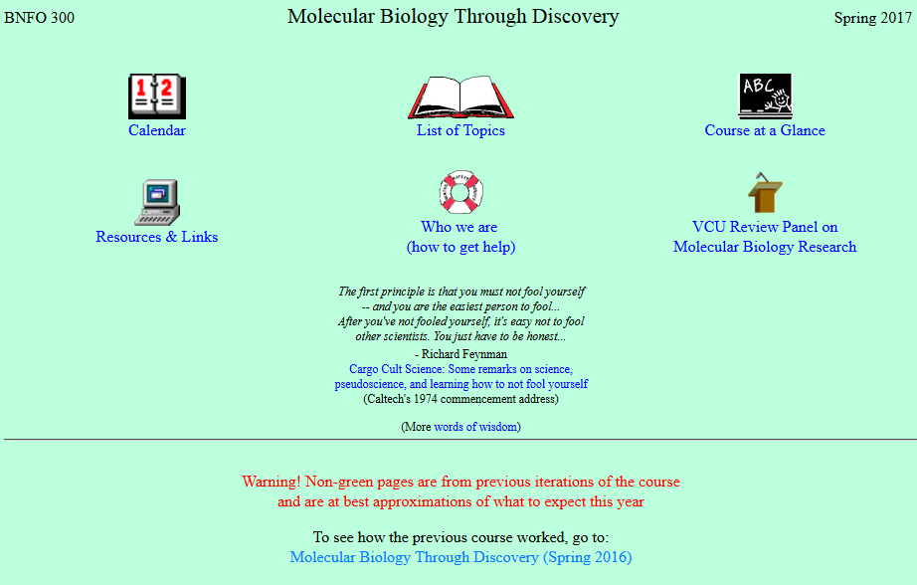

Slide 24
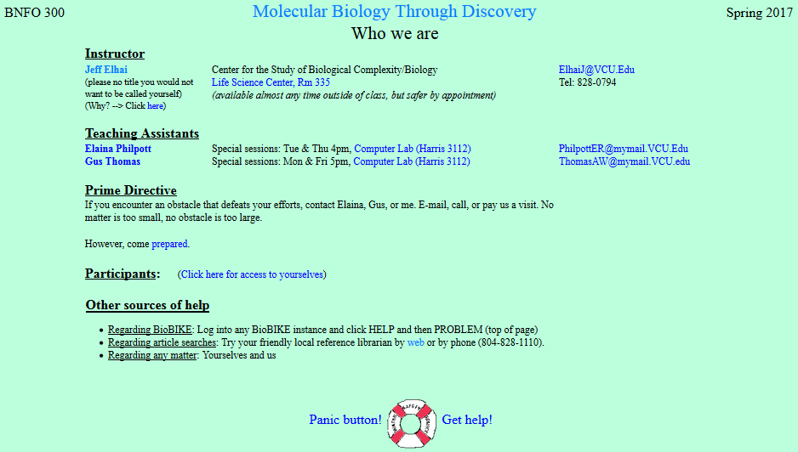
When will TA sessions begin?

Slide 25
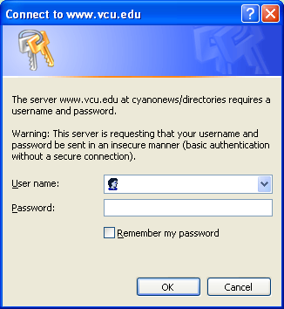
cyano
phyco

Slide 26
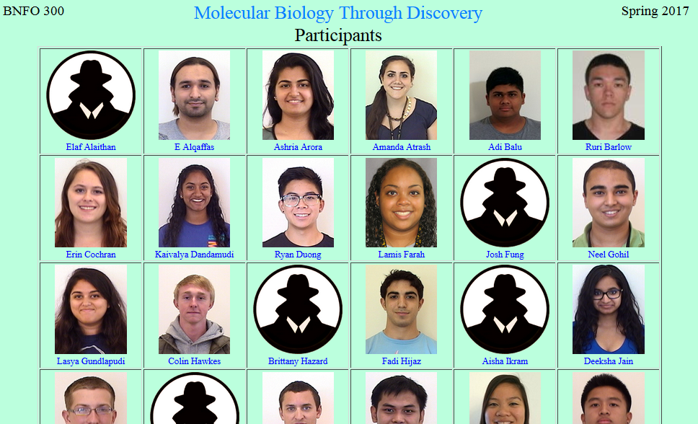

Slide 28
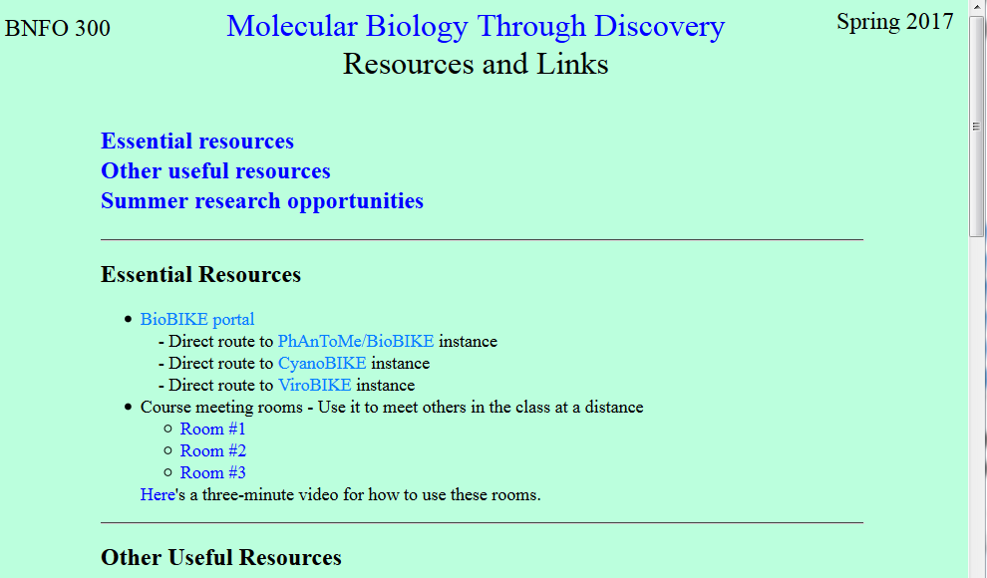
I find having a textbook for classes be useful. It serves as (at least) a last resort if I do not completely understand something.

Slide 29
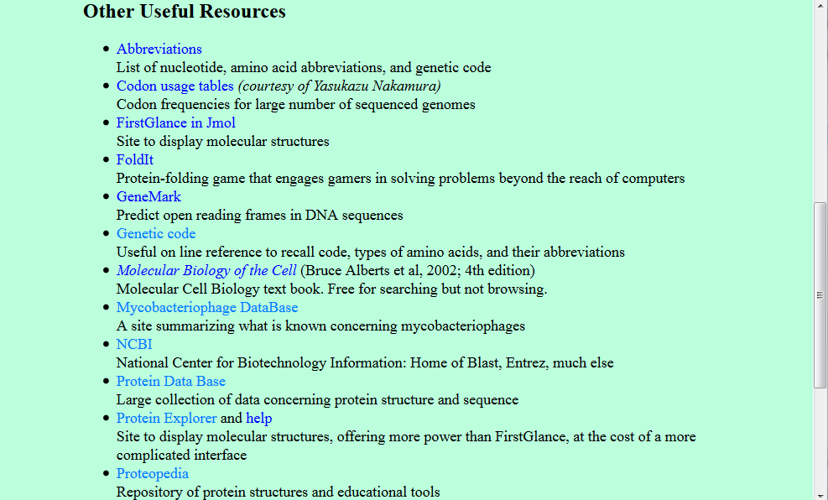
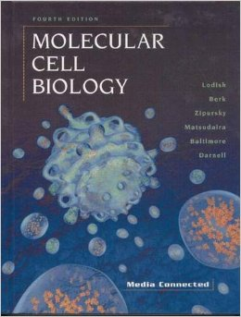

Slide 30
please be caring and open minded
I think that feeling completely lost during a class hinders growth. This happens sometimes when teachers… forget that those who are taking their class may not be as familiar in the topics they present

Slide 31
are you okay with us eating in class?

Slide 32
I would like to know if my answer to the study question at the end is correct.

Slide 33
I also want to gain good relationships with some professors which is something I have been struggling to do.

Slide 34
Welcome to Molecular Biology Through Discovery Thursday, 19 January 2017
What do we talk about?

Slide 35
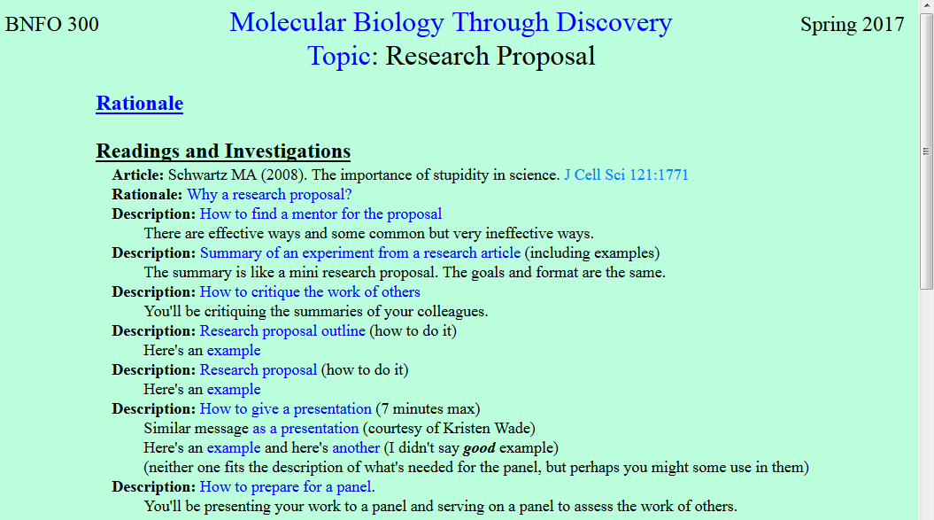

Slide 36
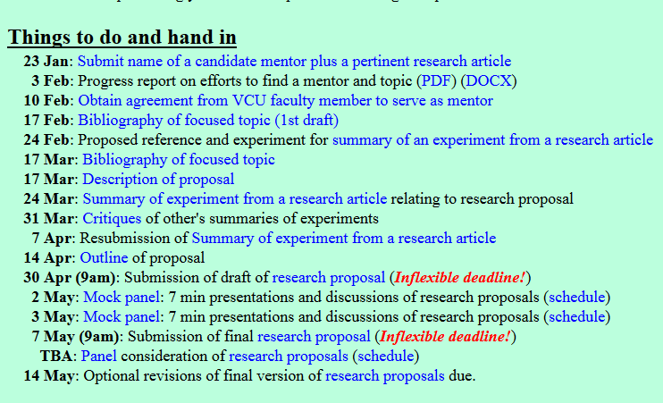
May I be able to change my interest later in the semester?
What kind of research am I supposed to write?

Slide 38
Welcome to Molecular Biology Through Discovery Thursday, 19 January 2017
What do we talk about?

Slide 39
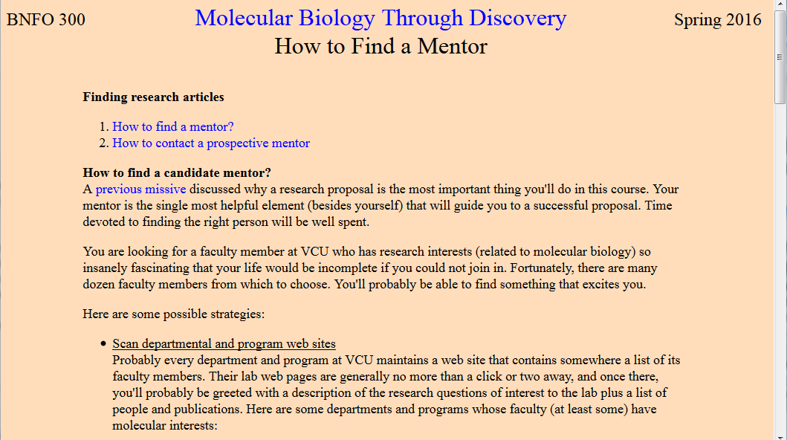

Slide 40
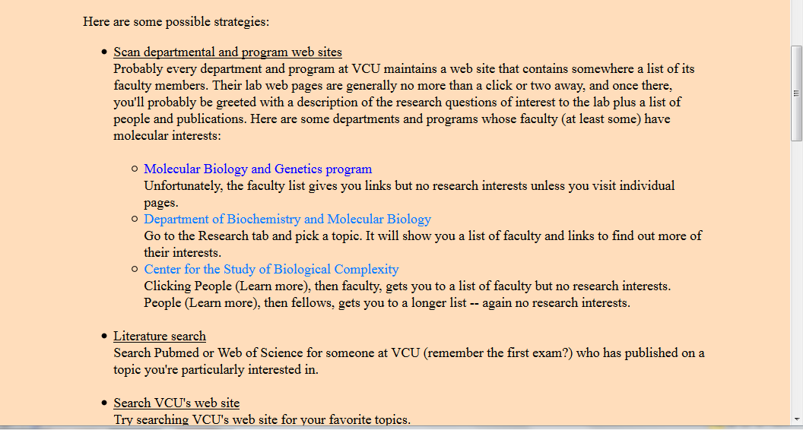

Slide 41
When will TA sessions begin?

Slide 42
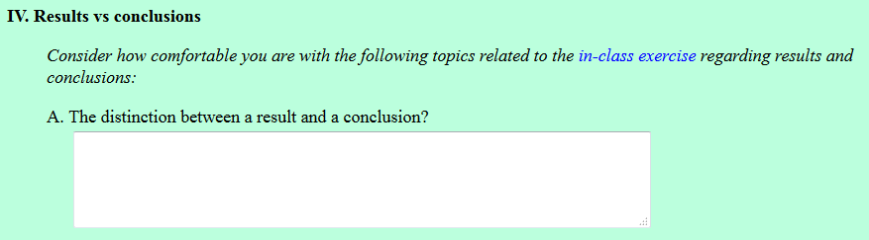
This topic is still somewhat unclear to me.

Slide 43
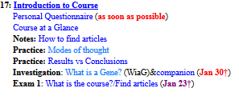
Welcome to Molecular Biology Through Discovery Thursday, 19 January 2017
what in the world will we be doing//learning//engaging each class and how will we go about covering it?

Slide 44

Practice: Results vs Conclusions
Me
1N
1S
2N
2S
3N
3S
4N
4S
5N
5S
6N
6S
7S

Slide 45
Practice: Results vs Conclusions
Me
1N
1S
2N
1
2
3
4
2S
3N
3S
4N
5
6
7
8
4S
5N
5S
6N
9
10
11
12
6S
7S

Slide 46
Practice: Results vs Conclusions
Me
1N
1S
2N
1
2
3
4
2S
3N
3S
4N
5
7
8
4S
5N
5S
6N
9
11
12
6S
7S

Slide 47
Practice: Results vs Conclusions
Me
1N
1S
A . Elaf Alaithan A. Lamis Farah
B. Colin Hawkes
C. Prathija Prem
D. Bethany Yachuw
A. E Alqaffas
B. Diana Marquez C. Aarthi Prakash D. Yash Singh
A. Neel Gohil
B. Alex Leath
C. Danny Rayes
D. Rahul Warrier
A. Erin Cochran
B. Jacob Jaminet
C. Jesse Raynor
D. Ankita Thakur
2N
2S
3N
3S
A. Ashria Arora B. Deeksha Jain B. Jared Mann
C. Rachel Miller
D. Peter Samuel
A. Adi Balu
B. Aisha Ikram
C. Thomas Raymond
D. Lucas Rizkalla
A. Ruri Barlow
B. Fadi Hijaz B. Gerell Malazarte
C. Nikhita Puthuveetil
D. Mouni Talari
4N
4S
5N
5S
A. Lasya Gundlapudi
B. Amanda Luong C. Bharath Peddibhotla D. Gabrielle Strandquist D. Darius Saunders
A. Ryan Duong
B. Alex Leath
B. Brittany Hazard
C. Jacob Mcgill
D. Sam Young
A. Amanda Atrash
B. Josh Kadrich
B. Kevin Limlengco
C. Yonathan Regassa D. Chris Rowe
6N
6S
7S

Slide 48
Welcome to Molecular Biology Through Discovery Thursday, 19 January 2017
what in the world will we be doing//learning//engaging each class and how will we go about covering it?

Slide 49
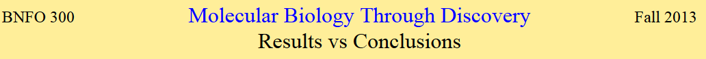
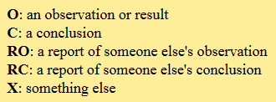
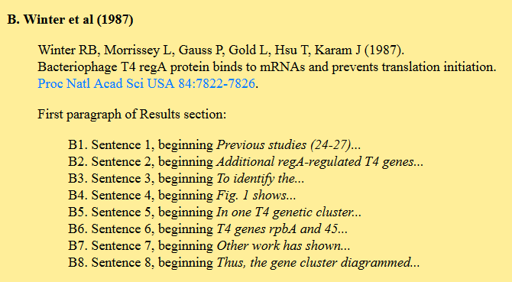
power strips would be a huge help

Slide 50
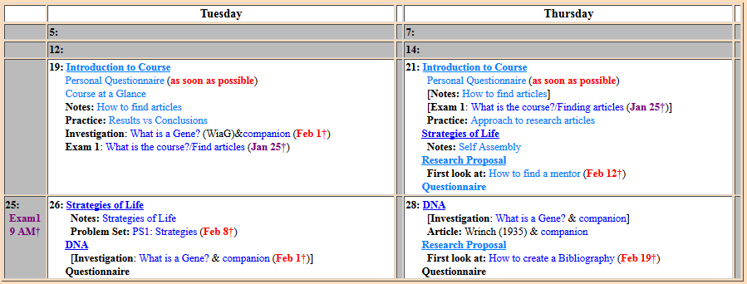
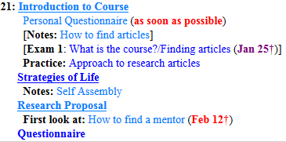
Welcome to Molecular Biology Through Discovery Thursday, 20 January 2016
What do we talk about?
Determined by Questionnaires

Slide 51
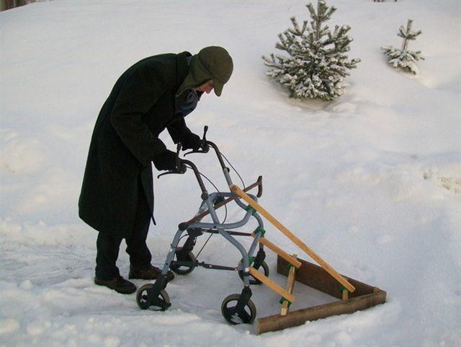
How to know what to do?

Slide 52






How to know what to do?

Slide 53

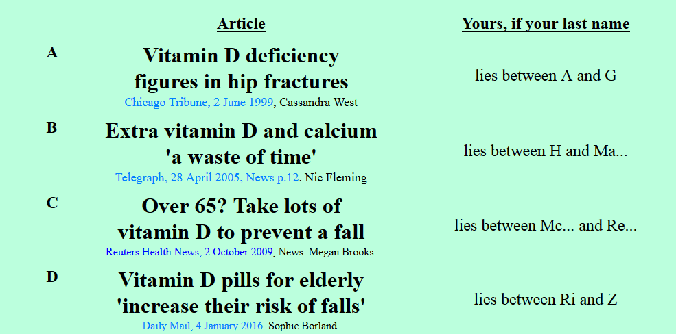
Found it odd that even though their experiment showed that …they still mentioned a quote that…. Which just contradicted their results.

Slide 54
Is it a good idea for your elderly aunt to take Vitamin D?
Me
1N
1S
2N
2S
3N
3S
4N
4S
5N
5S
6N
6S
7S

Slide 55
Is it a good idea for your elderly aunt to take Vitamin D?
Me
1N
1S
2N
1
2
3
4
2S
3N
3S
4N
5
6
7
8
4S
5N
5S
6N
9
10
11
12
6S
7S

Slide 56
Is it a good idea for your elderly aunt to take Vitamin D?
Me
1N
1S
2N
1
2
3
4
2S
3N
3S
4N
5
7
8
4S
5N
5S
6N
9
11
12
6S
7S

Slide 57
Is it a good idea for your elderly aunt to take Vitamin D?
Me
1N
1S
A . Elaf Alaithan A. Lamis Farah
B. Colin Hawkes
C. Prathija Prem
D. Bethany Yachuw
A. E Alqaffas
B. Diana Marquez C. Aarthi Prakash D. Yash Singh
A. Neel Gohil
B. Alex Leath
C. Danny Rayes
D. Rahul Warrier
A. Erin Cochran
B. Jacob Jaminet
C. Jesse Raynor
D. Ankita Thakur
2N
2S
3N
3S
A. Ashria Arora B. Deeksha Jain B. Jared Mann
C. Rachel Miller
D. Peter Samuel
A. Adi Balu
B. Aisha Ikram
C. Thomas Raymond
D. Lucas Rizkalla
A. Ruri Barlow
B. Fadi Hijaz B. Gerell Malazarte
C. Nikhita Puthuveetil
D. Mouni Talari
4N
4S
5N
5S
A. Lasya Gundlapudi
B. Amanda Luong C. Bharath Peddibhotla D. Gabrielle Strandquist D. Darius Saunders
A. Ryan Duong
B. Alex Leath
B. Brittany Hazard
C. Jacob Mcgill
D. Sam Young
A. Amanda Atrash
B. Josh Kadrich
B. Kevin Limlengco
C. Yonathan Regassa D. Chris Rowe
6N
6S
7S

Slide 58
Is it a good idea for your elderly aunt to take Vitamin D?
Your group’s considered opinion (conclusion)
Experimental justification (result / method)
Organized on a slide or page (to be shared – Zoom)
One intentional error

Slide 59
Is it a good idea for your elderly aunt to take Vitamin D?
Your group’s considered opinion (conclusion)
Experimental justification (result / method)
Organized on a slide or page (to be shared – Zoom)
One intentional error

Slide 60
Self Assembly
Click the mouse or press the right arrow key to continue
Best viewed as a slide show!
BNFO 491 Molecular Biology Through Discovery (2012) http://www.people.vcu.edu/~elhaij/bnfo491-12
Jeff Elhai
Center for the Study of Biological Complexity
Virginia Commonwealth University

Slide 61


A modification of that experiment…
This time run a string through the beads: first five plastic beads, then five glass beads, then five plastic beads.
Now grab hold of the two free ends of the string and yank.

Slide 62

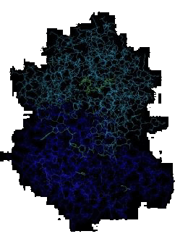


Molecular Biology through Discovery Thursday, 19 January 2017

Slide 63
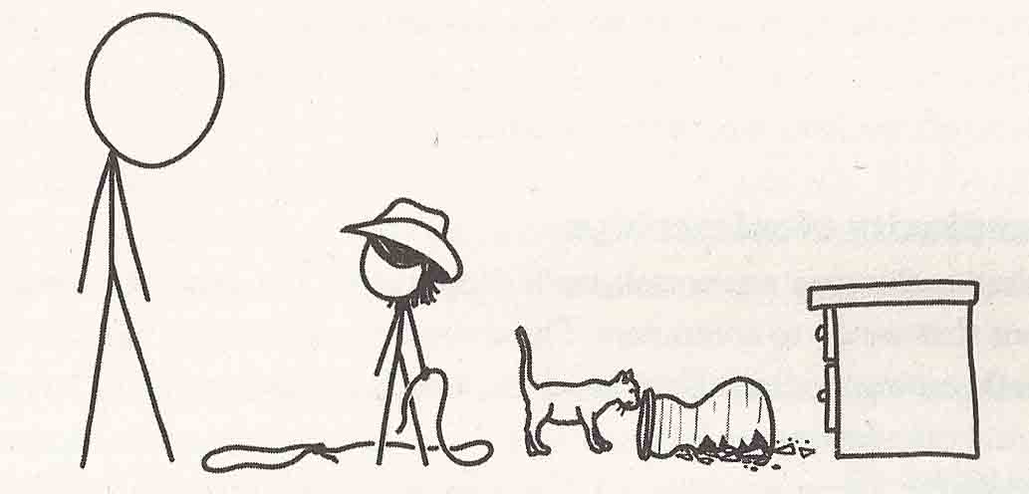
Modes of Thought
From What If by Randall Munroe

Slide 64
Modes of Thought
1. What am I supposed to say?
2. Yes, you’re right, and…
3. No! what about…?

Slide 65
Molecular Biology through Discovery Tuesday, 17 January 2017

