Slide 2
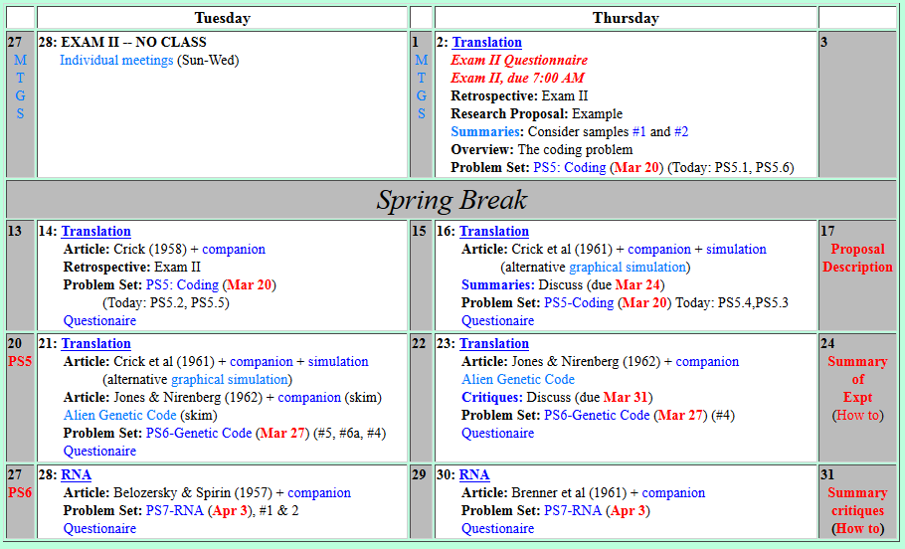
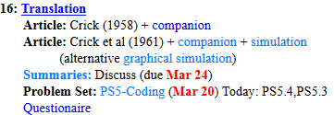
Welcome to Molecular Biology Through Discovery Thursday, 16 March 2017

Slide 4
Summary #1

Slide 5
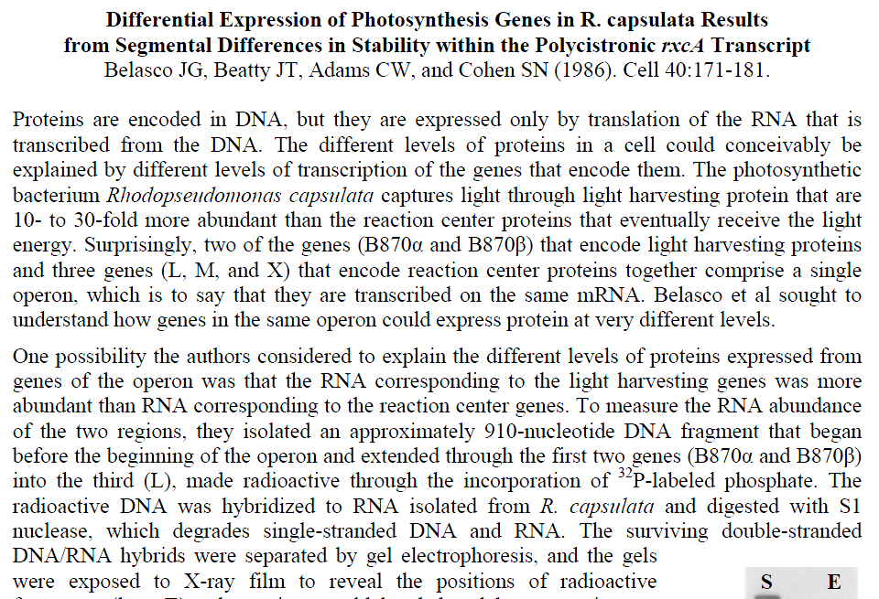
Summary #2

Slide 6

Problem Set 5, #2,#5
Me
1N
1S
2N
2S
3N
3S
4N
4S
5N
5S
6N
6S
7S

Slide 7
Problem Set 5, #2,#5
Me
Connect to: https://vcu.zoom.us/j/2504526209
1N
1S
2N
A
B
C
D
2S
3N
3S
4N
E
F
G H
4S
5N
5S
6N
I J
K
L
6S
7S

Slide 8


Welcome to Molecular Biology Through Discovery Thursday, 16 March 2017
…when an amino acid has more than three codes to be transcribed, does that makes it more "important" than, for example, His ( 2 possible codes)…?

Slide 9
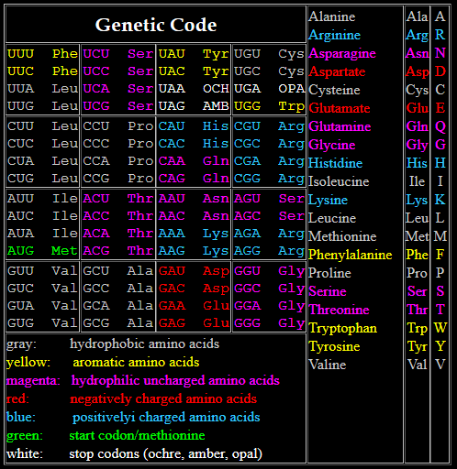
…when an amino acid has more than three codes to be transcribed, does that makes it more "important" than, for example, His ( 2 possible codes)…?

Slide 10

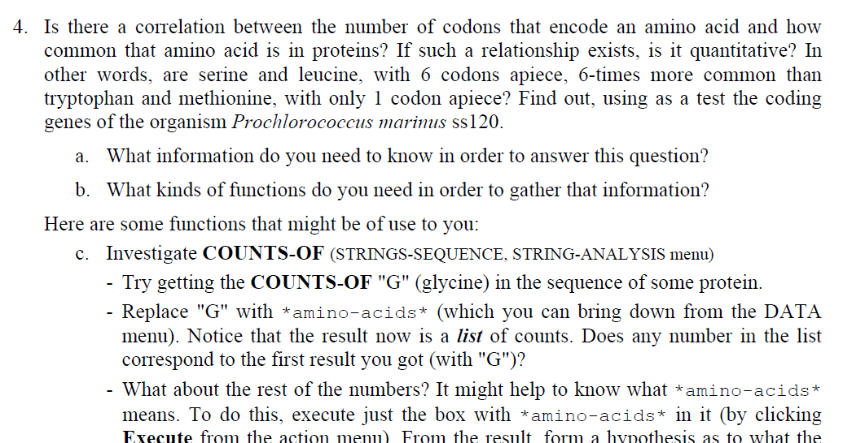

Slide 11
Welcome to Molecular Biology Through Discovery Thursday, 16 March 2017

Slide 12
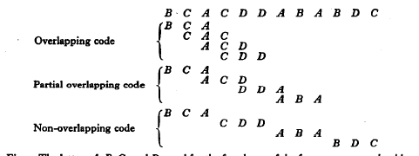
Types of Genetic Codes
Length – Duplet, Triplet, Variable,..
Degeneracy – Degenerate, non-degenerate
Overlap – (partially-, non-) overlapping

Slide 13
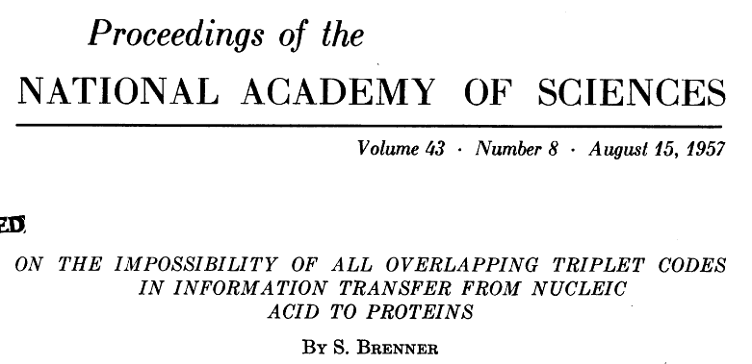
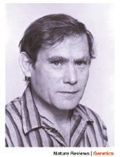
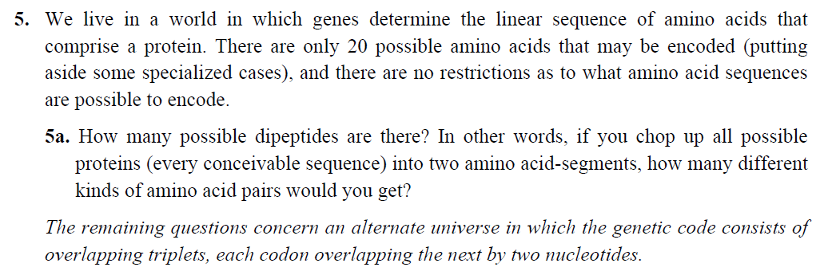
Problem Set 5, #5
Sydney Brenner

Slide 14
Types of Genetic Codes
Length – Duplet, Triplet, Variable,..
Degeneracy – Degenerate, non-degenerate
Overlap – (partially-, non-) overlapping

Slide 15
Welcome to Molecular Biology Through Discovery Thursday, 16 March 2017

Slide 17
Welcome to Molecular Biology Through Discovery Thursday, 16 March 2017

Slide 18
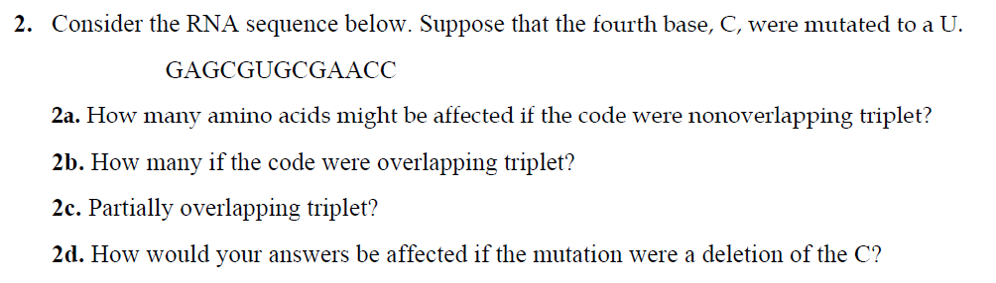
Problem Set 5, #2

Slide 19
Problem Set 5, #5
…what kind of degenerate [code] led to translation of His to occur first in the first dipeptide line and last on the second line?
Sydney Brenner

Slide 20
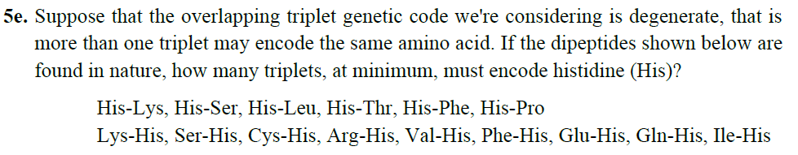
Problem Set 5, #5
…what kind of degenerate [code] led to translation of His to occur first in the first dipeptide line and last on the second line?

Slide 21
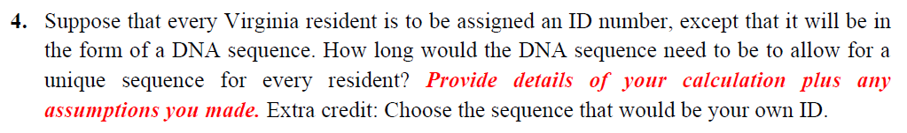
Problem Set 5, #4

Slide 22
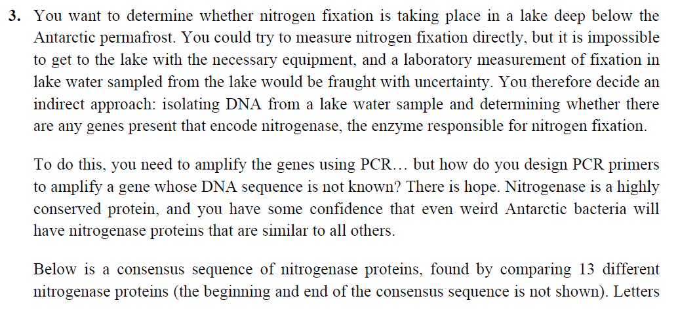
Problem Set 5, #3

Slide 23
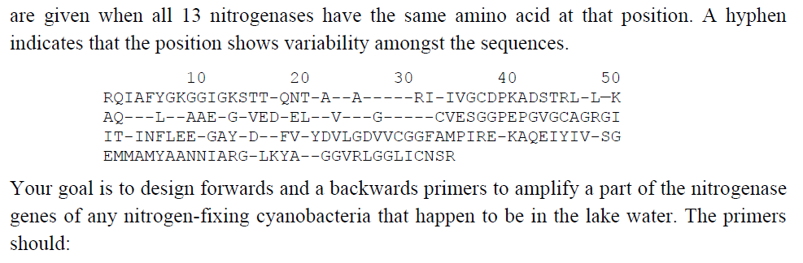
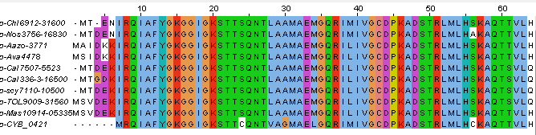
Problem Set 5, #3

Slide 24
Problem Set 5, #2,#5
Me
1N
1S
2N
2S
3N
3S
4N
4S
5N
5S
6N
6S
7S

Slide 25
Problem Set 5, #2,#5
Me
Connect to: https://vcu.zoom.us/j/2504526209
1N
1S
2N
A
B
C
D
2S
3N
3S
4N
E
F
G H
4S
5N
5S
6N
I J
K
L
6S
7S

Slide 26
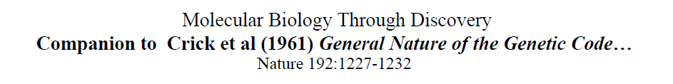
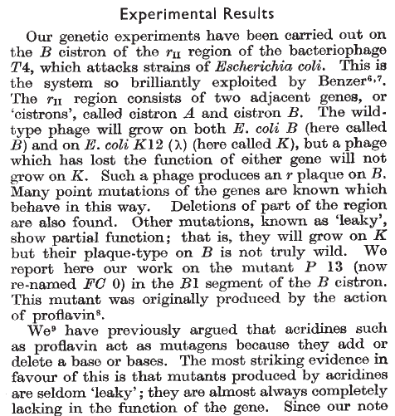
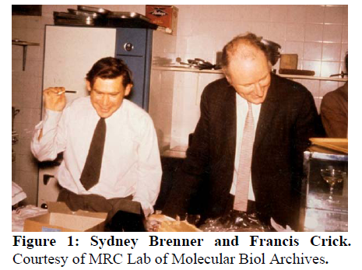

Slide 27
Crick et al (1961) experiment

Slide 28
Crick et al (1961) experiment

Slide 29
Crick et al (1961) experiment

Slide 30
Crick et al (1961) experiment

Slide 31
Crick et al (1961) experiment

Slide 32
Crick et al (1961) experiment
Tight (R+)
Large (R-)

Slide 34
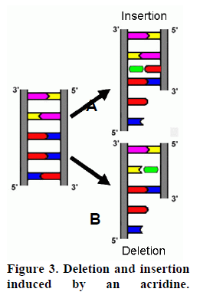
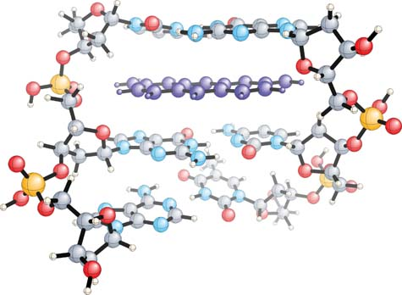
Mutagenesis by Acridines
Proflavine
Proflavine

Slide 35
Mutagenesis by Acridines

Slide 36
Mutagenesis by Acridines

Slide 37
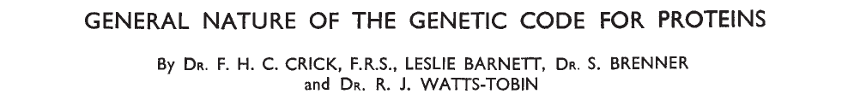
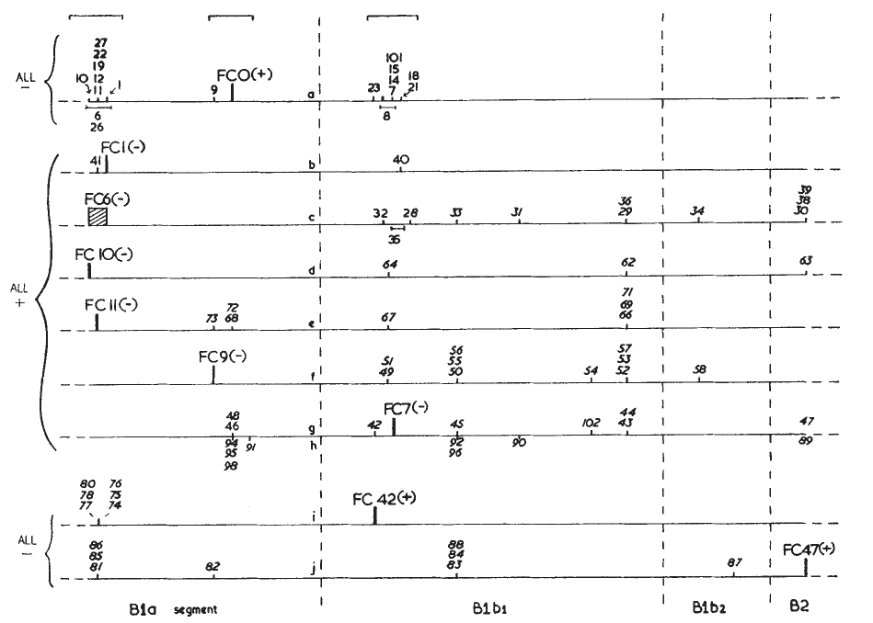
How to map mutations?

Slide 38
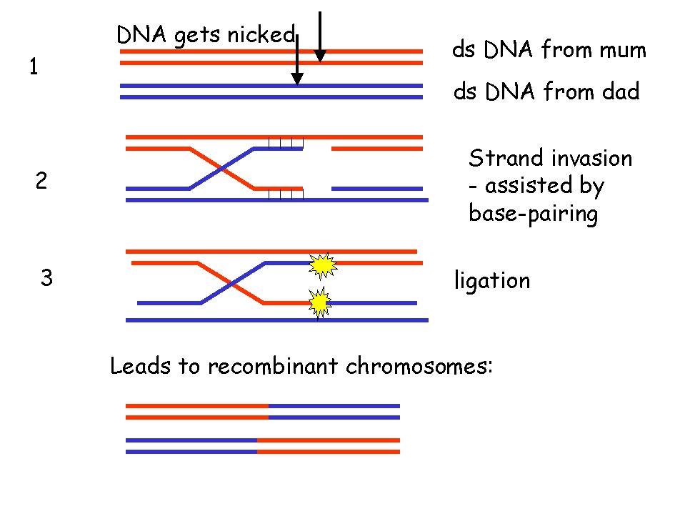
Recombination between DNA
What is the process of recombination between two phages in this experiment?
Pairing of ds DNA at nearly identical sequences
Adapted from Elizabeth Ellis University of Strathclyde

Slide 39
Recombination between DNA
What is the process of recombination between two phages in this experiment?
Pairing of ds DNA at nearly identical sequences
Strand invasion
Adapted from Elizabeth Ellis University of Strathclyde

Slide 40
Recombination between DNA
What is the process of recombination between two phages in this experiment?
Pairing of ds DNA at nearly identical sequences
Strand invasion
Ligation
Adapted from Elizabeth Ellis University of Strathclyde

Slide 41

Recombination between DNA
What is the process of recombination between two phages in this experiment?
Pairing of ds DNA at nearly identical sequences
Strand invasion
Ligation
Resolution
Adapted from Elizabeth Ellis University of Strathclyde

Slide 42
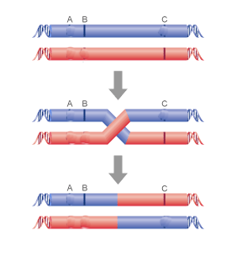
Recombination between DNA
Phenotype?
Defective T4
Defective T4
C

Slide 43
Recombination between DNA
Defective T4
Defective T4
C
C

Slide 44
Recombination between DNA
Defective T4
Defective T4
C
Phenotype?
C
Defective T4
C
Wild type T4

Slide 45
Phenotype of double mutations?

Slide 46
