Slide 2
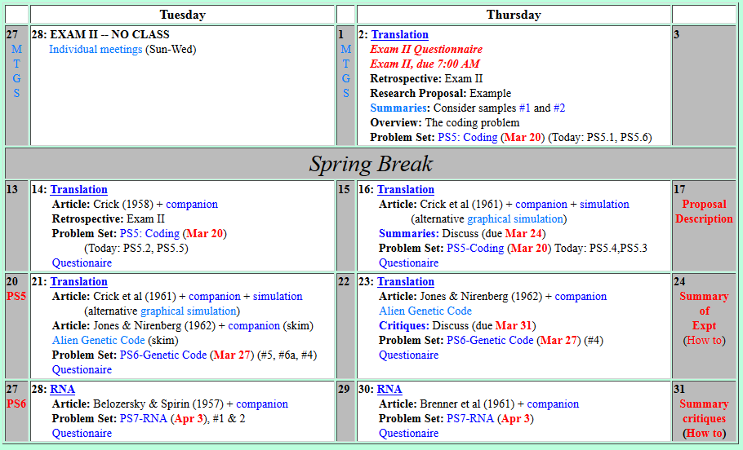

Welcome to Molecular Biology Through Discovery Tuesday, 21 March 2017
Could you speak on the BNFO300 summary blog? What is it and how to submit?

Slide 3
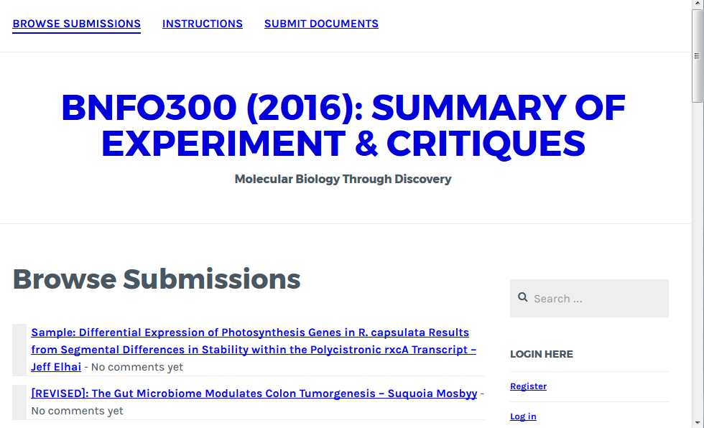

Slide 4
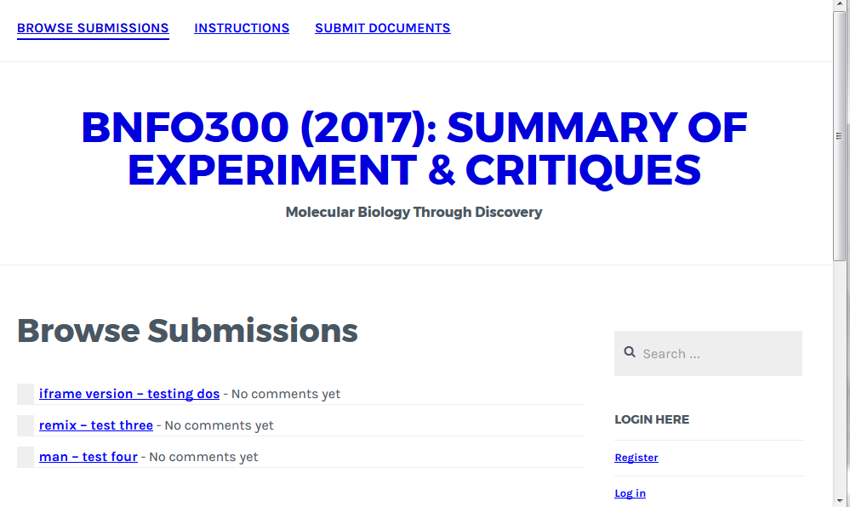

Slide 5
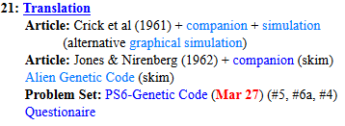
Welcome to Molecular Biology Through Discovery Tuesday, 21 March 2017

Slide 6
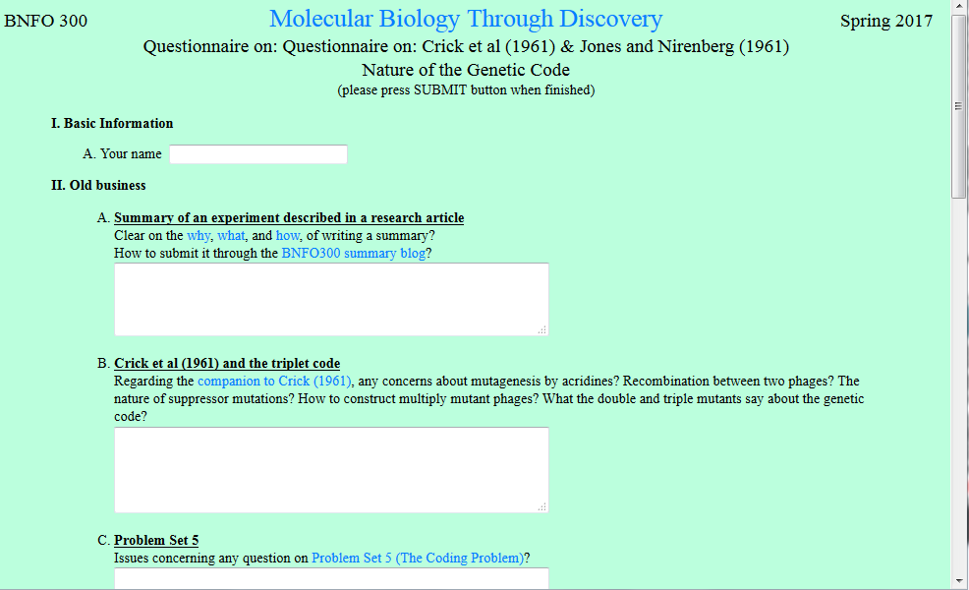
In Q3,…

Slide 7

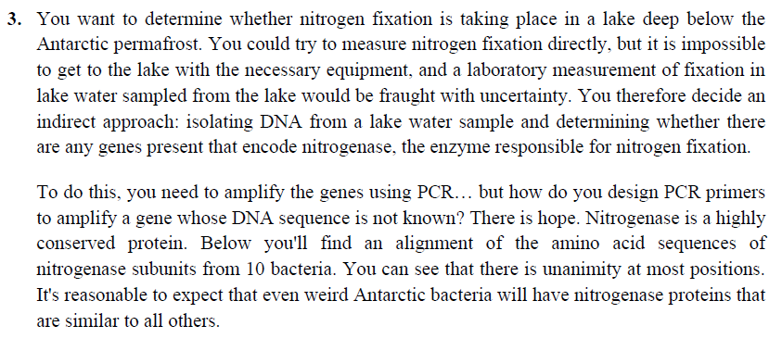

Slide 8
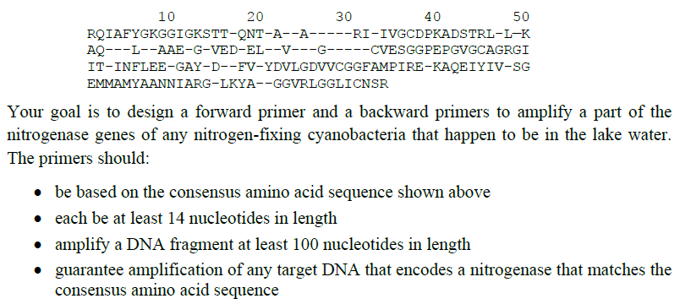


In Q3,… What I don't get is… when picking the primers, why don't we just go always to the terminals

Slide 9
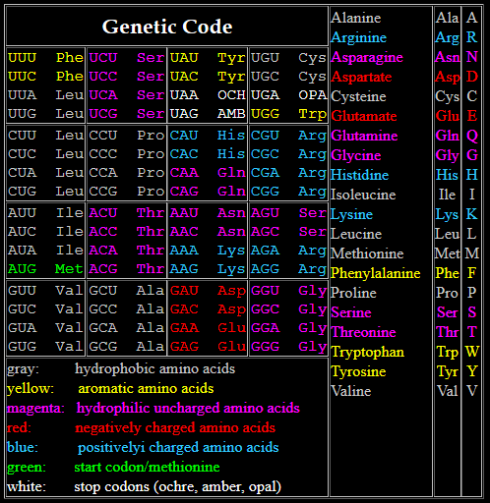
[CA]G[ACGT]

Slide 10
[CA]G[ACGT] 8 possibilities

Slide 11
CA[TC]
[CA]G[ACGT] 8 possibilities

Slide 12
CA[TC] 2 possibilities
[CA]G[ACGT] 8 possibilities

Slide 13
In Q3,… What I don't get is… when picking the primers, why don't we just go always to the terminals

Slide 14
Could we talk about the last question...

Slide 15
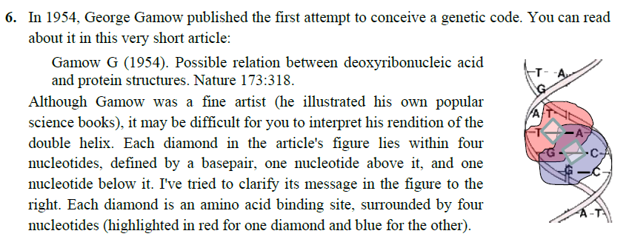

Slide 16
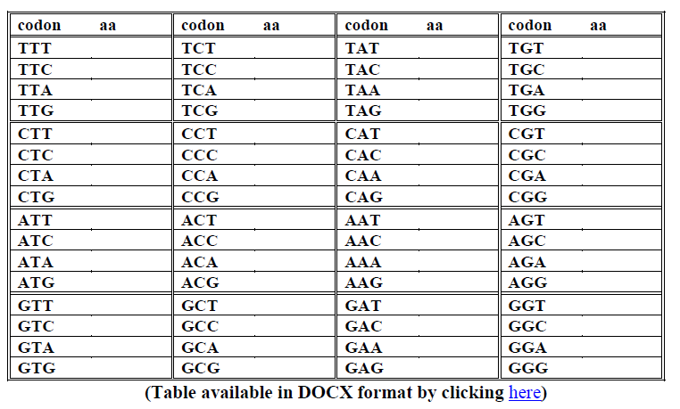
…I found myself having to assign a new one often and getting possible overlaps where a codon could possibly encode two amino acids.

Slide 17
Welcome to Molecular Biology Through Discovery Tuesday, 21 March 2017
I'm confused on the process as to why adding acridines during replication forces an insertion etc.

Slide 18
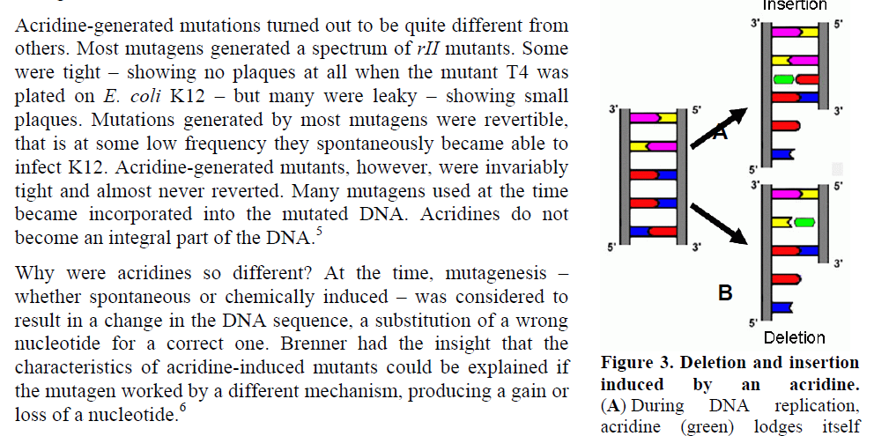
I'm confused on the process as to why adding acridines during replication forces an insertion etc.

Slide 19
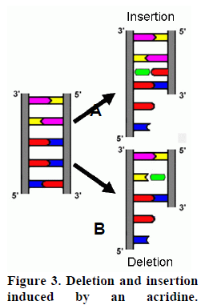
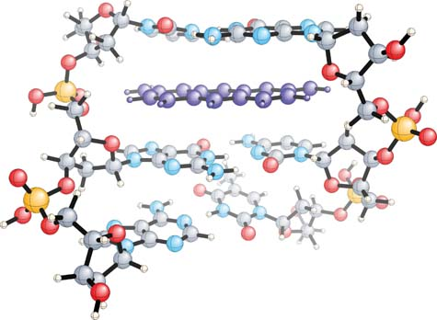
Mutagenesis by Acridines
Proflavine
Proflavine

Slide 20
Mutagenesis by Acridines

Slide 21
Mutagenesis by Acridines

Slide 22
Welcome to Molecular Biology Through Discovery Tuesday, 21 March 2017

Slide 23
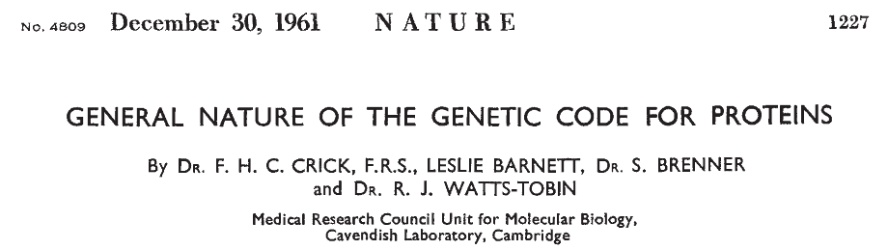
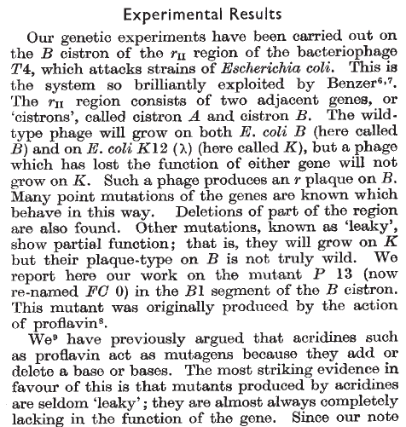
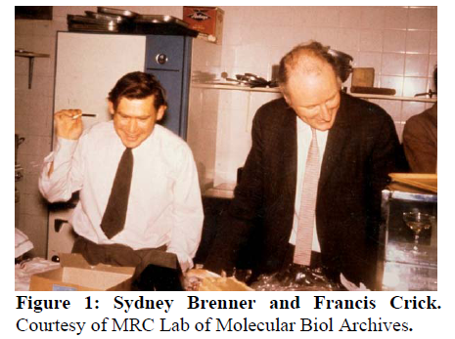

Slide 24
Welcome to Molecular Biology Through Discovery Tuesday, 21 March 2017
Having technical difficulties, so I will be using a desktop in the library to access
Unfortunately my computer is very spotty when it comes to running Java apps

Slide 25
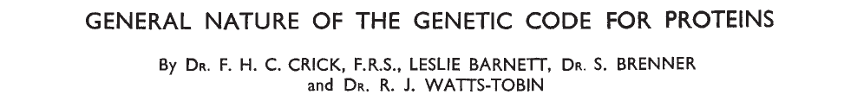
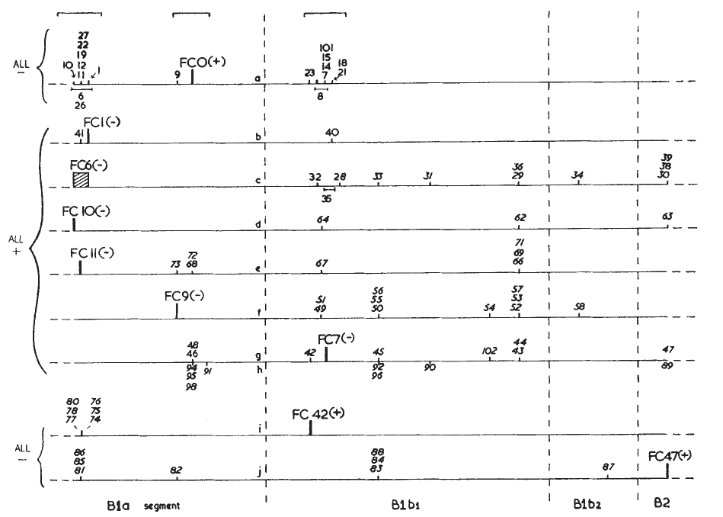

Slide 26
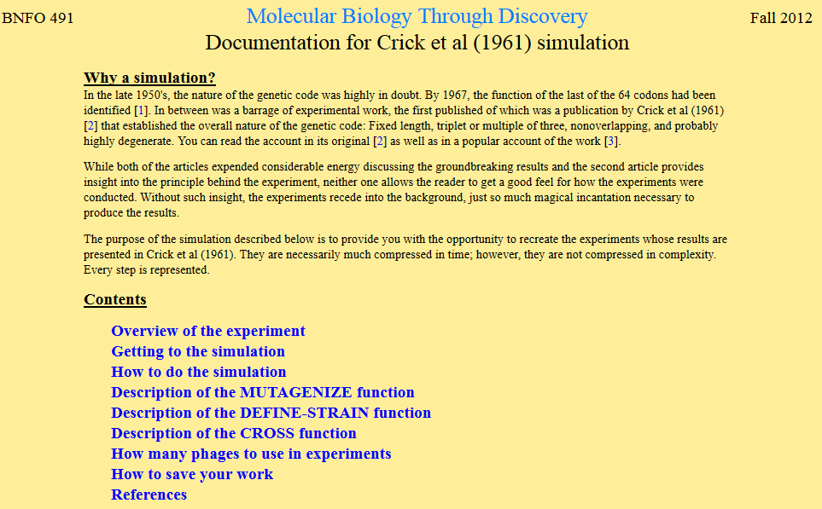

Slide 27
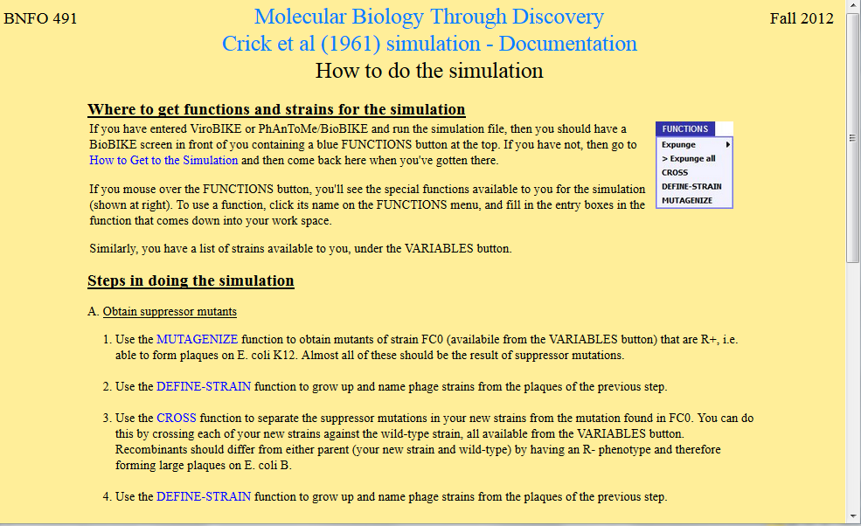

Slide 28

Crick et al (1961) Simulation
Me
Connect to: https://vcu.zoom.us/j/2504526209
1N
1S
2N
A
B
C
D
2S
3N
3S
4N
E
F
G H
4S
5N
5S
6N
I J
K
L
6S
7S

Slide 29
Welcome to Molecular Biology Through Discovery Tuesday, 21 March 2017

Slide 32
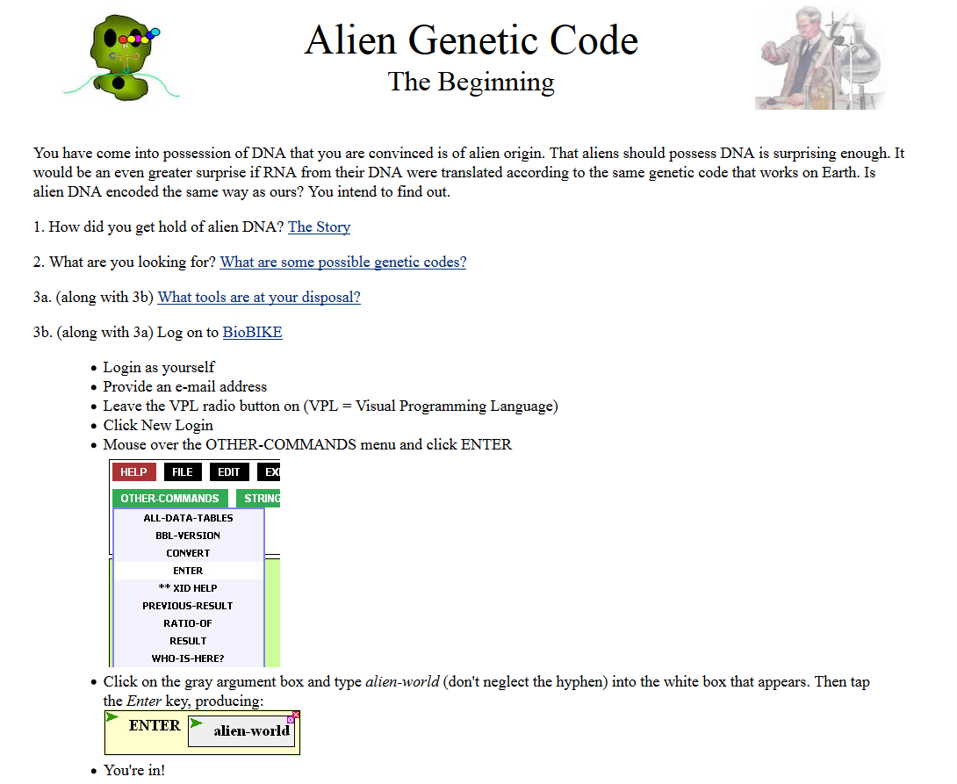
Where can I find the alien genetic code? or should I make some up?

Slide 34
Welcome to Molecular Biology Through Discovery Tuesday, 21 March 2017

Slide 35

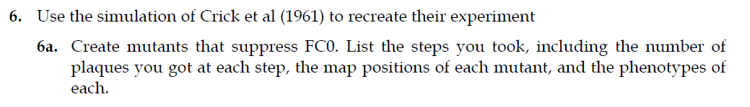

Slide 36
How to map mutations?

Slide 38
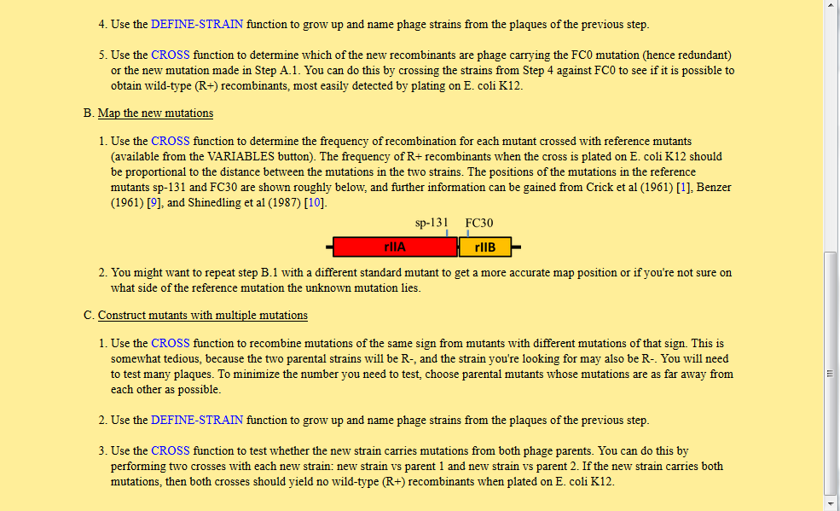

Slide 40
Problem Set 6, #6a, #4
Me
Connect to: https://vcu.zoom.us/j/2504526209
1N
1S
2N
A
B
C
D
2S
3N
3S
4N
E
F
G H
4S
5N
5S
6N
I J
K
L
6S
7S

Slide 41
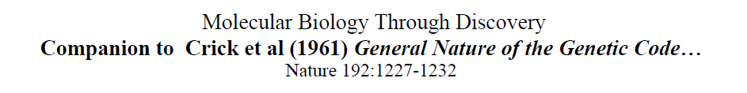

Slide 42
Crick et al (1961) experiment

Slide 43
Crick et al (1961) experiment

Slide 44
Crick et al (1961) experiment

Slide 45
Crick et al (1961) experiment

Slide 46
Crick et al (1961) experiment

Slide 47
Crick et al (1961) experiment
Tight (R+)
Large (R-)

Slide 48
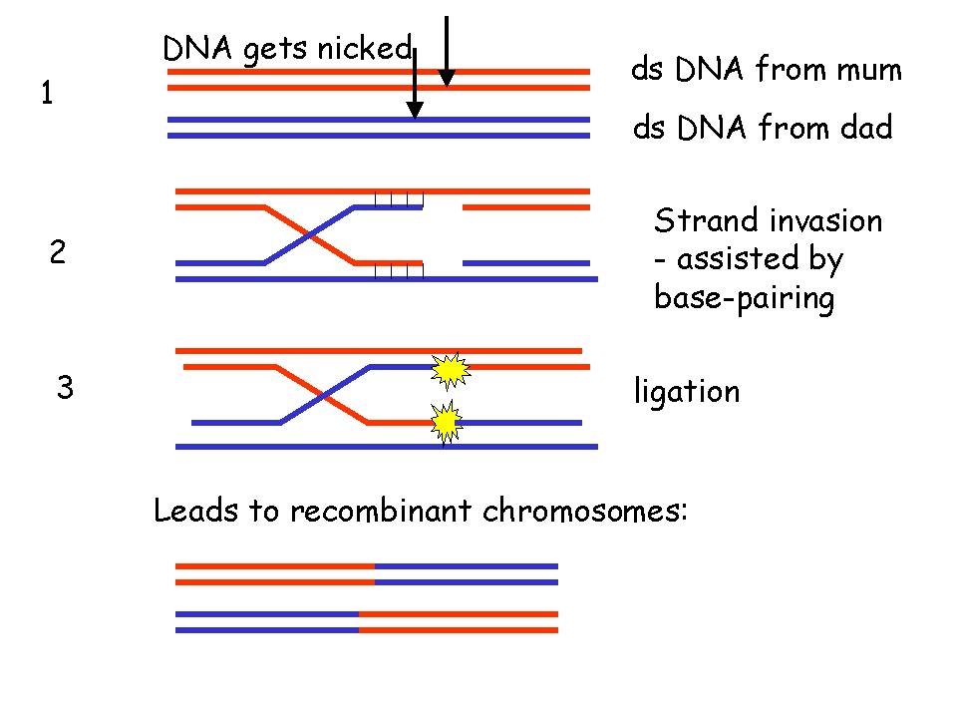
Recombination between DNA
What is the process of recombination between two phages in this experiment?
Pairing of ds DNA at nearly identical sequences
Adapted from Elizabeth Ellis University of Strathclyde

Slide 49
Recombination between DNA
What is the process of recombination between two phages in this experiment?
Pairing of ds DNA at nearly identical sequences
Strand invasion
Adapted from Elizabeth Ellis University of Strathclyde

Slide 50
Recombination between DNA
What is the process of recombination between two phages in this experiment?
Pairing of ds DNA at nearly identical sequences
Strand invasion
Ligation
Adapted from Elizabeth Ellis University of Strathclyde

Slide 51

Recombination between DNA
What is the process of recombination between two phages in this experiment?
Pairing of ds DNA at nearly identical sequences
Strand invasion
Ligation
Resolution
Adapted from Elizabeth Ellis University of Strathclyde

Slide 52
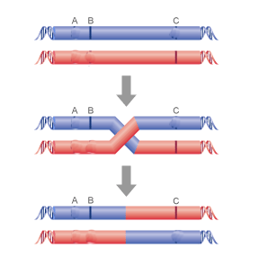
Recombination between DNA
Phenotype?
Defective T4
Defective T4
C

Slide 53
Recombination between DNA
Defective T4
Defective T4
C
C

Slide 54
Recombination between DNA
Defective T4
Defective T4
C
Phenotype?
C
Defective T4
C
Wild type T4

Slide 55
Phenotype of double mutations?

