Slide 2
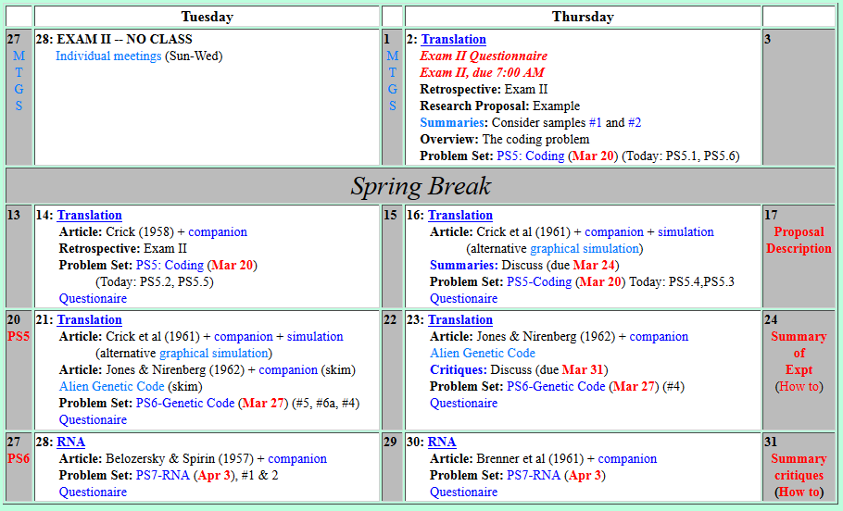
Welcome to Molecular Biology Through Discovery Thursday, 23 March 2017

Slide 3
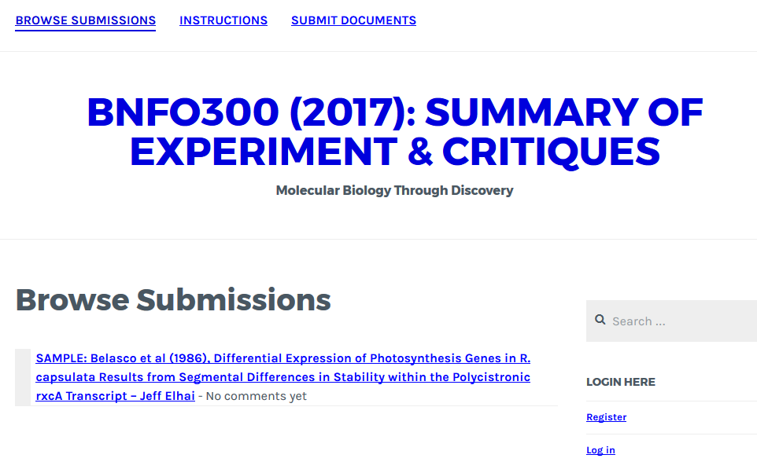

Slide 4
Welcome to Molecular Biology Through Discovery Thursday, 23 March 2017

Slide 5
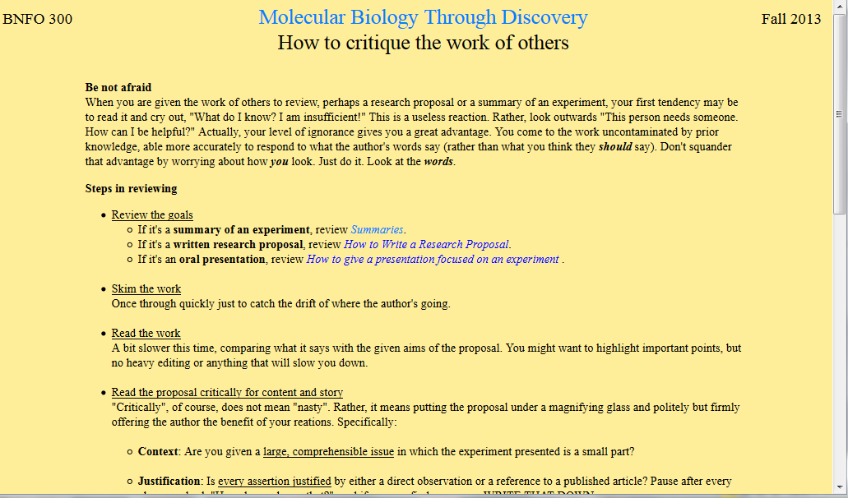

Slide 6
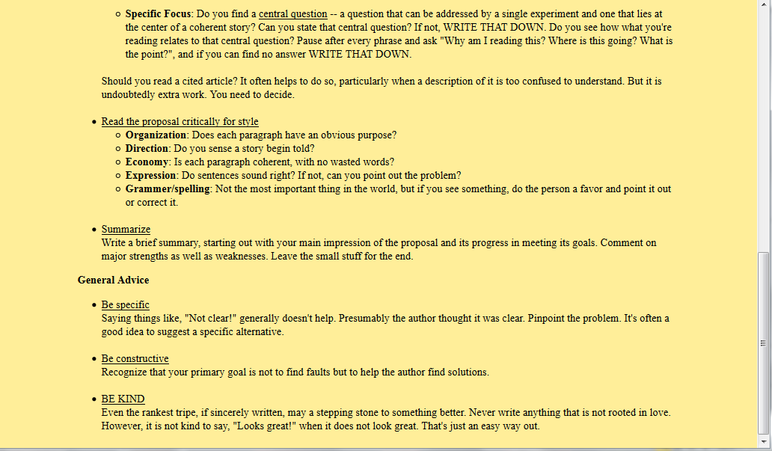

Slide 8
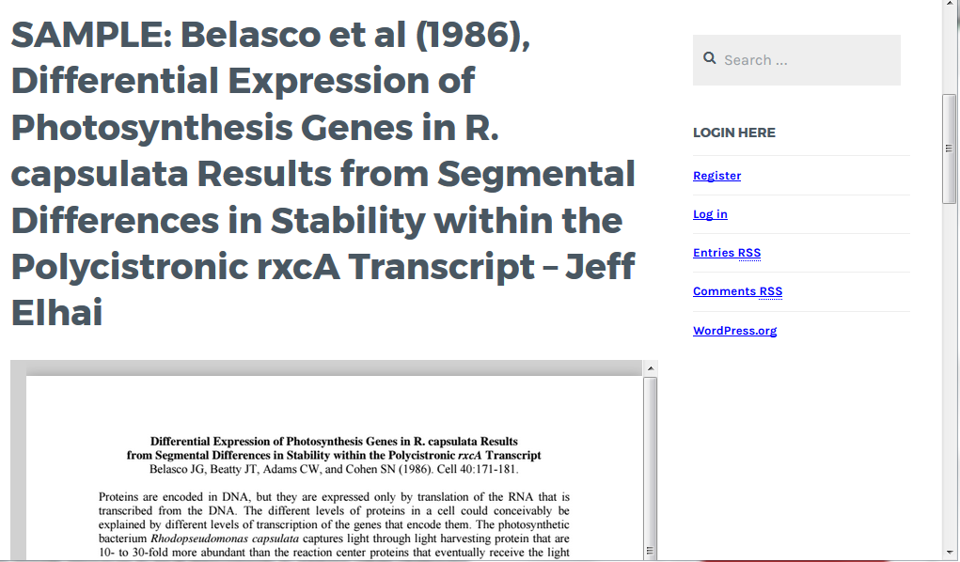

Slide 9
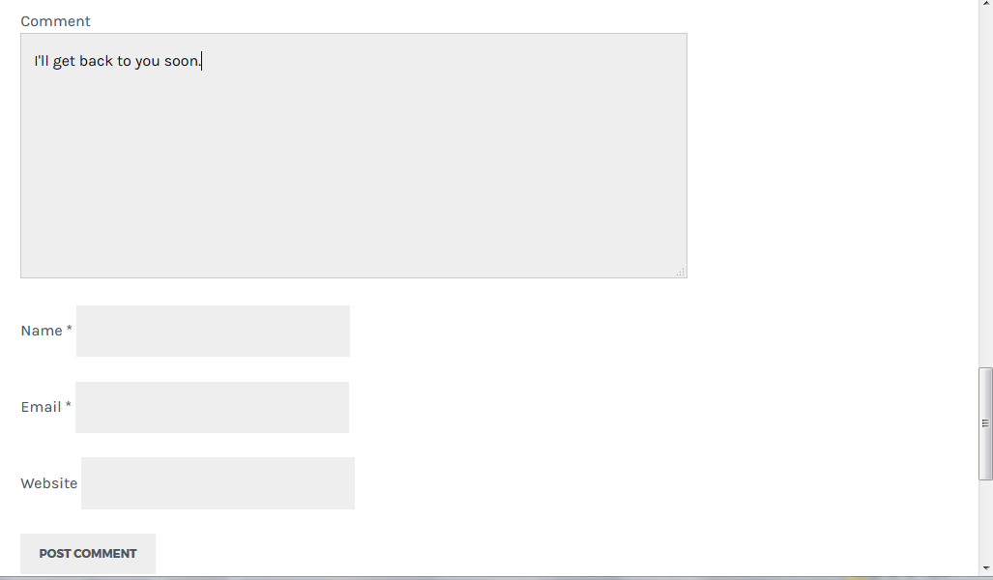

Slide 10
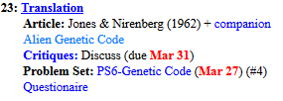
Welcome to Molecular Biology Through Discovery Thursday, 23 March 2017

Slide 11
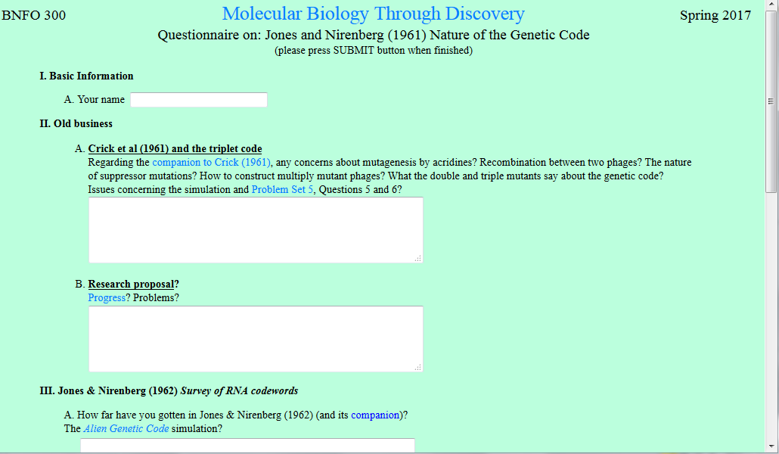

I am having some trouble obtaining FC0 mutants. I have plated them on E. Coli B, but all of the plaques that I have obtained are R-. I ran the simulation with 50, 500, 1000, and 1500 multiple times but have not received any R+.

Slide 13
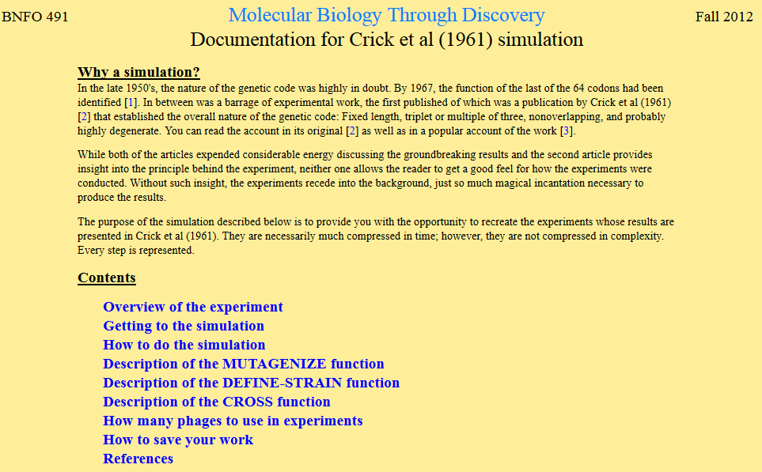

Slide 14
Crick et al (1961) experiment

Slide 15
Crick et al (1961) experiment
T4

Slide 16
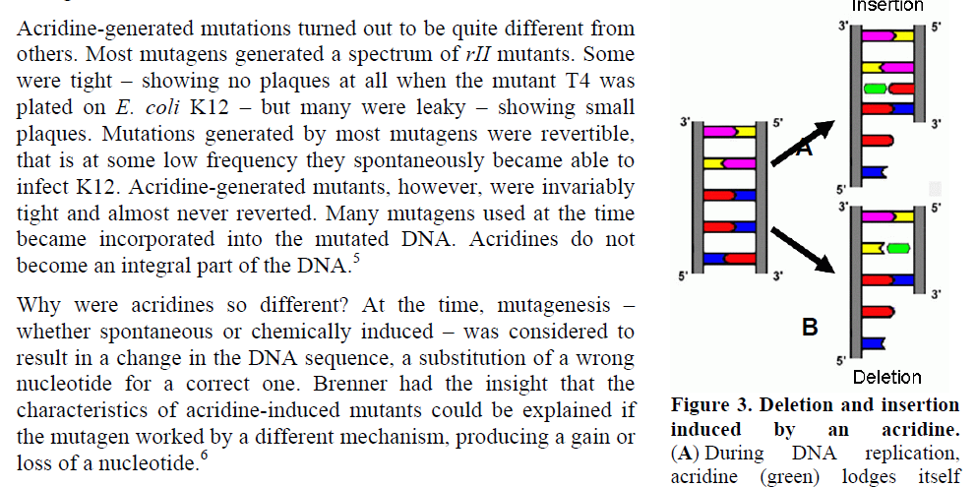

Slide 17
Welcome to Molecular Biology Through Discovery Thursday, 23 March 2017

Slide 18
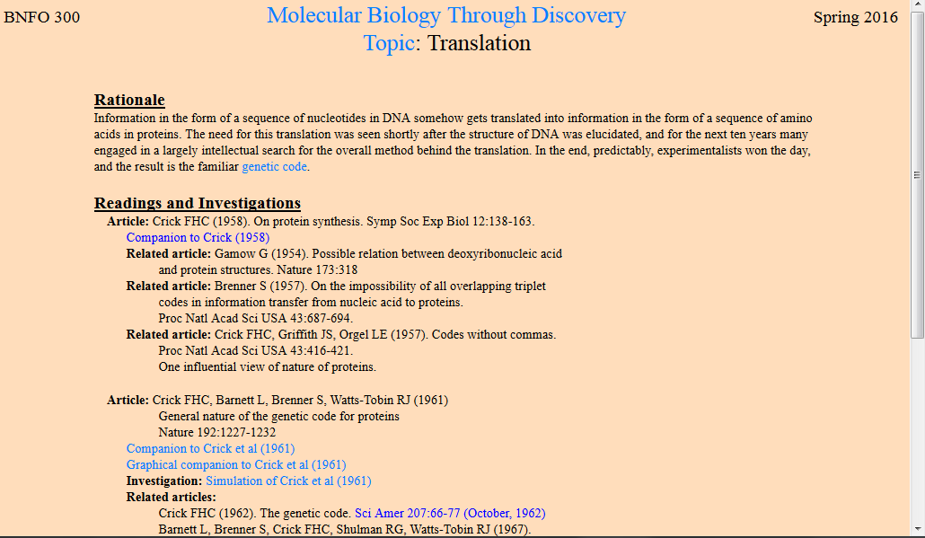

Slide 19
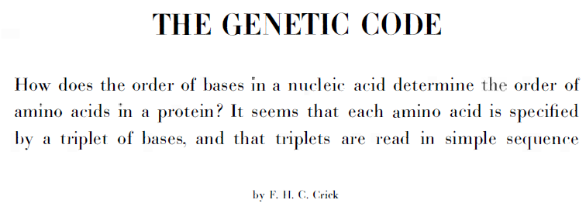
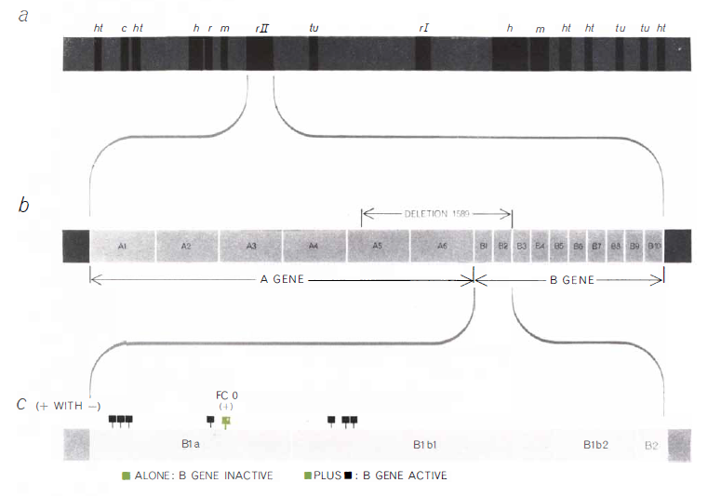
T4
rII
rIIB
FC0

Slide 20
Crick et al (1961) experiment
FC0
rIIB
T4
(ente-T4)

Slide 22

Crick et al (1961) experiment
FC0
rIIB
168903 nt

Slide 23
Crick et al (1961) experiment

Slide 25
Welcome to Molecular Biology Through Discovery Thursday, 23 March 2017

Slide 26
…regarding SQ13, I cant see why the numbers might be regarded as suspicious.
SQ13. Reinterpret the numbers for experiment J108, in light of the minus polynucleotide control… What makes them suspicious?

Slide 27
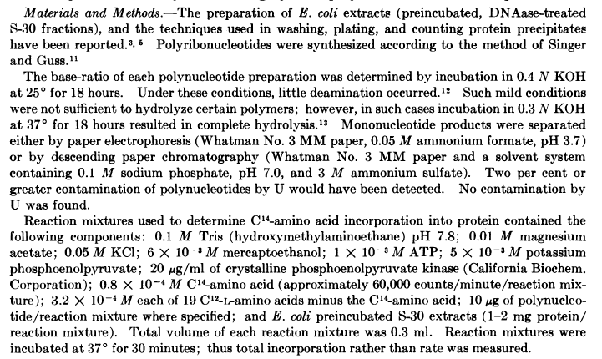

Slide 28
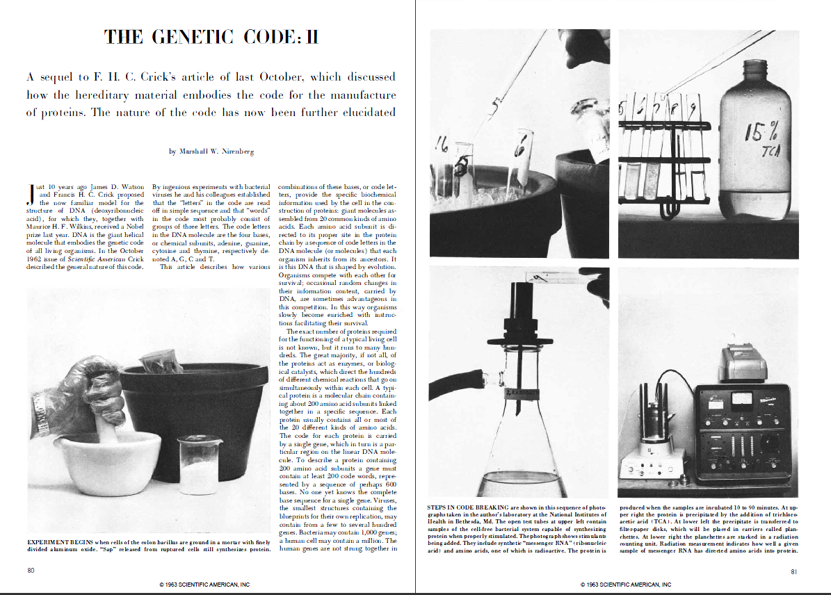

Slide 29
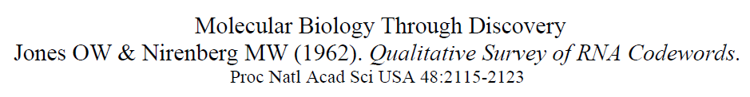
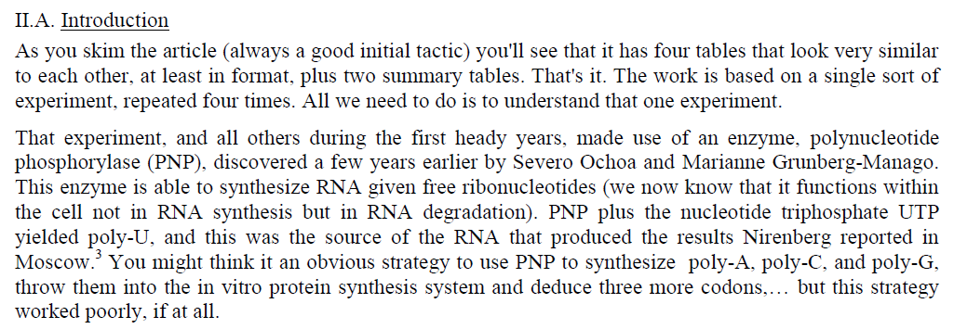
I'm having trouble understanding the role of PNP in the experiment. If it is usually involved in RNA degradation intra cellularly, how could it be used to synthesize RNA extra cellularly?

Slide 30
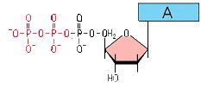
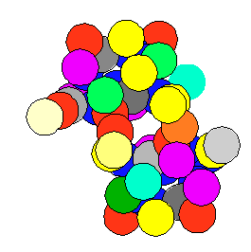
Polynucleotide Phosphorylase (PNP)
Polynucleotide Phosphoylase

Slide 31
…regarding SQ13, I cant see why the numbers might be regarded as suspicious.
SQ13. Reinterpret the numbers for experiment J108, in light of the minus polynucleotide control… What makes them suspicious?

Slide 32
Welcome to Molecular Biology Through Discovery Thursday, 23 March 2017

Slide 33

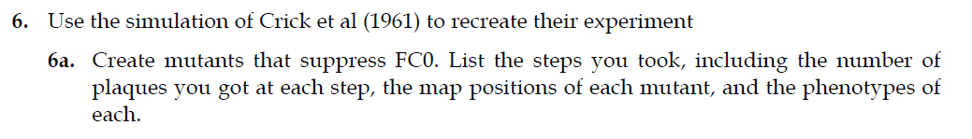
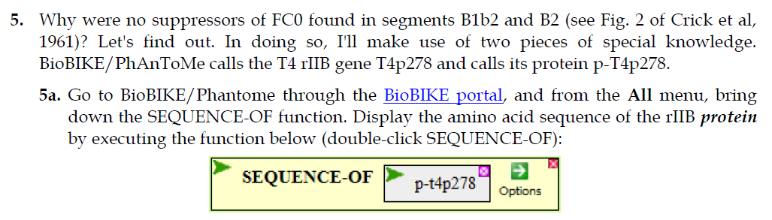

Slide 34
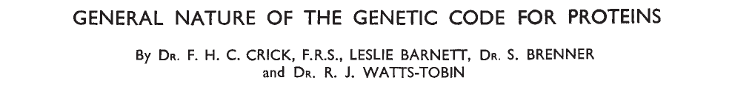
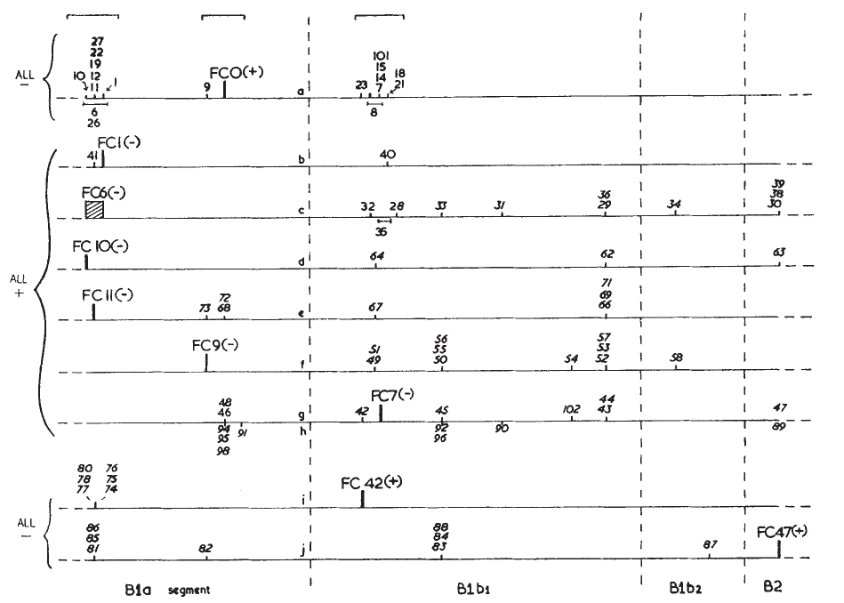

Slide 35

Problem Set 6, #6a, #4, #5
Me
Connect to: https://vcu.zoom.us/j/2504526209
1N
1S
2N
A
B
C
D
2S
3N
3S
4N
E
F
G H
4S
5N
5S
6N
I J
K
L
6S
7S

Slide 36
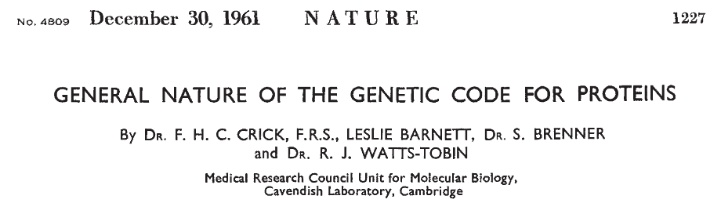
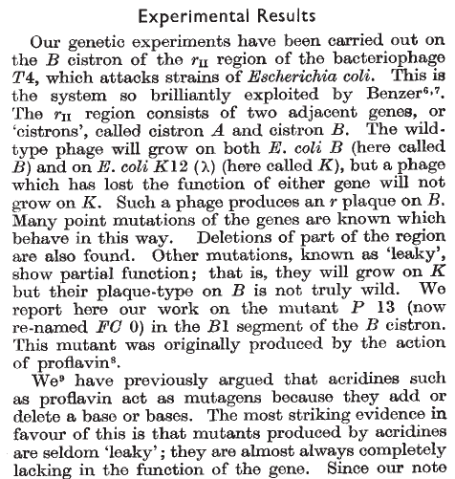
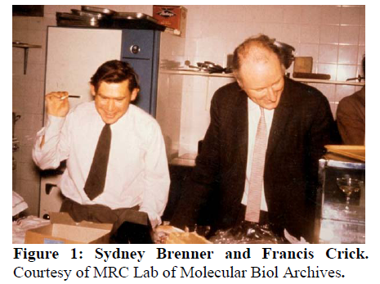

Slide 38
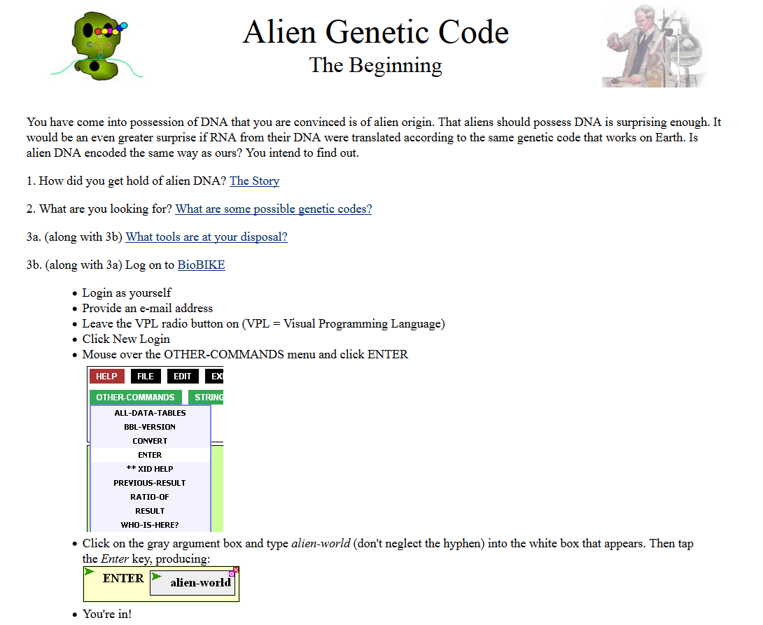
Where can I find the alien genetic code? or should I make some up?

Slide 39
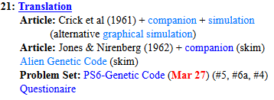
Welcome to Molecular Biology Through Discovery Tuesday, 21 March 2017

Slide 41
How to map mutations?

Slide 42
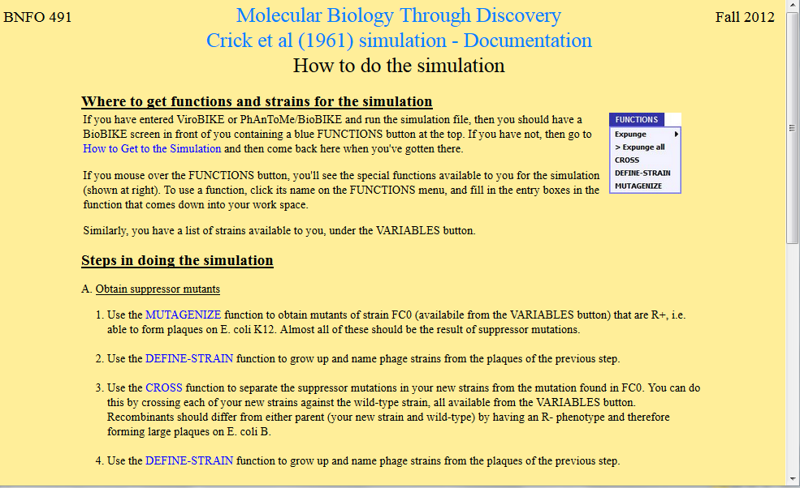

Slide 43
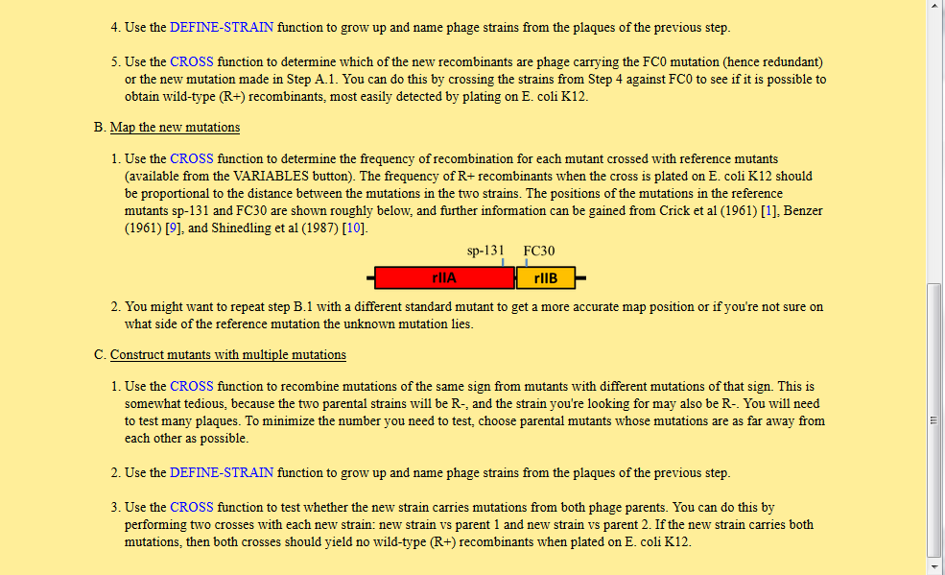

Slide 44
Problem Set 6, #6a, #4
Me
Connect to: https://vcu.zoom.us/j/2504526209
1N
1S
2N
A
B
C
D
2S
3N
3S
4N
E
F
G H
4S
5N
5S
6N
I J
K
L
6S
7S

Slide 45
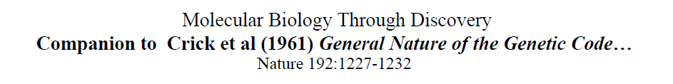

Slide 46
Crick et al (1961) experiment

Slide 47
Crick et al (1961) experiment

Slide 48
Crick et al (1961) experiment

Slide 49
Crick et al (1961) experiment

Slide 50
Crick et al (1961) experiment

Slide 51
Crick et al (1961) experiment
Tight (R+)
Large (R-)

Slide 52
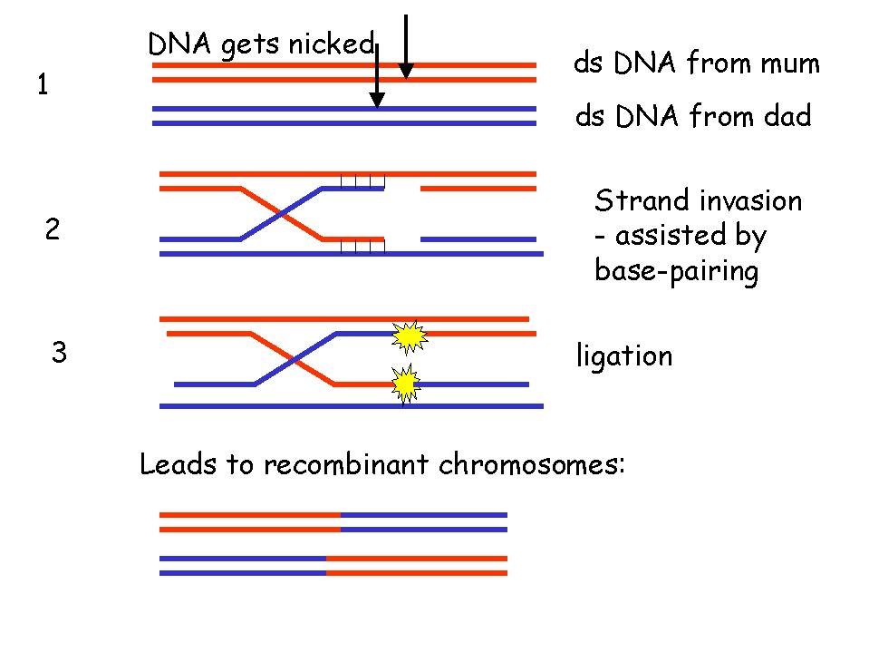
Recombination between DNA
What is the process of recombination between two phages in this experiment?
Pairing of ds DNA at nearly identical sequences
Adapted from Elizabeth Ellis University of Strathclyde

Slide 53
Recombination between DNA
What is the process of recombination between two phages in this experiment?
Pairing of ds DNA at nearly identical sequences
Strand invasion
Adapted from Elizabeth Ellis University of Strathclyde

Slide 54
Recombination between DNA
What is the process of recombination between two phages in this experiment?
Pairing of ds DNA at nearly identical sequences
Strand invasion
Ligation
Adapted from Elizabeth Ellis University of Strathclyde

Slide 55

Recombination between DNA
What is the process of recombination between two phages in this experiment?
Pairing of ds DNA at nearly identical sequences
Strand invasion
Ligation
Resolution
Adapted from Elizabeth Ellis University of Strathclyde

Slide 56
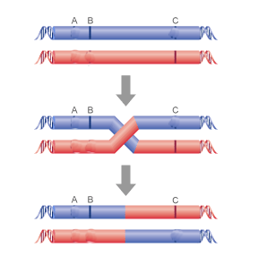
Recombination between DNA
Phenotype?
Defective T4
Defective T4
C

Slide 57
Recombination between DNA
Defective T4
Defective T4
C
C

Slide 58
Recombination between DNA
Defective T4
Defective T4
C
Phenotype?
C
Defective T4
C
Wild type T4

Slide 59
Phenotype of double mutations?

