Slide 2
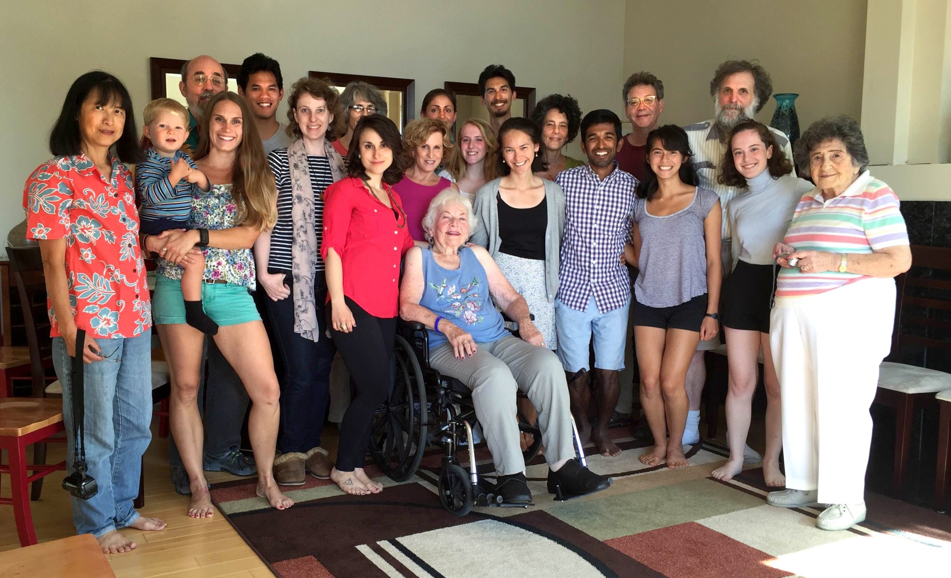
Family reunion

Slide 3
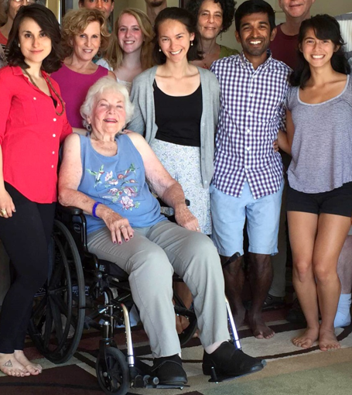
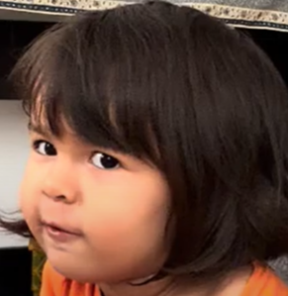
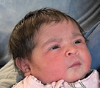
Mama Papa
Where is Surya?
Bubby
1
2
3
4

Slide 4
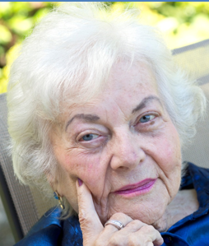
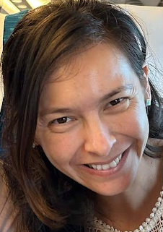
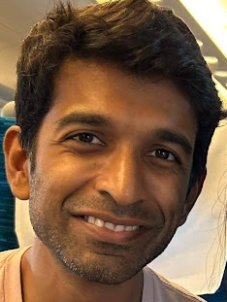
Mama Papa
Where is Surya?
Bubby
1
2
3
4
1
89

Slide 5
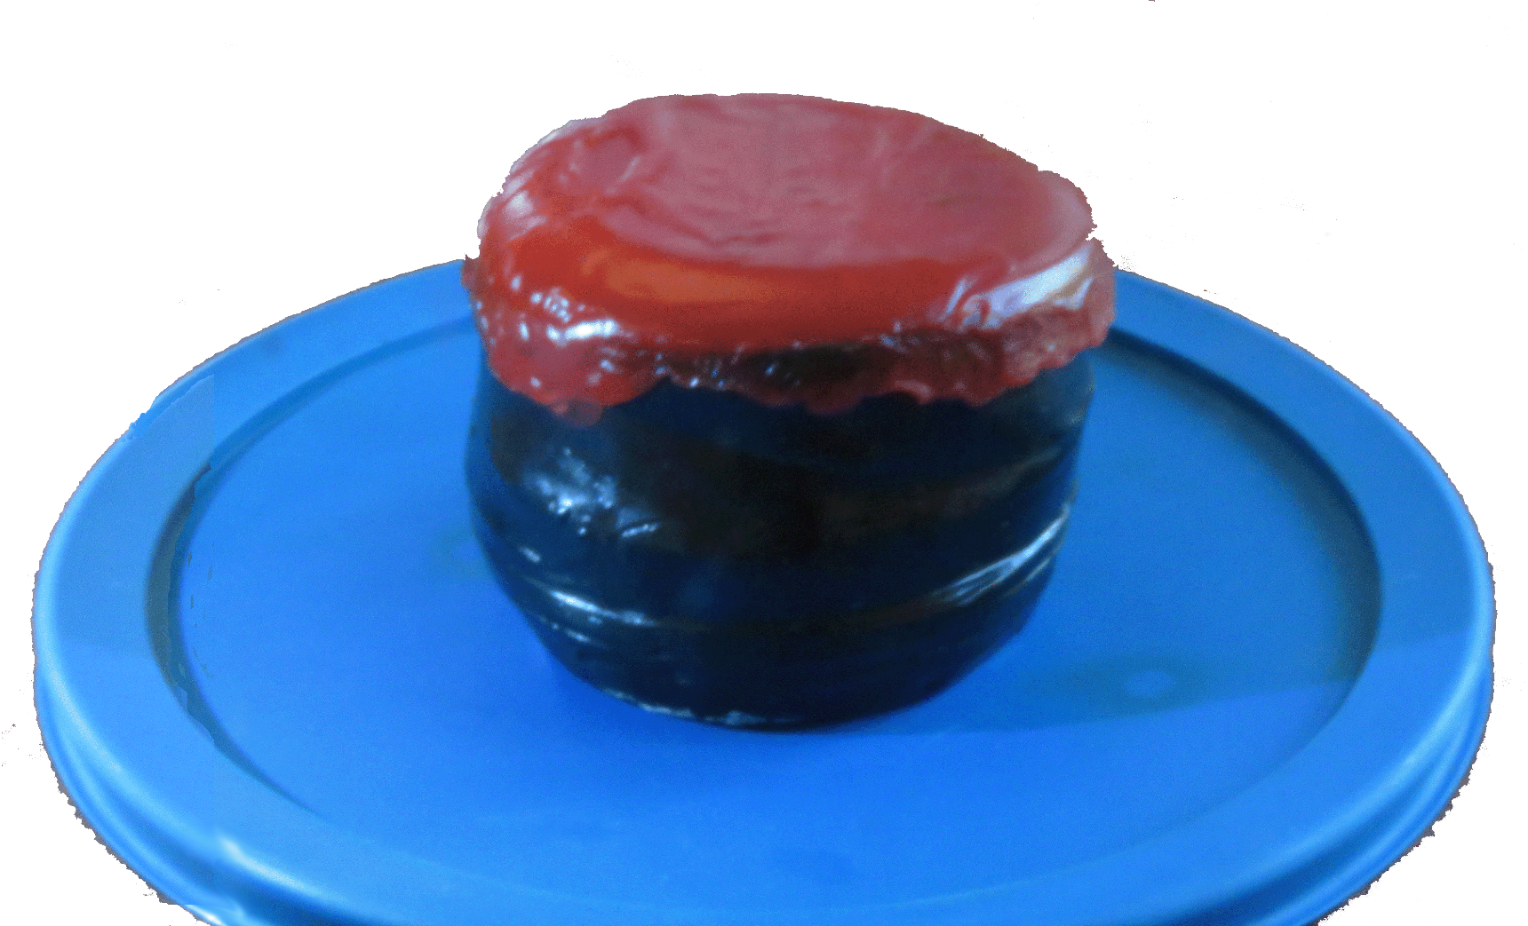
Bubby
Baga
89

Slide 6
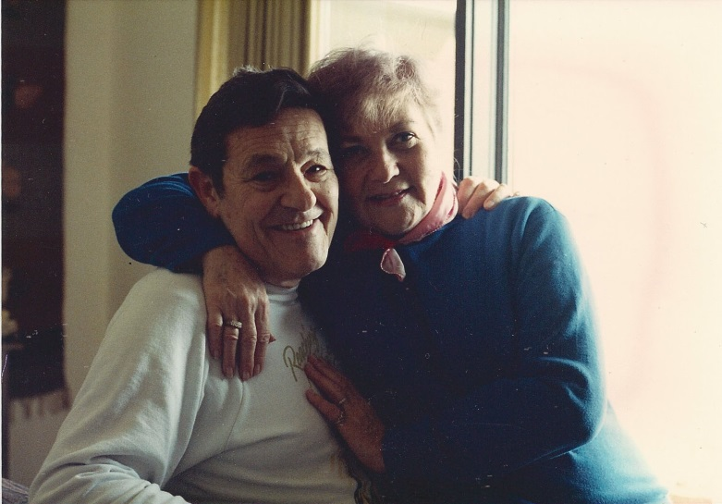

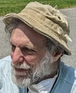
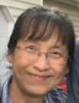
Baga
Bubby

Slide 7
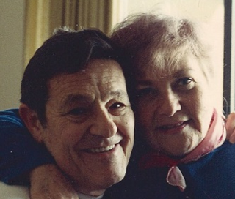
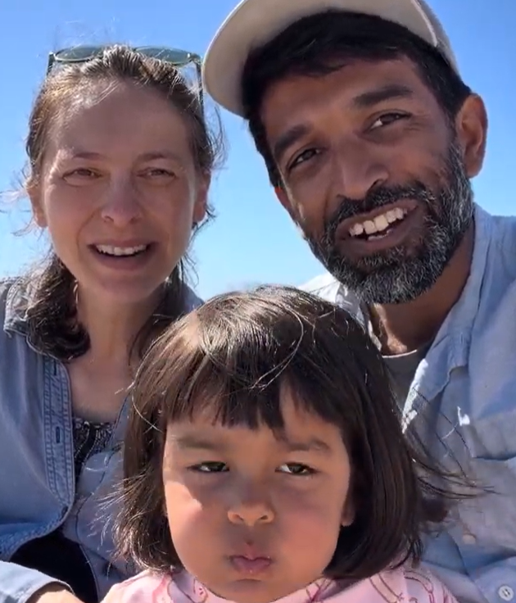

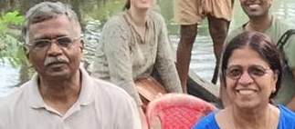
New York
Barcelona
New Jersey

Slide 8
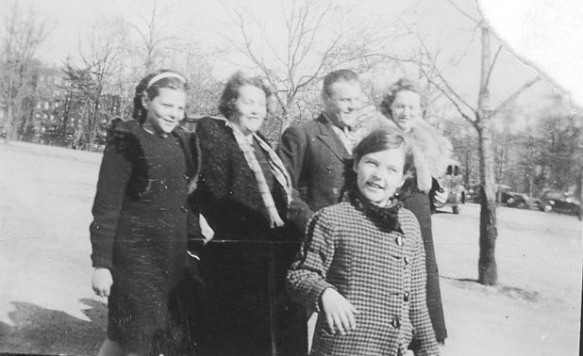
New York, ~1936
Bubby
Notes:
By the 1930’s, they had established a family: Sister Bunny (left), sister Rose (right), brother Dave (not shown), and the newest addition, Estelle, even then attentive to the camera.

Slide 9
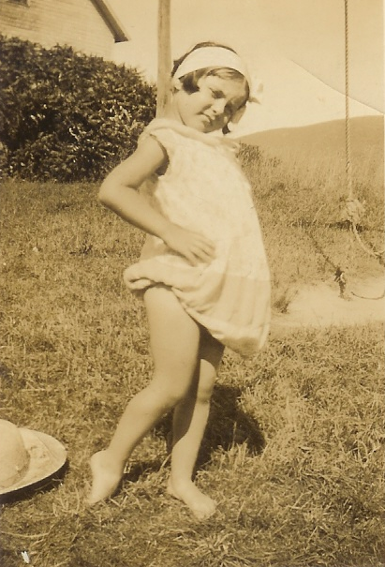
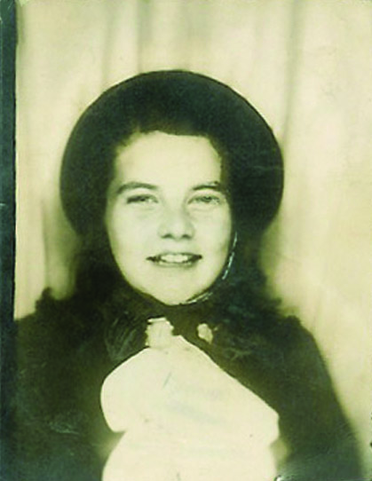
Bubby
Bubby

Slide 10
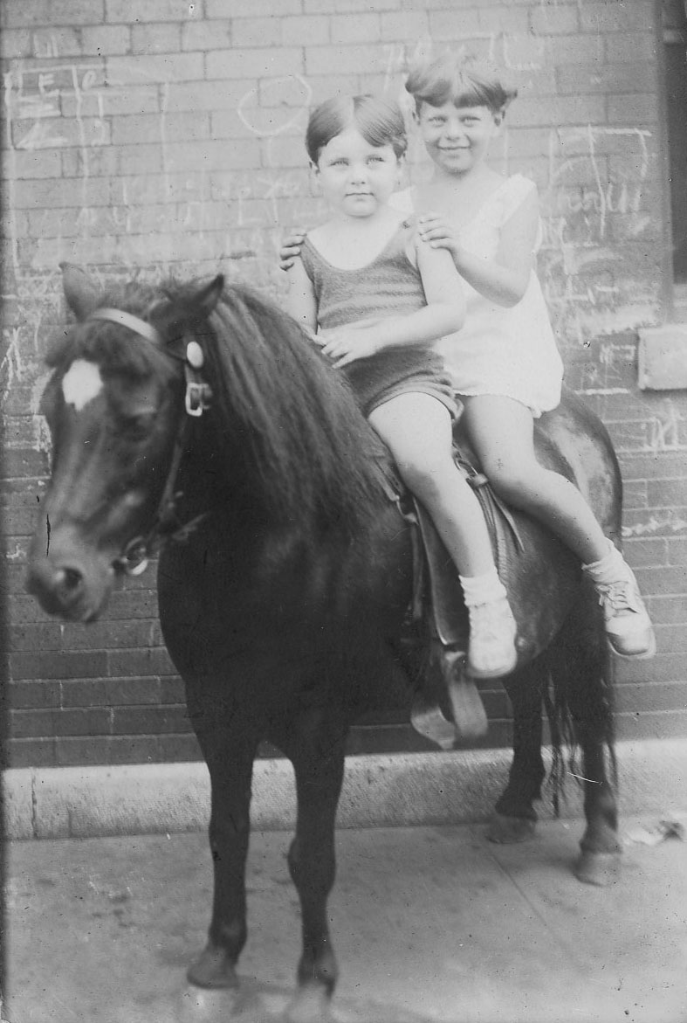
Bubby
Sister Bunny
Notes:
Her closest sib and frequent traveling companion was sister Bunny.

Slide 11
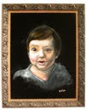
Baga

Slide 12
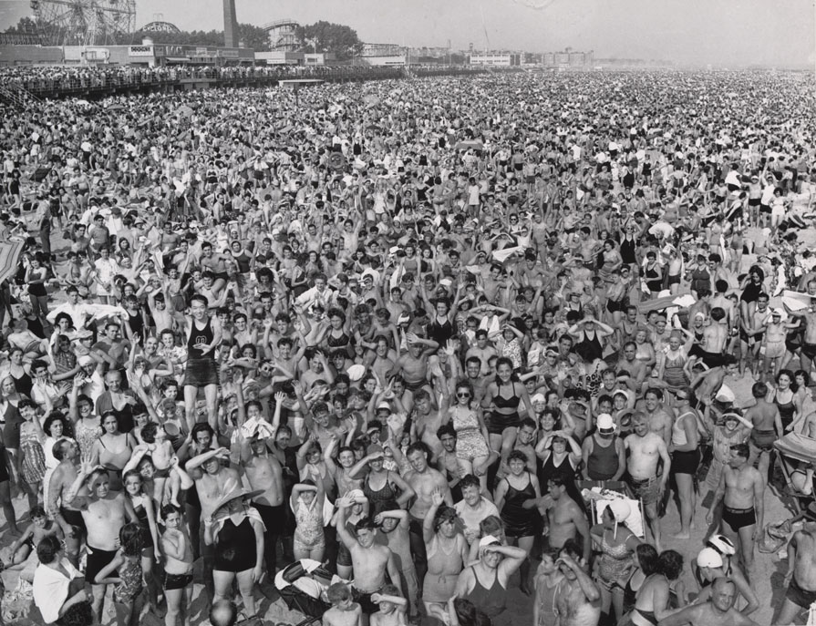
Notes:
Coney Island

Slide 13
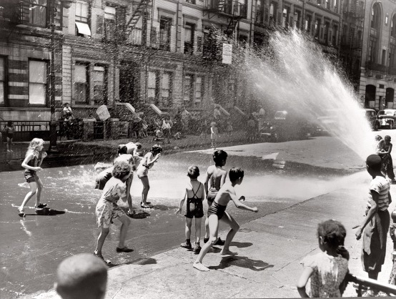
Notes:
She later told her children about the joy of fire hydrants in the summer.

Slide 14
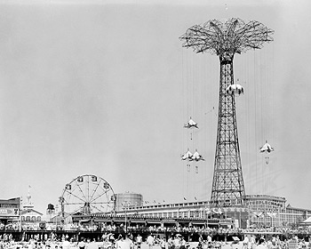
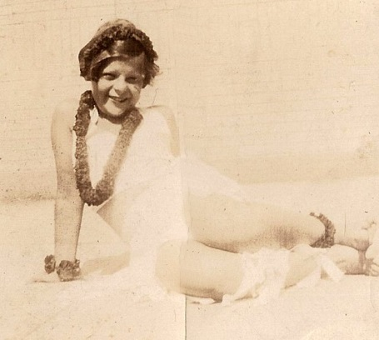
Notes:
…and Steeplechase.

Slide 15
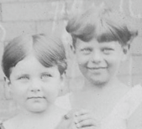
Los Angeles
New York

Slide 16
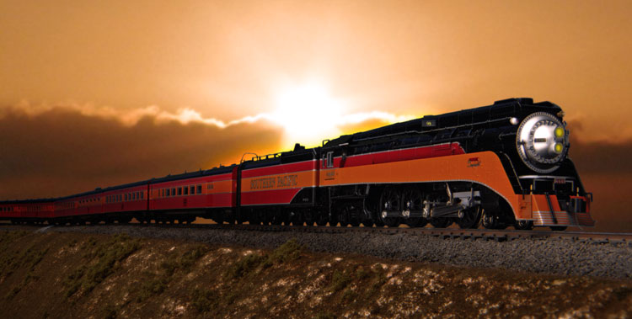
Summer 1942(?)
Notes:
…the glowing reports of brother Dave and later sister Rose induced Bunny and Estelle to hop on their horse and go west...

Slide 17
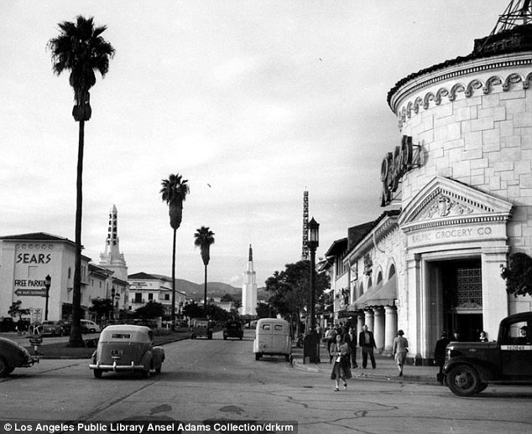
Los Angeles
Notes:
…to sunny Los Angeles…

Slide 18
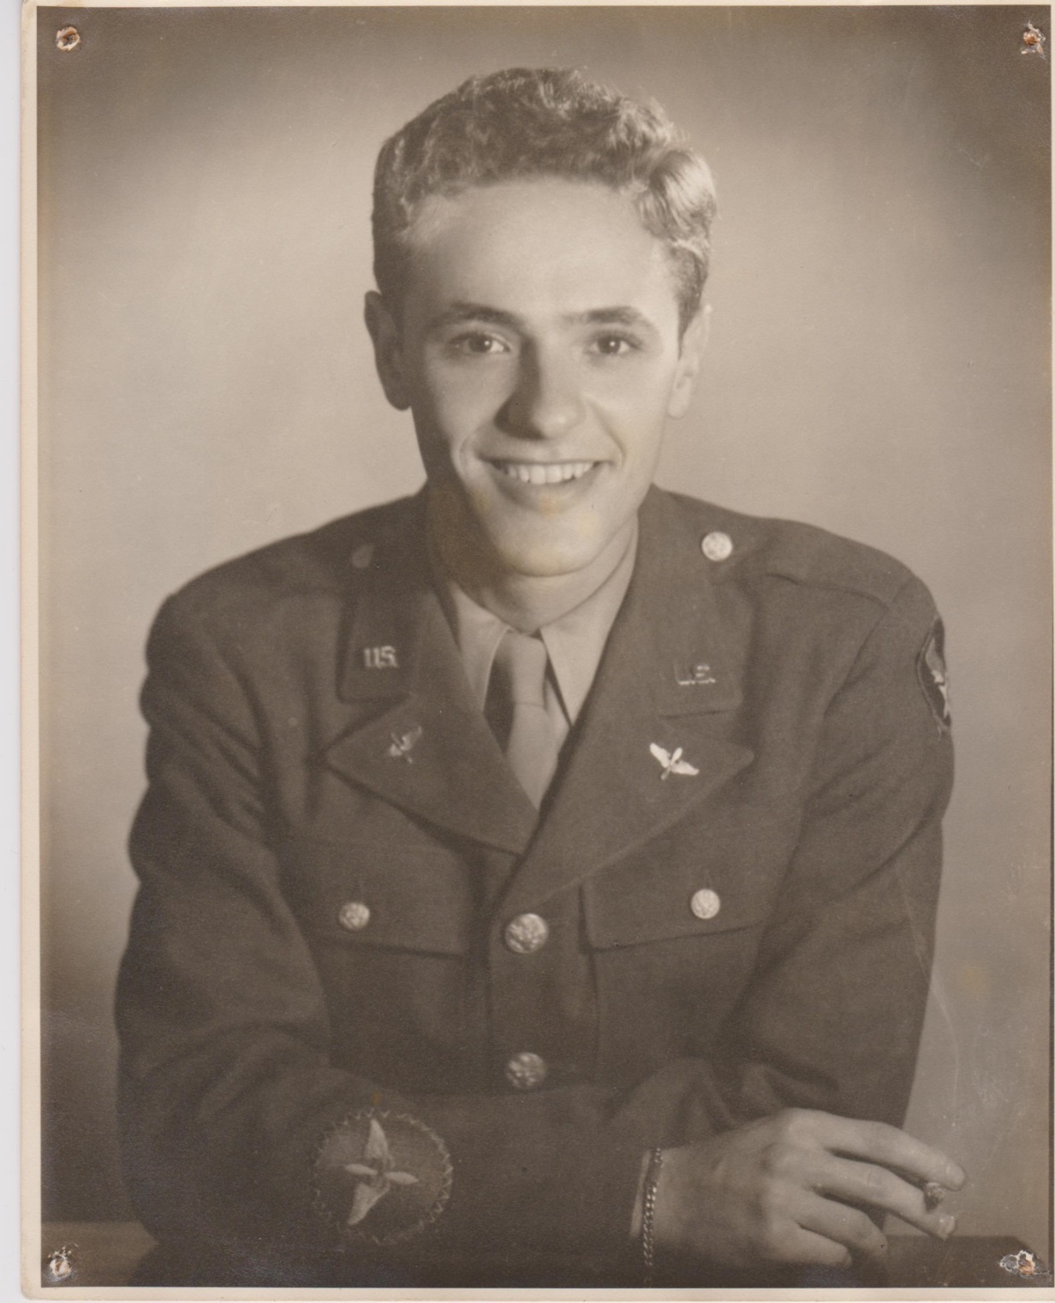
Baga
Notes:
…but instead, that path was put on hold by Sam, whom she met briefly in the Catskills when she was 14 years old.
They carried on a torrid correspondence during the war.

Slide 19
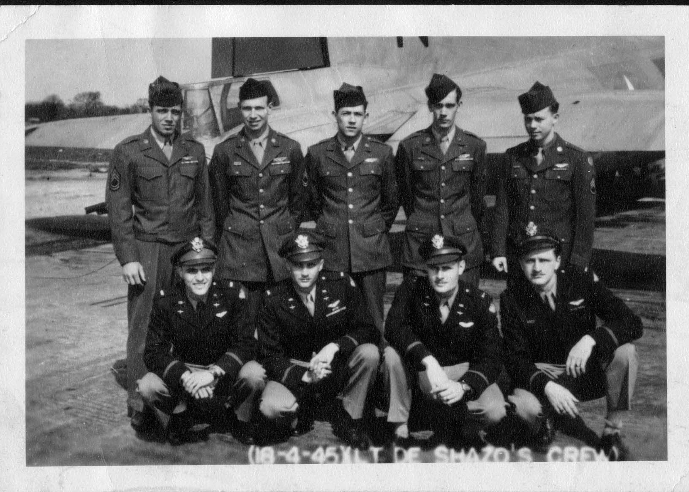
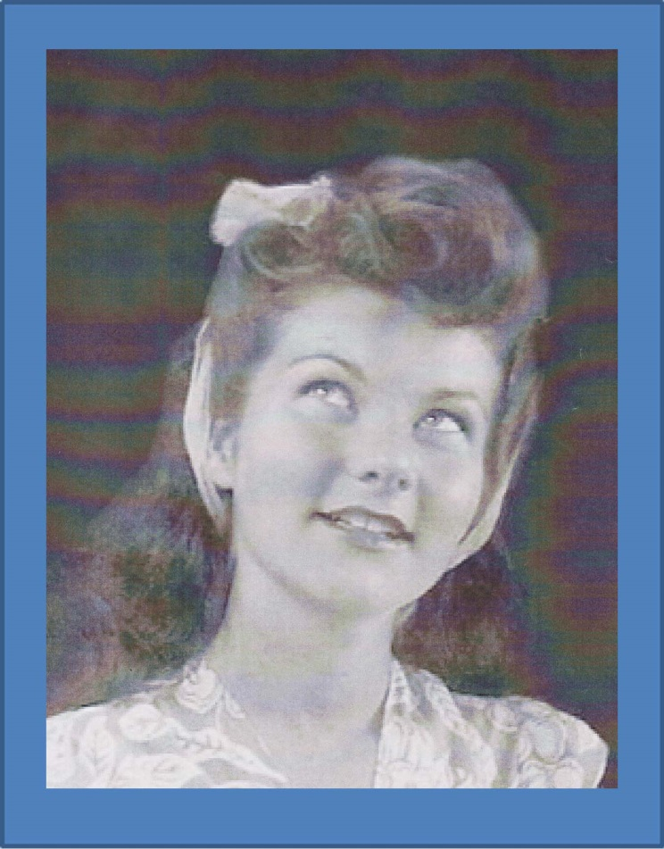
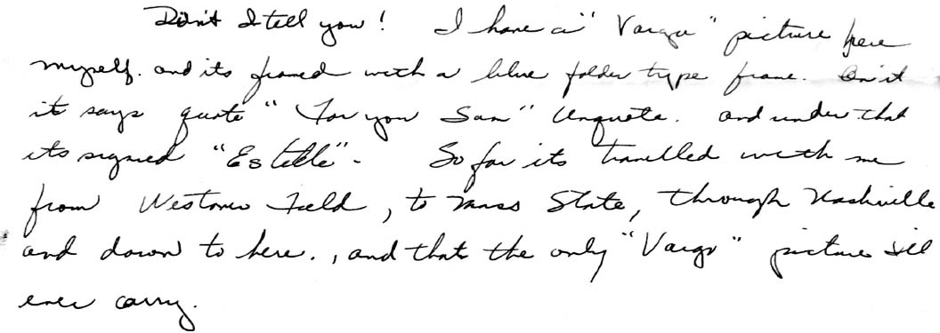
Baga
Bubby

Slide 20
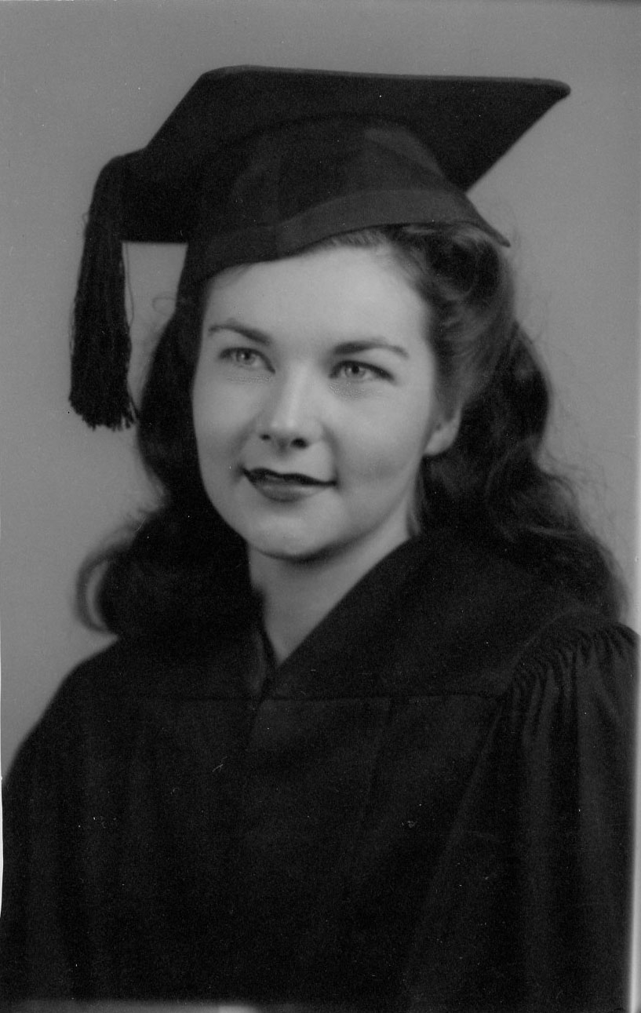
Bubby
Notes:
She came to LA just 15 years old, so there was still high school.
She graduated from Fairfax High in 1944.

Slide 21
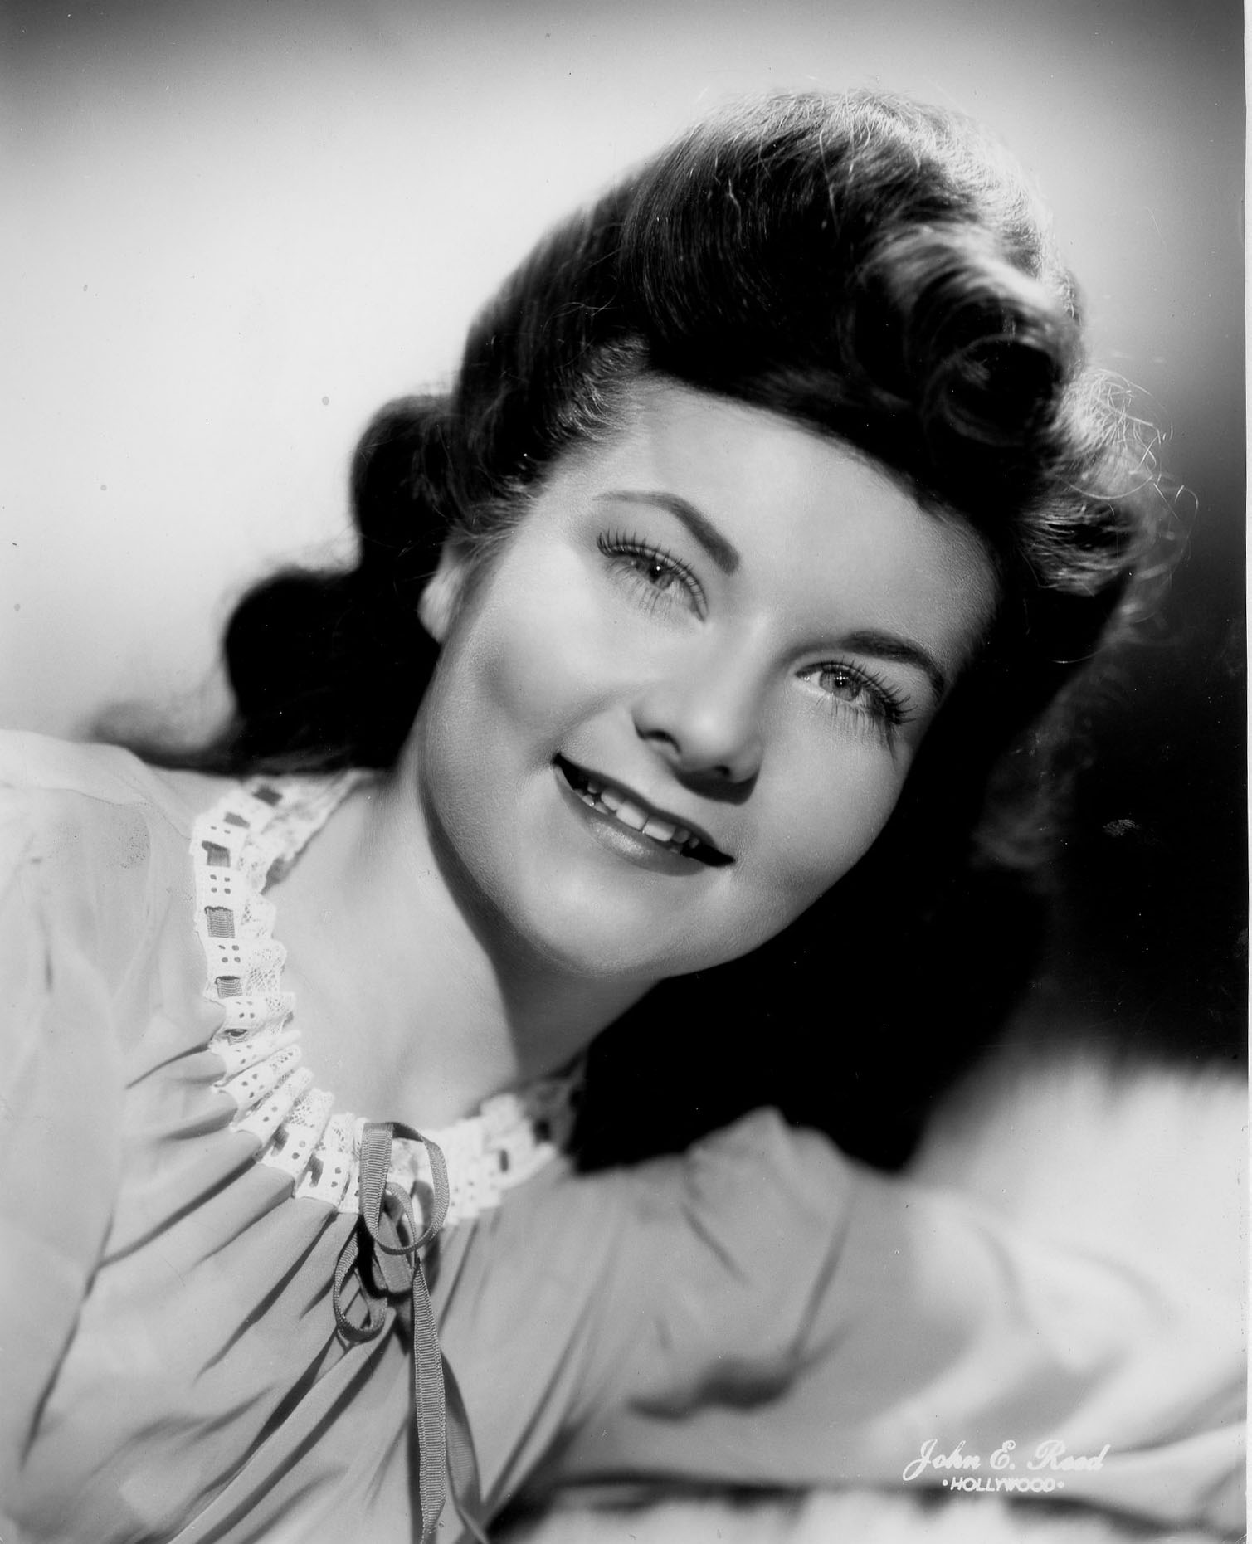
Bubby
Notes:
One of her odd jobs was something like a gofer at a movie studio. She had aspirations herself and took the initial steps of getting into the business.
Lore has it that she tried out for the lead in a movie, Junior Miss, a role that was in the end taken by Esther Williams.
Our lives would have been different (or, more likely, not at all), if she pursued this path, but…

Slide 22
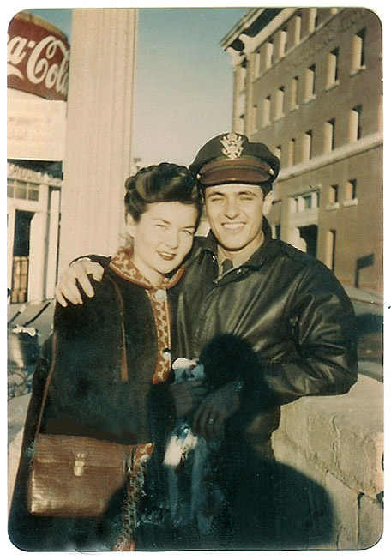
Bubby
Baga
Los Angeles
Notes:
He arranged to get discharged in Los Angeles
late 1945, and they were married January 13,1946.

Slide 23
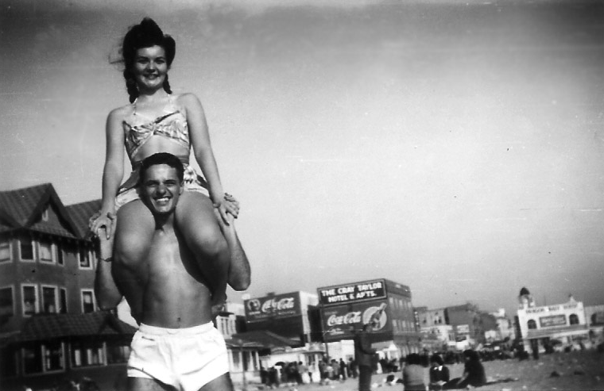
Notes:
You’d think that this photo came later during the following summer, but this is sunny California. Who knows?

Slide 24
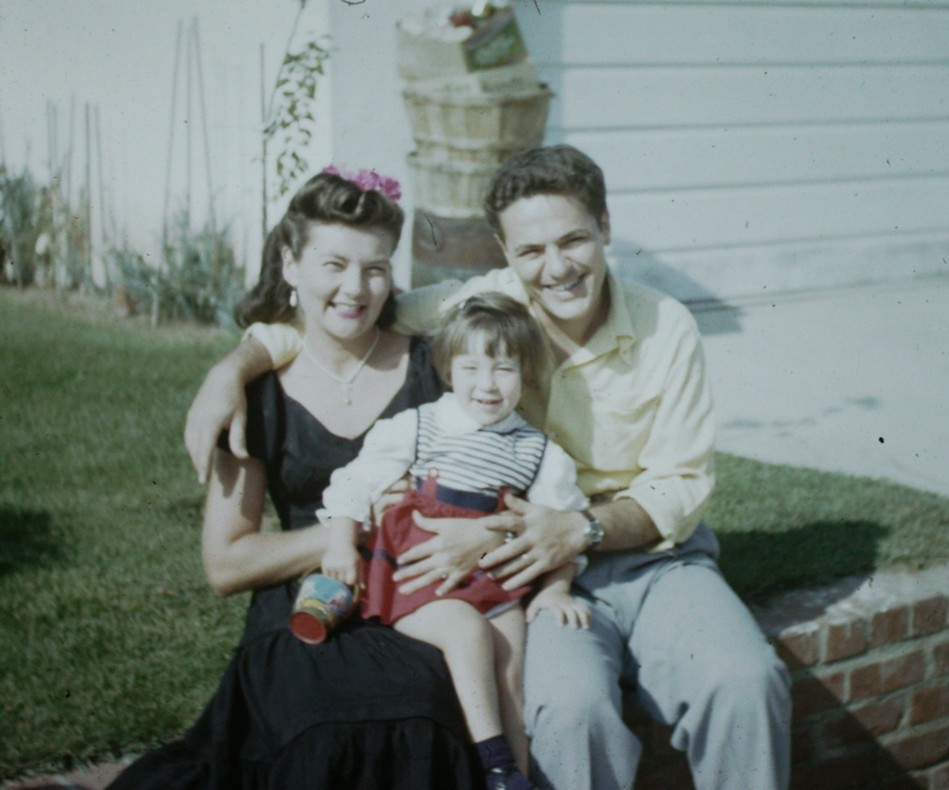

Laurisa

Slide 25
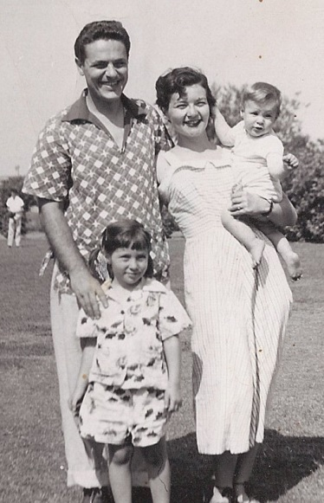
Baba
Laurisa

Slide 26
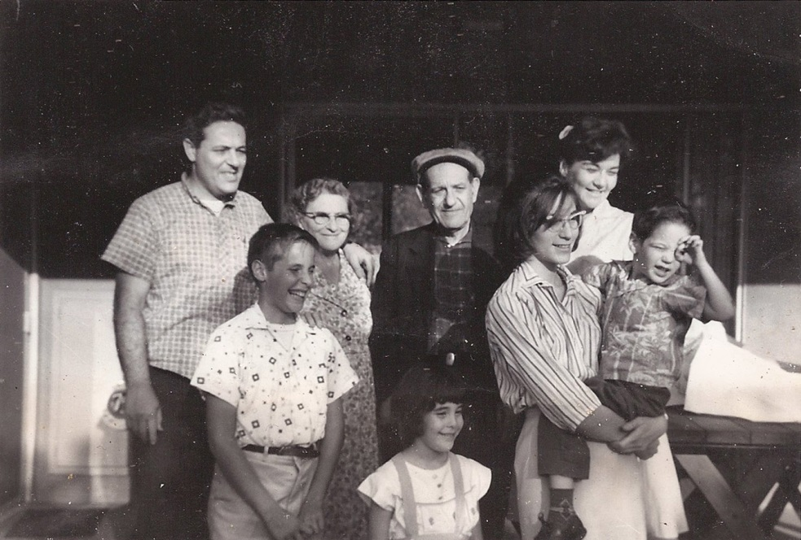
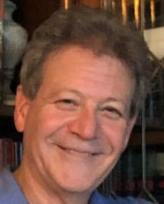
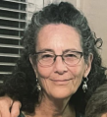
Jack
Joline

Slide 27
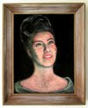





Her art

Slide 28
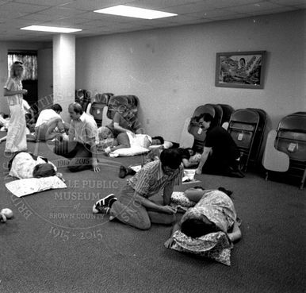
Notes:
Teaching Lamaze childbirth from the mid 1960’s to 2009

Slide 29
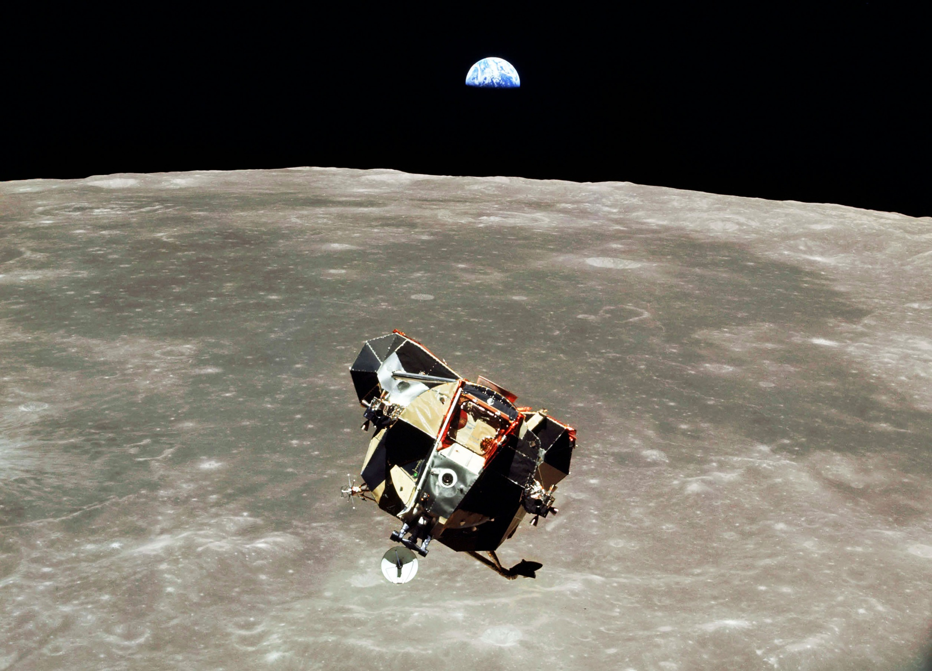

Slide 30
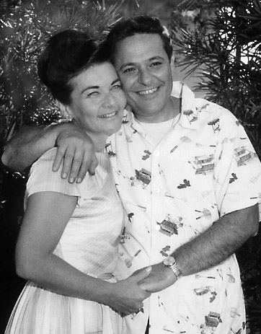

Slide 31
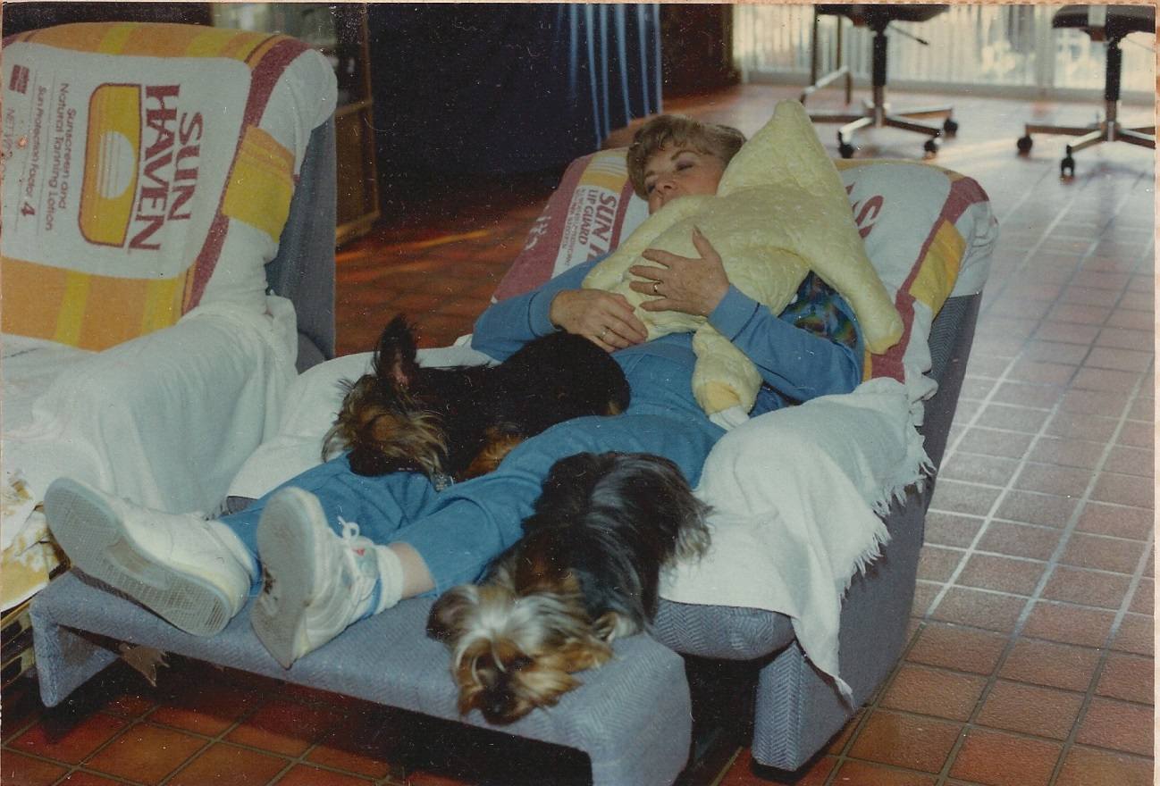
Notes:
And when all the children had flown, Samantha and Cleo

Slide 32
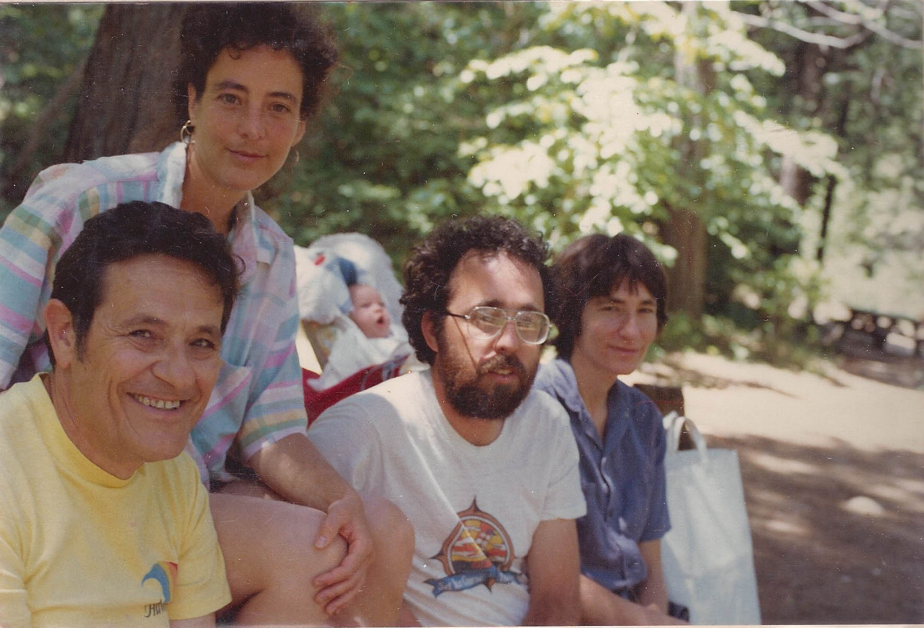
Notes:
Somewhere nice (1986)

Slide 33
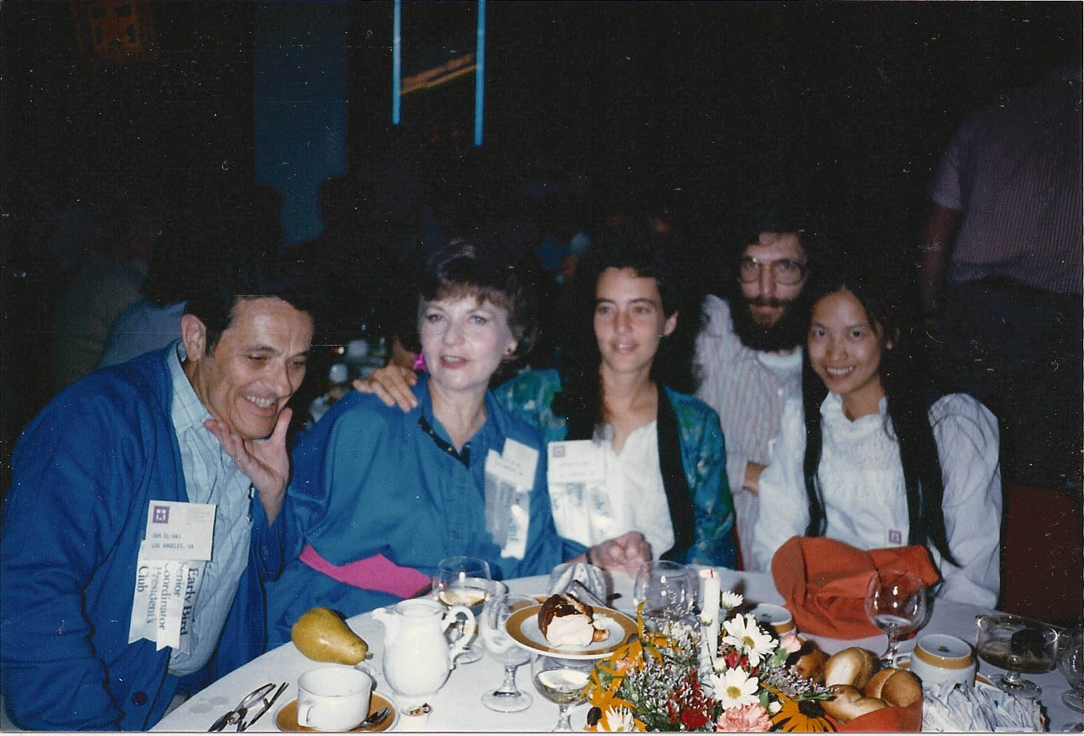
Baga
Bubby
Baba
Joline
Ama
Notes:
A successful Shaklee business built with Sam starting in 1970, enabling travel to yearly conventions (with children often in tow)

Slide 34
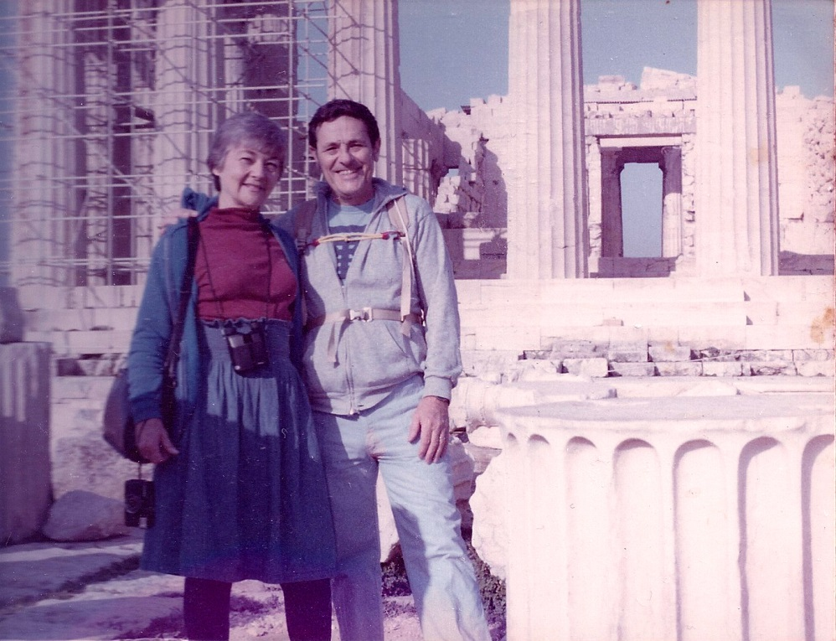

Slide 35
Baga
Bubby

Slide 36
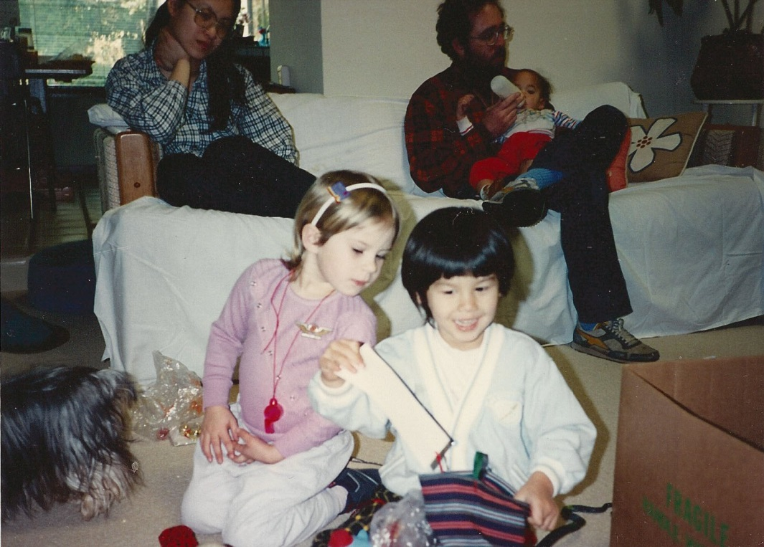
Robin
Wren
December - Fair Oaks 1990?
Notes:
She and Sam brought the family together each year, first at their house…

Slide 37
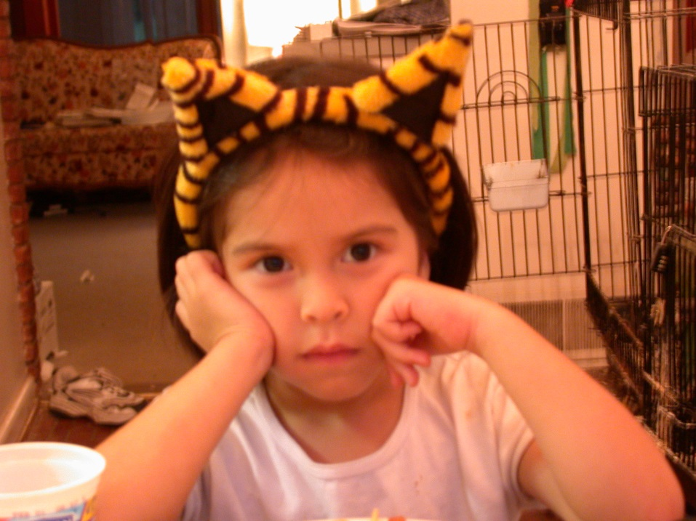
Coly

Slide 38
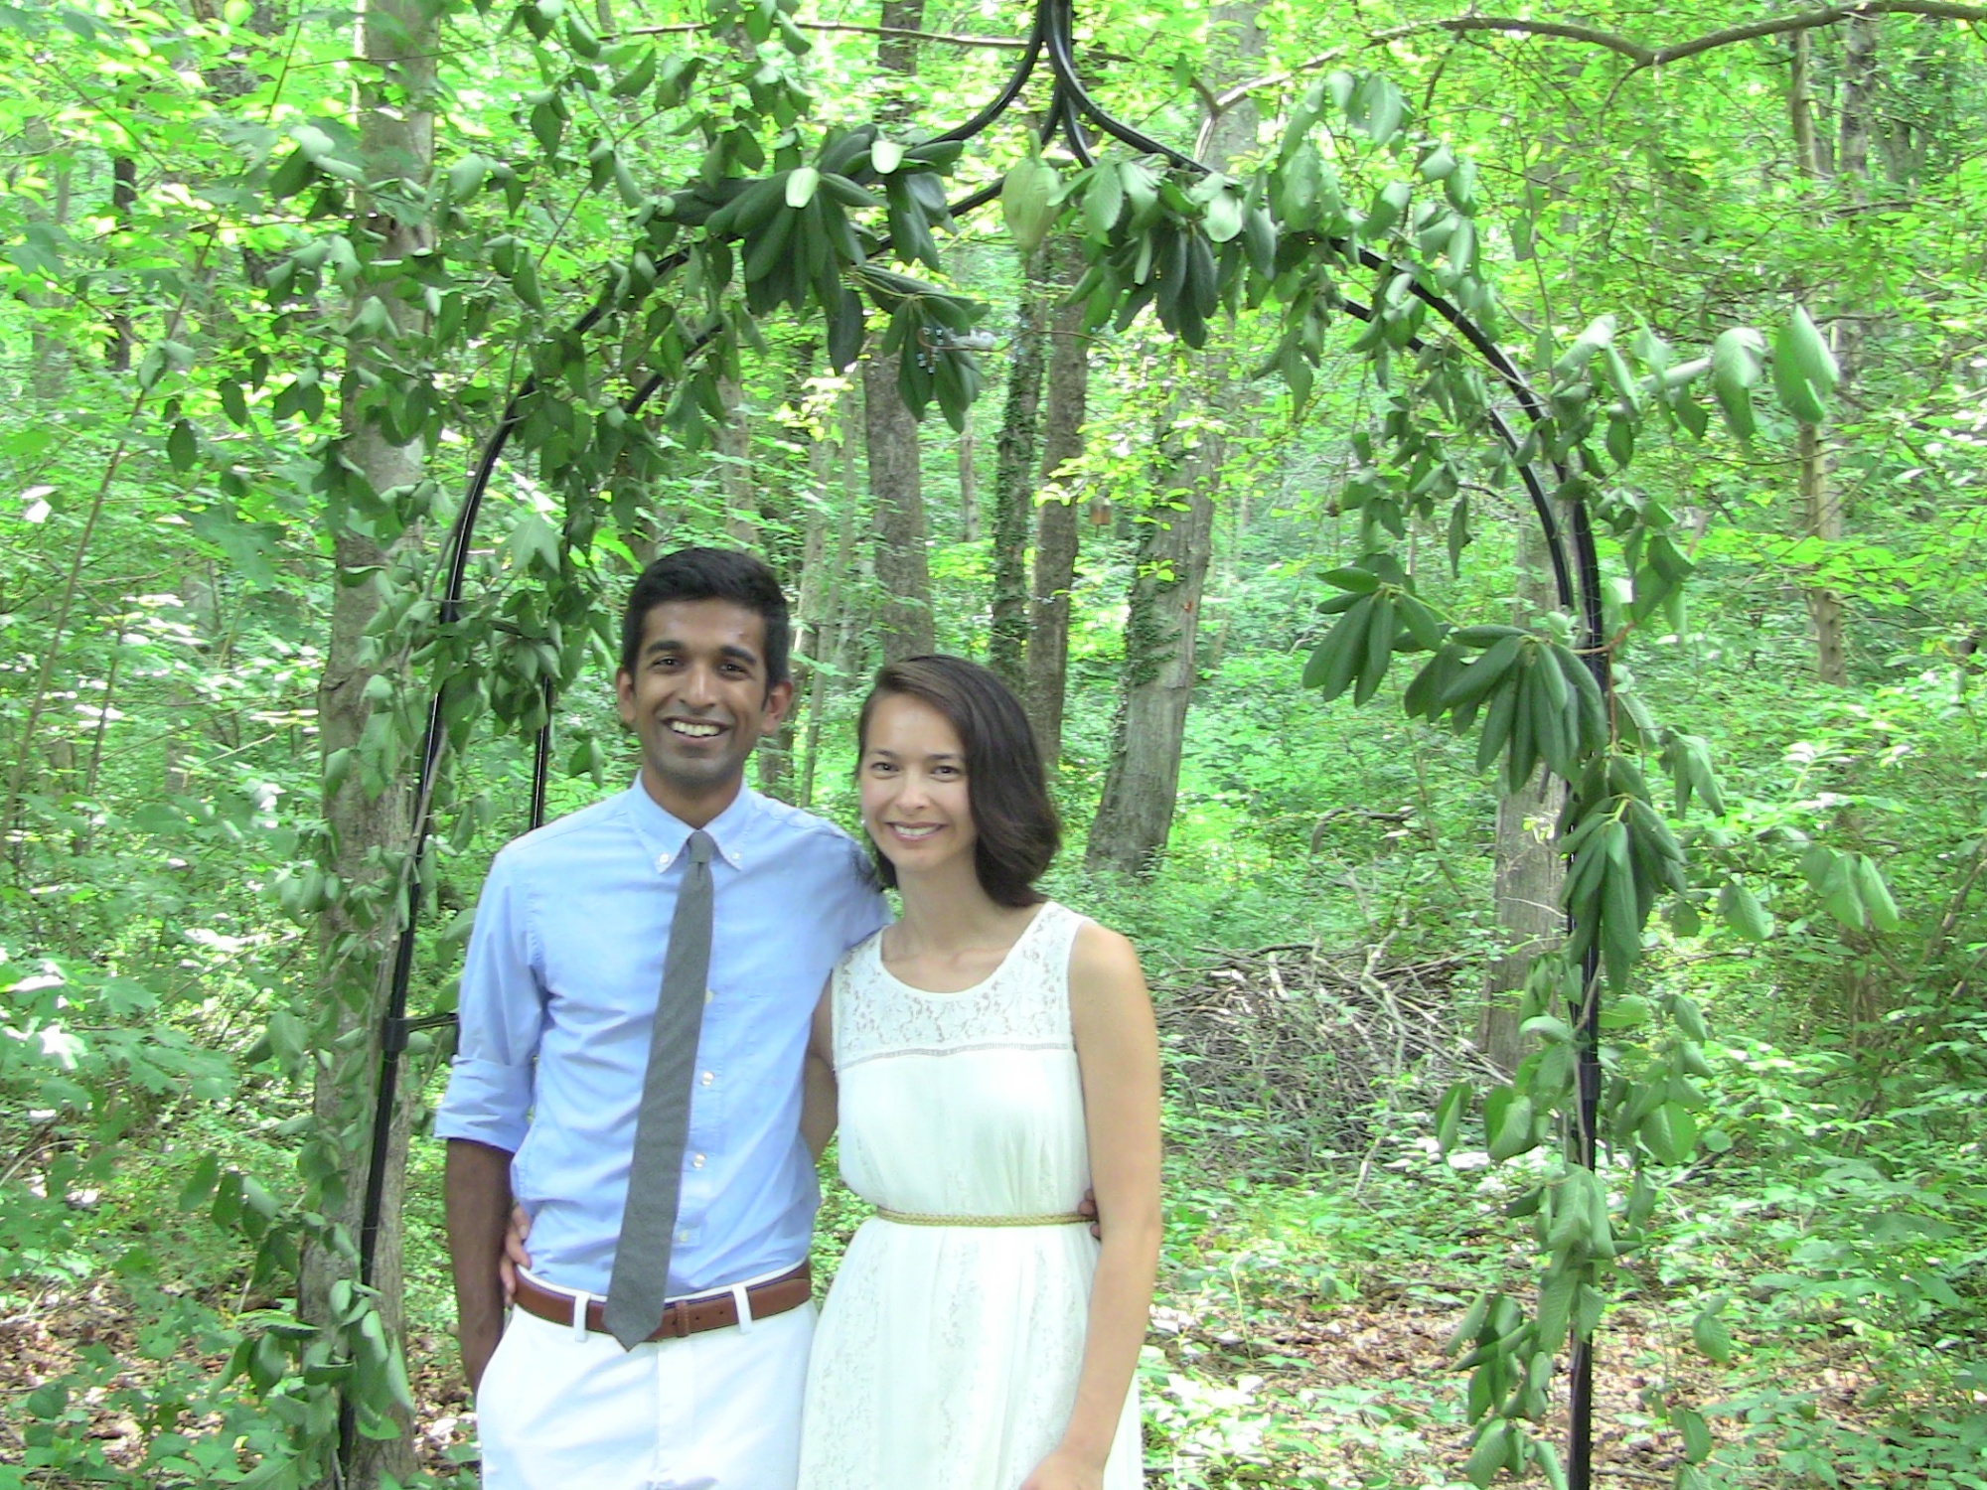
Papa Mama

Slide 39


Slide 40


Notes:
Back to movies… various Sun City extravaganzas, including a yearly Academy Awards show, with the help of friend Miriam.

Slide 41



Slide 42


Slide 44


Slide 45
Bubby
Baga

