Slide 1

DIGITAL LEARNING ANALYTICS:
2020-2025
Exploring Learner Engagement, Learning Paths, and Educational Outcomes
Presented by: Jayalekshmi G
“Transforming educational data into actionable learner insights.”
Python | Pandas | NumPy | Seaborn | Matplotlib | Plotly

Slide 2

Project Overview
Source: Kaggle.com
100,000 learner records
Dataset
This project analyzes digital learning data to understand demographic adoption patterns, course completion behavior, digital literacy impact and learning path effectiveness in online education platforms.
.
demographic data
behavioural data
learning analytics
engagement metrics
performance scores
completion outcomes
Data
Python – Core Analysis
Numpy & Pandas – Data Manipulation
Matplotlib, Seaborn, Plotly – Visualization
VS Code – Analysis Environment
Tools & Libraries

Slide 3




OBJECTIVES
Investigate demographic patterns in educational technology adoption
Analyze factors driving online course completion
Compare different learning path effectiveness
Study digital literacy impact on learning outcomes.

Slide 4




DATA CLEANING & PREPARATION
Irrelevant Column Removal
Dropped irrelevant or low-value fields
Retained only analysis-critical values
Duplication Check
Checked Full Row Duplicates & also duplicates for learner ID, an unique value
No duplicate records found
Handling Missing Values
Activity Columns (eg: forum_posts, peer_review_given) | Impute with 0
Performance Column (learning_efficiency_score) | Median imputation
Data Type Conversion
Date fields → converted to datetime
Categorical fields → converted to category type
Numeric fields → standardized to integer

Slide 5
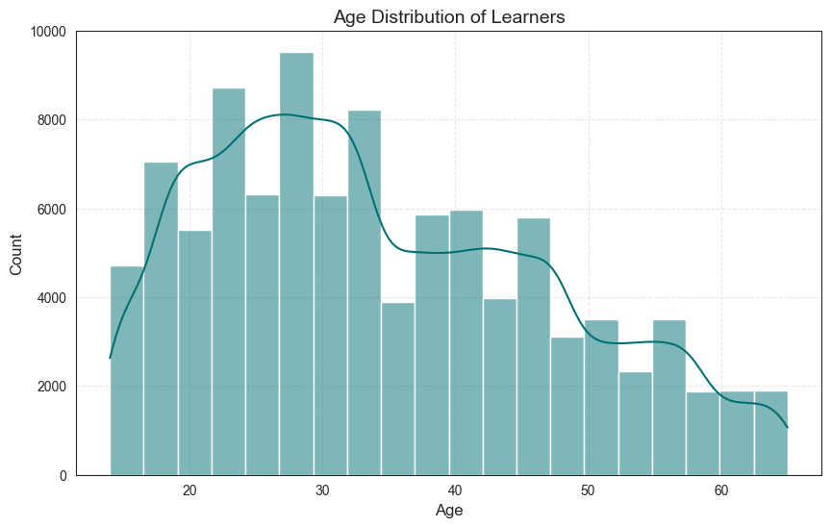
Demographic Patterns in Educational Technology Adoption
Most learners are young adults (18–32)
Peak participation in the mid‑20s.
Decline in participation as age increases.
Very few learners are above 40
This histogram was created using Pandas for data prep and Seaborn’s histplot with 20 bins and a KDE curve to show the age distribution.

Slide 6
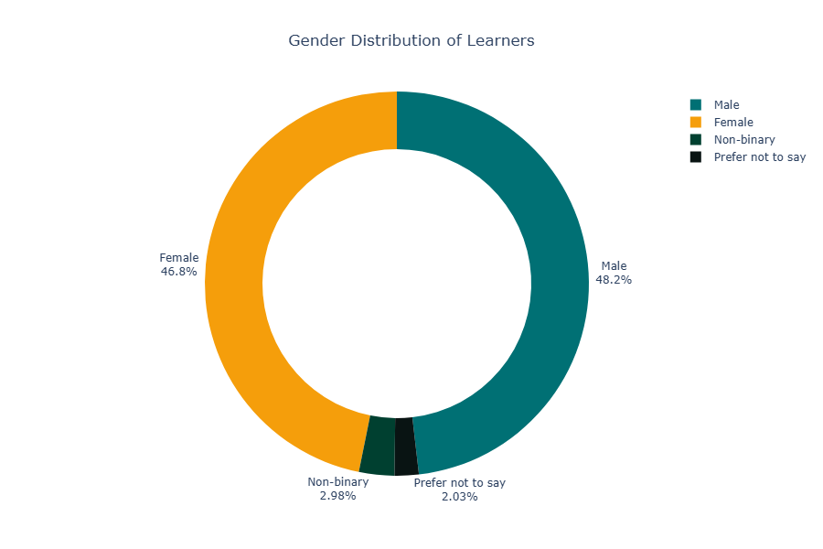
Demographic Patterns in Educational Technology Adoption
Nearly Equal Male and Female Participation
Non‑binary learners (and those who prefer not to disclose) form small but important segments,
This donut chart was created using Pandas for data aggregation and Plotly for interactive visualization and chart customization.

Slide 7
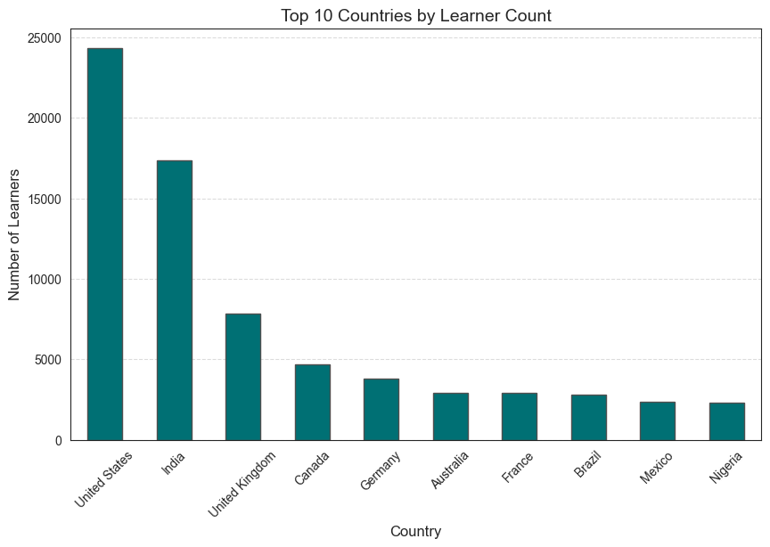
Demographic Patterns in Educational Technology Adoption
The US contributes the largest no. of learners
India follows
After the top 2–3 countries, learner counts reduce significantly.
This bar chart shows the top 10 countries with the highest number of learners, using Pandas to count country frequencies and Matplotlib to visualize the comparison.

Slide 8
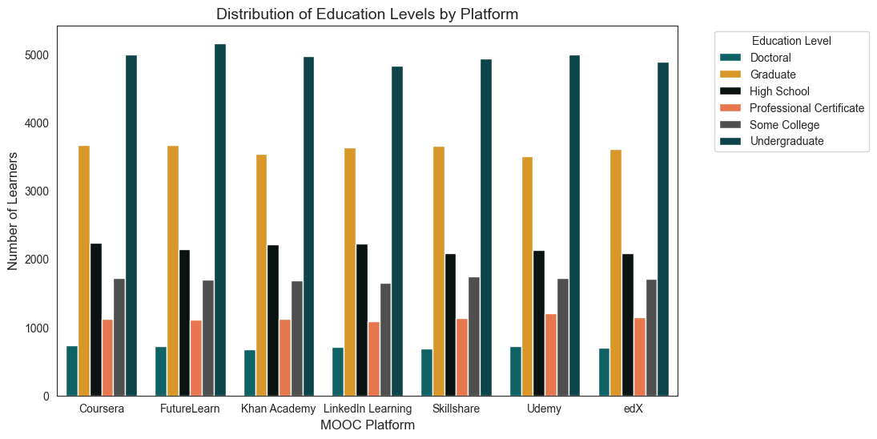
Demographic Patterns in Educational Technology Adoption
Undergraduate learners form the largest group
Graduate learners form the second‑largest segment.
Learner Distribution Is Relatively Consistent Across Platforms
This clustered bar chart was created using Pandas to segment categorical cross-tabulations and Seaborn’s countplot to visualize how learner backgrounds vary by platform

Slide 9
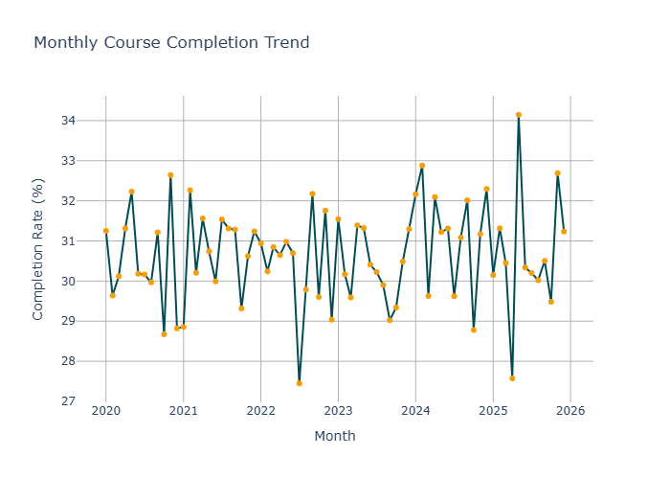
Analysis of Online Course Completion
Completion rates vary slightly each month
Minor ups and downs indicate possible seasonal trends in completions.
Completion rates stay consistently stable (29–32%).
This Line chart was created using Pandas by extracting the month from enrollment date using feature engineering and visualized with Plotly to track how completion rates change over time.

Slide 10
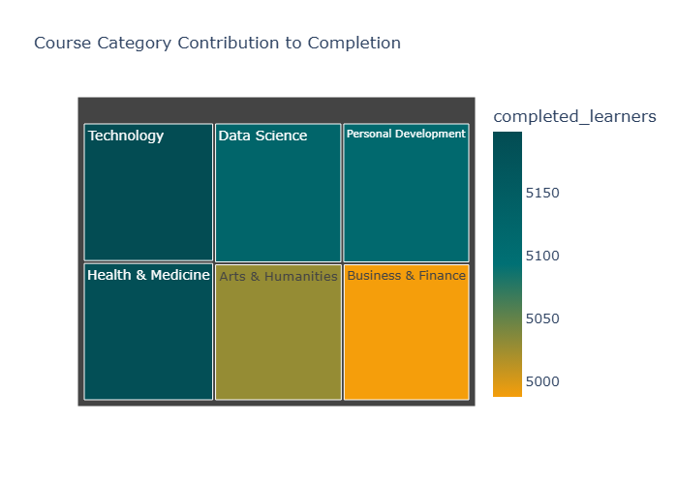
Analysis of Online Course Completion
Tech and Data Science lead in completion contribution.
Business, Finance, and Arts have slightly lower completions.
Completion rates are evenly distributed.
This Treemap was created using Pandas to calculate aggregated completion counts and Plotly’s treemap to compare category‑wise performance

Slide 11
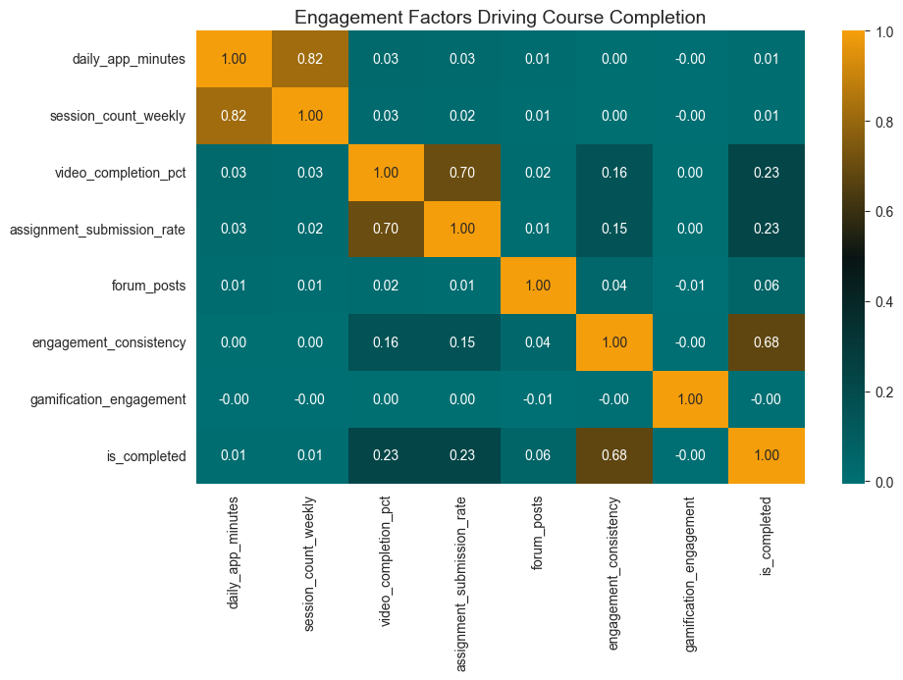
Analysis of Online Course Completion
Engagement consistency has the strongest impact
Active participation in videos and assignments boosts course completion.
Current gamification is not working effectively
This heatmap was created using Pandas for correlation analysis and Seaborn to visualize the strength of relationships between key engagement metrics and the completion outcome

Slide 12
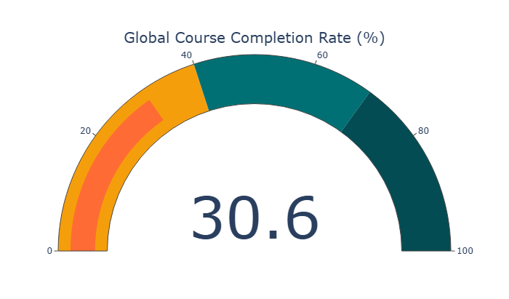
Analysis of Online Course Completion
Overall course completion rate (30.6%) is in the lower performance band of the gauge
Many learners enroll but do not complete courses
This gauge chart was created using Pandas for completion rate calculation using the average of the course_completed column and visualized with Plotly’s indicator gauge to show performance against a 0–100% scale.

Slide 13
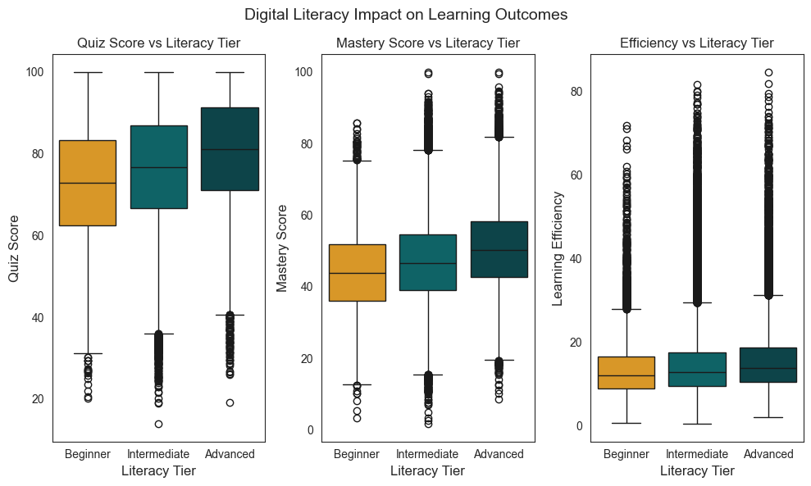
Digital Literacy Impact
Advanced learners consistently perform better across quiz scores, mastery, and efficiency.
Beginners show the lowest and most inconsistent results.
Learning performance improves from Beginner to Advanced levels
This multi-panel boxplot was created using Pandas to group learners into digital literacy tiers and visualizing the distribution of quiz, mastery, and efficiency scores across these tiers using Seaborn with Matplotlib for layout.

Slide 14
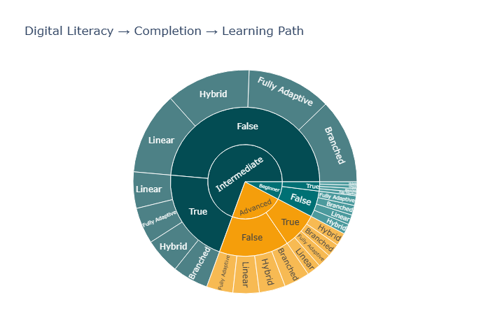
Digital Literacy Impact
Intermediate Learners form the largest learner segment
Course Non-Completion Is higher across all literacy levels
Advanced learners show better completion contribution in terms of learning paths
This sunburst chart was created using Pandas for hierarchical data preparation and Plotly Express to visualize the hierarchical flow from literacy skill band down to final learning path preferences.

Slide 15
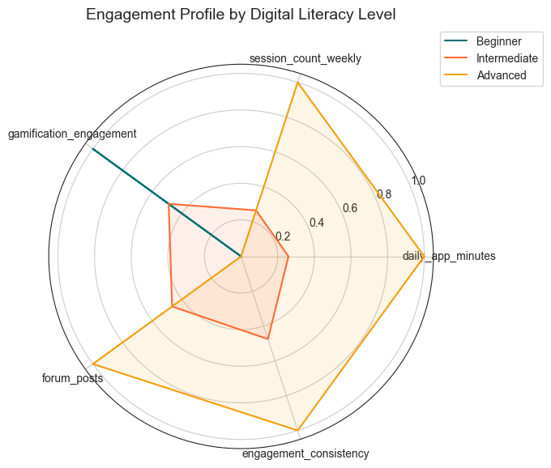
Digital Literacy Impact
Advanced Learners Show Highest Overall Engagement
Beginners rely more on gamification features
Intermediate learners display moderate engagement levels across all activities.
This Radar chart was created using Pandas to calculate group-level averages, NumPy for radar axis calculations, and Matplotlib for polar visualization and chart customization.

Slide 16
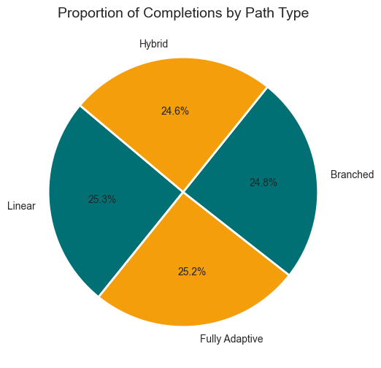
Analysis of Learning Path Type
All path types show similar completion levels (~24–25%).
Linear and Fully Adaptive paths lead slightly more completions.
Diverse learning preferences exist among learners
This Pie chart was created using Pandas to isolate successful graduates and compute categorical frequencies, and Matplotlib for proportional visualization and chart customization.

Slide 17
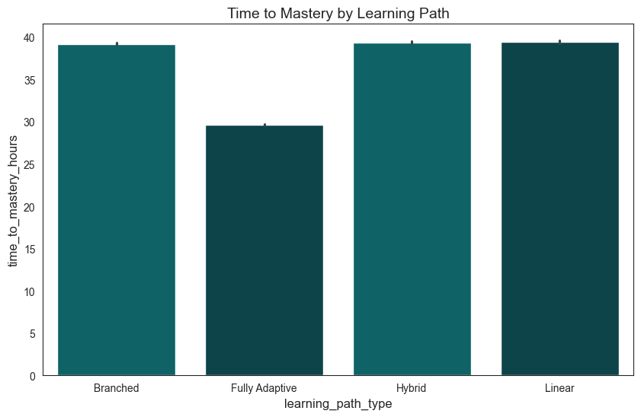
Analysis of Learning Path Type
Fully Adaptive learning paths require the least time to mastery
Linear, Hybrid, and Branched paths show similar and higher mastery times.
Adaptive learning significantly speeds up mastery.
This bar chart was created using Seaborn for comparing average mastery time across learning path types and Matplotlib for chart customization and styling.

Slide 18
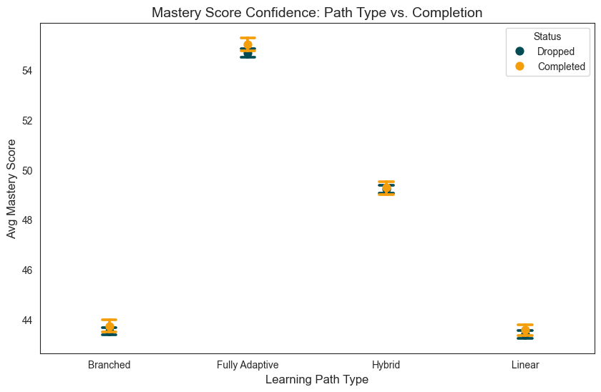
Analysis of Learning Path Type
Fully Adaptive paths show the best mastery performance.
Completers have slightly stronger mastery scores than dropouts.
Linear and Branched Paths Show Lower Mastery Scores
This point plot was created using Pandas for completion status mapping and Seaborn with Matplotlib for comparative confidence interval visualization across learning path types.

Slide 19
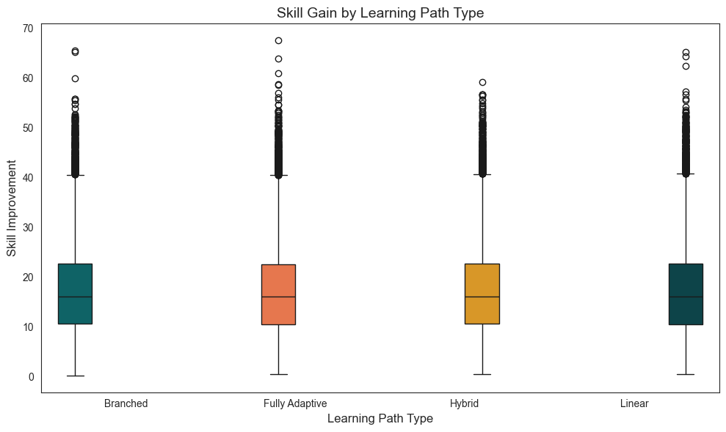
Analysis of Learning Path Type
Skill gains are consistent across all paths.
Skill gains are marginally higher in Fully Adaptive and Hybrid paths
High variability exists among learners
This boxplot was created using Pandas to calculate skill gain and Seaborn with Matplotlib for comparative distribution analysis and chart customization.

Slide 20
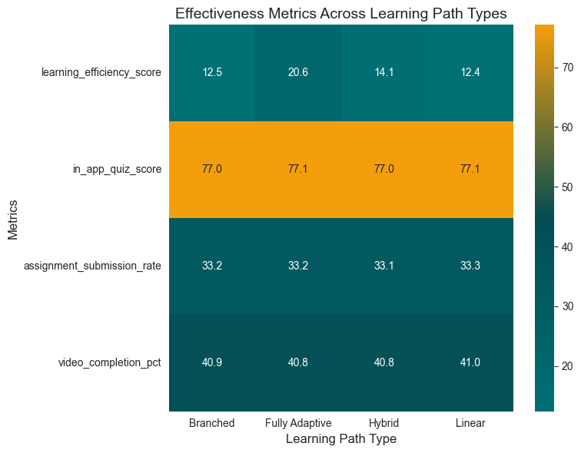
Analysis of Learning Path Type
Fully Adaptive paths are the most efficient.
High quiz scores across every path.
Video completion and assignment submission rates are similar
Fully Adaptive Paths still outperform overall
This heatmap was created using Pandas for grouped metric aggregation, Seaborn for comparative heatmap visualization, and Matplotlib for chart customization and layout styling.

Slide 21

KEY INSIGHTS
Learner demographics show a young, globally diverse audience
Course completion rates are relatively low
Course completion is strongly driven by engagement intensity
Technical and Career-Oriented Courses Drive Higher Completion
Digital literacy has a major impact on learning outcomes
Adaptive learning paths perform better than traditional models

Slide 22

RECOMMENDATIONS
Do’s
Improve Course Completion and Retention
Strengthen early‑stage engagement
Provide targeted support for low‑literacy learners.
Personalize learning experiences based on learner profiles.
Expand High-Demand Course Categories
Invest in Adaptive Learning Technologies

Slide 23

CONCLUSION
Learner Demographics
This analysis shows that learner engagement, digital literacy, and adaptive learning paths play a major role in improving course completion, mastery, and overall learning outcomes. These insights can help digital learning platforms enhance personalization, learner retention, and overall learning effectiveness.
Course Completion
Learning Path
mastery, learner outcomes
Learner Engagement
Digital Literacy

Slide 24
Thank you

