Slide 1

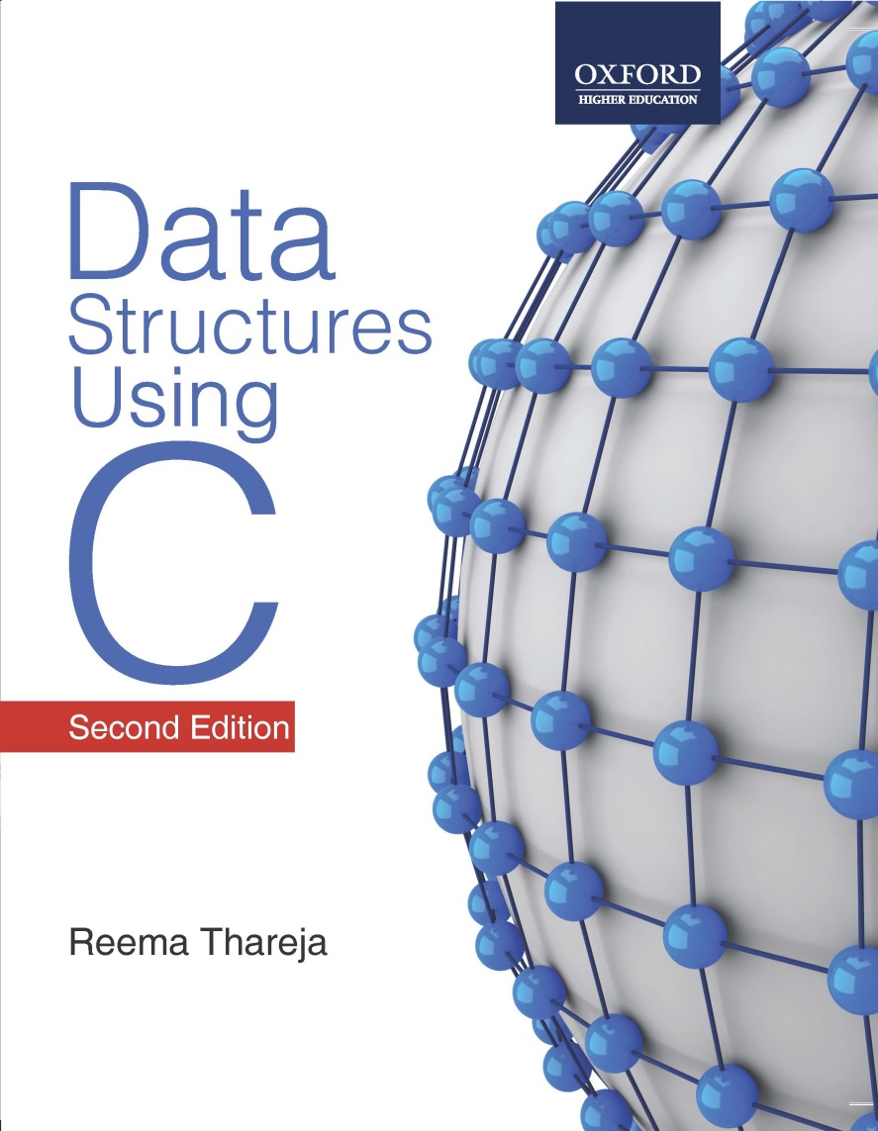
Data Structures Using C, 2e
Reema Thareja

Slide 2
Trees
A tree is recursively defined as a set of one or more nodes where one node is designated as the root of the tree and all the remaining nodes can be partitioned into non-empty sets each of which is a sub-tree of the root.
Types of Trees
  General Trees
  Forests
  Binary Trees
  Expression Trees
  Tournament Trees

Slide 3
General Trees
General trees are data structures that store elements hierarchically.
The top node of a tree is the root node and each node, except the root, has a parent.
A node in a general tree (except the leaf nodes) may have zero or more sub-trees.
General trees which have 3 sub-trees per node are called ternary trees.
However, the number of sub-trees for any node may be variable. For example, a node can have 1 sub-tree, whereas some other node can have 3 sub-trees.

Slide 4
Forests
A forest is a disjoint union of trees. A set of disjoint trees (or forest) is obtained by deleting the root and the edges connecting the root node to nodes at level 1.
Every node of a tree is the root of some sub-tree. Therefore, all the sub-trees immediately below a node form a forest.
A forest can also be defined as an ordered set of zero or more general trees.
While a general tree must have a root, a forest on the other hand may be empty because by definition it is a set, and sets can be empty.
We can convert a forest into a tree by adding a single node as the root node of the tree.

Slide 5
Binary Trees
A binary tree is a data structure which is defined as a collection of elements called nodes.
In a binary tree, the topmost element is called the root node, and each node has 0, 1, or at the most 2 children.
Every node contains a data element, a "left" pointer which points to the left child, and a "right" pointer which points to the right child.
The root element is pointed by a "root" pointer.
If root = NULL, then it means the tree is empty.
1
ROOT NODE
T₁
2
3
T₂
R – Root node (node 1)
T₁- left sub-tree (nodes 2, 4, 5, 8, 9)
T₂- right sub-tree (nodes 3, 6, 7, 10, 11, 12)
4
5
6
7
8
9
10
11
12

Slide 6
Binary Trees - Key Terms
Parent: If N is any node in T that has left successor S1 and right successor S2, then N is called the parent of S1 and S2. Correspondingly, S1 and S2 are called the left child and the right child of N. Every node other than the root node has a parent.
Sibling: S1 and S2 are said to be siblings. In other words, all nodes that are at the same level and share the same parent are called siblings (brothers).
Level number: Every node in the binary tree is assigned a level number. The root node is defined to be at level 0. The left and right child of the root node have a level number 1. Similarly, every node is at one level higher than its parents.
Leaf node: A node that has no children.
Degree: Degree of a node is equal to the number of children that a node has.

Slide 7
Binary Trees - Key Terms
In-degree of a node is the number of edges arriving at that node.
Out-degree of a node is the number of edges leaving that node.
Edge: It is the line connecting a node N to any of its successors
Path: A sequence of consecutive edges is called a path.
Depth: The depth of a node N is given as the length of the path from the root to the node N. The depth of the root node is zero.
Height: It is the total number of nodes on the path from the root node to the deepest node in the tree. A tree with only a root node has a height of 1.
A binary tree of height h has at least h nodes and at most 2^{h} – 1 nodes. This is because every level will have at least one node and can have at most 2 nodes.
The height of a binary tree with n nodes is at least log₂(n+1) and at most n.

Slide 8
Binary Trees - Key Terms
Similar binary trees: Given two binary trees T and T’ are said to be similar if both these trees have the same structure.
A
TREE T
F
TREE T”
B
C
G
H
D
I
E
J
Copies of binary trees: Two binary trees T and T’ are said to be copies if they have similar structure and same content at the corresponding nodes.
A
TREE T
A
TREE T”
B
C
B
C
D
E
D
E

Slide 9
Complete Binary Trees
A complete binary tree is a binary tree which satisfies two properties.
First, in a complete binary tree every level, except possibly the last, is completely filled.
Second, all nodes appear as far left as possible
In a complete binary tree T_{n}, there are exactly n nodes and level r of T can have at most 2^{r} nodes.
The formula to find the parent, left child and right child can be given as:
If K is a parent node, then its left child can be calculated as
2 * K and its right child can be calculated as 2 * K + 1.
For example, the children of node 4 are 8 (2*4) and 9 (2* 4 + 1).
Similarly, the parent of node K can be calculated as | K/2 |.
1
2
3
4
5
6
7
8
9
10
11
12
13

Slide 10
Extended Binary Trees
A binary tree T is said to be an extended binary tree (or a 2-tree) if each node in the tree has either no child or exactly two children.
In an extended binary tree nodes that have two children are called internal nodes and nodes that have no child or zero children are called external nodes. In the figure internal nodes are represented using a circle and external nodes are represented using squares.
To convert a binary tree into an extended tree, every empty sub-tree is replaced by a new node. The original nodes in the tree are the internal nodes and the new nodes added are called the external nodes.
Extended binary tree
Binary tree

Slide 11
Linked Representation of Binary Trees
In computer’s memory, a binary tree can be maintained either using a linked representation or using sequential representation.
In linked representation of binary tree, every node will have three parts: the data element, a pointer to the left node and a pointer to the right node. So in C, the binary tree is built with a node type given as below.
struct node
{
struct node* left;
int data;
struct node* right;
};
1
2
3
4
5
6
7
X
8
X
X
9
X
X
10
X
X
11
X
X
12
X

Slide 12
Sequential Representation of Binary Trees
Sequential representation of trees is done using a single or one dimensional array. Though, it is the simplest technique for memory representation, it is very inefficient as it requires a lot of memory space.
A sequential binary tree follows the rules given below:
One dimensional array called TREE is used.
The root of the tree will be stored in the first location. That is, TREE[1] will store the data of the root element.
The children of a node K will be stored in location (2*K) and (2*K+1).
The maximum size of the array TREE is given as (2^{h}-1), where h is the height of the tree.
An empty tree or sub-tree is specified using NULL. If TREE[1] = NULL, then the tree is empty.
20
15
35
12
17
21
39
16
18
36
45

Slide 13
Expression Trees
Binary trees are widely used to store algebraic expressions. For example, consider the algebraic expression Exp given as:
Exp = (a – b ) + ( c * d)
This expression can be represented using a binary tree as shown in figure
+
-
*
a
b
c
d

Slide 14
Tournament Trees
In a tournament tree (also called a selection tree), each external node represents a player and each internal node represents the winner of the match played between the players represented by its children nodes.
These tournament trees are also called winner trees because they are being used to record the winner at each level.
We can also have a loser tree that records the loser at each level.
a
a
e
a
d
e
g
a
b
c
d
e
f
g
h

Slide 15
Traversing a Binary Tree
Traversing a binary tree is the process of visiting each node in the tree exactly once in a systematic way.
There are three different algorithms for tree traversals, which differ in the order in which the nodes are visited.
These algorithms are:
Pre-order algorithm
In-order algorithm
Post-order algorithm

Slide 16
Pre-order Algorithm
To traverse a non-empty binary tree in preorder, the following operations are performed recursively at each node.
The algorithm starts with the root node of the tree and continues by:
Visiting the root node
Traversing the left subtree
Traversing the right subtree
A
B
C
D
E
A, B, D, C, E, F, G, H and I
F
G
H
I

Slide 17
In-order Algorithm
To traverse a non-empty binary tree in in-order, the following operations are performed recursively at each node.
The algorithm starts with the root node of the tree and continues by,
Traversing the left subtree
Visiting the root node
Traversing the right subtree
A
B
C
D
E
F
B, D, A, E, H, G, I, F and C
G
H
I

Slide 18
Post-order Algorithm
To traverse a non-empty binary tree in post-order, the following operations are performed recursively at each node.
The algorithm starts with the root node of the tree and continues by,
Traversing the left subtree
Traversing the right subtree
Visiting the root node
A
B
C
D
E
F
D, B, H, I, G, F, E, C and A
G
H
I

Slide 19
Applications of Trees
Trees are used to store simple as well as complex data. Here simple means an int value, char value and complex data (structure).
Trees are often used for implementing other types of data structures like hash tables, sets, and maps.
A self-balancing tree, Red-black tree is used in kernel scheduling to preempt massively multi-processor computer operating system use.
Another variation of tree, B-trees are used to store tree structures on disc. They are used to index a large number of records.
B-trees are also used for secondary indexes in databases, where the index facilitates a select operation to answer some range criteria.
Trees are used for compiler construction.
Trees are also used in database design.
Trees are used in file system directories.
Trees are also widely used for information storage and retrieval in symbol tables.

