Slide 1


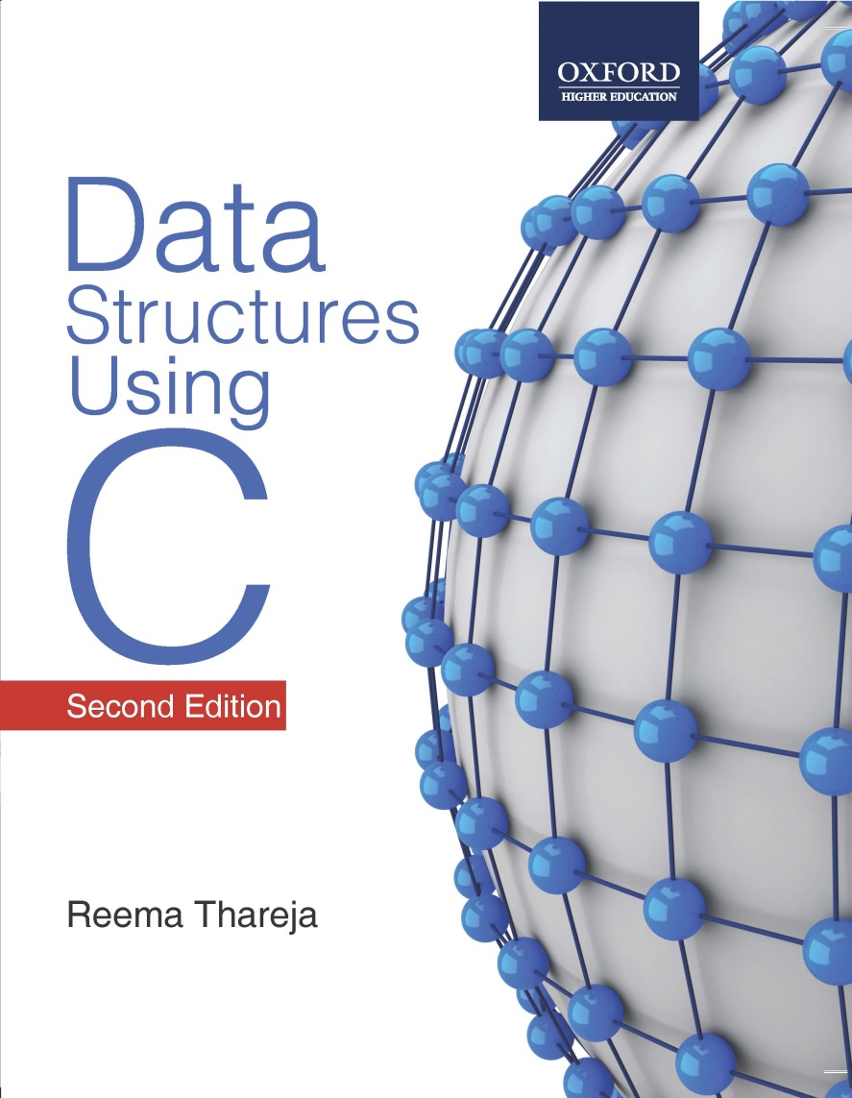
Data Structures Using C, 2e
Reema Thareja

Slide 2
Chapter 1
Introduction to C

Slide 3
Introduction
C was developed in the early 1970s by Dennis Ritchie at Bell Laboratories.
C was initially developed for writing system software.
Today, C has become a popular language and various software programs are written using this language.
Many other commonly used programming languages such as C++ and Java are also based on C.

Slide 4
Characteristics of C
A high level programming language
Small size. C has only 32 keywords. This makes it relatively easy to learn
Makes extensive use of function calls
Well suited for structured programming
Unlike PASCAL it supports loose typing (as a character can be treated as an integer and vice versa)

Slide 5
Characteristics of C
Stable language
Quick language
Facilitates low level (bitwise) programming
Supports pointers to refer computer memory, array, structures and functions
Portable language
Extensible language

Slide 6
Uses of C
Primarily used for system programming
The portability, efficiency, and the ability to access specific hardware addresses and low runtime demand on system resources makes it a good choice for implementing operating systems and embedded system applications
Has been so widely accepted by professionals that compilers, libraries, and interpreters of other programming languages are often implemented in C

Slide 7
Uses of C
For portability and convenience reasons, C is sometimes used as an intermediate language by implementations of other languages
Examples of compilers which use C this way are BitC, Gambit, the Glasgow Haskell Compiler, Squeak, and Vala
Widely used to implement end-user applications

Slide 8
Structure of a C Program
A C program contains one or more functions.
The statements in a C program are written in a logical sequence to perform a specific task.
Execution of a C program begins at the main() function.
You can choose any name for the functions.
Every program must contain one function that has its name as main().
main()
{
Statement 1;
Statement 2;
……………
……………
Statement N;
}
Function1()
{
Statement 1;
Statement 2;
……………
……………
Statement N;
}
Function2()
{
Statement 1;
Statement 2;
……………
……………
Statement N;
}
………………….
………………….
FunctionN()
{
Statement 1;
Statement 2;
……………
……………
Statement N;
}

Slide 9
Your First C Program
// This is my first program in C
#include <stdio.h>
int main()
{
printf("\n Welcome to the world of C ");
return 0;
}

Slide 10
Files Used in C Programs
Files in a C program
Source File
Header File
Object File
Executable File
Source code file
It contains the source code of the program.
The file extension of any C source code file is “.c”.
This file contains C source code that defines the main() function and maybe other functions.

Slide 11
Files Used in C Programs
Header Files
When working with large projects, it is often desirable to make sub-routines and store them in a different file known as header file.
Conventionally, header file name ends with a “.h” extension and its name can use only letters, digits, dashes, and underscores.
  While some standard header files are available in C, the programmer may also create his own user-defined header files.

Slide 12
Files Used in C Programs
Object Files
Object files are generated by the compiler as a result of processing the source code file.
Object files contain compact binary code of the function definitions.
Linker uses this object file to produce an executable file (.exe file) by combining the object files together.
Object files have a “.o” extension, although some operating systems including Windows and MS-DOS use a “.obj” extension.

Slide 13
Files Used in C Programs
Binary Executable File
The binary executable file is generated by the linker.
The linker links the various object files to produce a binary file that can be directly executed.
On Windows operating system, the executable files have “.exe” extension.

Slide 14
Compiling and Executing C Programs
The compilation process is done in two steps.
In the first step, the preprocessor program reads the source file as text, and produces another text file as output.
The output of the preprocessor is a text file which does not contain any preprocessor statements. This file is ready to be processed by the compiler.
The linker combines the object files with library routines (supplied with the compiler) to produce the final executable file.

Slide 15
Compiling and Executing C Programs
Source File
Pre-process
Compiler
Object Files
Linker
Library Files
Library Files
Executable Files
Pre-process
Compiler
Source File
Object Files
Library Files

Slide 16
Using Comments
It is a good programming practice to place some comments in the code to help the reader understand the code clearly.
Comments are just a way of explaining what a program does. It is merely an internal program documentation.
The compiler ignores the comments when forming the object file. This means that the comments are non-executable statements.

Slide 17
Using Comments
C supports two types of commenting:
// is used to comment a single statement. This is known as a line comment. A line comment can be placed anywhere on the line and it does not require to be specifically ended as the end of the line automatically ends the line.
/* is used to comment multiple statements. A /* is ended with */ and all statements that lie within these characters are commented.

Slide 18
Keywords
C has a set of 32 reserved words often known as keywords.
All keywords are basically a sequence of characters that have a fixed meaning.
By convention all keywords must be written in lowercase (small) letters.
Example: for, while, do-while, auto, break, case, char, continue, do, double, else, enum, extern, float, goto, if, int, long, register, return, short, signed, sizeof, static, struct, switch, typedef, union, unsigned, void, volatile

Slide 19
Identifiers
Names given to program elements such as variables, arrays and functions
Rules for forming identifiers
Cannot include any special characters or punctuation marks except the underscore"_"
There cannot be two successive underscores
Cannot be used as identifiers
Case sensitive. So, “FIRST” is different from “first” and “First”
Must begin with a letter or an underscore
Should not contain more than 31 characters
Example: roll_number, marks, _name, HRA

Slide 20
Data Types
DATA TYPE | SIZE IN BYTES | RANGE
char | 1 | -128 to 127
unsigned char | 1 | 0 to 255
signed char | 1 | -128 to 127
int | 2 | -32768 to 32767
unsigned int | 2 | 0 to 65535
signed short int | 2 | -32768 to 32767
signed int | 2 | -32768 to 32767
short int | 2 | -32768 to 32767
unsigned short int | 2 | 0 to 65535
long int | 4 | -2147483648 to 2147483647
unsigned long int | 4 | 0 to 4294967295
signed long int | 4 | -2147483648 to 2147483647
float | 4 | 3.4E-38 to 3.4E+38
double | 8 | 1.7E-308 to 1.7E+308
long double | 10 | 3.4E-4932 to 1.1E+4932

Slide 21
Variables in C
A variable is defined as a meaningful name given to the data storage location in computer memory
C language supports two basic kinds of variables:
  Numeric variables can be used to store either integer values or floating point values
  Character variables can include any letter from the alphabet or from the ASCII chart and numbers 0 – 9 that are put between single quotes

Slide 22
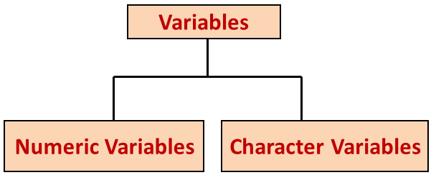
Variables in C
To declare a variable specify data type of the variable followed by its name
Variable names should always be meaningful and must reflect the purpose of their usage in the program
Variable declaration always ends with a semicolon
Examples:
  int emp_num;
  float salary;
  char grade;
  double balance_amount;

Slide 23
Constants
Constants are identifiers whose values do not change
Used to define fixed values like pi or the charge on an electron so that their values do not get changed in the program
To declare a constant, precede the normal variable declaration with const keyword and assign it a value. For example,
const float pi = 3.14;
Another way to designate a constant is to use the pre-processor command define
#define pi 3.14159

Slide 24
The printf () Function
The printf() function is used to display information required to the user and also prints the values of the variables. Its syntax can be given as
printf (“control string”, variable list);
The parameter control string is a C string that contains the text that has to be written on to the standard output device.
The prototype of the control string can be given as:
%[flags][width][.precision][modifier]type

Slide 25
The scanf () Function
The scanf() function is used to read formatted data from the keyboard. The syntax of the scanf() function can be given as:
scanf (“control string”, arg1, arg2, ………….argn);
The control string specifies the type and format of the data that has to be obtained from the keyboard and stored in the memory locations pointed by the arguments arg1, arg2,…, argn.
The prototype of the control string can be given as:
%[*][width][modifier]type

Slide 26
Operators in C
C language supports a lot of operators, which can be categorized into the following major groups:
  Arithmetic operators
  Relational Operators
  Equality Operators
  Logical Operators
  Unary Operators
  Conditional Operators
  Bitwise Operators
  Assignment operators
  Comma Operator
  Sizeof Operator

Slide 27
Arithmetic Operators
OPERATION | OPERATOR | SYNTAX | COMMENT | RESULT
Multiply | * | a * b | result = a * b | 27
Divide | / | a / b | result = a / b | 3
Addition | + | a + b | result = a + b | 12
Subtraction | - | a - b | result = a – b | 6
Modulus | % | a % b | result = a % b | 0

Slide 28
Relational Operators
Used to compare two values
Relational operators return true or false value, depending on whether the conditional relationship between the two operands holds or not
OPERATOR | MEANING | EXAMPLE
< | LESS THAN | 3 < 5 GIVES 1
> | GREATER THAN | 7 > 9 GIVES 0
>= | GREATER THAN OR EQUAL TO | 100 >= 100 GIVES 1
<= | LESS THAN OR EQUAL TO | 50 <=100 GIVES 1

Slide 29
Equality Operators
C language supports two kinds of equality operators to compare their operands for strict equality or inequality
They are equal to (==) and not equal to (!=) operator
Have lower precedence than the relational operators
OPERATOR | MEANING
== | RETURNS 1 IF BOTH OPERANDS ARE EQUAL, 0 OTHERWISE
!= | RETURNS 1 IF OPERANDS DO NOT HAVE THE SAME VALUE, 0 OTHERWISE

Slide 30
Logical Operators
C language supports three logical operators
They are: Logical AND (&&), Logical OR (||) and Logical NOT (!)
As in case of arithmetic expressions, the logical expressions are evaluated from left to right
A | B | A &&B
0 | 0 | 0
0 | 1 | 0
1 | 0 | 0
1 | 1 | 1
A | B | A || B
0 | 0 | 0
0 | 1 | 1
1 | 0 | 1
1 | 1 | 1
A | ! A
0 | 1
1 | 0

Slide 31
Unary Operators
Unary operators act on single operands
C language supports three unary operators: unary minus (-), increment(++), and decrement (--) operators
When an operand is preceded by a minus sign, the unary operator negates its value
The increment operator is a unary operator that increases the value of its operand by 1
Similarly, the decrement operator decreases the value of its operand by 1

Slide 32
Conditional Operators
The conditional operator (?:) is just like an if ... else statement that can be written within expressions.
The syntax of the conditional operator is
exp1 ? exp2 : exp3
Here, exp1 is evaluated first. If it is true then exp2 is evaluated and becomes the result of the expression. Otherwise exp3 is evaluated and becomes the result of the expression.
Also known as ternary operator as it is neither a unary nor a binary operator; it takes three operands.

Slide 33
Bitwise Operators
Bitwise operators perform operations at bit level.
Bitwise AND (&): bit in the first operand is ANDed with the corresponding bit in the second operand
Bitwise OR (I): bit in the first operand is ORed with the corresponding bit in the second operand
Bitwise NOT (~): performs logical negation on each bit of the operand and produces one’s complement of the given binary value

Slide 34
Bitwise Operators
Bitwise XOR (^): bit in the first operand is XORed with the corresponding bit in the second operand
Bitwise left shift (<<): when we apply a left shift, every bit in the operand is shifted to the left by one place
Bitwise right shift (>>): when we apply a right shift, every bit in the operand is shifted to the right by one place

Slide 35
Assignment Operators
The assignment operator is responsible for assigning values to the variables.
While the equal sign (=) is the fundamental assignment operator, C also supports other assignment operators that provide shorthand ways to represent common variable assignments.
OPERATOR | SYNTAX | EQUIVALENT TO
/= | variable /= expression | variable = variable / expression
\= | variable \= expression | variable = variable \ expression
*= | variable *= expression | variable = variable * expression
+= | variable += expression | variable = variable + expression
-= | variable -= expression | variable = variable - expression
&= | variable &= expression | variable = variable & expression
^= | variable ^= expression | variable = variable ^ expression
<<= | variable <<= amount | variable = variable << amount
>>= | variable >>= amount | variable = variable >> amount

Slide 36
Comma Operator
The comma operator takes two operands. It works by evaluating the first and discarding its value, and then evaluates the second and returns the value as the result of the expression.
Comma separated operands when chained together are evaluated in left-to-right sequence with the right-most value yielding the result of the expression.
Among all the operators, the comma operator has the lowest precedence.

Slide 37
Sizeof Operator
Sizeof is a unary operator used to calculate the sizes of data types
Can be applied to all data types
Returns the size of the variable, data type or expression in bytes
Used to determine the amount of memory space that the variable/expression/data type will take
For example,
sizeof(char) returns 1, that is the size of a character data type

Slide 38
Type Conversion
Type conversion of variables refers to changing a variable of one data type into another.
Type conversion is done when the expression has variables of different data types.
To evaluate the expression, the data type is promoted from lower to higher level where the hierarchy of data types can be given as: double, float, long, int, short and char.
Type conversion is automatically done when we assign an integer value to a floating point variable.

Slide 39
Typecasting
Typecasting is also known as forced conversion.
It is done when the value of one data type has to be converted into the value of another data type. For example, we need to explicitly typecast a floating point variable into an integer variable.
float salary = 10000.00;
int sal;
sal = (int) salary;
Typecasting can be done by placing the destination data type in parentheses followed by the variable name that has to be converted.

Slide 40
Decision Control Statements
Decision control statements are used to alter the flow of a sequence of instructions.
These statements help to jump from one part of the program to another depending on whether a particular condition is satisfied or not.
These decision control statements include:
  If statement
  If-else statement
  If-else-if statement
  Switch statement

Slide 41
If Statement
If statement is the simplest form of decision control statements that is frequently used in decision making.
First the test expression is evaluated. If the test expression is true, the statements of if block (statements 1 to n) are executed, otherwise these are skipped and the execution jumps to statement x.
SYNTAX OF IF STATEMENT if (test expression) { statement 1; .............. statement n; } statement x;

Slide 42
If Else Statement
In the if-else construct, first the test expression is evaluated.
If the expression is true, statement block 1 is executed and statement block 2 is skipped.
Otherwise, if the expression is false, statement block 2 is executed and statement block 1 is ignored.
In any case after the statement block 1 or 2 gets executed, the control passes to statement x.
SYNTAX OF IF-ELSE STATEMENT if (test expression) { statement_block 1; } else { statement_block 2; } statement x;

Slide 43
If Else If Statement
C language supports if-else-if statements to test additional conditions apart from the initial test expression.
The if-else-if construct works in the same way as a normal if statement.
SYNTAX OF IF-ELSE-IF STATEMENT
if ( test expression 1)
{
statement block 1;
}
else if ( test expression 2)
{
statement block 2;
}
...........................
else if (test expression N)
{
statement block N;
}
else
{
Statement Block X;
}
Statement Y;

Slide 44
Switch Case Statement
A switch case statement is a multi-way decision statement. Switch statements are used:
  When there is only one variable to evaluate in the expression
  When many conditions are being tested for
Is easy to debug, read, understand, and maintain
Executes faster than its equivalent if-else construct

Slide 45
Switch Case Program
// PROGRAM TO PRINT THE DAY OF THE WEEK
#include<stdio.h>
int main()
{
int day;
printf(“\n Enter any number from 1 to 7 : “);
scanf(“%d”,&day);
switch(day)
{
case 1: printf(“\n SUNDAY”); break;
case 2 : printf(“\n MONDAY”); break;
case 3 : printf(“\n TUESDAY”); break;
case 4 : printf(“\n WEDNESDAY”); break;
case 5 : printf(“\n THURSDAY”); break;
case 6 : printf(“\n FRIDAY”); break;
case 7 : printf(“\n SATURDAY”); break;
default: printf(“\n Wrong Number”);
}
return 0;
}

Slide 46
Iterative Statements
Iterative statements are used to repeat the execution of a list of statements, depending on the value of an integer expression.
Three types of statements:
    While loop
    Do-while loop
    For loop

Slide 47
While Loop
It is used to repeat one or more statements while a particular condition is true.
In the while loop, the condition is tested before any of the statements in the statement block is executed.
If the condition is true, only then the statements will be executed.
Otherwise the control will jump to the immediate statement outside the while loop block.
The condition of the while loop should be constantly updated.
while (condition)
{
statement_block;
}
statement x;

Slide 48
Do While Loop
The do-while loop is similar to the while loop. The only difference is that in a do-while loop, the test condition is tested at the end of the loop.
The body of the loop gets executed at least one time (even if the condition is false).
The do-while loop continues to execute whilst the condition is true.
Statement x;
do
{
statement_block;
} while (condition);
Statement y;

Slide 49
For Loop
For loop is used to repeat a task until a particular condition is true.
The syntax of for loop:
With every iteration of the loop, the value of the loop variable is updated and the condition is checked.
If the condition is true, the statement block of the loop is executed, else the statement block of the for loop is skipped and the control jumps to the statement following the loop body.
for (initialization; condition; increment / decrement / update)
{
statement block;
}
Statement Y;

Slide 50
Break Statement
It is used to terminate the execution of the nearest enclosing loop in which it appears.
When the compiler encounters a break statement, the control passes to the statement that follows the loop.
Syntax: break;
In switch statement if the break statement is missing then every case from the matched case label to the end of the switch, including the default, is executed.

Slide 51
Continue Statement
The continue statement can only appear in the body of a loop.
When the compiler encounters a continue statement then the rest of the statements in the loop are skipped and the control is unconditionally transferred to the loop-continuation portion of the nearest enclosing loop.
Syntax: continue;
If placed within a for loop, the continue statement causes a branch to the code that updates the loop variable.

Slide 52
Goto Statement
The goto statement is used to transfer control to a specified label.
Label is an identifier that specifies the place where the branch is to be made.
It can be any valid variable name that is followed by a colon (:).
Labels can be placed anywhere in the program either before or after the goto statement.
Whenever the goto statement is encountered, the control is immediately transferred to the statements following the label.

Slide 53
Functions
C enables its programmers to break up a program into segments commonly known as functions, each of which can be written more or less independently of the others.
Every function in the program is supposed to perform a well-defined task. Therefore, the program code of one function is completely insulated from that of other functions.
Every function has a name which acts as an interface to the outside world in terms of how information is transferred to it and how results generated by function are transmitted back from it.

Slide 54
Functions
In the figure, main() calls another function, func1().
main() is known as the calling function and func1() is known as the called function.
When the compiler encounters a function call, instead of executing the next statement in the calling function, the control jumps to the statements that are a part of the called function.
After the called function is executed, the control is returned back to the calling function.
main()
{
…………..
…………..
func1();
…………
………..
return 0;
}
func1()
{
Statement Block;
}

Slide 55
Functions
It is not necessary that the main() can call only one function, it can call as many functions as it wants and as many times as it wants. For example, a function call placed within a for loop, while loop or do-while loop may call the same function multiple times until the condition holds true.
It is not that only the main() function can call another functions. Any function can call any other function.

Slide 56
Why do we Need Functions?
Dividing the program into separate functions facilitates each function to be written and tested separately. This simplifies the process of getting the total program to work.
Understanding, coding, and testing multiple separate functions is far easier than doing the same for one big function.
If a big program has to be developed without the use of any function (except main()), then there will be countless lines in the main().

Slide 57
Terminology of Functions
A function (f) that uses another function (g) is known as the calling function and g is known as the called function.
The inputs that the function takes are known as arguments
When a called function returns some result back to the calling function, it is said to return that result.
The calling function may or may not pass parameters to the called function.
If the called function accepts arguments, the calling function will pass parameters, else not.

Slide 58
Function Declaration
Function declaration is a statement that identifies a function with its name, a list of arguments that it accepts and the type of data it returns.
The general format for declaring a function that accepts some arguments and returns some value as result can be given as:
  return_data_type function_name (data_type variable1, data_type variable2,..);
No function can be declared within the body of another function.
Example: float avg ( int a, int b);

Slide 59
Function Definition
Function definition consists of a function header that identifies the function, followed by the body of the function containing the executable code for that function.
When a function is defined, space is allocated for that function in the memory.
The syntax of a function definition can be given as:
return_data_type function_name(data_type variable1, data_type variable2,..)
{
………….
statements
………….
return( variable);
}

Slide 60
Function Call
The function call statement invokes the function.
When a function is invoked the compiler jumps to the called function to execute the statements that are a part of that function.
Once the called function is executed, the program control passes back to the calling function.
Function call statement has the following syntax:
function_name (variable1, variable2, …);

Slide 61
Points to Remember while Calling a Function
Function name and the number and type of arguments in the function call must be same as that given in the function declaration and function header of the function definition.
Names (and not the types) of variables in function declaration, function call and header of function definition may vary.
Arguments may be passed in the form of expressions to the called function. These arguments are first evaluated and converted to the type of formal parameters.
If the return type of the function is not void, then the value returned by the called function may be assigned to some variable as:
variable_name = function_name(variable1, variable2, …);

Slide 62
Return Statement
The return statement is used to terminate the execution of a function and return control to the calling function.
When a return statement is encountered, the program execution resumes in the calling function at the point immediately following the function call.
A return statement may or may not return a value to the calling function. The syntax of return statement can be given as:
return <expression> ;
By default, the return type of a function is int.

Slide 63
Passing Parameters to Functions
There are two ways in which arguments or parameters can be passed to the called function.
Call by value in which values of the variables are passed by the calling function to the called function.
Call by reference in which address of the variables are passed by the calling function to the called function.
Passing parameters to function
Call by value
Call by reference

Slide 64
Call by Value
In this method, the called function creates new variables to store the value of the arguments passed to it. Therefore, the called function uses a copy of the actual arguments to perform its intended task.
If the called function is supposed to modify the value of the parameters passed to it, then the change will be reflected only in the called function. In the calling function no change will be made to the value of the variables.

Slide 65
Call by Reference
In call by reference, we declare the function parameters as references rather than normal variables. When this is done any changes made by the function to the arguments it received are visible in the calling function.
To indicate that an argument is passed using call by reference, an * is placed after the type in the parameter list. This way, changes made to that parameter in the called function body will then be reflected in its value in the calling function.

Slide 66
Pointers
Every variable in C has a name and a value associated with it. When a variable is declared, a specific block of memory within the computer is allocated to hold the value of that variable. The size of the allocated block depends on the type of the data.
int x = 10;
When this statement executes, the compiler sets aside 2 bytes of memory to hold the value 10. It also sets up a symbol table in which it adds the symbol x and the relative address in memory where those 2 bytes are set aside.

Slide 67
Pointers
Thus, every variable in C has a value and an also a memory location (commonly known as address) associated with it. Some texts use the term rvalue and lvalue for the value and the address of the variable respectively.
The rvalue appears on the right side of the assignment statement and cannot be used on the left side of the assignment statement.
Therefore, writing 10 = k; is illegal.

Slide 68
Declaring Pointer Variables
A pointer is a variable that contains the memory location of another variable.
The general syntax of declaring pointer variable is
data_type *ptr_name;
The '*' informs the compiler that ptr_name is a pointer variable and data_type specifies that it will store the address of data_type variable.
The & operator retrieves the lvalue (address) of x, and copies that to the contents of the pointer ptr.

Slide 69
Dereferencing a Pointer Variable
We can "dereference" a pointer, i.e. refer to the value of the variable to which it points by using unary '*' operator as in *ptr.
That is, *ptr = 10, since 10 is value of x.

Slide 70
Pointer Expressions and Arithmetic
Pointer variables can also be used in expressions. For example,
int num1=2, num2= 3, sum=0, mul=0, div=1;
int *ptr1, *ptr2;
ptr1 = &num1, ptr2 = &num2;
sum = *ptr1 + *ptr2;
mul = sum * *ptr1;
We can add integers to or subtract integers from pointers as well as subtract one pointer from the other.
We can compare pointers by using relational operators in the expressions. For example p1 > p2 , p1==p2 and p1!=p2 are all valid in C.

Slide 71
Pointer Expressions and Arithmetic
When using pointers, unary increment (++) and decrement (--) operators have greater precedence than the dereference operator (*).
Therefore, the expression *ptr++ is equivalent to *(ptr++).
The expression will increase the value of ptr so that it now points to the next element.
In order to increment the value of the variable whose address is stored in ptr, write (*ptr)++.

Slide 72
Null Pointers
A null pointer is a special pointer value that is known not to point anywhere. This means that a NULL pointer does not point to any valid memory address.
To declare a null pointer you may use the predefined constant NULL.
int *ptr = NULL;
It is used in situations if one of the pointers in the program points somewhere some of the time but not all of the time.
In such situations it is always better to set it to a null pointer when it doesn't point anywhere valid, and to test to see if it's a null pointer before using it.

Slide 73
Generic Pointers
A generic pointer is pointer variable that has void as its data type.
The generic pointer can be pointed at variables of any data type.
It is declared by writing
void *ptr;
You need to cast a void pointer to another kind of pointer before using it.
Generic pointers are used when a pointer has to point to data of different types at different times.

Slide 74
Passing Arguments to Functions using Pointers
The calling function sends the addresses of the variables and the called function must declare those incoming arguments as pointers.
In order to modify the variables sent by the caller, the called function must dereference the pointers that were passed to it.
Thus, passing pointers to a function avoids the overhead of copying data from one function to another.

Slide 75
Pointer to Pointers
You can use pointers that point to pointers. The pointers in turn point to data (or even to other pointers). To declare pointers to pointers just add an asterisk (*) for each level of reference.
For example, if we have:
int x=10;
int *px, **ppx;
px=&x;
ppx=&px;
Now if we write,
printf(“\n %d”, **ppx);
This would print 10, the value of x.
10
1002
2004
x
px
ppx

