Slide 1
BomberMan (Unity)
Team RagingHamsters
Jasmine Hunter | Luke Lodhen | Matthew Ruiz | Arielle Chongco | Akihiro Izumi | Jaysen Gan

Slide 2
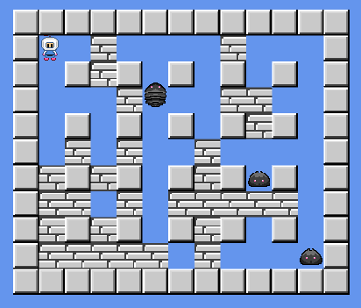
Game
Source Code Acquired from NoobTuts:
http://noobtuts.com/unity/2d-bomberman-game

Slide 3
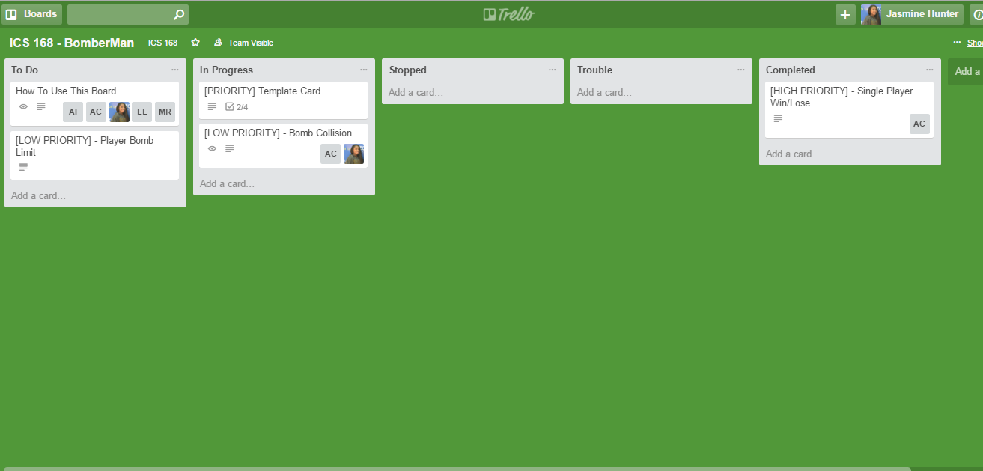
Resources and Organization
Trello (Sprint task management and tracking):
  https://trello.com/b/8JPQruJS/ics-168-bomberman
Changes Made:
Added Lives and Game Reset-ability
Initial Goals:
Limiting Number of Active Bombs
Bomb and Enemy Collision

