Slide 1
The Power of Difference
Mia Hampford, Peter Felland, Nuzaba Nuzhat, Sam Shankman, David Xue, Connor Yager, Carl Zhang, Will Zheng
Notes:
EVERYONE

Slide 2
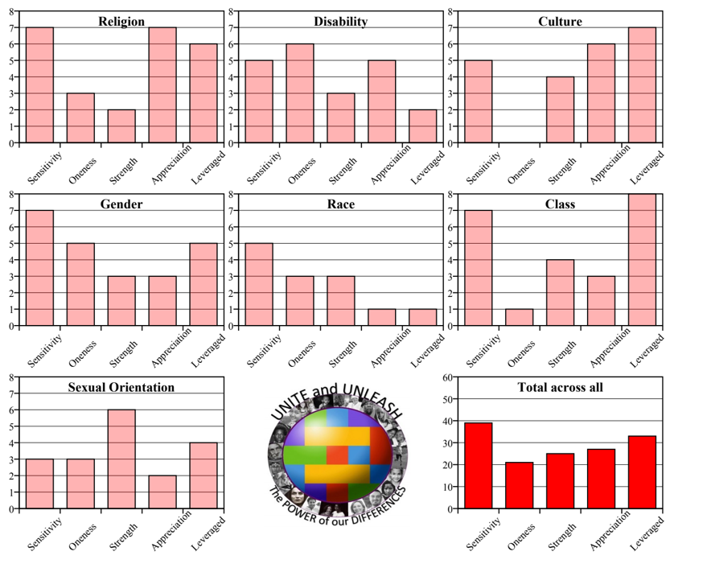
Introduction
The Sum
Stand in solidarity
Assessment System
Unconscious biases
Areas of strength and areas of growth
Consultations
Notes:
David

Slide 3






Tools and Technologies
Notes:
Will

Slide 4
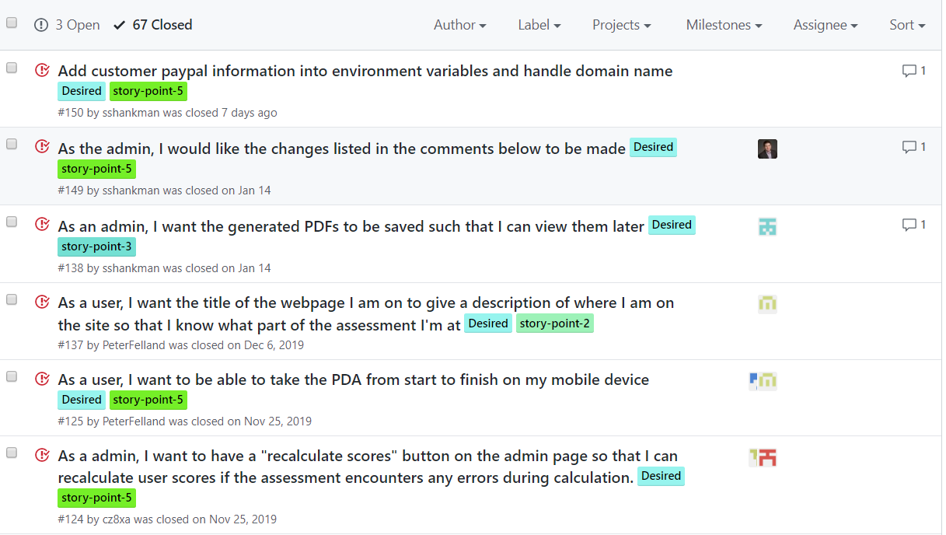
Requirements
User verification
Access Types
Taking the Assessment
Automatic Scoring and PDFs
Integrated Scheduling
URL Manipulation
UI of Website
Consultant Admin Privileges
AWS
Notes:
CONNOR

Slide 5
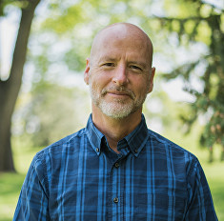
What Worked Well
Team Communication
Planning and Stand Ups
Customer Meetings
Organized GitHub
Notes:
Mia

Slide 6
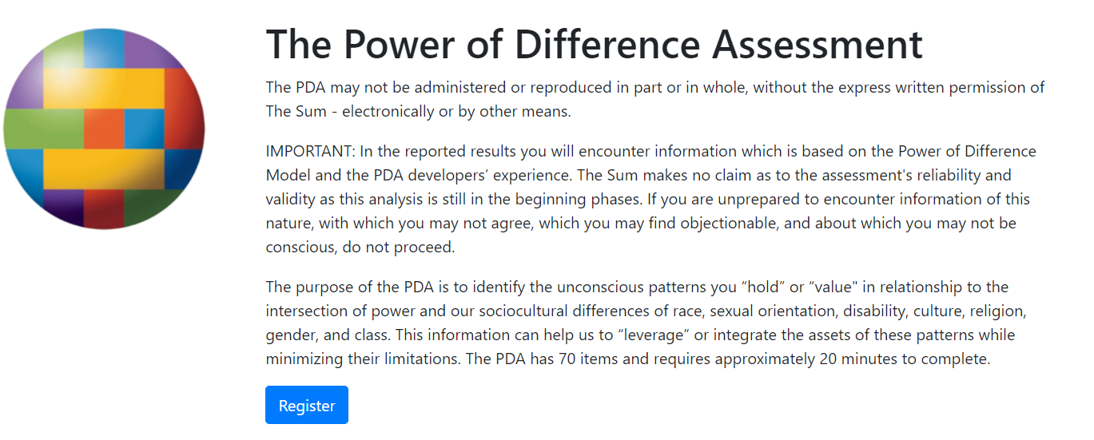
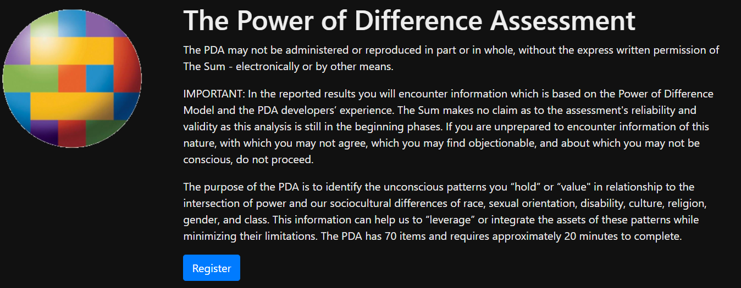
Where the System Excels
User Interface
Accessibility
Automated Emails
Correct Score Calculations
10 to 8 Integration
Notes:
Carl

Slide 7
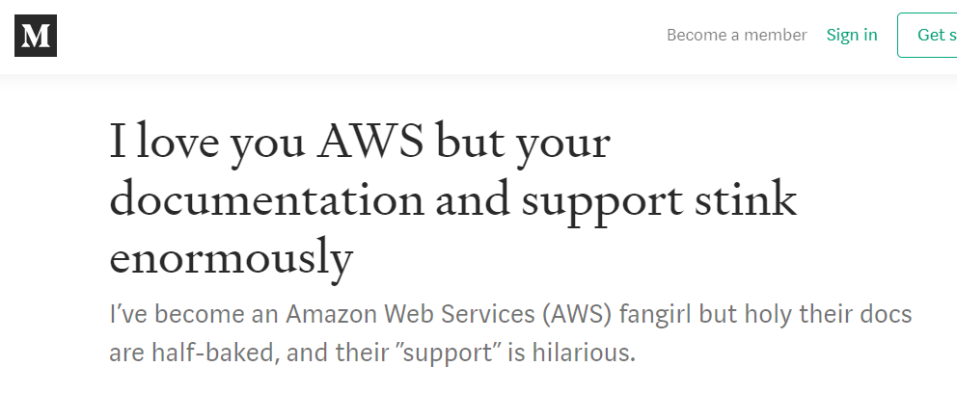
Difficulties / Challenges
Working with AWS
PDFs
Testing PayPal
3rd Party Packages
Notes:
Sam

Slide 8
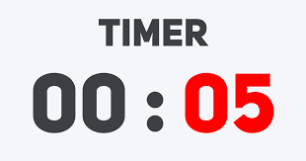
What Did Not Work Well
Too Many Cooks in the Kitchen
Knowledge Silos
Pull Requests at End of Sprints
Notes:
Peter

Slide 9
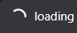
Where the System May Be Lacking
Potential URL misuses
Database Design
Loading time for calculations
Notes:
Nuzaba

Slide 10

Demo!
Notes:
WING IT BOYS
…. Perhaps a tag team duo of one person doing things and the other person talking
Sam - computer
Carl/Will/Nubaza - Admin
Mia - User side

