Slide 1
YouTube Video Sentiment Analysis
Logistic Progression
Jessica Ouyang and Joe Ellis
NLP/ML/Web Tech

Slide 2
Project Goals
Analyze Sentiment in YouTube Videos
Automatic YouTube Downloader and Crawler
Multimodal Features:
Audio, Video, Transcript, Metadata/comments
Classification Schemes:
Single Modalities
Combined-Modalities and Co-Training
Sentiment Rich Data-set
“React-To” videos

Slide 3
YouTube Downloader
Command Line Utility
Leverage “youtube-dl” and Google-APIs
Capabilities:
Download comments, metadata, transcripts, and .mp4 formatted video
Download all videos for…
Search Query
User
Video ID

Slide 4
Pre-Processing
Speaker Diarization
“SHoUT” toolkit used to perform speaker diarization on the videos.
Goal: To create smaller videos with coherent sentiment
Cut videos into shorter 5-10 second videos with only one speaker using ffmpeg.
Cut transcripts based on overlap with cut videos.

Slide 5
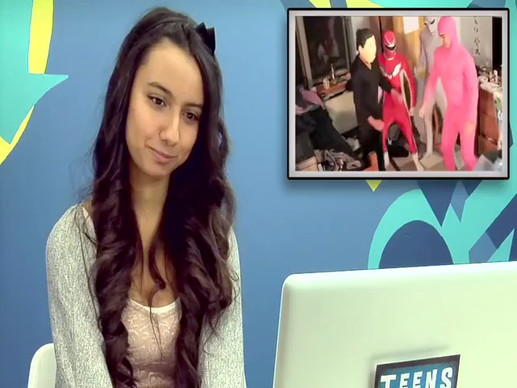
Video Examples

Slide 6
Visual Feature Extraction
Detect faces within the video
“Robust Real Time Face Detection” Viola, Jones 2013
Detect landmarks on face area
“Detector of Facial Landmarks using the output of Structured SVM”, Uricar, et al. 2012
Extract SIFT features from each landmark
“Object Recognition from local scale invariant features”, Lowe 1999
Track average motion of face per frame for video clip

Slide 7
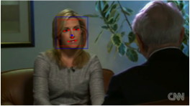
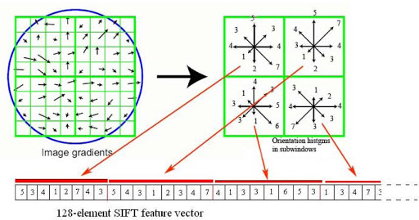
Visual Feature Extraction
Face Detection
and
Land-marking
SIFT Feature Extraction

Slide 8
Audio Feature Extraction
Energy Features
Energy of signal below 250 Hz
Energy of signal above 250 Hz
Energy of total signal
Pitch Features
Fundamental Frequency below 1500Hz
Fundamental Frequency above 1500Hz
Fundamental Frequency of total signal
Speech Features
13 MFCC coeffients
[For each feature described below the mean, standard deviation, max and min across the frames for a video clip was extracted]

Slide 9
Text Feature Extractions
Based on NRC-Canada system from SemEval 2013
Word ngrams (n from 1 to 5)
Character ngrams (n from 3 to 5)
All-caps words
Part of Speech tags
Lexicon scores
Exclamation points and question marks
Emoticons
Elongated words
Twitter token clusters
Negated contexts

Slide 10
Classification Results
90/10 Cross-Validation
Average accuracy over 100 test splits
RBF SVM-Classification (lib-svm)
Audio-Only Feature Classification
3-way: 47%
Binary: 62%
Visual-Only Feature Classification
3-way: 53%
Binary: 63%
Text-Only Feature Classification
3-way: 33%
Binary: 65%

