Slide 1
Relative Attributes Reproduction of Results
Joe Ellis
Relative Attributes Authors:
Devi Parikh and Kristen Grauman

Slide 2
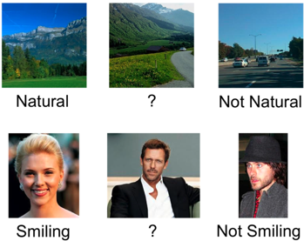
Motivation

Slide 3

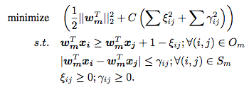
Approach
Ranking Function Constraints
Relaxed Optimization Problem

Slide 4
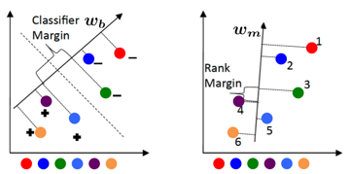
SVM Classification vs. Approach

Slide 5
Reproduction Process Pipeline
Extract features descriptors from images
GIST and Normalized LAB color histogram
Train ranking function
Augment RankSVM to take into account similarity ranks
Choose training images and pairings
Automatically choose random category pairings
Pick training images to train the ranking function from pairings
Build generative probability model for class ranks
Solve for the distributions of unseen classes given seen classes distributions

Slide 6


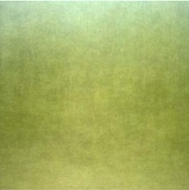
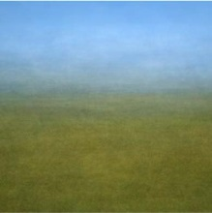
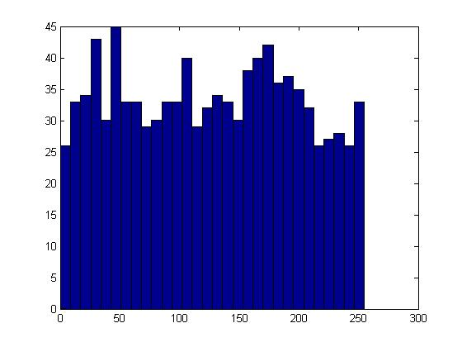
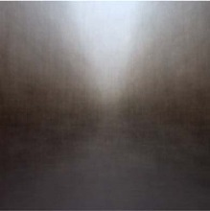

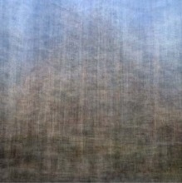
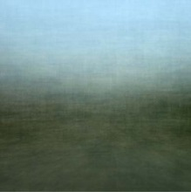
1. Feature Extraction
GIST
Normalized Color Histogram
Reproducibility Results

Slide 7
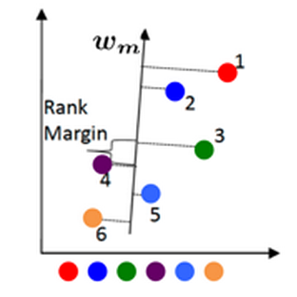
2. RankSVM Implementation
RankSVM with Similarity
Reproducibility Performance

Slide 8
3. Train Scheme
Train Scheme Description
“Unless speciﬁed, we use 2 unseen and 6 seen categories. To train the ranking functions, we use 4 category pairs among seen categories, and unseen categories are described relative to the two closest seen categories for each attribute (one stronger, one weaker). We use 30 training images per class, and the rest for testing”
OSR Relative Ordering

Slide 9
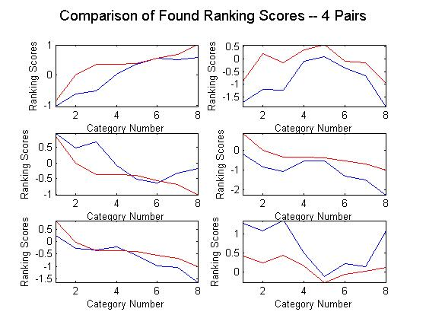
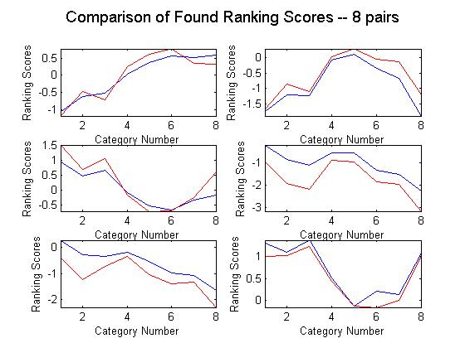
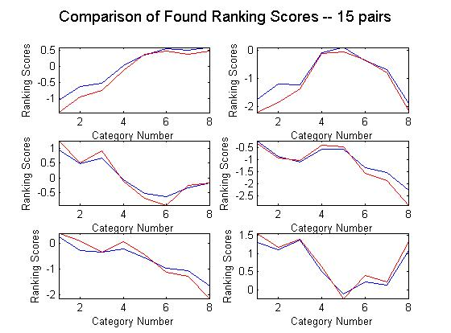
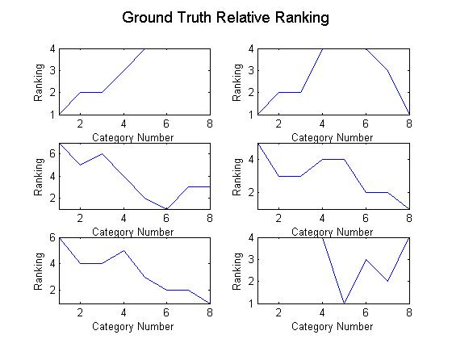

Slide 10
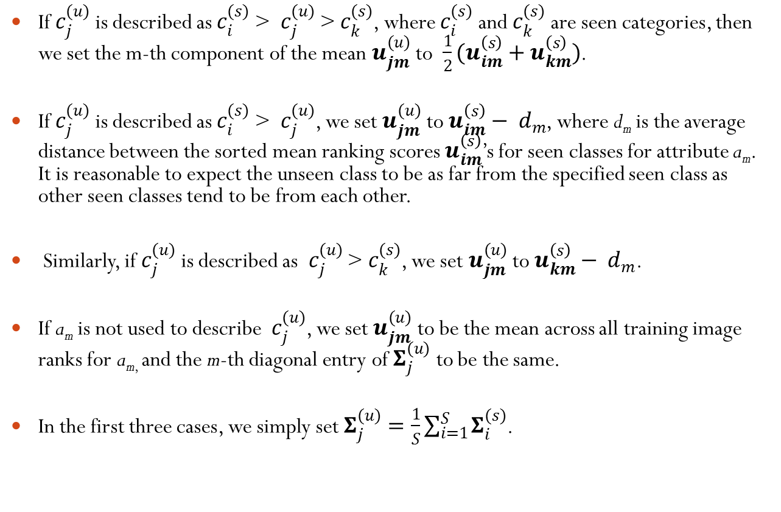
4. Generative Framework
If $c_{j}^{(u)}$ is described as $c_{i}^{(s)}$ > ­ $c_{j}^{(u)}$ > $c_{k}^{(s)}$, where $c_{i}^{(s)}$ and $c_{k}^{(s)}$ are seen categories, then we set the m-th component of the mean $u_{jm}^{(u)}$ to $\frac{1}{2}(u_{im}^{\left(s\right)}+u_{km}^{\left(s\right)})$.
If $c_{j}^{(u)}$ is described as $c_{i}^{(s)}$ > ­ $c_{j}^{(u)}$, we set $u_{jm}^{(u)}$ to $u_{im}^{\left(s\right)}− d_{m}$, where d_{m} is the average distance between the sorted mean ranking scores $u_{im}^{\left(s\right)}$’s for seen classes for attribute a_{m}. It is reasonable to expect the unseen class to be as far from the specified seen class as other seen classes tend to be from each other.
Similarly, if $c_{j}^{(u)}$ is described as ­ $c_{j}^{(u)}$ > $c_{k}^{(s)}$, we set $u_{jm}^{(u)}$ to $u_{km}^{\left(s\right)}− d_{m}$.
If a_{m} is not used to describe $c_{j}^{(u)}$, we set $u_{jm}^{(u)}$ to be the mean across all training image ranks for a_{m,} and the m-th diagonal entry of $Σ_{j}^{(u)}$ to be the same.
In the first three cases, we simply set $Σ_{j}^{(u)}=\frac{1}{S}\sum_{i=1}^{S}{Σ_{i}^{(s)}}$.

Slide 11
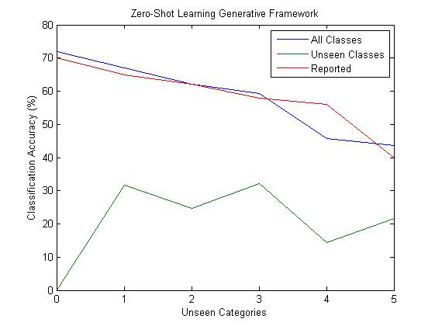

Slide 12
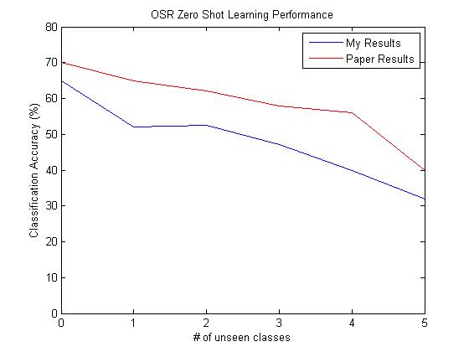
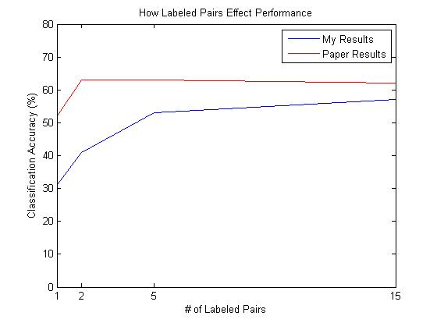
Complete Pipeline Results

Slide 13
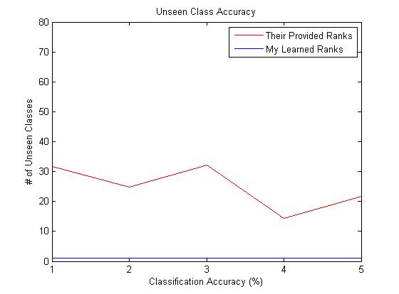
How well can we classify Unseen Classes?

Slide 14
Author Correspondence
Currently in Email Correspondence with the Author
She like my implementation and thought that everything was done properly
Discussed Training Scheme Implementation
“In our experiments, we randomly picked a total of 3000 constraints from all possible constraints.”
This needs to be tested
Offered to link to my implementation from the paper website.
There is no current open-source implementation of their experiments

Slide 15
Final Thoughts
VITAL portions of the experiments performed in “Relative Attributes”, are not properly detailed in the paper.
The Zero-Shot Learning Framework performs poorly
This result is cleverly hidden within the graphs that are presented in the paper.
Reproduction is HARD WORK

