Slide 1
Relative Attributes Reproduction of Results
Joe Ellis
Relative Attributes Authors:
Devi Parikh and Kristen Grauman

Slide 2
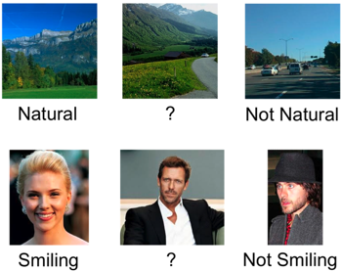
Motivation

Slide 3

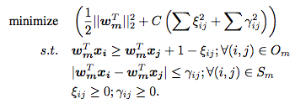
Approach
Ranking Function Desired Outcome
Relaxed Optimization Problem

Slide 4
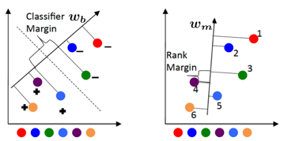
SVM Classification vs. Approach

Slide 5
Reproduction Process Pipeline
Choose training images and pairings
Automatically randomly choose category pairings
Pick training images to train the ranking function from pairings
Train ranking function
Augment RankSVM to take into account similarity ranks
Build generative probability model for class ranks
Solve for the distributions of unseen classes given seen classes distributions

Slide 6
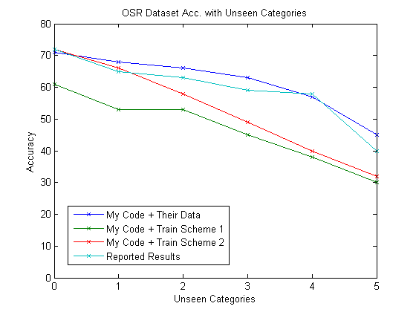
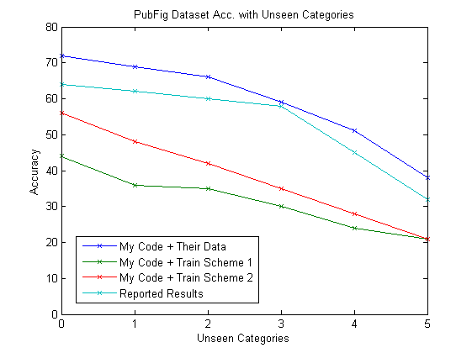
Results – Unseen Categories

Slide 7
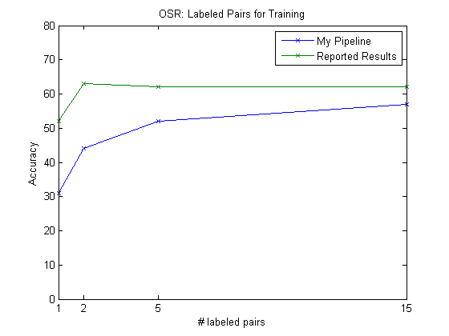
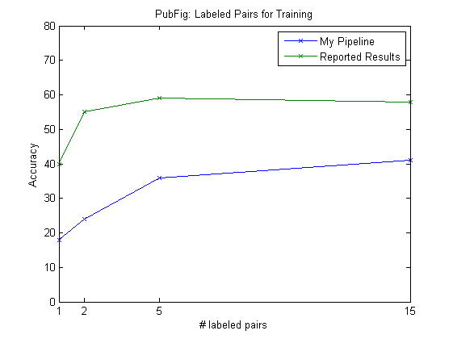
Results – Labeled Pairs

Slide 8
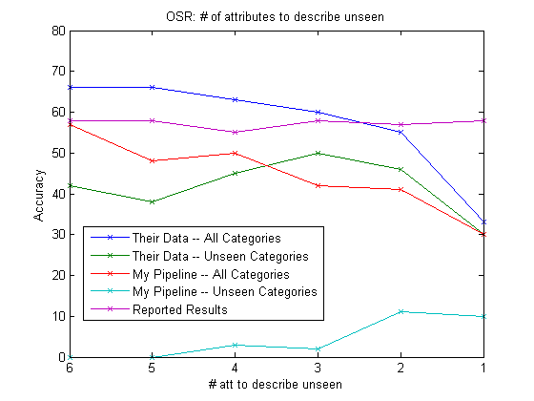
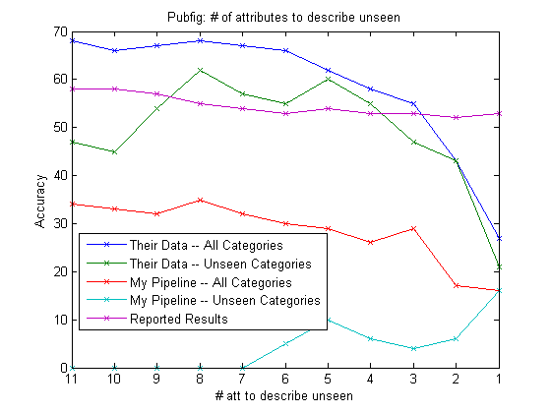
Results – Attributes Used

Slide 9


Reproduction Process Pipeline
Choose training images and pairings
Train ranking function
Build generative probability model for class ranks

Slide 10
Final Thoughts
Next Steps
Contact Author
Determine how they trained the ranking function
Time Permitting
Implement on Videos
Rank the amount of violence and other attributes within video clips
FRUSTRATION
Demonstration!

