Slide 1

Mahindra Tractor Customer Touch-Point Survey
Customer Satisfaction – 60 Day
October, November, December 2022
Prepared by

Slide 2
Purpose of the survey
Engage the customer
Evaluate customer experience
Identify areas of concern within the customer experience

Slide 3
Methodology
CCR completed 300 surveys with respondents who purchased a Mahindra tractor within the past 60 days.
The average survey length was 13.1 minutes.
The data was collected from February 2023 – March 2023.
Calls were made from a list of Mahindra retail customers who accepted delivery of their tractor from October to December 2022.
Individual analyses for product series with 3 or less data points were not conducted.
3

Slide 4
60 - Day

Slide 5
Media spots, dealer signage and friend/family recommendations dominate the ways that customers originally became aware of Mahindra Tractors.
How did you originally become aware of Mahindra Tractors?
5

Slide 6
9 in 10 (T3B = 86%) have high overall satisfaction with their Mahindra tractor.
How would you rate your overall satisfaction with your Mahindra tractor?

Slide 7
60-Day Satisfaction Comparison
(8, 9, & 10) Ratings Shown
Q. How would you rate your overall satisfaction with your Mahindra tractor?

Slide 8
60-Day Satisfaction by Series
Average Satisfaction = 86%
(8, 9, & 10) Ratings Shown
Q. How would you rate your overall satisfaction with your Mahindra tractor?

Slide 9
Product or Performance Quality Issues by Series
% Yes Shown
Q. Have you had any issues with the product or performance quality?

Slide 10

1600 Series

Slide 11
60-Day Satisfaction by Series
(8, 9, & 10) Ratings Shown
Average Satisfaction = 86%

Slide 12
What could Mahindra do to increase your satisfaction to a “9” or “10” rating?
Hydraulics are too slow and fuel problem. It consumes too much fuel.
I'd like to get my grapple fixed, and they sent me a grapple and it lasted for 20 hours and then it bent. I'm still waiting under the warranty.
There was a warranty issue right away, something didn't get tightened up correctly with the manufacturer.
When I bought the tractor I was told that there was no problem getting the parts. It’s a difficult time because it won't be until mid July until they could get the parts. Has been a frustrating experience.

Slide 13
Have you had any issues with product or performance quality?
Percentage represents “Yes” Responses

Slide 14
Please explain the product or performance quality issues that you experienced.
Issue with 1600 Series | Contacted Dealer? | Problem Resolved? | How Resolved?
Bought the tractor brand new and within the first week of having it, a nut came off the shuttle. Called dealer and they order the part but didn't offer to put it on. | Yes | Yes | Called the dealer to order the part that was needed.
Bucket doesn't tilt fast. It's too slow. | No | No
Hydraulic valve on the loader needed to be adjusted, loader was leaking down if you let set over night. | Yes | No
I thought it could be a little stronger but it works great. | Yes | No
I've had some hydraulic fluid leakage. | No | No
Isn't easy to access operate. | Yes | No
It does not tighten, have to tighten multiple things between usage. | Yes | Yes | Just went to the dealer and realized that is how the system is.
14

Slide 15
Please explain the product or performance quality issues that you experienced.
Issue with 1600 Series | Contacted Dealer? | Problem Resolved? | How Resolved?
It was called a right b arm in the back that was bent, had to buy a new one. | No | No
Some hydraulic issue. | Yes | Yes | I only used it 10-15 hours at this point, so I’m waiting to see how it's going to perform.
Some of the bolts weren’t tightened up and had rattled loose during transport on the loader. | Yes | Yes | I’m fine with it.
The equipment wasn't aligned properly on the backside of the tractor, and when I called the dealer he didn't respond to my complaint. | Yes | No
The hydraulics stopped working and got fixed under warranty. | Yes | Yes | They did it as quick as they could possibly do it. It's a little dealership.
The motor is great, but the bottom hook keeps snapping off. I switched them out. | Yes | Yes | Fixed myself.
15

Slide 16
For which of the following items do you use your new Mahindra Tractor?
n = 71
16

Slide 17
What is your primary use of your new Mahindra Tractor?
How many acres do you currently own or lease?
17

Slide 18
What are the primary reasons you choose Mahindra over other brands you considered?
Other Mentions
Durability
American made
Close location
No regen/DPF
Delivery time/availability
Dealership employees, service
n = 71
18

Slide 19
Approximately how many hours do you have on your Mahindra tractor?
9 of 12 have had their 50-hour service completed.
Of these:
5 did it themselves
3 Mahindra dealership
1 had a non-Mahindra mechanic or technician complete it
n = 71
19

Slide 20
How likely would you be to recommend Mahindra to a friend or colleague?
Means – Using a 10-point scale.
1 = Definitely Would Not Recommend
10 = Definitely Would Recommend

Slide 21
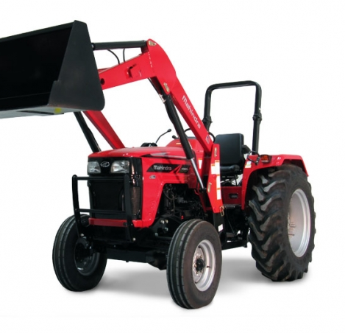
4500 Series

Slide 22
60-Day Satisfaction by Series
(8, 9, & 10) Ratings Shown
Average Satisfaction = 86%

Slide 23
What could Mahindra do to increase your satisfaction to a “9” or “10” rating?
Better dealership service. I had to have a third function valve put on it which was done at the dealership for an added amount of $1100-$1200. A couple days later I noticed a leak up on the front, and both sides were loose, and I was losing hydraulic fluid. Later on I see on a different location more hydraulic fluid on the ground, and then come to find out we have another leak on the main valve that we installed. I didn't take that back to the dealer because of the previous problem and I took care of the problem myself. They didn't seem to understand what I was talking about when I described the problem and asked the mechanics to get back with me, and nobody got back to me.
Better quality control before shipping to dealership.
Get my tractor fixed.
I should have bought an automatic, but I bought a stick shift instead.
Tractor that has six hours and cannot use. Says he is waiting on a check from Mahindra.
When I bought the tractor I had issues with it. It wouldn't crank, and from my understanding it wasn't programmed properly from the dealership that I bought it from. I had other issues with hydraulic, but they have been resolved as well. Issues that were inconvenient that were necessary for the daily functions that made it difficult.

Slide 24
Have you had any issues with product or performance quality?
Percentage represents “Yes” Responses

Slide 25
Please explain the product or performance quality issues that you experienced.
Issue with 4500 Series | Contacted Dealer? | Problem Resolved? | How Resolved?
It won’t drive, it won’t pull itself. Nothing. Received a broken tractor from the very beginning. | Yes | Yes | Have no clue what’s going on with the tractor.
Oil leak. | No | No
Some of the metal is kind of cheap. They break. Had a problem with the hood latch. | No | Yes | I fixed the hood, and everything, we went through the insurance, and I ended up fixing it myself because it was much cheaper due to the deductible of $500 that they asked for as far as my insurance.
The lift on the rear wouldn't go down. | No | Yes | Warranty fixed it.
The clutch situation. My foot is large and messes up the body work of the tractor. | No | No
The differential lock wasn't engaging all the way, it kind of had to maneuver it back and forth to lock in. | No | Yes | I just had to figure out what was going on, everything is resolved.
The exhaust from the engine melted the protective cover for the hydraulic lines. | No | No
25

Slide 26
Please explain the product or performance quality issues that you experienced.
Issue with 4500 Series | Contacted Dealer? | Problem Resolved? | How Resolved?
The exhaust from the engine melted the protective cover for the hydraulic lines. | No | No
The front bearings on the tractor and the wheels went out, and I had an oil cooler leak that was oil. | Yes | Yes | They picked it up and fixed it and brough it back.
The seat was broken and I’m waiting on a new one to come in and get it replaced. | Yes | No
There is a brace on the loader itself. It's about an inch and a half in diameter. I'm working on my loader nothing heavy duty, and I take it over to my burn pile and I went to open the grapple up to let the trash out and my loader wouldn't open up. When I checked it what I noticed that the brace was bent about 4-5 inches up. My friend had to weld that part, and I’ve seen other people with the same similar issue with the brace bending on the Mahindra site. | Yes | No
They ran a wire in the wrong place at the exhaust melted it. | Yes | Yes | Fine.
26

Slide 27
For which of the following items do you use your new Mahindra Tractor?
n = 52
27

Slide 28
What is your primary use of your new Mahindra Tractor?
How many acres do you currently own or lease?
28

Slide 29
What are the primary reasons you choose Mahindra over other brands you considered?
Other Mentions
Quality, durability
No Regen, no DPF
Looks, style
Dealership employees, service
n = 52
29

Slide 30
Approximately how many hours do you have on your Mahindra tractor?
1 of 7 have had their 50-hour service completed.
Of these:
1 did it themselves
n = 52
30

Slide 31
How likely would you be to recommend Mahindra to a friend or colleague?
Means – Using a 10-point scale.
1 = Definitely Would Not Recommend
10 = Definitely Would Recommend

Slide 32
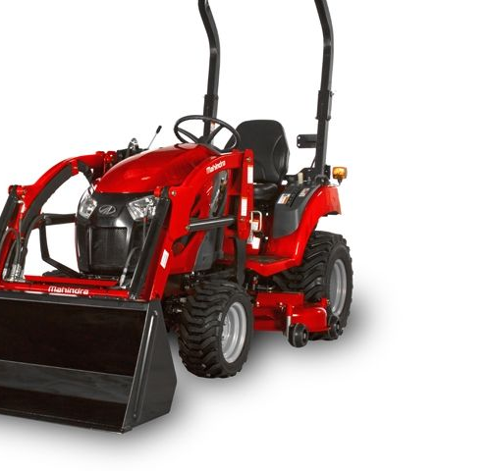
eMax Series

Slide 33
60-Day Satisfaction by Series
(8, 9, & 10) Ratings Shown
Average Satisfaction = 86%

Slide 34
What could Mahindra do to increase your satisfaction to a “9” or “10” rating?
Make sure the fuel gauges work. I just found there's a hydraulic leak and maybe better service because my tractor was delivered where my fuel gauge was not working.
Nothing. Nope 7 is it right now.
They need to redesign the cab of the tractor because it's too small.
Well, give me a heavier unit with better traction. That's not Mahindra’s fault...it's mine. I underestimated the size tractor I got. I wanted a subcompact to get between the house and garage.
Well, the tractor itself is okay but I’m problems with the windshield wiper motor that put me back 3 weeks (having to bring it to them and it was always an excuse from them that the parts were in back order) and that's my second Mahindra that I’ve bought.
Well, there's a couple of design issues: the PTO lines come into the cab on the model I have and for my hand to get in there to change out the ports is very difficult to reach. I could have extensions to the hoses but it will cost me $600.

Slide 35
Have you had any issues with product or performance quality?
Percentage represents “Yes” Responses

Slide 36
Please explain the product or performance quality issues that you experienced.
Issue with eMax Series | Contacted Dealer? | Problem Resolved? | How Resolved?
My tractor stalled out and didn't want to run in extreme temps (around 20 degrees). | No | Yes | I just did a fuel additive and never ran my tractor at such cold temps. (20 degrees).
The 4-wheel drive went out twice because they (the dealer) tried to fix it and they ended up having to buy new parts; but once they got the parts everything has been good. And there was something that made the blades cause the electrics to go out. | Yes | Yes | Dealer repaired once they got the parts.
The part (turn buckle) that connects the 3 point hitch adjustment should be steel instead of aluminum. | No | No
36

Slide 37
Please explain the product or performance quality issues that you experienced.
Issue with eMax Series | Contacted Dealer? | Problem Resolved? | How Resolved?
The snow blower vibrates so bad when it's engaged, and they don't know if it's the drive shaft. It's supposed to be one of the smoothest and I’m getting trouble from Mahindra and the dealer and have requested a new drive shaft but I’m not hearing from anyone. | Yes | No
There was some fluid leaks (hydraulic leak from under the tractor somewhere) and one of the controls (the front loader controls) was not working properly. | Yes | Yes | They repaired the problems with my hydraulic fluid leaks and the control to my front end loader.
37

Slide 38
For which of the following items do you use your new Mahindra Tractor?
n = 40
38

Slide 39
What is your primary use of your new Mahindra Tractor?
How many acres do you currently own or lease?
39

Slide 40
What are the primary reasons you choose Mahindra over other brands you considered?
Other Mentions
Familiarity
Only dealership around to get one.
Size
n = 40
40

Slide 41
Approximately how many hours do you have on your Mahindra tractor?
4 of 4 have had their 50-hour service completed.
Of these:
3 Mahindra dealership
1 did it themselves
n = 40
41

Slide 42
How likely would you be to recommend Mahindra to a friend or colleague?
Means – Using a 10-point scale.
1 = Definitely Would Not Recommend
10 = Definitely Would Recommend

Slide 43
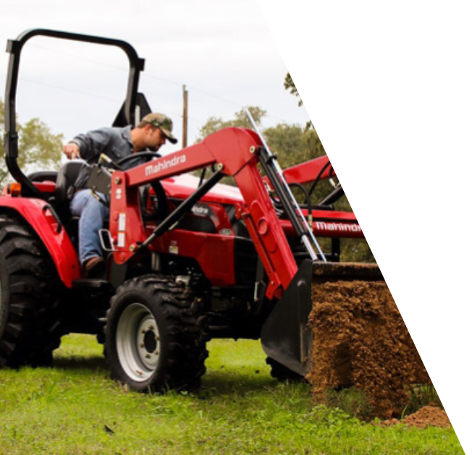
2600 Series

Slide 44
60-Day Satisfaction by Series
(8, 9, & 10) Ratings Shown
Average Satisfaction = 86%

Slide 45
What could Mahindra do to increase your satisfaction to a “9” or “10” rating?
Give money back.
Give more training.
Have another dealership in town.
I don't really know what’s going on. It will not start in the cold weather, that's all I could say.
I think my biggest dissatisfaction is hydraulic because it has a lack of power. It could have more power.
I thought the tractor would have a little more power than it does.
There's just been a few things: a flaw with the couplings. The dealer is going to replace it with the warranty, though. And the tractor also feels a little under-powered (and it's supposed to have more power than the John Deere and Kubota). But I haven't had it long enough yet; but have read so many negative comments and I hope none of them apply to me.

Slide 46
Have you had any issues with product or performance quality?
Percentage represents “Yes” Responses

Slide 47
Please explain the product or performance quality issues that you experienced.
Issue with 2600 Series | Contacted Dealer? | Problem Resolved? | How Resolved?
380 hours and air issue. | Yes | Yes | Sold it.
A little disappointed with the hydraulics on the loader. | Yes | Yes | They did a test on it to see and make sure the hydraulic pump is working at capacity.
Bucket in the front is bent to lite material | No | No
First day I used it the transmission lines were turning red so the battery was over heating the lines. I took it to the dealership and got the problem fixed before it became a larger issue. | Yes | Yes | The dealer handled it.
It's the shifting of the ranges that haven’t meshed together. The 3 point hitch, the sensitivity of the height of the 3 point is far too sensitive, and not precise. | No | No
Lack of power due to the hydraulic transmission. | Yes | No
47

Slide 48
Please explain the product or performance quality issues that you experienced.
Issue with 2600 Series | Contacted Dealer? | Problem Resolved? | How Resolved?
Main plug for wiring harness wouldn’t connect which made it unable to start. | Yes | Yes | Dealership fixed.
Puts in park rolls away, won’t move, rolls away | Yes | Yes | Call and someone picked up tractor.
Steering wheel broke. | Yes | No
The low power and the leaking couplings. And I had smoke blow out of the engine after about an hour and a half and so I cut it off and everything was fine; the levels were still good. And it ran fine the next time I crank it up. | Yes | No
Upon receiving the tractor when I put the machine in 4 wheel drive, and I reverse I get a loud screeching noise from the front end. | No | No
48

Slide 49
For which of the following items do you use your new Mahindra Tractor?
n = 52
49

Slide 50
What is your primary use of your new Mahindra Tractor?
How many acres do you currently own or lease?
50

Slide 51
What are the primary reasons you choose Mahindra over other brands you considered?
Other Mentions
I did a comparison and test drove.
Smaller tractor.
n = 52
51

Slide 52
Approximately how many hours do you have on your Mahindra tractor?
7 of 9 have had their 50-hour service completed.
Of these:
3 Mahindra dealership
1 had a non-Mahindra mechanic complete it
3 did it themselves
n = 52
52

Slide 53
How likely would you be to recommend Mahindra to a friend or colleague?
Means – Using a 10-point scale.
1 = Definitely Would Not Recommend
10 = Definitely Would Recommend

Slide 54
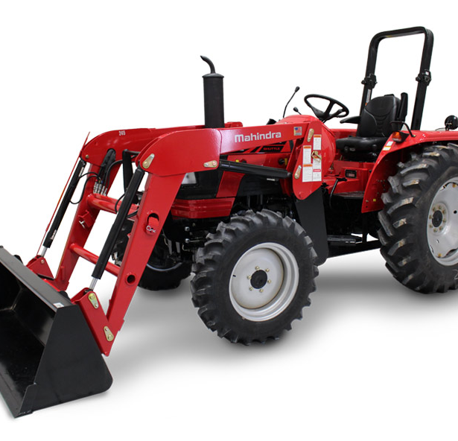
5100 Series

Slide 55
60-Day Satisfaction by Series
(8, 9, & 10) Ratings Shown
Average Satisfaction = 86%

Slide 56
What could Mahindra do to increase your satisfaction to a “9” or “10” rating?
I love the tractor, and they said that we don't have any of the tires (farm) that I wanted, and the tires that I have on them originally are useless, I asked them to swap them, and the dealer was willing but Mahindra wasn't willing to swap them. I have to buy r1 tires (agricultural) , and I have to pay $3000 dollars for them, so I’m stuck with useless tires for my application.
I recently took my tractor into the dealership for a service and they did a terrible job, I don't believe they serviced it to the Mahindra requirements. The first fifty hour service has quite a few things, and I believe they didn't check all those things. And when I got it back my brakes weren’t adjusted properly, and I had an engine light that came on as well.
I wish I would have got a shuttle shift instead of the manual shift
I'm currently in a back and forth with Mahindra customer service, where it turned out that there was a manufacturing issue, added Mahindra backhoe, and there is a sub frame that it attaches to which interferes with the operation of the 3-point hitch.
Just learning how to use it.
They can have some service.

Slide 57
Have you had any issues with product or performance quality?
Percentage represents “Yes” Responses

Slide 58
Please explain the product or performance quality issues that you experienced.
Issue with 5100 Series | Contacted Dealer? | Problem Resolved? | How Resolved?
Bought two and one used and beat up. | Yes | No
Fuel tank has issues. Running out at half. | Yes | No
I have a bottom hose leak on the radiator. | No | No
It wouldn’t drive. | Yes | No
One of the arms on the front end loader is working appropriately. There’s a lot of loose screws, that I continue to find, and have to retighten, however didn't expect to be doing that service that early from getting it for a couple months. | No | No
Same thing, 3-point hitch capturing earlier. | Yes | No
58

Slide 59
Please explain the product or performance quality issues that you experienced.
Issue with 5100 Series | Contacted Dealer? | Problem Resolved? | How Resolved?
The right hydraulic hose was spilling hydraulic fluid out, and it was the way the hose was positioned, so the dealership did a work around. | Yes | Yes | They came out and they did a work around the positioning of the hydraulic hose. And they did it on site on my farm.
The shifter the throttle sticks and doesn’t go into gear a lot of the times | No | No
The third function but the dealer came and fixed it. | Yes | Yes | Came out and fix it.
There were wires that were disconnected and erosion. | Yes | Yes | They came to me for the fix.
Well, the tractor literally depowers itself, you step on the gas and it doesn't want to go. The tractor will not move. It's been doing that on and off, and at one time it wouldn't move at all. | Yes | No
The left turn signal no longer works on the control knob. A broken turf piece, so I can't grease it because it's broken off. I need the pin replaced. | Yes | No
59

Slide 60
For which of the following items do you use your new Mahindra Tractor?
n = 30
60

Slide 61
What is your primary use of your new Mahindra Tractor?
How many acres do you currently own or lease?
61

Slide 62
What are the primary reasons you choose Mahindra over other brands you considered?
Other Mentions
Easy access
No electrical issues
Only thing available
n = 30
62

Slide 63
Approximately how many hours do you have on your Mahindra tractor?
5 of 5 have had their 50-hour service completed.
Of these:
1 Mahindra dealership
1 had a non-Mahindra mechanic complete it
3 did it themselves
n = 30
63

Slide 64
How likely would you be to recommend Mahindra to a friend or colleague?
Means – Using a 10-point scale.
1 = Definitely Would Not Recommend
10 = Definitely Would Recommend

Slide 65
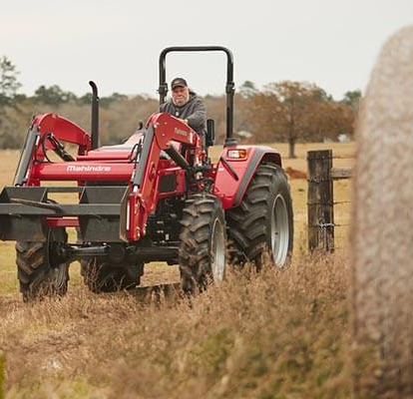
6000 Series

Slide 66
60-Day Satisfaction by Series
(8, 9, & 10) Ratings Shown
Average Satisfaction = 86%

Slide 67
What could Mahindra do to increase your satisfaction to a “9” or “10” rating?
Buy back the tractors I just bought.
Feels as if it’s under powered and light on the rear end wish I had got the more horse power.
Had issues with the tractor low fluid.
Having problems with the tractor.
The last one that I sold had a battery problem.
Their service isn't good. I live on a dirt road on a hill and it wouldn't go up the hill and called them and told them about it and came and fixed the cab on it, but they didn't do anything to make it go up the hill easier. He was trying to put me in a used tractor with an oil leak on it. The warranty didn't cover this issue, and I’m not happy with it.

Slide 68
Have you had any issues with product or performance quality?
Percentage represents “Yes” Responses

Slide 69
Please explain the product or performance quality issues that you experienced.
Issue with 6000 Series | Contacted Dealer? | Problem Resolved? | How Resolved?
Bought the tractor first week of December. Had the hydraulic lines blow on the tractor. The dealership handled the issues on Feb 6. I put a box blade the raised the lift and it got stuck. The dealership has come to get the tractor and they haven’t returned the tractor and I feel like the dealership is giving me the run around. I have had a brand new tractor that’s been pretty much broke since I’ve purchased the tractor. | Yes | No
Doesn’t have the power we thought it should. Afraid it may not tow uphill. | Yes | No
Electrical issues with the air add speed no protection around the third function value. | Yes | No
Electrical problems. It’s been in the shop for two weeks. | Yes | No
69

Slide 70
Please explain the product or performance quality issues that you experienced.
Issue with 6000 Series | Contacted Dealer? | Problem Resolved? | How Resolved?
Front end cylinder broke. | Yes | Yes | Took it to the dealership to be fixed.
Front loader leaks. | Yes | No
Housing transmission broke. | Yes | Yes | Trade in for a new one.
Joystick issues a piece made cheaply not working. | Yes | Yes | I fixed it myself.
Leaking water. | Yes | No
The power steering line was loose. | Yes | Yes | All I had to do was tighten it up.
70

Slide 71
For which of the following items do you use your new Mahindra Tractor?
n = 30
71

Slide 72
What is your primary use of your new Mahindra Tractor?
How many acres do you currently own or lease?
72

Slide 73
What are the primary reasons you choose Mahindra over other brands you considered?
Other Mentions
Just downsizing
Not have scrub maintenance
n = 30
73

Slide 74
Approximately how many hours do you have on your Mahindra tractor?
4 of 4 have had their 50-hour service completed.
Of these:
1 Mahindra dealership
1 had a non-Mahindra mechanic complete it
2 did it themselves
n = 30
74

Slide 75
How likely would you be to recommend Mahindra to a friend or colleague?
Means – Using a 10-point scale.
1 = Definitely Would Not Recommend
10 = Definitely Would Recommend

Slide 76
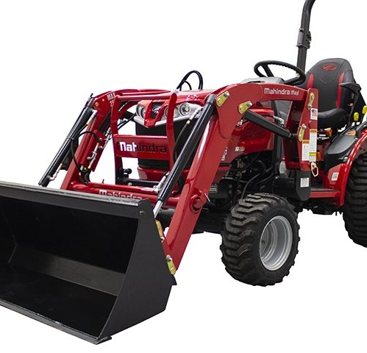
Max

Slide 77
60-Day Satisfaction by Series
(8, 9, & 10) Ratings Shown
Average Satisfaction = 86%

Slide 78
What could Mahindra do to increase your satisfaction to a “9” or “10” rating?
The tractor is a little bit narrow so it has a high probability of rolling over which is how guys get killed. The grapple attachment on the universal skid steer falls off. If I give it down pressure the latching pins fall off. The mountain bracket to the auxiliary hydraulic control is mounted on the crossbeam of the front loader which broke right off. They came out to fix it (the service tech--Mr. Birden) and he came with no tools to fix it. So they picked it up and it took them 3 days to fix it. The sales guy was great, though. The heater doesn't work to the cab, and I found out they didn't hook it up right. So, I called Goff dealership and talked to the guy and they took the broken bracket and used the same single bolt (but just used a bigger bolt) that goes to the front loader crossbeam and this hydraulic bracket flexes back and forth now.

Slide 79
Have you had any issues with product or performance quality?
Percentage represents “Yes” Responses

Slide 80
Please explain the product or performance quality issues that you experienced.
Issue with Max Series | Contacted Dealer? | Problem Resolved? | How Resolved?
I have a hydraulic leak that I’ll have to call the dealer to take a look at. | No | No
My hydraulic leaks down and it makes the bucket sag. | Yes | No
Radiator | Yes | Yes | Replaced the radiator.
80

Slide 81
For which of the following items do you use your new Mahindra Tractor?
n = 20
81

Slide 82
What is your primary use of your new Mahindra Tractor?
How many acres do you currently own or lease?
82

Slide 83
What are the primary reasons you choose Mahindra over other brands you considered?
Other Mentions
Advertisements and experience with other brands
Bought on a whim
Didn't have the after treatment
Ease of purchase
Just drove by and liked the product
n = 20
83

Slide 84
Approximately how many hours do you have on your Mahindra tractor?
2 of 2 have had their 50-hour service completed.
Of these
2 did it themselves
n = 20
84

Slide 85
How likely would you be to recommend Mahindra to a friend or colleague?
Means – Using a 10-point scale.
1 = Definitely Would Not Recommend
10 = Definitely Would Recommend

Slide 86
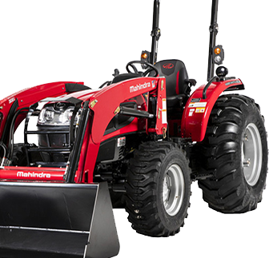
3600 Series

Slide 87
60-Day Satisfaction by Series
(8, 9, & 10) Ratings Shown
Average Satisfaction = 86%

Slide 88
What could Mahindra do to increase your satisfaction to a “9” or “10” rating?
Just when I got it once I drove it speed wise it just needed some tweaks, some rear tires needed a little alignment, and a few things that needed tightened up tweaked.

Slide 89
Have you had any issues with product or performance quality?
Percentage represents “Yes” Responses

Slide 90
Please explain the product or performance quality issues that you experienced.
Issue with 3600 Series | Contacted Dealer? | Problem Resolved? | How Resolved?
Fuse keeps blowing. | No | No
90

Slide 91
For which of the following items do you use your new Mahindra Tractor?
n = 4
91

Slide 92
What is your primary use of your new Mahindra Tractor?
How many acres do you currently own or lease?
92

Slide 93
What are the primary reasons you choose Mahindra over other brands you considered?
Other Mentions
None
n = 4
93

Slide 94
Approximately how many hours do you have on your Mahindra tractor?
0 of 2 have had their 50-hour service completed.
n = 4
94

Slide 95
How likely would you be to recommend Mahindra to a friend or colleague?
Means – Using a 10-point scale.
1 = Definitely Would Not Recommend
10 = Definitely Would Recommend

Slide 96
Overall Scores

Slide 97
Likelihood to Recommend Comparison
(8, 9, & 10) Ratings Shown
97

Slide 98
Availability, support, knowledge and the ability to answer questions are the most important attributes that customers seek.
-3
-4
-5
-3
-3
-21
-1
-1
+12
Listed in order of importance
N = 300
98

Slide 99
78% are highly satisfied with their overall dealer experience.
Overall, how satisfied are you with your dealer experience?
Based on a 10-point scale where a 1 means “very dissatisfied” and a 10 means “very satisfied”.
99

Slide 100
Fixing problems and being honest can help increase satisfaction with dealer.
What could have been done to increase your satisfaction with your Mahindra dealer?
Only asked to those who rated their overall satisfaction with the dealer experience a 7 or lower.
n = 32
100

Slide 101
Parts and routine service dominate the reasons that customers have visited the dealer since purchasing a tractor.
Since purchasing your Mahindra tractor, have you visited the dealer for any of the following reasons?
Other Mentions
Auger fault
Nothing for the tractor, but I had to go to sign paperwork
Sensor blowing up more smoke initially after purchase
Multiple responses allowed
N = 300
101

Slide 102
Types of routine maintenance and/or warranty issue/repair – Hydraulic Repair
What type of routine maintenance and/or warranty issue/repair was required?
Type of Issue/Repair | Series
I went in because I had a leak in my hydraulic line, and they came right out and fixed it. | EMAX
Loose and leaky hydraulic hose for the backhoe. | 1600
The hydraulic thing. | 1600
The hydraulics stopped working and got fixed under warranty on my front-end loader. | 1600
To check the hydraulic pump capability. | 2600
Warranty Repair
102

Slide 103
Types of routine maintenance and/or warranty issue/repair – Performance Failure
What type of routine maintenance and/or warranty issue/repair was required?
Type of Issue/Repair | Series
Front end loader is stuck. | 6000
Repair of faulty heater, bracket to control central station, etc. | MAX
The shaft on the PTO was too long and they came and fixed that. But they made it good. | 2600
The tractor wouldn't start so they had to go in and check all the programming for the tractor. They had to change the main wiring harness on the tractor. | 4500
Windshield wipers and the AC unit is not turning on. | 2600
Warranty Repair
103

Slide 104
Types of routine maintenance and/or warranty issue/repair – Damage From Usage
What type of routine maintenance and/or warranty issue/repair was required?
Type of Issue/Repair | Series
They’re working on replacing the seat. | 4500
Warranty Repair
104

Slide 105
Types of routine maintenance and/or warranty issue/repair – Leak or Fluid Replacement
What type of routine maintenance and/or warranty issue/repair was required?
Type of Issue/Repair | Series
A leaky valve. | 1600
The broken hose. | 6000
Leak | 3600
Warranty Repair
105

Slide 106
Types of routine maintenance and/or warranty issue/repair – Other
What type of routine maintenance and/or warranty issue/repair was required?
Type of Issue/Repair | Series
I was calling on behalf of the battery due to not getting the tractor started. | 2600
It didn't need repair but the hose needed a better installment. | 1600
It was one of the lug nuts on the trailer had to be replaced. | 1600
Quick connects were faulty. | 2600
The clutch | 1600
Warranty Repair
106

Slide 107
Rating Post Purchase Dealer Visit Comparison
Percent ‘Good’ or ‘Excellent’ Ratings Shown
107

Slide 108
Reasons the dealer experience was excellent.
What about the dealer experience made you rate it that way?
Coded Open-End Responses
n = 64
108

Slide 109
Reasons the dealer experience was good.
What about the dealer experience made you rate it that way?
Because they were responsive to my issue, I had 10 bails of hay to be stacked and they came out to fix my issue immediately. Because they had the answers and took the time to find what I needed.
For one the maintenance service part just jumped right on it and got me right in and it wasn't a problem at all.
Friendly people.
Good satisfaction and answered all my questions.
I called them a couple of times then I took it over there and they took care of it.
I think the salesman was very knowledgeable and friendly, he was very easy to work with.
So when I called the dealer was very friendly. When me and my wife came in to look at the tractor they spent a considerate amount of time for us and even stayed open late for us.
They are really good.
They got it taken care of: it took them about 5 days but once they got the parts, they had it fixed the next business day.
They had the parts I needed
They responded to my request and were friendly.
They treated us nice and didn’t have us wait for hours.
They were prompt in getting back to me and had a good recommendation.
They were very efficient.
They were very helpful as far as getting me good hoses and they are very friendly people.
The dealer seemed to have a handle on the whole situation regarding my backhoe.
109

Slide 110
Reasons the dealer experience was neutral.
What about the dealer experience made you rate it that way?
I haven’t been there yet.
I went back and forth from a little while. Had to drive for an hour so I can overpay.
Because I didn't have between neutral and excellent.
110

Slide 111
Reasons the dealer experience was fair.
What about the dealer experience made you rate it that way?
Because the issue is not resolved (fuel gauge is not working); the hydraulic fluid is leaking.
Bought something and wasn’t satisfied.
People at the shop itself wasn't that good but the manger was very helpful.
The parts I was looking for were not available in stock.
The two or three issues I had when buying a brand-new tractor. If I could do it over I wouldn't even buy from the dealer. I had to go and fix my tractor which I shouldn't have to fix.
They've had it for 2 weeks now, and there telling me my tractor should be ready this next week, so I didn't get a speedier response.
111

Slide 112
Reasons the dealer experience was poor.
What about the dealer experience made you rate it that way?
Couldn’t help me. Couldn’t fix my tire.
Lying to me and not telling the truth to me. I had 3 servicemen talk me out of turf tires, and I now have turf tires coming in through a friend in ct.
Overall had to call numerous times to ensure that tractor was ready, once there had to wait 4-5 hours because tractor was not ready.
They fixed 2 out of the 3 things that needed fixing.
They were very slow and were lying to me about stuff.
Well because of the delays in service parts that they promised me for over a month to have done and hadn't done it.
112

Slide 113
Demographic

Slide 114
Demographics
Ethnicity
White Non-Hispanic | 85%
African American | 3%
Hispanic | 4%
Native American | 2%
Other | 4%
Refused | 4%
Gender
Male | 96%
Female | 4%
How many people live in your household?
1 | 11%
2 | 41%
3 | 14%
4 | 14%
5 | 6%
6 + | 6%
Refused | 8%
Age
18 – 24 | 2%
25 – 34 | 4%
35 – 44 | 17%
45 – 54 | 23%
55 – 64 | 27%
65 – 74 | 18%
75+ | 7%
Refused | 2%
Total Household Income
Under $30,000 | 3%
$30,000 but less than $50,000 | 6%
$50,000 but less than $75,000 | 11%
$75,000 but less than $100,000 | 13%
$100,000 but less than $150,000 | 14%
$150,000 + | 25%
Refused | 28%
What is the highest level of education you have completed?
Less than High School | 6%
Graduated H.S. | 33%
Some College | 21%
Graduated College | 29%
Post-Grad | 6%
Refused | 6%
Marital Status
Married | 71%
Single | 13%
Separated | 0%
Divorced | 4%
Widowed | 4%
Refused | 7%
114

