Slide 1
FPGA DRAM Tutorial
2021.05.06 v1.0 黃家翰

Slide 2
Outline
External Memory Interface IP
Avalon Memory-Mapped Protocol
Example Code
Quartus Project Settings
RTL Simulation with Qsys IP
Extension

Slide 3
Outline
External Memory Interface IP
Avalon Memory-Mapped Protocol
Example Code
Quartus Project Settings
RTL Simulation with Qsys IP
Extension

Slide 4
External Memory Interface IP
Arria 10 External Memory Interfaces (EMIF)
這個IP可以將我們用Avalon Memory-Mapped介面傳輸的資料轉換為以DRAM介面傳輸的資料。
由於DRAM控制較複雜，有這個IP我們就能更方便的存取DRAM中的資料。
除了DRAM之外，這個IP也能改成與其他種類的外部記憶體溝通。 Ex. QDRII+ SRAM
External Memory
Arria 10 EMIF
Avalon Memory-Mapped Protocol
User Logic
DRAM Protocol

Slide 5
Outline
External Memory Interface IP
Avalon Memory-Mapped Protocol
Example Code
Quartus Project Settings
RTL Simulation with Qsys IP
Extension

Slide 6
Avalon Memory-Mapped Protocol
The Avalon Memory-Mapped interface specification is designed to accommodate peripheral development for the system-on-a-programmable-chip (SOPC) environment.
The specification provides peripheral designers with a basis for describing the address-based read/write interface found on master and slave peripherals.

Slide 7
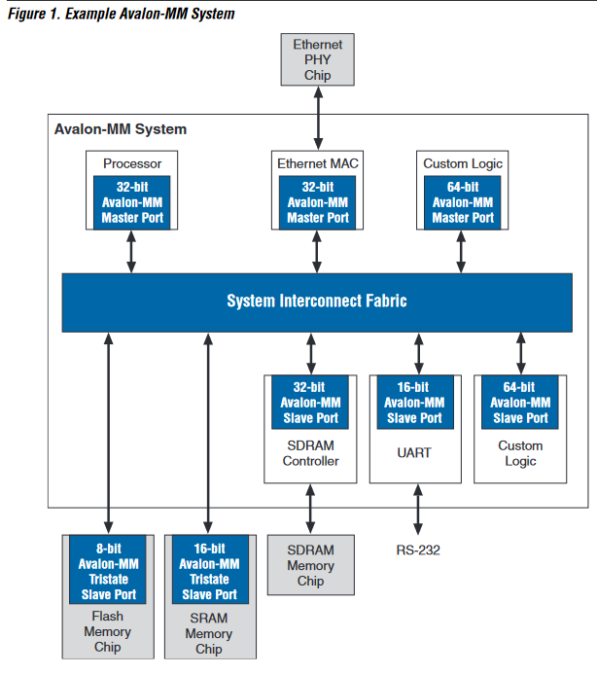

Slide 8
Avalon MM Basic Signals
Signal Type | Width | Direction | Description
address | 1-32 | M -> S | Slave address.
read | 1 | M -> S | Read-request signal to the slave port.
readdata | 1-1024 | S -> M | Data transferred from slave to master by the read operation.
write | 1 | M -> S | Write-request signal to the slave port.
writedata | 1-1024 | M -> S | Data transferred from master to slave by the write operation.
waitrequest | 1 | S -> M | Used to stall the system interconnect fabric when the slave port is not able to respond immediately.
readdatavalid | 1 | S => M | Marks the rising clock edge when the slave asserts valid readdata.

Slide 9
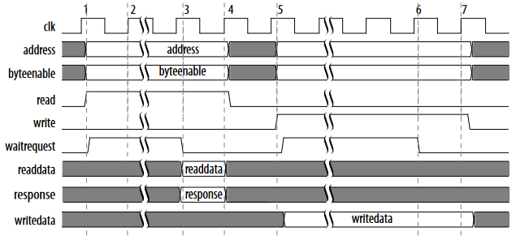
Avalon MM Basic Waveform
readdatavalid

Slide 10
Avalon MM Slave Transfer Types
Variable Latency
Fixed Latency
Pipelined Variable Latency
Pipelined Fixed Latency
Tristate
Burst
More Info:
http://www1.cs.columbia.edu/~sedwards/classes/2009/4840/mnl_avalon_spec.pdf
http://www.innovateasia.com/asia/download/document/knowledge_11_Taiwan.pdf

Slide 11
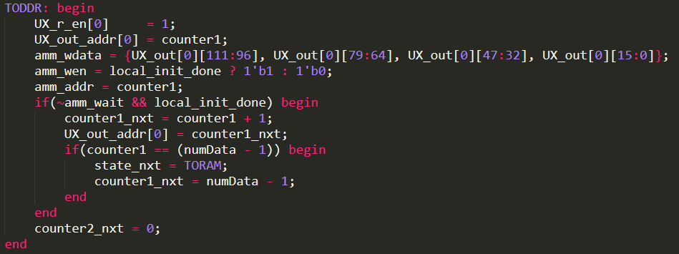
Basic Avalon MM Operation in the example
Write:
與SRAM操作類似。將write拉高並設定好address和writedata。但是當waitrequest訊號為1時，write、writedata、address必須保持為固定值。

Slide 12
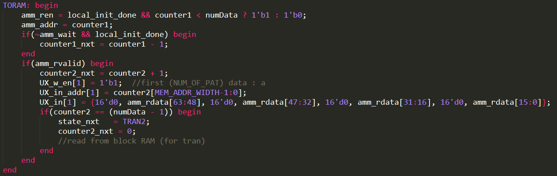
Basic Avalon MM Operation in the Example
Read:
與SRAM操作類似。將read拉高並設定好address。但是當waitrequest訊號為1時，read、address必須保持為固定值。當readdatavalid訊號為1時，表示此時的readdata為有效值。

Slide 13
Outline
External Memory Interface IP
Avalon Memory-Mapped Protocol
Example Code
Quartus Project Settings
RTL Simulation with Qsys IP
Extension

Slide 14
Example Code
Download: https://github.com/jelly99709/FPGA-DRAM-Tutorial
Data Flow:
Input -> Store in BRAM (A) -> Read from (A), Store in DDR4 -> Read from DDR4, Store in BRAM (B) (reversed order) -> Read from (B)-> Output
PCIe
On-Chip
Block-RAM
(A)
Off-Chip
DDR4
On-Chip
Block-RAM
(B)

Slide 15
Example Code
Platform: DE5a-Net (with Arria 10 FPGA)
PCIe: Gen2x8 (250 MHz, 128 bit)
Lab Workstation: (Winnie)
IP: 140.112.48.159
Port: 40720
Prerequisites
FPGA Riffa Tutorial https://github.com/b03901165Shih/2019-FPGA-training-course
DE5a Riffa Settings https://github.com/jelly99709/DE5a-Riffa-Setup

Slide 16
Example Code
Download: https://github.com/jelly99709/FPGA-DRAM-Tutorial
Data Flow:
Input -> Store in BRAM (A) -> Read from (A), Store in DDR4 -> Read from DDR4, Store in BRAM (B) (reversed order) -> Read from (B)-> Output
PCIe
On-Chip
Block-RAM
(A)
Off-Chip
DDR4
On-Chip
Block-RAM
(B)

Slide 17
Example Code
由於DE5a板子上DDR4記憶體的寬度為64bit，而PCIe每個週期傳輸128bit (4筆32bit的資料)。因此在此範例中為了方便起見，每筆資料僅比對低位16bit的正確性。
128 bit
64 bit
128 bit

Slide 18
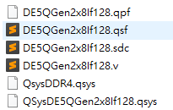

Example Code Reproduce
Copy RIFFA from workstation
cp -r /mnt/ds1515/fpga/riffa_2.2.2/ ./
Open project directory DE5Gen2x8If128
Located at ./riffa_2.2.2/source/fpga/altera/de5/
Copy files under Quartus_Project into their corresponding folders
*.qpf, *.qsf -> prj
*.sdc -> constr
*.v -> hdl
*.qsys -> ip
Copy files under test_DRAM into their corresponding folders.
*.v -> ./riffa_2.2.2/source/fpga/riffa_hdl/
sample_app -> ./riffa_2.2.2/source/c_c++/linux/x64/

Slide 19
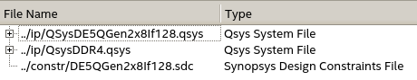
Example Code Reproduce
Open project in Quartus
Open Qsys IP files and generate HDL (兩個IP都要)
Open Qsys tool
File -> Open -> ../ip/QsysDE5Gen2x8If128.qsys or ../ip/QsysDDR4.qsys
Generate -> Generate HDL
Check user-define SDC in the last order
Quartus -> Assignments -> TimeQuest Timing Analyzer
Compile and Program Device
Reboot Computer and Test

Slide 20
Outline
External Memory Interface IP
Avalon Memory-Mapped Protocol
Example Code
Quartus Project Settings
RTL Simulation with Qsys IP
Extension

Slide 21
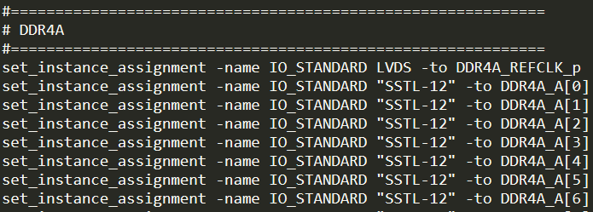
Quartus Project Settings
Check the user manual and example projects in the CD-ROM for more information
DE5: https://www.terasic.com.tw/cgi-bin/page/archive.pl?Language=Taiwan&CategoryNo=159&No=726&PartNo=4
DE5a: https://www.terasic.com.tw/cgi-bin/page/archive.pl?Language=Taiwan&CategoryNo=2&No=1138&PartNo=4
Assignment Settings File
Add DDR4 and RZQ pin assignments to the *.qsf file

Slide 22
DDR4 Qsys IP Design
避免EMIF和clock-crossing bridge中間有timing violation。但會使latency增加。可省略。
處理跨越不同clock domain的AMM訊號
外部記憶體控制IP
Arria 10 EMIF
Pipeline Bridge
Clock-Crossing Bridge
DDR4 Protocol
AMM
AMM
AMM
To DDR
To user logic
(300 MHz)
(300 MHz)
(300 MHz) (user clk)
(user clk)

Slide 23
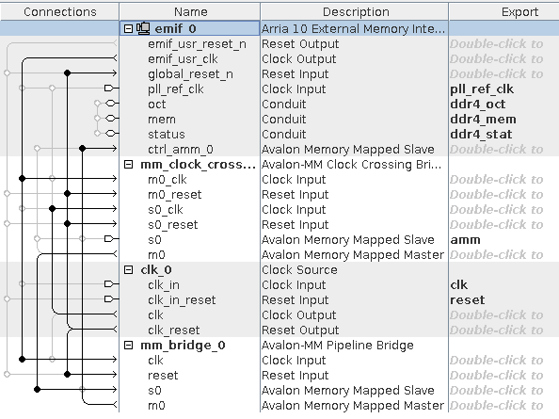
DDR4 Qsys IP Design
如右圖設定IP連線與對外接腳
個別IP參數設定請參考IP_Settings資料夾 (clk、pipelining、burst、FIFO可視需求更改)
EMIF參數設定與DE5a上裝置之DDR有關，請勿任意更改。
完成後點選generate HDL

Slide 24
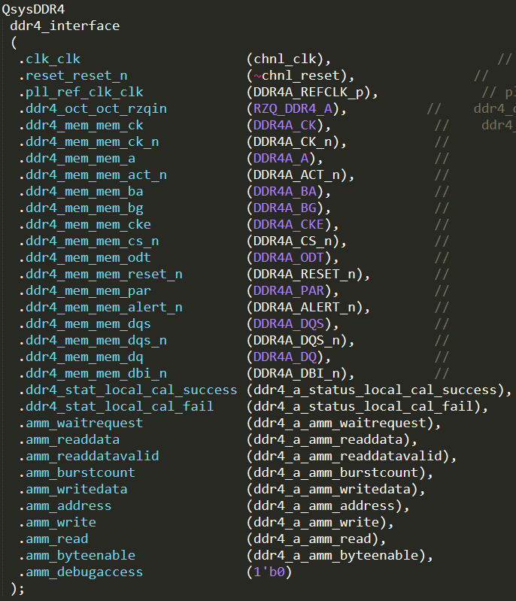
Quartus Top Module
新增對外DDR pin。
新增DDR4 IP instance與對應接腳。
Reset訊號是active low，與riffa reset反相。
新增chnl_tester與DDR4 IP的接口
EMIF校正狀態訊號 只有剛啟動時會出現 當success非1時 不能以AMM與EMIF溝通
※ 具體設置請參考example code

Slide 25
SDC File
EMIF IP status signals to user logic and clock-crossing bridge (EMIF校正狀態訊號並未經過clock-crossing處理，且僅初始化時變動，故設false path)
RIFFA reset signal to Altera EMIF IP (recover time violation) (EMIF內部有reset synchronizer，故可忽略input async reset的recover time violation)

Slide 26
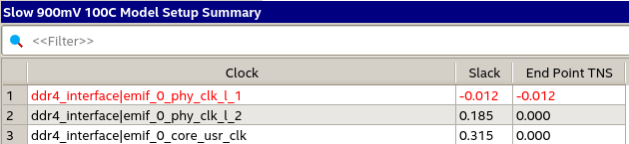
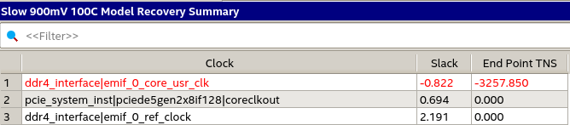
Timing
Compile完在EMIF內部仍有timing violation。但這結果與terasic提供之範例程式結果相似，故暫時忽略。

Slide 27
Outline
External Memory Interface IP
Avalon Memory-Mapped Protocol
Example Code
Quartus Project Settings
RTL Simulation with Qsys IP
Extension

Slide 28
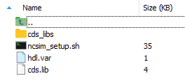
RTL simulation with Qsys IP
Simulation using NCVerilog
cd (Qsys Path)/(IP Name)/sim/cadence/
setenv CDS_ROOT “/cad/cadence/INCISIV/cur/”
bash ncsim_setup.sh SKIP_ELAB=1 SKIP_SIM=1
cp <design and testbench files> ./
ncverilog <testbench_files> <design_files> +access+r

Slide 29
Simulation Memory IP Selection - 1
Altera EMIF IP
Need external memory pins.
DE5a-Net uses Micron DDR4 SODIMM 64x 4GB Memory.
However, Micorn dose not provide verilog simulation model for SODIMM.
External Memory Pins

Slide 30
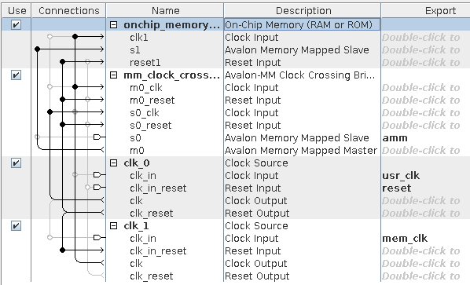
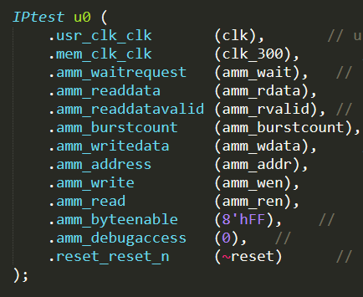
Simulation Memory IP Selection - 2
Altera On-Chip Memory IP
No external pin connection.
Limited memory size (<64Mbit)
See ./Simulation/IPtest.qsys for more information

Slide 31
Simulation Memory IP Selection - 3
Hand-crafted Avalon MM Slave Model
See ./Simulation/amm_slave.v for more information (A simple amm slave model in the variable latency transfer mode)

Slide 32
Memory IP Simulation Example Code
To run the example code in ./Simulation folder:
Open IPtest.qsys in Qsys tool and gerenate HDL.
Follow the instructions in page 26
Data Flow
Testbench
On-Chip
Block-RAM
Model
Memory IP Simulation Model
On-Chip
Block-RAM
Model

Slide 33
Outline
External Memory Interface IP
Avalon Memory-Mapped Protocol
Example Code
Quartus Project Settings
RTL Simulation with Qsys IP
Extension

Slide 34
Extension
Directly Data Transmission between Riffa and DRAM
RTL Simulation with Qsys IP and SODIMM Model
RTL Simulation with hand-crafted full-function amm slave model
Low-Latency DDR Access
Avalon-MM Burst Mode
Avalon-MM DDR Memory Half-Rate Bridge
Timing Violation

Slide 35
Appendix
DDR3 SDRAM Controller with UniPHY
使用在DE5板子(Stratix V FPGA)上時所需的IP，與EMIF的功能大同小異。
IP參數設定與pin assignment請參考附件DRAM_DE5.zip
DDR3
Memory
SDRAM Control
Avalon Memory-Mapped Protocol
User Logic
DDR3 Protocol

