Slide 1
SIGNATURE LINE
Signature Line
Signature Care Crafted with Ceramique’s Exclusive Recipe
KS Injection
KS Injection Ceramique-recipe booster from autologous cell components — Injucell · Celcore regeneration program
3cc 790,000
6cc 1,410,000
KK Injection
KK Injection Premium booster: Ceramique recipe of autologous cells & collagen — RAJUNISS stem cells · Celcore
1 Kit 3,850,000
Premium KK Injection
3 Kits 4,500,000
Full-Face Contouring Botox
Customized planning before treatment.
Precisely refines all facial muscles for a defined yet soft impression.
Domestic 250,000
Imported 550,000
Neck Contouring Botox
Customized planning before treatment.
Eases turtle neck and slims the jaw, neck and shoulder lines for an elegant look.
Domestic 300,000
Imported 700,000
Signature Face and Neck Total Contouring Botox
Customized planning before treatment.
Precisely balanced to refine face shape, neckline, décolletage, and skin texture.
Domestic 500,000
Imported 1,100,000
Skin Texture Smoothing Program
Pores / Scars / Trouble Spots 1:1 Custom Curation
Potenza (Full-Face)
Analyzes the cause · size · depth · texture · color of pores, scars and breakouts to improve them
* Pain Care: Anesthetic Cream, Local Anesthesia
* Aftercare: O2Derm + Modeling Pack
* Each session is customized by combining Potenza + JUVELOOK, Olidia, or Skin Botox (choose 1) depending on skin condition.
1 Session 550,000
3 Sessions 1,450,000
5 Sessions 1,990,000
* VAT 10% excluded.

Slide 2
BOTULINUM TOXIN
Botox
Domestic · Domestic Premium, Low-Resistance German · American Original
Wrinkle Botox
Wrinkle Botox 1 Area Softens wrinkles to restore a naturally relaxed expression.
Choose 1: forehead / glabella / around the eyes / bridge of the nose / cobblestone chin
Domestic 30,000
Premium 50,000
German 80,000
American 120,000
Muscle Botox
Jaw Botox 50U
A treatment that eases unconscious tension and softens a squared jawline into a smooth contour.
Domestic 70,000
Premium 100,000
German 150,000
American 300,000
Special Area Botox
Special Area Botox 50U
Controls excessive muscle movement in each area to ease facial asymmetry
and imbalances caused by expression habits,
creating an overall refined facial contour.
Choose 1: Nostrils / Mouth Corners / Upper-Lip Wrinkles / Gummy Smile / Temporalis / Submandibular Gland / Parotid Gland
Domestic 100,000
Premium 150,000
German 200,000
American 350,000
Skin Botox
Full-Face Skin Botox 3cc
Focuses on forehead and cheek texture — tiny, dense doses injected into the dermal · sub-epidermal layer.
Domestic 100,000
Premium 150,000
German 200,000
American 300,000
Jawline Skin Botox 2cc
Improves jawline and under-jaw skin elasticity, refining the jaw contour.
Domestic 50,000
Premium 70,000
German 100,000
American 150,000
Hyperhidrosis · Body Botox
Hyperhidrosis Botox 100U
Choose 1: Hands / Feet / Underarms
Domestic 200,000
Premium 300,000
German 400,000
American 500,000
Body Botox 100U
Choose 1: Calves / Front Thighs / Trapezius · Customized planning before treatment.
Domestic 250,000
Premium 350,000
German 450,000
American 550,000
* VAT 10% excluded.

Slide 3
FILLER
Fillers
Volume Restoration
Face Filler
*Face 1cc excludes special areas
Celestella Hyaluronic Acid (HA) based filler.
Face 1cc 150,000
JUVÉDERM / BELOTERO
Premium HA filler from global pharma companies
Face 1cc 400,000
Aegyo · Under-eye · Special Areas · Glabella · Eyelids · Brow Bone 1cc 550,000
Restylane Swedish Galderma premium Hyaluronic Acid (HA) filler.
Face 1cc 450,000
Filler Package Available for 3cc or more.
Determined after consultation.
Filler Dissolving Injection
Hyalase 1 Syringe
100,000
* VAT 10% excluded.

Slide 4
FAT DISSOLVING
Fat Dissolving
Face and Body Shape Refinement
CeraFit
CeraFit FACE (1cc)
1 Session 30,000
3 Sessions 80,000
5 Sessions 130,000
CeraFit BODY (10cc)
1 Session 80,000
3 Sessions 180,000
5 Sessions 250,000
CeraFit Package (FACE)
Double Chin (3cc)
1 Session 69,000
3 Sessions 180,000
5 Sessions 250,000
Buccal Fat (3cc)
1 Session 69,000
3 Sessions 180,000
5 Sessions 250,000
Both Cheeks (6cc)
1 Session 120,000
3 Sessions 290,000
5 Sessions 450,000
Bellacholine
Bellacholine Double Chin (2cc)
1 Session 400,000
3 Sessions 990,000
5 Sessions 1,490,000
CeraFit Package (BODY)
Upper / Lower Abdomen / Love Handles (30cc)
1 Session 220,000
3 Sessions 600,000
5 Sessions 950,000
Upper Arm / Accessory Breast / Bra-Line (60cc)
1 Session 400,000
3 Sessions 990,000
5 Sessions 1,300,000
Choose 1: Inner Thighs / Outer Thighs / Saddlebags
1 Session 550,000
3 Sessions 1,200,000
5 Sessions 1,500,000
* VAT 10% excluded.

Slide 5
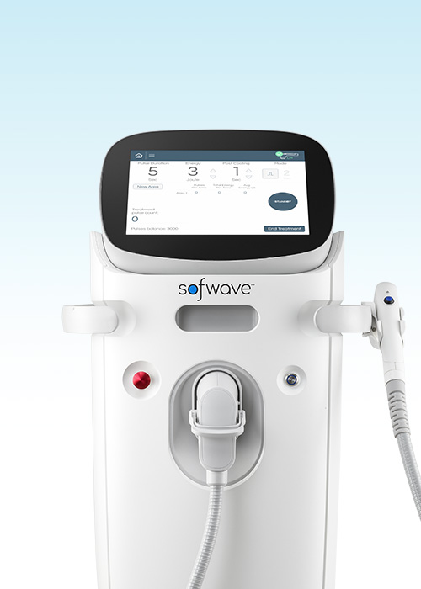
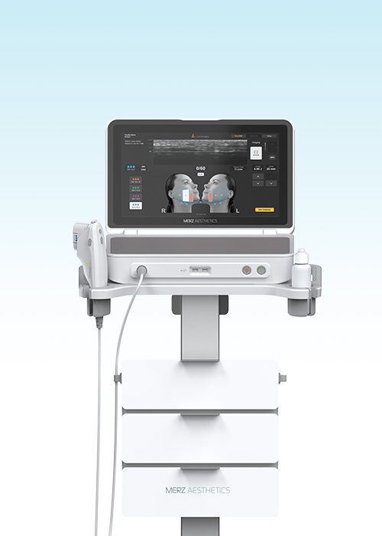
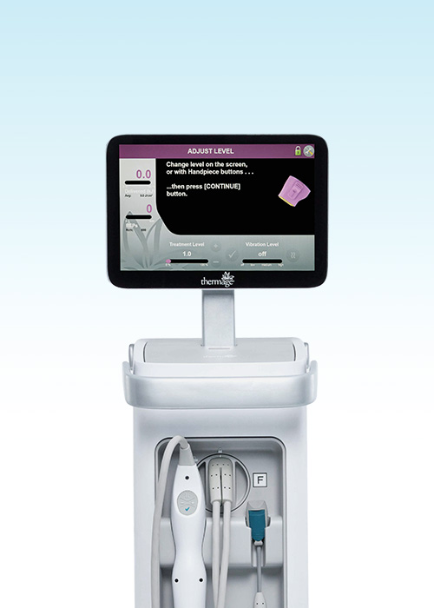
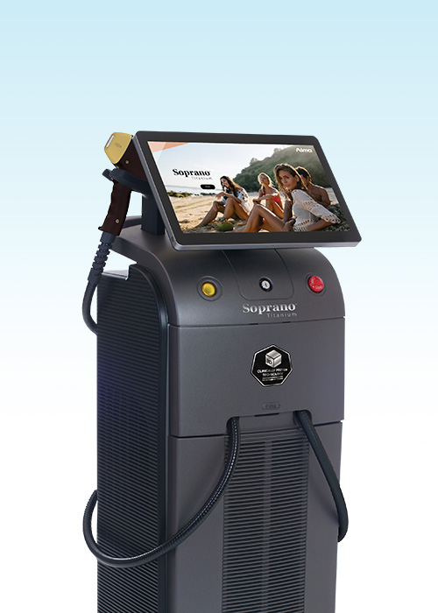
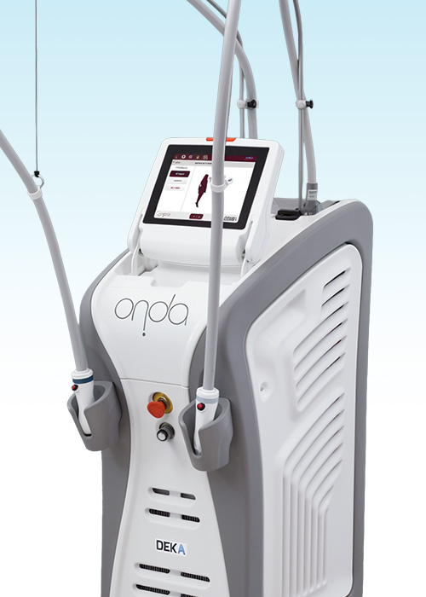
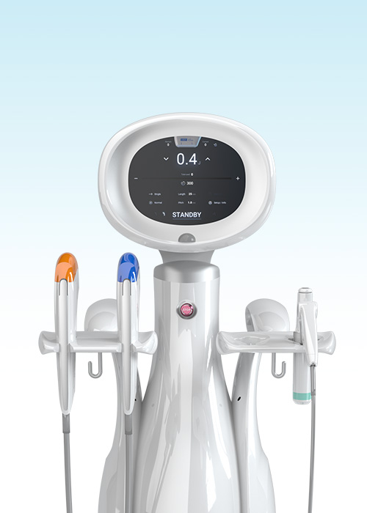
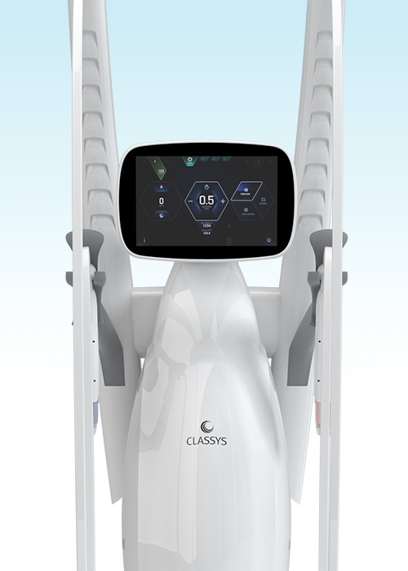
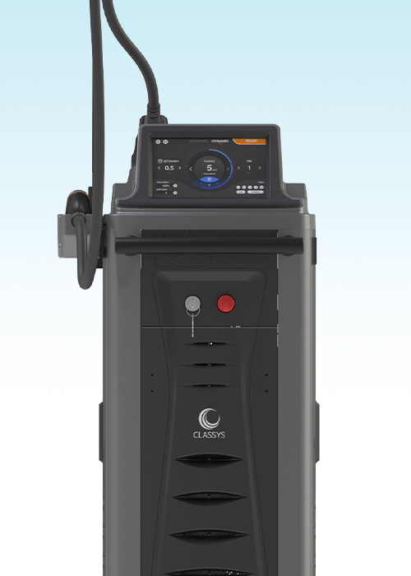
LIFTING DEVICE
Lifting Devices
A Personalized Anti-Aging Plan
SOFWAVE
Sofwave
ULTHERAPY PRIME
Ultrasound lifting that targets the
mid-to-lower dermis at 1.5mm.
Firms thin, sagging skin
without the risk of
cheek hollowing.
Ultherapy PRIME
Focused ultrasound reaching the
sagging facial SMAS layer.
Powerful contouring and lifting
that lasts over a year.
THERMAGE FLX
TITANIUM
Thermage FLX
Titanium
Monopolar radiofrequency
tightens the entire dermis,
effective for firmness and
fine-line improvement.
Precise energy delivery
activates collagen for firmness
that builds deep from within
and long-lasting lifting.
ONDA
SHURINK UNIVERSE
ONDA
Shurink Universe
Microwave energy for
fat & cellulite reduction.
Low discomfort, for both
FACE · BODY care.
2nd-gen HIFU delivered from the
SMAS layer to the dermis.
2.5x faster speed and
7 customizable cartridges.
VOLNEWMER
FORTRA
Volnewmer
Fortra
Delivers 6.78MHz monopolar RF
deep into the skin.
Dermal collagen regeneration
for lifting and firmness.
755·808·940·1064nm
4 wavelengths and powerful cooling reduce pain while promoting fat reduction · retaining-ligament strengthening · collagen remodeling.

Slide 6
LIFTING
Lifting
A Personalized Anti-Aging Plan
Sofwave
Sofwave
100 Pulses 1,100,000
200 Pulses 1,900,000
300 Pulses 2,700,000
Ultherapy PRIME
Ultherapy PRIME
300 Shots 1,300,000
600 Shots 2,300,000
900 Shots 3,400,000
100 Shots Extra Standalone Not Available
450,000
Thermage FLX
Eye Thermage
225 Shots 1,300,000
450 Shots 2,000,000
Thermage FLX
300 Shots 1,500,000
600 Shots 2,200,000
900 Shots 3,000,000
Fortra
Fortra
30KJ 500,000
50KJ 800,000
100KJ 1,300,000
10KJ Extra Standalone Not Available
200,000
Titanium
Titanium
30KJ 500,000
50KJ 800,000
100KJ 1,300,000
10KJ Extra Standalone Not Available
200,000
ONDA
ONDA FACE
50KJ Double Chin 400,000
80KJ Double Chin + Lower Face 600,000
100KJ Full-Face 800,000
ONDA FACE 10KJ Extra Standalone Not Available
100,000
ONDA BODY
100KJ 900,000
200KJ 1,500,000
300KJ 2,200,000
500KJ 3,000,000
Shurink Universe
Eye Shurink Universe
200 Shots 150,000
Derma Shurink Universe
300 Shots 200,000
Shurink Universe
300 Shots 200,000
600 Shots 350,000
1,000 Shots 600,000
Volnewmer
Volnewmer
Eye Area 200 Shots 380,000
Sagging Jawline 300 Shots 550,000
Full-Face 600 Shots 990,000
* VAT 10% excluded.

Slide 7




LASER DEVICE
Laser Devices
Melasma/Spots · Redness · Pores/Scars · Hair Removal
PICOLITE BLACK
PICOLITE Black
A pico laser emitting ultra-short bursts of energy lasting one-trillionth of a second.
Gentler than nano lasers, it improves pigmentation · pores · scars · skin tone
precisely and safely.
Pico Toning
Melasma · Spots
Mole · Age Spot Removal
CO2
Co2
A laser that precisely vaporizes and cuts lesion tissue. Used to remove moles, milia, seborrheic keratosis, flat warts and other superficial skin lesions, and for skin-surface resurfacing treatments.
Moles · Milia
Seborrheic Keratosis · Warts
Skin Lesion Removal
POTENZA
Potenza
Micro-needles penetrate the skin to deliver radiofrequency (RF) energy
to the target depth. Various tips and modes help improve pores · scars · texture ·
elasticity, and it can be combined with skin booster treatments.
Pores · Scars
Skin Texture · Elasticity
Skin Booster Injection
BROADBAND LIGHT
BBL
A light therapy device delivering broadband light energy to different skin depths. It improves pigmentation such as melasma and spots along with redness and vascular lesions, for a clear, even skin tone and texture.
Melasma · Spots
Redness · Vessels
Even Skin Tone
AVALANCHE
Avalanche
Device image
A laser hair-removal device that adjusts energy to hair type and skin type. Powerful cooling reduces pain, removing hair quickly and evenly over large areas from face to body.
Women’s Hair Removal
Men’s Hair Removal
Face · Body

Slide 8
LASER
Laser
Melasma/Spots · Pores/Scars
Melasma/Spots
PICOLITE Black — Improves pigmentation and skin tone precisely and safely with ultra-short pulse energy.
Pico Toning
1 Session 150,000
5 Sessions 650,000
10 Sessions 1,100,000
Body Toning
1 Session 200,000
5 Sessions 900,000
10 Sessions 1,300,000
Tattoo Removal
1 Session / 1x10 Lettering 200,000
1 Session / Business Card-Sized 250,000
CO2 Mole Removal
Precise removal of moles, milia, age spots, flat warts / Retouch not included
Small Mole (1 ea) 30,000
Full-Face or Full Neck (up to 50 ea)
500,000
Big Mole (1 ea) 50,000
BBL HERO (FACE)
Premium high-end light therapy · 1 Session
Forever Young 550,000
SkinTyte 550,000
Clear 550,000
BBL HERO (BODY)
Per 15 × 15 cm area or per body part · 1 Session
Forever Young 800,000
SkinTyte 800,000
Clear 800,000
* Forever Young: skin texture · skin tone (BODY: DNA rejuvenation), SkinTyte: pores · fine lines · lifting, Clear: breakouts
Pores / Scars
Pico Fraxel
A fractional laser that emits micro-beams to stimulate skin regeneration.
Butterfly Zone 100,000
Full-Face 200,000
Potenza Pores · Scars
Full-Face · Personal Tip — micro-needle heat: renewal · pores
1 Session 250,000
3 Sessions 690,000
5 Sessions 990,000
Add-on) Subcision, 1 area (palm-sized)
A procedure that releases the fibrous tissue beneath depressed acne scars so the scars fill back up.
1 Session 150,000
* VAT 10% excluded.

Slide 9
LASER HAIR REMOVAL
Laser Hair Removal
Avalanche — Women’s · Men’s Hair Removal
Avalanche Women’s Hair Removal
Underarms or Upper Lip or Sideburns
1 Session 50,000
5 Sessions 150,000
Underarms + Upper Lip
1 Session 80,000
5 Sessions 250,000
Forehead (incl. Hairline) or Back of Neck
1 Session 90,000
5 Sessions 300,000
Full-Face (incl. Forehead · Glabella)
1 Session 120,000
5 Sessions 390,000
Fingers + Back of Hands or Toes + Tops of Feet
1 Session 70,000
5 Sessions 200,000
Lower or Upper Arm (incl. Elbow)
1 Session 120,000
5 Sessions 390,000
Full Arms (to Wrists)
1 Session 200,000
5 Sessions 600,000
Calves (incl. Knees)
1 Session 120,000
5 Sessions 390,000
Thighs (incl. Knees)
1 Session 160,000
5 Sessions 500,000
Full Legs (to Ankles)
1 Session 230,000
5 Sessions 700,000
Abdomen (incl. Happy Trail)
1 Session 120,000
5 Sessions 390,000
Full Back
1 Session 200,000
5 Sessions 600,000
Avalanche Men’s Hair Removal
Upper Lip + Chin + Under-Chin
1 Session 80,000
5 Sessions 300,000
Full Lower Face (Upper Lip · Chin · Jawline · Sideburns · Cheeks · Under-Chin)
1 Session 120,000
5 Sessions 450,000
Full-Face (incl. Forehead · Hairline · Glabella · Under-Chin)
1 Session 170,000
5 Sessions 650,000
Add-on) Neck
1 Session 70,000
5 Sessions 250,000
Forehead (incl. Hairline)
1 Session 70,000
5 Sessions 250,000
Back of Neck
1 Session 120,000
5 Sessions 390,000
Underarms
1 Session 70,000
5 Sessions 200,000
Fingers + Back of Hands or Toes + Tops of Feet
1 Session 70,000
5 Sessions 200,000
Lower or Upper Arm (incl. Elbow)
1 Session 150,000
5 Sessions 450,000
Full Arms (to Wrists)
1 Session 230,000
5 Sessions 700,000
Calves (incl. Knees)
1 Session 150,000
5 Sessions 450,000
Thighs (incl. Knees)
1 Session 200,000
5 Sessions 600,000
Full Legs (to Ankles)
1 Session 250,000
5 Sessions 750,000
Chest (incl. Areola) or Abdomen (incl. Happy Trail) *Based on the solar plexus line
1 Session 160,000
5 Sessions 500,000
Full Back
1 Session 250,000
5 Sessions 750,000
* VAT 10% excluded.

Slide 10
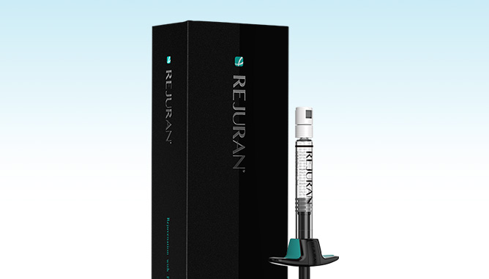
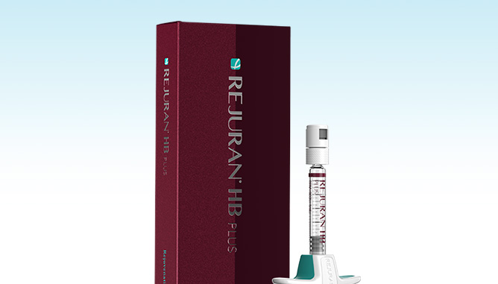
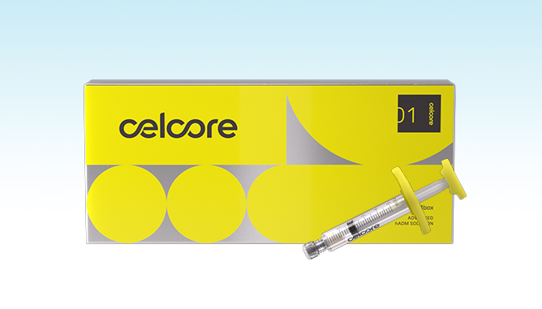
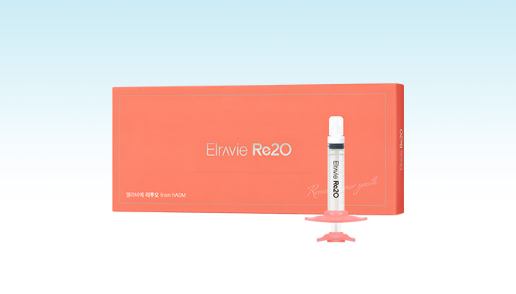
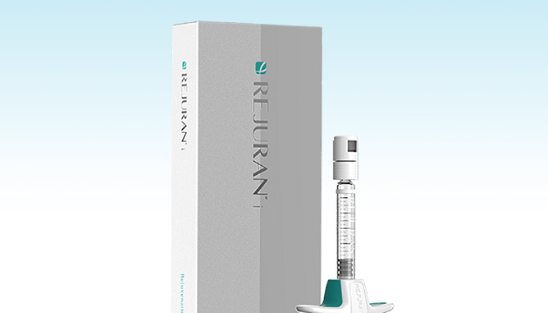
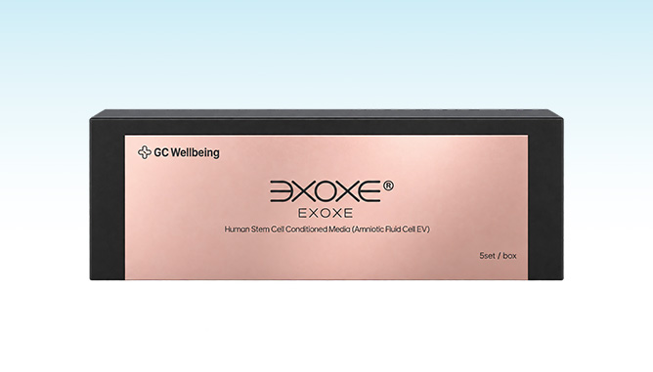
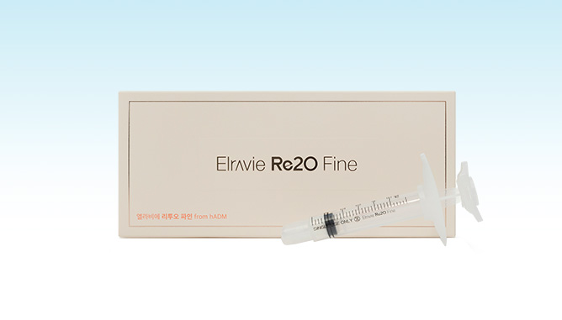
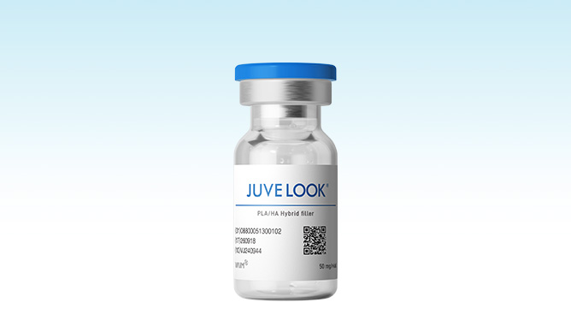
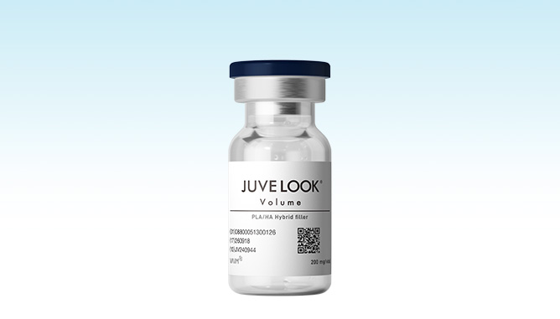
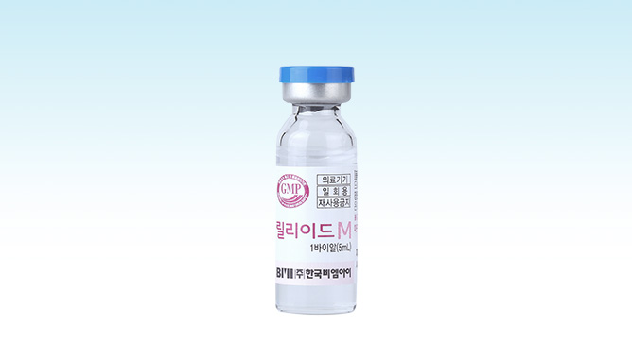
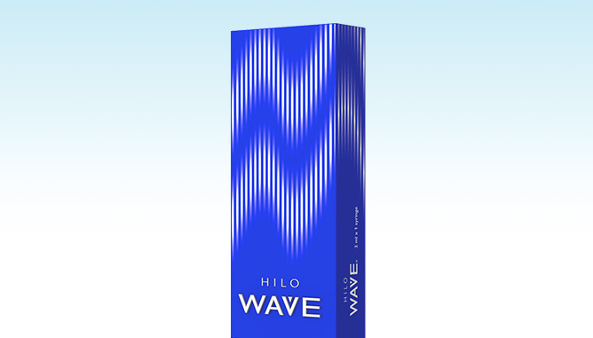
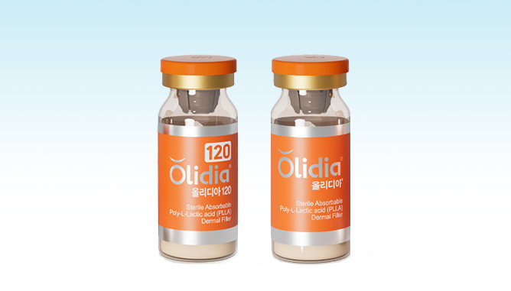
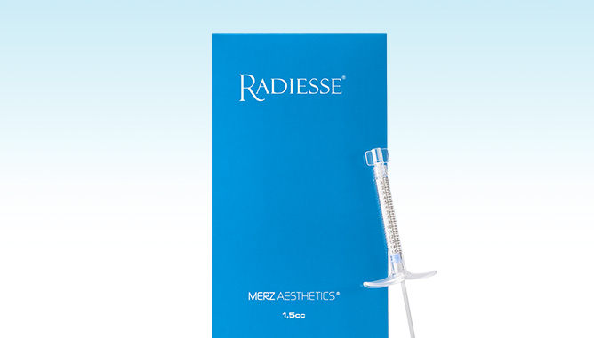
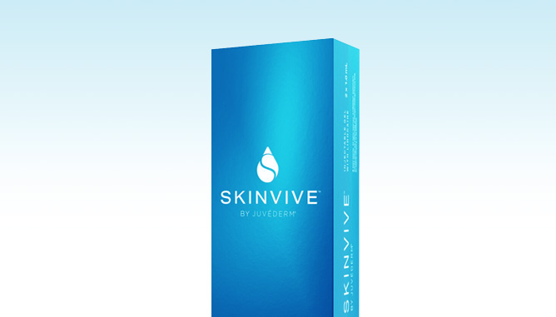
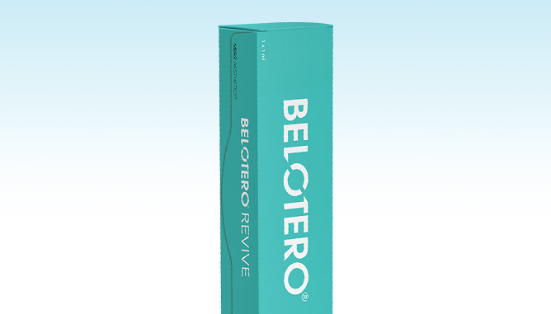
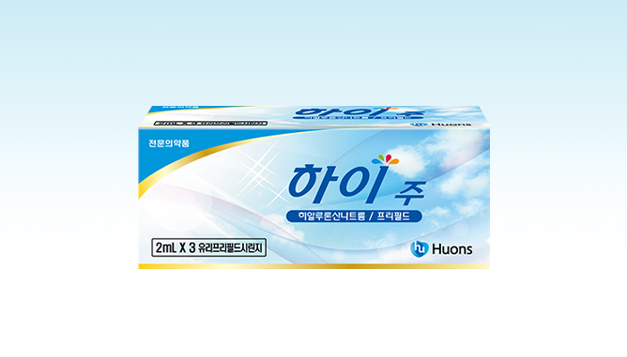
SKIN BOOSTER
Skin Booster
Regeneration · Collagen/Volume · ECM · Elasticity/Glow
Regeneration
ECM
REJURAN Healer
REJURAN HB
Celcore
Elravie Re2O
Salmon-derived PN — Strengthens Skin Barrier
Low pain · Hyaluronic Acid added for Extra Hydration
ECM-based — Structural Skin
Regeneration and Restoration
Acellular Dermal Matrix-based — Immediate Skin
Remodeling
REJURAN I
EXOXE
Elravie Re2O Fine
Eye-area only — Softens Fine Lines
Regenerative Signaling — Barrier Repair ·
Anti-inflammation · Elasticity · Texture
For Delicate Areas — Acellular Dermal Matrix
Skin Booster
Collagen / Volume
Elasticity / Glass Skin
JUVELOOK Skin
JUVELOOK Volume
Lilied M
HILO WAVE
PDLLA — Texture Refinement · Pore Reduction
A Collagen Booster for
an Elegant Contour
HA — Hydration and Oil-Water Balance
High-Purity HA Collagen Booster
— Hydration · Elasticity · Texture
Olidia 120 · 365
RADIESSE
JUVÉDERM SKINVIVE
BELOTERO REVIVE
PLLA — Stimulates fibroblasts,
Induces Collagen Production
CaHA — Immediate Volume and
Long-lasting Elasticity
Premium HA — Long-lasting Hydration ·
Fine-line Improvement
HA + Glycerol — Hydration · Barrier Strengthening · Anti-inflammation
HIJU
High-Density Hydration Care

Slide 11
SKIN BOOSTER
Skin Booster
Regeneration · Collagen/Volume · ECM · Elasticity/Glow
Regeneration
REJURAN Healer (2cc)
300,000
REJURAN HB (1cc)
200,000
REJURAN I (1cc)
200,000
EXOXE (2.5cc)
300,000
Collagen · Volume
JUVELOOK Skin
4cc 400,000
1Vial(8cc) 700,000
JUVELOOK Volume (8cc)
1 Session 800,000
3 Sessions 2,000,000
Olidia
120 (4cc) 400,000
365 (1 Vial) 800,000
RADIESSE 1 Syringe
1 Session 1,000,000
3 Sessions 2,500,000
ECM
Celcore 1 Syringe
800,000
Elravie Re2O 1 Vial (6cc)
800,000
Elravie Re2O Fine 1 Vial (2cc)
600,000
Elasticity · Glass Skin
Basic Glass Skin Injection (2cc)
99,000
Lilied M 1 Vial (5cc)
180,000
HILO WAVE
2cc 700,000
4cc 1,400,000
JUVÉDERM SKINVIVE (2cc)
700,000
BELOTERO REVIVE (2cc)
800,000
Tip Add-ons
Add-on: DermaShine Tip
100,000
Add-on: Potenza Pumping Tip
250,000
* VAT 10% excluded.

Slide 12
MEDICAL SKINCARE
Medical Skincare
Medical Skincare Recommended by Ceramique
Cleansing & Daily Care
Aqua Peel (Stage 1/2/3)
Removes impurities and sebum from pores + supplies hydration and nutrition
1 Session 69,000
5 Sessions 299,000
Cryo Soothing Care
Rapid cooling — Soothes redness and swelling
1 Session 69,000
5 Sessions 299,000
Ion Vitamin Whitening Care
Delivers highly concentrated ionized Vitamin C deep into the skin
1 Session 69,000
5 Sessions 299,000
SONO Ultrasound Care
Stabilizes skin condition through ultrasound vibration
1 Session 69,000
5 Sessions 299,000
Ionzyme Whitening Care
Uses micro-current for hydration · soothing · texture improvement
1 Session 69,000
5 Sessions 299,000
Ionzyme + SONO Care
Skin condition stabilization · Texture improvement
1 Session 99,000
5 Sessions 450,000
Special Care
LDM (Ulkin)
Triple ultrasound — Cell activation · Skin remodeling · Effective for sensitive, bruised, swollen or reddened skin
1 Session (6 min) 100,000
1 Session (12 min) 200,000
O2Derm High-concentration oxygen · anions — skin regeneration and soothing
100,000
Peeling
Pumpkin Peel Natural pumpkin enzymes — Exfoliation · Skin tone · Texture improvement
150,000
Black Peel Removes excess sebum · impurities and refines pores
150,000
PLA Peel Low-irritation peel that protects the skin barrier
150,000
LaLa Peel Gentle LHA-based peel — Exfoliation · sebum control · Improves texture
150,000
LaLa Jet Hydro-fountain · hydro-delivery system — ultra-fine water jets clear impurities and sebum from pores · renews skin for a clear, radiant glow
200,000
Pink Peel Gentle peel with brightening and firming ingredients — Clears impurities · Improves skin tone and elasticity
170,000
Yes Peel Recovery peel that helps restore skin condition — Exfoliation · Improves texture and hydration
170,000
Extraction · Anti-Inflammatory Injection
Extraction
Specialized removal of sebum, blackheads, whiteheads, comedones (tiny bumps) and pustular acne
1 ea 10,000
Full-Face 80,000
Anti-Inflammatory Injection
Direct injection of anti-inflammatory medication into inflamed acne lesions
1 ea 10,000
Full-Face 50,000
* VAT 10% excluded.

Slide 13
CERA CELL & IV THERAPY
IV Therapy / Pain Care
Custom IV drips for your condition, plus pain care for a comfortable procedure
IV Therapy
Diet IV Boosts metabolism
90,000
Licorice Injection Liver Detox · Anti-Inflammation · Fatigue Relief
50,000
Multivitamin Eliminates Free Radicals · Improves Condition
50,000
Garlic Injection High-concentration fatigue-recovery ingredients
50,000
Cinderella Injection Antioxidant · Diet
30,000
Placenta Injection Fatigue Recovery · Immunity Boost
30,000
Whitening Injection Clear Skin · Fatigue Recovery
30,000
Pain Care
Numbing Cream Temporarily dulls surface sensation to ease pain · discomfort
10,000
Local Anesthesia Anesthetic injected directly into the treatment area to temporarily block pain
50,000
Sleep Sedation Procedure performed while you rest comfortably under IV sedation
200,000
Numbing IV An IV with analgesic ingredients to ease discomfort during treatment
100,000
* VAT 10% excluded.

