Slide 1
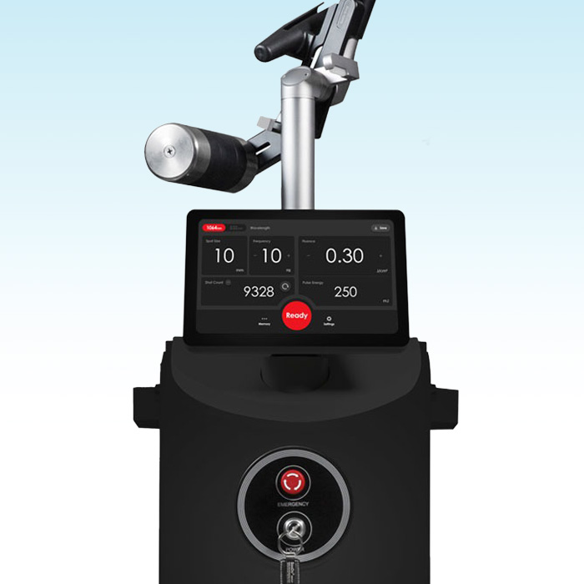
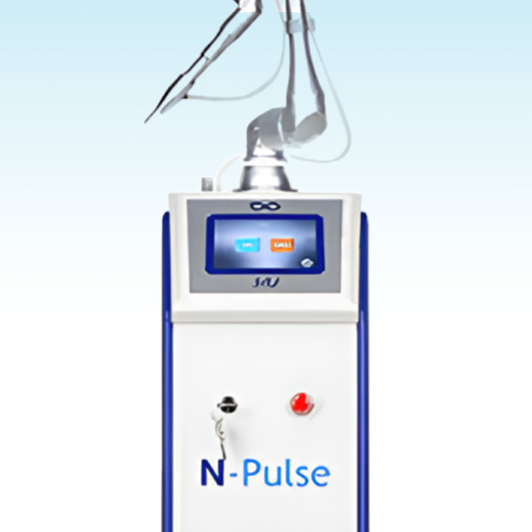
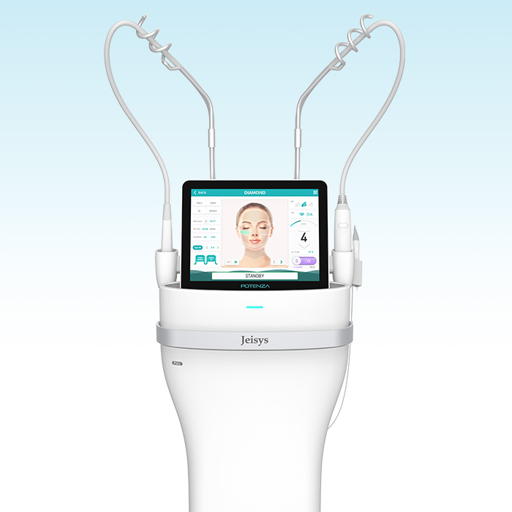
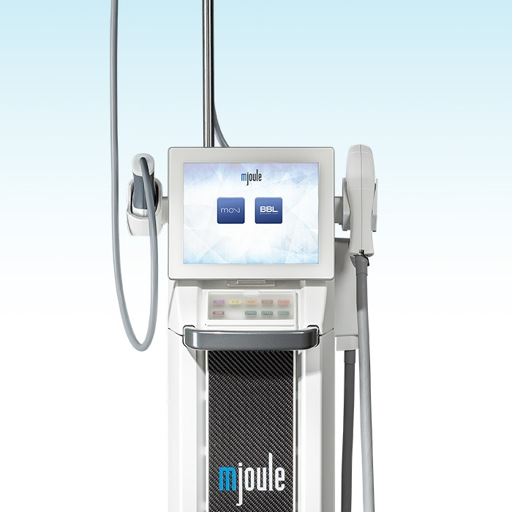
LASER DEVICE
Laser Devices
Melasma/Spots · Redness · Pores/Scars
PICOLITE BLACK
PicoLite Black
A picosecond laser that delivers ultra-short bursts of energy lasting one trillionth of a second. Gentler than conventional nanosecond lasers, it precisely and safely improves pigmentation, pores, scars and skin tone.
Pico Toning
Melasma · Spots
Mole & Age Spot Removal
CO2
CO2 Laser
A laser that precisely vaporizes and removes lesion tissue. It is used to remove a wide range of superficial skin lesions such as moles, milia, age spots and flat warts, and for skin resurfacing.
Moles · Milia
Age Spots · Warts
Lesion Removal
POTENZA
Potenza
Microneedles deliver radiofrequency (RF) energy to a target depth in the skin. Various tips and modes help improve pores, scars, texture and firmness, and it pairs well with skin boosters.
Pores · Scars
Texture · Firmness
Skin Booster Delivery
BROADBAND LIGHT
BBL
A light therapy device delivering broadband light energy to different skin depths. It treats melasma, spots, redness and vascular lesions at once for a clear, even skin tone and texture.
Melasma · Spots
Redness · Vessels
Even Skin Tone

Slide 2
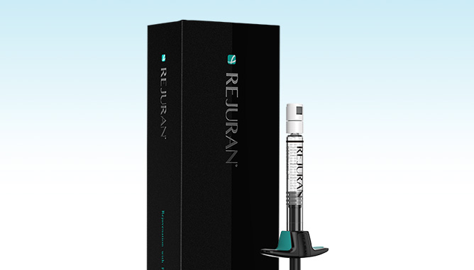

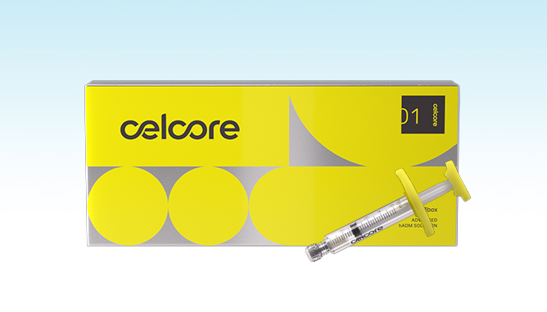
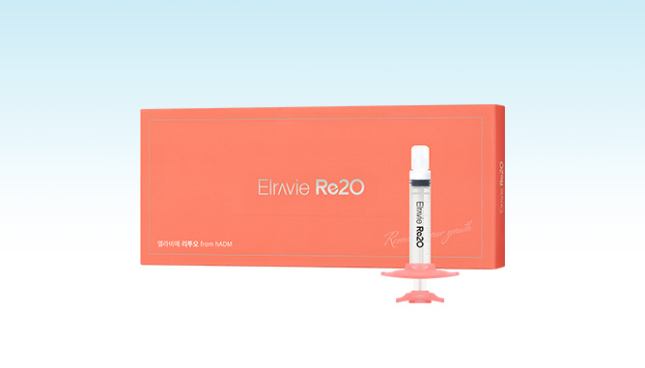
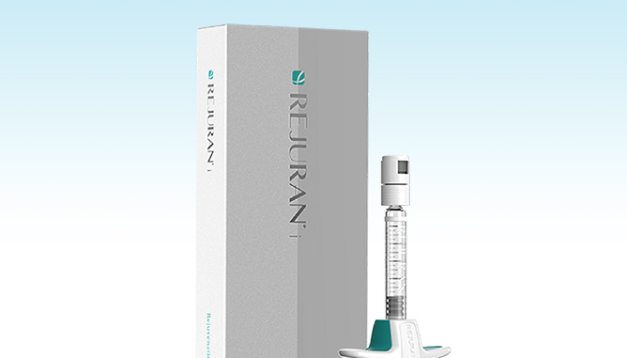
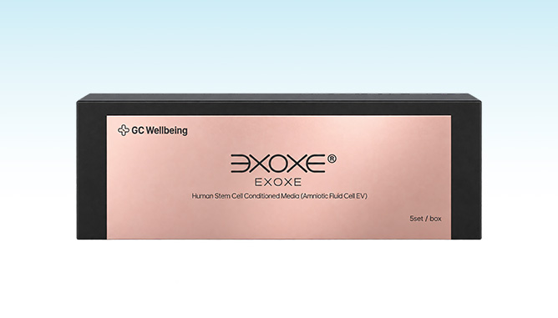
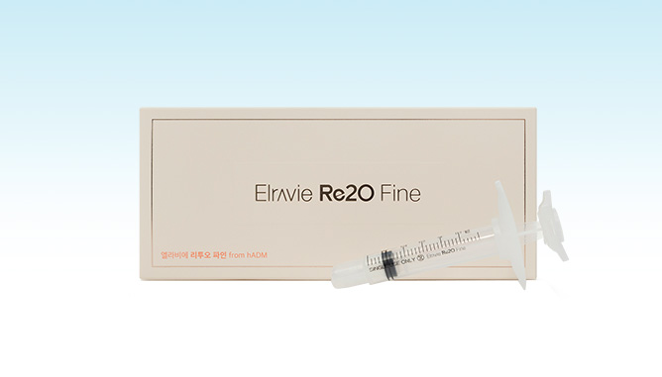
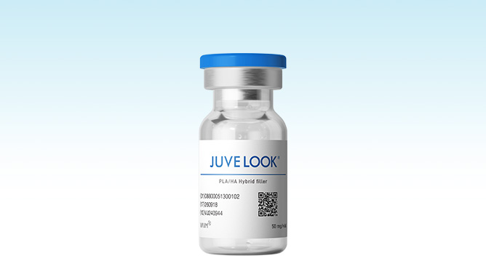
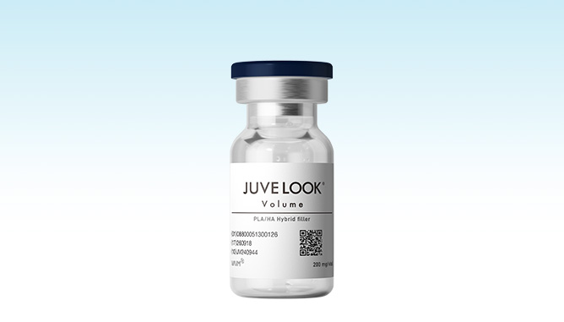
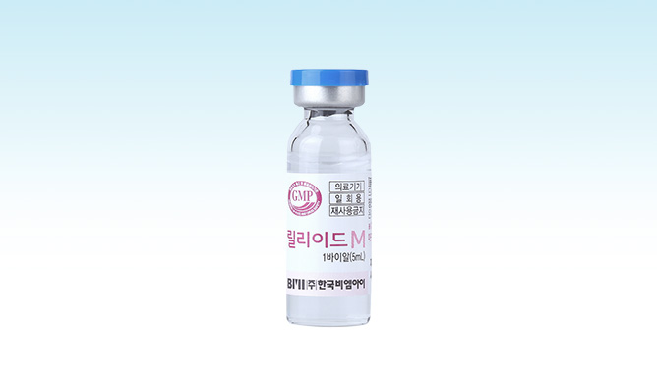
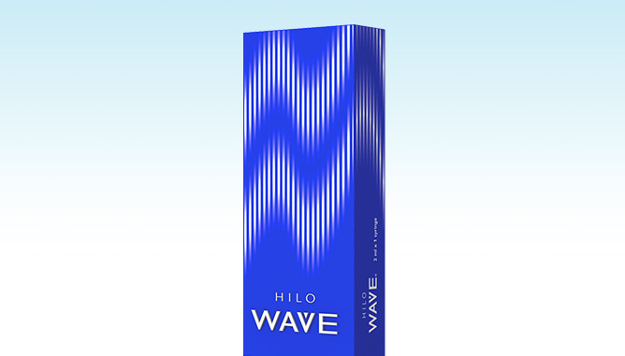
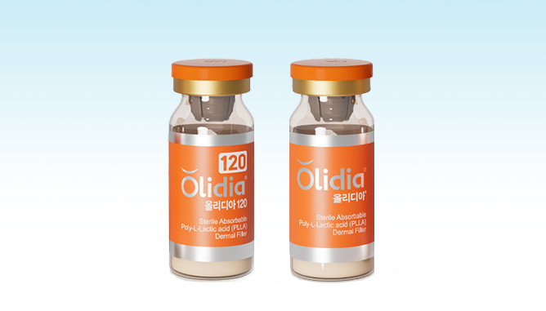
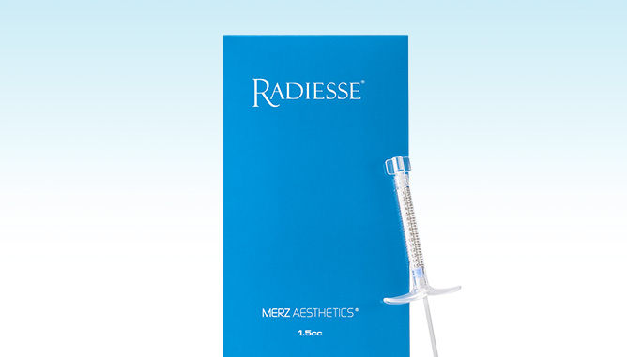
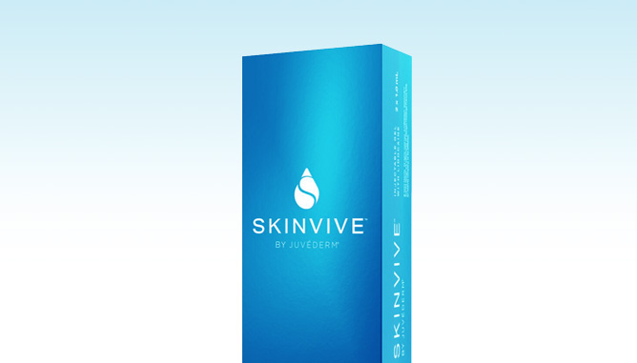
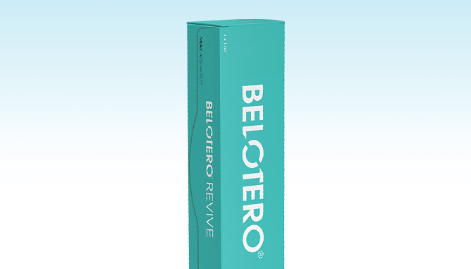
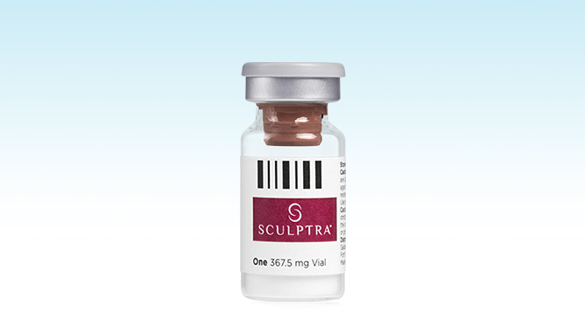
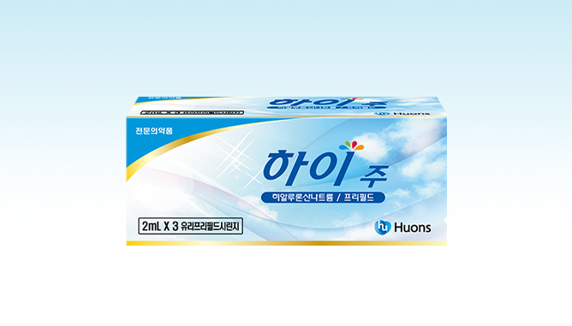
SKIN BOOSTER
Skin Boosters
Regeneration · Collagen/Volume · ECM · Elasticity/Glow
Regeneration
ECM
Rejuran Healer R
Rejuran Healer HB
Celcore
Elravie Re2O
Salmon-derived PN — strengthens the skin barrier
Low pain · with hyaluronic acid for added hydration
ECM-based — structural skin regeneration and repair
Human dermis-derived — immediate skin remodeling
Rejuran Healer I
EXOXE
Elravie Re2O Fine
For the eye area — softens fine lines
Stem cell-derived — skin regeneration and barrier repair
Human dermis skin booster for delicate areas
Collagen / Volume
Elasticity / Glow
Juvelook Skin
Juvelook Volume
Lilied M
Hilowave
PDLLA — refines texture · minimizes pores
Collagen booster for elegant, defined contours
HA — hydration and oil-moisture balance
High-purity HA collagen booster — hydration · firmness · texture
Olidia 120 · 365
Radiesse
Juvéderm SKINVIVE
Belotero Revive
PLLA — stimulates fibroblasts to boost collagen production
CaHA — instant volume and lasting firmness
Premium HA — long-lasting hydration · softens fine lines
HA + glycerol — hydration · barrier care · anti-inflammatory
Sculptra
HIJU
PLLA — natural volume and balanced contours
High-density hydration care

