Slide 1
Complexity Theory
Discrete Mathematics and Theory 2 Mark Floryan

Slide 2
Goals!
1. Measuring Time and Space complexity of algorithms on Turing Machines (You already know a lot of this!)
2. Introducing the most famous complexity classes (P, NP, NP-Hard, etc.)
3. Showing how a difficult a problem is through the use of mapping reductions (you’ve already seen some of this in DSA2)!

Slide 3
Part 1: Something!!

Slide 4
Overview of Theory of Computation
Defining Computation
Input
Computing Machine / Program / Algorithm
Output
Computational Models
Circuits
Finite Automata
Pushdown Automata
Turing Machine
RAM Model
<
<
<
=
Computational Complexity
Decidability
P, NP, NP-Hard
P-Space, Co-NP, etc

Slide 5
Part 1: Measuring Time and Space Complexity

Slide 6

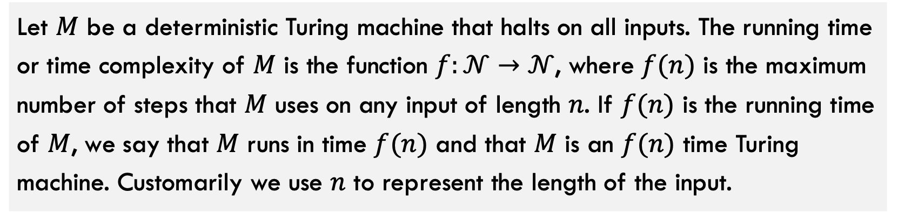
Time Complexity
Let $M$ be a deterministic Turing machine that halts on all inputs. The running time or time complexity of $M$ is the function $f:𝒩→𝒩$, where $f(n)$ is the maximum number of steps that $M$ uses on any input of length $n$. If $f(n)$ is the running time of $M$, we say that $M$ runs in time $f(n)$ and that $M$ is an $f(n)$ time Turing machine. Customarily we use $n$ to represent the length of the input.
You should already be familiar with this definition / concept
Short version: $f(n)$ is the worst case runtime for machine $M$ as a function of input size $n$.

Slide 7





Review: Time Complexity
The following items, you should already know from previous courses.
$O(f\left(n\right))$, $o(f\left(n\right))$
Asymptotic upper bounds
$Ω(f\left(n\right))$, $ω(f\left(n\right))$
Asymptotic lower bounds
$$Θ(f\left(n\right))$$
Asymptotic tight bound
$$1,\log\left(n\right), n, nlog\left(n\right), n^{2}, n^{3}$$
Some common complexity classes
$$\log_{a}{n}∈o\left(n^{b}\right)∈o(c^{n})$$
Every log is bounded by any polynomial is bounded by any exponential

Slide 8
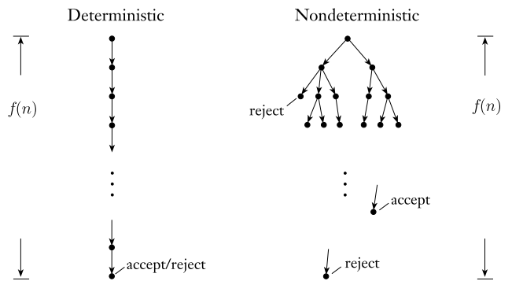
Quick note on Non-Deterministic Time
What about non-deterministic Turing machines (NTMs)? How do we measure running time of such a device?
With deterministic computation, we simply look at longest the one branch of computation can possibly be.
For non-deterministic deciders (does not loop forever), we measure the length of the longest branch of computation

Slide 9
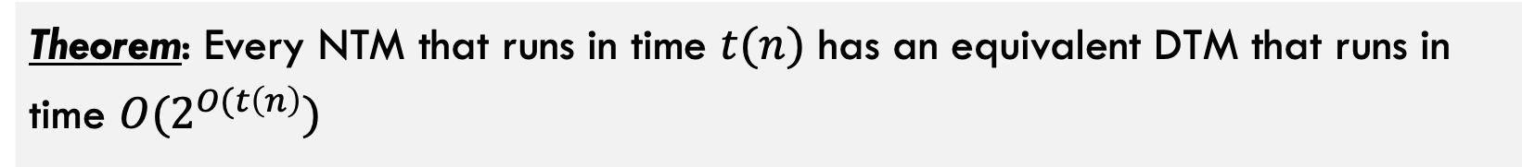
Quick note on Non-Deterministic Time
Theorem: Every NTM that runs in time $t(n)$ has an equivalent DTM that runs in time $O(2^{O(t\left(n\right)})$

Slide 10

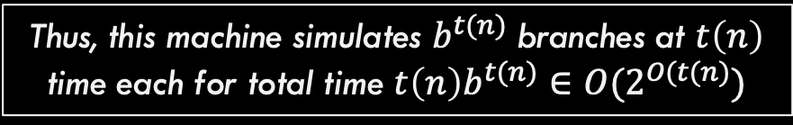
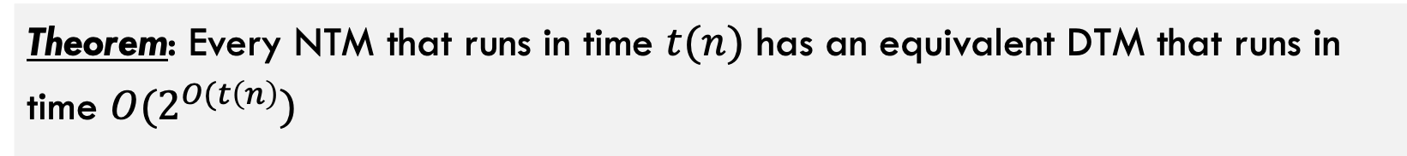


Comparing NTM and DTM
Theorem: Every NTM that runs in time $t(n)$ has an equivalent DTM that runs in time $O(2^{O(t\left(n\right)})$
let $b$ be the maximum number of branches this computation can have
Here, $f(n)$ is some function $t(n)$
The computation tree has at most $b^{t(n)}$ leaves and each branch to each node has length at most $t(n)$
Construct a DTM with three tapes that simulates this NTM as we did in the Turing Machine section earlier. This machines manually computes / simulates each branch individually.
Thus, this machine simulates $b^{t(n)}$ branches at $t\left(n\right)$ time each for total time $t\left(n\right)b^{t(n)}∈O(2^{O(t(n)})$

Slide 11
Part 1: Complexity Classes

Slide 12
Problem Types

Slide 13
Problem types
Given a problem we want to solve, there are three important variations of that problem
Traveling Salesperson Problem: Given a weighted graph G and start node s, find the minimum weight path starting and ending at s that visits every node exactly once.
Function Problem: Return the actual solution
Decision Problem: Convert problem to have Boolean output
Verification Problem: Given a solution, verify if it works
Given G and s, return the weight of the path P (list of nodes to visit in order) that minimizes the sum of the weights of the edges along P.
Given G, s, and integer k, can you find a valid path with total weight less than k?
Given G, s, path P, and integer k
Does path P valid and is it weight less than k?

Slide 14
Why Do These Matter?
Function Problem: Return the actual solution
Decision Problem: Convert problem to have Boolean output
Verification Problem: Given a solution, verify if it works
Given G and s, return the weight of the path P (list of nodes to visit in order) that minimizes the sum of the weights of the edges along P.
Given G, s, and integer k, can you find a valid path with total weight less than k?
Given G, s, path P, and integer k
Does path P valid and is it weight less than k?
Because if you can solve the decision problem, you can repeatedly invoke it with lower values of k until the Yes responses change to No
If you can solve the decision problem you can also solve the function problem Why?

Slide 15
Why Do These Matter?
Function Problem: Return the actual solution
Decision Problem: Convert problem to have Boolean output
Verification Problem: Given a solution, verify if it works
Given G and s, return the weight of the path P (list of nodes to visit in order) that minimizes the sum of the weights of the edges along P.
Given G, s, and integer k, can you find a valid path with total weight less than k?
Given G, s, path P, and integer k
Does path P valid and is it weight less than k?
Answer: Maybe? If verifier exists, we can call the verifier over and over again with possible paths until we get a Yes response. We will see soon though that this is usually NOT efficient
If you can solve the verification problem, does it help you solve the decision problem?

Slide 16
Why Do These Matter?
Function Problem: Return the actual solution
Decision Problem: Convert problem to have Boolean output
Verification Problem: Given a solution, verify if it works
Given G and s, return the weight of the path P (list of nodes to visit in order) that minimizes the sum of the weights of the edges along P.
Given G, s, and integer k, can you find a valid path with total weight less than k?
Given G, s, path P, and integer k
Does path P valid and is it weight less than k?
We will focus on these two from now on because Turing machines return Yes/No answers.

Slide 17
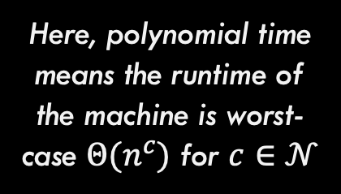
Comparing NTM and DTM
Theorem: A problem P is verifiable in polynomial time by a DTM if and only if it is solvable (decision problem) in polynomial time by an NTM
Here, polynomial time means the runtime of the machine is worst-case $Θ(n^{c})$ for $c∈𝒩$

Slide 18



Comparing NTM and DTM
Theorem: A problem P is verifiable in polynomial time by a DTM if and only if it is solvable (decision problem) in polynomial time by an NTM
Direction 1: If a problem is verifiable by a DTM in polynomial time, then it is solvable in polynomial time by an NTM.
Given: P is verifiable by a DTM. Thus, the DTM that verifies instances of this problem exists
NTM Solver for P
DTM Verifier for P
No
Possible solution 1
$$ε$$
$$ε$$
Possible solution 2
DTM Verifier for P
No
$$ε$$
Possible solution 3
DTM Verifier for P
Yes
$$ε$$
Potential solution s
DTM Verifier for P
Yes/No s is valid solution
Possible solution 4
DTM Verifier for P
No

Slide 19
Comparing NTM and DTM
Theorem: A problem P is verifiable in polynomial time by a DTM if and only if it is solvable (decision problem) in polynomial time by an NTM
Direction 2 (Harder): If a problem is solvable by an NTM in polynomial time, then it is verifiable in polynomial time by a DTM.
Given: P is solvable by an NTM. Thus, the NTM that exists
NTM Solver for P
Purple path that leads to Yes is a verifier for P. Why?
N
N
Y
N
Input
NTM Solver for P
Yes/No decision
N
N

Slide 20
Comparing NTM and DTM
Theorem: A problem P is verifiable in polynomial time by a DTM if and only if it is solvable (decision problem) in polynomial time by an NTM
This theorem is critical to remember! It will be very important in a moment.

Slide 21
Complexity Classes (Finally!)

Slide 22

The class P
Important: P is a set of problems (not solutions, not algorithms)
Example problems in this set include:
Sorting a list of numbers Inserting into a binary tree Computing the average of a list of numbers Printing “hello world” Find() in a hash table …and many more
P
The class P is the set of all problems that can be solved by a deterministic Turing machine in time $O(n^{c})$ such that $c∈𝒩$

Slide 23

The class NP
Remember: We also showed that any NTM solver has an equivalent exponential time DTM. So all problems in NP are solvable in exponential time.
Example problems in this set include:
Everything in P (will prove shortly) Traveling Salesperson Problem Circuit Satisfiability Vertex Cover Independent Set Subset Sum …and many more
NP
Equivalent Definition: By our recently proved theorem, this also means these problems can be verified in polynomial time using a deterministic Turing machine!
The class NP is the set of all problems that can be solved by a non-deterministic Turing machine in time $O(n^{c})$ such that $c∈𝒩$

Slide 24

$$P⊆NP$$
NP
Hard Problems
Proof:
Everything in P can be solved in polynomial time by a DTM, so it can definitely be verified as well (just solve it and then verify the solution)
Is $P⊂NP$? This is still unknown today!
P
Easy Problems

Slide 25

$$P⊆NP$$
We are interested in finding the hardest problem in NP (at the VERY top of the bubble). Why? It is the MOST likely to not be in P if $P≠NP$
NP
Hard Problems
P
It is true that we DO NOT know if there are actually any unique problems in NP (that are not also in P).
Easy Problems

Slide 26
NP-Hard
NP
Hard Problems
Suppose we have find the hardest problem in NP
P
NP-Hard problems are defined to be all problems that are this hard OR harder.
Easy Problems

Slide 27
NP-Hard
NP-Hard
Goes up to indefinite difficulty.
NP
Hard Problems
Note that NP-Hard and NP intersect here. Problems in this intersection are the hardest problems in NP
P
Easy Problems

Slide 28
NP-Complete
NP-Hard
This section (purple) is the set of NP-Complete problems. The hardest problems in NP
NP
Hard Problems
Definition: A problem is NP-Complete if and only if the problem:
Is in NP
Is NP-Hard
P
Easy Problems

Slide 29

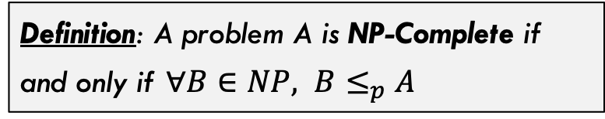
NP-Complete
NP-Hard
A different definition of NP-Complete
Definition: A problem A is NP-Complete if and only if $∀B∈NP, B≤_{p}A$
NP
Hard Problems
$B≤_{p}A$ means that problem A is harder than problem B, shown through a reduction, which we will see in a moment.
P
Easy Problems

Slide 30
More on Reductions: Mapping Reductions

Slide 31
What we have already seen
Reduction: A reduction exists between problems A and B if a solution to B can be used to develop a solution for A.
Problem A
Solve problem B
Problem B
Do easy work
Reduces to
Solve problem B
Do more easy work
…
This kind of reduction involves the decidability of Problems A and B. If B is decidable then A is decidable!

Slide 32



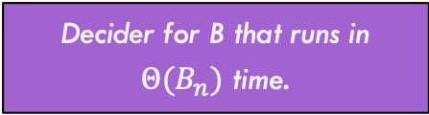
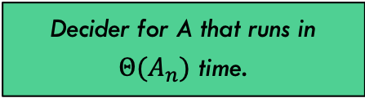
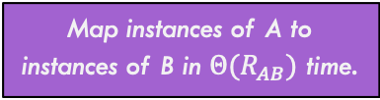
Mapping Reduction
A mapping reduction uses a reduction function R() to map instances of one problem (A) to instances of another problem (B) such that for any input string $w$, $A\left(w\right)==B(R\left(w\right))$
Map instances of A to instances of B in $Θ(R_{AB})$ time.
One way (green route) to solve A is to use the decider in $Θ(A_{n})$ time
Problem A
Problem B
Decider for A that runs in $Θ(A_{n})$ time.
Decider for B that runs in $Θ(B_{n})$ time.
Solution A
Solution B
Map solutions of B to solutions of A in $Θ({RS}_{BA})$ time.
Another way to solve A is to use the purple path. Takes:
$$Θ(R_{AB}+B_{n}+RS_{BA})$$

Slide 33




Reductions You’ve Probably seen before!
Reduction:
Details:
Max-Flow ${≤≥}_{Θ(1)}$ Min-Cut
No conversion necessary. Value of maximum flow is equal to capacity of minimum cut on the same, unaltered graph.
Bi-Partite Matching $≤_{Θ(\left|V\right|+\left|E\right|)}$ Max-Flow
Conversion involved adding capacities to edges, adding source and sink node, adding edges to / from source / sink node, etc.
FindMedian $≤_{Θ(1)}$ Sorting
No conversion necessary. Sort the list, then pull out the middle element in the array.
FindMin $≤_{Θ(1)}$ Sorting
No conversion necessary. Sort the list, then pull the first element in the array. Note that this one is a reduction to a HARDER problem. So won’t be used in practice.

Slide 34


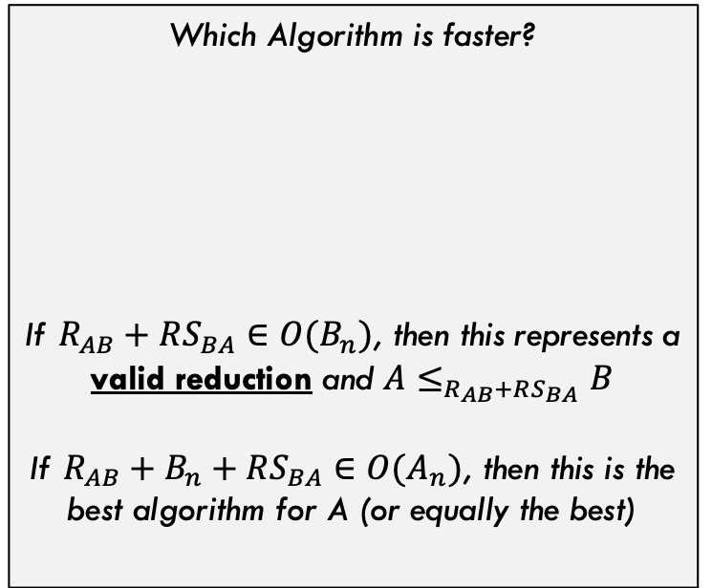


Runtime Comparison
Map instances of A to instances of B in $Θ(R_{AB})$ time.
Problem A
Problem B
Which Algorithm is faster?
If $R_{AB}+RS_{BA}∈O(B_{n})$, then this represents a valid reduction and $A≤_{R_{AB}+RS_{BA}}B$
If $R_{AB}+B_{n}+RS_{BA}∈O(A_{n})$, then this is the best algorithm for A (or equally the best)
$$A_{n}$$
Decider for A that runs in $Θ(A_{n})$ time.
Decider for B that runs in $Θ(B_{n})$ time.
$$R_{AB}+B_{n}+RS_{BA}$$
Solution A
Solution B
Map solutions of B to solutions of A in $Θ({RS}_{BA})$ time.

Slide 35



Runtime Comparison
Harder Problems (fastest algorithm has slower runtime)
$$B_{n}$$
$$A_{n}$$
Which Algorithm is faster?
$$A_{n}$$
$$R_{AB}+B_{n}+RS_{BA}∈Θ(B_{n})$$
Not surprisingly, if these two algorithms have same overall runtime, then either can be used (they are equivalent).
Easy Problems (fastest algorithm has very fast runtime)

Slide 36


Runtime Comparison
Harder Problems (fastest algorithm has slower runtime)
$$B_{n}$$
Which Algorithm is faster?
$$A_{n}$$
$$A_{n}$$
$$R_{AB}+B_{n}+RS_{BA}∈Θ(B_{n})$$
If solving A through reduction is SLOWER than directly solving A, this means problem B is simply harder than problem A (but the reduction is still valid)
Easy Problems (fastest algorithm has very fast runtime)

Slide 37


Runtime Comparison
Harder Problems (fastest algorithm has slower runtime)
$$A_{n}$$
Which Algorithm is faster?
$$A_{n}$$
$$B_{n}$$
$$R_{AB}+B_{n}+RS_{BA}∈Θ(B_{n})$$
If the reduction is FASTER than directly solving A, What does this mean? It means the reduction IS the best way to solve A (and this picture doesn’t make sense)
Easy Problems (fastest algorithm has very fast runtime)

Slide 38



Runtime Comparison
Harder Problems (fastest algorithm has slower runtime)
OLD $A_{n}$
Which Algorithm is faster?
$$A_{n}$$
$$A_{n}=B_{n}$$
$$R_{AB}+B_{n}+RS_{BA}∈Θ(B_{n})$$
…and the direct algorithm for A is obsolete. The reduction through problem B is the direct way to solve A
Easy Problems (fastest algorithm has very fast runtime)

Slide 39
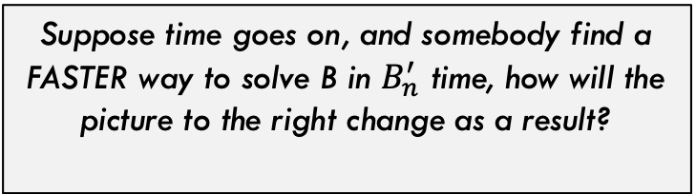


Runtime Comparison
Harder Problems (fastest algorithm has slower runtime)
Suppose time goes on, and somebody find a FASTER way to solve B in $B_{n}^{′}$ time, how will the picture to the right change as a result?
$$A_{n}=B_{n}$$
A now has a faster algorithm also! So improving B’s algorithm improves A’s. They are linked in this direction!
$${A′}_{n}=R_{AB}+{B′}_{n}+RS_{BA}$$
This is ONLY true if the reduction stays valid, meaning the conversion is still fast: $R_{AB}+RS_{BA}∈O(B_{n}^{′})$
Easy Problems (fastest algorithm has very fast runtime)

Slide 40


Runtime Comparison
Harder Problems (fastest algorithm has slower runtime)
Now suppose time goes on and someone finds a VERY fast algorithm for A. What could happen?
$${B′}_{n}$$
$${A′}_{n}$$
Now, the reduction may still be valid, but we are back to B being strictly harder than A
Easy Problems (fastest algorithm has very fast runtime)

Slide 41
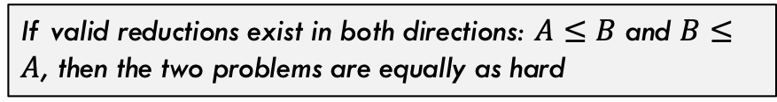
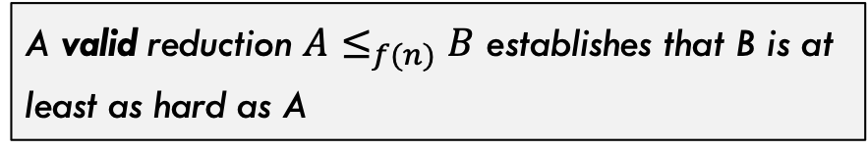
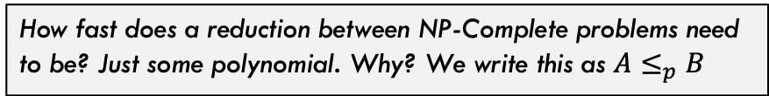
Big Picture
NP-Hard
Hard Problems
So, via reduction
A valid reduction $A≤_{f(n)}B$ establishes that B is at least as hard as A
NP
Some related facts!
If valid reductions exist in both directions: $A≤B$ and $B≤A$, then the two problems are equally as hard
NP-Complete problems are the hardest in NP, so by definition there is a valid reduction from anything in NP to them.
P
How fast does a reduction between NP-Complete problems need to be? Just some polynomial. Why? We write this as $A≤_{p}B$
Easy Problems

Slide 42
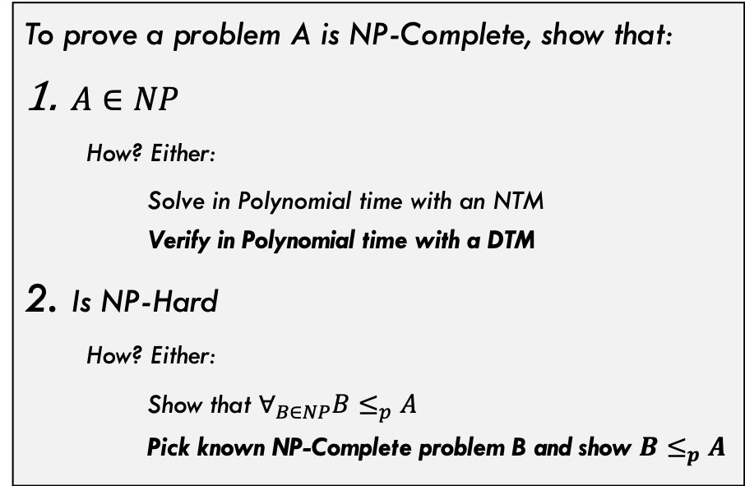
Proving NP-Completeness
NP-Hard
Usually we do the bolded ones
But for second step, we need a known NP-Complete problem. What was the first one?
NP
Hard Problems
To prove a problem A is NP-Complete, show that:
$A∈NP$
How? Either:
Solve in Polynomial time with an NTM Verify in Polynomial time with a DTM
Is NP-Hard
How? Either:
Show that $∀_{B∈NP}B≤_{p}A$ Pick known NP-Complete problem B and show $B≤_{p}A$
P
Easy Problems

Slide 43
Cook-Levin Theorem

Slide 44
Cook-Levin Theorem
Cook-Levin Theorem: The Satisfiability (SAT) problem is NP-Complete
Incredibly famous theorem. Established the first known NP-Complete problem!
Developed independently by Stephen Cook (US) and Leonid Levin (USSR) in 1971 & 1973

Slide 45
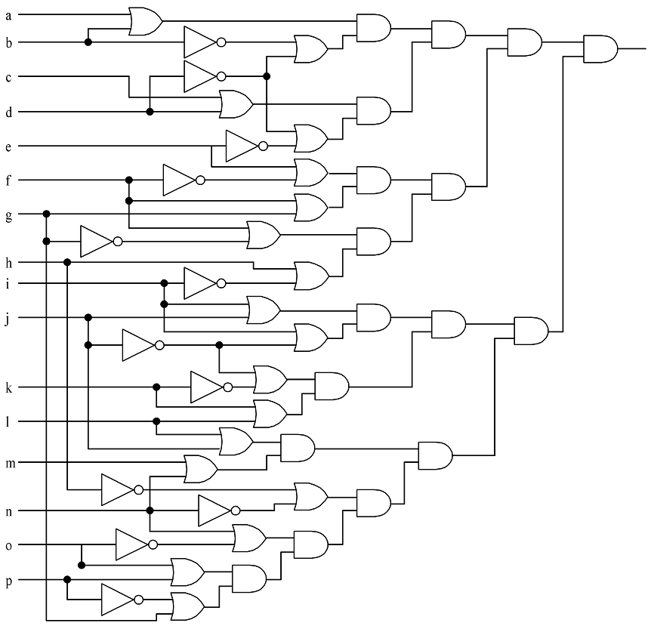
Circuit Satisfiability (Circuit-SAT)
Given a circuit with boolean inputs, AND, OR, and NOT gates…is it possible to assign values to the input such that the output is TRUE?

Slide 46
Circuit Satisfiability (Circuit-SAT)
Solutions:
1110111110011001
1010111111011001
0110111110111001
0110111110011001
1110111111011001
1010111110011001
1010111110111001
0110111111011001
1110111110111001

Slide 47
Circuit-Sat vs SAT
(v[0] || v[1]) && (!v[1] || !v[3]) && (v[2] || v[3]) && (!v[3] || !v[4]) && (v[4] || !v[5]) && (v[5] || !v[6]) && (v[5] || v[6]) && (v[6] || !v[15]) && (v[7] || !v[8]) && (!v[7] || !v[13]) && (v[8] || v[9]) && (v[8] || !v[9]) && (!v[9] || !v[10]) && (v[9] || v[11]) && (v[10] || v[11]) && (v[12] || v[13]) && (v[13] || !v[14]) && (v[14] || v[15])
These are two variations of the exact same problem. We will stick with the right side (SAT) from now on

Slide 48
Proof of the Cook-Levin Theorem

Slide 49
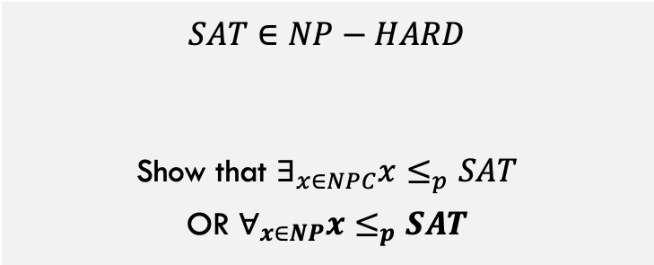
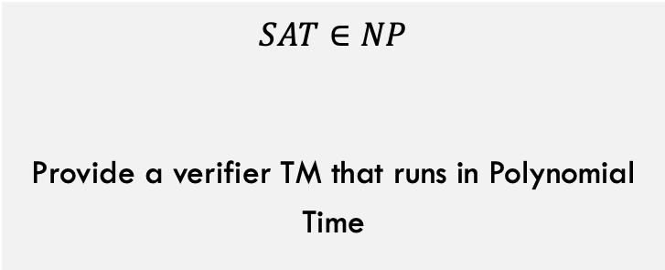
$$SAT∈NPC$$
To show that $SAT∈NPC$, we must show both that:
$$SAT∈NP$$
Provide a verifier TM that runs in Polynomial Time
$$SAT∈NP−HARD$$
Show that $∃_{x∈NPC}x≤_{p}SAT$ OR $∀_{x∈NP}x≤_{p}SAT$
Here, we must use the second (bold) option because there are not any NPC problems that exist yet! Ugh!!

Slide 50
$$SAT∈NPC$$
Let’s do this one first:
Verifier:
$$SAT∈NP$$
Provide a verifier TM that runs in Polynomial Time
Given variables V, formula F, and potential values for each variable V’:
Scan over formula F for first operator (Op) that should be applied (deepest in parens and/or lowest precedence)
Find the two variables X and Y on each side of Op, this gives X Op Y (example: V1 AND V7)
Apply operator Op to the values X and Y given by V’ or by result of a previous operation and replace X Op Y with this Boolean result.
Loop back to step 1 until only one Boolean remains. This Boolean is true if and only if the solution V’ is verified.
Needs to be polynomial runtime, is it? Yes!

Slide 51
∀_{X∈NP} X≤_{p}SAT
Every problem in NP can be reduced to SAT
Consider an NTM that accepts a generic problem X in NP
M = (Q, Σ, s, F, δ)
We will see how to reduce this general problem X to an instance of SAT

Slide 52
Variables
Variables used in our conversion:
n is the input size
p(n) is the (polynomial) time the NTM takes
q ∈ Q
-p(n) ≤ i ≤ p(n)
j ∈Σ
0 ≤ k ≤ p(n)
Variable | Meaning | How many
T_{ijk} | True if tape cell i contains symbol j at step k of the computation | O(p(n)²)
H_{ik} | True if the M’s read/write head is at tape cell i at step k of the computation | O(p(n)²)
Q_{qk} | True if M is in state q at step k of the computation | O(p(n))

Slide 53
Create a conjunction ‘B’ of…
Expression | Conditions | Interpretation | How many
T_{ij0} | Tape cell i initially contains symbol j | Initial tape state; blank symbols below 0 and above n | O(p(n))
Q_{s0} |  | Initial state of the NTM | 1
H₀₀ |  | Initial position of the read/write head | 1
T_{ijk} → ¬T_{ij’k} | j != j’ | One symbol per tape cell | O(p(n)²)
T_{ijk} = T_{ij(k+1)} ∨ H_{jk} |  | Tape remains unchanged unless written | O(p(n)²)
Q_{qk} → ¬Q_{q’k} | q ≠ q’ | Only one state at a time | O(p(n))
H_{jk} → ¬H_{j’k} | i ≠ i’ | Only one head position at a time | O(p(n)²)
(H_{ij} ∧ Q_{qk} ∧ T_{iσk}) → (H_{(i+d)(k+1)} ∧ Q_{q’(k+1)} ∧ T_{iσ(k+1)}) | (q, σ, q’, σ’, d) ∈ δ | Possible transitions at computation step k when head position is at position I | O(p(n)²)
∨_{f∈F} Qfp(n) |  | Must finish in an accepting state | 1

Slide 54
Final part of the proof
If there is an accepting computation for the NTM on input I, then B is satisfiable by assigning T_{ijk}, H_{jk}, and Q_{jk} their intended interpretations
The number of sub-expressions is 2p(n) + 4p(n)² + 3 = O(p(n)²)
Which means the reduction is polynomial
B is called the tableau of the NTM

Slide 55
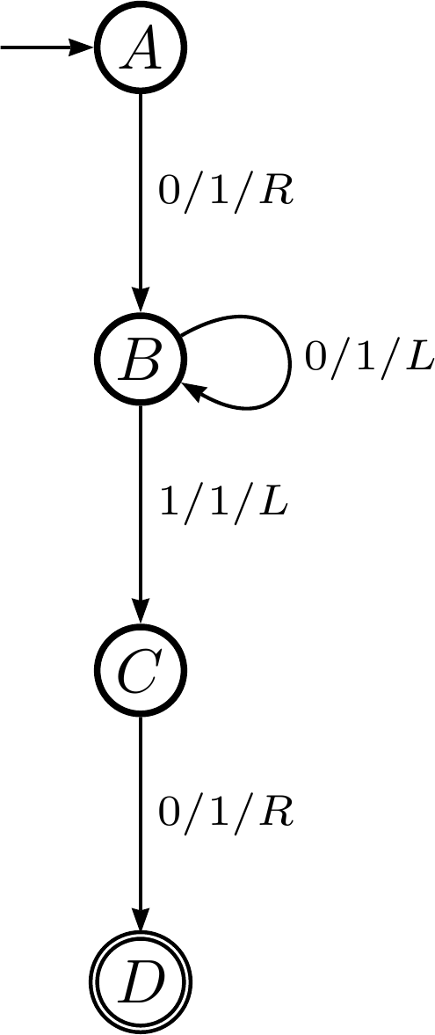
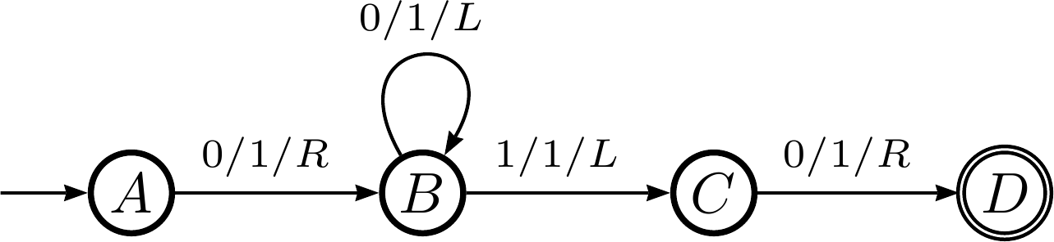
Cook-Levin proof example
Consider the following DTM:

Slide 56
Cook-Levin proof example
Step 0: in state A
Step 1: in state B
Step 2: in state B
Step 3: in state C
Step 4: in state D
…
0
0
0
0
0
0
0
…
…
0
0
0
1
0
0
0
…
…
0
0
0
1
1
0
0
…
…
0
0
0
1
1
0
0
…
…
0
0
1
1
1
0
0
…

Slide 57
The state of the TM, part 1
The tape is all zeros for the 7 cells we care about (cells 0-6)
T_{ijk} is true if the tape cell i contains symbol j at step k
T₀₀₀ ∧ T₁₀₀ ∧ T₂₀₀ ∧ T₃₀₀ ∧ T₄₀₀ ∧ T₅₀₀ ∧ T₆₀₀
The initial state of the TM is state A
Q_{qk} is true if the TM is in state q at step k
Q_{A0}
The head is in the center (cell 3)
H_{ik} is true if the TM is in cell i at step k
H₃₀

Slide 58
The state of the TM, part 2
The tape is all zeros for the 7 cells we care about (cells 0-6)
We’ll only focus on cells 2-4 for brevity
T_{ijk} is true if the tape cell i contains symbol j at step k
T_{ijk} → T_{ij’k} where j!=j’
(T₂₀₀ → ¬T₂₁₀) ∧ (T₃₀₀ → ¬T₃₁₀) ∧ (T₄₀₀ → ¬T₄₁₀)
Likewise for all the other steps (0 ≤ k ≤ 4)
Convert that to an or clause: p→q ≡ ¬p∨q
(¬T₂₀₀ ∨ ¬T₂₁₀) ∧ (¬T₃₀₀ ∨ ¬T₃₁₀) ∧ (¬T₄₀₀ ∨ ¬T₄₁₀)

Slide 59
Create a conjunction ‘B’ of…
Expression | Conditions | Interpretation | How many
T_{ij0} | Tape cell i initially contains symbol j | Initial tape state; blank symbols below 0 and above n | O(p(n))
Q_{s0} |  | Initial state of the NTM | 1
H₀₀ |  | Initial position of the read/write head | 1
T_{ijk} → ¬T_{ij’k} | j != j’ | One symbol per tape cell | O(p(n)²)
T_{ijk} = T_{ij(k+1)} ∨ H_{jk} |  | Tape remains unchanged unless written | O(p(n)²)
Q_{qk} → ¬Q_{q’k} | q ≠ q’ | Only one state at a time | O(p(n))
H_{jk} → ¬H_{j’k} | i ≠ i’ | Only one head position at a time | O(p(n)²)
(H_{ij} ∧ Q_{qk} ∧ T_{iσk}) → (H_{(i+d)(k+1)} ∧ Q_{q’(k+1)} ∧ T_{iσ(k+1)}) | (q, σ, q’, σ’, d) ∈ δ | Possible transitions at computation step k when head position is at position I | O(p(n)²)
∨_{f∈F} Qfp(n) |  | Must finish in an accepting state | 1

Slide 60
End conjunction
B = T₀₀₀ ∧ T₁₀₀ ∧ T₂₀₀ ∧ T₃₀₀ ∧ T₄₀₀ ∧ T₅₀₀ ∧ T₆₀₀ ∧ Q_{A0} ∧ H₃₀ ∧ (¬T₂₀₀ ∨ ¬T₂₁₀) ∧ (¬T₃₀₀ ∨ ¬T₃₁₀) ∧ (¬T₄₀₀ ∨ ¬T₄₁₀) ∧ …
If the TM successfully completes the computation, then B will be true

Slide 61
How to prove problem X is NP-complete
Show it is in NP
Any solution to a NP problem can be verified in polynomial time by a DTM
Equivalent statement: solvable in polynomial time by a NTM
Show it is in NP-hard
You can convert any NP problem into L in polynomial time
Done via a reduction: SAT ≤_{p} X

Slide 62
Other NP-Complete Problems (Reductions)

Slide 63
-----------------------------------------------------

Slide 64
P = NP?

Slide 65
Does P = NP?
We have not found any efficient solution to any of the NP-complete problems
But that doesn’t mean one does not exist
It’s possible that one does, and we just haven’t found it yet
But nobody really believes that
However, nobody has been able to prove that P ≠ NP

Slide 66
What if P does equal NP?
That would be bad
There are many things that we want to be hard
Cracking any sort of encryption, for example
This would then be computable in polynomial time

Slide 67

Funny:

Slide 68
Why we believe that P ≠ NP
After decades of study, nobody has been able to find an efficient solution to any one of over 3,000 known NP-complete problems
Many of these problems were analyzed long before NP-completeness was defined

Slide 69
Earn a million dollars!
The Clay Mathematics Institute defined 7 “Millennium Problems”
And offered $1 million to anybody who can offer a solution (one way or the other) to one of them
One of the is if P = NP or not
http://www.claymath.org/millennium/P_vs_NP/
Only one has been solved: the Poincare conjecture

Slide 70
3-SAT

Slide 71
Circuit-SAT versus SAT
Circuit-SAT is a translation of a Boolean circuit
Only and, or, and not
Each operator only operates on 2 literals (or their negations)
SAT can be any Boolean expression
Including conditionals and bi-conditionals
Sometimes called Formula SAT to differentiate it
They were known to be equivalent in expressive power long before NP-completeness came around
And are thus used rather interchangeably

Slide 72
3-SAT
Satisfiability (SAT) takes pretty much any Boolean expression
And, or, conditional, bi-conditional, etc.
In 3-SAT, we claim that the Boolean expression must be a conjunction of disjunctions
Each clause is a disjunction (OR’ing) of literals (or their negations)
The overall expression is a conjunction (AND’ing) of the clauses
Each clause can have exactly 3 literals
It’s called 3-CNF-SAT because it must be in conjunctive normal form (a conjunction of disjunctions)

Slide 73
Showing 3-SAT is NP-complete
First, we must show it’s in NP
A NTM can decide it in polynomial time
Rephrased: it can be verified by a DTM in polynomial time
The equivalence of those two statements is on slide 30
This second one is easy to show
A formal proof would require showing how, which I’ll do verbally
Next we must show that 3-SAT is NP-hard: that we can reduce an NP-complete problem to 3-SAT
Not surprisingly, we choose SAT
We’ll consider the following formula:
φ = ((x₁ → x₂) ∨ ¬((¬x₁ ↔ x₃) ∨ x₄)) ∧ ¬x₂

Slide 74
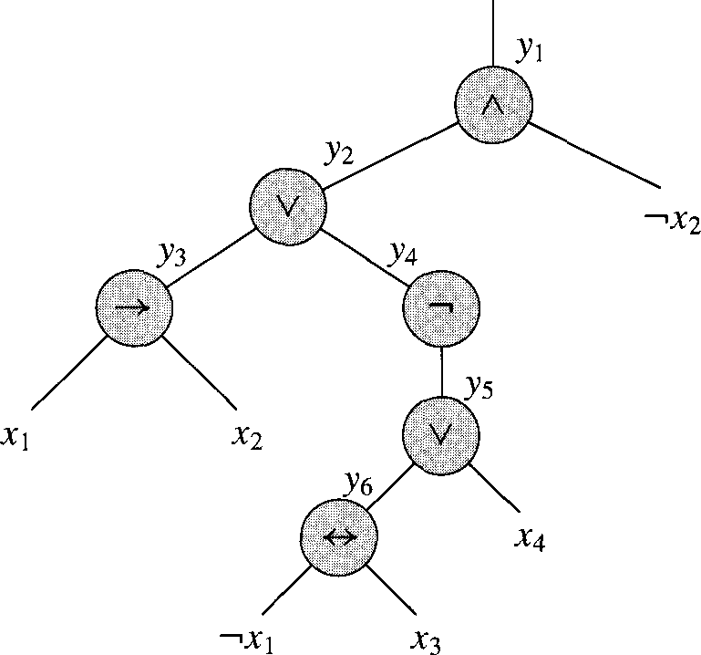
Converting SAT to 3-SAT, step 1
φ = ((x₁ → x₂) ∨ ¬((¬x₁ ↔ x₃) ∨ x₄)) ∧ ¬x₂
We parse the expression into an expression tree
You did this in 2150 lab 5 with arithmetic operators; same principle applies
Since each operator (other than ¬) is binary, it will be a binary tree

Slide 75
Converting SAT to 3-SAT, step 2
We introduce a variable y_{i} for each internal node
We can then re-write our expression:
φ’ = y₁ ∧ (y₁ ↔ (y₂ ∧ ¬x₂)
∧ (y₂ ↔ (y₃ ∨ y₄))
∧ (y₃ ↔ (x₁ → x₂))
∧ (y₄ ↔ ¬y₅)
∧ (y₅ ↔ (y₆ ∨ x₄))
∧ (y₆ ↔ (¬x₁ ↔ x₃))

Slide 76
Converting SAT to 3-SAT, step 3
φ’ = y₁ ∧ (y₁ ↔ (y₂ ∧ ¬x₂)
∧ (y₂ ↔ (y₃ ∨ y₄))
∧ (y₃ ↔ (x₁ → x₂))
∧ (y₄ ↔ ¬y₅)
∧ (y₅ ↔ (y₆ ∨ x₄))
∧ (y₆ ↔ (¬x₁ ↔ x₃))
We have an equation with at most 3 literals each
But it’s not in CNF!
So we build a truth table for each clause φ’_{i}:
y₁ | y₂ | _{X2} | (y₁ ↔ (y₂ ∧ ¬x₂))
1 | 1 | 1 | 0
1 | 1 | 0 | 1
1 | 0 | 1 | 0
1 | 0 | 0 | 0
0 | 1 | 1 | 1
0 | 1 | 0 | 0
0 | 0 | 1 | 1
0 | 0 | 0 | 1

Slide 77
Converting SAT to 3-SAT, step 4
For each clause φ’_{i}, we create new DNF (disjunctive normal form) clauses for when it’s false:
¬φ’_{i} = (y₁∧y₂∧x₂) ∨ (y₁∧¬y₂∧x₂) ∨ (y₁∧¬y₂∧¬x₂) ∨ (¬y₁∧y₂∧¬x₂)
We then negate that to get when it’s true
So we build a truth table for each clause φ’_{i}:
y₁ | y₂ | x₂ | (y₁ ↔ (y₂ ∧ ¬x₂))
1 | 1 | 1 | 0
1 | 1 | 0 | 1
1 | 0 | 1 | 0
1 | 0 | 0 | 0
0 | 1 | 1 | 1
0 | 1 | 0 | 0
0 | 0 | 1 | 1
0 | 0 | 0 | 1

Slide 78
Converting SAT to 3-SAT, step 5
¬φ’_{i} = (y₁∧y₂∧x₂) ∨ (y₁∧¬y₂∧x₂) ∨ (y₁∧¬y₂∧¬x₂) ∨ (¬y₁∧y₂∧¬x₂)
Then the negation (DeMorgan’s law!) is:
φ’_{i} = (¬y₁∨¬y₂∨¬x₂) ∧ (¬y₁∨y₂∨¬x₂) ∧ (¬y₁∨y₂∨x₂) ∧ (y₁∨¬y₂∨x₂)
So we build a truth table for each clause φ’_{i}:
y₁ | y₂ | x₂ | (y₁ ↔ (y₂ ∧ ¬x₂))
1 | 1 | 1 | 0
1 | 1 | 0 | 1
1 | 0 | 1 | 0
1 | 0 | 0 | 0
0 | 1 | 1 | 1
0 | 1 | 0 | 0
0 | 0 | 1 | 1
0 | 0 | 0 | 1

Slide 79
Converting SAT to 3-SAT, step 6
Three cases can occur for all the CNF clauses C_{i}:
C_{i} has 3 literals: then we include it in the final formula
C_{i} has 2 literals (l₁ and l₂): we include (l₁ ∨ l₂ ∨ p) ∧ (l₁ ∨ l₂ ∨ ¬p)
It doesn’t matter whether p is true or false; one clause will evaluate to true, the other to l₁ ∨ l₂
C_{i} has just one literal (l): we include the following:
(l ∨ p ∨ q) ∧ (l ∨ ¬p ∨ q) ∧ (l ∨ p ∨ ¬q) ∧ (l ∨ ¬p ∨ ¬q)
Regardless of what p and q are, 3 clauses will evaluate to true, and the other one to l

Slide 80
We’re done!
Whew!
Note that each step of converting SAT to 3-SAT was in polynomial time
And thus the entire thing in polynomial time

Slide 81
Cliques

Slide 82
Clique
A Clique in a graph G is a set of nodes such that each one is connected to each other in the set
In other words, it’s a maximal sub-graph of G
The problem is to find the maximal clique in a graph

Slide 83
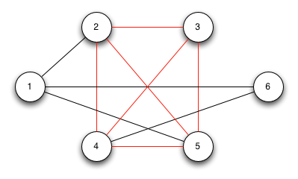
Clique
A Clique in a graph G is a set of nodes such that each one is connected to each other in the set
In other words, it’s a maximal sub-graph of G
The problem is to find the maximal clique in a graph

Slide 84
Proving Clique is NP-complete
First show it’s in NP
Can we verify it with a DTM in polynomial time?
Given a set of nodes, we can quickly determine if they are all connected to each other
A formal proof will require explaining how, which I’ll do verbally
Done!
Next, show it’s NP-hard
We reduce another NP-complete problem to Clique
Our choices so far are SAT and 3-SAT
We’ll use 3-SAT
In other words, that we can use a Clique solution to solve a 3-SAT problem
3-SAT ≤_{p} Clique

Slide 85
The reduction
Consider a 3-SAT problem with k clauses, C₁ to C_{k}; each clause C_{r} (where 1 ≤ r ≤ k) has literals l^{r}₁, l^{r}₂, l^{r}₃
We create a graph G as follows:
For each literal, create a vertex
Draw an edge between each vertex and every other vertex that:
Is not in the same clause
Is consistent: i.e., is not the negation of that literal
Claim: if the there is a clique of size k in G, then the equation is satisfiable

Slide 86
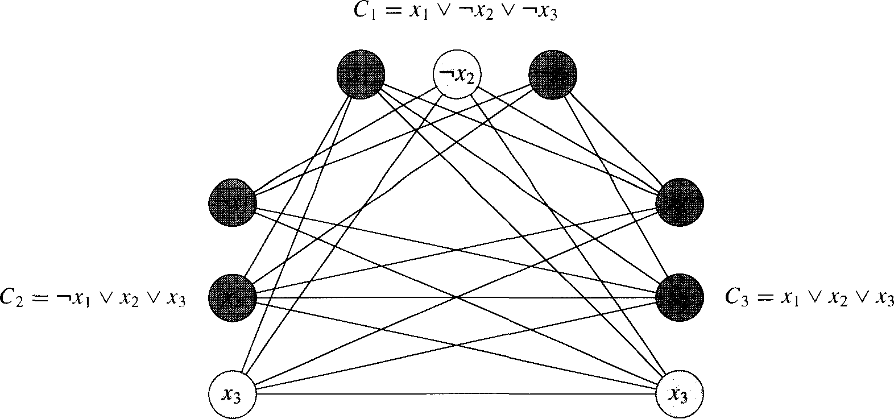
Reduction example
φ = (x₁∨¬x₂∨¬x₃)∧(¬x₁∨x₂∨x₃)∧(x₁∨x₂∨x₃)
x₁
¬x₃
¬x₁
x₁
x₂
x₂

Slide 87
Satisfiable(φ) → Clique(G, k)
If the equation is satisfiable:
Then there is at least one true literal in each clause
We pick one such true literal from each clause
They are all connected to each other, since inconsistent nodes are not connected to each other
They form a click of size k
You cannot have a clique of size k+1
Since nodes within a clause are not connected to each other
Thus, if the equation of k clauses is satisfiable, there is a clique of size k in graph G
And if there is a clique of size k in the graph G, then the equation is satisfiable

Slide 88
Clique(G, k) → Satisfiable(φ)
If the equation is not satisfiable:
Then there is at least one clause where all literals are false
Thus, you cannot have a clique of size k
Since there are only k-1 clauses left to form a clique
Recall that no nodes in the same clause are connected to each other, so we can get at most one node in the clique from each clause
Thus, if the equation of k clauses is not satisfiable, there is not a clique of size k in graph G
And if there is not a clique of size k in the graph G, then the equation is not satisfiable

Slide 89
Notes about this proof
It is notable because it shows a reduction from a formulaic problem to a graph problem
And the Cook-Levin theorem translates the graph problem (Clique) back to a formulaic problem (SAT)

Slide 90
Vertex Cover

Slide 91
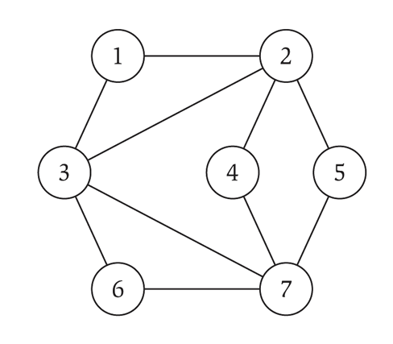
Vertex Cover
A vertex cover (VC) on a graph G = (V,E) is a subset of vertices S ⊆ V such that every edge in the graph is connected to at least one vertex in S
We typically look for the smallest vertex cover
The smallest vertex cover in the graph to the right is of size 3
2, 3, 7

Slide 92
Vertex Cover
We will reduce Clique to VC
Decision problem we will prove: given a graph G, is there a vertex cover of size k?
VC ∈NP: given a set of vertices, we can tell in polynomial time on a DTM if they form a proper VC
A formal proof will require explaining how, which I’ll do verbally
VC is NP-hard: done by a reduction
Clique ≤_{p} VC

Slide 93
Reduction
Given a graph G, we want to find a clique
To do so, we take the complement graph G’
G’ has edges between every pair of nodes that do not have edges between them in G
… and we find the vertex cover on G’
Claim: if there is a VC in G’ of size k, then there is a clique in G of size |V|-k
Or if a VC in G’ is of size |V|-k, then there is a clique of size k in G

Slide 94
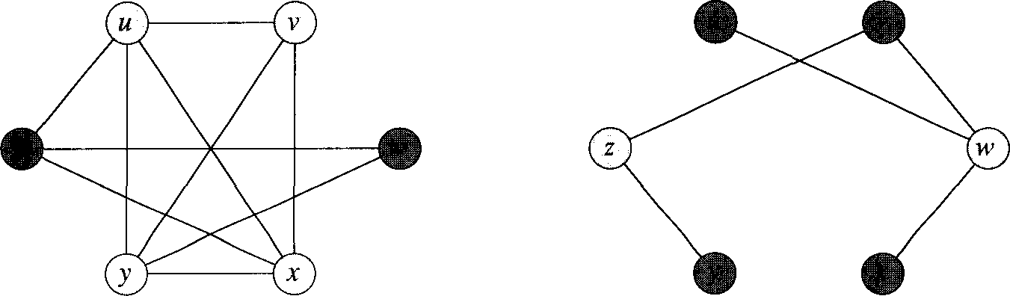
Reduction example
G is on the left, and the white nodes form a Clique
G’ is on the right, and the white nodes form a VC
u
v
z
w
y
z

Slide 95
How does this work?
Suppose G has a clique C ⊆ V with |C| = k
The claim is that V-C is a VC in G’
Let (u,v) be any edge in E’
Thus, (u,v) ∉E, since E’ is the complement of E
Then at least one of u or v does not belong to C (since C is a clique)
And thus at least one of u or v is in V-C (the VC)
So the edge (u,v) is covered by the VC
This is true for all edges in E’
Thus, V-C has size |V|-k, and forms a VC of G’

Slide 96
How does this work?
Conversely, suppose that G’ has a VC Cover ⊆ V with |Cover| = k
Then G has a clique of V-Cover, of size |V|-k
Same basic argument.
Examine the complement of Cover (call it Cover’)
No hypothetical edge e between two nodes in Cover’ exists in G’ because then the original Cover wouldn’t be a valid VC
Thus, the complement of E’ (which is just E) contains ALL of the edges between all pairs of nodes in Cover’
Thus Cover’ is a clique
|Cover’| = |V| - |Cover| = |V| - k

Slide 97
More Reductions

Slide 98
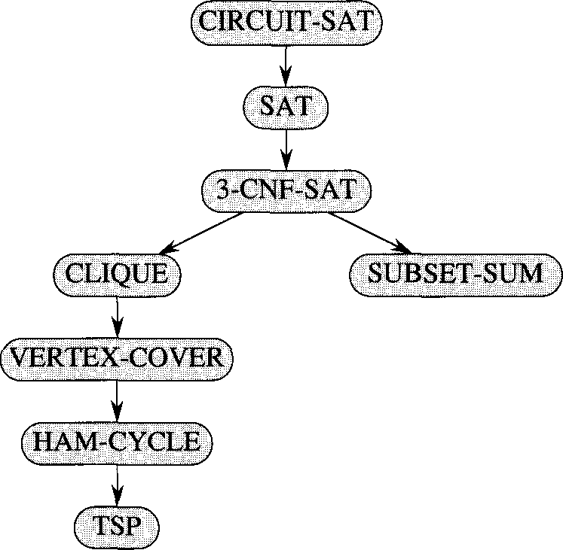
More reductions!
In 1972, Richard Karp showed a number of problems were NP-complete
The problems were known to be “hard”, but how “hard” was not really quantified until then

Slide 99
Trying to prove X ∈P is NP-complete
We know that X is in NP
Since P ⊆ NP, then the same reasoning that applies for NP problems applies for P problems
In other words, X ≤_{p} SAT
Next, we show a known NP-complete problem Y reduces to X
In other words, Y ≤_{p} X
This would imply that we could use a polynomial-time solution to X to solve the NP-complete problem Y
This is where the proof would most likely fail

Slide 100
NP-complete proofs we won’t see
Hamiltonian cycle (reduces from 3-SAT)
3-D matching (reduces from 3-SAT)
Subset Sum (reduces from 3-D matching)
These are all in the textbook or online

Slide 101
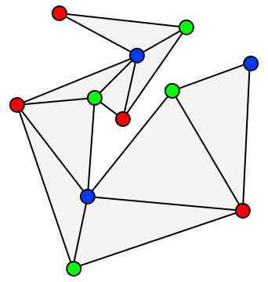
3-Coloring
Given graph G, and three colors c1,c2,c3 (not really given as input)
Can we color the graph with these colors such that no adjacent nodes have the same color.
Turns out that 3-Coloring is NP-Complete

Slide 102
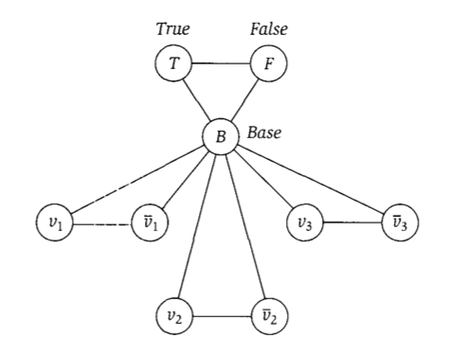
Reducing 3-SAT to 3-coloring

Slide 103
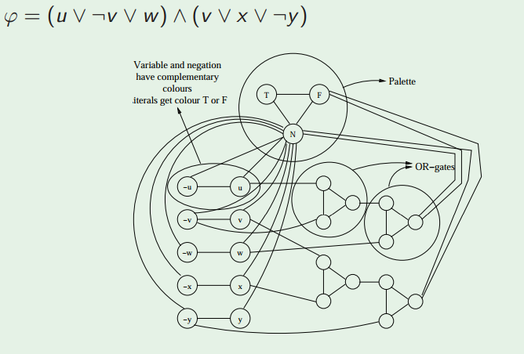
Reducing 3-SAT to 3-coloring

Slide 104
(VERY informal) proof of reduction
Sat(Φ) → G is 3-Colorable
Assume Φ is satisfiable
3 colors (true, false, base)
Color B,T,F with these colors
Color variable nodes with T and F depending on their satisfying values for Φ
Or gates always colorable so that they represent correct OR (output is true iff one or more inputs true)
Thus G is 3-Colorable
G is 3-Colorable → Sat(Φ)
Assume G is 3-Colorable
Color the graph
Let the colors of the B,T,F nodes represent base, true, and false respectively.
Re-arrange OR gate colors slightly if necessary so output is always T or F
Let variable assignments be the color they were given
These assignments satisfy Φ

Slide 105
CS 2150 lecture planning
There are n total guest lectures that can be given
There are l guest lectures to be given (one per week) during the first “half” of the course
For each week, a different set of lectures are available
There may be more guest lectures than l
During the second “half” of the course, there are p projects to be completed, one each week
Each project requires one of a set of guest lectures
Can you schedule l guest lecturers (one per week) such that all p the projects can be completed?

Slide 106
Lecture planning example
l (the number of weeks of lectures) = 2
p (the number of projects) = 3
n (the number of possible guest lecturers) = 4
Availability for the two weeks:
L₁ = {A, B, C}, L₂ = {A, D}
Which lectures/lecturers are needed for each of the 3 projects:
P₁ = {B, C}, P₂ = {A, B, D}, P₃ = {C, D}
Of the 4 lecturers, can we schedule 2 of them such that all 3 of the projects can be completed?
Yes, we can schedule B in the first week and D in the second week

Slide 107
Prove that Lecture Planning is NP-complete
Can reduce from 3-SAT
Can you do it?
Notes:
Pages 502-505

Slide 108
Co-NP

Slide 109
Algorithmic Complement
Given a problem X, we can define the complement, X’
Take the decision version of the problem X
Change all the ‘yes’ answers to ‘no’ and visa-versa
Consider the problem of if a number is prime
The complement problem is if a number is composite

Slide 110
co-NP
NP contains the set of problems for which proof of a ‘yes’ solution is easily verifiable
To show a ‘yes’ instance, I just have to show one: exists quantifier
To show no instances, I have to show it’s ‘no’ for all: for all quantifier
To show that there is no satisfiable set of truth values for a SAT problem, you have to show each possible one
co-NP contains the set of problems for which proof of no solutions is easily verifiable

Slide 111
co-NP examples
SAT: given a expression, is there a satisfiable set of truth assignments?
To prove a ‘yes’ instance, you just (quickly) check a given (correct) answer (polynomial time)
To prove there are no instances, you must show for all (exponential time)
co-SAT: given an expression, are there no satisfiable set of truth assignments?
To prove a ‘no’ instance (which means there is a satisfiable truth assignment), we just (quickly) check a given (correct) answer (polynomial time)
To prove ‘yes’, you must show for all (exponential time)

Slide 112
co-NP
Consider subset-sum: given a finite set of integers, is there a non-empty subset which sums to zero?
To prove a ‘yes’, specify the non-empty subset
The complement asks, “given a finite set of integers, does every non-empty subset have non-zero sum?”
To prove a ‘no’, specify a non-empty subset

Slide 113
P is closed under complement
Meaning P = P’
For problems in P: finding a ‘yes’ instance or finding there are no instances are both polynomial time
For problems in P’: finding a ‘no’ instance or finding there are yes instances are both polynomial time
For NP/co-NP, one way was exponential

Slide 114
Does NP = co-NP?
We don’t know for sure
We know that P ⊆ NP
Likewise, P ⊆ co-NP
Given a problem in P, it’s complement P’ is also in P
P’ is in co-NP
Thus P ⊆ co-NP

Slide 115
NP and co-NP
We’ll show that if P = NP then NP = co-NP
We don’t think that P = NP, but we can still show the conditional is true
Assume P = NP…
Let X ∈NP
Then, X ∈ P because P=NP
X’ ∈ P because P closed under complement
X’ ∈ NP because P=NP
X ∈ co-NP because definition of co-NP
Same Exact argument backwards for the other way
Thus, if P = NP then NP = co-NP

Slide 116
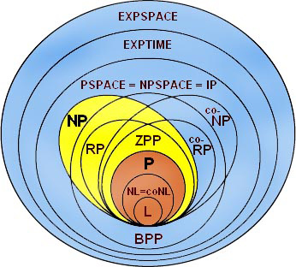
Complexity class diagram

Slide 117
A couple complexity classes we won’t see:
EXPTIME
Deterministic exponential time
NEXPTIME
Non-Deterministic exponential time
PSPACE
Deterministic Polynomial Space
NPSPACE
Non-Deterministic Polynomial Space
EXPSPACE
Deterministic Exponential Space
NEXPSPACE
Non-Deterministic Exponential Space

Slide 118
A couple complexity classes we won’t see:
PSPACE
Deterministic Polynomial Space
NPSPACE
Non-Deterministic Polynomial Space
EXPSPACE
Deterministic Exponential Space
NEXPSPACE
Non-Deterministic Exponential Space
PSPACE = NPSPACE and EXPSPACE = NEXPSPACE
WOAH! That’s pretty cool!

