Slide 1
Turing Machines
Discrete Mathematics and Theory 2 Mark Floryan

Slide 2
Goals!
1. Very quick review of the Chomsky Hierarchy (overall picture).
2. Our second model of computation, the pushdown automata!! Let’s add memory to that finite state machine!!
3. What languages can this new model of computation now recognize? Can we find languages it cannot recognize now?

Slide 3
Part 1: Reminder of where we are / Chomsky Hierarchy

Slide 4
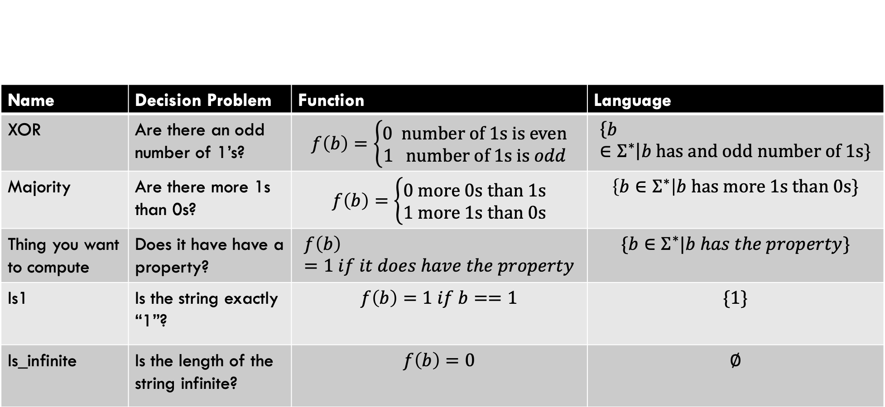
Types of Problems
Name | Decision Problem | Function | Language
XOR | Are there an odd number of 1’s? | $$f\left(b\right)=\left\{\begin{aligned}0 number of 1s is even \\ 1 number of 1s is odd\end{aligned}\right.$$ | $$\left\{b∈Σ^{∗}\right|b has and odd number of 1s\}$$
Majority | Are there more 1s than 0s? | $$f\left(b\right)=\left\{\begin{aligned}0 more 0s than 1s \\ 1 more 1s than 0s\end{aligned}\right.$$ | $$\left\{b∈Σ^{∗}\right|b has more 1s than 0s\}$$
Thing you want to compute | Does it have have a property? | $$f\left(b\right)=1 if it does have the property$$ | $$\{b∈Σ^{∗}|b has the property\}$$
Is1 | Is the string exactly “1”? | $$f\left(b\right)=1 if b==1$$ | $$\{1\}$$
Is_infinite | Is the length of the string infinite? | $$f\left(b\right)=0$$ | $$∅$$

Slide 5
Chomsky Hierarchy
A description of languages and their relationship to one another
Each language has a computational model that recognizes it
In this deck, we will see the context-free languages and the machines that recognize them

Slide 6
Overview of This Deck
These are all equivalent in their expressive power.
Pushdown Automata
NFA w/ a stack. Can recognize exactly the context-free languages
Context-Free Languages:
A Class of languages that are more expressive than regular languages
Context-Free Grammar:
A “string” description of a context-free language (by definition)
At the end of this deck, we will also see that context-free languages have a pumping lemma that can be used to prove some languages are NOT context-free.
For now, we allow non-determinism freely with this computational model. We will discuss (briefly) the ramifications for this later in the deck.

Slide 7
Part 2: Context-Free Grammars

Slide 8
Introduction: What is a Context-Free Grammar

