Slide 1
Decidability
Discrete Mathematics and Theory 2 Mark Floryan

Slide 2
Goals!
1. Let’s find some undecidable languages I think…
…
…

Slide 3
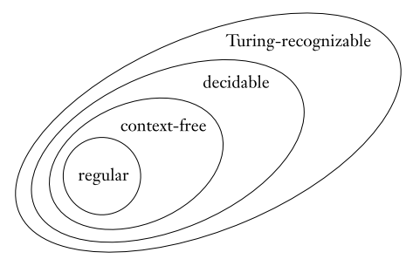
Goals!

Slide 4
Part 1: Decidable Languages

Slide 5

Decidable Languages
Example: $A_{DFA}=\left\{\left(B,w\right) \right| B is a DFA that accepts input string w\}$
Show a language is decidable by describing a TM

Slide 6
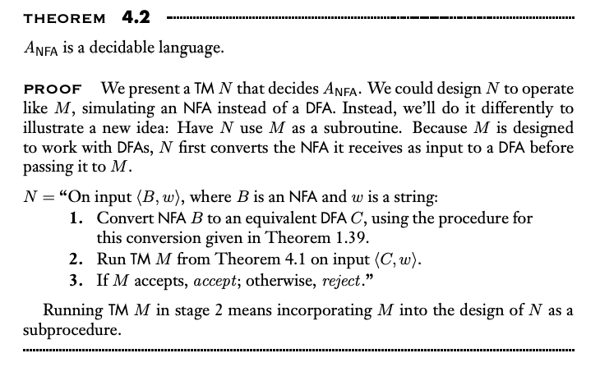
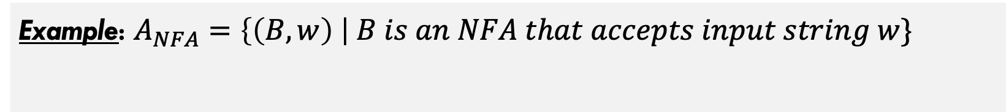
Decidable Languages
Example: $A_{NFA}=\left\{\left(B,w\right) \right| B is an NFA that accepts input string w\}$
Show a language is decidable by describing a TM

Slide 7
Decidable Languages
Example:
List out some other decidable languages
emptiness testing DFA
Equivalence testing DFA
CFG accepting
CFG emptiness
CFG equivalence

Slide 8
Part 2: Undecidable Languages

Slide 9
Do undecidable languages exits?
Do they?
…………

Slide 10
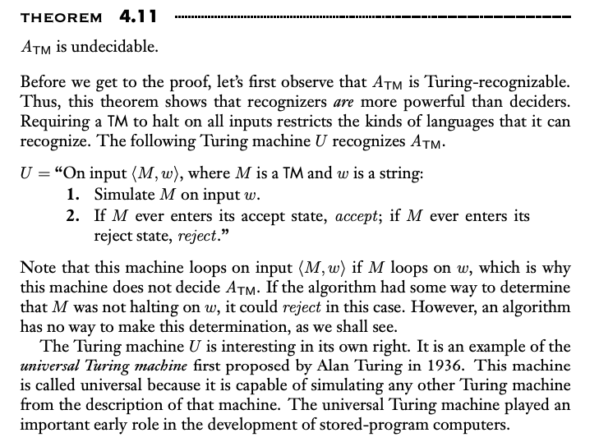
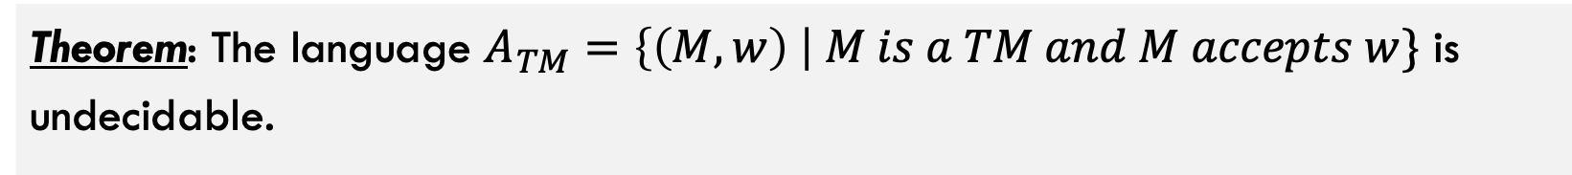
Do undecidable languages exits?
Theorem: The language $A_{TM}=\left\{\left(M,w\right) \right| M is a TM and M accepts w\}$ is undecidable.
This language is recognizable!!!!

Slide 11
Quick Reminder(s) from Earlier!!
Theorem: The language $A_{TM}=\left\{\left(M,w\right) \right| M is a TM and M accepts w\}$ is undecidable.
Remember the following things:
Infinite sets do not always have the same size We can show two infinite sets DO have the same size by giving a bijection!! We can show they DO not have the same size through diagonalization
Set of unique TMs is countable, but number of functions is NOT. Thus, languages aren’t even turing recognizable!!!!

Slide 12
Quick Reminder(s) from Earlier!!
Theorem: The language $A_{TM}=\left\{\left(M,w\right) \right| M is a TM and M accepts w\}$ is undecidable.
See proof in book…

Slide 13
Part 3: Non-Recognizable Languages?

Slide 14
Quick Reminder(s) from Earlier!!
Theorem: A language is decideable iff it is Turing-recognizable and it is co-Turing-recognizable
A lot of stuff to unpack here

Slide 15
Quick Reminder(s) from Earlier!!
Theorem: A language is decideable iff it is Turing-recognizable and it is co-Turing-recognizable
By the theorem above, we can easily show that the complement of Atm is not recognizable

Slide 16
Part 4: Reducibility

Slide 17
What is Reducibility?
Reduction: def…
Many examples in real life. Getting to Paris reduces to buying a plane ticket. Solving a system of linear equations reduces to inverting a matrix, etc.

Slide 18
Reduction Process
Reduction: Problem A and B. Reduction shows a conversion from A to B
If B is decidable, then is A decidable?

Slide 19
The Halting Problem
Halting Problem: blah blah
We can show halting is undecidable easily by using a reduction proof.

Slide 20
TM Emptiness Testing
Emptiness Test: Etm is undecidable
Also through reduction

Slide 21
Some other Undecidable Problems
Examples
Does a TM recognize a regular language, and thus can be converted to a DFA?
Does a TM recognize a CFG, and thus can be converted to a pushdown automata?
Are the languages of two TMs A and B equivalent to each other?

Slide 22
Rice’s Theorem
Rice’s Theorem: Any non-trivial property P of a program (e.g., halting) is undecidable
…

