Slide 1
Complexity Theory
Discrete Mathematics and Theory 2 Mark Floryan

Slide 2
Goals!
1. Measuring Time and Space complexity of algorithms on Turing Machines (You already know a lot of this!)
2. Introducing the most famous complexity classes (P, NP, NP-Hard, etc.)
3. Showing how a difficult a problem is through the use of mapping reductions (you’ve already seen some of this in DSA2)!

Slide 3
Part 1: Something!!

Slide 4
Overview of Theory of Computation
Defining Computation
Input
Computing Machine / Program / Algorithm
Output
Computational Models
Circuits
Finite Automata
Pushdown Automata
Turing Machine
RAM Model
<
<
<
=
Computational Complexity
Decidability
P, NP, NP-Hard
P-Space, Co-NP, etc

Slide 5
Part 1: Measuring Time and Space Complexity

Slide 6

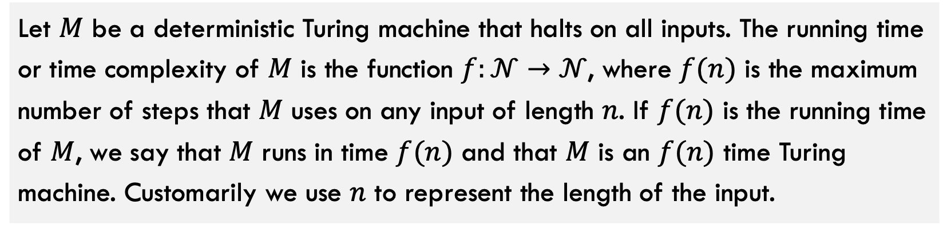
Time Complexity
Let $M$ be a deterministic Turing machine that halts on all inputs. The running time or time complexity of $M$ is the function $f:𝒩→𝒩$, where $f(n)$ is the maximum number of steps that $M$ uses on any input of length $n$. If $f(n)$ is the running time of $M$, we say that $M$ runs in time $f(n)$ and that $M$ is an $f(n)$ time Turing machine. Customarily we use $n$ to represent the length of the input.
You should already be familiar with this definition / concept
Short version: $f(n)$ is the worst case runtime for machine $M$ as a function of input size $n$.

Slide 7





Review: Time Complexity
The following items, you should already know from previous courses.
$O(f\left(n\right))$, $o(f\left(n\right))$
Asymptotic upper bounds
$Ω(f\left(n\right))$, $ω(f\left(n\right))$
Asymptotic lower bounds
$$Θ(f\left(n\right))$$
Asymptotic tight bound
$$1,\log\left(n\right), n, nlog\left(n\right), n^{2}, n^{3}$$
Some common complexity classes
$$\log_{a}{n}∈o\left(n^{b}\right)∈o(c^{n})$$
Every log is bounded by any polynomial is bounded by any exponential

Slide 8
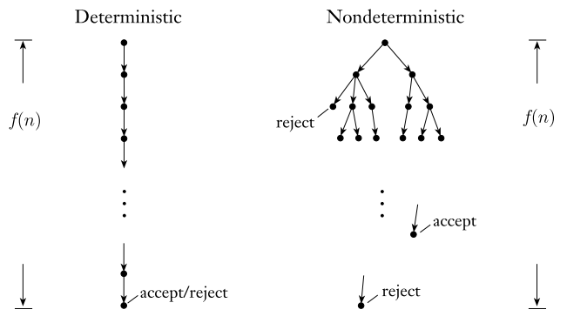
Quick note on Non-Deterministic Time
What about non-deterministic Turing machines (NTMs)? How do we measure running time of such a device?
With deterministic computation, we simply look at longest the one branch of computation can possibly be.
For non-deterministic deciders (does not loop forever), we measure the length of the longest branch of computation

Slide 9
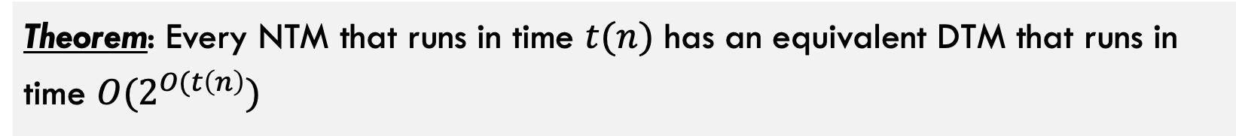
Quick note on Non-Deterministic Time
Theorem: Every NTM that runs in time $t(n)$ has an equivalent DTM that runs in time $O(2^{O(t\left(n\right)})$

Slide 10

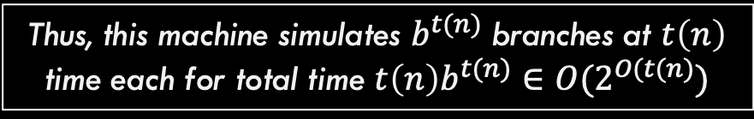
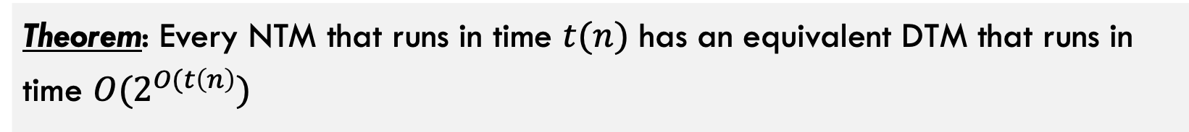


Comparing NTM and DTM
Theorem: Every NTM that runs in time $t(n)$ has an equivalent DTM that runs in time $O(2^{O(t\left(n\right)})$
let $b$ be the maximum number of branches this computation can have
Here, $f(n)$ is some function $t(n)$
The computation tree has at most $b^{t(n)}$ leaves and each branch to each node has length at most $t(n)$
Construct a DTM with three tapes that simulates this NTM as we did in the Turing Machine section earlier. This machines manually computes / simulates each branch individually.
Thus, this machine simulates $b^{t(n)}$ branches at $t\left(n\right)$ time each for total time $t\left(n\right)b^{t(n)}∈O(2^{O(t(n)})$

Slide 11
Part 1: Complexity Classes

Slide 12
Problem Types

Slide 13
Problem types
Given a problem we want to solve, there are three important variations of that problem
Traveling Salesperson Problem: Given a weighted graph G and start node s, find the minimum weight path starting and ending at s that visits every node exactly once.
Function Problem: Return the actual solution
Decision Problem: Convert problem to have Boolean output
Verification Problem: Given a solution, verify if it works
Given G and s, return the weight of the path P (list of nodes to visit in order) that minimizes the sum of the weights of the edges along P.
Given G, s, and integer k, can you find a valid path with total weight less than k?
Given G, s, path P, and integer k
Does path P valid and is it weight less than k?

Slide 14
Why Do These Matter?
Function Problem: Return the actual solution
Decision Problem: Convert problem to have Boolean output
Verification Problem: Given a solution, verify if it works
Given G and s, return the weight of the path P (list of nodes to visit in order) that minimizes the sum of the weights of the edges along P.
Given G, s, and integer k, can you find a valid path with total weight less than k?
Given G, s, path P, and integer k
Does path P valid and is it weight less than k?
Because if you can solve the decision problem, you can repeatedly invoke it with lower values of k until the Yes responses change to No
If you can solve the decision problem you can also solve the function problem Why?

Slide 15
Why Do These Matter?
Function Problem: Return the actual solution
Decision Problem: Convert problem to have Boolean output
Verification Problem: Given a solution, verify if it works
Given G and s, return the weight of the path P (list of nodes to visit in order) that minimizes the sum of the weights of the edges along P.
Given G, s, and integer k, can you find a valid path with total weight less than k?
Given G, s, path P, and integer k
Does path P valid and is it weight less than k?
Answer: Maybe? If verifier exists, we can call the verifier over and over again with possible paths until we get a Yes response. We will see soon though that this is usually NOT efficient
If you can solve the verification problem, does it help you solve the decision problem?

Slide 16
Why Do These Matter?
Function Problem: Return the actual solution
Decision Problem: Convert problem to have Boolean output
Verification Problem: Given a solution, verify if it works
Given G and s, return the weight of the path P (list of nodes to visit in order) that minimizes the sum of the weights of the edges along P.
Given G, s, and integer k, can you find a valid path with total weight less than k?
Given G, s, path P, and integer k
Does path P valid and is it weight less than k?
We will focus on these two from now on because Turing machines return Yes/No answers.

Slide 17
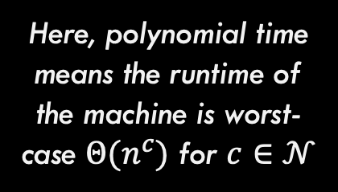
Comparing NTM and DTM
Theorem: A problem P is verifiable in polynomial time by a DTM if and only if it is solvable (decision problem) in polynomial time by an NTM
Here, polynomial time means the runtime of the machine is worst-case $Θ(n^{c})$ for $c∈𝒩$

Slide 18



Comparing NTM and DTM
Theorem: A problem P is verifiable in polynomial time by a DTM if and only if it is solvable (decision problem) in polynomial time by an NTM
Direction 1: If a problem is verifiable by a DTM in polynomial time, then it is solvable in polynomial time by an NTM.
Given: P is verifiable by a DTM. Thus, the DTM that verifies instances of this problem exists
NTM Solver for P
DTM Verifier for P
No
Possible solution 1
$$ε$$
$$ε$$
Possible solution 2
DTM Verifier for P
No
$$ε$$
Possible solution 3
DTM Verifier for P
Yes
$$ε$$
Potential solution s
DTM Verifier for P
Yes/No s is valid solution
Possible solution 4
DTM Verifier for P
No

Slide 19
Comparing NTM and DTM
Theorem: A problem P is verifiable in polynomial time by a DTM if and only if it is solvable (decision problem) in polynomial time by an NTM
Direction 2 (Harder): If a problem is solvable by an NTM in polynomial time, then it is verifiable in polynomial time by a DTM.
Given: P is solvable by an NTM. Thus, the NTM that exists
NTM Solver for P
Purple path that leads to Yes is a verifier for P. Why?
N
N
Y
N
Input
NTM Solver for P
Yes/No decision
N
N

Slide 20
Comparing NTM and DTM
Theorem: A problem P is verifiable in polynomial time by a DTM if and only if it is solvable (decision problem) in polynomial time by an NTM
This theorem is critical to remember! It will be very important in a moment.

Slide 21
Complexity Classes (Finally!)

Slide 22

The class P
Important: P is a set of problems (not solutions, not algorithms)
Example problems in this set include:
Sorting a list of numbers Inserting into a binary tree Computing the average of a list of numbers Printing “hello world” Find() in a hash table …and many more
P
The class P is the set of all problems that can be solved by a deterministic Turing machine in time $O(n^{c})$ such that $c∈𝒩$

Slide 23

The class NP
Remember: We also showed that any NTM solver has an equivalent exponential time DTM. So all problems in NP are solvable in exponential time.
Example problems in this set include:
Everything in P (will prove shortly) Traveling Salesperson Problem Circuit Satisfiability Vertex Cover Independent Set Subset Sum …and many more
NP
Equivalent Definition: By our recently proved theorem, this also means these problems can be verified in polynomial time using a deterministic Turing machine!
The class NP is the set of all problems that can be solved by a non-deterministic Turing machine in time $O(n^{c})$ such that $c∈𝒩$

Slide 24

$$P⊆NP$$
NP
Hard Problems
Proof:
Everything in P can be solved in polynomial time by a DTM, so it can definitely be verified as well (just solve it and then verify the solution)
Is $P⊂NP$? This is still unknown today!
P
Easy Problems

Slide 25

$$P⊆NP$$
We are interested in finding the hardest problem in NP (at the VERY top of the bubble). Why? It is the MOST likely to not be in P if $P≠NP$
NP
Hard Problems
P
It is true that we DO NOT know if there are actually any unique problems in NP (that are not also in P).
Easy Problems

Slide 26
NP-Hard
NP
Hard Problems
Suppose we have find the hardest problem in NP
P
NP-Hard problems are defined to be all problems that are this hard OR harder.
Easy Problems

Slide 27
NP-Hard
NP-Hard
Goes up to indefinite difficulty.
NP
Hard Problems
Note that NP-Hard and NP intersect here. Problems in this intersection are the hardest problems in NP
P
Easy Problems

Slide 28
NP-Complete
NP-Hard
This section (purple) is the set of NP-Complete problems. The hardest problems in NP
NP
Hard Problems
Definition: A problem is NP-Complete if and only if the problem:
Is in NP
Is NP-Hard
P
Easy Problems

Slide 29

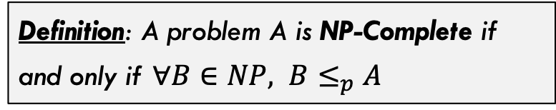
NP-Complete
NP-Hard
A different definition of NP-Complete
Definition: A problem A is NP-Complete if and only if $∀B∈NP, B≤_{p}A$
NP
Hard Problems
$B≤_{p}A$ means that problem A is harder than problem B, shown through a reduction, which we will see in a moment.
P
Easy Problems

Slide 30
More on Reductions: Mapping Reductions

Slide 31
What we have already seen
Reduction: A reduction exists between problems A and B if a solution to B can be used to develop a solution for A.
Problem A
Solve problem B
Problem B
Do easy work
Reduces to
Solve problem B
Do more easy work
…
This kind of reduction involves the decidability of Problems A and B. If B is decidable then A is decidable!

Slide 32



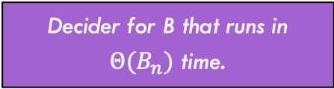
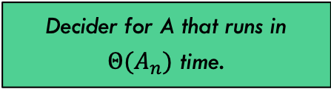
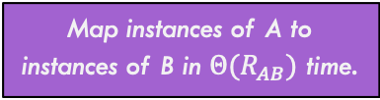
Mapping Reduction
A mapping reduction uses a reduction function R() to map instances of one problem (A) to instances of another problem (B) such that for any input string $w$, $A\left(w\right)==B(R\left(w\right))$
Map instances of A to instances of B in $Θ(R_{AB})$ time.
One way (green route) to solve A is to use the decider in $Θ(A_{n})$ time
Problem A
Problem B
Decider for A that runs in $Θ(A_{n})$ time.
Decider for B that runs in $Θ(B_{n})$ time.
Solution A
Solution B
Map solutions of B to solutions of A in $Θ({RS}_{BA})$ time.
Another way to solve A is to use the purple path. Takes:
$$Θ(R_{AB}+B_{n}+RS_{BA})$$

Slide 33




Reductions You’ve Probably seen before!
Reduction:
Details:
Max-Flow ${≤≥}_{Θ(1)}$ Min-Cut
No conversion necessary. Value of maximum flow is equal to capacity of minimum cut on the same, unaltered graph.
Bi-Partite Matching $≤_{Θ(\left|V\right|+\left|E\right|)}$ Max-Flow
Conversion involved adding capacities to edges, adding source and sink node, adding edges to / from source / sink node, etc.
FindMedian $≤_{Θ(1)}$ Sorting
No conversion necessary. Sort the list, then pull out the middle element in the array.
FindMin $≤_{Θ(1)}$ Sorting
No conversion necessary. Sort the list, then pull the first element in the array. Note that this one is a reduction to a HARDER problem. So won’t be used in practice.

Slide 34


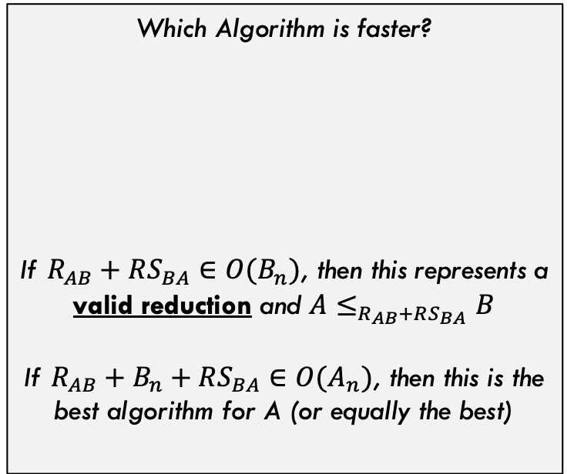

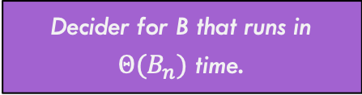
Runtime Comparison
Map instances of A to instances of B in $Θ(R_{AB})$ time.
Problem A
Problem B
Which Algorithm is faster?
If $R_{AB}+RS_{BA}∈O(B_{n})$, then this represents a valid reduction and $A≤_{R_{AB}+RS_{BA}}B$
If $R_{AB}+B_{n}+RS_{BA}∈O(A_{n})$, then this is the best algorithm for A (or equally the best)
$$A_{n}$$
Decider for A that runs in $Θ(A_{n})$ time.
Decider for B that runs in $Θ(B_{n})$ time.
$$R_{AB}+B_{n}+RS_{BA}$$
Solution A
Solution B
Map solutions of B to solutions of A in $Θ({RS}_{BA})$ time.

Slide 35



Runtime Comparison
Harder Problems (fastest algorithm has slower runtime)
$$B_{n}$$
$$A_{n}$$
Which Algorithm is faster?
$$A_{n}$$
$$R_{AB}+B_{n}+RS_{BA}∈Θ(B_{n})$$
Not surprisingly, if these two algorithms have same overall runtime, then either can be used (they are equivalent).
Easy Problems (fastest algorithm has very fast runtime)

Slide 36


Runtime Comparison
Harder Problems (fastest algorithm has slower runtime)
$$B_{n}$$
Which Algorithm is faster?
$$A_{n}$$
$$A_{n}$$
$$R_{AB}+B_{n}+RS_{BA}∈Θ(B_{n})$$
If solving A through reduction is SLOWER than directly solving A, this means problem B is simply harder than problem A (but the reduction is still valid)
Easy Problems (fastest algorithm has very fast runtime)

Slide 37


Runtime Comparison
Harder Problems (fastest algorithm has slower runtime)
$$A_{n}$$
Which Algorithm is faster?
$$A_{n}$$
$$B_{n}$$
$$R_{AB}+B_{n}+RS_{BA}∈Θ(B_{n})$$
If the reduction is FASTER than directly solving A, What does this mean? It means the reduction IS the best way to solve A (and this picture doesn’t make sense)
Easy Problems (fastest algorithm has very fast runtime)

Slide 38



Runtime Comparison
Harder Problems (fastest algorithm has slower runtime)
OLD $A_{n}$
Which Algorithm is faster?
$$A_{n}$$
$$A_{n}=B_{n}$$
$$R_{AB}+B_{n}+RS_{BA}∈Θ(B_{n})$$
…and the direct algorithm for A is obsolete. The reduction through problem B is the direct way to solve A
Easy Problems (fastest algorithm has very fast runtime)

Slide 39
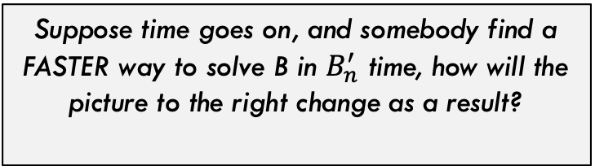


Runtime Comparison
Harder Problems (fastest algorithm has slower runtime)
Suppose time goes on, and somebody find a FASTER way to solve B in $B_{n}^{′}$ time, how will the picture to the right change as a result?
$$A_{n}=B_{n}$$
A now has a faster algorithm also! So improving B’s algorithm improves A’s. They are linked in this direction!
$${A′}_{n}=R_{AB}+{B′}_{n}+RS_{BA}$$
This is ONLY true if the reduction stays valid, meaning the conversion is still fast: $R_{AB}+RS_{BA}∈O(B_{n}^{′})$
Easy Problems (fastest algorithm has very fast runtime)

Slide 40


Runtime Comparison
Harder Problems (fastest algorithm has slower runtime)
Now suppose time goes on and someone finds a VERY fast algorithm for A. What could happen?
$${B′}_{n}$$
$${A′}_{n}$$
Now, the reduction may still be valid, but we are back to B being strictly harder than A
Easy Problems (fastest algorithm has very fast runtime)

Slide 41
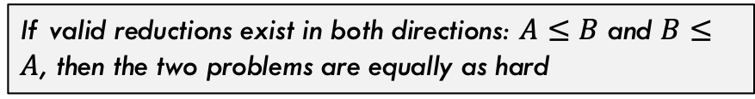
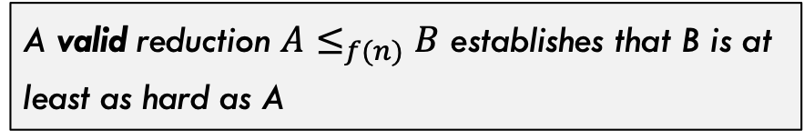
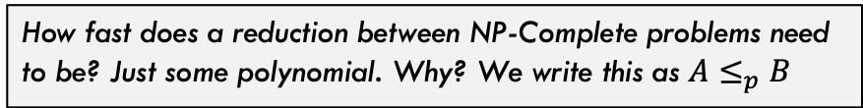
Big Picture
NP-Hard
Hard Problems
So, via reduction
A valid reduction $A≤_{f(n)}B$ establishes that B is at least as hard as A
NP
Some related facts!
If valid reductions exist in both directions: $A≤B$ and $B≤A$, then the two problems are equally as hard
NP-Complete problems are the hardest in NP, so by definition there is a valid reduction from anything in NP to them.
P
How fast does a reduction between NP-Complete problems need to be? Just some polynomial. Why? We write this as $A≤_{p}B$
Easy Problems

Slide 42
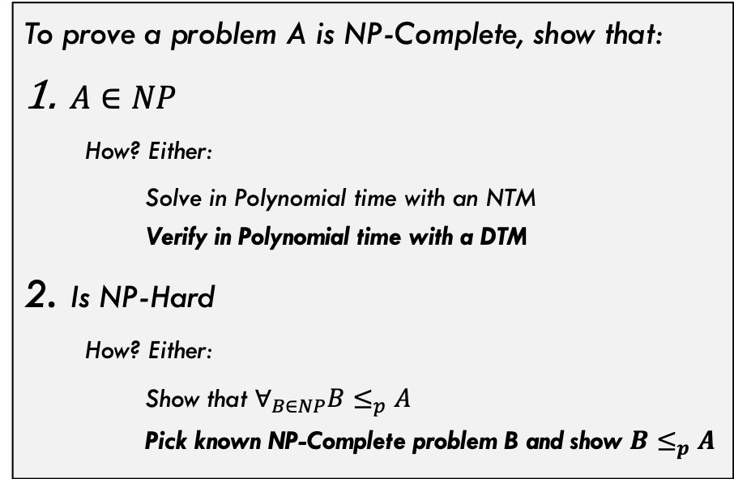
Proving NP-Completeness
NP-Hard
Usually we do the bolded ones
But for second step, we need a known NP-Complete problem. What was the first one?
NP
Hard Problems
To prove a problem A is NP-Complete, show that:
$A∈NP$
How? Either:
Solve in Polynomial time with an NTM Verify in Polynomial time with a DTM
Is NP-Hard
How? Either:
Show that $∀_{B∈NP}B≤_{p}A$ Pick known NP-Complete problem B and show $B≤_{p}A$
P
Easy Problems

Slide 43
Cook-Levin Theorem

Slide 44
Cook-Levin Theorem
Cook-Levin Theorem: The Satisfiability (SAT) problem is NP-Complete
Incredibly famous theorem. Established the first known NP-Complete problem!
Developed independently by Stephen Cook (US) and Leonid Levin (USSR) in 1971 & 1973

Slide 45
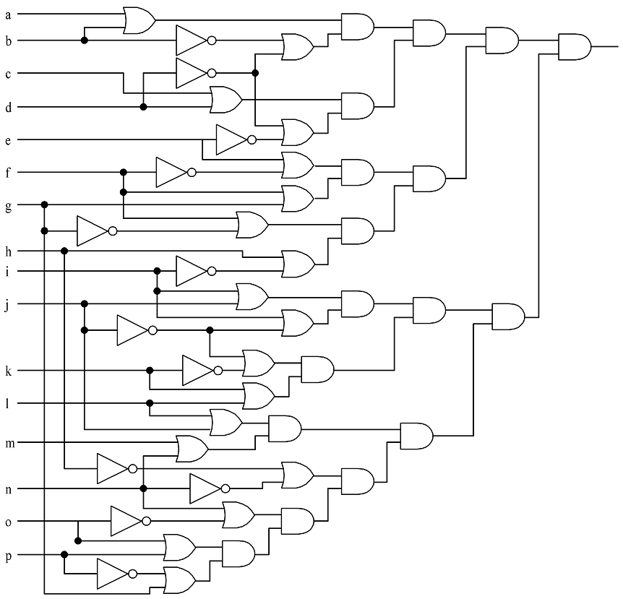
Circuit Satisfiability (Circuit-SAT)
Given a circuit with boolean inputs, AND, OR, and NOT gates…is it possible to assign values to the input such that the output is TRUE?

Slide 46
Circuit Satisfiability (Circuit-SAT)
Solutions:
1110111110011001
1010111111011001
0110111110111001
0110111110011001
1110111111011001
1010111110011001
1010111110111001
0110111111011001
1110111110111001

Slide 47
Circuit-Sat vs SAT
(v[0] || v[1]) && (!v[1] || !v[3]) && (v[2] || v[3]) && (!v[3] || !v[4]) && (v[4] || !v[5]) && (v[5] || !v[6]) && (v[5] || v[6]) && (v[6] || !v[15]) && (v[7] || !v[8]) && (!v[7] || !v[13]) && (v[8] || v[9]) && (v[8] || !v[9]) && (!v[9] || !v[10]) && (v[9] || v[11]) && (v[10] || v[11]) && (v[12] || v[13]) && (v[13] || !v[14]) && (v[14] || v[15])
These are two variations of the exact same problem. We will stick with the right side (SAT) from now on

Slide 48
Proof of the Cook-Levin Theorem

Slide 49
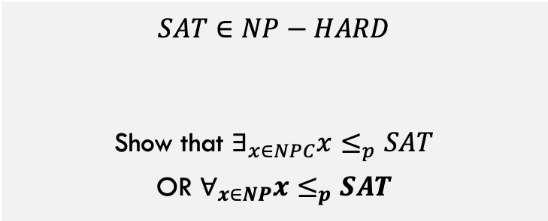
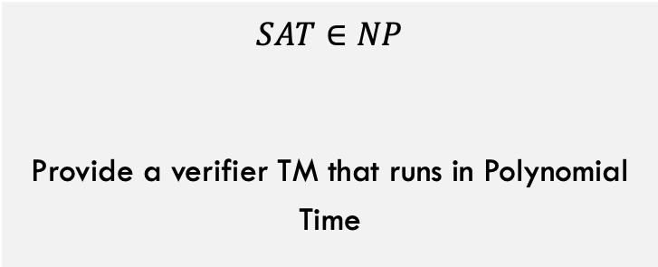
$$SAT∈NPC$$
To show that $SAT∈NPC$, we must show both that:
$$SAT∈NP$$
Provide a verifier TM that runs in Polynomial Time
$$SAT∈NP−HARD$$
Show that $∃_{x∈NPC}x≤_{p}SAT$ OR $∀_{x∈NP}x≤_{p}SAT$
Here, we must use the second (bold) option because there are not any NPC problems that exist yet! Ugh!!

Slide 50
$$SAT∈NPC$$
Let’s do this one first:
Verifier:
$$SAT∈NP$$
Provide a verifier TM that runs in Polynomial Time
Given variables V, formula F, and potential values for each variable V’:
Scan over formula F for first operator (Op) that should be applied (deepest in parens and/or lowest precedence)
Find the two variables X and Y on each side of Op, this gives X Op Y (example: V1 AND V7)
Apply operator Op to the values X and Y given by V’ or by result of a previous operation and replace X Op Y with this Boolean result.
Loop back to step 1 until only one Boolean remains. This Boolean is true if and only if the solution V’ is verified.
Needs to be polynomial runtime, is it? Yes!

Slide 51
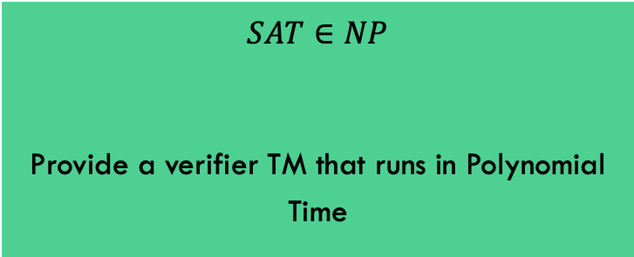
$$SAT∈NPC$$
To show that $SAT∈NPC$, we must show both that:
$$SAT∈NP$$
Provide a verifier TM that runs in Polynomial Time
$$SAT∈NP−HARD$$
Show that $∃_{x∈NPC}x≤_{p}SAT$ OR $∀_{x∈NP}x≤_{p}SAT$
This part is done!!

Slide 52
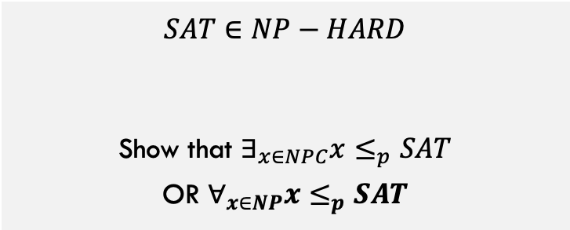
Sat is NP-Hard
$$SAT∈NP−HARD$$
Show that $∃_{x∈NPC}x≤_{p}SAT$ OR $∀_{x∈NP}x≤_{p}SAT$
As we stated. before, we have to use the second option because there (when this proof was done) are no NP-Complete problems yet!

Slide 53



Sat is NP-Hard
$$SAT∈NP−HARD$$
$$∀_{x∈NP}x≤_{p}SAT$$
Choose arbitrary $x∈NP$
Reduce problem x
To an instance of SAT
NTM Decider for x
$$x_{1} ∧ \overline{x_{2}} ∨\left(\overline{x_{3}}∧x_{2}\right)…$$
How are we going to do this?

Slide 54
Sat is NP-Hard
$$SAT∈NP−HARD$$
$$∀_{x∈NP}x≤_{p}SAT$$
Choose arbitrary $x∈NP$
Reduce problem x
To an instance of SAT
NTM Decider for x
Tape moved right AND 1 written to first cell of tape AND …
IDEA: For any generic problem x in NP, it has a decider NTM. Convert that NTM into a Boolean expression that describes the operation of the machine. Why is this a valid reduction?

Slide 55
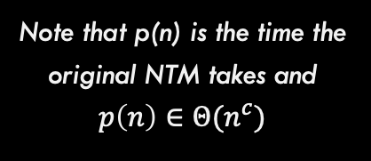
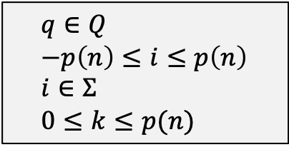
Variables We Need
Variable | Meaning | How many
T_{ijk} | True if tape cell i contains symbol j at step k of the computation | O(p(n)²)
H_{ik} | True if the M’s read/write head is at tape cell i at step k of the computation | O(p(n)²)
Q_{qk} | True if M is in state q at step k of the computation | O(p(n))
Some constraints:
$$q∈Q \\ −p\left(n\right)≤i≤p\left(n\right) \\ i∈Σ \\ 0≤k≤p(n)$$
Note that p(n) is the time the original NTM takes and $p\left(n\right)∈Θ(n^{c})$

Slide 56
Create a conjunction ‘B’ of…
Expression | Conditions | Interpretation | How many
T_{ij0} | Tape cell i initially contains symbol j | Initial tape state; blank symbols below 0 and above n | O(p(n))
Q_{s0} |  | Initial state of the NTM | 1
H₀₀ |  | Initial position of the read/write head | 1
T_{ijk} → ¬T_{ij’k} | j != j’ | One symbol per tape cell | O(p(n)²)
T_{ijk} = T_{ij(k+1)} ∨ H_{jk} |  | Tape remains unchanged unless written | O(p(n)²)
Q_{qk} → ¬Q_{q’k} | q ≠ q’ | Only one state at a time | O(p(n))
H_{jk} → ¬H_{j’k} | i ≠ i’ | Only one head position at a time | O(p(n)²)
(H_{ij} ∧ Q_{qk} ∧ T_{iσk}) → (H_{(i+d)(k+1)} ∧ Q_{q’(k+1)} ∧ T_{iσ(k+1)}) | (q, σ, q’, σ’, d) ∈ δ | Possible transitions at computation step k when head position is at position I | O(p(n)²)
∨_{f∈F} Qfp(n) |  | Must finish in an accepting state | 1

Slide 57
Is the reduction Valid?
NTM for x accepts iff and only if SAT equation can be satisfied
The time and space complexity of the reduction is polynomial
If there is an accepting computation for the NTM on input I, then B is satisfiable by assigning T_{ijk}, H_{jk}, and Q_{jk} their intended interpretations.
Yes!
The number of sub-expressions is:
2p(n) + 4p(n)² + 3 = O(p(n)²)
and each is computed in less than that.

Slide 58
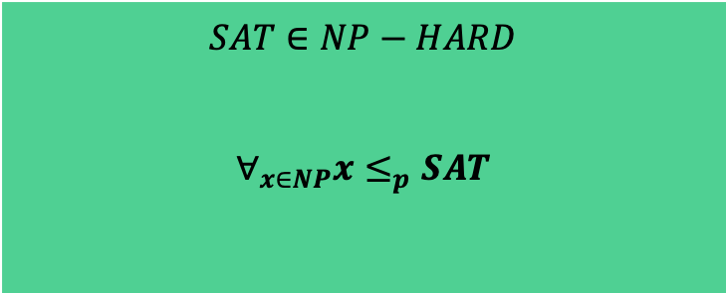
$$SAT∈NPC$$
To show that $SAT∈NPC$, we must show both that:
$$SAT∈NP$$
Provide a verifier TM that runs in Polynomial Time
$$SAT∈NP−HARD$$
$$∀_{x∈NP}x≤_{p}SAT$$
Thus, it is proven!!

Slide 59
Other NP-Complete Problems (Reductions)

Slide 60
3-SAT

Slide 61
3-SAT
3-SAT = Can a provided Boolean expression in 3-Conjunctive-Normal Form (3-CNF) be satisfied?
$$V=\left(v_{1}∧v_{2}∧\overline{v_{3}}\right)∨\left(v_{4}∧\overline{v_{1}}∧v_{2}\right)∨\left(v_{4}∧\overline{v_{3}}∧\overline{v_{1}}\right)∨…$$
Each Clause contains a conjunction (AND) of 3 literals (or negated literals)
The expression must be a disjunction (OR) of multiple clauses
Is it easier to decide 3-SAT because the format is simpler?

Slide 62
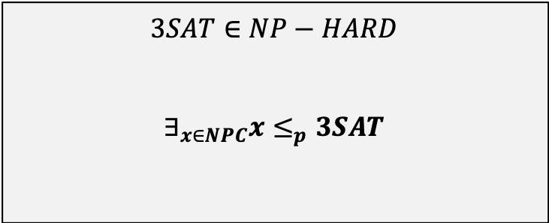
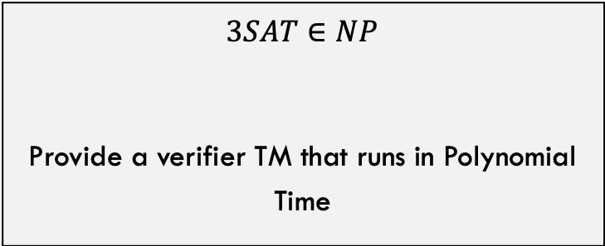
Showing that $3SAT∈NPC$
To show that $3SAT∈NPC$, we must show both that:
$$3SAT∈NP$$
Provide a verifier TM that runs in Polynomial Time
$$3SAT∈NP−HARD$$
$$∃_{x∈NPC}x≤_{p}3SAT$$
This time we can reduce from a concrete, known, NPC problem. We only have SAT so far, so that is what we will choose!
This one, as usual, is not difficult.

Slide 63
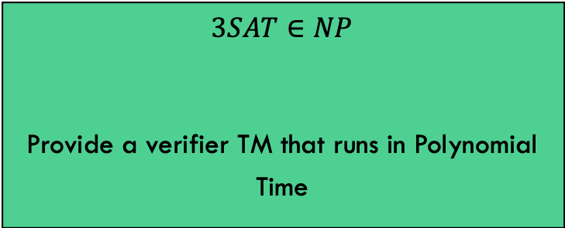
Showing that $3SAT∈NPC$
$$3SAT∈NP$$
Provide a verifier TM that runs in Polynomial Time
This is trivial. The verifier we developed for SAT will also work for 3SAT.

Slide 64
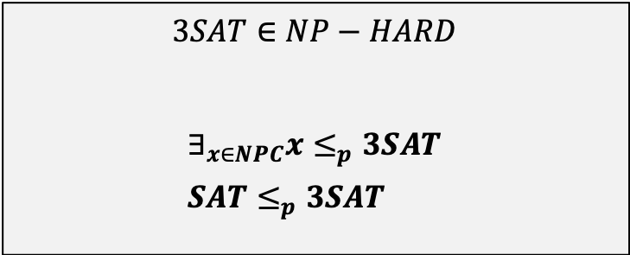
Showing that $3SAT∈NPC$
$$3SAT∈NP−HARD$$
$$∃_{x∈NPC}x≤_{p}3SAT \\ SAT≤_{p}3SAT$$
Need to show 3SAT is at least as hard as SAT. How? Show a reduction.
Given a generic SAT input, can we convert it into an equivalent formula in 3SAT?
SAT input x:
e.g., φ = ((x₁ → x₂) ∨ ¬((¬x₁ ↔ x₃) ∨ x₄)) ∧ ¬x₂
Equivalent 3SAT formula:
e.g., φ’_{i} = (¬y₁∨¬y₂∨¬x₂) ∧ (¬y₁∨y₂∨¬x₂) ∧ (¬y₁∨y₂∨x₂) ∧ (y₁∨¬y₂∨x₂)…

Slide 65
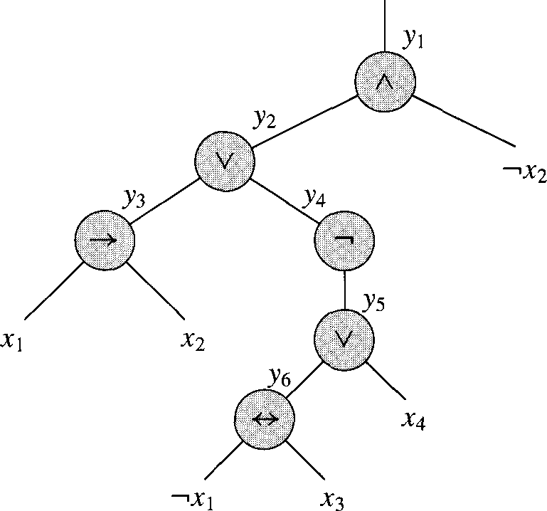
Converting SAT to 3-SAT, step 1
Input: φ = ((x₁ → x₂) ∨ ¬((¬x₁ ↔ x₃) ∨ x₄)) ∧ ¬x₂
Step 1: Parse the expression into an expression tree

Slide 66
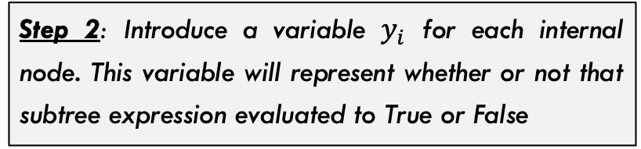
Converting SAT to 3-SAT, step 2
Step 2: Introduce a variable $y_{i}$ for each internal node. This variable will represent whether or not that subtree expression evaluated to True or False
We can then re-write our expression:
φ’ = y₁ ∧ (y₁ ↔ (y₂ ∧ ¬x₂)
∧ (y₂ ↔ (y₃ ∨ y₄))
∧ (y₃ ↔ (x₁ → x₂))
∧ (y₄ ↔ ¬y₅)
∧ (y₅ ↔ (y₆ ∨ x₄))
∧ (y₆ ↔ (¬x₁ ↔ x₃))

Slide 67
Converting SAT to 3-SAT, step 3
Step 3:
Build a truth table for each clause φ’_{i}:
y₁ | y₂ | _{X2} | (y₁ ↔ (y₂ ∧ ¬x₂))
1 | 1 | 1 | 0
1 | 1 | 0 | 1
1 | 0 | 1 | 0
1 | 0 | 0 | 0
0 | 1 | 1 | 1
0 | 1 | 0 | 0
0 | 0 | 1 | 1
0 | 0 | 0 | 1
φ’ = y₁ ∧ (y₁ ↔ (y₂ ∧ ¬x₂)
∧ (y₂ ↔ (y₃ ∨ y₄))
∧ (y₃ ↔ (x₁ → x₂))
∧ (y₄ ↔ ¬y₅)
∧ (y₅ ↔ (y₆ ∨ x₄))
∧ (y₆ ↔ (¬x₁ ↔ x₃))

Slide 68
Converting SAT to 3-SAT, step 4 / 5
Step 4: For each clause, construct a DNF (disjunctive normal form) for when it is False (based on truth table)
Step 5: Take this formula and negate it to get all the instances where the clause is true in CNF (conjunctive normal form).
y₁ | y₂ | x₂ | (y₁ ↔ (y₂ ∧ ¬x₂))
1 | 1 | 1 | 0
1 | 1 | 0 | 1
1 | 0 | 1 | 0
1 | 0 | 0 | 0
0 | 1 | 1 | 1
0 | 1 | 0 | 0
0 | 0 | 1 | 1
0 | 0 | 0 | 1
¬φ’_{i} = (y₁∧y₂∧x₂) ∨ (y₁∧¬y₂∧x₂) ∨ (y₁∧¬y₂∧¬x₂) ∨ (¬y₁∧y₂∧¬x₂)
¬φ’_{i} =
(y₁∧y₂∧x₂) ∨
(y₁∧¬y₂∧x₂) ∨
(y₁∧¬y₂∧¬x₂) ∨
(¬y₁∧y₂∧¬x₂)
Negate formula
φ’_{i} = (¬y₁∨¬y₂∨¬x₂) ∧ (¬y₁∨y₂∨¬x₂) ∧ (¬y₁∨y₂∨x₂) ∧ (y₁∨¬y₂∨x₂)

Slide 69
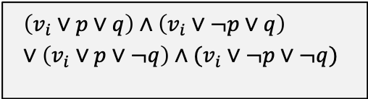





Converting SAT to 3-SAT, step 6
φ’_{i} = (¬y₁∨¬y₂∨¬x₂) ∧ (¬y₁∨y₂∨¬x₂) ∧ (¬y₁∨y₂∨x₂) ∧ (y₁∨¬y₂∨x₂)
Step 6: Almost done. This works but some clauses may have only 1 or 2 literals (3 are required for every single clause). Add dummy variables to force each clause to have three literals.
Case 1: Clause has 3 literals
Case 2: Clause has only 2 literals
Case 3: Clause has only 1 literal
$$(v_{i}∨v_{j}∨v_{k})$$
$$(v_{i}∨v_{j})$$
$$(v_{i})$$
Becomes: Introduce dummy variable p
Becomes: Introduce dummy variables p and q
Do nothing, already fine
$$\left(v_{i}∨p∨q\right)∧\left(v_{i}∨¬p∨q\right)∨\left(v_{i}∨p∨¬q\right)∧(v_{i}∨¬p∨¬q)$$
$$\left(v_{i}∨v_{j}∨v_{k}\right)$$
$$\left(v_{i}∨v_{j}∨p\right)∧\left(v_{i}∨v_{j}∨¬p\right)$$

Slide 70
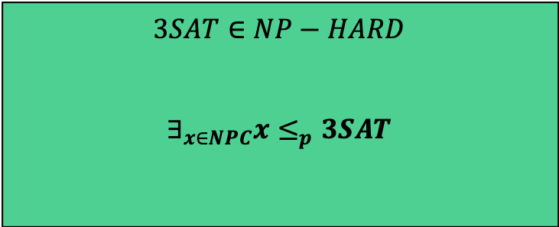
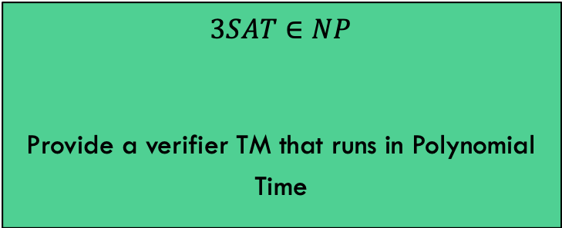
Showing that $3SAT∈NPC$
To show that $3SAT∈NPC$, we must show both that:
$$3SAT∈NP$$
Provide a verifier TM that runs in Polynomial Time
$$3SAT∈NP−HARD$$
$$∃_{x∈NPC}x≤_{p}3SAT$$
We are done!!

Slide 71
Cliques

Slide 72
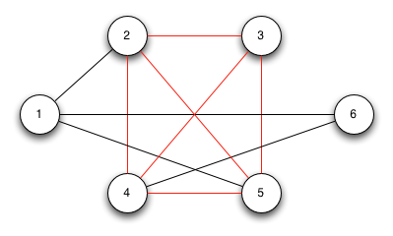
Clique
A Clique in a graph G is a set of nodes such that each one is connected to each other in the set
In other words, it is a maximal sub-graph of G
Problem: Find the maximum size clique in a graph G

Slide 73
Clique
A Clique in a graph G is a set of nodes such that each one is connected to each other in the set
Can we frame this as a Decision Problem?
Given a graph G and an integer k, return Yes iff G has a click of size k or larger.

Slide 74
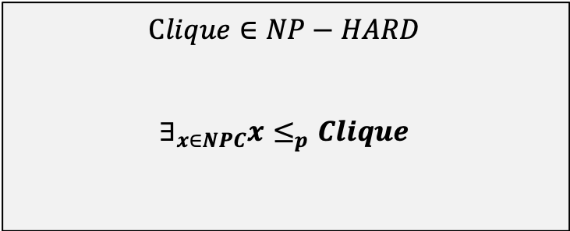
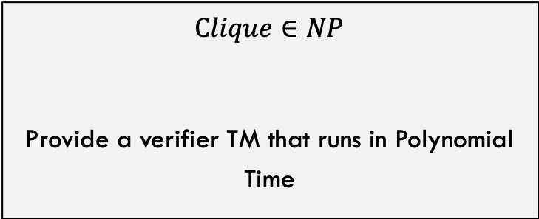
Showing that $Clique∈NPC$
To show that $Clique∈NPC$, we must show both that:
$$Clique∈NP$$
Provide a verifier TM that runs in Polynomial Time
$$Clique∈NP−HARD$$
$$∃_{x∈NPC}x≤_{p}Clique$$
As usual, this one is pretty simple
For this one, we can choose SAT or 3-SAT

Slide 75
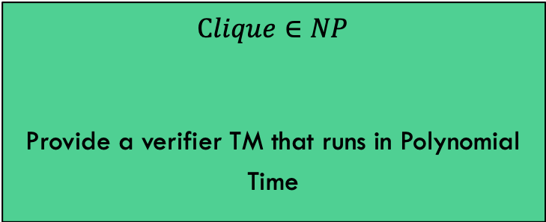

Showing that $Clique∈NPC$
$$Clique∈NP$$
Provide a verifier TM that runs in Polynomial Time
Verifier:
Given G, k, and a subset $V^{′}⊆V$ of nodes
Verify that number of nodes in V’ is k or larger
For each pair of nodes (p,q) in V’:
check that edge p,q exists in G
If not, return NO
Return YES

Slide 76
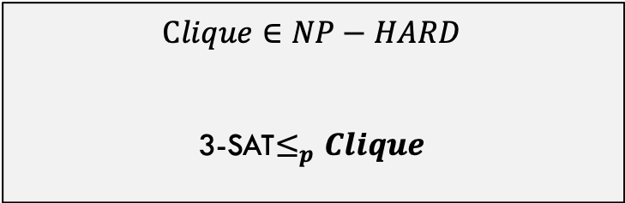
Showing that $Clique∈NPC$
$$Clique∈NP−HARD$$
3-SAT$≤_{p}Clique$
We choose 3-SAT
Goal: Given a generic 3-SAT input, can we convert it into graph and integer k such that the 3-SAT formula is satisfiable IFF the graph has a click of at least size k?
Input: 3SAT formula:
e.g., φ’_{i} = (¬y₁∨¬y₂∨¬x₂) ∧ (¬y₁∨y₂∨¬x₂) ∧ (¬y₁∨y₂∨x₂) ∧ (y₁∨¬y₂∨x₂)…
Graph G and integer k
Converting a Boolean formula into a graph is strange, right? Let’s see how it works!

Slide 77
Proving Clique is NP-complete
First show it’s in NP
Can we verify it with a DTM in polynomial time?
Given a set of nodes, we can quickly determine if they are all connected to each other
A formal proof will require explaining how, which I’ll do verbally
Done!
Next, show it’s NP-hard
We reduce another NP-complete problem to Clique
Our choices so far are SAT and 3-SAT
We’ll use 3-SAT
In other words, that we can use a Clique solution to solve a 3-SAT problem
3-SAT ≤_{p} Clique

Slide 78
The reduction
Consider a 3-SAT problem with k clauses, C₁ to C_{k}; each clause C_{r} (where 1 ≤ r ≤ k) has literals l^{r}₁, l^{r}₂, l^{r}₃
We create a graph G as follows:
For each literal, create a vertex
Draw an edge between each vertex and every other vertex that:
Is not in the same clause
Is consistent: i.e., is not the negation of that literal
Claim: if the there is a clique of size k in G, then the equation is satisfiable

Slide 79
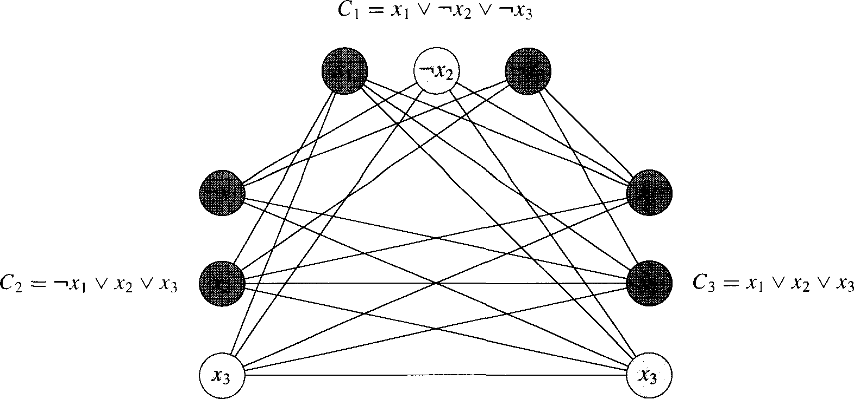
Reduction example
φ = (x₁∨¬x₂∨¬x₃)∧(¬x₁∨x₂∨x₃)∧(x₁∨x₂∨x₃)
x₁
¬x₃
¬x₁
x₁
x₂
x₂

Slide 80
Satisfiable(φ) → Clique(G, k)
If the equation is satisfiable:
Then there is at least one true literal in each clause
We pick one such true literal from each clause
They are all connected to each other, since inconsistent nodes are not connected to each other
They form a click of size k
You cannot have a clique of size k+1
Since nodes within a clause are not connected to each other
Thus, if the equation of k clauses is satisfiable, there is a clique of size k in graph G
And if there is a clique of size k in the graph G, then the equation is satisfiable

Slide 81
Clique(G, k) → Satisfiable(φ)
If the equation is not satisfiable:
Then there is at least one clause where all literals are false
Thus, you cannot have a clique of size k
Since there are only k-1 clauses left to form a clique
Recall that no nodes in the same clause are connected to each other, so we can get at most one node in the clique from each clause
Thus, if the equation of k clauses is not satisfiable, there is not a clique of size k in graph G
And if there is not a clique of size k in the graph G, then the equation is not satisfiable

Slide 82
Notes about this proof
It is notable because it shows a reduction from a formulaic problem to a graph problem
And the Cook-Levin theorem translates the graph problem (Clique) back to a formulaic problem (SAT)

Slide 83
Vertex Cover

Slide 84
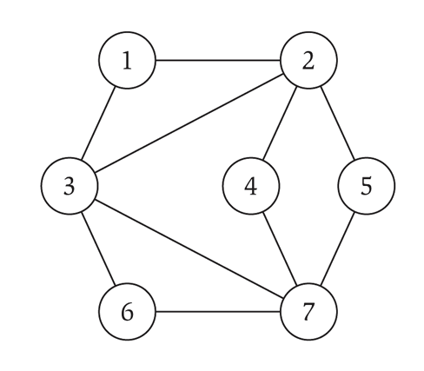
Vertex Cover
A vertex cover (VC) on a graph G = (V,E) is a subset of vertices S ⊆ V such that every edge in the graph is connected to at least one vertex in S
We typically look for the smallest vertex cover
The smallest vertex cover in the graph to the right is of size 3
2, 3, 7

Slide 85
Vertex Cover
We will reduce Clique to VC
Decision problem we will prove: given a graph G, is there a vertex cover of size k?
VC ∈NP: given a set of vertices, we can tell in polynomial time on a DTM if they form a proper VC
A formal proof will require explaining how, which I’ll do verbally
VC is NP-hard: done by a reduction
Clique ≤_{p} VC

Slide 86
Reduction
Given a graph G, we want to find a clique
To do so, we take the complement graph G’
G’ has edges between every pair of nodes that do not have edges between them in G
… and we find the vertex cover on G’
Claim: if there is a VC in G’ of size k, then there is a clique in G of size |V|-k
Or if a VC in G’ is of size |V|-k, then there is a clique of size k in G

Slide 87
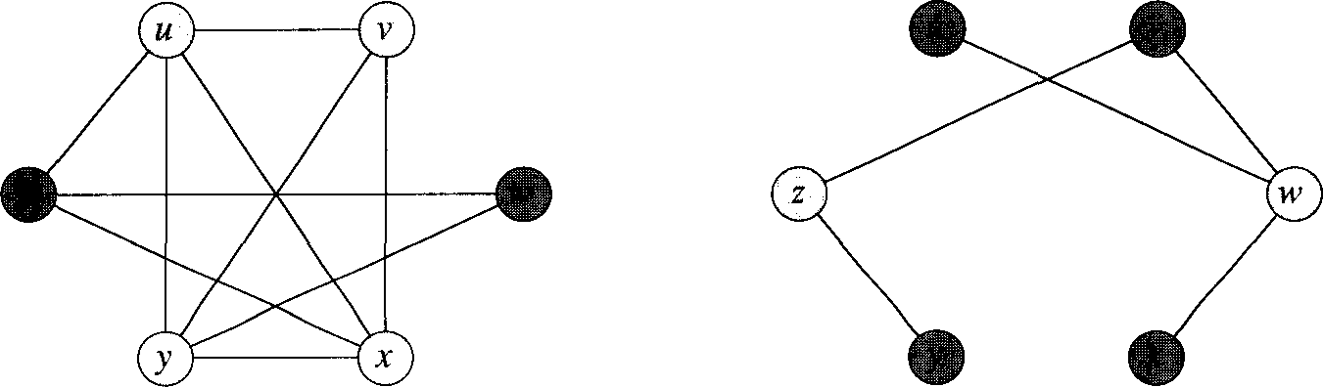
Reduction example
G is on the left, and the white nodes form a Clique
G’ is on the right, and the white nodes form a VC
u
v
z
w
y
z

Slide 88
How does this work?
Suppose G has a clique C ⊆ V with |C| = k
The claim is that V-C is a VC in G’
Let (u,v) be any edge in E’
Thus, (u,v) ∉E, since E’ is the complement of E
Then at least one of u or v does not belong to C (since C is a clique)
And thus at least one of u or v is in V-C (the VC)
So the edge (u,v) is covered by the VC
This is true for all edges in E’
Thus, V-C has size |V|-k, and forms a VC of G’

Slide 89
How does this work?
Conversely, suppose that G’ has a VC Cover ⊆ V with |Cover| = k
Then G has a clique of V-Cover, of size |V|-k
Same basic argument.
Examine the complement of Cover (call it Cover’)
No hypothetical edge e between two nodes in Cover’ exists in G’ because then the original Cover wouldn’t be a valid VC
Thus, the complement of E’ (which is just E) contains ALL of the edges between all pairs of nodes in Cover’
Thus Cover’ is a clique
|Cover’| = |V| - |Cover| = |V| - k

Slide 90
More Reductions

Slide 91
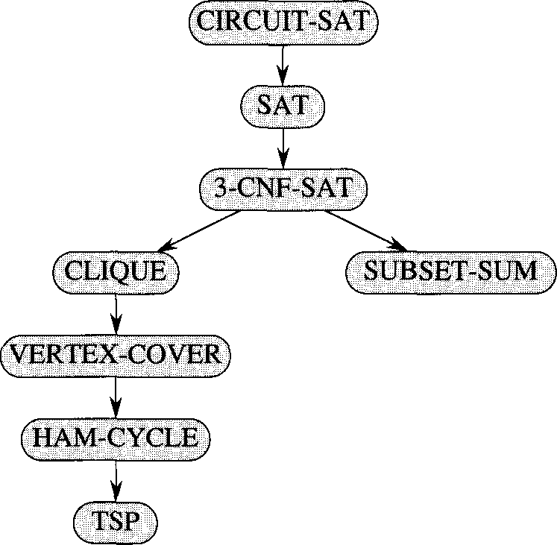
More reductions!
In 1972, Richard Karp showed a number of problems were NP-complete
The problems were known to be “hard”, but how “hard” was not really quantified until then

Slide 92
Trying to prove X ∈P is NP-complete
We know that X is in NP
Since P ⊆ NP, then the same reasoning that applies for NP problems applies for P problems
In other words, X ≤_{p} SAT
Next, we show a known NP-complete problem Y reduces to X
In other words, Y ≤_{p} X
This would imply that we could use a polynomial-time solution to X to solve the NP-complete problem Y
This is where the proof would most likely fail

Slide 93
NP-complete proofs we won’t see
Hamiltonian cycle (reduces from 3-SAT)
3-D matching (reduces from 3-SAT)
Subset Sum (reduces from 3-D matching)
These are all in the textbook or online

Slide 94
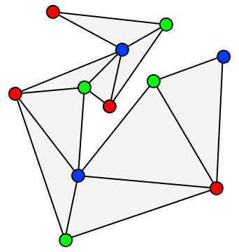
3-Coloring
Given graph G, and three colors c1,c2,c3 (not really given as input)
Can we color the graph with these colors such that no adjacent nodes have the same color.
Turns out that 3-Coloring is NP-Complete

Slide 95
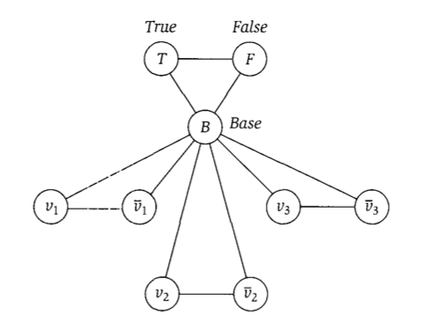
Reducing 3-SAT to 3-coloring

Slide 96
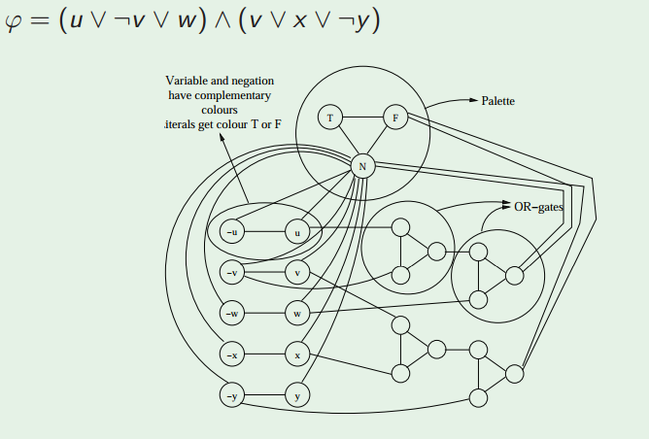
Reducing 3-SAT to 3-coloring

Slide 97
(VERY informal) proof of reduction
Sat(Φ) → G is 3-Colorable
Assume Φ is satisfiable
3 colors (true, false, base)
Color B,T,F with these colors
Color variable nodes with T and F depending on their satisfying values for Φ
Or gates always colorable so that they represent correct OR (output is true iff one or more inputs true)
Thus G is 3-Colorable
G is 3-Colorable → Sat(Φ)
Assume G is 3-Colorable
Color the graph
Let the colors of the B,T,F nodes represent base, true, and false respectively.
Re-arrange OR gate colors slightly if necessary so output is always T or F
Let variable assignments be the color they were given
These assignments satisfy Φ

Slide 98
CS 2150 lecture planning
There are n total guest lectures that can be given
There are l guest lectures to be given (one per week) during the first “half” of the course
For each week, a different set of lectures are available
There may be more guest lectures than l
During the second “half” of the course, there are p projects to be completed, one each week
Each project requires one of a set of guest lectures
Can you schedule l guest lecturers (one per week) such that all p the projects can be completed?

Slide 99
Lecture planning example
l (the number of weeks of lectures) = 2
p (the number of projects) = 3
n (the number of possible guest lecturers) = 4
Availability for the two weeks:
L₁ = {A, B, C}, L₂ = {A, D}
Which lectures/lecturers are needed for each of the 3 projects:
P₁ = {B, C}, P₂ = {A, B, D}, P₃ = {C, D}
Of the 4 lecturers, can we schedule 2 of them such that all 3 of the projects can be completed?
Yes, we can schedule B in the first week and D in the second week

Slide 100
Prove that Lecture Planning is NP-complete
Can reduce from 3-SAT
Can you do it?
Notes:
Pages 502-505

Slide 101
Co-NP

Slide 102
Algorithmic Complement
Given a problem X, we can define the complement, X’
Take the decision version of the problem X
Change all the ‘yes’ answers to ‘no’ and visa-versa
Consider the problem of if a number is prime
The complement problem is if a number is composite

Slide 103
co-NP
NP contains the set of problems for which proof of a ‘yes’ solution is easily verifiable
To show a ‘yes’ instance, I just have to show one: exists quantifier
To show no instances, I have to show it’s ‘no’ for all: for all quantifier
To show that there is no satisfiable set of truth values for a SAT problem, you have to show each possible one
co-NP contains the set of problems for which proof of no solutions is easily verifiable

Slide 104
co-NP examples
SAT: given a expression, is there a satisfiable set of truth assignments?
To prove a ‘yes’ instance, you just (quickly) check a given (correct) answer (polynomial time)
To prove there are no instances, you must show for all (exponential time)
co-SAT: given an expression, are there no satisfiable set of truth assignments?
To prove a ‘no’ instance (which means there is a satisfiable truth assignment), we just (quickly) check a given (correct) answer (polynomial time)
To prove ‘yes’, you must show for all (exponential time)

Slide 105
co-NP
Consider subset-sum: given a finite set of integers, is there a non-empty subset which sums to zero?
To prove a ‘yes’, specify the non-empty subset
The complement asks, “given a finite set of integers, does every non-empty subset have non-zero sum?”
To prove a ‘no’, specify a non-empty subset

Slide 106
P is closed under complement
Meaning P = P’
For problems in P: finding a ‘yes’ instance or finding there are no instances are both polynomial time
For problems in P’: finding a ‘no’ instance or finding there are yes instances are both polynomial time
For NP/co-NP, one way was exponential

Slide 107
Does NP = co-NP?
We don’t know for sure
We know that P ⊆ NP
Likewise, P ⊆ co-NP
Given a problem in P, it’s complement P’ is also in P
P’ is in co-NP
Thus P ⊆ co-NP

Slide 108
NP and co-NP
We’ll show that if P = NP then NP = co-NP
We don’t think that P = NP, but we can still show the conditional is true
Assume P = NP…
Let X ∈NP
Then, X ∈ P because P=NP
X’ ∈ P because P closed under complement
X’ ∈ NP because P=NP
X ∈ co-NP because definition of co-NP
Same Exact argument backwards for the other way
Thus, if P = NP then NP = co-NP

Slide 109
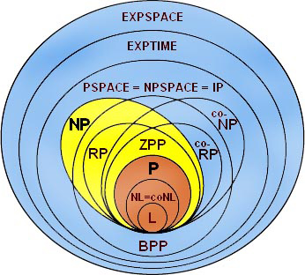
Complexity class diagram

Slide 110
A couple complexity classes we won’t see:
EXPTIME
Deterministic exponential time
NEXPTIME
Non-Deterministic exponential time
PSPACE
Deterministic Polynomial Space
NPSPACE
Non-Deterministic Polynomial Space
EXPSPACE
Deterministic Exponential Space
NEXPSPACE
Non-Deterministic Exponential Space

Slide 111
A couple complexity classes we won’t see:
PSPACE
Deterministic Polynomial Space
NPSPACE
Non-Deterministic Polynomial Space
EXPSPACE
Deterministic Exponential Space
NEXPSPACE
Non-Deterministic Exponential Space
PSPACE = NPSPACE and EXPSPACE = NEXPSPACE
WOAH! That’s pretty cool!

