Slide 1
Cardinality
Discrete Mathematics and Theory 2 Mark Floryan

Slide 2
Goals!
1. Quick review of functions!
2. How do we use functions to compare the sizes of sets? Why might this be useful as we move forward talking about computation?
3. Do all infinite sets have the same size? What can this tell us (already) about the theory of computation?

Slide 3
Part 1: Quick Review of Functions

Slide 4
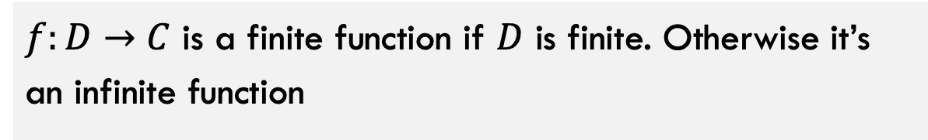
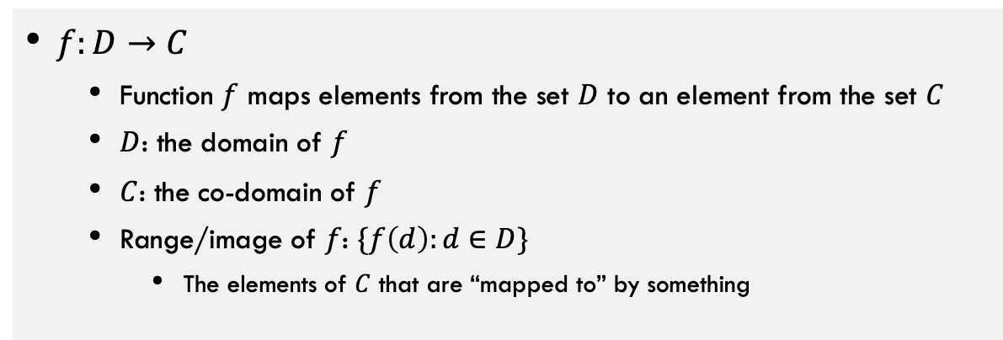
Defining Functions
Function: a “mapping” from input to output
$f:D→C$
Function $f$ maps elements from the set $D$ to an element from the set $C$
$D$: the domain of $f$
$C$: the co-domain of $f$
Range/image of $f$: $\{f\left(d\right):d∈D\}$
The elements of $C$ that are “mapped to” by something
Finite function: a function with a finite domain
$f:D→C$ is a finite function if $D$ is finite. Otherwise it’s an infinite function

Slide 5
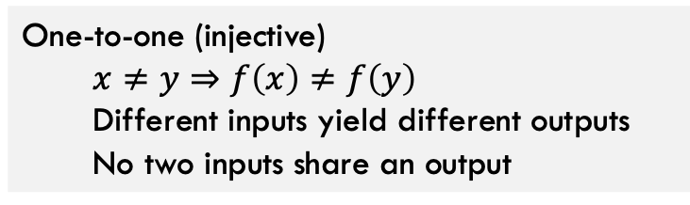
Injective Functions
Domain
Co-Domain
Domain
Co-Domain
INJECTIVE FUNCTION
NON-INJECTIVE FUNCTION
One-to-one (injective)
$$x≠y⇒f\left(x\right)≠f\left(y\right)$$
Different inputs yield different outputs
No two inputs share an output

Slide 6
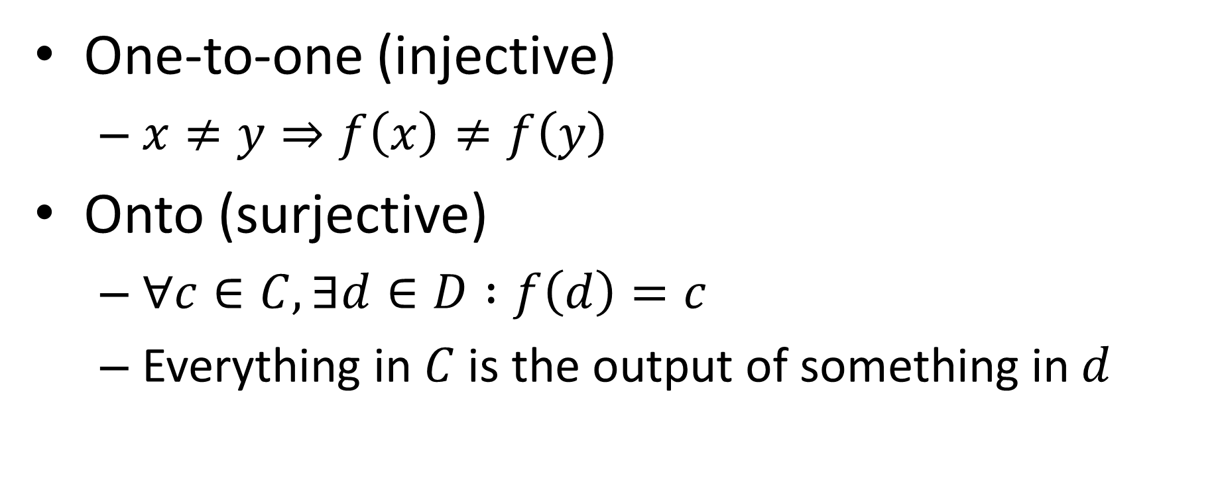
Properties of Functions
One-to-one (injective)
$x≠y⇒f\left(x\right)≠f\left(y\right)$
Onto (surjective)
$∀c∈C, ∃d∈D :f\left(d\right)=c$
Everything in $C$ is the output of something in $d$

Slide 7
Onto, Surjective Functions
Domain
Co-Domain
Domain
Co-Domain
SURJECTIVE FUNCTION
NON-SURJECTIVE FUNCTION
Everything in Co-Domain “receives” something

Slide 8

Properties of Functions
One-to-one (injective)
$x≠y⇒f\left(x\right)≠f\left(y\right)$
Onto (surjective)
$∀c∈C, ∃d∈D :f\left(d\right)=c$
One-to-one Correspondence (bijective)
Both one-to-one and surjective
Everything in $C$ is mapped to by a unique element in $D$
All elements from domain and co-domain are perfectly “partnered”

Slide 9
Bijective Functions
Domain
Co-Domain
Because Onto:
Everything in Co-Domain “receives” something
Because 1-1:
Nothing in Co-Domain “receives” two things
BIJECTIVE FUNCTION
Conclusion:
Things in the Domain exactly “partner” with things in Co-Domain

Slide 10
Part 2: Using Functions to Compare Sizes of Sets

Slide 11
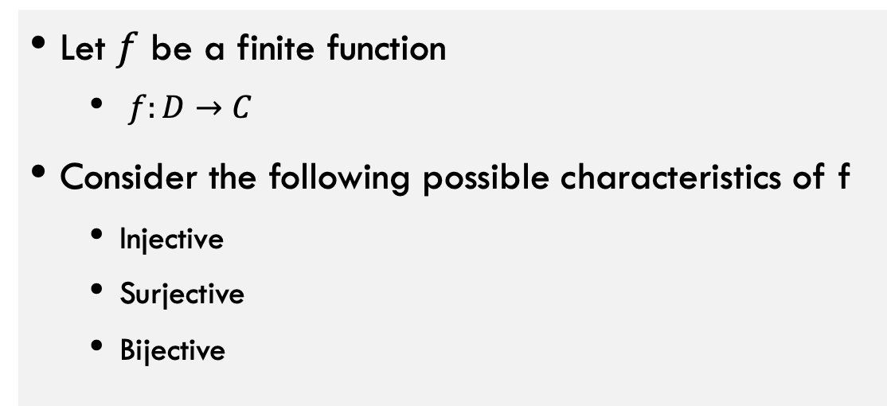
Comparing Cardinalities with Functions
Let $f$ be a finite function
$f:D→C$
Consider the following possible characteristics of f
Injective
Surjective
Bijective
Each of these will tell us something about the relative sizes of D and C

Slide 12

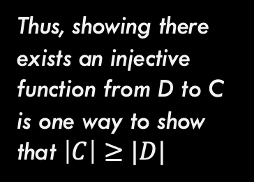
1-1, Injective Functions
Domain
Co-Domain
Thus, showing there exists an injective function from D to C is one way to show that $\left|C\right|≥|D|$
INJECTIVE FUNCTION
Nothing in Co-Domain “receives” two things
**Only possible if $\left|C\right|≥|D|$

Slide 13
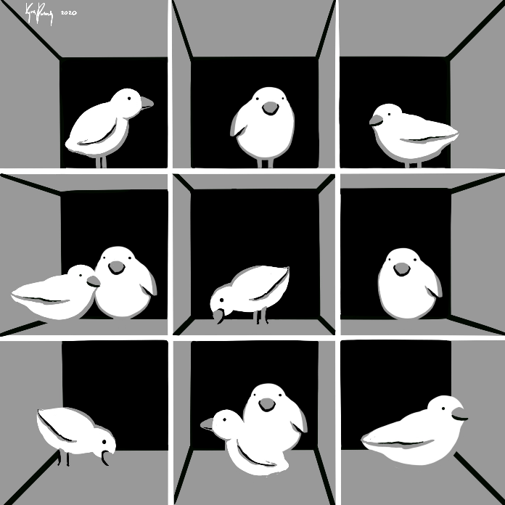
Pigeonhole Principle
Every pigeon is sitting in a hole
There are more pigeons than there are holes
At least one hole has at least two pigeons

Slide 14

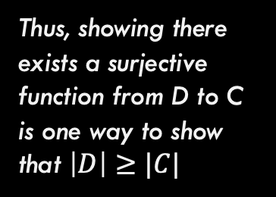
Onto, Surjective Functions
Domain
Co-Domain
Thus, showing there exists a surjective function from D to C is one way to show that $\left|D\right|≥|C|$
SURJECTIVE FUNCTION
Everything in Co-Domain “receives” something
**Only possible if $\left|D\right|≥|C|$

Slide 15



Bijective Functions
Domain
Co-Domain
Because 1-1:
Nothing in Co-Domain “receives” two things
$\left|C\right|≥|D|$
Because Onto:
Everything in Co-Domain “receives” something
$\left|D\right|≥|C|$
BIJECTIVE FUNCTION
Conclusion:
Things in the Domain exactly “partner” with things in Co-Domain
**Note: This means that $\left|D\right|=|C|$

Slide 16

Comparing Cardinalities with Functions
To show $\left|S\right|≥|T|$
Find a surjective function $f:S→T$
Find an injective function $f:T→S$
To show $\left|S\right|=|T|$
Find a bijective function $f:S↔T$
Find both a surjective function $f_{1}:S→T$ and an injective function $f_{2}:S→T$

Slide 17

How to show $f:D→C$ is a bijection?
Show that it is injective:
$∀x∈D. ∀y∈D. \left(x≠y\right)→\left(f\left(x\right)≠f\left(y\right)\right)$
How do we know different inputs have different outputs?
Show that is in surjective:
$∀y∈C. ∃x∈D. f\left(x\right)=y$
How do we know everything is mapped to?

Slide 18

Comparing Cardinalities with Functions
To show $\left|S\right|≥|T|$
Find a surjective function $f:S→T$
Find an injective function $f:T→S$
To show $\left|S\right|=|T|$
Find a bijective function $f:S↔T$
Find both a surjective function $f_{1}:S→T$ and an injective function $f_{2}:T→S$

Slide 19

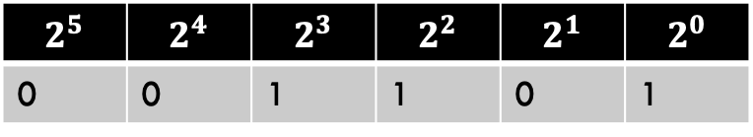
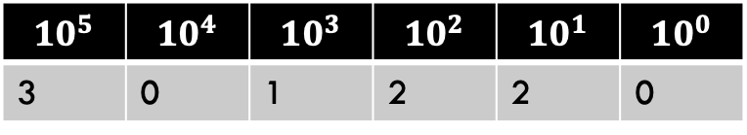
$\left|{\left\{0,1\right\}}^{n}\right|=2^{n}$ via bijection
$$10^{5}$$ | $$10^{4}$$ | $$10^{3}$$ | $$10^{2}$$ | $$10^{1}$$ | $$10^{0}$$
3 | 0 | 1 | 2 | 2 | 0
Proof idea:
Find a bijection $f_{n}:{\left\{0,1\right\}}^{n}↔\left\{x∈ℕ|x<2^{n}\right\}$
Given $b∈{\left\{0,1\right\}}^{n}$, what is $f_{n}\left(b\right)∈\left\{x∈ℕ|x<2^{n}\right\}$?
$f_{n}\left(b\right)=\sum_{i=0}^{n−1}{{b_{i}⋅2}^{i}}$
E.g. $1101=1⋅2^{0}+0⋅2^{1}+1⋅2^{2}+1⋅2^{3}=13$
Given $x∈\left\{x∈ℕ|x<2^{n}\right\}$, what is $f_{n}^{−1}\left(x\right)∈{\left\{0,1\right\}}^{n}$?
Do $n$ times: if $x$ is even, make $0$ the next bit of $b$, otherwise make it $1$. Let $x=\left\lfloor \frac{x}{2}\right\rfloor$
$$2^{5}$$ | $$2^{4}$$ | $$2^{3}$$ | $$2^{2}$$ | $$2^{1}$$ | $$2^{0}$$
0 | 0 | 1 | 1 | 0 | 1

Slide 20


Calculating binary of 13
$13$ is odd, so last bit is $1$
$x=\left\lfloor \frac{13}{2}\right\rfloor =6$
6 is even, so next bit is $0$
$x=\left\lfloor \frac{6}{2}\right\rfloor =3$
3 is odd, so next bit is 1
$x=\left\lfloor \frac{3}{2}\right\rfloor =1$
1 is odd, so next bit is 1
$$b=$$
1
1
0
1
…and fill with the last n-4 zeros to ensure there are n digits

Slide 21

For a finite set $S$, $\left|𝒫\left(S\right)\right|=2^{|S|}$
Find a function $f:𝒫\left(S\right)↔{\left\{0,1\right\}}^{|S|}$
Example: let $S=\left\{1,2,3\right\}$
$𝒫\left(S\right)=\left\{∅, \left\{1\right\}, \left\{2\right\}, \left\{3\right\}, \left\{1,2\right\}, \left\{1,3\right\}, \left\{2,3\right\}, \{1,2,3\}\right\}$
$f\left(\left\{1,2\right\}\right)=110$
$f\left(∅\right)=000$
Bijection: give each value of $S$ an index, for a particular subset of S, make the bit at that index 0 if it is absent, otherwise make it 1.

Slide 22

Why is this a bijection?
Show that it’s injective
Different subsets of $S$ result in different strings
This holds because for two subsets of $S$, call them $X$ and $Y$, if $X≠Y$ there must be some value $a∈S$ such that $\left(a∈X\right)≠(a∈Y)$. This means that $f(X)$ is different from $f(Y)$ at the bit associated with element $a$.
Show that it’s surjective
Every string is mapped to by some subset of $S$
Consider that we have some string $b∈{\left\{0,1\right\}}^{|S|}$. We can find the subset of $S$ called $B$such that $f\left(B\right)=b$ by including the value associated with bit $i$ in $b$ provided that bit is 1

Slide 23
Part 3: Comparing Sizes of Infinite Sets

Slide 24
Infinite Cardinality
How do we compare the sizes of two infinite sets? Wait…do they not automatically have the same size?

Slide 25

Infinite Cardinality
We say that for (infinite) sets $A$ and $B$, that $\left|A\right|=|B|$ if there is a bijection $f:A↔B$
What sets have the same cardinality as ${\left\{0,1\right\}}^{∗}$?

Slide 26

Countability and Uncountability
A set $S$ is countable if $\left|S\right|≤|\text{ℕ}\text{|}$
If $\left|S\right|=|\text{ℕ}\text{|}$, then $S$ is “countably infinite”
A set $S$ is countable if there is an onto (surjective) function from $\text{ℕ}$ to $S$
Otherwise a set is uncountable.

Slide 27

We know $\left|{\left\{0,1\right\}}^{∗}\right|≥|ℕ|$
How?
What doesn’t this already show that ${\left\{0,1\right\}}^{∗}$ is countable?

Slide 28
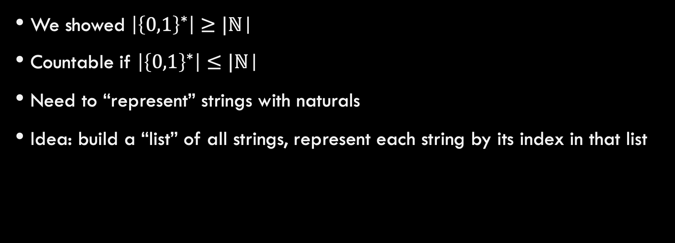
${\left\{0,1\right\}}^{∗}$ is countable
We showed $\left|{\left\{0,1\right\}}^{∗}\right|≥|\text{ℕ}\text{|}$
Countable if $\left|{\left\{0,1\right\}}^{∗}\right|≤|\text{ℕ}\text{|}$
Need to “represent” strings with naturals
Idea: build a “list” of all strings, represent each string by its index in that list

Slide 29

Listing all strings (bad way)
$f_{bad}:{\left\{0,1\right\}}^{∗}→ℕ$ can be defined as follows:
$f_{bad}\left(s\right)=$ the number that $s$ represents
Why is this function not a bijection?

Slide 30
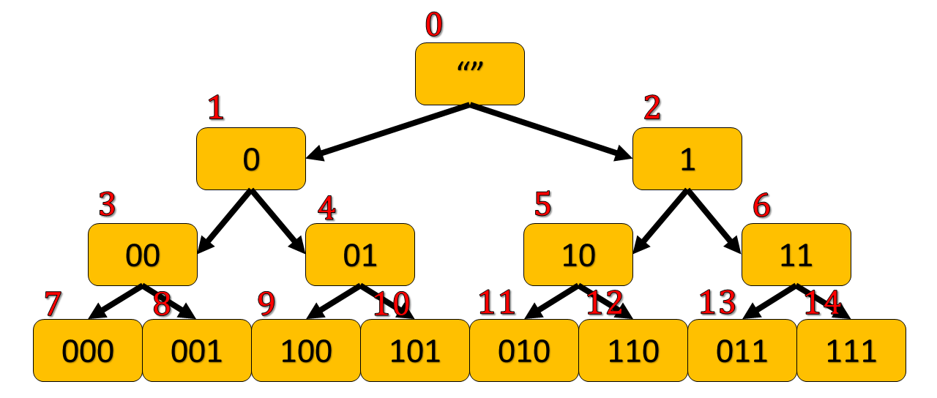

Listing all strings
${\left\{0,1\right\}}^{0}=\left\{""\right\}$
${\left\{0,1\right\}}^{1}=\left\{0,1\right\}$
${\left\{0,1\right\}}^{2}=\left\{00,01,10,11\right\}$
${\left\{0,1\right\}}^{3}=\{000,001,010,011,100,101,110,111\}$
0
1
2
3
4
5
6
7
8
9
10
11
12
13
14

Slide 31
Why is this a bijection?
Injective: different strings map to different numbers:
Different strings map to different nodes in the tree
No two nodes in the tree have the same index
Surjective: every number appears
We listed them one by one and there are an infinite number of nodes.

Slide 32

Listing all strings (Different Way)
$f:{\left\{0,1\right\}}^{∗}↔ℕ$ can be defined as follows:
$f\left(s\right)=$ the value you get by $2^{\left|s\right|}−1+f_{|s|}(s)$, where $\left|s\right|$ means the length of the string $s$ and $f_{\left|s\right|}\left(s\right)$ is the number that $s$ represents (using the function $f_{n}$ we defined last class with $n=|s|$).
$$f\left(001010\right)=2^{6}−1+10=73$$
Idea: all strings of length $5$ map to numbers $≥2^5$ and $<2^{6}$.
There are $2^{5}=32$ strings of length $5$, $2^{6}−2^{5}=64−32=32$

Slide 33

$f\left(s\right)=2^{\left|s\right|}−1+f_{n}\left(s\right)$ is a bijection
Proof:
$f$ is injective:
Suppose $s≠t$.
Case 1: $\left|s\right|=\left|t\right|$
Then $2^{\left|s\right|}−1=2^{\left|t\right|}−1$, however $f_{|s|}\left(s\right)≠f_{\left|s\right|}(t)$ because $f_{\left|s\right|}$ is a bijection.
Case 2: $\left|s\right|≠|t|$
Assume without loss of generality that $\left|s\right|>|t|$. This means that $f\left(s\right)>f\left(t\right)$. To show this, note that the smallest possible value of $f(s)$ is given by $2^{\left|s\right|}−1$ (i.e. the case where $s$ contains only 0s). The largest value of $f(t)$ is $2^{|t|}−1+2^{\left|t\right|}−1$, i.e. $2(2^{\left|t\right|}−1)$ which if $\left|s\right|−\left|t\right|≥1$ then it must be that $2\left(2^{\left|t\right|}−1\right)<2^{\left|s\right|}−1$

Slide 34

$f\left(s\right)=2^{\left|s\right|}−1+f_{n}\left(s\right)$ is a bijection
Proof:
$f$ is surjective:
Since $f$ is injective we know each member of ${\left\{0,1\right\}}^{n}$ maps to a different number in the range $[2^{n},2^{n+1})$, since there are $2^{n}$ strings and $2^{n}$ numbers, all must be mapped to.

Slide 35

Demonstrate that each of the following is countable
$ℤ^{+}=ℕ∖\left\{0\right\}$
$\{n∈ℕ|n is even\}$
$\{n∈ℕ|n is odd\}$
$ℤ$
$ℕ×ℕ$
$ℚ$

Slide 36

Proof: $ℤ^{+}$ is countable
$f_{+}:ℤ^{+}↔ℕ$

Slide 37

Proof: $\{n∈ℕ|n is even\}$ is countable
$f_{e}:\{n∈ℕ|n is even\}↔ℕ$

Slide 38

Proof: $\{n∈ℕ|n is odd\}$ is countable
$f_{0}:\{n∈ℕ|n is odd\}↔ℕ$

Slide 39

$ℤ$ is countable
To build $f_{z}:ℤ↔ℕ$
Idea: map natural numbers to evens, map negative numbers to odds
$f_{z}\left(x\right)=$
$f_{e}^{−1}(x)$ If $x∈ℕ$
$f_{o}^{−1}(−x)$ if $x∈ℤ^{−}$
Note that this means that if $A$ and $B$ are both countable then $A∪B$ is also countable!

Slide 40
$ℕ×ℕ$ is countable
Thoughts on how to prove it?

Slide 41


$ℕ×ℕ$ is countable
$$ℕ$$
0 1 2 3 4 5
$$ℕ$$
…
0
0,0 0,1 0,2 0,3 0,4 0,5
…
1
1,0 1,1 1,2 1,3 1,4 1,5
…
2
2,0 2,1 2,2 2,3 2,4 2,5
…
3
3,0 3,1 3,2 3,3 3,4 3,5
…
4
4,0 4,1 4,2 4,3 4,4 4,5
…
…
…
…
…
…

Slide 42

$ℚ$ is countable
Idea: there is a surjective mapping from $ℤ ×ℤ^{+}$ to $ℚ$
This one is on your homework assignment

Slide 43
How Many Python/Java programs?
How do we represent Java/Python programs?
How many things can we represent using that method?

Slide 44

How many functions $Σ^{∗}→Σ^{∗}$?
Short answer: Too many!
Uncountable
$\left|\left\{f \right|f:Σ^{∗}→Σ^{∗}\right\}|>|\text{ℕ}\text{|}$
Conclusion: Some functions cannot be computed by any java/python program
How to prove this?

Slide 45
How to show something is uncountable?

Slide 46
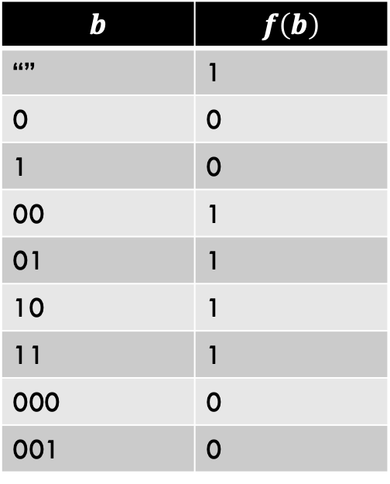

Uncountably many functions
If we show a subset of $\left\{f \right|f:Σ^{∗}→Σ^{∗}\}$is uncountable, then $\left\{f \right|f:Σ^{∗}→Σ^{∗}\}$ is uncountable too
Consider just the “yes/no” functions (decision problems): $\left\{f \right|f:{\{0,1\}}^{∗}→\{0,1\}\}$
The right-hand column is an infinite binary string that represents that function
$$b$$ | $$f\left(b\right)$$
“” | 1
0 | 0
1 | 0
00 | 1
01 | 1
10 | 1
11 | 1
000 | 0
001 | 0

Slide 47

Goal: $\left\{f:{\left\{0,1\right\}}^{∗}→{\left\{0,1\right\}}^{∗}\right\}$ is uncountable
Consider a simpler subset of our goal: $\left\{f:{\left\{0,1\right\}}^{∗}→\left\{0,1\right\}\right\}$
If the subset is uncountable, so is the superset
Consider a simpler set that’s the same size as set 1: ${\left\{0,1\right\}}^{∞}$
If the same-size set is uncountable, so was the set from step 1.
Give a bijection to between the set from step 1 and the set from step 2, therefore they are the same size
No onto mapping from $ℕ$ to ${\left\{0,1\right\}}^{∞}$

Slide 48


$$\left|{\left\{0,1\right\}}^{∞}\right|>|\text{ℕ}\text{|}$$
Idea:
show there is no way to “list” all infinite length binary strings
Any list of binary strings we could ever try will be leaving out elements of ${\left\{0,1\right\}}^{∞}$

Slide 49
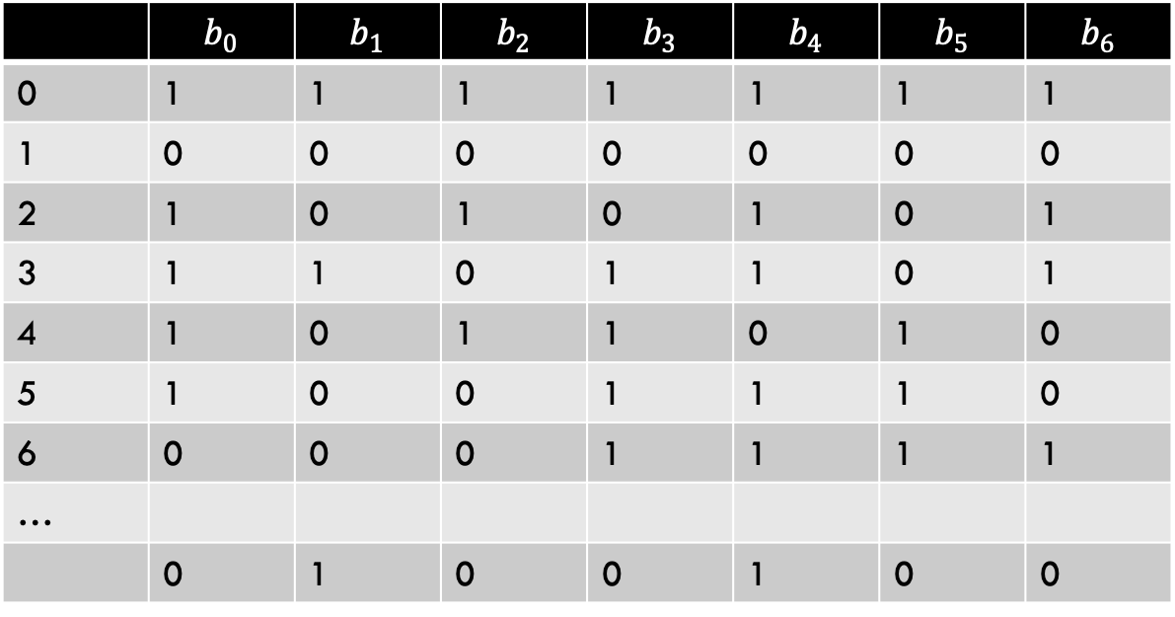
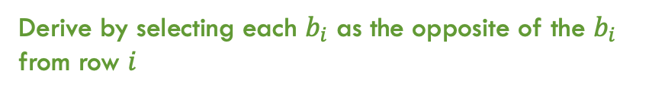

$$\left|{\left\{0,1\right\}}^{∞}\right|>|\text{ℕ}\text{|}$$
 | $$b_{0}$$ | $$b_{1}$$ | $$b_{2}$$ | $$b_{3}$$ | $$b_{4}$$ | $$b_{5}$$ | $$b_{6}$$
0 | 1 | 1 | 1 | 1 | 1 | 1 | 1
1 | 0 | 0 | 0 | 0 | 0 | 0 | 0
2 | 1 | 0 | 1 | 0 | 1 | 0 | 1
3 | 1 | 1 | 0 | 1 | 1 | 0 | 1
4 | 1 | 0 | 1 | 1 | 0 | 1 | 0
5 | 1 | 0 | 0 | 1 | 1 | 1 | 0
6 | 0 | 0 | 0 | 1 | 1 | 1 | 1
…
 | 0 | 1 | 0 | 0 | 1 | 0 | 0
Attempt at mapping $\text{ℕ}$ to ${\left\{0,1\right\}}^{∞}$
A string that our attempt missed
Derive by selecting each $b_{i}$ as the opposite of the $b_{i}$ from row $i$

Slide 50

$\left|{\left\{0,1\right\}}^{∞}\right|>|\text{ℕ}\text{|}$ proof summary
Assume towards reaching a contradiction that ${\left\{0,1\right\}}^{∞}$ is countable
This means we can find a bijection $f:\text{ℕ}→{\left\{0,1\right\}}^{∞}$
Using $f$, we can find $s∈{\left\{0,1\right\}}^{∞}$ which is not in the range of $f$:
let bit $i$ of $s$ be the opposite of bit $i$ of $f(i)$
This is missing from the range because it must be different from every output (at the position indexed by the input)

Slide 51

How to do a proof by diagonalization
Goal: to show that some set $S$ is uncountable
Assume toward contradiction that $S$ is countable
This means that there must be a bijection between $S$ and $ℕ$, so consider such a bijection $f$
We could use $f$ to list all the values of $S$ in order of the natural number they map to in order make some table
Follow a diagonal on that table to construct something that is:
A member of $S$
Missing from the table
This contradicts that $f$ was onto

Slide 52
Other countable/uncountable sets
Countable sets:
Integers
Rational numbers
Any finite set
Uncountable Sets:
Real numbers
The power set of any infinite set

Slide 53

Cantor’s Theorem
For any set $S$, $\left|S\right|<|2^{S}|$
Even if $S$ is infinite!
Idea:
$\left|S\right|≤|2^{S}|$ (why?)
There cannot be a bijection between $S$ and $2^{s}$

Slide 54

$$\left|S\right|≠|2^{S}|$$
Consider, towards reaching a contradiction, that there is a bijection $f:S→2^{S}$
Consider the set $P=\{x :x∈S∧x∉f(x)\}$
What are the “types” of:
$S$
$2^{S}$
$x$
$f(x)$
$P$
Let $f\left(p\right)=P$, is $p∈P$?

Slide 55
Conclusion
There are countably many strings
And therefore binary strings, programs, etc.
We can’t write down (or compute) all things from an uncountable set
There are uncountably many functions
Some functions can’t be implemented

Slide 56
END

