Slide 1
Turing Machines
Discrete Mathematics and Theory 2 Mark Floryan

Slide 2
Goals!
1. Our next .
2. Our second model of computation, the pushdown automata!! Let’s add memory to that finite state machine!!
3. What languages can this new model of computation now recognize? Can we find languages it cannot recognize now?

Slide 3
Part 1: Reminder of where we are / Chomsky Hierarchy

Slide 4
Overview of Theory of Computation
Defining Computation
Input
Computing Machine / Program / Algorithm
Output
Computational Models
Circuits
Finite Automata
Pushdown Automata
Turing Machine
RAM Model
<
<
<
=
Computational Complexity
Decidability
P, NP, NP-Hard
P-Space, Co-NP, etc

Slide 5
Overview of This Deck
…………..
Turing Machines
What are they? How do they work? What are some definitions associated?
TBD
TBD
Something here????
I will come back and do this slide later.

Slide 6
Introducing The Turing Machine

Slide 7
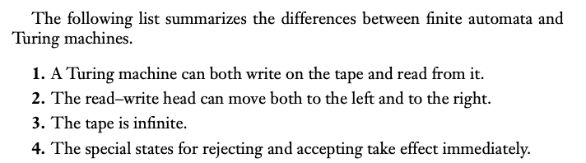
What is a Turing Machine!
Overview of the features of a TM
…………

Slide 8
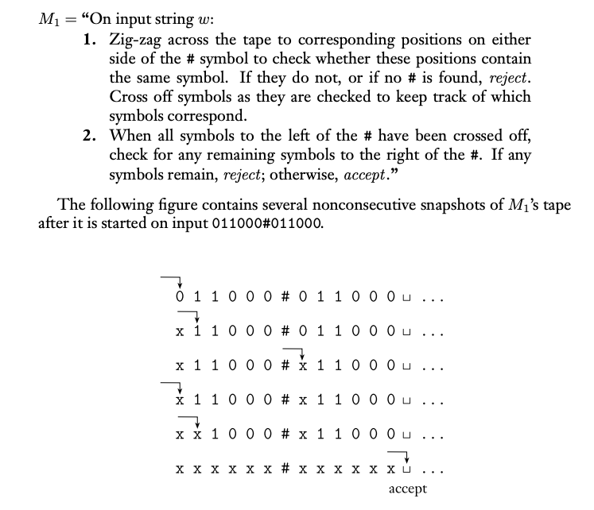
Intuitive Example
Intuition of what these machines can do…
…………

Slide 9
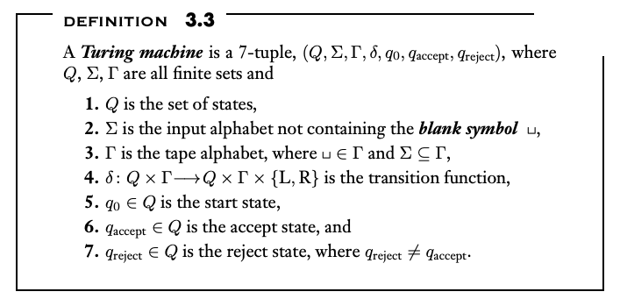
Formal Definition of TM
…
…………

Slide 10
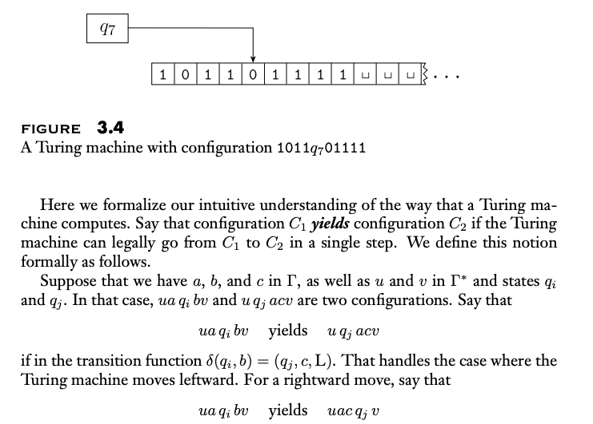
Configurations of A TM
…
…………

Slide 11
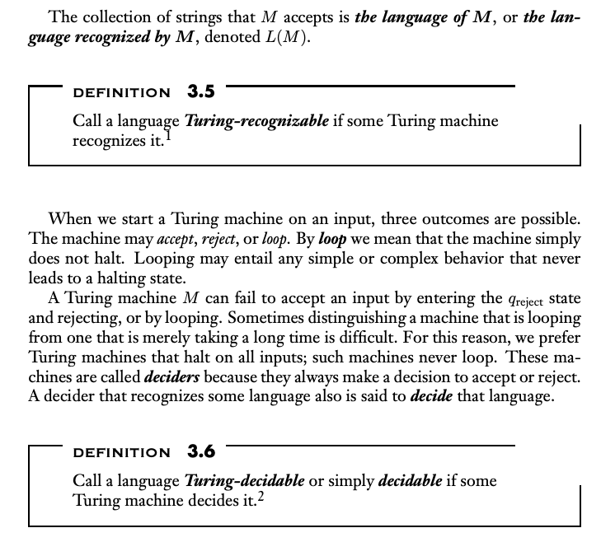
Recognizing VS Deciding
…
…………

Slide 12
Examples: Designing Turing Machines

Slide 13
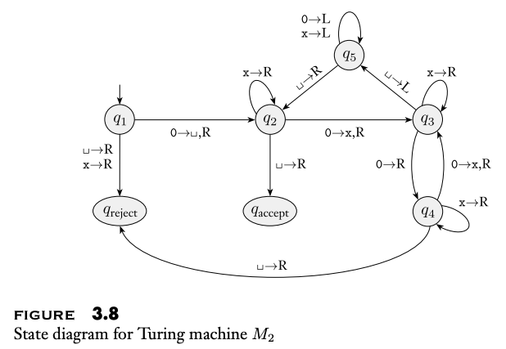
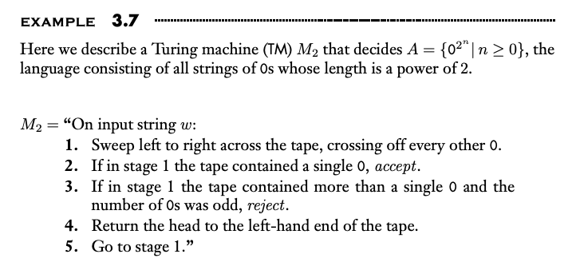
Practice 1: Design a TM
Example Problem
…………

Slide 14
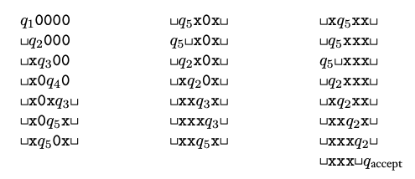
Example Execution
On Input 0000
…………

Slide 15
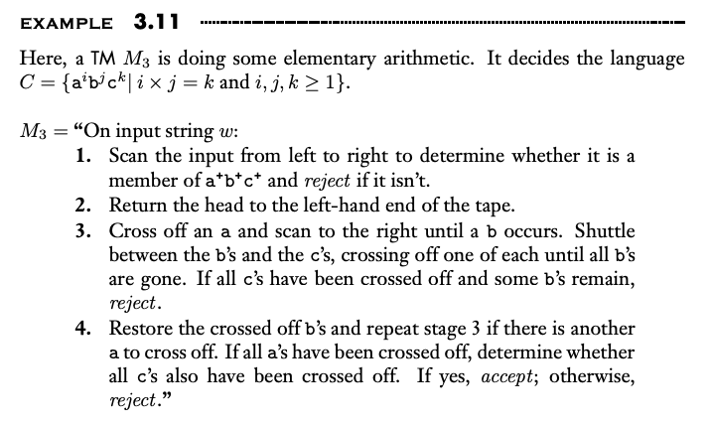
Example 2!!
…
…………

Slide 16
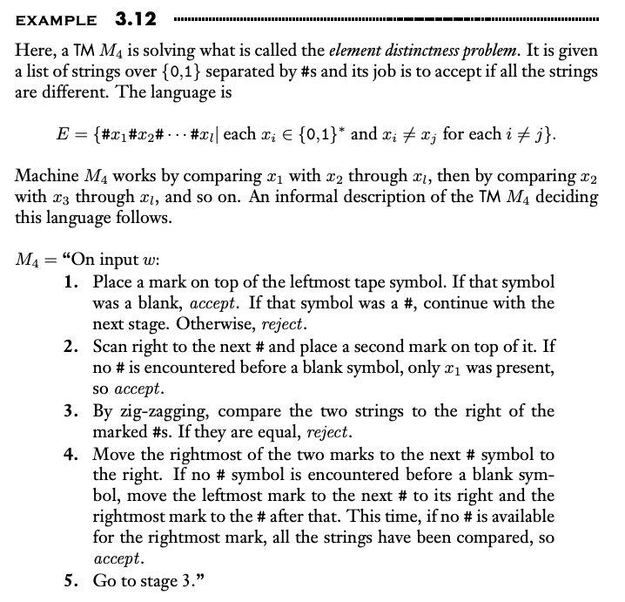
Example 3!!
Element distinctness
…………

Slide 17
Turing Machine Variants

Slide 18
Motivating Question
Can we have different features of TMs that increase / or don’t the recognizing power of the traditional TM?
…………

Slide 19
MultiTape Turing Machine
TM that has multiple tapes
…………

Slide 20
MultiTape Turing Machine
MultiTape TMs are equivalent to traditional TMs
Proof in book

Slide 21
Non-Deterministic Turing Machines (NTM)
Same as DFA to NFA. TM can be in multiple states at once.
Proof in book

Slide 22
NTM versus DTM
Theorem: Every NTM has an equivalent DTM
Proof in book

Slide 23
NTM versus DTM
Theorem: A language is decidable if and only if some non-deterministic turing machine decides it.
Proof in book

Slide 24
Last Conclusion
Any computational model satisfying reasonable requirements to that of a TM is equivalent in power to a TM
Most notably: Access to unlimited memory and the ability to only perform a finite amount of work in a single step.

Slide 25
The Definition of An Algorithm

Slide 26
Short Discussion
What is an Algorithm? Does seeing the TM change your perspective on this at all?
…

Slide 27
Hilbert’s Problems
See page 183 of book
Story of finding polynomial roots. Not possible to prove because no formal definition of algorithm

Slide 28
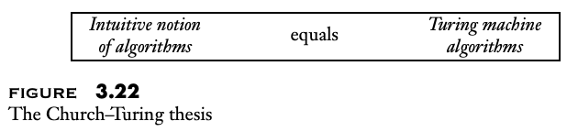
The Church-Turing Thesis
The Church-Turing Thesis (1936): Lambda-Calculus (Alonzo Church) and Turing Machines (Alan Turing) provide the mechanism for formally defining an algorithm.
…

Slide 29
Finding Polynomial Roots is Recognizable
Show how to do it.
Decidable for one variable. Famously not decidable for multiple variables.

Slide 30
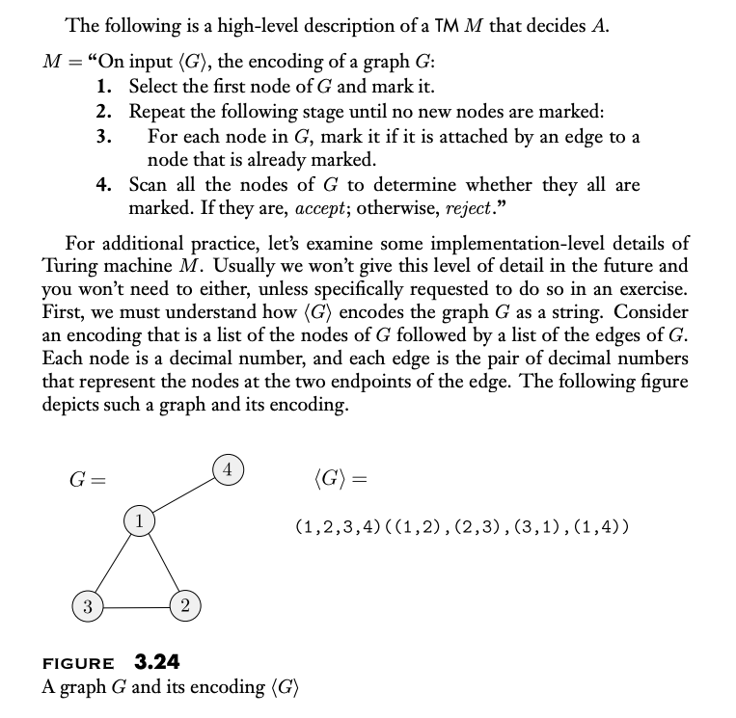
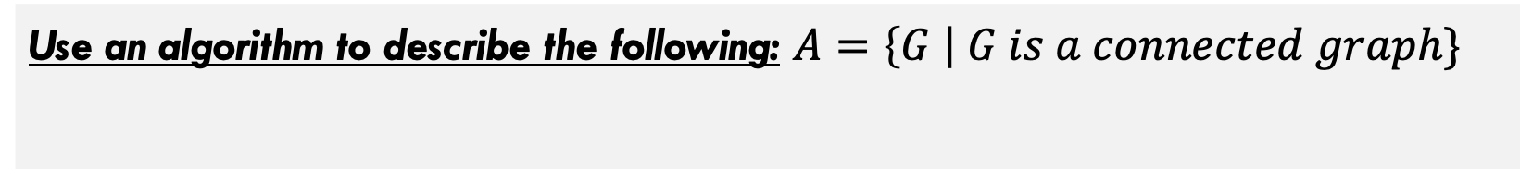
Example TM with Algorithmic Description
Use an algorithm to describe the following: $A=\left\{G \right| G is a connected graph\}$
Decidable for one variable. Famously not decidable for multiple variables.

Slide 31
What did we learn in this deck
Definition of Turing Machines, both deterministic and non-deterministic along with other variants
Simple design of algorithms using Turing Machines
Definitions of recognizable vs decidable languages

