Slide 1
Turing Machines
Discrete Mathematics and Theory 2 Mark Floryan

Slide 2
Goals!
1. Our next computational model: The Turing Machine!
2. Analysis of different variations of Turing Machines (including non-deterministic Turing Machines).
3. Formalizing the concept of decidability versus recognizability, algorithms, and an introduction to computability theory.

Slide 3
Part 1: Reminder of where we are / Chomsky Hierarchy

Slide 4
Overview of Theory of Computation
Defining Computation
Input
Computing Machine / Program / Algorithm
Output
Computational Models
Circuits
Finite Automata
Pushdown Automata
Turing Machine
RAM Model
<
<
<
=
Computational Complexity
Decidability
P, NP, NP-Hard
P-Space, Co-NP, etc

Slide 5
What is a Turing Machine?
A Turing Machine (TM), sometimes called a Deterministic Turing Machine (DTM) is a finite state machine that can read/write from an infinite tape (memory)
Some other features of the Turing Machine:
1. A TM can both read and write to/from the tape 2. The TM contains a head that can move left and right along the tape 3. The tape is infinite 4. The special states for accepting / rejecting take effect immediately

Slide 6
Introducing The Turing Machine

Slide 7
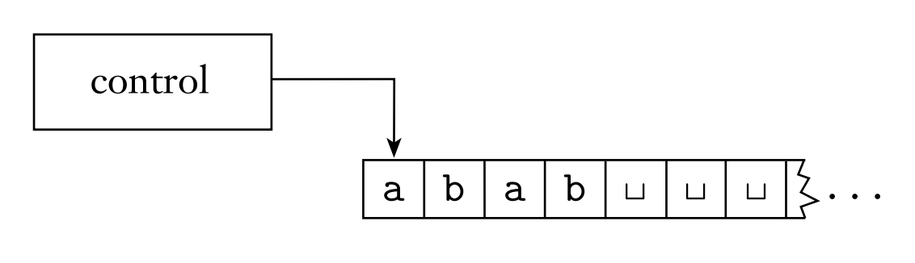
What is a Turing Machine?
This control is a traditional DFA, except the accept/reject states take effect immediately.
The arrow here represents the head of the machine. It can move left and right and also read/write the symbol at that position.
This tape contains the input when execution begins.

Slide 8

Example Turing Machine
Let’s design a Turing Machine to recognize the following language: $$B=\left\{w\#w \right| w∈{\left\{0,1\right\}}^{∗}\}$$
Any ideas on how we might do this?
Remember that the proposed string is written on the tape at the beginning of execution, and the head of the tape begins at index 0

Slide 9
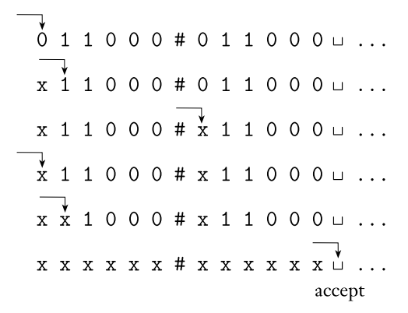

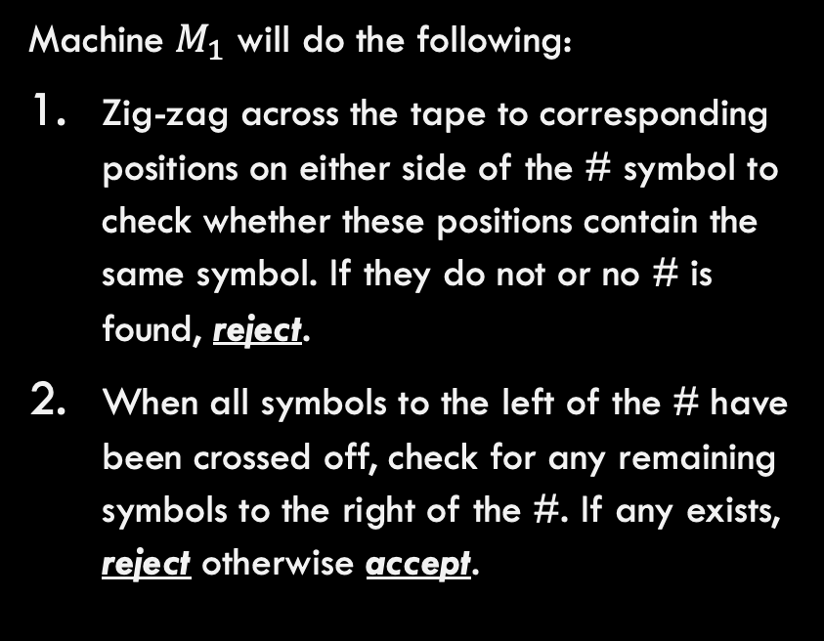
Example Turing Machine
Let’s design a Turing Machine to recognize the following language: $$B=\left\{w\#w \right| w∈{\left\{0,1\right\}}^{∗}\}$$
Machine $M_{1}$ will do the following:
Zig-zag across the tape to corresponding positions on either side of the # symbol to check whether these positions contain the same symbol. If they do not or no # is found, reject.
When all symbols to the left of the # have been crossed off, check for any remaining symbols to the right of the #. If any exists, reject otherwise accept.

Slide 10
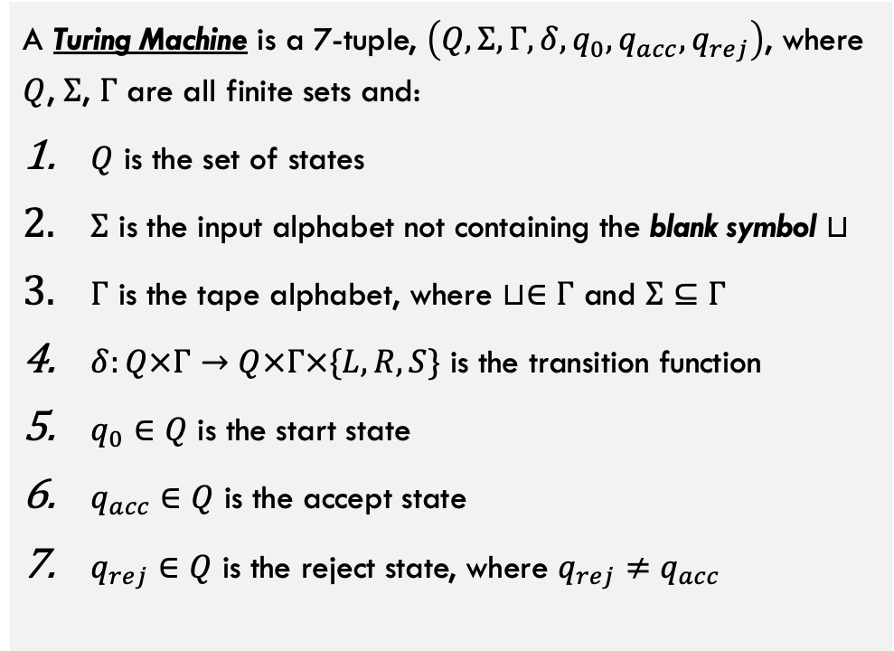
Formal Definition of TM
Blank symbol often used to mark special cases, end of input, etc.
A Turing Machine is a 7-tuple, $\left(Q,Σ,Γ,δ,q_{0},q_{acc},q_{rej}\right)$, where $Q$, $Σ$, $Γ$ are all finite sets and:
$Q$ is the set of states
$Σ$ is the input alphabet not containing the blank symbol $⊔$
$Γ$ is the tape alphabet, where $⊔∈Γ$ and $Σ⊆Γ$
$δ:Q×Γ→Q×Γ×\{L,R,S\}$ is the transition function
$q_{0}∈Q$ is the start state
$q_{acc}∈Q$ is the accept state
$q_{rej}∈Q$ is the reject state, where $q_{rej}≠q_{acc}$
L, R, S here represent moving the head left or right or staying still
Note that TMs have one accept and one reject state, and they cannot be equal.

Slide 11
Transition Function
$δ:Q×Γ→Q×Γ×\{L,R,S\}$ is the transition function
Machine will enter a new state (optional) Machine will write something to the tape (optional) Head will move Left or Right (or S for staying put)
Where the TM transitions depends on this input. What state the machine is in and what symbol is currently on the tape at the head’s current position.

Slide 12





















Example Turing Machine
Let’s design a Turing Machine to recognize the following language: $$B=\left\{w\#w \right| w∈{\left\{0,1\right\}}^{∗}\}$$
$$0,1→ε,S$$
$$0,1→ε,R$$
$$x→ε,R$$
$$x→ε,R$$
ACC
$$⊔→ε,R$$
Chk Rt.
Find #
$$\#→ε,R$$
Find 0
$$0→x,R$$
$$\#→ε,R$$
$$1,⊔→ε, ε$$
$$0,1→ε,L$$
$$0,1,x→ε,L$$
$$0→x,L$$
Mv Rt
Reset to Lft
Reset to #
REJ
$$x→ε,R$$
$$x→ε,S$$
$$\#→ε,L$$
$$1→x,L$$
$$0,1→ε,R$$
$$1→x,R$$
$$0,⊔→ε, ε$$
Find #
$$\#→ε,R$$
Find 0
$$x→ε,R$$

Slide 13
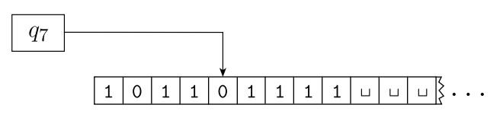
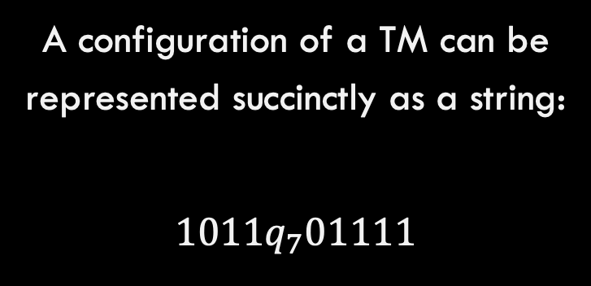
Configurations of A TM
A configuration of a Turing Machine is the complete state the machine is in at any point during execution. This includes the state, the contents of the tape, and the position of the head.
A configuration of a TM can be represented succinctly as a string:
$$1011q_{7}01111$$
This machine is in state q7, and the contents of the tape / position of the head can be seen in the diagram.

Slide 14
Recognizing VS Deciding
When a Turing Machine executes, there are three possible outcomes
Accept: Input on tape is in language
Some Turing Machine
Executes on input / tape
Input written to TM tape
Reject: Input on tape is NOT in language
Loop: TM runs forever, never reaching accept or reject state

Slide 15
Recognizing VS Deciding
A Turing Machine decides a language (is a decider) if it never loops and always correctly accepts or rejects strings for the given language.
Accept: Input on tape is in language
A TM decides the language if it always halts and outputs one of these two possibilities. The language of this TM is said to be a decidable language.
Some Turing Machine
Executes on input / tape
Reject: Input on tape is NOT in language
Loop: TM runs forever, never reaching accept or reject state

Slide 16
Recognizing VS Deciding
A Turing Machine recognizes a language (is a recognizer) if it always accepts strings that are in the language, but might reject or might loop forever on strings that are NOT in the language.
Accept: Input on tape is in language
A recognizer will always accept when the string IS in the language
Some Turing Machine
Executes on input / tape
Reject: Input on tape is NOT in language
However, when the input string is NOT in the language, a recognizer might reject or it might just loop forever.
Loop: TM runs forever, never reaching accept or reject state
Languages that can be recognized are called Turing-Recognizable

Slide 17
Examples: Designing Turing Machines

Slide 18

Practice 1: Design a TM
Construct a Turing Machine that decides the following language: $$A=\left\{0^{2^{n}} \right| n≥0\}$$

Slide 19

Practice 1: Design a TM
Construct a Turing Machine that decides the following language: $$A=\left\{0^{2^{n}} \right| n≥0\}$$
Overall Approach, on input w:
Sweep left to right across the tape, crossing off every other 0.
If in stage 1 the tape contained a single 0, accept
If in stage 1 the tape contained more than a single 0 and the number of 0s was odd, reject
Return the head to the left end of the tape
Go to stage 1

Slide 20
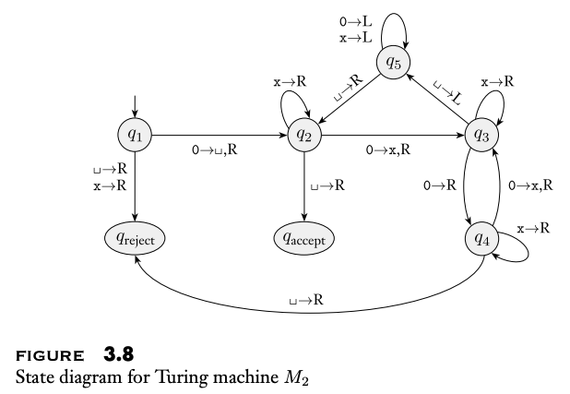
Practice 1: Design a TM

Slide 21
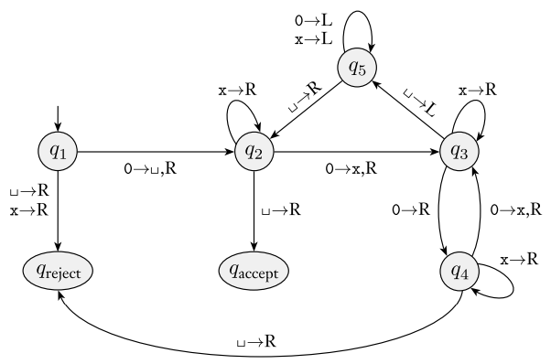
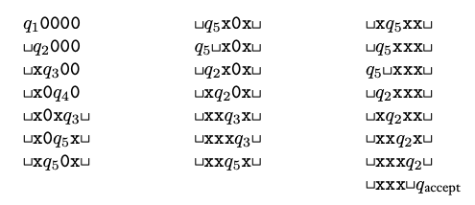
Practice 1: Design a TM
Q1 represents start state. We mark first 0 with blank Q2 represents we have seen one 0 Q3 represents seen one 0 or even number of 0s Q4 represents seen an odd number of 0s Q5 represents moving head back to the front

Slide 22

Example 2!!
Construct a Turing Machine that decides the following language:
$$C=\left\{a^{i}b^{j}c^{k} \right| i×j=k∧ i,j,k≥1\}$$

Slide 23
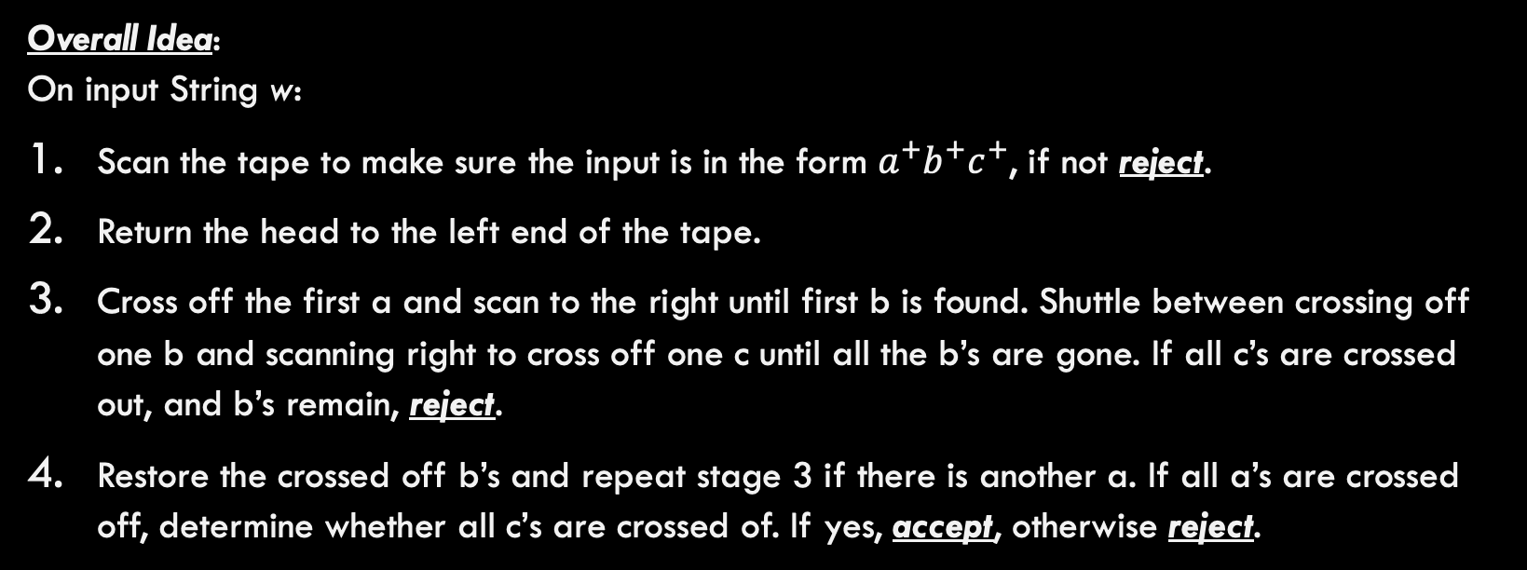
Example 2!!
Construct a Turing Machine that decides the following language:
$$C=\left\{a^{i}b^{j}c^{k} \right| i×j=k∧ i,j,k≥1\}$$
Overall Idea: On input String w:
Scan the tape to make sure the input is in the form $a^{+}b^{+}c^{+}$, if not reject.
Return the head to the left end of the tape.
Cross off the first a and scan to the right until first b is found. Shuttle between crossing off one b and scanning right to cross off one c until all the b’s are gone. If all c’s are crossed out, and b’s remain, reject.
Restore the crossed off b’s and repeat stage 3 if there is another a. If all a’s are crossed off, determine whether all c’s are crossed of. If yes, accept, otherwise reject.

Slide 24
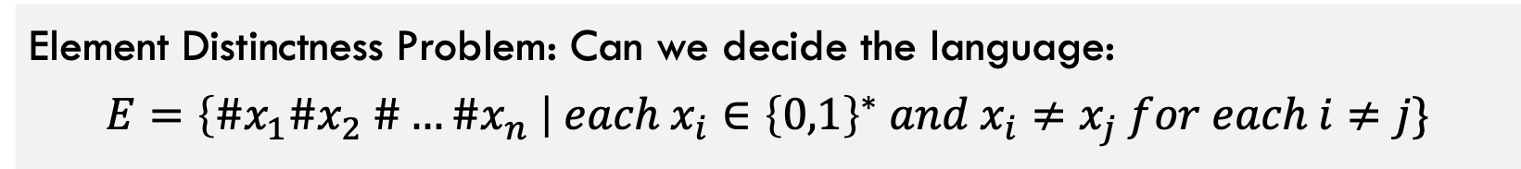
Example 3!!
Element Distinctness Problem: Can we decide the language:
$$E=\left\{\#x_{1}\#x_{2} \#…\#x_{n} \right| each x_{i}∈{\left\{0,1\right\}}^{∗} and x_{i}≠x_{j} for each i≠j\}$$

Slide 25
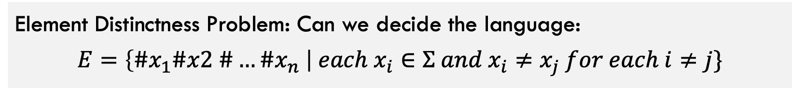
Example 3!!
Element Distinctness Problem: Can we decide the language:
$$E=\left\{\#x_{1}\#x2 \#…\#x_{n} \right| each x_{i}∈Σ and x_{i}≠x_{j} for each i≠j\}$$
Key ideas we will need for this one:
The tape can be marked to keep track of loops (which characters are being compared with which characters). This is why the # symbols are useful.
How do we actually compare the characters? It is annoying but can be done with many states. How do you think that would work?

Slide 26

tracking loops!!
How do we keep track of loops with a Turing Machine?
First, introduce new tape symbols that represent the loop beginning and end. Here we will use ( and ). Remember that goal is to compare every pair of characters.
#
f
(
a
#
c
#
e
#
s
)
l
#
k
$$⊔$$
….
When starting an outer loop, mark the relevant part of the tape with open paren.
Mark closing paren to mark outer loop location if necessary.

Slide 27

Comparing Characters
How hard is it to compare characters?
This machine will have to check characters for equivalence. How do we do this? Let’s suppose that $Σ=\left\{a,b\right\}$ and tape is pointing at left side of $c_{1}\#c_{2}$
reject
a → R
b → R
b → R
# → R
comp
a
# → R
b
a → R
b → L
a → L
a’
b’
Back to some other computation

Slide 28
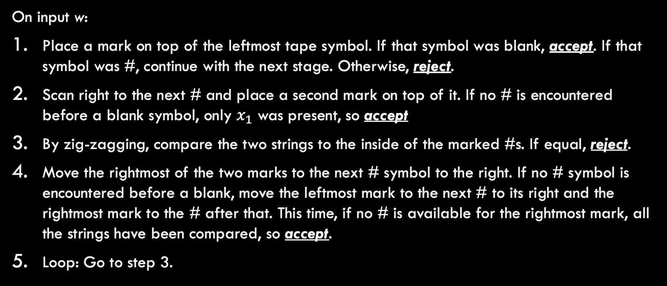
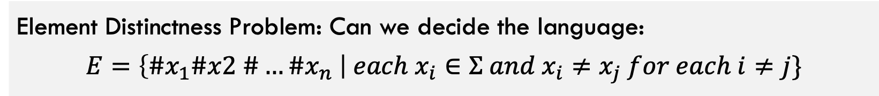
Example 3!!
Element Distinctness Problem: Can we decide the language:
$$E=\left\{\#x_{1}\#x2 \#…\#x_{n} \right| each x_{i}∈Σ and x_{i}≠x_{j} for each i≠j\}$$
On input w:
Place a mark on top of the leftmost tape symbol. If that symbol was blank, accept. If that symbol was #, continue with the next stage. Otherwise, reject.
Scan right to the next # and place a second mark on top of it. If no # is encountered before a blank symbol, only $x_{1}$ was present, so accept
By zig-zagging, compare the two strings to the inside of the marked #s. If equal, reject.
Move the rightmost of the two marks to the next # symbol to the right. If no # symbol is encountered before a blank, move the leftmost mark to the next # to its right and the rightmost mark to the # after that. This time, if no # is available for the rightmost mark, all the strings have been compared, so accept.
Loop: Go to step 3.

Slide 29
Turing Machine Variants

Slide 30
Motivating Question
Can we have different features of TMs that increase / or don’t the recognizing power of the traditional TM?
Some we will see:
Turing machines with multiple tapes Non-deterministic Turing Machines

Slide 31
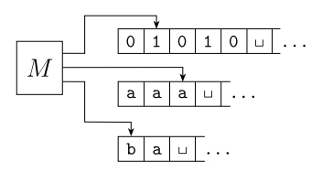

MultiTape Turing Machine
A Multitape Turing Machine is like an ordinary TM but it has several tapes instead of one. Each tape has an independent head that can be moved.
The transition function is updated to:
$$δ:Q×Γ^{k}→Q×Γ^{k}×{\left\{L,R,S\right\}}^{k}$$
Here, k is the number of tapes. So each tape can be read at each step of computation, each head can write / move as well.

Slide 32
MultiTape Turing Machine
Theorem: Every Multitape Turing Machine has an equivalent single-tape Turing machine.

Slide 33
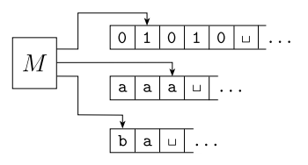

MultiTape Turing Machine
Theorem: Every Multitape Turing Machine has an equivalent single-tape Turing machine.
Goal: Given an arbitrary MTTM, convert it into an equivalent TM
**Need to argue that S simulates M’s computation exactly in all scenarios

Slide 34
MultiTape Turing Machine
Two major issues we need to overcome for this proof:
Issue 1: How to simulate multiple tapes / heads with only one tape / head?
Issue 2: How to handle space constraints fitting k tapes on just 1?
For issue 1, we make special versions of each tape symbol that represent a “virtual head” being positioned at that location.
For issue 2, we separate each tape by a special # symbol and create a subroutine that shifts the contents of everything to the right down when we need more space on any individual tape.

Slide 35
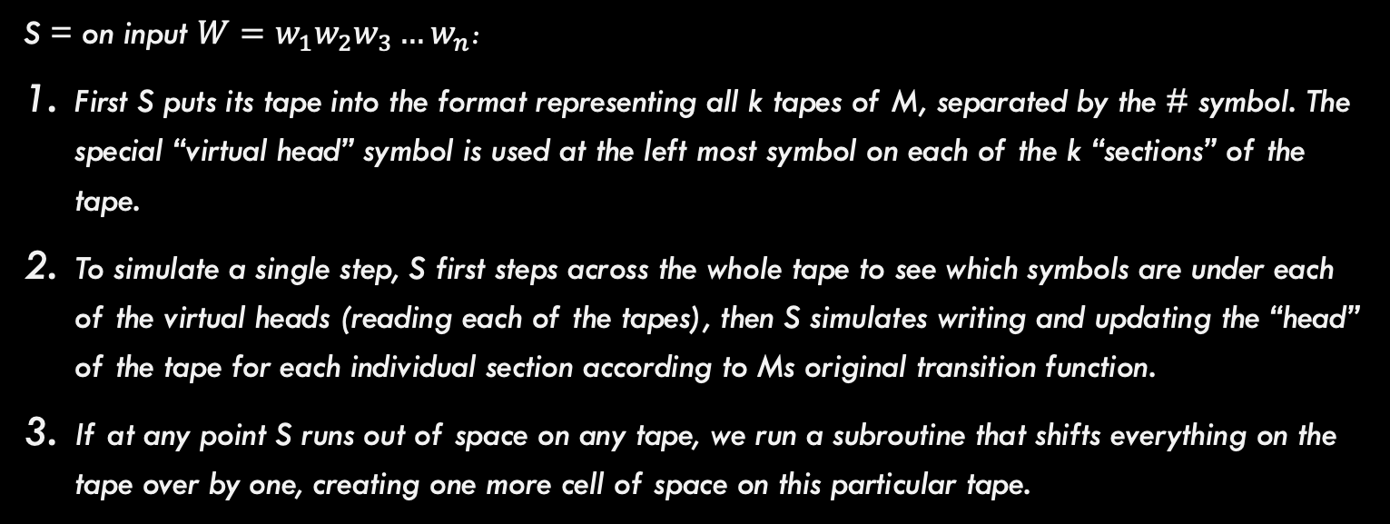
MultiTape Turing Machine
Summary of how to simulate M with S
S = on input $W=w_{1}w_{2}w_{3}…w_{n}$:
First S puts its tape into the format representing all k tapes of M, separated by the # symbol. The special “virtual head” symbol is used at the left most symbol on each of the k “sections” of the tape.
To simulate a single step, S first steps across the whole tape to see which symbols are under each of the virtual heads (reading each of the tapes), then S simulates writing and updating the “head” of the tape for each individual section according to Ms original transition function.
If at any point S runs out of space on any tape, we run a subroutine that shifts everything on the tape over by one, creating one more cell of space on this particular tape.

Slide 36
MultiTape Turing Machine
Theorem: Every Multitape Turing Machine has an equivalent single-tape Turing machine.
Corrollary: A language is Turing-recognizable iff some Multitape Turing Machine recognizes it.
Proof: Direction 1: A Turing recognizable language is recognized by some Turing Machine, and any TM is also a valid multitape TM.
Direction 2: If a multitape TM recognizes a language, then it can be converted into an equivalent single tape TM as described earlier.

Slide 37

Non-Deterministic Turing Machines (NTM)
A non-deterministic Turing Machine (NTM) can branch into many possibilities. Transition function has form: $δ:Q × Γ→𝒫\left(Q × Γ × \left\{L,R,S\right\}\right)$
The tape, state, etc. are all branched to an independent machine. No resources are shared across the branches.

Slide 38
NTM versus DTM
Theorem: Every NTM has an equivalent DTM

Slide 39
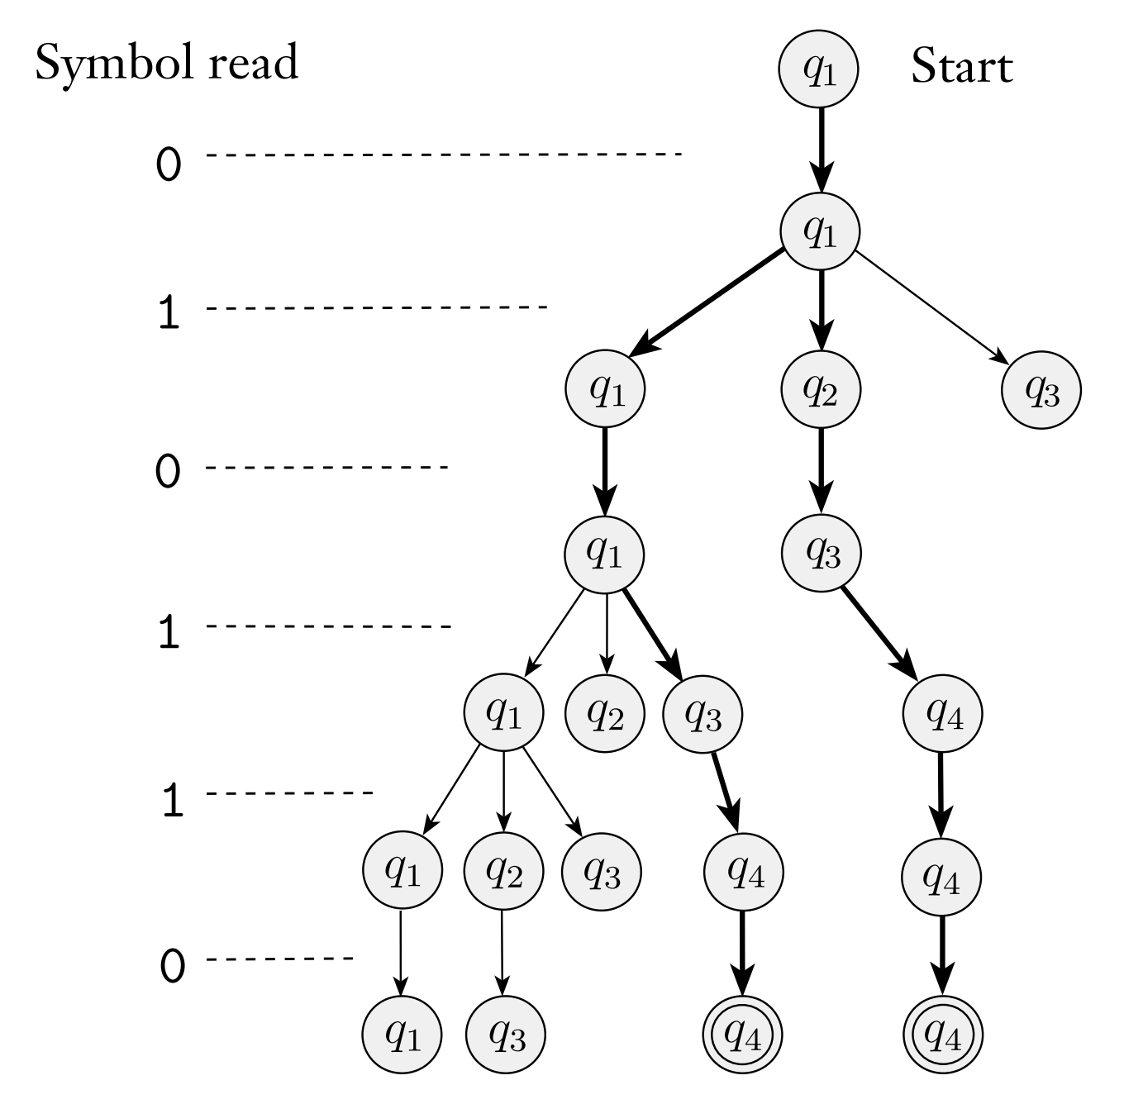
NTM versus DTM
Theorem: Every NTM has an equivalent DTM
Idea: Machine N has branching computations. Let’s search this computation tree in a breadth-first manner.
Using D, simulate N’s execution exactly
N (NTM)
D (DTM)
Issues:
How to switch between branches?
Why BFS instead of DFS?
Keeping track of tree location?

Slide 40
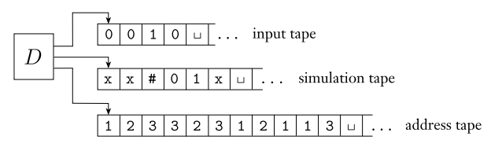
NTM versus DTM
Theorem: Every NTM has an equivalent DTM
Proof Idea: Simulate the NTM with a DTM (multi-tape)
Tape 1 contains the input and will never be altered.
Tape 2 contains N’s tape at that particular branch of execution as we simulate
Tape 3 is the address tape, it tells us which branch of computation to simulate at each step (more about this on the next slide).

Slide 41
NTM versus DTM
Theorem: Every NTM has an equivalent DTM
“”
1
2
3
Let’s look at Tape 3 for a moment
11
12
13
21
31
32
33
Tape 3 tells you which direction down tree to go each time you make a step in your computation. Each cell is at most b, where b is the max number of branches possible for that machine.
For example, if tape 3 contains ”13”, we will simulate the highlighted (white) path above and terminate (even if there is more computation possible).
Tape 3 will try “”, 1, 2, 3, 11, 12, 13, 21, 31, 32, 33, ….

Slide 42
NTM versus DTM
Theorem: Every NTM has an equivalent DTM
Given Machine N, Machine D Proceeds As Follows:
Tape 1 contains the input, tapes 2 and 3 are empty.
Copy tape 1 onto tape 2 to initialize the simulation.
Use tape 2 to simulate N on input. At every stage of computation, look at tape 3 to determine which non-deterministic branch to follow (which next state out of many choices to take). If we reach an accept state, then accept! If we run out of branches to follow on tape 3, or we reach a reject state, or this configuration is invalid (the choice on tape 3 is not a valid choice), then abort this branch and go to step 4.
Replace the string on tape 3 with the next string in the string ordering (e.g., “11” might become “12”). Simulate the next branch by going to step 2.
This machine rejects if all branches are enumerated and no accept state is found (note the machine could loop forever).

Slide 43
NTM versus DTM
Theorem: A language is decidable if and only if some non-deterministic Turing machine decides it (same holds for recognizing).
This follows from our previous proof. Any NTM can be simulated with a DTM so these machines are equivalent for deciding languages!

Slide 44
Last Conclusion
Any computational model satisfying reasonable requirements to that of a TM is equivalent in power to a TM
Most notably:
Access to unlimited memory
The ability to perform a finite amount of work in a single step

Slide 45
The Definition of An Algorithm

Slide 46
Short Discussion
What is an Algorithm? Does seeing the Turing Machine change your perspective on this at all?
**It was not until the 20th century that the notion of an algorithm was defined precisely.

Slide 47
Hilbert’s Problems
David Hilbert: German Mathematician
In 1900, Hilbert gave a now famous address at the International Congress of Mathematicians in Paris. He identified 23 mathematical problems and posed them as a challenge for the coming century. Hilbert’s 10th problem concerned algorithms.
What was Hilbert’s 10th problem: Devise an algorithm that tests whether a polynomial has an integral root (he did not use the word “algorithm”).

Slide 48
Hilbert’s Problems
David Hilbert: German Mathematician
Hilbert used the word “devise”, implying that some algorithm / process must exist (he was wrong about that part).
The 10th problem is unsolvable, but mathematicians in 1900 only had an intuitive understanding of algorithm.
The world needed a formal definition of an “algorithm” in order to prove that this particular problem was unsolvable…

Slide 49
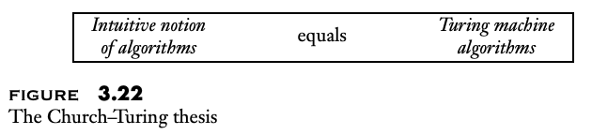
The Church-Turing Thesis
The Church-Turing Thesis (1936): Lambda-Calculus (Alonzo Church) and Turing Machines (Alan Turing) provide the mechanism for formally defining an algorithm.
So…an algorithm is any process that can be programmed on a Turing Machine in order to recognize or decide some function (or language).

Slide 50

Finding Polynomial Roots is Recognizable
Problem: Can you recognize (not decide) the following language:
$$D_{1}=\left\{p\right|p is a polynomial over x with an integral root\}$$
Note that the polynomial is guaranteed to be over just one variable.
Also recall that this language is recognizable if you will can find the root if it exists, but you can loop forever if it does not exist.

Slide 51
Finding Polynomial Roots is Recognizable
Problem: Can you recognize (not decide) the following language:
$$D_{1}=\left\{p\right|p is a polynomial over x with an integral root\}$$
Solution:
On input <p>:
Evaluate p with x set successfully to the values 0, 1, -1, 2, -2, 3, -3, …
Accept if at any point the polynomial evaluates to 0
Notice that this solution loops forever anytime the answer should be “reject”. It is possible to turn this into a decider (see book for details)

Slide 52
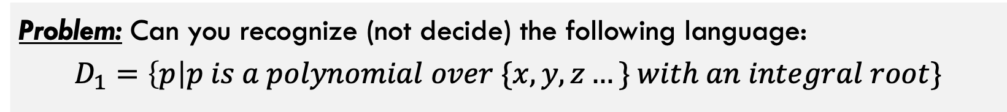
Finding Polynomial Roots is Recognizable
Problem: Can you recognize (not decide) the following language:
$$D_{1}=\left\{p\right|p is a polynomial over \{x,y,z…\} with an integral root\}$$
This problem is undecidable, meaning there does not exist an algorithm (Turing Machine) that decides it. Now that we understand Turing Machines, we can begin to formulate how some problems cannot be decided.

Slide 53
What did we learn in this deck
Definition of Turing Machines, both deterministic and non-deterministic along with other variants
Simple design of algorithms using Turing Machines
Definitions of recognizable vs decidable languages
Practice with designing Turing Machines for simple problems.

