Slide 1
Review of Proof Techniques
Discrete Mathematics and Theory 2 Mark Floryan

Slide 2
Goals!
1. Why do we need proofs for theory of computation? Do we HAVE to do it?
2. What are the main proof techniques we will be using? Let’s review each one!

Slide 3
Part 1: Why do we need proofs?

Slide 4
Discussion! Why do we need proofs?
What do you think?

Slide 5
Discussion! Why do we need proofs?
Computing Machine / Program / Algorithm
Input
Output
Imagine we have two computational models A and B (for middle box)
Proofs allow us to answer questions like: - Is there a some function A can compute but B cannot? - Can B be compute all the same functions as A? - Is there a function that neither A nor B can compute?

Slide 6
Part 2: Review of Proof Techniques

Slide 7
Proof Strategies
Construction
Direct Proof
Contradiction
Cases
Induction
Important: Some proofs could employ multiple strategies! Others might not fit any well!

Slide 8
Direct Proof

Slide 9
Direct Proof
Direct Proof: Given starting assumptions, show a set of logical steps that lead to the desired conclusion.
Theorem 1: There is SOME natural number that is divisible by 3 but not divisible by 9
Theorem 2: Every natural number divisible by 9 is divisible by 3

Slide 10
Direct Proof Checklist
Start only with what the theorem assumes.
Draw “obvious” conclusions from the assumptions and/or prior conclusions.
End with the desired statement being true.

Slide 11
Direct Proof
Theorem 1: There is SOME natural number that is divisible by 3 but not divisible by 9
Proof: Find a specific number that fits the description!

Slide 12
Direct Proof
Theorem 1: There is SOME natural number that is divisible by 3 but not divisible by 9
Start w/ assumption: 6 is a number divisible 3
Obvious Conclusion: 6 is not divisible by 9
Thus there is some natural number that is divisible by 3 but not 9
Proof: Find a specific number that fits the description!

Slide 13
Direct Proof
Theorem 2: Every natural number divisible by 9 is divisible by 3
Proof: Start w/ assumption and proceed 1 step at a time

Slide 14

Direct Proof
Theorem 2: Every natural number divisible by 9 is divisible by 3
Start w/ assumption: if a natural number is divisible by 9. So grab an arbitrary one $n=9k$ for some $k∈N$
Obvious Conclusions: $n=\left(3\right)3k$ for some $k∈N$ n is divisible by 3 ← This is what we wanted to prove
Proof: Start w/ assumption and proceed 1 step at a time

Slide 15
Proof by Construction

Slide 16
Proof By Construction
Proof By Construction: When a theorem states that a particular type of object exists, we can demonstrate HOW to construct it.
Anatomy of proof by construction:
Purple boxes are NESTED proofs. Often use / require another proof technique.
Theorem: something P exists
INPUT: None
<Algorithm>
Output: P
Step 1: Describe this algorithm
Prove proposition S:
S = Algorithm given in step 1 correctly constructs P with desired properties
Step 2: Prove algorithm correctly constructs P

Slide 17
Proof By Construction
Proof By Construction: When a theorem states that a particular type of object exists, we can demonstrate HOW to construct it.
Theorem: For each even number n > 2, there exists a 3-regular graph with n nodes.
Proof idea: Show how to construct the graph for any arbitrary n. Usually this is a process for constructing the graph (an algorithm!)
3-regular means every node has degree 3

Slide 18
Proof by Construction Checklist
Fully define construction
Describe how we know it satisfies the theorem

Slide 19
Proof By Construction
Theorem: For each even number n > 2, there exists a 3-regular graph with n nodes.

Slide 20
Proof By Construction
Theorem: For each even number n > 2, there exists a 3-regular graph with n nodes.
Overall Idea: Draw nodes in a circle and number them 0 through n-1. Match each node with the one next to it (2 edges per node) and also to the one directly across from it (node that is n/2 away).
1
0
2
5
3
4

Slide 21


Proof By Construction
Theorem: For each even number n > 2, there exists a 3-regular graph with n nodes.
$$G=\left(V,E\right)$$
$$V=\{0, 1,…,n−1\}$$
$$E=\left\{\left\{i, i+1\right\} | 0≤i≤n−2\right\} \\ ∪\left\{\{n−1, 0\}\right\} \\ ∪\left\{\left\{i, i+\frac{n}{2}\right\}\right|0≤i≤\frac{n}{2}−1\}$$
How do we know G satisfies the theorem (is 3-regular). Because each node is “drawn in a circle” and paired with its neighbors and the one directly across the circle. Even number n means the pairing is perfect, so every node has 3 edges.

Slide 22

Proof By Construction
Proof By Construction: When a theorem states that a particular type of object exists, we can demonstrate HOW to construct it.
Anatomy of proof by construction:
Purple boxes are NESTED proofs. Often use / require another proof technique.
Theorem: $p→q$
INPUT: p
<Algorithm>
Output: q
Step 1: Describe this algorithm
Prove proposition S:
S = Algorithm given in step 1 correctly constructs q from p with desired properties
Step 2: Prove algorithm correctly constructs P

Slide 23
Proof By Contradiction

Slide 24
Proof By Contradiction
Proof by Contradiction: Assume the theorem is FALSE, and show through direct proof that this leads to some impossibility

Slide 25
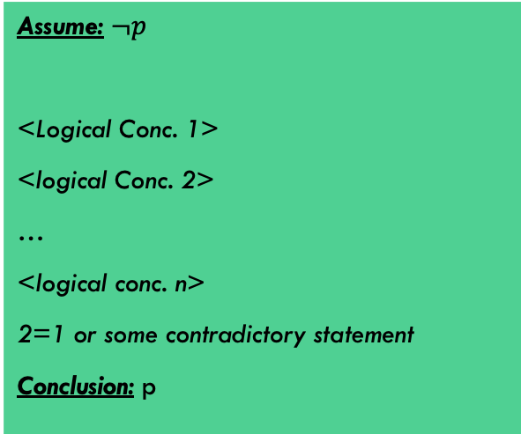

Proof By Contradiction
Anatomy of proof by contradiction:
Note that each logical step may involve a sub-proof that proves that logical step. Not always
Theorem: $p$
Assume: $¬p$
<Logical Conc. 1>
<logical Conc. 2>
…
<logical conc. n>
2=1 or some contradictory statement
Conclusion: p
Proof that:
<Log. Conc. 1> → <Log. Conc. 2>

Slide 26
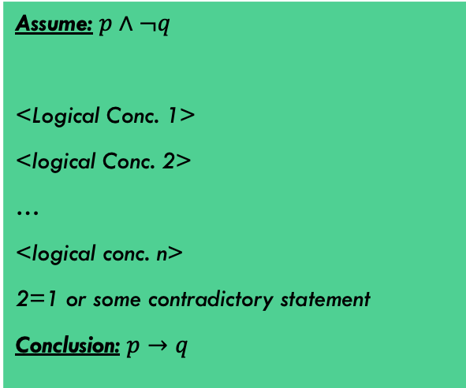

Proof By Contradiction
Anatomy of proof by contradiction:
Note that each logical step may involve a sub-proof that proves that logical step. Not always
Theorem: $p→q$
Assume: $p∧¬q$
<Logical Conc. 1>
<logical Conc. 2>
…
<logical conc. n>
2=1 or some contradictory statement
Conclusion: $p→q$
Proof that:
<Log. Conc. 1> → <Log. Conc. 2>

Slide 27
Proof By Contradiction
Proof by Contradiction: Assume the theorem is FALSE, and show through direct proof that this leads to some impossibility
Theorem: $\sqrt{2}$ is irrational
Oftentimes, contradiction proofs are much easier than direct proofs. Sometimes not.

Slide 28
Proof by Contradiction Checklist
Start by assuming the opposite of the statement
Usually this means assuming that something satisfied the left-hand-side of an implication but not the right-hand side
Draw “obvious” conclusions from the assumptions and/or prior conclusions
Show that the conjunction of 2 assumptions and/or conclusions is obviously false

Slide 29
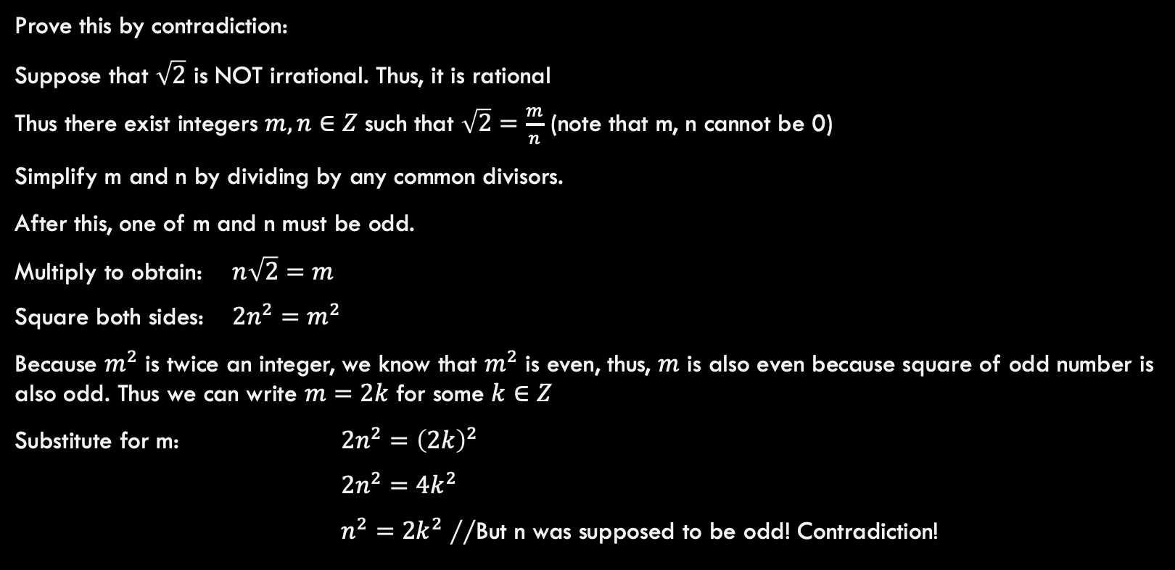
Proof By Contradiction
Theorem: $\sqrt{2}$ is irrational
Prove this by contradiction:
Suppose that $\sqrt{2}$ is NOT irrational. Thus, it is rational
Thus there exist integers $m,n∈Z$ such that $\sqrt{2}=\frac{m}{n}$ (note that m, n cannot be 0)
Simplify m and n by dividing by any common divisors.
After this, one of m and n must be odd.
Multiply to obtain: $n\sqrt{2}=m$
Square both sides: $2n^{2}=m^{2}$
Because $m^{2}$ is twice an integer, we know that $m^{2}$ is even, thus, $m$ is also even because square of odd number is also odd. Thus we can write $m=2k$ for some $k∈Z$
Substitute for m: $2n^{2}={\left(2k\right)}^{2}$
$2n^{2}=4k^{2}$
$n^{2}=2k^{2}$ //But n was supposed to be odd! Contradiction!

Slide 30
Proof By Induction

Slide 31

Proof by Induction Checklist
Show the theorem holds for some initial value $b$ (i.e. “Base Case”)
Assume that the theorem holds for some arbitrary value $n≥b$. (i.e. “Inductive Hypothesis”)
Show that we can conclude that the theorem holds for $n+1$ (i.e. “Inductive Step”)

Slide 32
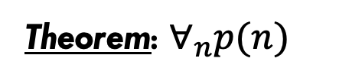
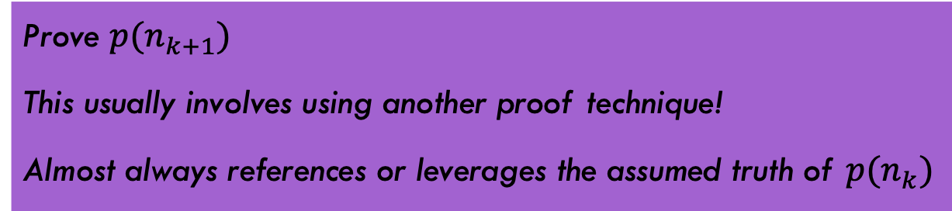

Proof By Induction
Anatomy of proof by induction:
Theorem: $∀_{n}p(n)$
Base Case
Provide a proof for small n (first n or first few n). Usually trivial.
$$p\left(n_{k}\right)→p(n_{k+1})$$
Inductive Hypothesis
Assume $p(n_{k})$ for some arbitrary k (sometime “up through k”).
Inductive Step
Prove $p(n_{k+1})$
This usually involves using another proof technique!
Almost always references or leverages the assumed truth of $p(n_{k})$
Remember that purple boxes are sub-proofs!!

Slide 33
There are $2^{n}$ binary strings of length $n|n≥1$.
Base Case (n=1):
$2^{1}=2$, Strings are “0” and “1”

Slide 34
There are $2^{n}$ binary strings of length $n|n≥1$.
Base Case (n=1):
$2^{1}=2$, Strings are “0” and “1”
Ind. Hypothesis
Suppose $2^{k}$ strings exist for length k

Slide 35
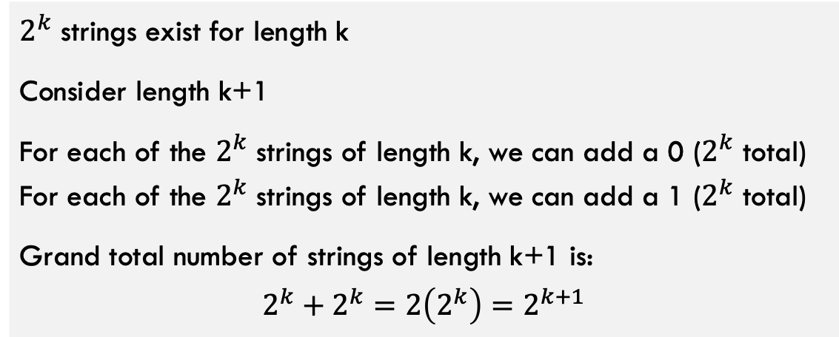
There are $2^{n}$ binary strings of length $n|n≥1$.
Base Case (n=1):
$2^{1}=2$, Strings are “0” and “1”
Ind. Hypothesis
Suppose $2^{k}$ strings exist for length k
Ind. Step
$2^{k}$ strings exist for length k
Consider length k+1
For each of the $2^{k}$ strings of length k, we can add a 0 ($2^{k}$ total) For each of the $2^{k}$ strings of length k, we can add a 1 ($2^{k}$ total)
Grand total number of strings of length k+1 is: $$2^{k}+2^{k}=2\left(2^{k}\right)=2^{k+1}$$

Slide 36

There are $n!$ Permutations of a list of length $n$

Slide 37
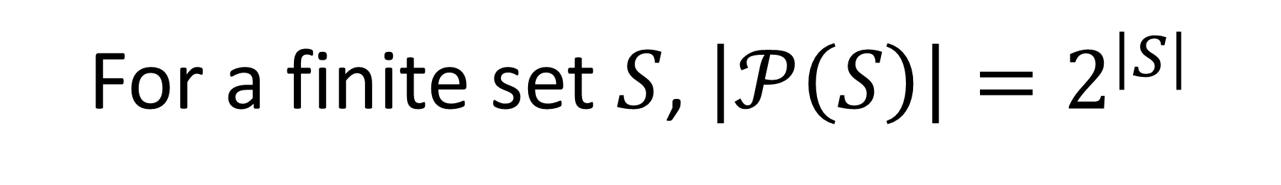
For a finite set $S$, $\left|𝒫\left(S\right)\right|=2^{|S|}$

Slide 38
Proof By Induction
Anatomy of proof by induction:
Theorem: $∀_{n}p(n)$
Base Case
Provide a proof for small n (first n or first few n). Usually trivial.
$$p\left(n_{k}\right)→p(n_{k+1})$$
Inductive Hypothesis
Assume $p(n_{k})$ for some arbitrary k (sometime “up through k”).
Inductive Step
Prove $p(n_{k+1})$
This usually involves using another proof technique!
Almost always references or leverages the assumed truth of $p(n_{k})$
Remember that purple boxes are sub-proofs!!

Slide 39
Floryan’s Proof Writing Tips
Identify the nature of the claim
Is it a “there exists” statement, a “for all” statement?
Write out all the important definitions (assumptions, the goal, etc.)
Manipulate definitions to see how they relate and develop intuition
Organize your discoveries into one or more proof strategies
There exists: usually by construction, sometimes by other means
For all: rarely by construction, typically by one of the other methods
Write your proof to be obvious to the typical CS3102 student last week.
Name your proof strategy, briefly mention how you’re going to use the strategy, explain what you mentioned in detail
If some step would have been confusing to the typical classmate last week, you should break it up into smaller steps

