Slide 1
Decidability
Discrete Mathematics and Theory 2 Mark Floryan

Slide 2
Goals!
1. Let’s find some undecidable languages I think…
…
…

Slide 3
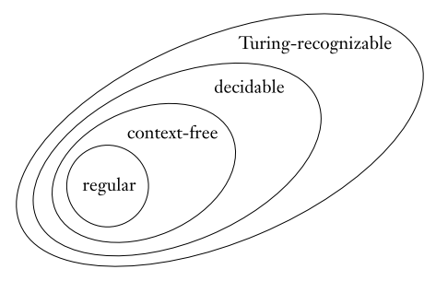
Goals!

Slide 4
Part 1: Decidable Languages

Slide 5
Decidable Languages
Recall that a decidable language is a language for which a Turing Machine exists that computes it and always halts.
Let’s look at a few more decidable languages and eventually start discovering some undecidable languages.

Slide 6
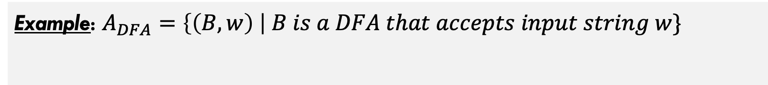
Decidable Languages
Example: $A_{DFA}=\left\{\left(B,w\right) \right| B is a DFA that accepts input string w\}$
Can you describe a Turing Machine that decides this language?

Slide 7
Decidable Languages
Example: $A_{DFA}=\left\{\left(B,w\right) \right| B is a DFA that accepts input string w\}$
M = “On input <B,w>:
Simulate B on input w
If B ends in accept state, accept. Otherwise, reject.”
w is finite, B is also guaranteed to halt. So the simulation must be possible and it must halt.
Let’s briefly discuss some of the implementation details involved in this.

Slide 8
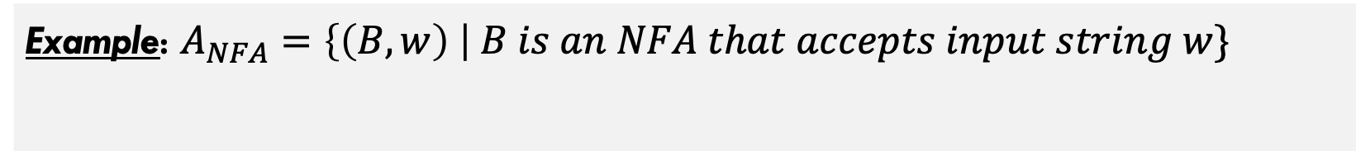
Decidable Languages
Example: $A_{NFA}=\left\{\left(B,w\right) \right| B is an NFA that accepts input string w\}$
How about this one? How would you design the machine this time?

Slide 9
Decidable Languages
Example: $A_{NFA}=\left\{\left(B,w\right) \right| B is an NFA that accepts input string w\}$
N = “On input <B,w>:
Convert NFA B into DFA C using procedure given previously.
Run Turing Machine M from previous slide on <C,w>
If M accepts, then accept. Otherwise, reject.”

Slide 10



More Decidable Languages
All of the following languages are similarly decidable:
$$A_{REX}=\left\{R,w \right| R is a reg. exp. that generates w\}$$
Does a given expression generate this string?
$$E_{DFA}=\left\{A \right| A is a DFA and L\left(A\right)=∅\}$$
Is language of the DFA empty?
$${EQ}_{DFA}=\left\{A,B \right| A,B are DFA∧L\left(A\right)=L(B)\}$$
Does a given expression generate this string?
…and analogous languages for Context-Free Grammars (CFGs)

Slide 11
Part 2: Undecidable Languages

Slide 12
Do undecidable languages exiSt?
Are there problems that are unsolvable by computers (Turing Machines)?

Slide 13
Do undecidable languages exiSt?
Many of these problems are recognizable, but not decidable.
Are there problems that are unsolvable by computers (Turing Machines)?
This has profound philosophical implications in Computer Science. Some things are fundamental limitations that computers cannot overcome.
Yes! In fact, many simple and common problems are undecidable.

Slide 14
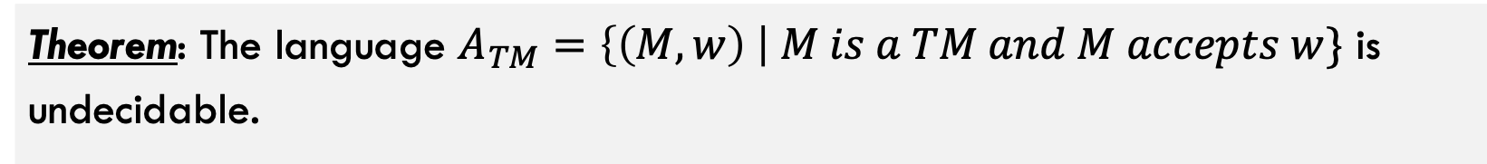
Do undecidable languages exist?
Theorem: The language $A_{TM}=\left\{\left(M,w\right) \right| M is a TM and M accepts w\}$ is undecidable.
This language is Turing-Recognizable though. Here is how:
U = “On input <M,w>:
Simulate M on input w
If M ever accepts, then accept.
If M ever reject, then reject.
Note that if M loops forever, then so will U

Slide 15
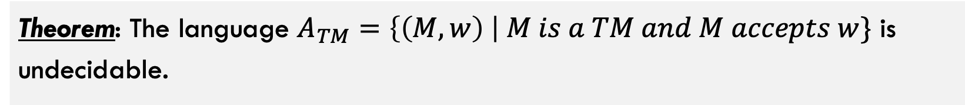
Do undecidable languages exist?
Theorem: The language $A_{TM}=\left\{\left(M,w\right) \right| M is a TM and M accepts w\}$ is undecidable.
Okay, let’s prove it. Intuitively, what is the potential issue here?
This is one of the most famous proofs in Computer Science

Slide 16
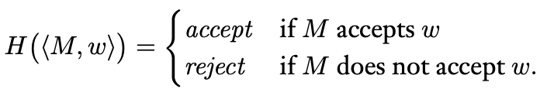

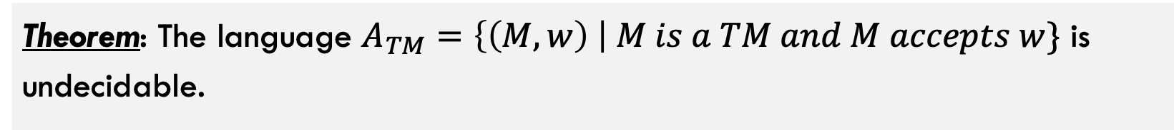
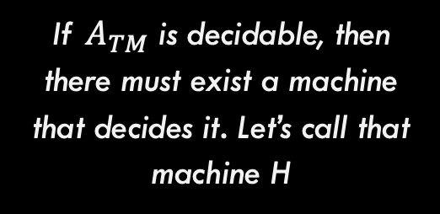
Do undecidable languages exist?
Theorem: The language $A_{TM}=\left\{\left(M,w\right) \right| M is a TM and M accepts w\}$ is undecidable.
Step 1: For the sake of contradiction, assume $A_{TM}$ is decidable
If $A_{TM}$ is decidable, then there must exist a machine that decides it. Let’s call that machine H

Slide 17
Do undecidable languages exist?
Theorem: The language $A_{TM}=\left\{\left(M,w\right) \right| M is a TM and M accepts w\}$ is undecidable.
Step 2: Construct a new machine D that uses H as a subroutine.
D
Input <M>
accept
reject
H(<M, M>)
reject
accept

Slide 18
Some Comments on Machine D
D
Input <M>
accept
reject
H(<M, M>)
reject
accept
Notice that we flip the output here. This will be important for creating the contradiction
What does it mean to run a machine with itself as input? Is this even possible?

Slide 19
Some Comments on Machine D
Step 3: Run the machine D with itself (D) as input. What happens?
D
Input <D>
accept
reject
H(<D, D>)
reject
accept
Notice that D is running with itself as input in two places, once overall (green square) and once simulated inside of H
Which means these outputs should match because they are the output of the exact same thing (D running on D as input)

Slide 20
Some Comments on Machine D
Step 3: Run the machine D with itself (D) as input. What happens?
D
Input <D>
accept
reject
H(<D, D>)
reject
accept
Q.E.D: This is a contradiction because if H exists (ATM is decidable), then there is at least one set of inputs where H produces the wrong answer (well, it cannot produce the right answer by definition).

Slide 21
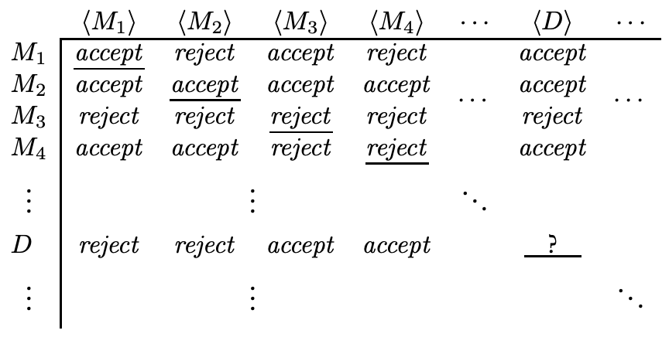
Do undecidable languages exist?
This is really a proof by diagonalization

Slide 22
Do undecidable languages exist?
This is really a proof by diagonalization
Each entry is a machine’s output when another machine’s description is given as input
But this entry has to be both accept and reject at the same time, leading to the contradiction
D is defined to be the machine that has the opposite output from the corresponding diagonal (see green outlines)

Slide 23
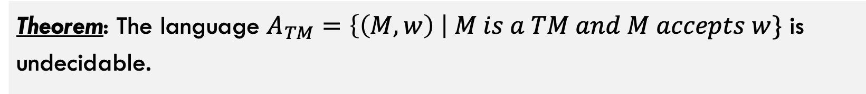
Do undecidable languages exist?
Theorem: The language $A_{TM}=\left\{\left(M,w\right) \right| M is a TM and M accepts w\}$ is undecidable.
Thus it is proven, and there is at least one undecidable language

Slide 24
Part 3: Non-Recognizable Languages?

Slide 25

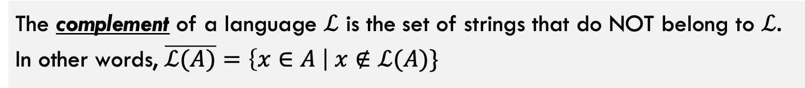

Definition: Complement of a Language
The complement of a language $ℒ$ is the set of strings that do NOT belong to $ℒ$. In other words, $\overline{ℒ(A)}=\left\{x∈A \right| x∉ℒ(A)\}$
Some Examples:
$$ℒ(A)$$
$$\overline{ℒ(A)}$$
Strings containing less than ten 1’s
Strings containing ten or more 1’s
DFA <A> accepts string <w>
DFA <A> rejects string <w>
TM <M> halts on input <w>
TM <M> loops forever on input <w>

Slide 26
More on complements
TM <M> halts on input <w>
Accept: Input on tape is in language
In language above, Accepts (Yes) is easy because if machine halts we are sure it is a Yes
Some Turing Machine
Executes on input / tape
Reject: Input on tape is NOT in language
However, distinguishing between Reject (No) and Looping Forever is difficult to ascertain. Is the machine just taking a long time?
Loop: TM runs forever, never reaching accept or reject state

Slide 27
More on complements
TM <M> loops forever on input <w>
Accept: Input in language
Some Turing Machine
Executes on input / tape
Reject: Input Not in language
Now, Rejecting (No) is easy. If we halt then we output Reject (No).
Loop: TM runs forever
Now, distinguishing between Accept (Yes) and Looping Forever is hard. Is the machine just taking a long time and we should really reject or is it actually looping forever?

Slide 28

Co-Turing Recognizable
A language $ℒ$ is co-Turing recognizable iff the complement $\overline{ℒ}$ is Turing recognizable.
A lot of stuff to unpack here

Slide 29
Quick Reminder(s) from Earlier!!
Theorem: A language is decidable iff it is Turing-recognizable and it is co-Turing-recognizable
A lot of stuff to unpack here

Slide 30
Quick Reminder(s) from Earlier!!
Theorem: A language is decideable iff it is Turing-recognizable and it is co-Turing-recognizable
By the theorem above, we can easily show that the complement of Atm is not recognizable

Slide 31
Part 4: Reducibility

Slide 32
What is Reducibility?
Reduction: def…
Many examples in real life. Getting to Paris reduces to buying a plane ticket. Solving a system of linear equations reduces to inverting a matrix, etc.

Slide 33
Reduction Process
Reduction: Problem A and B. Reduction shows a conversion from A to B
If B is decidable, then is A decidable?

Slide 34
The Halting Problem
Halting Problem: blah blah
We can show halting is undecidable easily by using a reduction proof.

Slide 35
TM Emptiness Testing
Emptiness Test: Etm is undecidable
Also through reduction

Slide 36
Some other Undecidable Problems
Examples
Does a TM recognize a regular language, and thus can be converted to a DFA?
Does a TM recognize a CFG, and thus can be converted to a pushdown automata?
Are the languages of two TMs A and B equivalent to each other?

Slide 37
Rice’s Theorem
Rice’s Theorem: Any non-trivial property P of a program (e.g., halting) is undecidable
…

