Slide 1
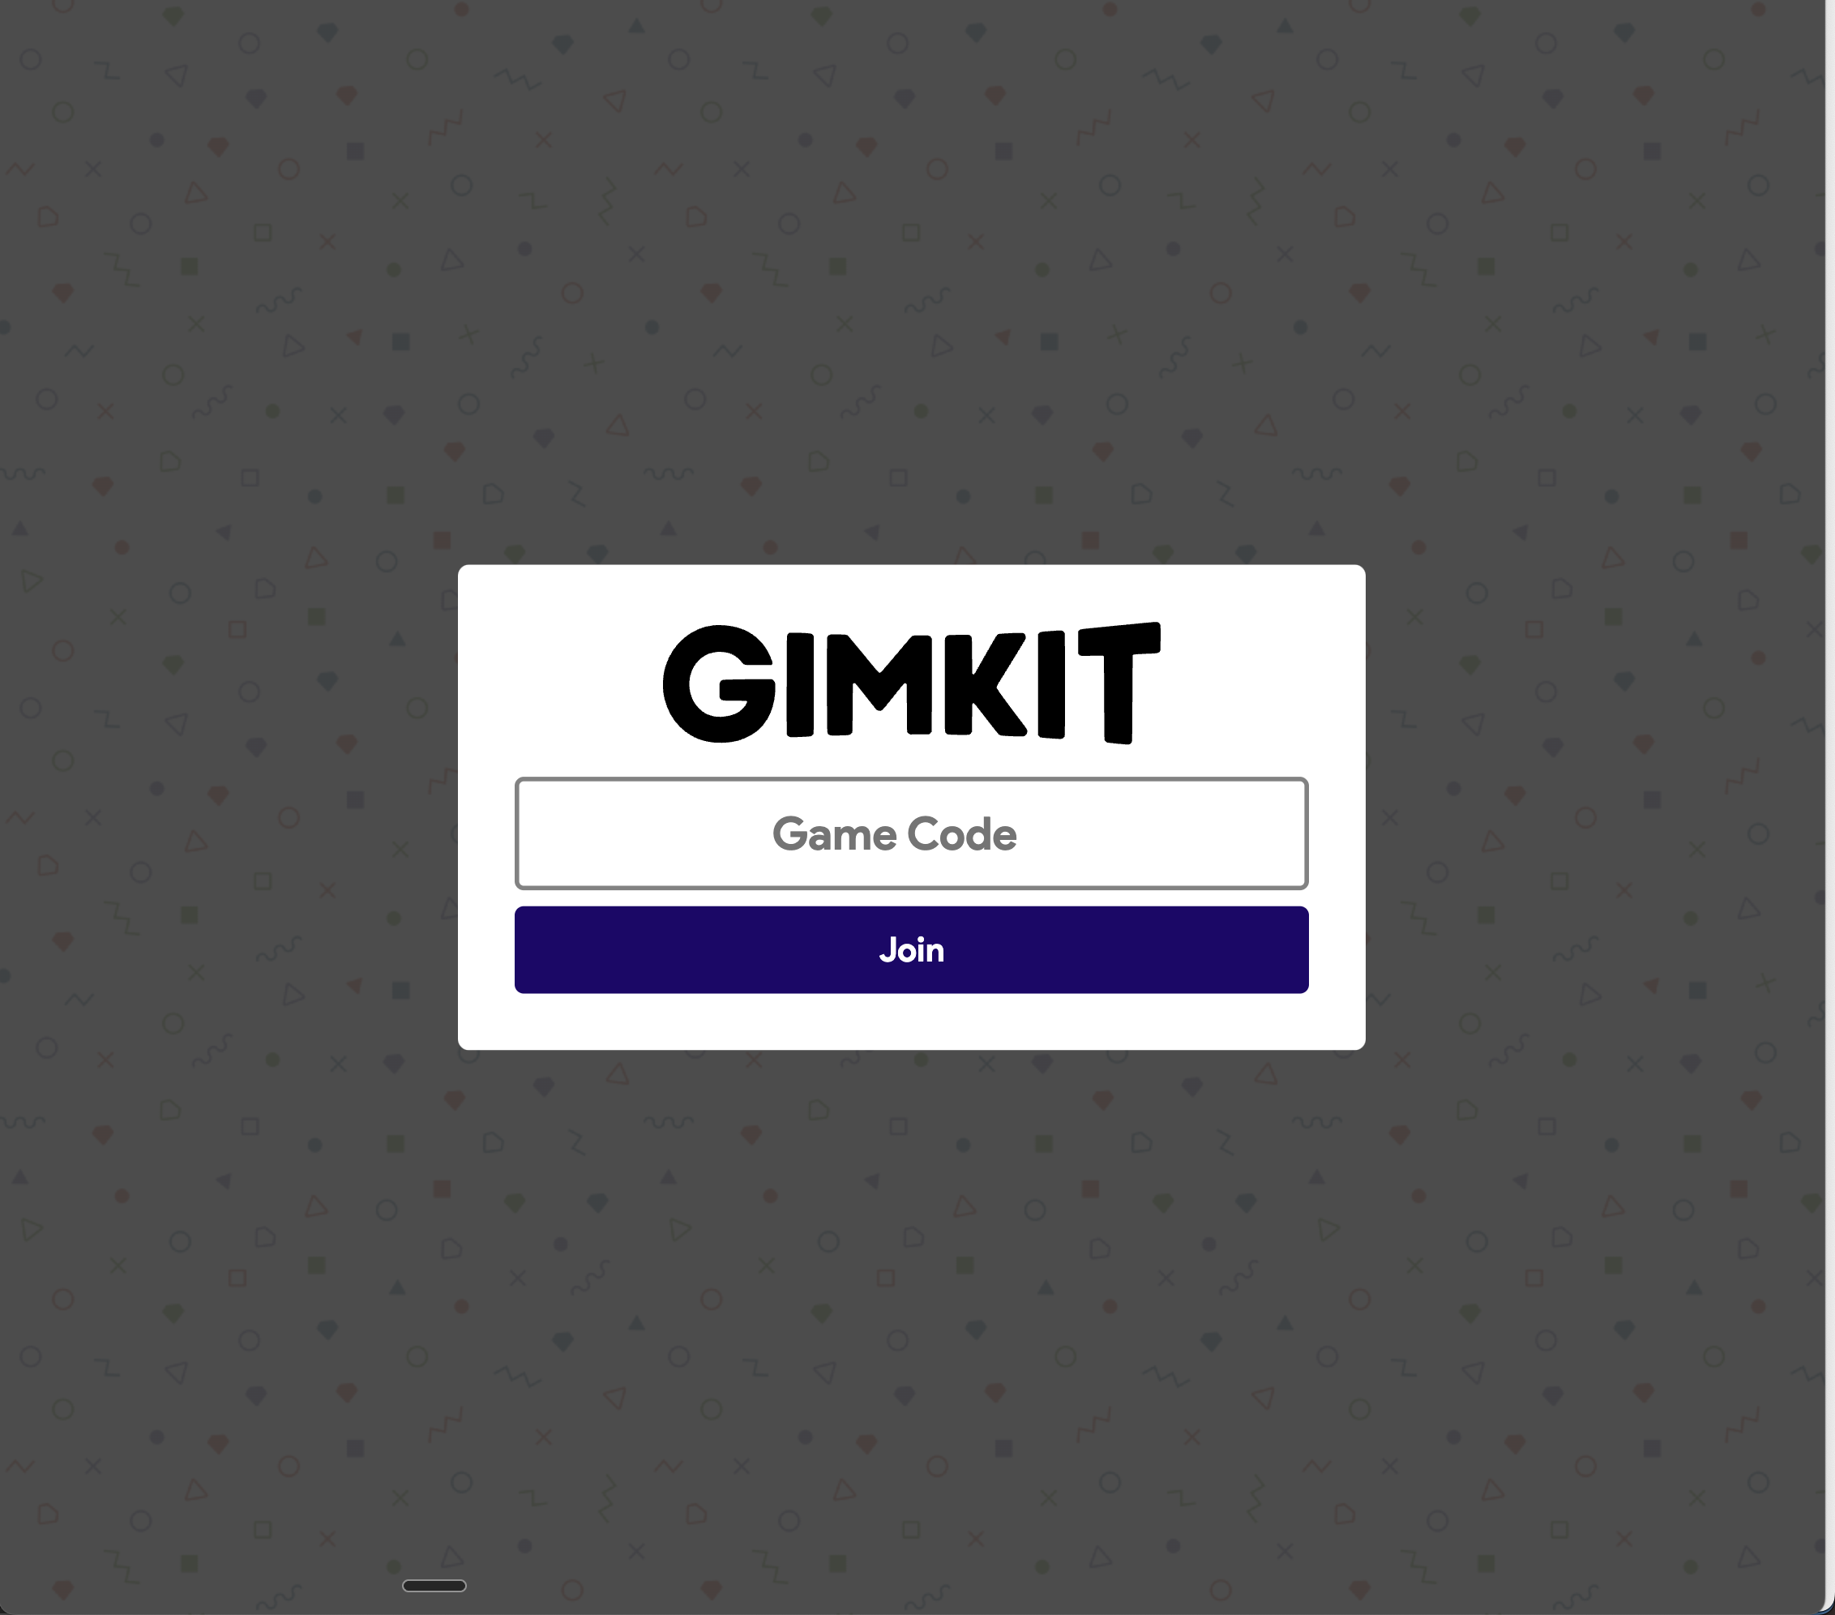
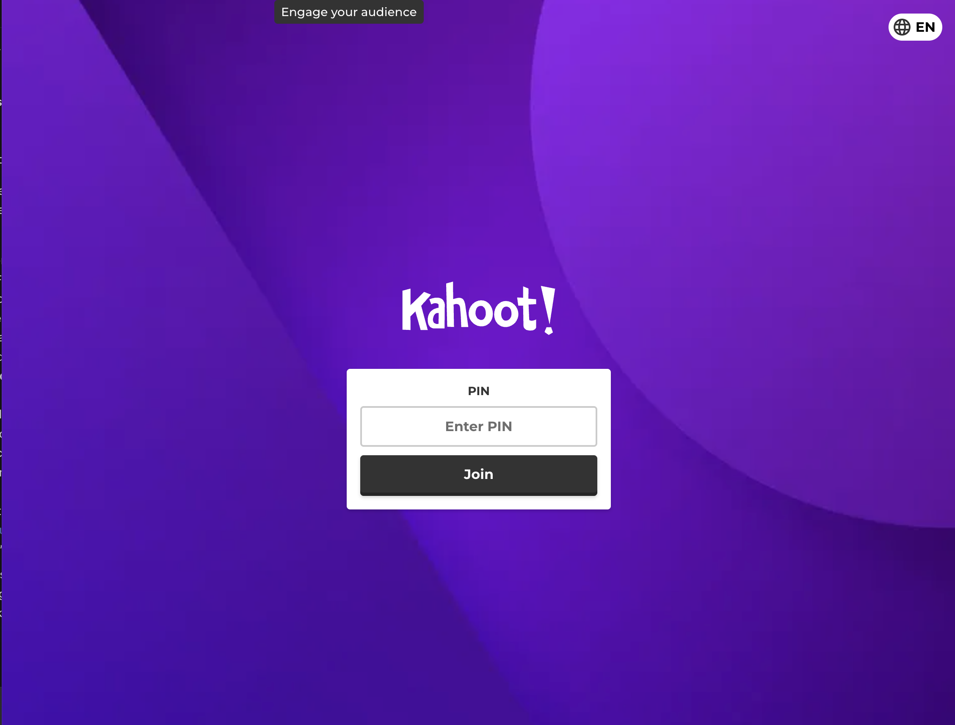
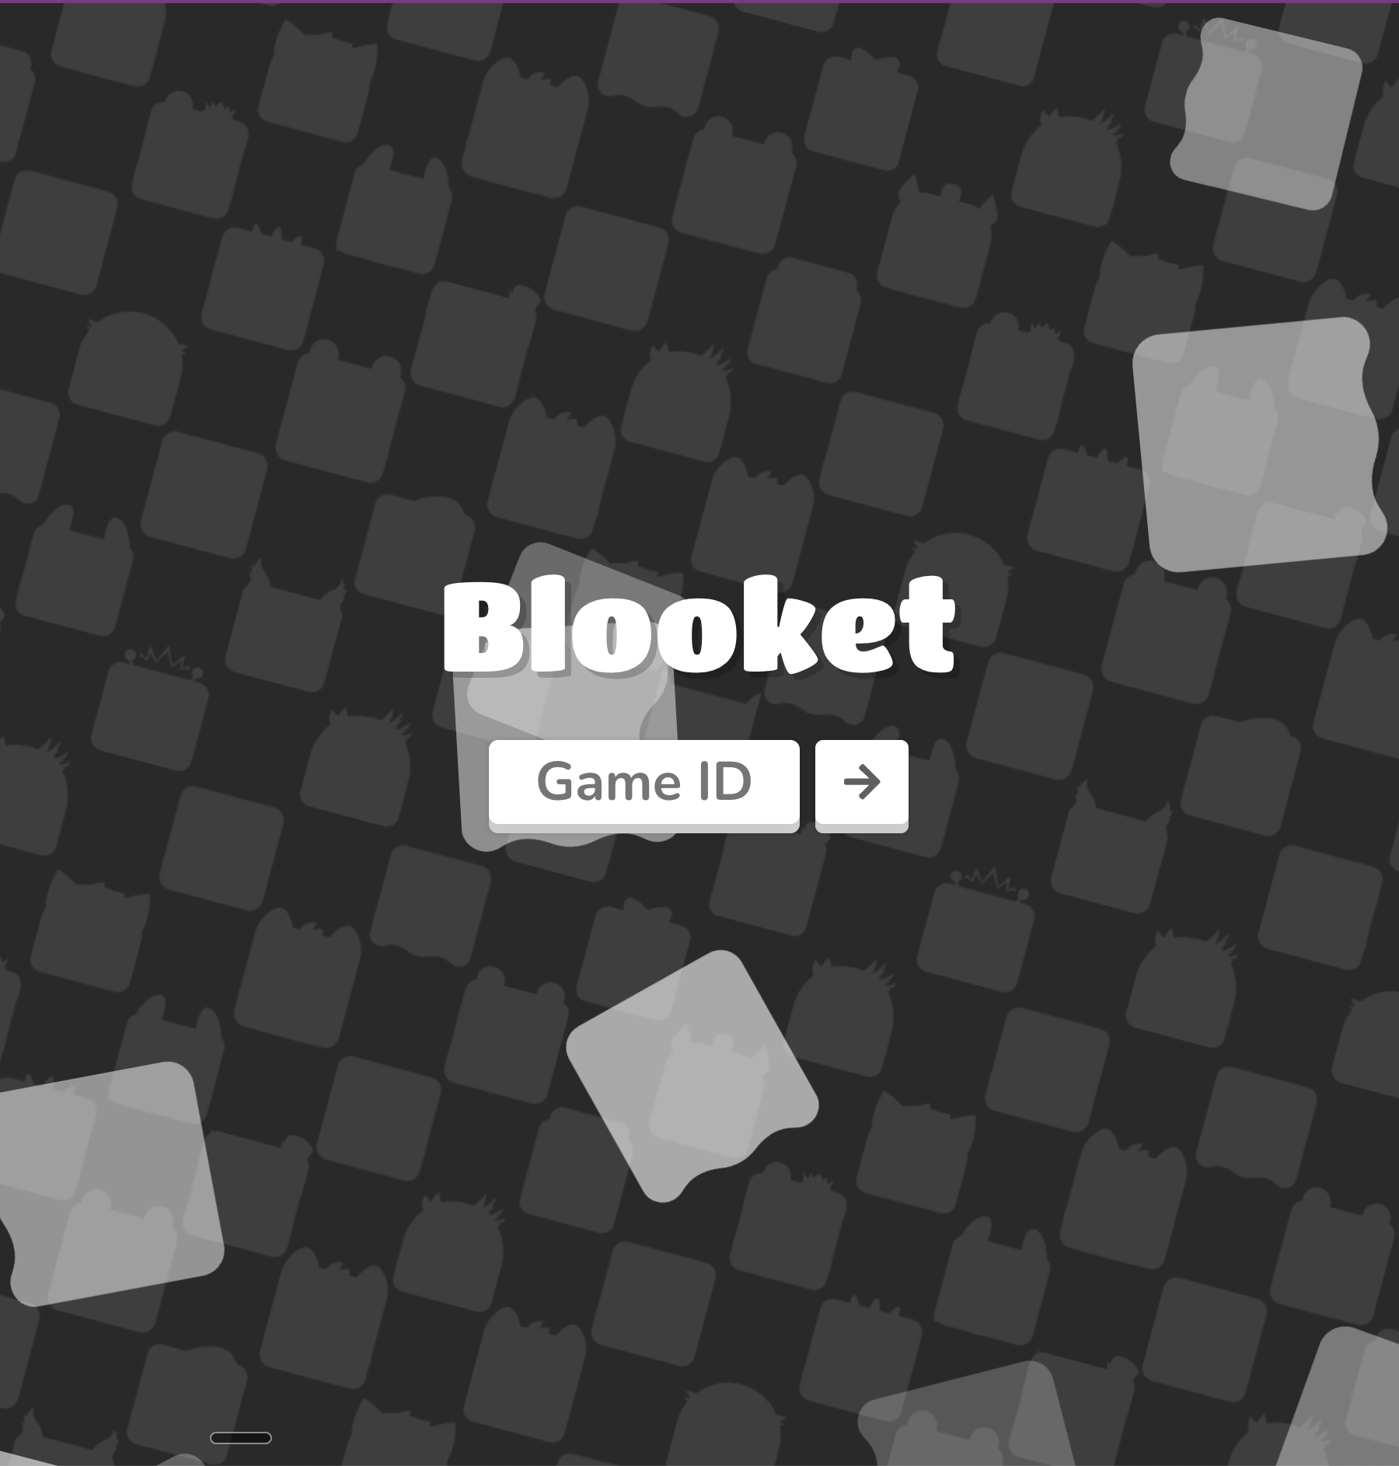
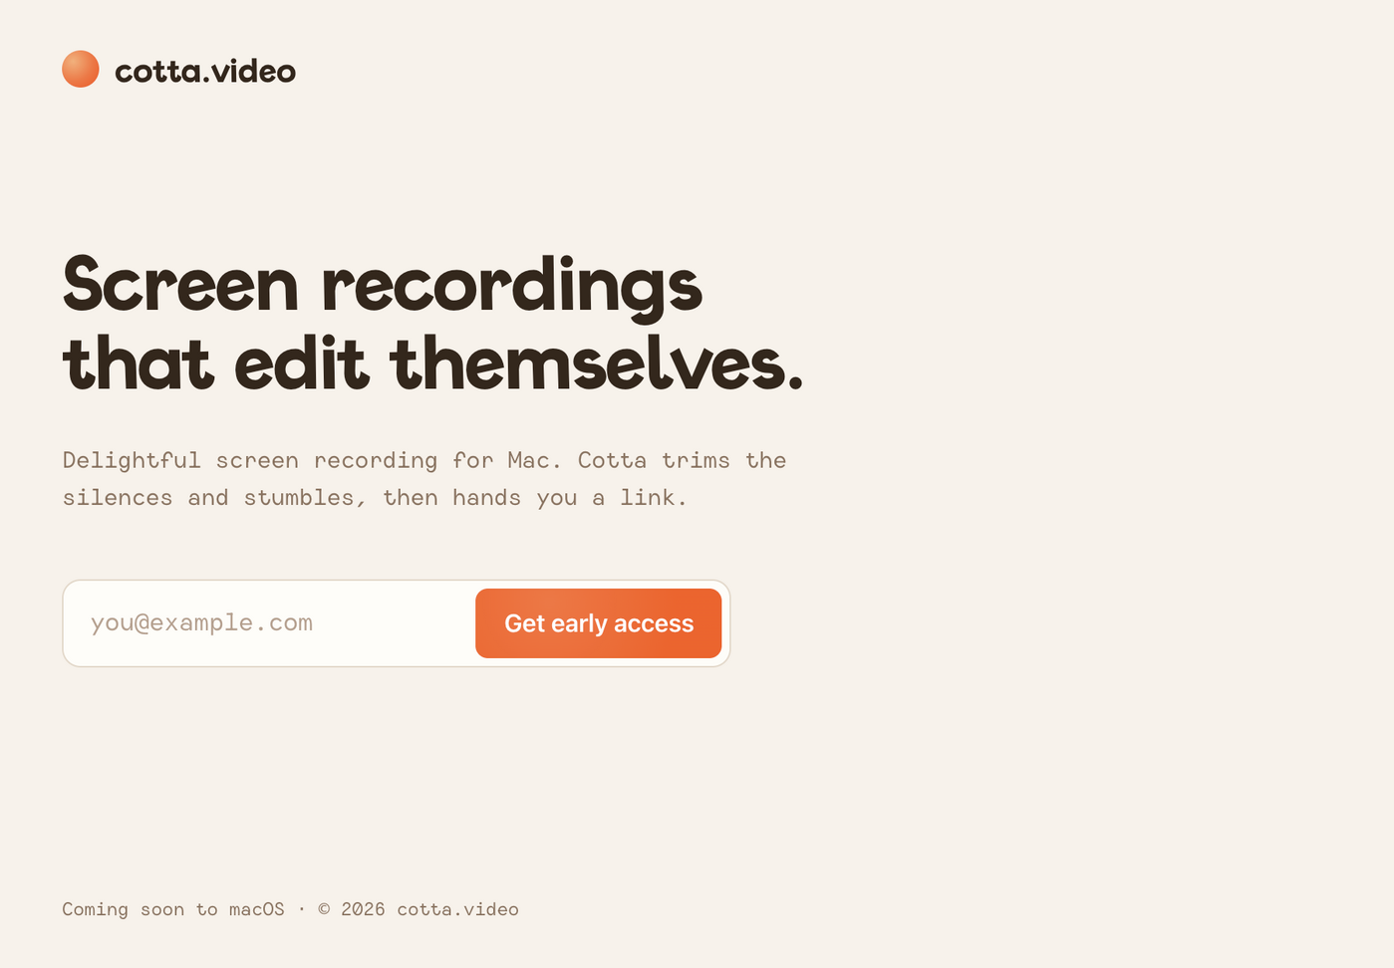
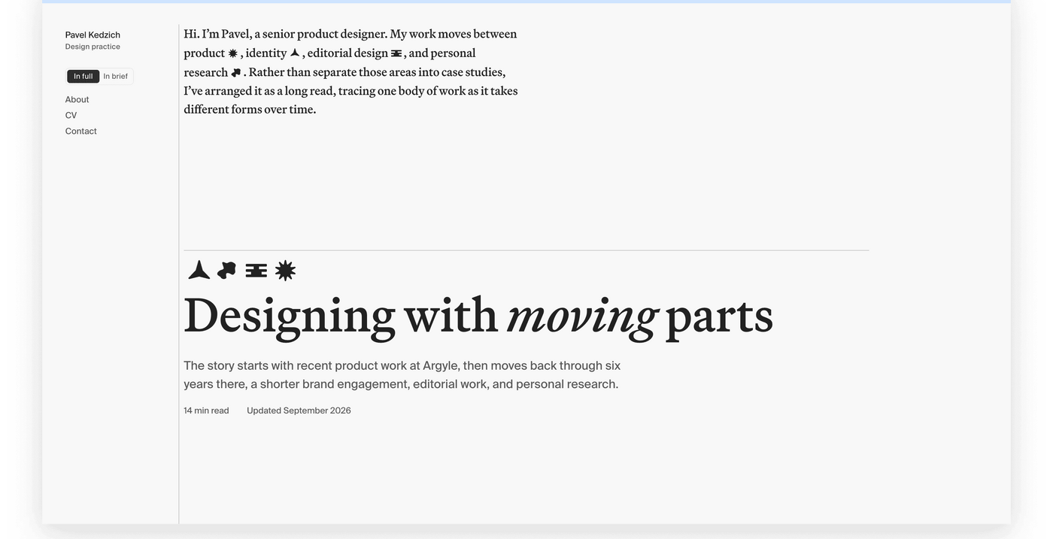
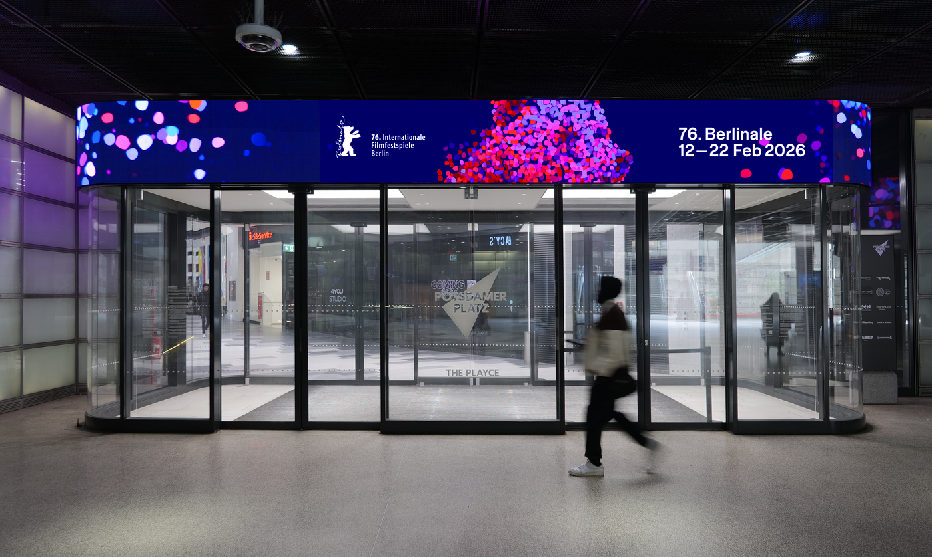
TYPOGRAPHY
Clear next actions with a playful voice
Roam: code first so joining feels immediate.
Roam: bold names make booths easy to scan.
WHAT I NOTICE
1–3 Big, playful names; one obvious next action. The screens feel game-like without making the form hard to use.
4–6 Characterful display type paired with quieter supporting text. Pavel shows that a serif can work too.
1 Gimkit
2 Kahoot
3 Blooket
4 Cotta
WORDS FOR THIS
Display = expressive headline
Hierarchy = size guides the eye
Weight = stroke thickness
Serif = finishing strokes
Used in Roam: booth name and call action lead; quieter labels make the next step clear.
5 Pavel Kedzich
6 Berlinale 2026
Notes:
Draft visual study. Sources: local Gimkit, Kahoot, and Blooket screenshots in docs/inspiration; https://fontsinuse.com/uses/80040/cotta-video-identity-and-landing-page ; https://fontsinuse.com/uses/80138/pavel-kedzich-portfolio-website ; https://fontsinuse.com/uses/80128/berlinale-2026 . Other saved typography references to consider in the next revision: https://fontsinuse.com/uses/78391/later and https://fontsinuse.com/uses/80139/overplay-card-game . The shared direction is an interpretation of the user's choices, not a claim that all references use the same font family. Decisions about which choices reach the app will be added after implementation.

Slide 2
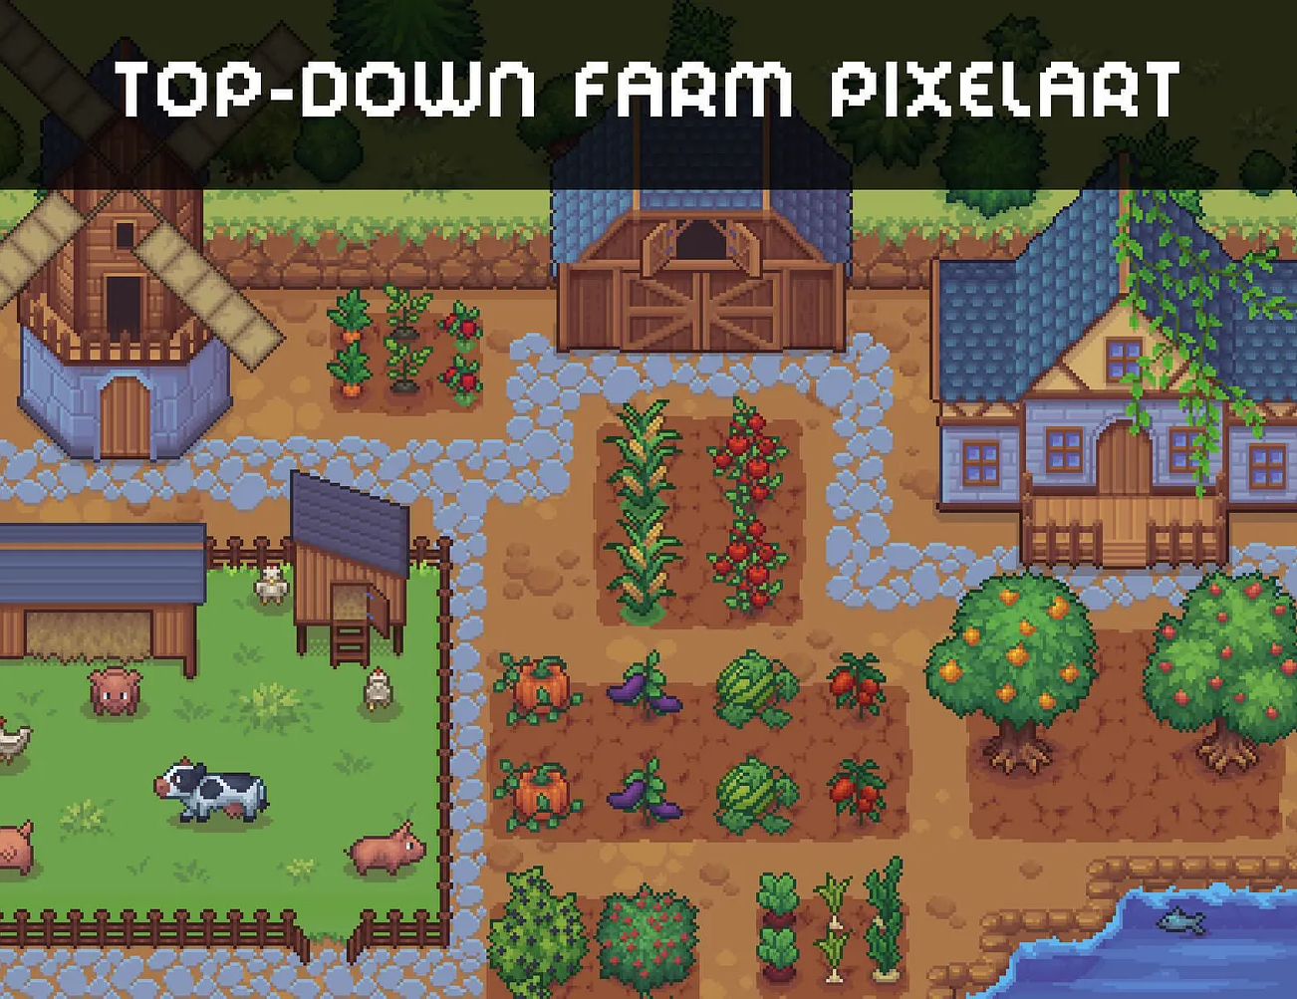
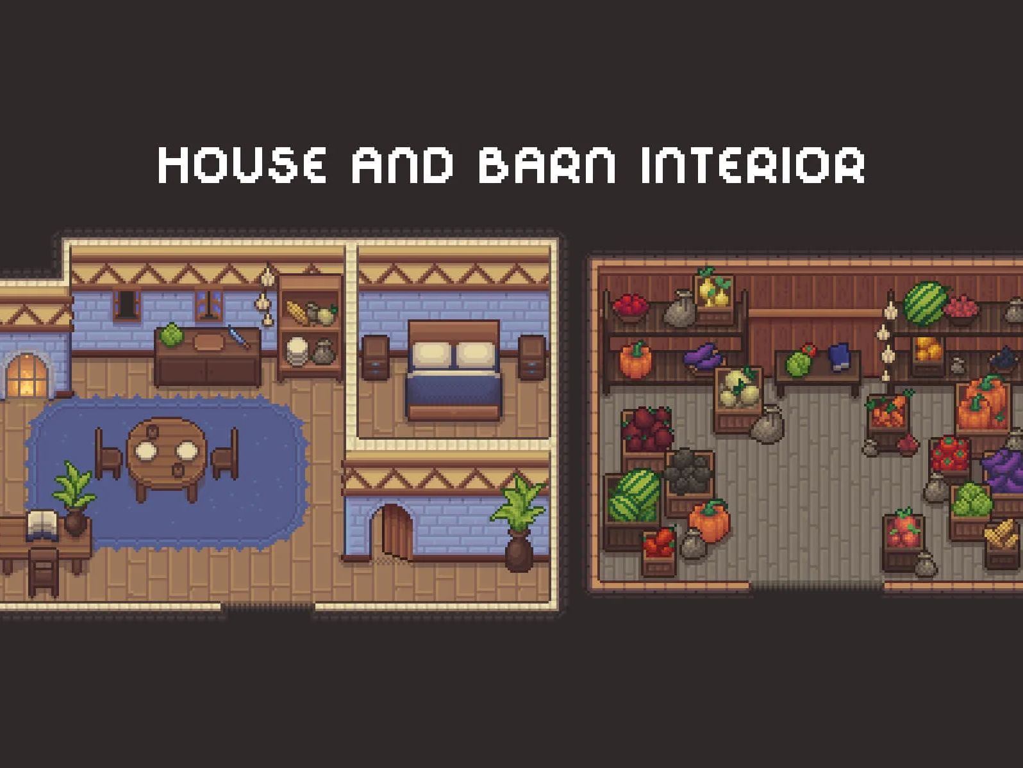
COLOR
Playful and chill, with dark blue as the base
Roam: night blue + white card make entry easy to spot.
WHAT I NOTICE
1, 4 Dark backgrounds let one bright action stand out. The rest of the screen can stay calm.
Roam: indoor tiles + furniture make booths feel like places.
2, 3 A map can feel playful through distinct spaces and small details, not constant saturated color.
1 Gimkit
2 Pixel art map
3 Pixel art rooms
5 Bright accents feel lively against deep blue, while white type remains easy to spot.
USED IN ROAM
Night blue backdrop
White and soft blue panels
Violet primary action
Small warm map accents
4 Kahoot
5 Berlinale 2026
Notes:
Draft visual study. Sources: local Gimkit and Kahoot screenshots plus two pixel-art images in docs/inspiration; https://fontsinuse.com/uses/80128/berlinale-2026 . Proposed palette is exploratory. It is not an assertion that these exact colors already appear in Roam. Later annotate which choices were used in the UI and why, including contrast and how queue and invitation states are distinguished with text as well as color.

