Slide 1

Robot Operating System
Dong Li

Slide 2
Topics
Introduction to ROS
ROS Software Development
Demo
Todo

Slide 3
Introduction to ROS
Created by Stanford AI Lab in 2007
Open source and developed by many groups
Has been applied to many commercial products and industry

Slide 4

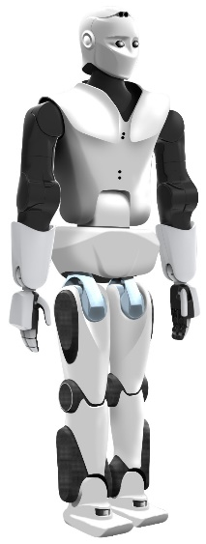
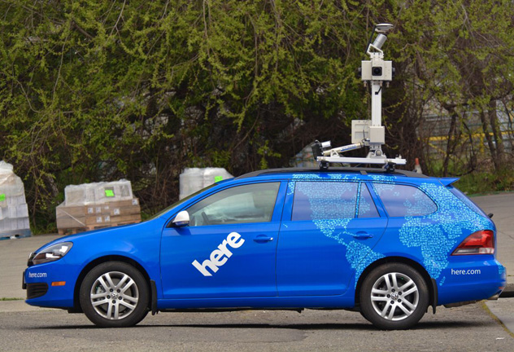
Introduction to ROS
HERE map car
Hekateros robotic arms
PAL Robotics
http://www.ros.org/news/robots/

Slide 5
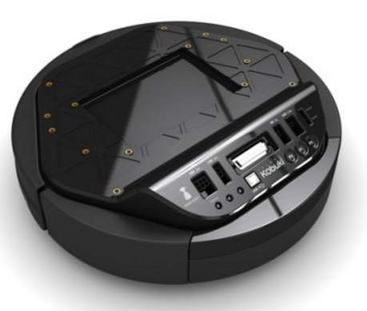
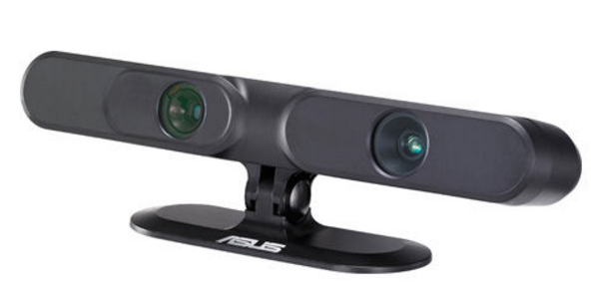
Introduction to ROS

Slide 6
Introduction to ROS
a flexible framework for writing robot software
a collection of tools, libraries

Slide 7
Introduction to ROS: framework
Basic compoment: node
Publisher:
publish msg with some topic
Subscriber:
receive msg with some topic
Server:
receive the req from client and answer to it
Client:
Send req to server and receive the answer
node
Publisher
Subscriber
server
Client

Slide 8
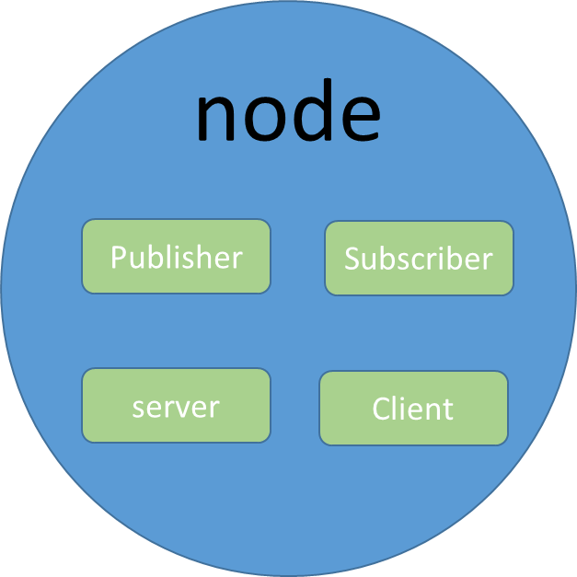
Introduction to ROS: framework
ROS Master

Slide 9
Introduction to ROS: framework
Client
Req
Server
Ans
Publisher 1
Subscriber 1
msg1
msg1, msg2
Topic
Publisher 2
Subscriber 2
msg2
msg1, msg2

Slide 10
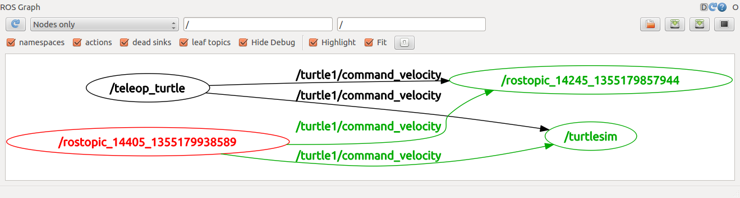
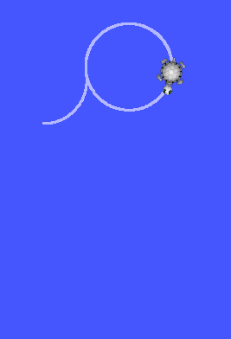
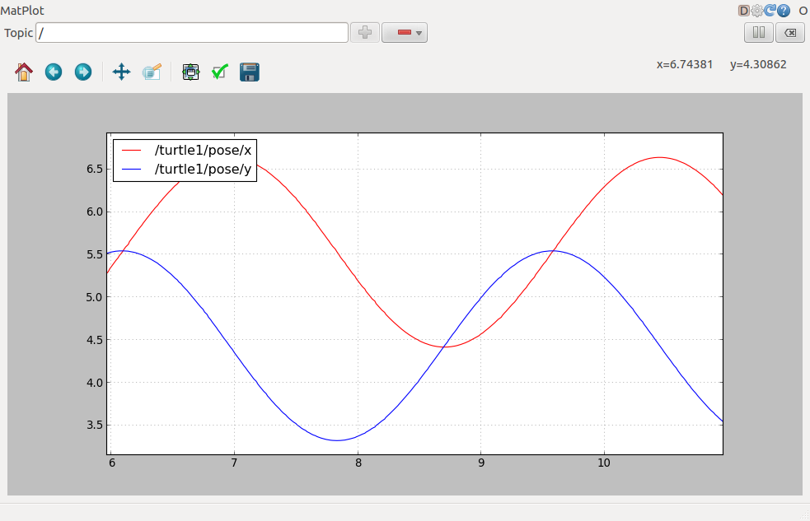
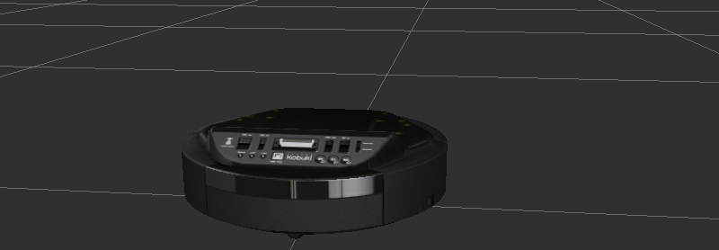
Introduction to ROS: tools
Command line:
roscd, rosls, rosrun etc
rostopic pub etc
roswtf
GUI tools: rqt
node monitor
data visualization
model simulator

Slide 11
ROS Software Development
Platform: Linux, Mac, Windows
Processor: x86, ARM
Language:
C/C++, Python
Java (for Android)
Javascript (for web app, ROSjs)
Objective-C (for iOS, RBManager)

Slide 12
ROS Software Development
One ROS app is called a package in ROS workspace
src (for C++/C)
scripts (for Python)
msg
srv
launch
include (dependencies)

Slide 13

ROS Software Development
Msg: msgName.msg
Define the format of msg
Both publisher and subscriber nodes must have the file so that the msg can be decode correctly
E.g
Special msg: numpy.array, sensor_msg like video (predefined)

Slide 14
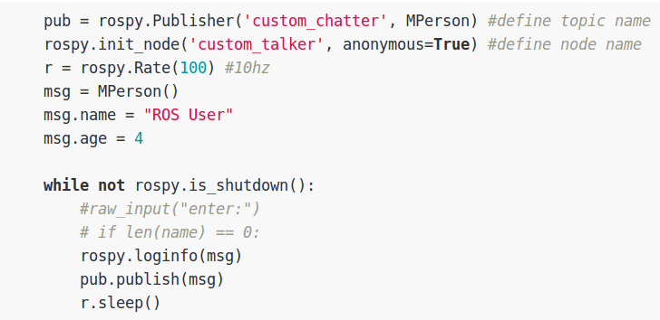
ROS Software Development
Msg: msgName.msg
Publisher

Slide 15
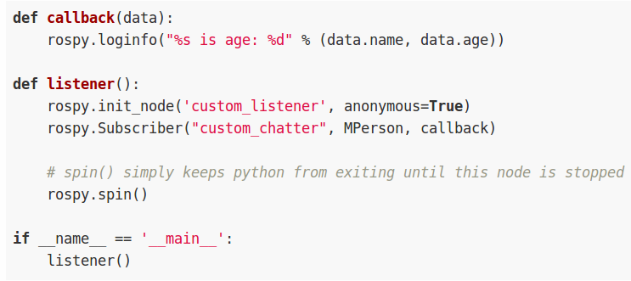
ROS Software Development
Msg: msgName.msg
Subscriber

Slide 16
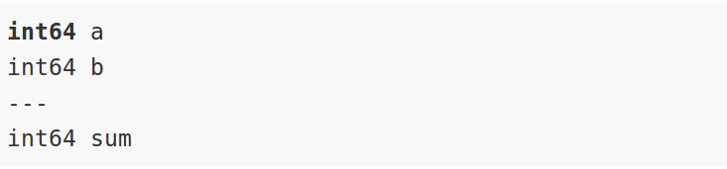
ROS Software Development
Srv: msgName.srv
Define the format of srv
Both server and client nodes must have the file so that the req and ans can be decode correctly
E.g

Slide 17
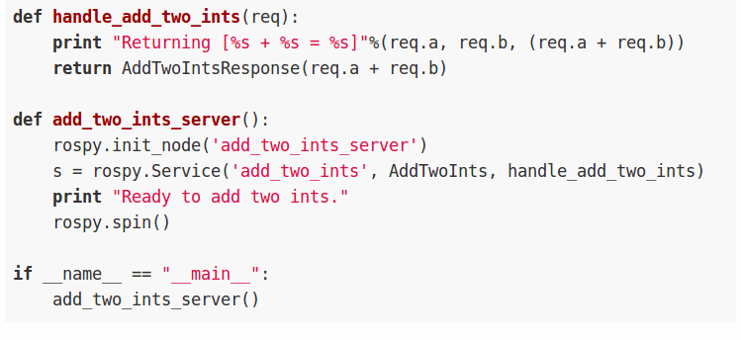
ROS Software Development
Srv: msgName.srv
Service

Slide 18
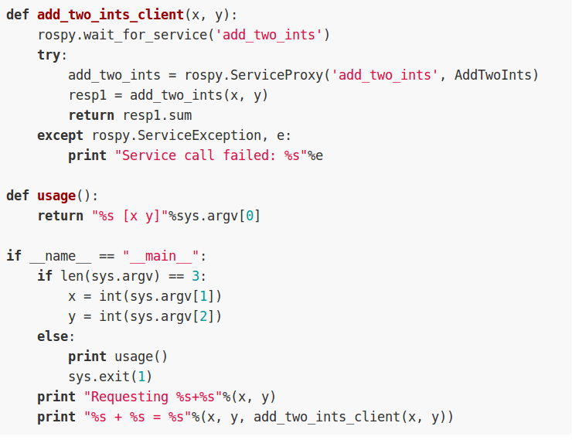
ROS Software Development
Srv: msgName.srv
Client

Slide 19
Demo
Publisher and subscriber
Hello word
Camera (android and labptop)
Server and Client
Add two number
Robot
rqt simulator
Speech control
Look at me

Slide 20
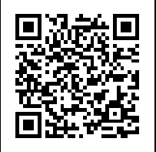
Todo
Implant current code to the Kobuki board
Enhance the camera
recognize more objects like face, wall, desk etc
openCV, deep learning
Speech recognition: Api.ai, Google Cloud Speech API
Setup ROS master on server
Gitbook
https://www.gitbook.com/book/jellylidong/ros-development-note/details
Document what have achieved

Slide 21
Thank you

