Slide 1

CS1020 Data Structures and Algorithms I Lecture Note #5
Abstract Data Type (The Walls)

Slide 2
Objectives
Understanding data abstraction
Defining ADT with Java Interface
Implementing data structure given a Java Interface
Understanding exceptions

Slide 3
References
Book
ADTs: Chapter 4, pages 221 to 258
CS1020 website → Resources → Lectures
http://www.comp.nus.edu.sg/ ~cs1020/2_resources/lectures.html
Exceptions: Chapter 1, Section 1.6, pages 64 to 72

Slide 4
Outline
Software Engineering Issues (Motivation)
1.1 Loose coupling
1.2 Data abstraction
Abstract Data Type
2.1 Data Structure
2.2 Understanding ADT
Java Interface
3.1 Using Java interface to define ADT
3.2 Complex Number Interface
3.3 Complex ADT: Cartesian Implementation
3.4 Complex ADT: Polar Implementation
Practice Exercises: Fraction as ADT
Exceptions

Slide 5
1 Software Engineering Issues
Motivation

Slide 6
1. Software Engineering Issues (1/5)
Section 5.1 – 5.5 Program Design Principles
Abstraction
Concentrate on what it can do and not how it does it
Use of Java Interface
Coupling
Restrict interdependent relationship among classes to the minimum
Coherent
A class should be about a single entity only
There should be a clear logical grouping of all functionalities
Information Hiding
Expose only necessary information to outside

Slide 7
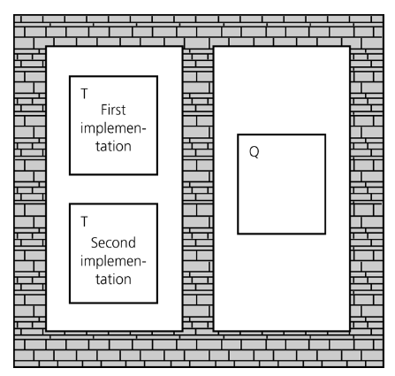
1. Software Engineering Issues (2/5)
Information Hiding
Information hiding is like walls building around the various classes of a program.
The wall around each class T prevents the other classes from seeing how T works.
Thus, if class Q uses (depends on) T, and if the approach for performing T changes, class Q will not be affected.
Our textbook is called the “Walls & Mirrors”. What are the walls?
Makes it easy to substitute new,
improved versions of how to do
a task later

Slide 8
1. Software Engineering Issues (3/5)
Information Hiding is not complete isolation of the classes
Information released is on a need-to-know basis
Class Q does not know how class T does the work, but it needs to know how to invoke T and what T produces
E.g: The designers of the methods of Math and Scanner classes have hidden the details of the implementations of the methods from you, but provide enough information (the method headers and explanation) to allow you to use their methods
What goes in and comes out is governed by the terms of the method’s specifications
If you use this method in this way, this is exactly what it will do for you (pre- and post-conditions)

Slide 9
1. Software Engineering Issues (4/5)
Pre- and post-conditions (for documentation)
Pre-conditions
Conditions that must be true before a method is called
“This is what I expect from you”
The programmer is responsible for making sure that the pre-conditions are satisfied when calling the method
Post-conditions
Conditions that must be true after the method is completed
“This is what I promise to do for you”
Example
// Pre-cond: x >= 0
// Post-cond: Return the square root of x
public static double squareRoot(double x) {
. . .
}

Slide 10
1. Software Engineering Issues (5/5)
Information Hiding CAN also apply to data
Data abstraction asks that you think in terms of what you can do to a collection of data independently of how you do it
Data structure is a construct that can be defined within a programming language to store a collection of data
Abstract data type (ADT) is a collection of data & a specification on the set of operations/methods on that data
Typical operations on data are: add, remove, and query (in general, management of data)
Specification indicates what ADT operations do, but not how to implement them

Slide 11
2 Abstract Data Type
Collection of data + set of operations on the data

Slide 12
Data Structure
2. ADT
Data structure is a construct that can be defined within a programming language to store a collection of data
Arrays, which are built into Java, are data structures
We can create other data structures. For example, we want a data structure (a collection of data) to store both the names and salaries of a collection of employees
or
static final int MAX_NUMBER = 500; // defining a constant
String[] names = new String[MAX_NUMBER];
double[] salaries = new double[MAX_NUMBER];
// employee names[i] has a salary of salaries[i]
class Employee {
static final int MAX_NUMBER = 500;
private String names;
private double salaries;
}
...
Employee[] workers = new Employee[Employee.MAX_NUMBER];
(better
choice)

Slide 13
Abstract Data Type (ADT) (1/4)
2. ADT
An ADT is a collection of data together with a specification of a set of operations on the data
Specifications indicate what ADT operations do, not how to implement them
Data structures are part of an ADT’s implementation
Collection of data
Spec. of a set of operations
ADT
When a program needs data operations that are not directly supported by a language, you need to create your own ADT
You should first design the ADT by carefully specifying the operations before implementation

Slide 14
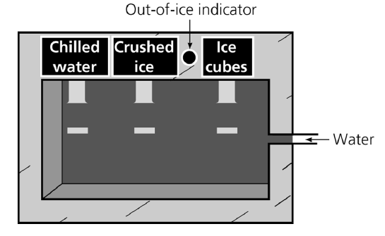
Abstract Data Type (ADT) (2/4)
2. ADT
Example: A water dispenser as an ADT
Data: water
Operations: chill, crush, cube, and isEmpty
Data structure: the internal structure of the dispenser
Walls: made of steel
The only slits in the walls:
Input: water
Output: chilled water, crushed ice, or ice cubes.
Using an ADT is like using a vending machine.
Crushed ice can be made in many ways.
We don’t care how it was made

Slide 15
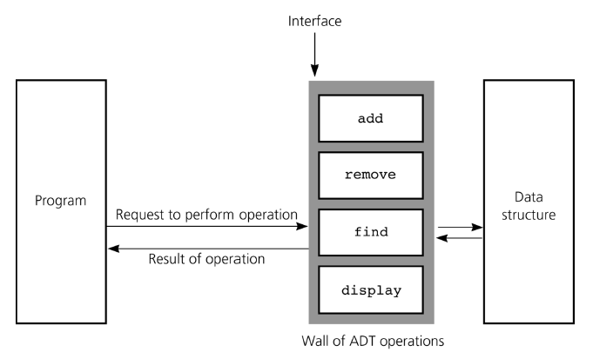
Abstract Data Type (ADT) (3/4)
2. ADT
A WALL of ADT operations isolates a data structure from the program that uses it
An interface is what a program/module/class should understand on using the ADT

Slide 16
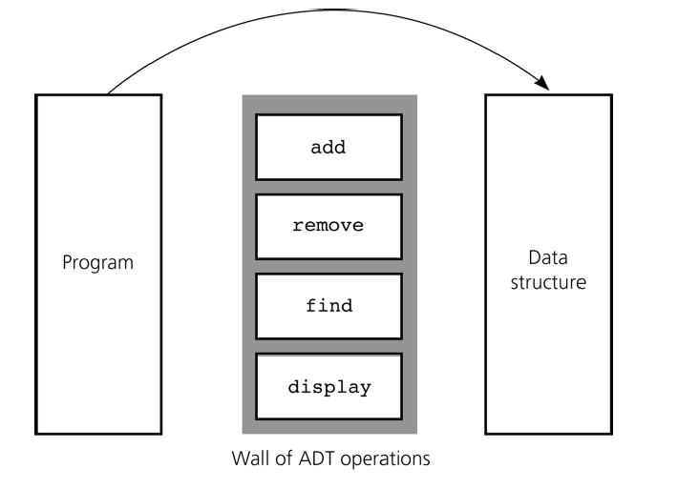
Abstract Data Type (ADT) (4/4)
2. ADT
An interface is what a program/module/class should understand on using the ADT
The following bypasses the interface to access the data structure. This violates the wall of ADT operations.
interface

Slide 17
Eg: Primitive Types as ADTs (1/2)
2. ADT
Java’s predefined data types are ADTs
Representation details are hidden which aids portability as well
Examples: int, boolean, double
--
||
–
*
int
&&
boolean
+
/
++
!
int type with the operations (e.g.: --, /) defined on it.
boolean type with the operations (e.g.: &&) defined on it.

Slide 18
Eg: Primitive Types as ADTs (2/2)
2. ADT
Broadly classified as: (the example here uses the array ADT)
Constructors (to add, create data)
int[] z = new int[4];
int[] x = { 2,4,6,8 };
Mutators (to modify data)
x[3] = 10;
Accessors (to query about state/value of data)
int y = x[3] + x[2];

Slide 19
Eg: Complex Number as ADT (1/6)
2. ADT
A complex number comprises a real part a and an imaginary part b, and is written as a + bi
i is a value such that i² = -1.
Examples: 12 + 3i, 15 – 9i, -5 + 4i, -23, 18i
A complex number can be visually represented as a pair of numbers (a, b) representing a vector on the two-dimensional complex plane (horizontal axis for real part, vertical axis for imaginary part)
Imag
b
a + bi
Real
0
a

Slide 20
Eg: Complex Number as ADT (2/6)
2. ADT
User-defined data types can also be organized as ADTs
Let’s create a “Complex” ADT for complex numbers
add(c)
Complex(r,i)
times(c)
Complex
realpart()
minus(c)
imagpart()
Note: add(c) means to add complex number object c to “this” object. Likewise for times(c) and minus(c).

Slide 21
Eg: Complex Number as ADT (3/6)
2. ADT
A possible Complex ADT class:
class Complex {
private ... // data members
public Complex(double r, double i) { ... } // create a new object
public void add(Complex c) { ... } // this = this + c
public void minus(Complex c) { ... } // this = this - c
public void times(Complex c) { ... } // this = this * c
public double realpart() { ... } // returns this.real
public double imagpart() { ... } // returns this.imag
}
Using the Complex ADT:
Complex c = new Complex(1,2); // c = (1,2)
Complex d = new Complex(3,5); // d = (3,5)
c.add(d); // c = c + d
d.minus(new Complex(1,1)); // d = d - (1,1)
c.times(d); // c = c * d

Slide 22
Eg: Complex Number as ADT (4/6)
2. ADT
One possible implementation: Cartesian
class Complex {
private double real;
private double imag;
// CONSTRUCTOR
public Complex(double r, double i) { real = r; imag = i; }
// ACCESSORS
public double realpart() { return real; }
public double imagpart() { return imag; }
// MUTATORS
public void add (Complex c) { // this = this + c
real += c.realpart();
imag += c.imagpart();
}
public void minus(Complex c) { // this = this - c
real -= c.realpart();
imag -= c.imagpart();
}
public void times(Complex c) { // this = this * c
real = real*c.realpart() - imag*c.imagpart();
imag = real*c.imagpart() + imag*c.realpart();
}
}
(a + bi) + (c + di)
= (a + c) + (b + d)i
(a + bi) – (c + di)
= (a – c) + (b – d)i
(a + bi) × (c + di)
= (ac – bd) + (ad + bc)i

Slide 23
Eg: Complex Number as ADT (5/6)
2. ADT
Another possible implementation: Polar
class Complex {
private double ang; // the angle of the vector
private double mag; // the magnitude of the vector
:
:
public times(Complex c) { // this = this * c
ang += c.angle();
mag *= c.mag();
}
:
:
}

Slide 24
Eg: Complex Number as ADT (6/6)
2. ADT
“Relationship” between Cartesian and Polar representations
From Polar to Cartesian: real = mag * cos(ang);
imag = mag * sin(ang);
From Cartesian to Polar: ang = tan⁻¹(imag/real);
mag = real / cos(ang);
or mag = sqrt(real² + imag²);
y-axis
E.g.: Complex number 2 + i
2
(real, imag)
mag = 2/cos(ang) or sqrt(2² + 1²) = 2.236
(2, 1)
real = 2
imag = 1
mag
1
ang
ang = tan⁻¹(1/2) = 0.464
x-axis
1
2
3

Slide 25
3 Java Interface
Specifying related methods

Slide 26
Java Interface
Java interfaces provide a way to specify common behaviour for a set of (possibly unrelated) classes
Java interface can be used for ADT
It allows further abstraction/generalization
It uses the keyword interface, rather than class
It specifies methods to be implemented
A Java interface is a group of related methods with empty bodies
It can have constant definitions (which are implicitly
public static final)
A class is said to implement the interface if it provides implementations for ALL the methods in the interface
3. Java Interface

Slide 27
Example #1
// package in java.lang;
public interface Comparable <T> {
int compareTo(T other);
}
3. Java Interface
class Shape implements Comparable <Shape> {
static final double PI = 3.14;
double area() {...};
double circumference() { ... };
int compareTo(Shape x) {
if (this.area() == x.area())
return 0;
else if (this.area() > x.area())
return 1;
else
return -1;
}
}
Implementation of compareTo()

Slide 28
Example #2: Interface for Complex
E.g. Complex ADT interface
anticipate both Cartesian and Polar implementations
3. Java Interface
Complex.java
public interface Complex {
public double realpart(); // returns this.real
public double imagpart(); // returns this.imag
public double angle(); // returns this.ang
public double mag(); // returns this.mag
public void add(Complex c); // this = this + c
public void minus(Complex c); // this = this - c
public void times(Complex c); // this = this * c
}
In interface, methods have signatures (headers) but no implementation

Slide 29
Example #2: ComplexCart (1/2)
Cartesian Implementation (Part 1 of 2)
3. Java Interface
ComplexCart.java
class ComplexCart implements Complex {
private double real;
private double imag;
// CONSTRUCTOR
public ComplexCart(double r, double i) { real = r; imag = i; }
// ACCESSORS
public double realpart() { return this.real; }
public double imagpart() { return this.imag; }
public double mag() { return Math.sqrt(real*real + imag*imag); }
public double angle() {
if (real != 0) {
if (real < 0) return (Math.PI + Math.atan(imag/real));
else return Math.atan(imag/real);
}
else if (imag == 0) return 0;
else if (imag > 0) return Math.PI/2;
else return –Math.PI/2;
}

Slide 30
Example #2: ComplexCart (2/2)
Cartesian Implementation (Part 2 of 2)
3. Java Interface
ComplexCart.java
// MUTATORS
public void add(Complex c) {
this.real += c.realpart();
this.imag += c.imagpart();
}
public void minus(Complex c) {
this.real -= c.realpart();
this.imag -= c.imagpart();
}
public void times(Complex c) {
double tempReal = real * c.realpart() – imag * c.imagpart();
imag = real * c.imagpart() + imag * c.realpart();
real = tempReal;
}
public String toString() {
if (imag == 0) return (real + "");
else if (imag < 0) return (real + "" + imag + "i");
else return (real + "+" + imag + "i");
}
}
Why can’t we write the following?
if (imag == 0) return (real);

Slide 31
Example #2: ComplexPolar (1/3)
Polar Implementation (Part 1 of 3)
ComplexPolar.java
3. Java Interface
class ComplexPolar implements Complex {
private double mag; // magnitude
private double ang; // angle
// CONSTRUCTOR
public ComplexPolar(double m, double a) { mag = m; ang = a; }
// ACCESSORS
public double realpart() { return mag * Math.cos(ang); }
public double imagpart() { return mag * Math.sin(ang); }
public double mag() { return mag; }
public double angle() { return ang; }
// MUTATORS
public void add(Complex c) { // this = this + c
double real = this.realpart() + c.realpart();
double imag = this.imagpart() + c.imagpart();
mag = Math.sqrt(real*real + imag*imag);
if (real != 0) {
if (real < 0) ang = (Math.PI + Math.atan(imag/real));
else ang = Math.atan(imag/real);
}
else if (imag == 0) ang = 0;
else if (imag > 0) ang = Math.PI/2;
else ang = -Math.PI/2;
}

Slide 32
Example #2: ComplexPolar (2/3)
Polar Implementation (Part 2 of 3)
3. Java Interface
ComplexPolar.java
public void minus(Complex c) { // this = this - c
double real = mag * Math.cos(ang) - c.realpart();
double imag = mag * Math.sin(ang) - c.imagpart();
mag = Math.sqrt(real*real + imag*imag);
if (real != 0) {
if (real < 0) ang = (Math.PI + Math.atan(imag/real));
else ang = Math.atan(imag/real);
}
else if (imag == 0) ang = 0;
else if (imag > 0) ang = Math.PI/2;
else ang = -Math.PI/2;
}

Slide 33
Example #2: ComplexPolar (3/3)
Polar Implementation (Part 3 of 3)
3. Java Interface
ComplexPolar.java
public void times(Complex c) { // this = this * c
mag *= c.mag();
ang += c.angle();
}
public String toString() {
if (imagpart() == 0)
return (realpart() + "");
else if (imagpart() < 0)
return (realpart() + "" + imagpart() + "i");
else
return (realpart() + "+" + imagpart() + "i");
}
}

Slide 34
Example #2: TestComplex (1/3)
Testing Complex class (Part 1 of 3)
3. Java Interface
TestComplex.java
public class TestComplex {
public static void main(String[] args) {
// Testing ComplexCart
Complex a = new ComplexCart(10.0, 12.0);
Complex b = new ComplexCart(1.0, 2.0);
System.out.println("Testing ComplexCart:");
a.add(b);
System.out.println("a=a+b is " + a);
a.minus(b);
System.out.println("a-b (which is the original a) is " + a);
System.out.println("Angle of a is " + a.angle());
a.times(b);
System.out.println("a=a*b is " + a);
Testing ComplexCart:
a=a+b is 11.0+14.0i
a-b (which is the original a) is 10.0+12.0i
Angle of a is 0.8760580505981934
a=a*b is -14.0+32.0i

Slide 35
Example #2: TestComplex (2/3)
Testing Complex class (Part 2 of 3)
3. Java Interface
TestComplex.java
// Testing ComplexPolar
Complex c = new ComplexPolar(10.0, Math.PI/6.0);
Complex d = new ComplexPolar(1.0, Math.PI/3.0);
System.out.println("\nTesting ComplexPolar:");
System.out.println("c is " + c);
System.out.println("d is " + d);
c.add(d);
System.out.println("c=c+d is " + c);
c.minus(d);
System.out.println("c-d (which is the original c) is " + c);
c.times(d);
System.out.println("c=c*d is " + c);
Testing ComplexPolar:
c is 8.660254037844387+4.999999999999999i
d is 5.000000000000001+8.660254037844386i
c=c+d is 13.660254037844393+13.660254037844387i
c-d (which is ... c) is 8.660254037844393+5.000000000000002i
c=c*d is 2.83276944823992E-14+100.00000000000007i

Slide 36
Example #2: TestComplex (3/3)
Testing Complex class (Part 3 of 3)
TestComplex.java
3. Java Interface
// Testing Combined
System.out.println("\nTesting Combined:");
System.out.println("a is " + a);
System.out.println("d is " + d);
a.minus(d);
System.out.println("a=a-d is " + a);
a.times(d);
System.out.println("a=a*d is " + a);
d.add(a);
System.out.println("d=d+a is " + d);
d.times(a);
System.out.println("d=d*a is " + d);
}
}
Testing Combined:
a is -14.0+32.0i
d is 5.000000000000001+8.660254037844386i
a=a-d is -19.0+23.339745962155614i
a=a*d is -297.1281292110204-47.84609690826524i
d=d+a is -292.12812921102045-39.18584287042089i
d=d*a is 84924.59488697552+25620.40696350589i

Slide 37
Java Interface
Each interface is compiled into a separate bytecode file, just like a regular class
We cannot create an instance of an interface, but we can use an interface as a data type for a variable, or as a result of casting
3. Java Interface
public boolean equals (Object cl) {
if (cl instanceof Complex) {
Complex temp = (Complex) cl; // result of casting
return (Math.abs(realpart() - temp.realpart()) < EPSILON
&& Math.abs(imagpart() - temp.imagpart()) < EPSILON);
}
return false;
}
Note: EPSILON is a very small value (actual value up to programmer), defined as a constant at the beginning of the class, e.g.:
public static final double EPSILON = 0.0000001;

Slide 38
4 Fraction as ADT
Practice Exercises

Slide 39
Fraction as ADT (1/3)
4. Pract. Ex.
We are going to view Fraction as an ADT, before we proceed to provide two implementations of Fraction
Qn: What are the data members (attributes) of a fraction object (without going into its implementation)?
Qn: What are the behaviours (methods) you want to provide for this class (without going into its implementation)?
Data members
Numerator
Denominator
Behaviors
Add
Minus
Times
Simplify
We will leave out divide for the moment

Slide 40
Fraction as ADT (2/3)
4. Pract. Ex.
How do we write an Interface for Fraction? Let’s call it FractionI
You may refer to interface Complex for idea
But this time, we wants add(), minus(), times() and simplify() to return a fraction object
FractionI.java
public interface FractionI {
public int getNumer(); //returns numerator part
public int getDenom(); //returns denominator part
public void setNumer(int numer); //sets new numerator
public void setDenom(int denom); //sets new denominator
public FractionI add(FractionI f); //returns this + f
public FractionI minus(FractionI f); //returns this - f
public FractionI times(FractionI f); //returns this * f
public FractionI simplify(); //returns this simplified
}

Slide 41
Fraction as ADT (3/3)
4. Pract. Ex.
Now, to implement this Fraction ADT, we can try 2 approaches
Fraction: Use 2 integer data members for numerator and denominator (you have done this in Practice Exercise #11)
We will do this in Practice Exercise #20
FractionArr: Use a 2-element integer array for numerator and denominator
We will do this in Practice Exercise #21
We want to add a toString() method and an equals() method as well

Slide 42
PracEx#20: TestFraction (1/2)
To write Fraction.java to implementation the FractionI interface.
The client program TestFraction.java is given
4. Pract. Ex.
TestFraction.java
// To test out Fraction class
import java.util.*;
public class TestFraction {
public static void main(String[] args) {
Scanner sc = new Scanner(System.in);
System.out.print("Enter 1st fraction: ");
int a = sc.nextInt();
int b = sc.nextInt();
FractionI f1 = new Fraction(a, b);
System.out.print("Enter 2nd fraction: ");
a = sc.nextInt();
b = sc.nextInt();
FractionI f2 = new Fraction(a, b);
System.out.println("1st fraction is " + f1);
System.out.println("2nd fraction is " + f2);

Slide 43
PracEx#20: TestFraction (2/2)
To write Fraction.java, an implementation of FractionI interface.
The client program TestFraction.java is given
4. Pract. Ex.
TestFraction.java
if (f1.equals(f2))
System.out.println("The fractions are the same.");
else
System.out.println("The fractions are not the same.");
FractionI sum = f1.add(f2);
System.out.println("Sum is " + sum);
FractionI diff = f1.minus(f2);
System.out.println("Difference is " + diff);
FractionI prod = f1.times(f2);
System.out.println("Product is " + prod);
}
}
Enter 1st fraction: 2 4
Enter 2nd fraction: 2 3
1st fraction is 2/4
2nd fraction is 2/3
The fractions are not the same.
Sum is 7/6
Difference is -1/6
Product is 1/3

Slide 44
PracEx#20: Fraction (1/2)
Skeleton program for Fraction.java
4. Pract. Ex.
Fraction.java
class Fraction implements FractionI {
// Data members
private int numer;
private int denom;
// Constructors
public Fraction() { this(1,1); }
public Fraction(int numer, int denom) {
setNumer(numer);
setDenom(denom);
}
// Accessors
public int getNumer() { // fill in the code }
public int getDenom() { // fill in the code }
// Mutators
public void setNumer(int numer) { // fill in the code }
public void setDenom(int denom) { // fill in the code }

Slide 45
PracEx#20: Fraction (2/2)
Fraction.java
4. Pract. Ex.
// Returns greatest common divisor of a and b
// private method as this is not accessible to clients
private static int gcd(int a, int b) {
int rem;
while (b > 0) {
rem = a%b;
a = b;
b = rem;
}
return a;
}
// Fill in the code for all the methods below
public FractionI simplify() { // fill in the code }
public FractionI add(FractionI f) { // fill in the code }
public FractionI minus(FractionI f) { // fill in the code }
public FractionI times(FractionI f) { // fill in the code }
// Overriding methods toString() and equals()
public String toString() { // fill in the code }
public boolean equals() { // fill in the code }
}

Slide 46
PracEx#21: TestFractionArr
To write FractionArr.java to implementation the FractionI interface.
The client program TestFractionArr.java is given
4. Pract. Ex.
TestFractionArr.java
// To test out FractionArr class
import java.util.*;
public class TestFractionArr {
public static void main(String[] args) {
Scanner sc = new Scanner(System.in);
System.out.print("Enter 1st fraction: ");
int a = sc.nextInt();
int b = sc.nextInt();
FractionI f1 = new FractionArr(a, b);
System.out.print("Enter 2nd fraction: ");
a = sc.nextInt();
b = sc.nextInt();
FractionI f2 = new FractionArr(a, b);
// The rest of the code is the same as TestFraction.java
}

Slide 47
PracEx#21: FractionArr
Skeleton program for FractionArr.java
4. Pract. Ex.
FractionArr.java
class FractionArr implements FractionI {
// Data members
private int[] members;
// Constructors
public FractionArr() { this(1,1); }
public FractionArr(int numer, int denom) {
members = new int[2];
setNumer(numer);
setDenom(denom);
}
// Accessors
public int getNumer() { // fill in the code }
public int getDenom() { // fill in the code }
// Mutators
public void setNumer(int numer) { // fill in the code }
public void setDenom(int denom) { // fill in the code }
// The rest are omitted here
}

Slide 48
5 Exceptions
Handling error events

Slide 49
Motivation (1/2)
Consider the factorial() method:
What if the caller supplies a negative parameter?
5. Exceptions
public static int factorial(int n) {
int ans = 1;
for (int i = 2; i <= n; i++) ans *= i;
return ans;
}
What if n is negative?
Should we terminate the program?
public static int factorial(int n) {
if (n < 0) {
System.out.println("n is negative");
System.exit(1);
}
//Other code not changed
}
System.exit(n) terminates the program with exit code n.
In UNIX, you can check the exit code immediately after the program is terminated, with this command: echo $?
Note that factorial() method can be used by other programs
Hence, difficult to cater to all possible scenarios

Slide 50
Motivation (2/2)
5. Exceptions
Instead of deciding how to deal with an error, Java provides the exception mechanism:
Indicate an error (exception event) has occurred
Let the user decide how to handle the problem in a separate section of code specific for that purpose
Crash the program if the error is not handled
Exception mechanism consists of two components:
Exception indication
Exception handling
Note that the preceding example of using exception for (n < 0) is solely illustrative. Exceptions are more appropriate for harder to check cases such as when the value of n is too big, causing overflow in computation.

Slide 51
Exception Indication: Syntax (1/2)
5. Exceptions
To indicate an error is detected:
Also known as throwing an exception
This allows the user to detect and handle the error
SYNTAX
throw ExceptionObject;
Exception object must be:
An object of a class derived from class Throwable
Contain useful information about the error
There are a number of useful predefined exception classes:
ArithmeticException
NullPointerException
IndexOutOfBoundsException
IllegalArgumentException

Slide 52
Exception Indication: Syntax (2/2)
5. Exceptions
The different exception classes are used to categorize the type of error:
There is no major difference in the available methods
Constructor
 | ExceptionClassName(String Msg) Construct an exception object with the error message Msg
Common methods for Exception classes
String | getMessage() Return the massage stored in the object
void | printStackTrace() Print the calling stack

Slide 53
Exception Indication: Example
5. Exceptions
public static int factorial(int n)
throws IllegalArgumentException {
if (n < 0) {
IllegalArgumentException exObj
= new IllegalArgumentException(n + " is invalid!");
throw exObj;
}
int ans = 1;
for (int i = 2; i <= n; i++)
ans *= i;
return ans;
}
This declares that method factorial() may throw IllegalArgumentException
Actual act of throwing an exception (Note: ‘throw’ and not ‘throws’ ). These 2 statements can be shortened to:
throw new
IllegalArgumentException(n + " is invalid!");
Note:
A method can throw more than one type of exception

Slide 54
Exception Handling: Syntax
5. Exceptions
As the user of a method that can throw exception(s):
It is your responsibility to handle the exception(s)
Also known as exception catching
try { statement(s); }
// try block // exceptions might be thrown // followed by one or more catch block
catch (ExpClass1 obj1) { statement(s); }
catch (ExpClass2 obj2) { statement(s); }
// a catch block // Do something about the exception // catch block for another type of exception
finally { statement(s); }
// finally block – for cleanup code

Slide 55
Exception Handling: Example
5. Exceptions
public class TestException {
public static int factorial(int n)
throws IllegalArgumentException { //code not shown }
public static void main(String[] args) {
Scanner sc = new Scanner(System.in);
System.out.print("Enter n: ");
int input = sc.nextInt();
try {
System.out.println("Ans = " + factorial(input));
}
catch (IllegalArgumentException expObj) {
System.out.println(expObj.getMessage());
}
}
}
We choose to print out the error message in this case. There are other ways to handle this error.

Slide 56
Execution Flow
Exceptions/TestException.java
public static int factorial(int n)
throws IllegalArgumentException {
System.out.println("Before Checking");
if (n < 0) {
throw new IllegalArgumentException(...);
}
System.out.println("After Checking");
//…Other code not shown
}
5. Exceptions
Enter n: 4
Before factorial()
Before Checking
After Checking
Ans = 24
After factorial()
Finally!
public static void main(String[] args) {
// Other code not shown
try {
System.out.println("Before factorial()");
System.out.println("Ans = " + factorial(input));
System.out.println("After factorial()");
} catch (IllegalArgumentException expObj){
System.out.println("In Catch Block");
System.out.println(expObj.getMessage());
} finally {
System.out.println("Finally!");
}
}
Enter n: -2
Before factorial()
Before Checking
In Catch Block
-2 is invalid!
Finally!

Slide 57
Example: Fraction (1/2)
We are to include a divide(FractionI f) method in the FractionI interface, and implement this method in Fraction.java to compute and return the division of two fractions.
What if the fraction f is zero? Then we have a division by zero operation which is illegal.
Use exception to handle such an error.
5. Exceptions
Exceptions/FractionI.java
public interface FractionI {
public int getNumer(); //returns numerator part
public int getDenom(); //returns denominator part
public void setNumer(int numer); //sets new numerator
public void setDenom(int denom); //sets new denominator
public FractionI add(FractionI f); //returns this + f
public FractionI minus(FractionI f); //returns this - f
public FractionI times(FractionI f); //returns this * f
public FractionI divide(FractionI f); //returns this / f
public FractionI simplify(); //returns this simplified
}

Slide 58
Example: Fraction (2/2)
5. Exceptions
Exceptions/Fraction.java
// Only divide() method is shown here
// Return this / f
public FractionI divide(FractionI f)
throws ArithmeticException {
int numer = this.getNumer() * f.getDenom();
int denom = this.getDenom() * f.getNumer();
try {
if (denom == 0) { // a division-by-zero-error occurs
throw new ArithmeticException("Division by zero error!");
}
}
catch (ArithmeticException e) {
System.out.println(e.getMessage());
System.exit(1);
}
FractionI ans = new Fraction(numer, denom);
return ans.simplify();
}

Slide 59
Summary
We learn about the need of data abstraction
We learn about using Java Interface to define an ADT
With this, we will learn and define various kinds of ADTs/data structures in subsequent lectures
We learn about exceptions, how to raise them and handle them

Slide 60
End of file

