Slide 1

CS1020: Intro Workshop

Slide 2
Topics
Login to UNIX operating system
……………………………………
……………………………………
……………………………………
……………………………………
Intro Workshop - 2

Slide 3




sunfire UNIX server
or
Intro Workshop - 3

Slide 4
Logging into UNIX System (1/3)
To login to sunfire server, you need your SoC UNIX account user-name and password.
If you don’t have it yet, create your account here:
https://mysoc.nus.edu.sg/~newacct
We will start at _______
In the meantime, please read the document “Intro Workshop: Developing Java programs on sunfire” on this CS1020 web page:
http://www.comp.nus.edu.sg/~cs1020/3_ca/labs.html
Intro Workshop - 4
Notes:
For students who forgot their UNIX password, they can go to https://mysoc.nus.edu.sg/~myacct/iforgot.cgi to reset their password.

Slide 5
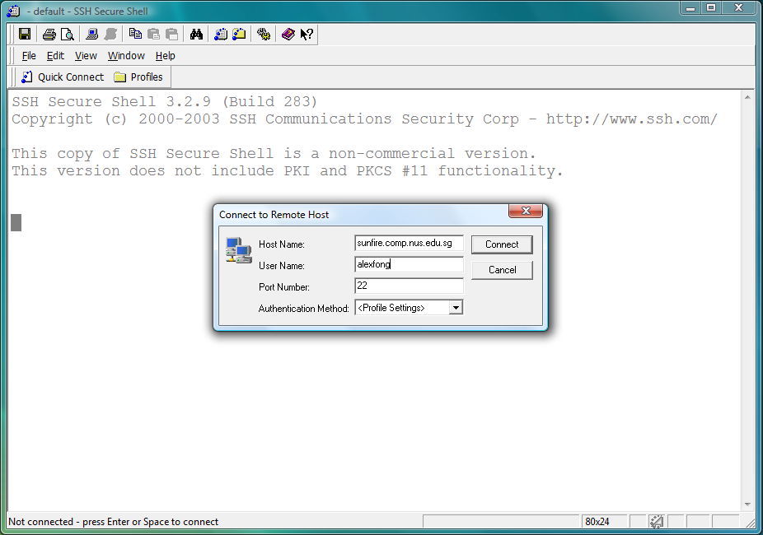
Logging into UNIX System (2/3)
1. Look for the SSH Secure Shell Client icon or Xshell icon on your desktop, and double click on it. We shall assume you are using the former here.
or
Click on “Quick Connect” to get the pop-up window. Enter “sunfire” for Host Name if connecting within campus or “sunfire.comp.nus.edu.sg” if connecting from off campus Enter your UNIX id as User Name.
Intro Workshop - 5

Slide 6
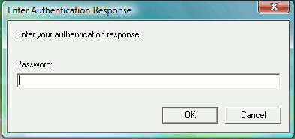
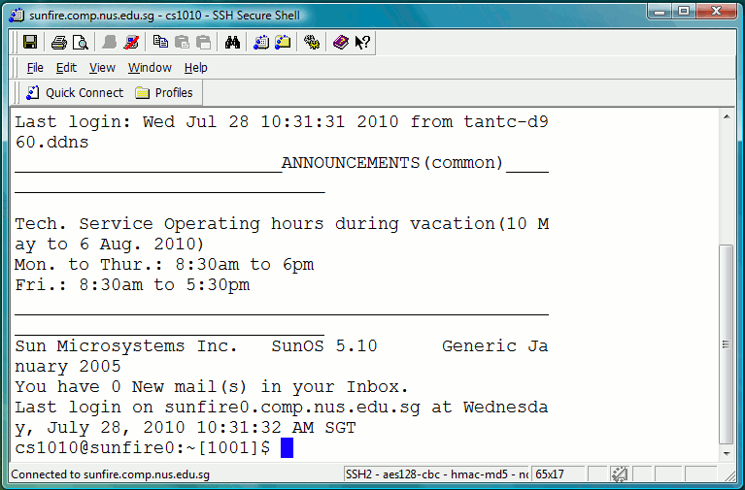
Logging into UNIX System (3/3)
3. Enter your UNIX password.
4. Once you log in successfully into your UNIX account, you will see this screen (actual display may vary).
5. To log out from your UNIX account, type “exit” or “logout”.
Intro Workshop - 6

Slide 7
Topics
Login to UNIX operating system
Setup your Sunfire account
……………………………………
……………………………………
……………………………………
Intro Workshop - 7

Slide 8
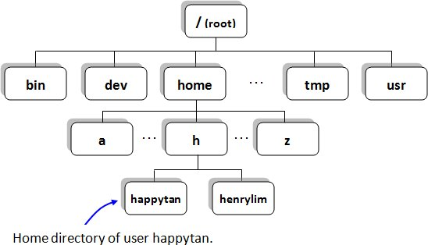
Set up Your Sunfire Account (1/2)
Now you are successfully connected to sunfire.
What happened indeed?
Intro Workshop - 8

Slide 9
Set up Your Sunfire Account (2/2)
Every SoC student has an account on sunfire.
You can do many things with your sunfire account.
Some treat their sunfire account as a backup harddisk
Account comes with paper quota.
Intro Workshop - 9

Slide 10
First Time Logging In…
If this is your first time logging in
Type the following two commands one by one to configure your account for programming:
~cs1020/workshop/setup
(enter y when prompted)
source .bash_profile
(no response from the system is good news!)
Ignore the next slide if you have done the above
Step (1) above does the following:
Creates java subdirectory and copies HelloWorld.java into it
Copies a number of system files, including .vimrc (vim configuration file) into your home directory
Intro Workshop - 10

Slide 11
Not Your First Time Logging In…
If you have done setup in CS1010 last semester and/or don’t want to replace the system files, you may still create the java subdirectory and copy HelloWorld.java into it as follows
In your home directory, type the following
mkdir java
cp ~cs1020/workshop/HelloWorld.java java
If your .vimrc file is lost/corrupted
In your home directory, type the following
cp ~cs1020/.vimrc .
Intro Workshop - 11

Slide 12
Topics
Login to UNIX operating system
Setup your Sunfire account
Basic UNIX commands
……………………………………
……………………………………
Intro Workshop - 12

Slide 13
Basic UNIX commands (1/5)
Tree structure
Intro Workshop - 13

Slide 14
Basic UNIX commands (2/5)
In a UNIX shell (like sunfire), you need a lot of typing but much less mouse clicking, compared with Windows operating system which you might be more familiar with.
There are a few useful commands that you need to remember which will facilitate your navigation in the UNIX world.
Practice is the best way to recognize UNIX commands. Gradually you will be more and more familiar with UNIX commands – so don’t worry too much at the beginning.
Intro Workshop - 14

Slide 15
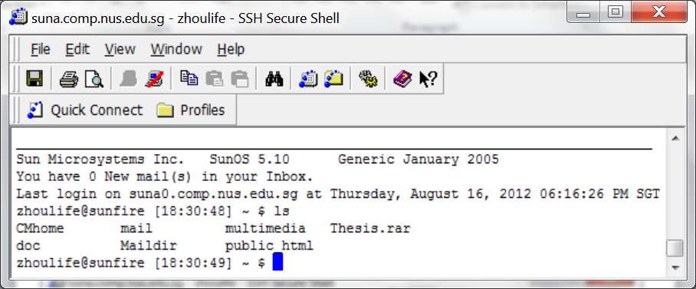
Basic UNIX commands (3/5)
ls command (means list directory contents) will enable you to see all the files and subfolders in current folder.
There are a few more complex usage of ls, but first of all, be familiar with the simplest one – just “ls”.
Intro Workshop - 15

Slide 16
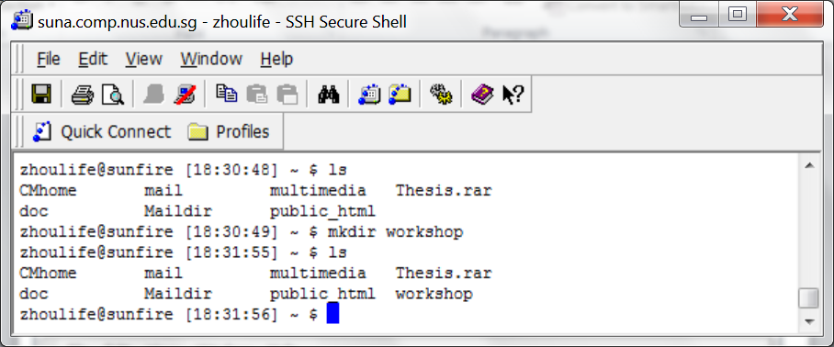
Basic UNIX commands (4/5)
mkdir (means make directory) will create a sub-directory.
rmdir (means remove directory) will delete an empty directory.
make a new directory
the new directory just created
Intro Workshop - 16

Slide 17
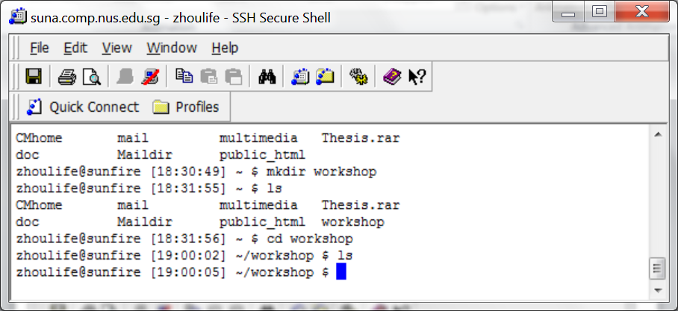
Basic UNIX commands (5/5)
cd command allows you to enter a designated directory.
cd workshop will bring you to workshop directory
cd .. will bring you back to the parent directory (note there must be at least one space between cd and ..)
Enter this directory
Intro Workshop - 17

Slide 18
Topics
Login to UNIX operating system
Setup your Sunfire account
Basic UNIX commands
Coding: Edit – Compile – Run
……………………………………
Intro Workshop - 18

Slide 19
Programs: Edit, Compile and Execute
Source code
Editor
produces
HelloWorld.java
vim HelloWorld.java
Bytecode
Compiler
produces
HelloWorld.class
javac HelloWorld.java
Sample output
Execution
produces
Hello World!
java HelloWorld
Intro Workshop - 19

Slide 20
Writing a Java Program using vim
Vim is a powerful text editor
Command Mode is used to issue vim commands.
Insert Mode is used to type in text.
Switch back and forth between two modes:
i (to get into insert mode; other commands possible)
<Esc> (to go to command mode)
Intro Workshop - 20

Slide 21
Writing a Java Program using vim
Now use vim to type in the follow program:
vim First.java
When finished:
Switch back to command mode
Save and quit vim by pressing key combination :wq
// This program adds two integers
import java.util.*;
class First {
public static void main(String[] args) {
int x, y, sum;
Scanner sc = new Scanner(System.in);
System.out.print("Enter 2 integers: ");
x = sc.nextInt();
y = sc.nextInt();
sum = x + y;
System.out.println("Sum = " + sum);
}
}
Hint: different colours imply different meanings…
If you get a wrong colour, it means something is wrong!
Intro Workshop - 21

Slide 22
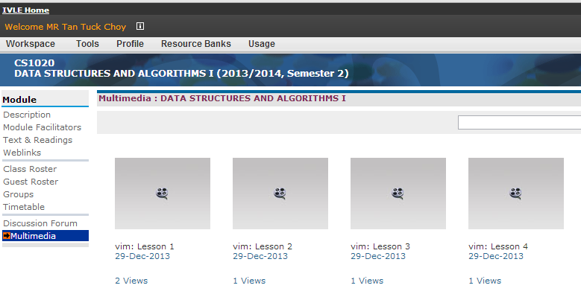
Videos on vim
Four videos on vim are available on IVLE multimedia
These videos were created for CS1010 using C programs as examples. However, the vim commands are the same.
Intro Workshop - 22

Slide 23
Compile a Program with javac
javac is a compiler to translate your Java source code into bytecode.
javac First.java
javac may report compilation (syntax) error to you if any. Correct your program till it is free of syntax errors.
If there is no error, a bytecodef First.class will be created in the same directory; type ls to look for it.
Run the bytecode by using java:
java First
Note: Not “java First.class”
Intro Workshop - 23

Slide 24
UNIX Commands for File Processing
cp command makes a copy of a file.
mv command moves a file to another folder.
mv command can also be used to rename a file.
rm command deletes a file.
Check the write-up for more information
Intro Workshop - 24

Slide 25
Topics
Login to UNIX operating system
Setup your Sunfire account
Basic UNIX commands
Coding: Edit – Compile – Run
File transfer between your Sunfire account and your own computer/laptop
Intro Workshop - 25

Slide 26
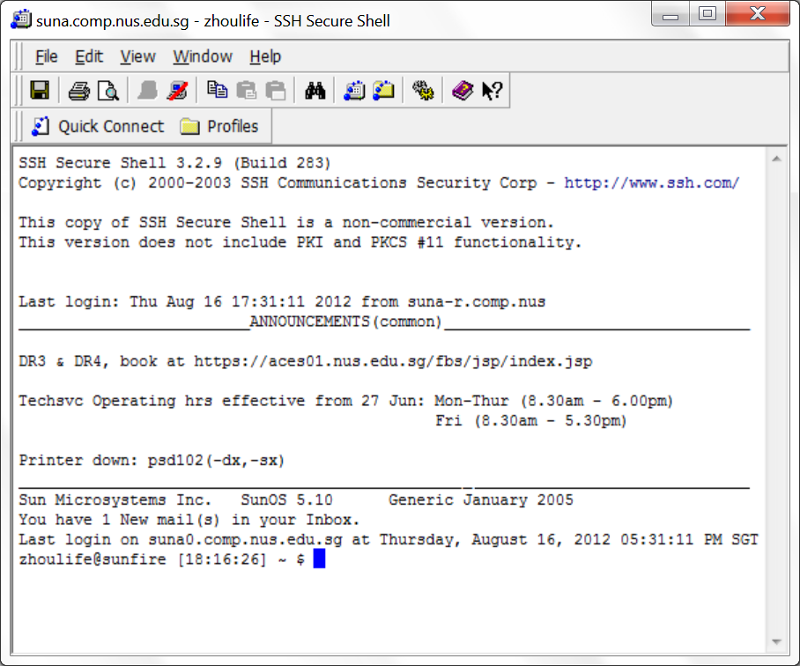
File Transfer from/to Sunfire
Intro Workshop - 26

Slide 27
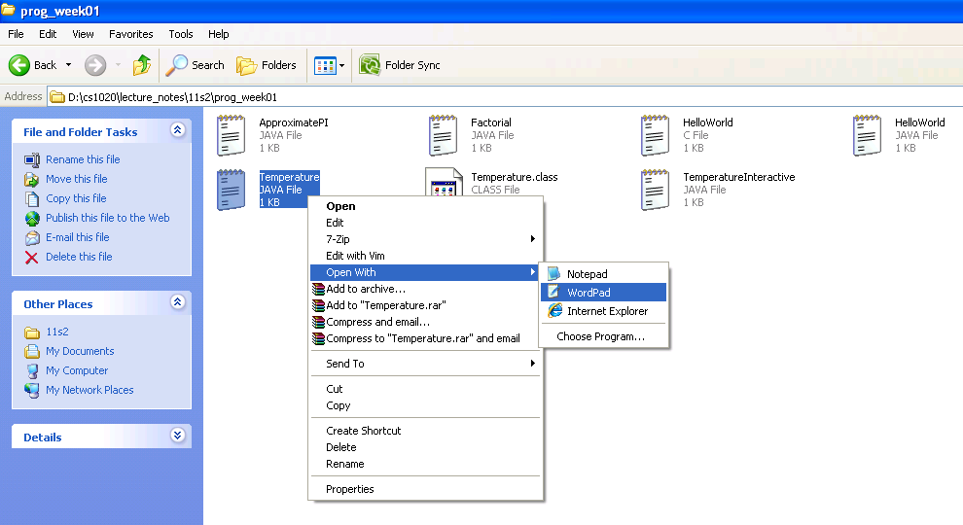
Opening a Java Program in Windows
Intro Workshop - 27

Slide 28
Congratulations!
You have cleared this workshop (no certificate will be issued though…)
You will gain more experience after days and weeks.
Now you may want to log out from sunfire.
The command is quite simple: exit or logout
Remember to log out from your NUSNET account as well
Intro Workshop - 28

Slide 29
End of File

