Slide 1

CS1020 Data Structures and Algorithms I Lecture Note #0
Course Admin
(AY2013/4 Semester 2)

Slide 2
Outline
Module Overview
Objectives
Staff
Resources
Schedules
Assessments

Slide 3
Module Overview
Object Oriented Programming (OOP) model
Using Java
Classic data structures
Lists, Stacks, Queues
Basic analysis of algorithm
Recursion
More advanced than CS1010
Sorting algorithms
More advanced than CS1010
Hashing
OOP
CS1010
CS1020
CS2010
Algorithms
Linear Data Structures

Slide 4
Objectives
With this course, you should be able to:
Use object oriented modeling to formulate solution
Utilize appropriate simple data structures in problem solving
Understand data abstraction
Understand recursion
Understand program efficiency through analysis of algorithms

Slide 5

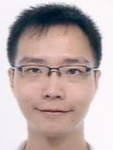
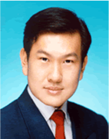
Lecturers
Prof Ling Tok Wang COM2-03-01 lingtw@comp.nus.edu.sg
Mr Zhao Jin COM2-02-50 zhaojin@comp.nus.edu.sg
Mr. Aaron Tan Tuck Choy COM1-03-12 tantc@comp.nus.edu.sg

Slide 6

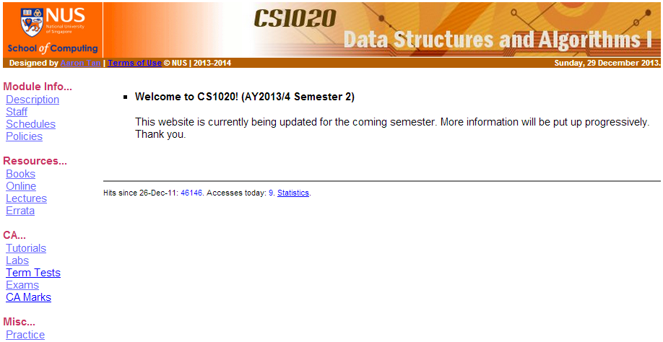
Module website
Resources
http://www.comp.nus.edu.sg/~cs1020

Slide 7
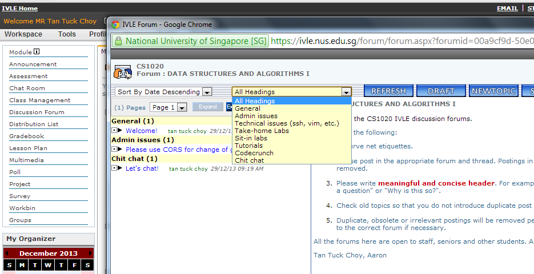
IVLE
https://ivle.nus.edu.sg
Resources
Announcements: Check daily
Forums: Use appropriate heading when you post
Tutorials: Prof Ling will put up tutorial questions/answers in the workbin

Slide 8
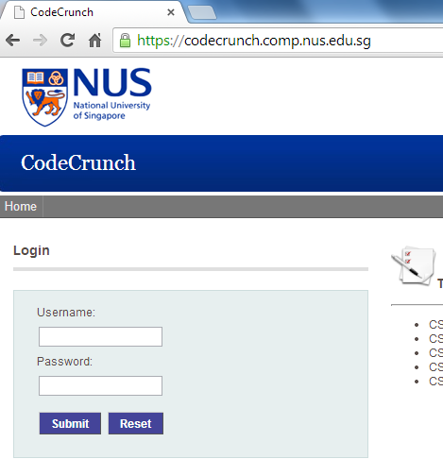
CodeCrunch
Resources
http://codecrunch.comp.nus.edu.sg

Slide 9
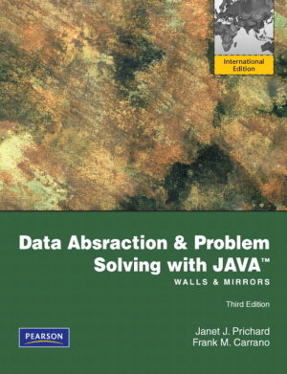
Textbook
Resources
Data Abstraction and Problem Solving with Java: Walls and Mirror
International edition, 3rd edition
Authors: Janet J. Prichard and Frank M. Carrano
Publisher: Pearson
ISBN: 9780273751205
Textbooks for loan
For needy students
Please refer to IVLE forum for details

Slide 10
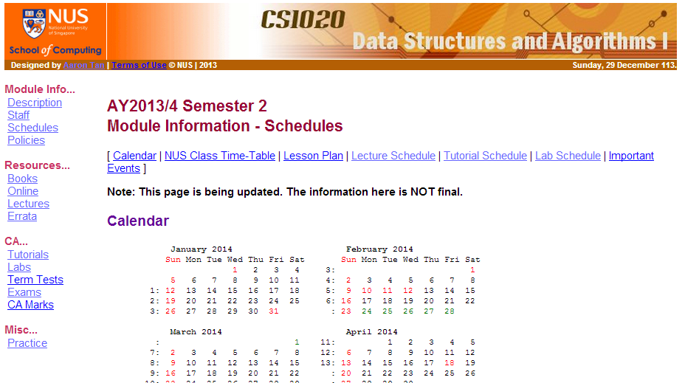
Schedules
http://www.comp.nus.edu.sg/~cs1020/1_module_info/sched.html

Slide 11
Assessments: Overview
CA 55%
Labs 30%
More on this later
Midterm test (closed book) 20%
Week 7 (date and time to be announced)
Venue to be announced
1 piece of A4 HANDWRITTEN (no photocopy) reference sheet allowed
Tutorial attendance/participation 5%
Final Exam (closed book) 45%
1 piece of A4 HANDWRITTEN (no photocopy) reference sheet
Monday, 5 May 2014, 5pm

Slide 12

Tutorials
Assessments
See module website for updates
Weekly, starting from week 4
Week 3’s tutorials are cancelled due to Chinese New Year
You are expected to present solutions and participate in the discussion
Suggested solutions will be released in the following week on the module website and IVLE workbin

Slide 13
Laboratory sessions
Assessments
See module website for updates
Actual lab session starts from week 3
A special lab 0 will be released in/before week 2
Familiarize yourself with the UNIX system and vim
Give away 1% for “free”
If you complete and submit lab 0 before deadline
Two types of lab session:
Take-home labs
1% per session, total 5%
Sit-in labs
8% per session, total 24% (Best 3 out of 4 sessions)

Slide 14
Take-home Labs
Assessments
5 take-home labs (excluding lab #0)
Exercises released on CodeCrunch
You should attempt them before attending the lab
During the lab session, lab TA will:
Discuss possible approaches
Cover additional syntax (if any) or other related exercises/topics
Each take-home lab is worth 1%
Must be submitted to CodeCrunch BEFORE deadline
Must be of decent effort (at least 60/100 marks) for every exercise in that take-home lab assignment

Slide 15
Sit-in Labs
Assessments
There are 4 sit-in labs
A sit-in lab is like a mini practical exam to test your programming skills
Each sit-in lab is:
1 hour 40 minutes in duration and worth 8%
Open book, but limited to printed material only
Your best 3 sit-in labs out of 4 will be chosen
Total 24%
You will get a makeup only if:
You missed 2 or more sit-in labs with valid medical certificates or official excuses

Slide 16
Sit-in Labs: Marking Scheme (1/2)
Assessments
Programming style: 30%
Checked by Lab TAs
Meaningful comments: 10%
Purpose of methods and statements
Pre- and post-conditions
Modularity: 10%
Meaningful identifiers: 5%
Indentation: 5%
Try to get the “free” 30% for every sit-in lab!

Slide 17
Sit-in Labs: Marking Scheme (2/2)
Assessments
Correctness and efficiency: 70%
Lab TA manually inspects your program
Partial credit will be awarded
Penalties:
If the program contains logic flaws not caught by CodeCrunch testing, marks will be deducted for correctness/design. In other words, CodeCrunch’s correctness mark is not final.
Commented codes are ignored in general.
Uncompilable codes will receive zero or very low mark for correctness.

Slide 18
Lab Schedules (Tentative)
Plan is tentative. Refer to module website for the most up-to-date plan.
Assessments
Week | Date | Type | Topics
1 | 17th Jan | Special | Intro Workshop
2 | -- | Take-home #0 | Basic Java
3 | 30th Jan | Take-home #1 | OOP
4 | 6th Feb | Sit-in #1 | OOP
5 | 13th Feb | Take-home #2 | Arrays and OOP
6 | 20th Feb | Sit-in #2 | Arrays and OOP
7 | 6th Mar | Take-home #3 | Linked List
8 | 13th Mar | Take-home #4 | Stack/Queue
9 | 20th Mar | Sit-in #3 | LL/Stack/Queue
10 | 27th Mar | Take-home #5 | Recursion
11 | 3rd Apr | Sit-in #4 | Recursion
12 | 10th Apr | Optional | Other topics

Slide 19
Summary and advice (1/2)
The labs focus more on your programming skills:
Ability to translate idea into actual program
Midterm and final exam focus more on your problem-solving skills:
Ability to understand and reason about the problem
Ability to apply your knowledge to formulate solution
You need to spend time on:
Actually coding to improve your skill
Thinking deep and exploring as memorization does not help
Asking questions! (Use the IVLE forums.)

Slide 20



Summary and advice (2/2)
We provide you
Practice exercises on CodeCrunch
Self-assessments (quizzes) on IVLE
Help sessions (on request)
But, ultimately…
must be prepared and willing to
put in a lot of efforts!

Slide 21
Introductory Workshop
Those of you who have taken CS1010 are familiar with UNIX system and vim.
For those who did not take CS1010 and hence are unfamiliar with UNIX and vim, please attend an Intro Workshop on 16th January, Thursday, at PL2 (COM1 basement)
Session 1: 10am – 11:30am
Session 2: 12nn – 1:30pm
Please refer to IVLE forum “Intro Workshop” and sign up there

Slide 22
End of file

