Slide 1
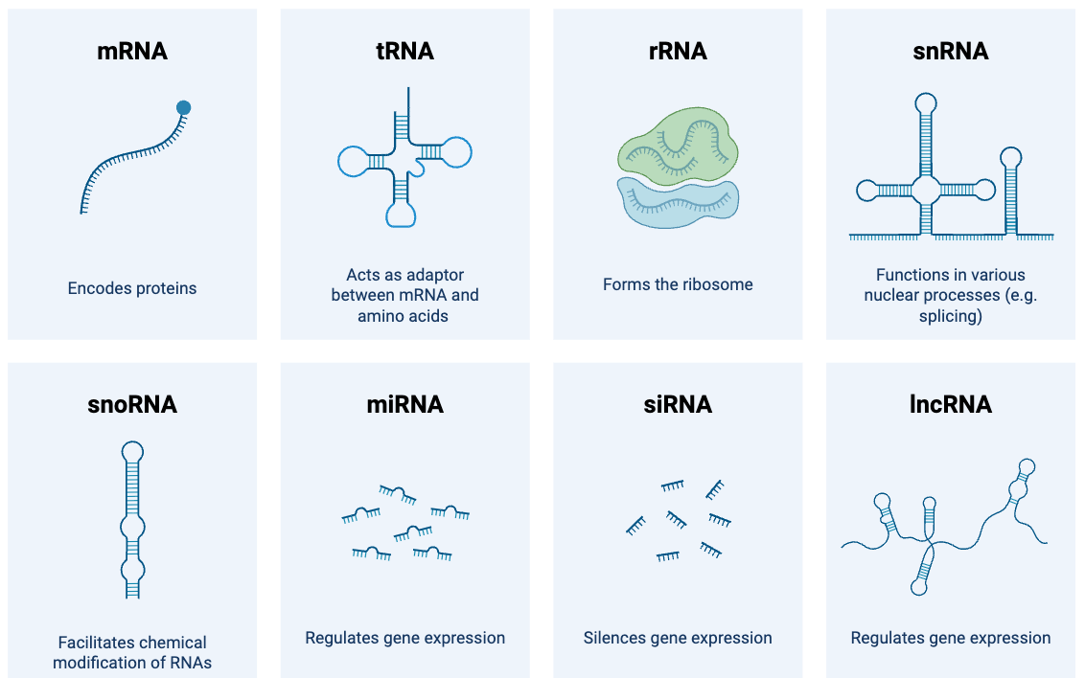

Slide 2
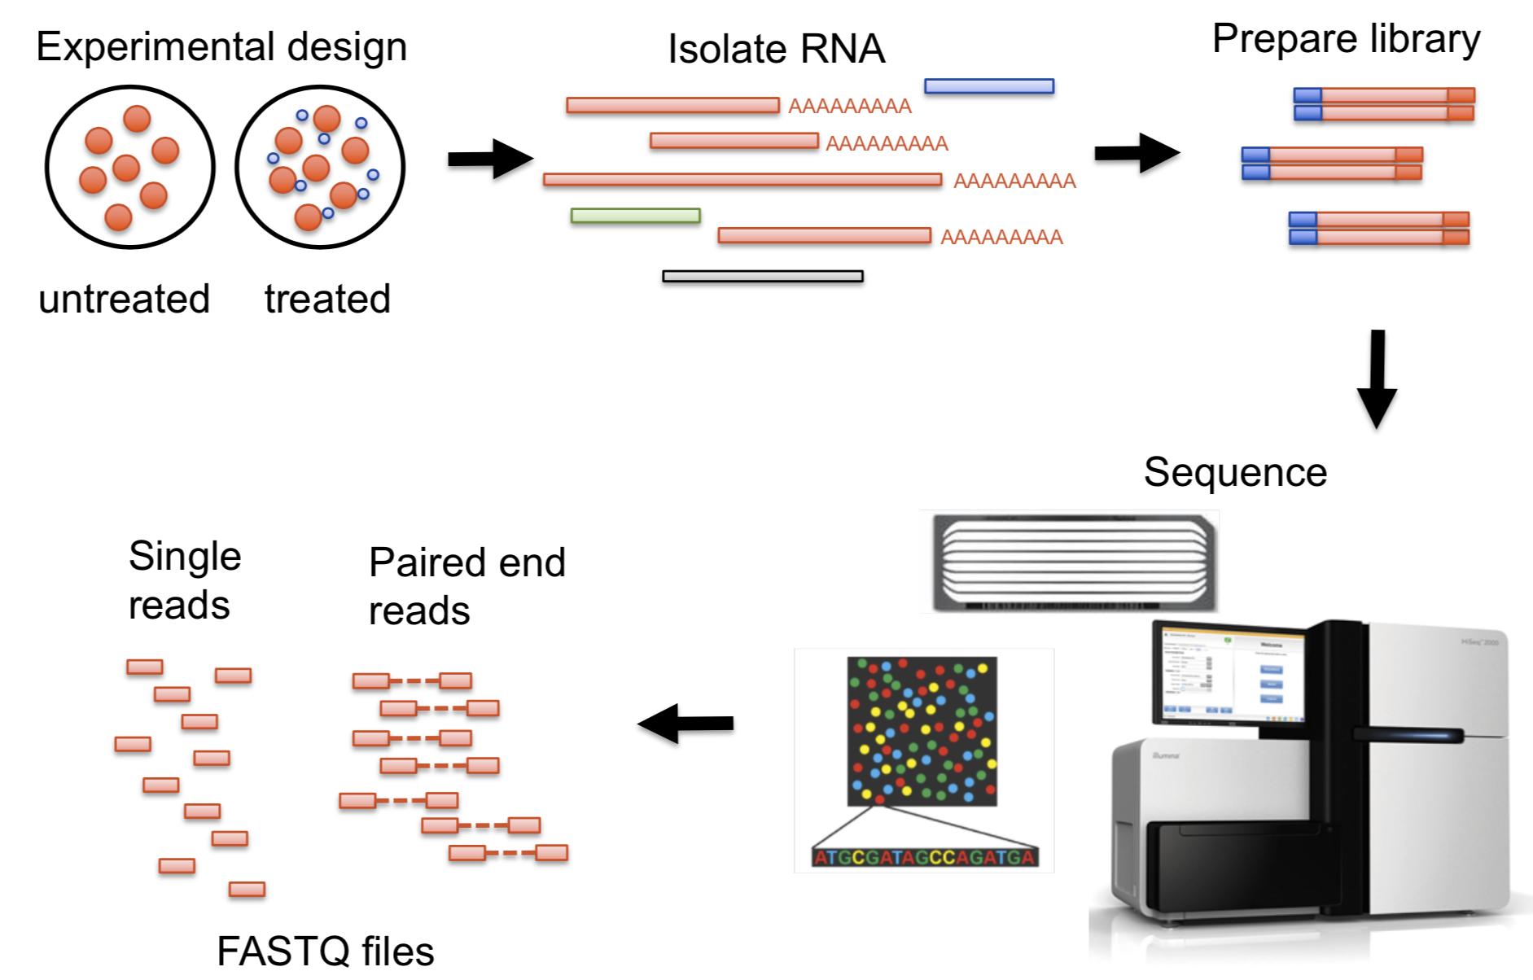
Prepare
library
Samples
Extract RNA

Slide 3
Prepare
library
Samples
Extract RNA
Sequence
Reads

Slide 4
Prepare
library
Samples
Extract RNA
Sequence
Reads

Slide 5

Infected with Plasmodium cathemerium
Infected with Plasmodium relictum
Control
1 dpi
10 dpi
Time after infection
21 dpi

Slide 6
Infected with Plasmodium cathemerium
Infected with Plasmodium relictum
Control
1 dpi
10 dpi
Time after infection
21 dpi

Slide 7
Infected with Plasmodium cathemerium
Infected with Plasmodium relictum
Control
1 dpi
10 dpi
Time after infection
21 dpi

Slide 8
Infected with Plasmodium cathemerium
Infected with Plasmodium relictum
Control
1 dpi
10 dpi
Time after infection
21 dpi

Slide 9


Slide 10
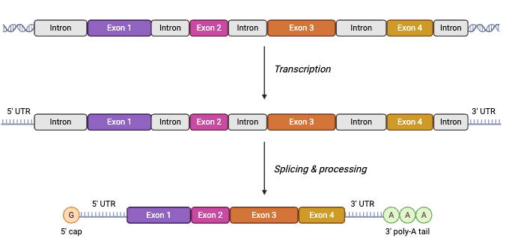
DNA
Transcription
Pre-mRNA
Splicing & processing
mature
mRNA

Slide 11
DNA
Transcription
Pre-mRNA
Splicing & processing
mature
mRNA

