Slide 1
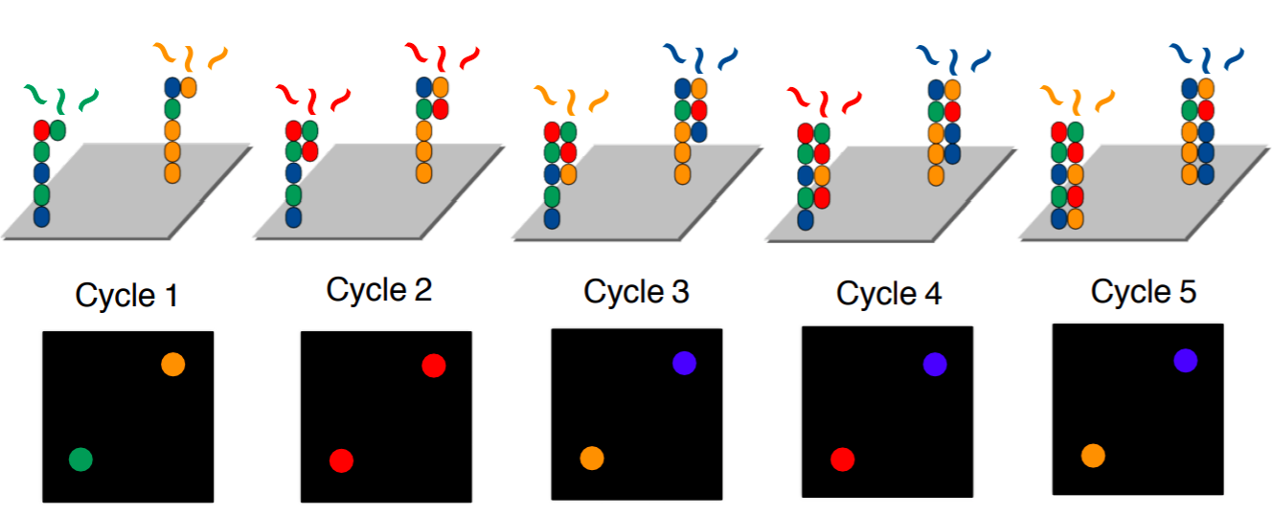
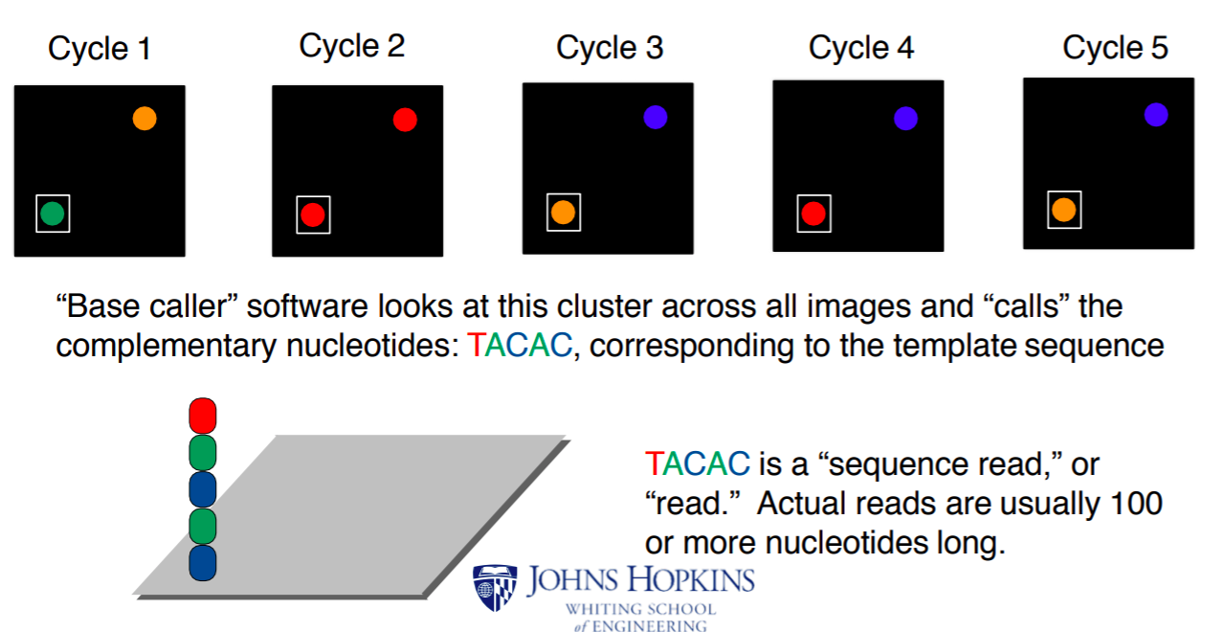

Slide 6
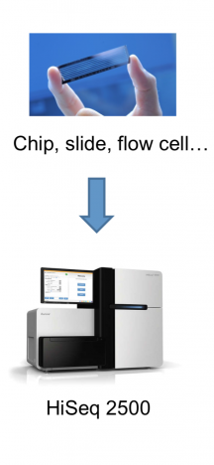
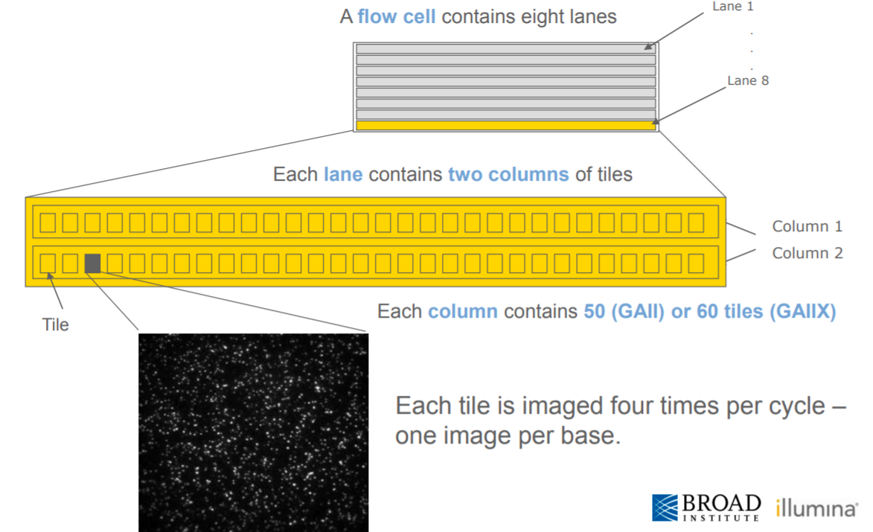
Illumina: flowcells and lanes
Tile
Each speck is from a different read

Slide 7
Illumina: flowcells and lanes
Lane
Tile
Each speck is from a different read

Slide 8
Illumina: flowcells and lanes
Flowcell
Lane
Tile
Each speck is from a different read

Slide 9
Illumina: flowcells and lanes
Flowcell
Lane
Tile
Each speck is from a different read

